Slide 1

The Web Economy, Politics and Data Futures
by Prof Leslie Carr, Prof Hugh Davis
for MOOC Students from
Beijing Normal University, China.

Slide 2
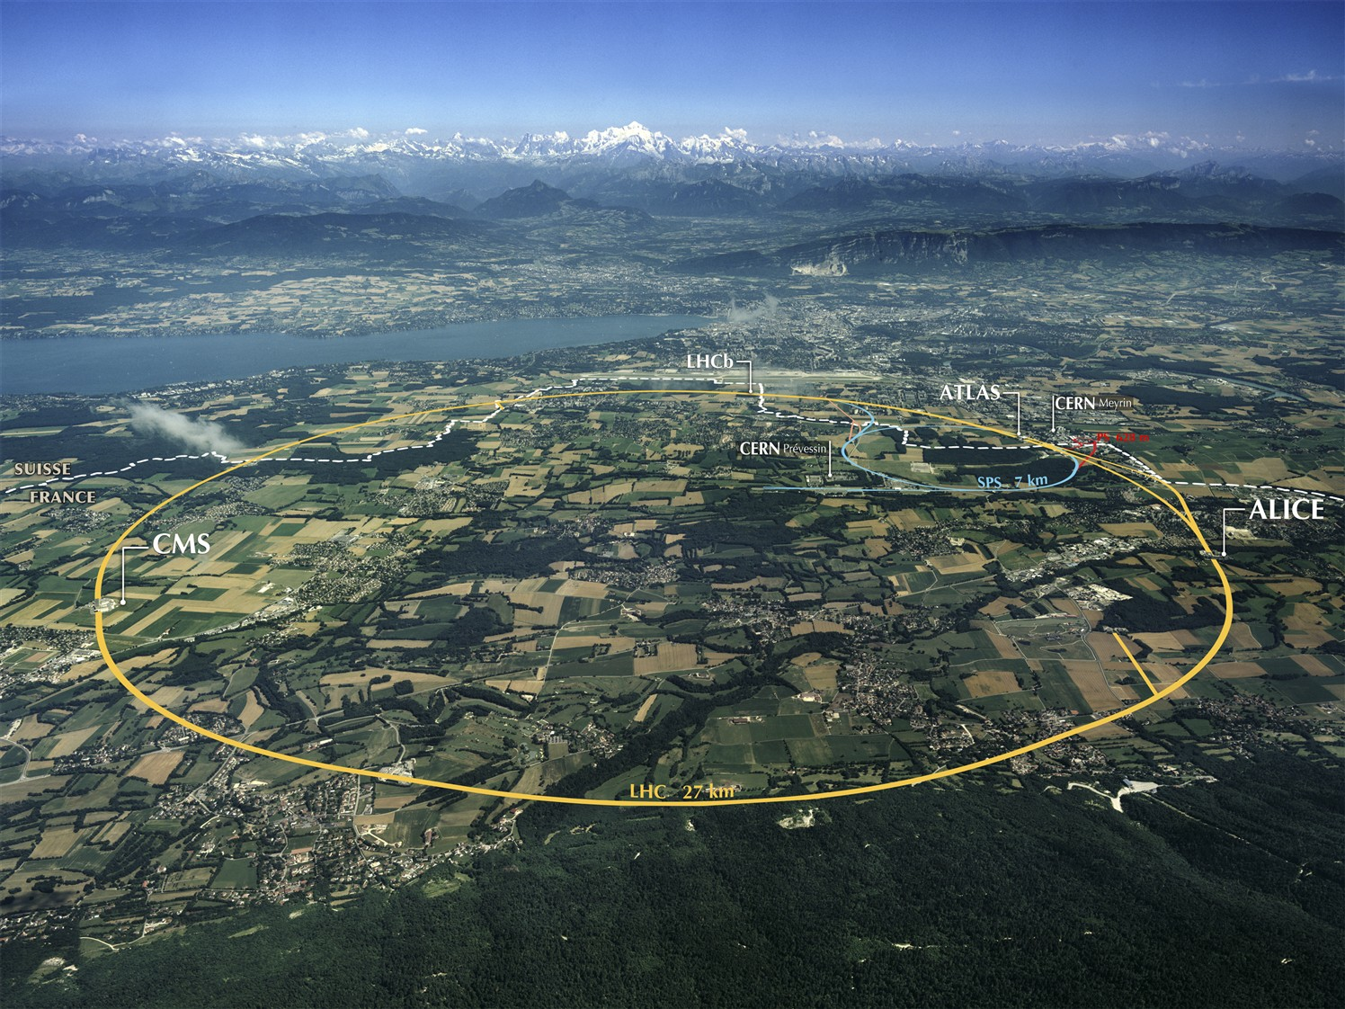


Beginning of the Web
Developed at Central European Nuclear Research facility
In 1989 the Web established itself in CERN, then international academia, industry and the rest of the world

Slide 3
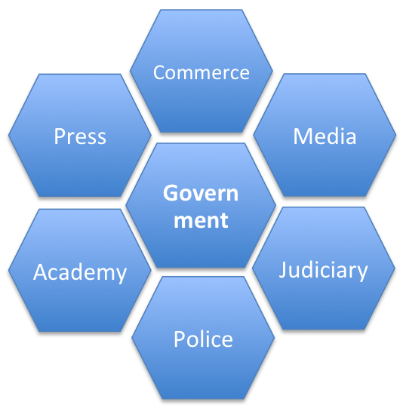
Society is Diverse.
One Web Fits All?
Institution | Objective
Academy | Create and transmit knowledge
Commerce | Make and trade goods
Press | Investigate and report news
Media | Create and broadcast content
Police | Maintain order and public surveillance
Judiciary | Apply law and resolve disputes
Government | Control society and share resources
The development of society as a whole (nuanced and structured and refined) is inextricably related to the technology of information provision, consumption and dissemination (e.g. writing, reading, printing, education). Different parts of society have different objectives and hence incompatible Web requirements, e.g. openness, security, transparency, privacy.

Slide 4

Web Development
The Web isn't a thing but an activity
  the active and ongoing creation of a
  network of information by a network of individuals.
The Web wasn't invented by Tim Berners-Lee,
  it is being invented by all of us as we gradually adapt our tools and change our practice.
  co-opting existing networks and existing practices
The web both shapes and is shaped by society.
Co-constitution

Slide 5
Understanding the Web
It’s not just a technology but a socio-technical hybrid
The Web is a collection of Web Activities
  Online Shopping, Online Banking, E-Government, Social Networking, etc.
  These activities reflect human interaction and technological development
Web Activities are not exclusive
  They develop together with other activities
  Their development are internally and externally co-constructive
Notes:
Internally – they are constructed from Humans and Technologies
Externally – networks of social machines interact and co-evolve with each other.
i.e. new social networking, meaning new comments tech on Website
new social policies mean new open data, meaning new Web activities emerging

Slide 6
Retail
In your opinion, what is the influence on the digital business to the shops offline?
  Multichannel
  customer journey
  Fish were the fish were
Does the e-books impact the books in store? Why?
  In the UK, ebooks have outsold other categories since 2011

Slide 7
Retail
What is you opinion about nowadays more and more crazy shopping online? Is this phenomenon good or bad? And why?
  Does this mean people buying things they don’t need? In which case is it any different from over spending in stores? Or maybe it is just quicker and easier to do so online. Some people would say that business thrives by selling as much stuff to as many people as possible, but this is usually only a short term benefit and damages the brand very quickly (Ryanair for example). A more measured approach of selling useful things to the right people is what builds long term business relationships.

Slide 8
Retail
Do you think that web economy will become the main form of the economy in the future? Why?
  The economy is the economy. “Web” as a distinct category will disappear as digital increasingly integrates and mainstreams

Slide 9
Politics
Can the internet be a truly democratic platform? If so, is that the ideal form?
  What is needed for TRUE democracy?

Slide 10
Intelligent Web
Could you explain the relationship among AI(Artificial Intelligence), semantic web and web3.0 for us？
  Human-like knowledge, knowledge representation, global data
As the computer becomes more and more intelligent, we will operate the computer even with our words. What do you think about the development of intelligent network?
  I welcome our new robot masters!

Slide 11
Big Data Web
How can we get information from so many data efficiently?
  Data, information, knowledge.
What influence will the Logistics network have to china? As the big data is being hot! Big data-data which is difficult to deal with due to its size, structure and the speed of updates.
  Government data
  Transactional data
  Supply chain data

