Slide 1
WEBS6203
Interdisciplinary Thinking
W7 focus on hand-ins
Su White
http://www.edshare.soton.ac.uk/13581/

Slide 2
Weekly focus
1 | Introductions and scoping
2 | Clarification and beginnings
3 | Process lecture: specifications and structures
4 | Independent study: Blogging and surgeries
5 | Independent study: Blogging and surgeries
6 | Independent study: Blogging and surgeries
7 | Focus on hand ins: Revisit specification for posters and reports
8 | Poster surgery
9 | Poster pitches and poster hand in
10 | Independent study: Peer review and revisions
11 | Q&A
Vacation 1-3
12 | Last minute surgery, report hand in
Exam period

Slide 3
How you will demonstrate your learning
Poster
Report
Provide a structured overview of your chosen areas
Communicate key points in visually compelling manner
reading
blogging
discussing
reviewing
thinking
reflecting
revising

Slide 4
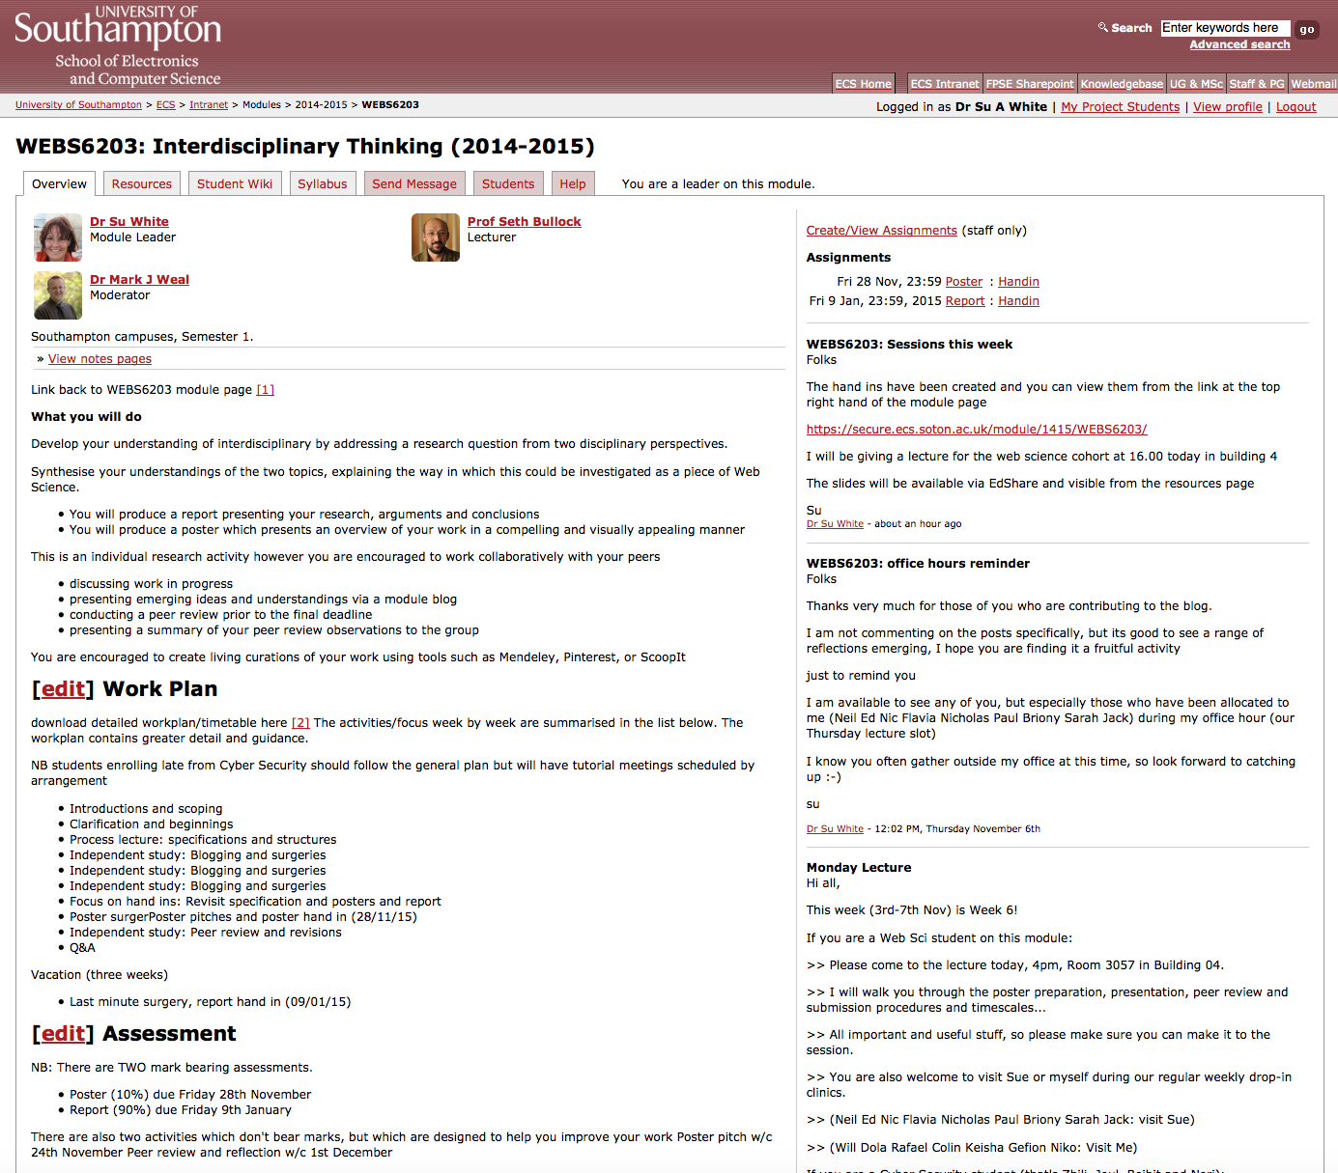

Hand in details via module page
https://secure.ecs.soton.ac.uk/module/1415/WEBS6203

Slide 5
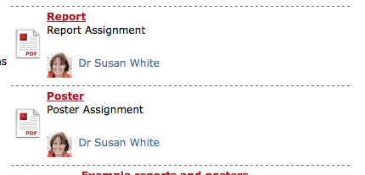
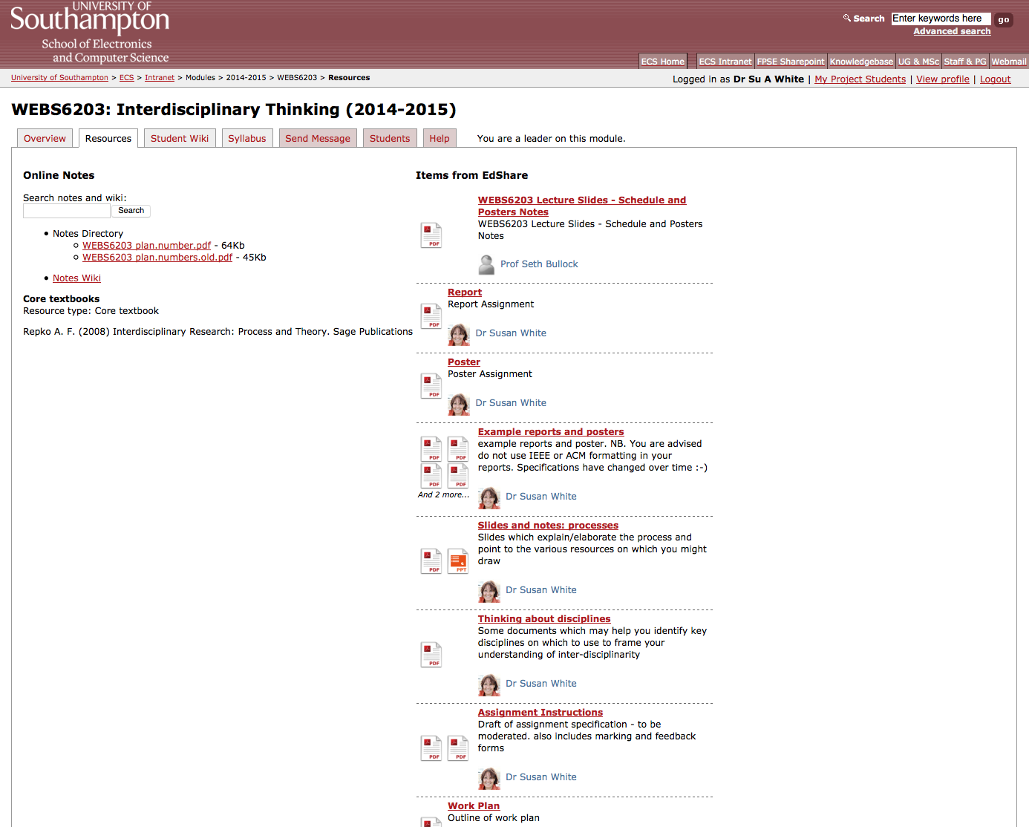
Resources via the module page
Walk through

Slide 6
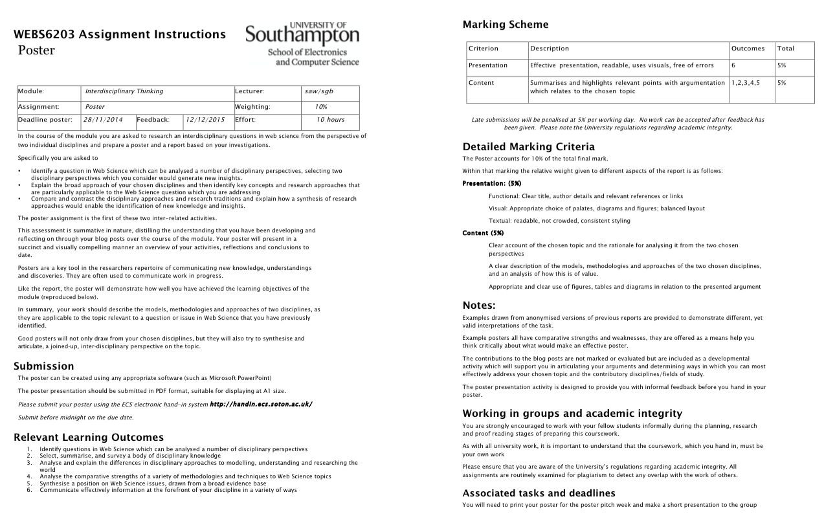
http://www.edshare.soton.ac.uk/13566/
Notes:
Handout printout in class

Slide 7
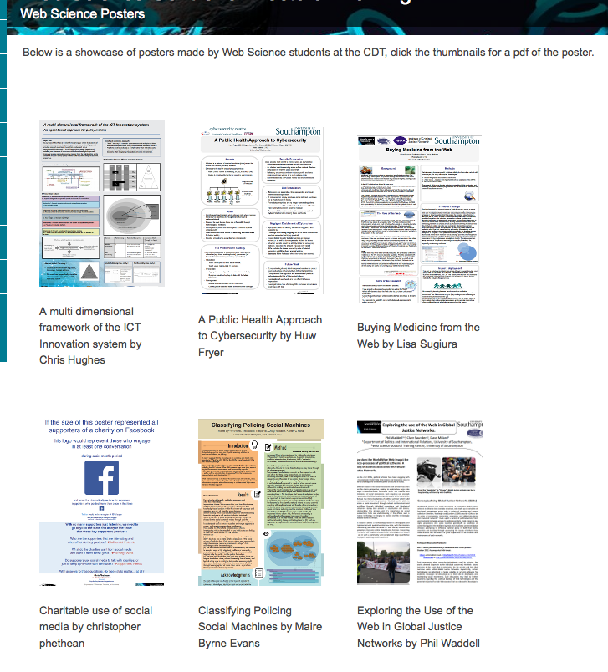
In class activity
Preview the posters via the handout
We will load up chosen examples of the posters in succession
You will look at them and discuss them (in pairs)
http://dtc.webscience.ecs.soton.ac.uk/people-and-partners/list-of-students/student-research-interests/web-science-posters/

Slide 8

Activity
Using the specification plus the example posters from the web
http://www.edshare.soton.ac.uk/13359/
Notes:
Handout printout in class

Slide 9
Activities
Review the requirements
Thinking about posters
Individually or in pairs
Read through the final version of the assessment criteria for the poster
  Do you understand what you have to do?
  Do you understand what you have to hand in?
Individually or in pairs
Choose one of the posters to review
Using the mark criteria decide:
  What are the strengths?
  What are the weaknesses?
  What would you change to get more marks?
Notes:
Using the two handouts

Slide 10
Opportunities to improve
From now on
Informally asking fellow students to feedback
During W9
During the poster pitch and poster presentation session

Slide 11
Report
You may find the poster creation process helps you clarify your ideas
The peer review and surgery sessions are designed to build in time for reflection
Like all assessments check with the assessment criteria to make sure
1) you are clear with what is expected of you
and
2) how you will be marked

Slide 12
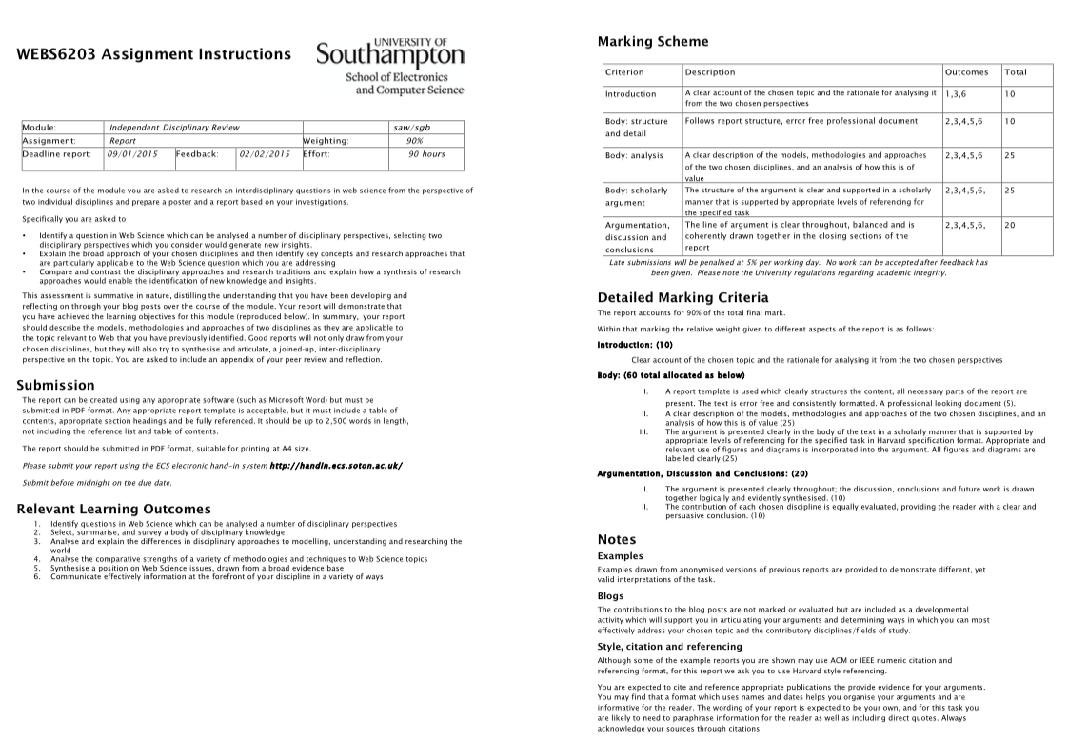
http://www.edshare.soton.ac.uk/13569/

Slide 13


