Slide 1
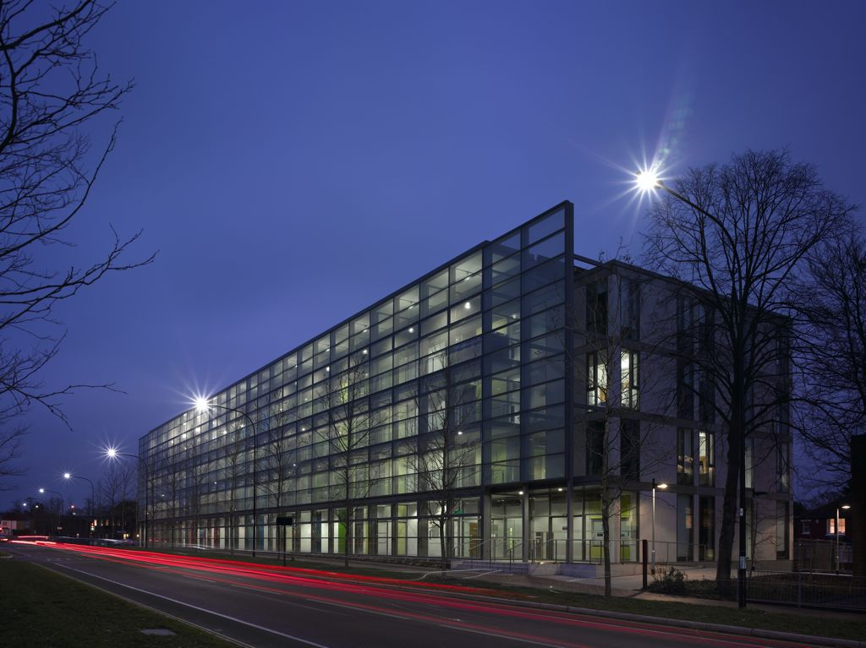
The Development of the Web, Security and Privacy
by Prof Leslie Carr, Prof Hugh Davis
for MOOC Students from
Beijing Normal University, China.

Slide 2
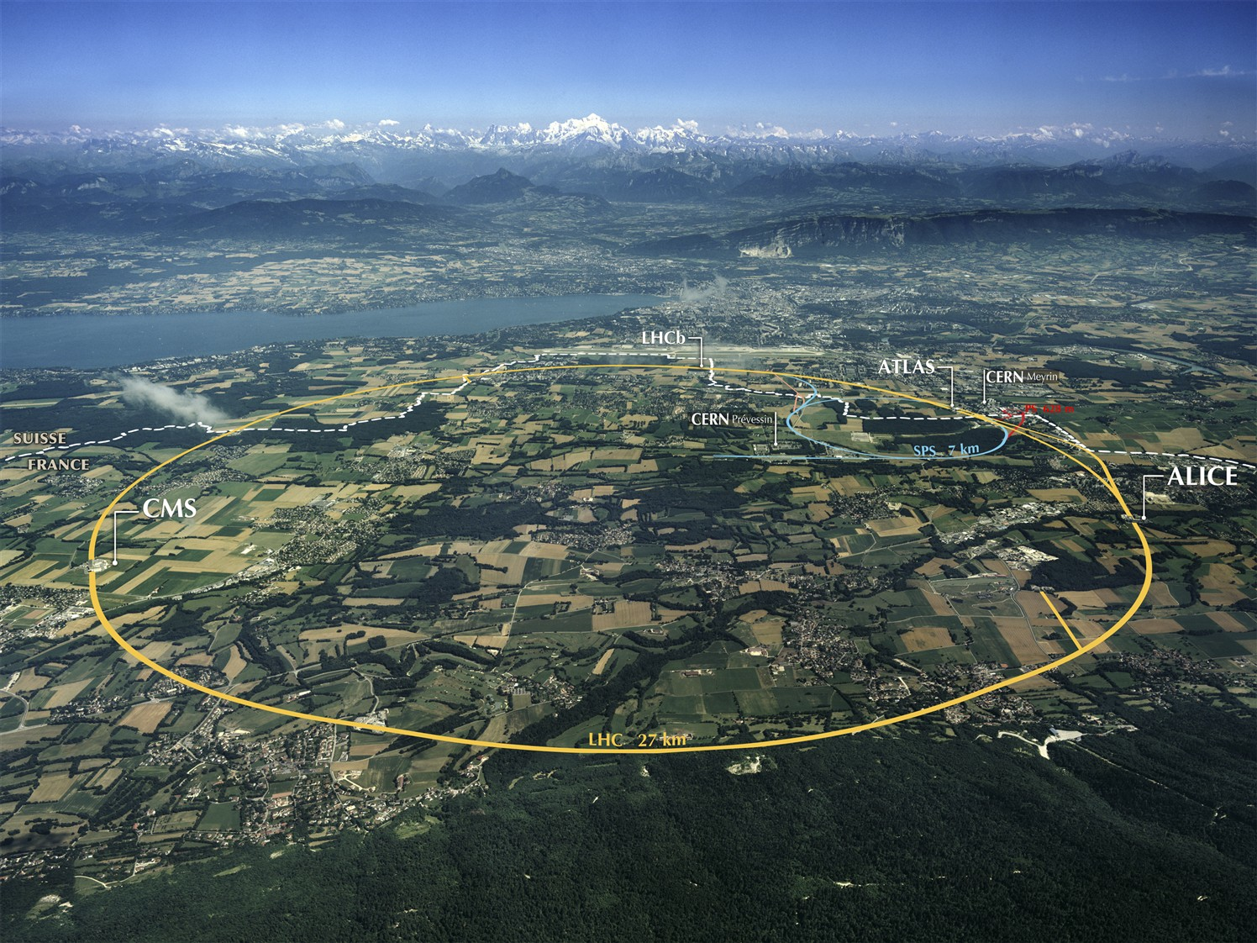


Beginning of the Web
Developed at Central European Nuclear Research facility
In 1989 the Web established itself in CERN, then international academia, industry and the rest of the world

Slide 3
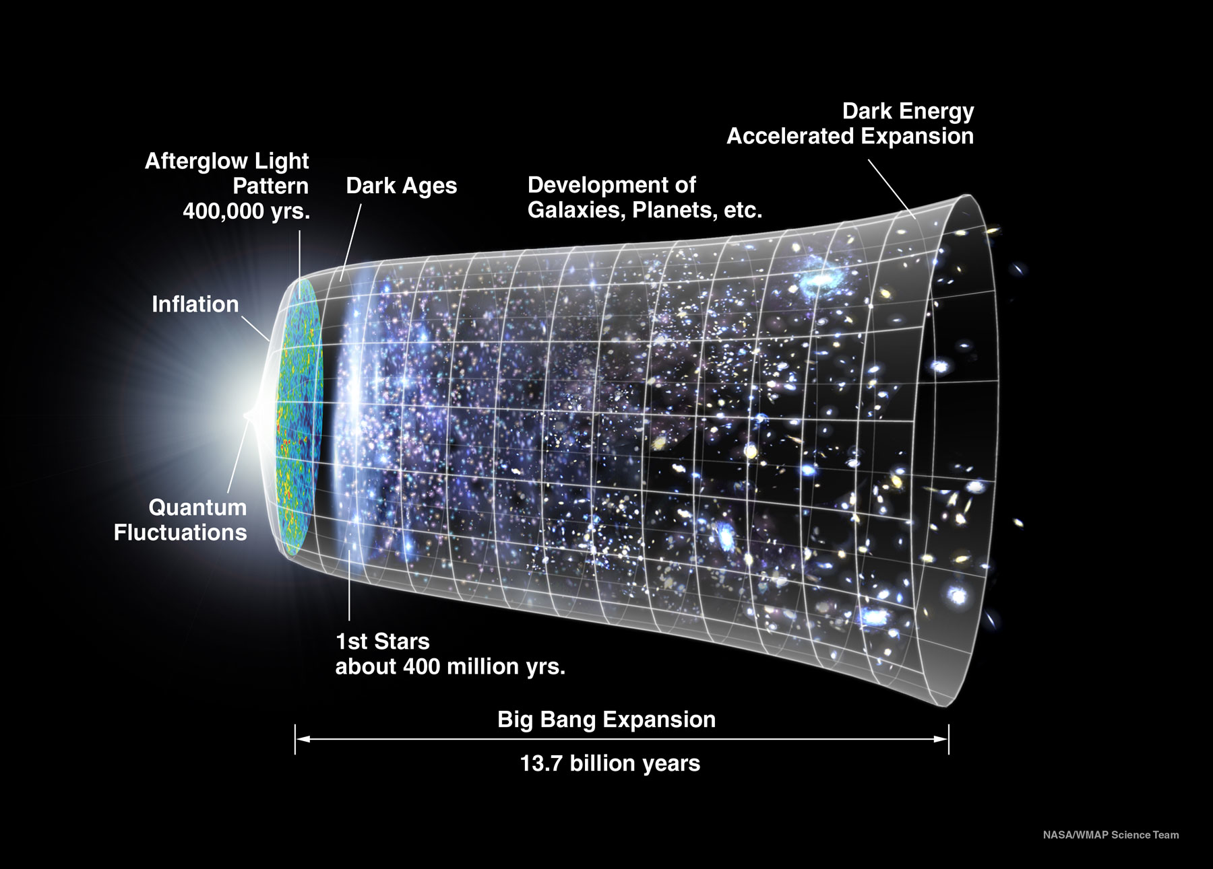
Expansion of the Web
The Web spread the conditions of its initial creation throughout the whole of society as it underwent an initial inflationary phase.
The academy has
  government patronage
  large-scale co-operation
  sharing of intellectual property with others
Diagram: Big Bang Expansion (NASA).
This is not like other areas of society – e.g. media, industry, commerce.

Slide 4
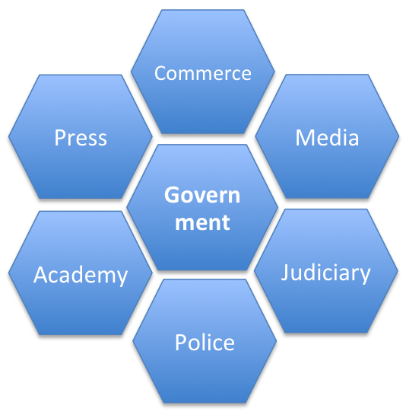
Society is Diverse.
One Web Fits All?
Institution | Objective
Academy | Create and transmit knowledge
Commerce | Make and trade goods
Press | Investigate and report news
Media | Create and broadcast content
Police | Maintain order and public surveillance
Judiciary | Apply law and resolve disputes
Government | Control society and share resources
The development of society as a whole (nuanced and structured and refined) is inextricably related to the technology of information provision, consumption and dissemination (e.g. writing, reading, printing, education). Different parts of society have different objectives and hence incompatible Web requirements, e.g. openness, security, transparency, privacy.

Slide 5
Historic Attempts at Webs
Sponsor | System | Scope | Real | Date | Important Properties
Finance / Press | Reuters | Professional, centralised | ✔ | 1850 | News & stock information (originally carrier pigeon and subsequently telegraph)
Private Institution | Mundaneum | Public, centralised | ✔ | 1920 | Based on indexing technology (the library card)
Military | Memex | Scholarly, individual, centralised | ✗ | 1945 | Aimed at Scientists and Technologists in WWII
Media | Xanadu | Public, decentralised | ✗ | 1960 | Focused on DRM, reuse and writing for “creatives”
Media | CEEFAX | Public, national, centralised | ✔ | 1970 | Broadcast, linked, not participatory
Government | Minitel | Public, national, centralised | ✔ | 1980 | Commercial services and information
Academy (CS & HEP) | FTP / Archie / Anarchie | Public, decentralised | ✔ | 1985 | Download resources (papers, reports) to hard drives and print them on LaserWriters.
Commerce | Hypercard, HyperTIES | Private, centralised | ✔ | 1988 | Personal applications, sometimes tied to multimedia resources on CDROMs / video disks
Academy (HEP) | WWW | Public, global, decentralised | ✔ | 1990 | Universal naming, linking, interoperability, participative. However no writing, no indexing in public version.
Academy (CS) | Microcosm | Private, centralised | ✔ | 1990 | Sophisticated linking and openness for personal information stores
Academy (CS) | HyperG | Public, centralised | ✔ | 1990 | Extension of Web for with support for writing, indexing and consistency management.
Commerce | AOL, CompuServ | Public, centralised | ✔ | 1990 | Dialup walled garden access to email, forums, chat rooms and information resources

Slide 6
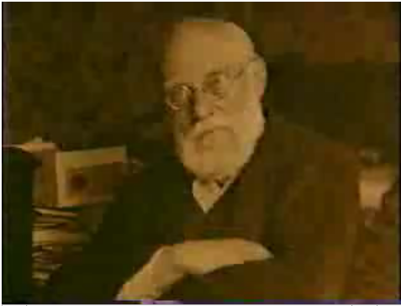
Paul Otlet, 1868-1944
Belgian lawyer
Introduced US 3"x5" library card to Europe
Traité de Documentation (1934)
  the systematic organisation of all knowledge and thought
Mundanaeum: 15 million index card bibliographic index, 1 million documents and images, classified and searchable. Query became part of the bibliographic record. Content was interlinked.

Slide 7
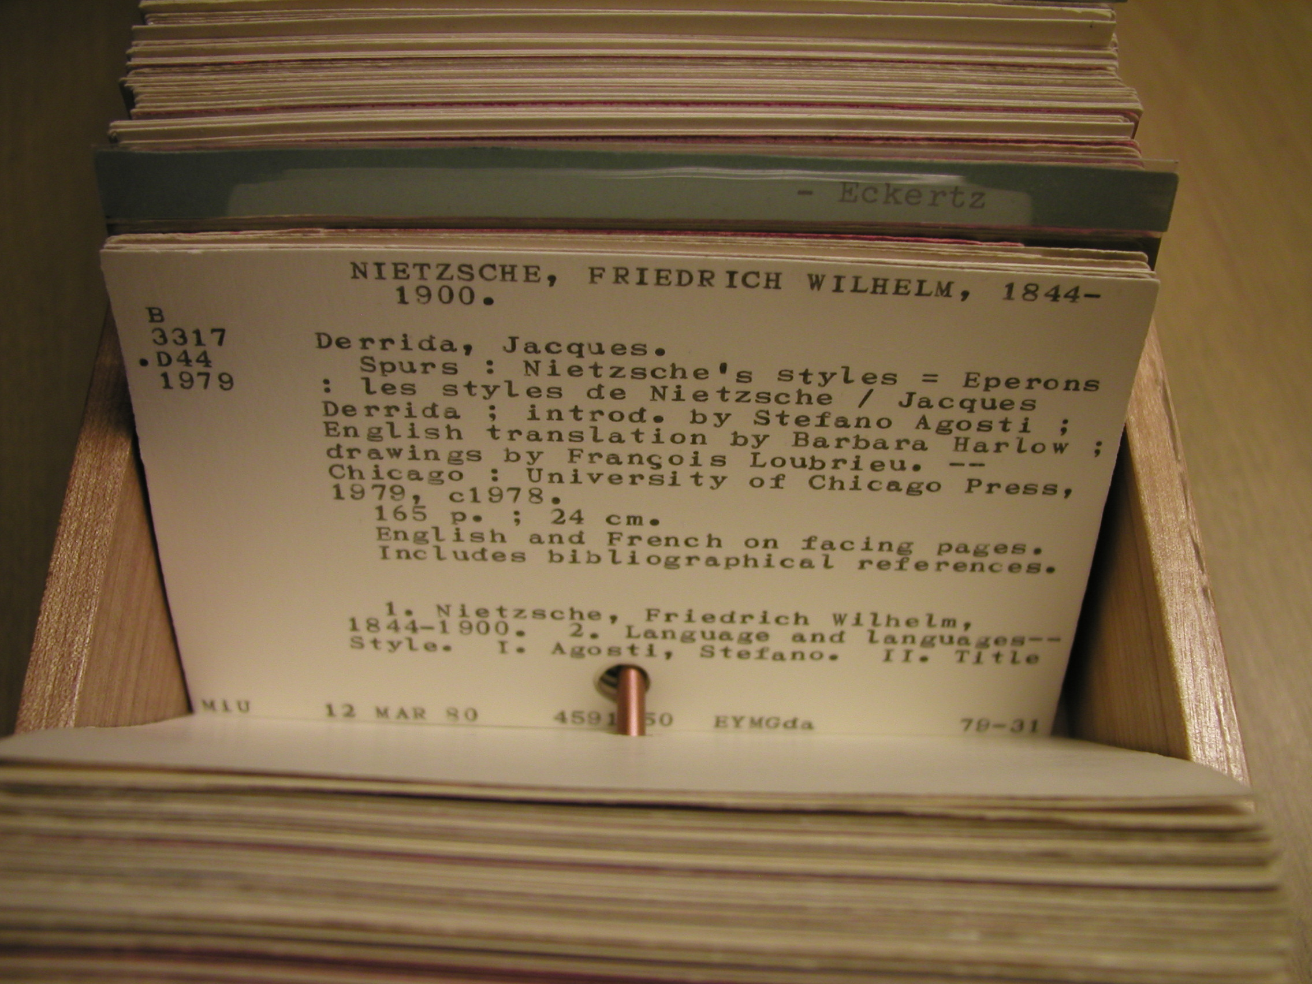
Available Technology
The library card, used for the mundaneum

Slide 8
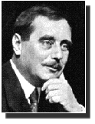
H. G. Wells, World Brain: The
Idea of a Permanent World Encyclopaedia, Encyclopédie Française, August, 1937
Encyclopaedias of the past sufficed for the needs of a cultivated minority
  universal education was unthought of
  gigantic increase in recorded knowledge
  more gigantic growth in the numbers of human beings requiring accurate and easily accessible information
Discontent with the role of universities and libraries in the intellectual life of mankind
Universities multiply but do not enlarge their scope
  thought & knowledge organization of the world
No obstacle to the creation of an efficient index to all human knowledge, ideas and achievement

Slide 9
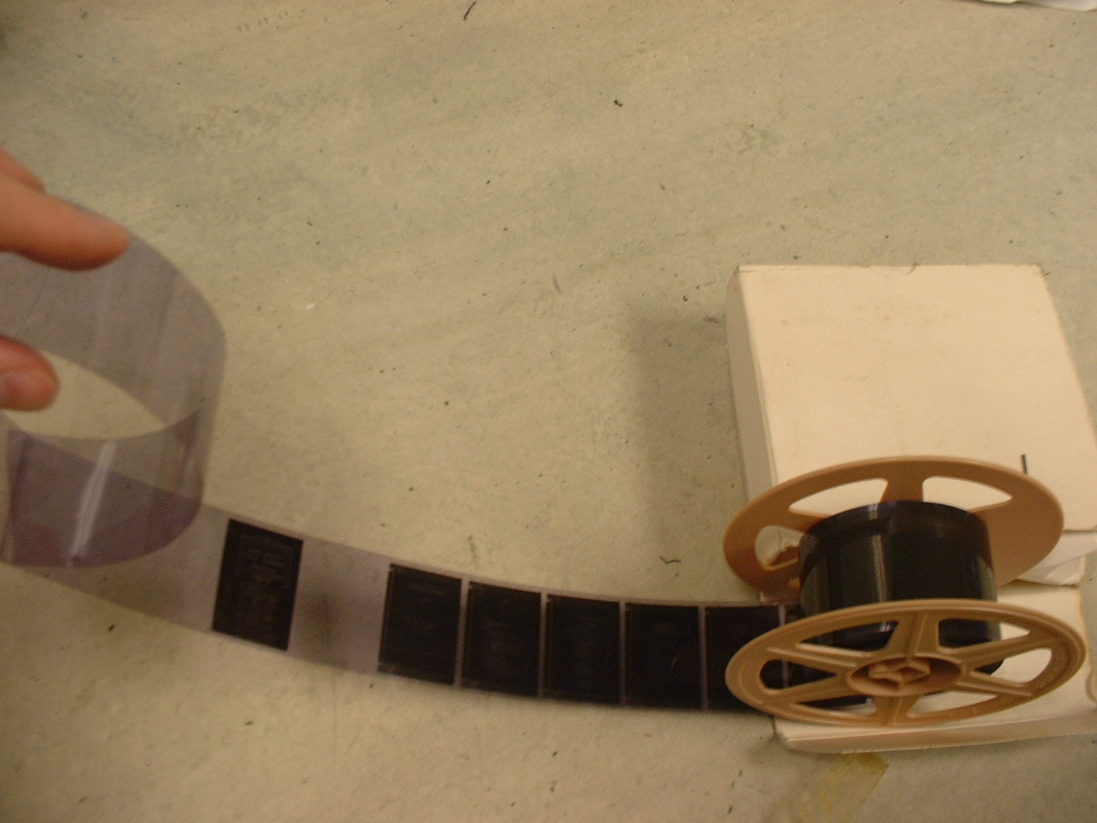
Available Technology
The microfilm (modern example), proposed for the World Brain

Slide 10


Tim Berners-Lee
The “inventor of” the Web
  Browsing
  HTTP, HTML, URL
A network of interconnected documents built on a network of interconnected servers by a network of interconnected people.

Slide 11
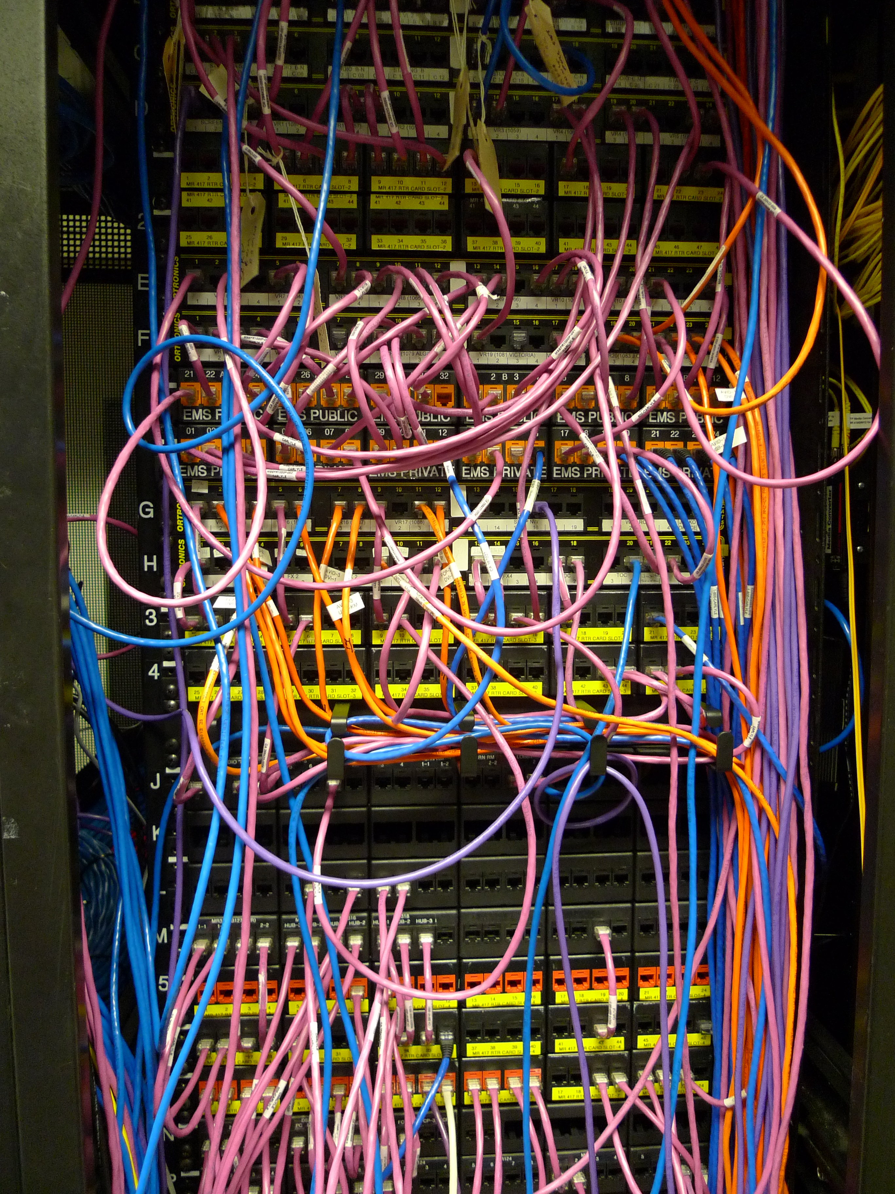
Available Technology
The Internet – the interconnected networks of wires and computers that exchange messages with each other.

Slide 12
The Web is Evolving
Pretty much none of the things that we do on the Web were invented by Tim or available to Tim
  Searching for things on Google
  Looking up facts in Wikipedia
  Sharing photos on Flickr
  Blogging about professional issues
  Watching catchup TV on Netflix
  Updating your Facebook status on your smartphone

Slide 13
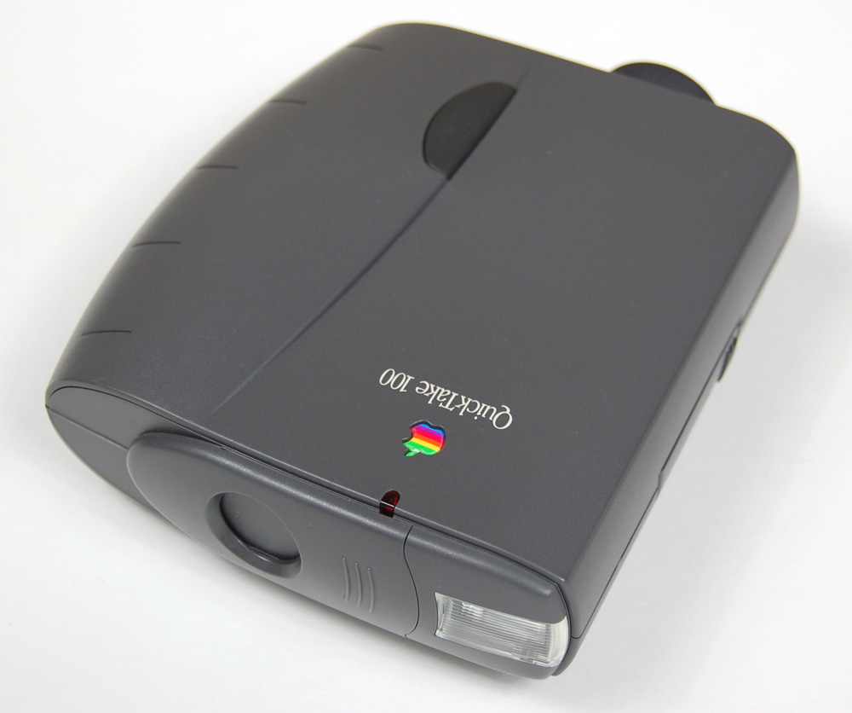
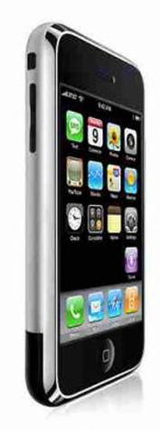

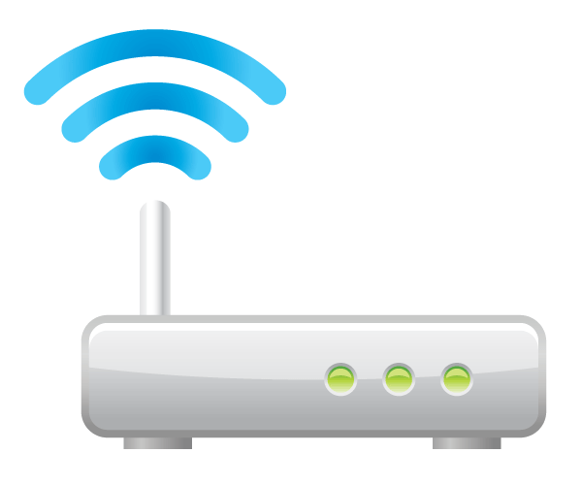
What Was Tim’s Web Missing?
Digital Cameras (1994)
Search engine (1996)
Wifi (2000, first campus coverage in US)
Broadband (2000, UK BT)
Smartphone (2007)

Slide 14
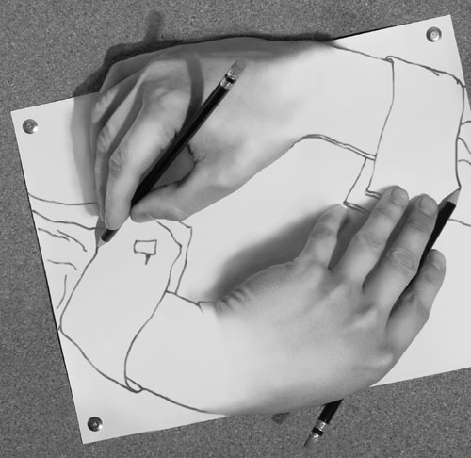
Web Development
The Web isn't a thing but an activity
  the active and ongoing creation of a
  network of information by a network of individuals.
The Web wasn't invented by Tim Berners-Lee,
  it is being invented by all of us as we gradually adapt our tools and change our practice.
  co-opting existing networks and existing practices
The web both shapes and is shaped by society.
Co-constitution

Slide 15
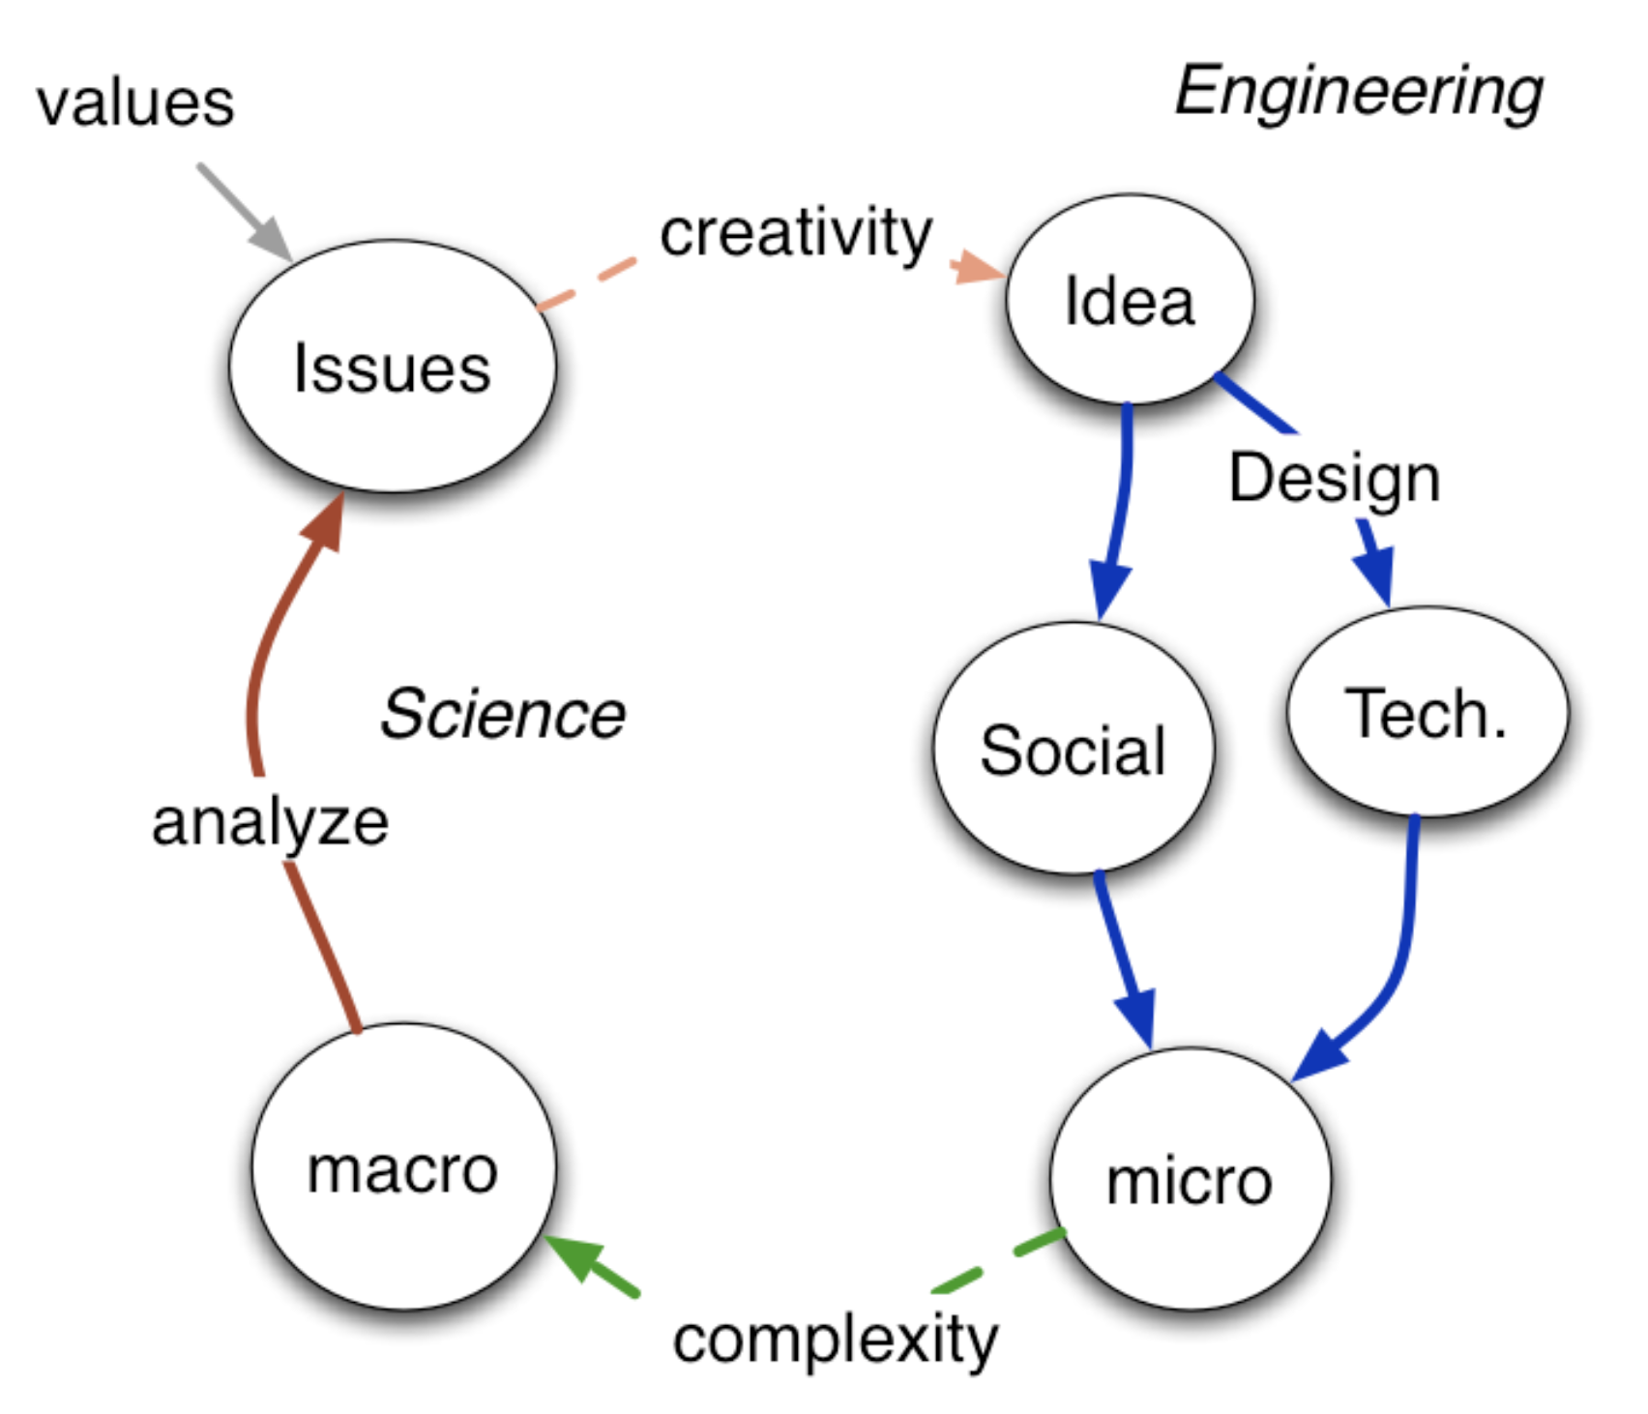
The “Magic” of Web Science
People design web systems in the lab (the micro) and release them into the wild (the macro).

Slide 16
Understanding the Web
It’s not just a technology but a socio-technical hybrid
The Web is a collection of Web Activities
  Online Shopping, Online Banking, E-Government, Social Networking, etc.
  These activities reflect human interaction and technological development
Web Activities are not exclusive
  They develop together with other activities
  Their development are internally and externally co-constructive
Notes:
Internally – they are constructed from Humans and Technologies
Externally – networks of social machines interact and co-evolve with each other.
i.e. new social networking, meaning new comments tech on Website
new social policies mean new open data, meaning new Web activities emerging

