Slide 1
WEBS2002
Interdisciplinary Project
Understanding Interdisciplinarity
How do we know?
Have we shown interdisciplinarity?

Slide 2
purpose
The purpose of this session is to prompt you to think critically
  Review your progress
  Deepen your understanding of interdisciplinarity
  Frame your understanding
    through your practical activity of the project

Slide 3
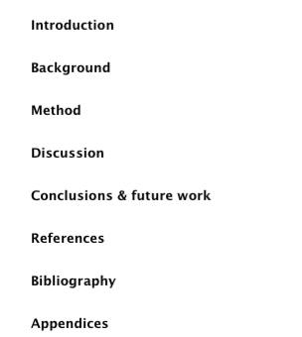
Issues: navigating the language
How have you navigated the language of different disciplines?
  As you have conducted your research
    Individually
    As a group
Are you reflecting this?
  In each section of the report?
  In the language and subtexts of the report
You have further opportunities via the reflection

Slide 4
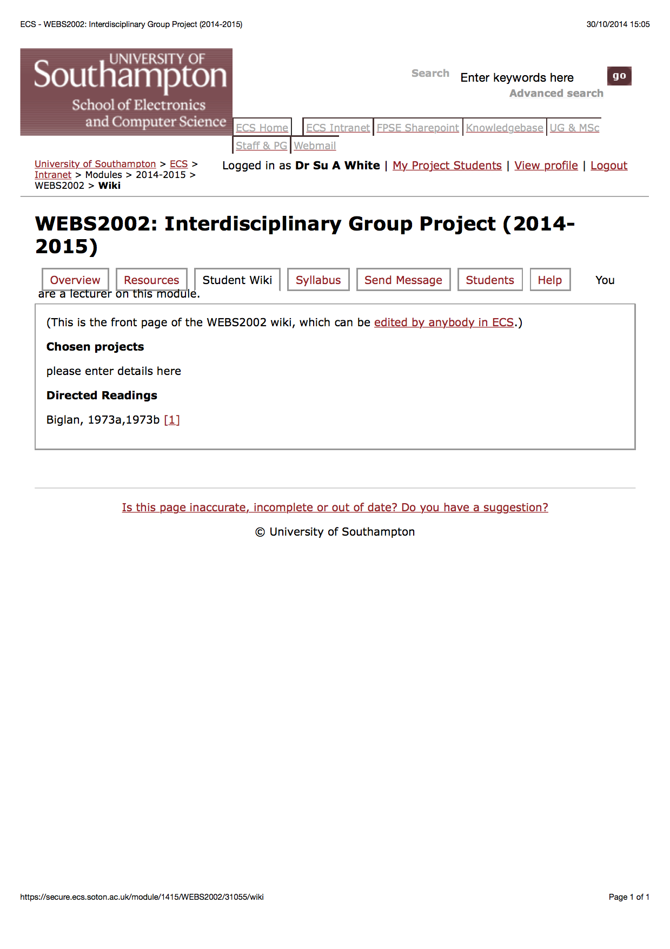
First
Project and FAQ section
live edit

Slide 5
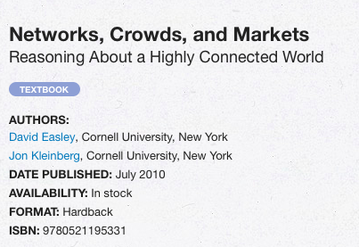
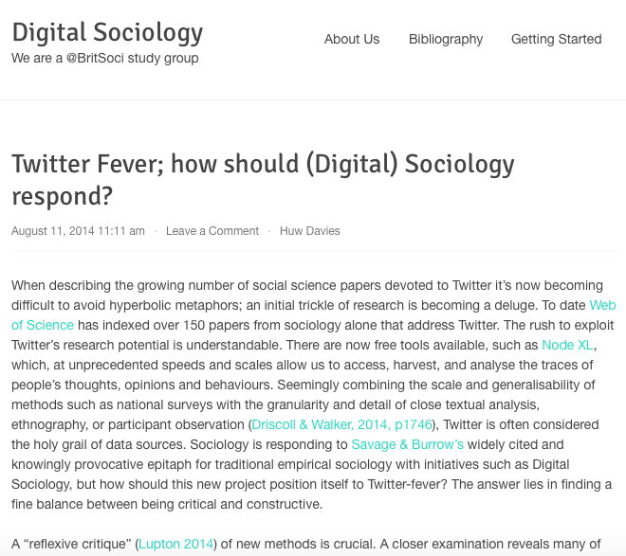
Literature: models
Sociology/interdisciplinarity
CS/Interdisciplinarity
http://www.cs.cornell.edu/home/kleinber/networks-book/
http://digitalsociology.org.uk
Notes:
The language of the digital sociology group is very different to that of Jon Kleinberg of Cornell

Slide 6
Follow up: Look at the two sites
Look at the two sites
  Compare the language
  The way they define the area
  The way they define problems and possible approaches to solutions in the area
Think about your own work, are you using the language of one community/discipline?
How might you change aspects of your approach?

Slide 7
Your project as a focus
Applying the theory

Slide 8
Repko: The flow of activities
problem
Disciplinary insights
Integration
Understanding

Slide 9

Methods (Repko)
Have you defined the problem?
  How?
    Textually?
    Visually?
  Have you defined a clear research question?
    Is it short
    Is it understandable?

Slide 10
Repko (method)
Have you mapped the problem space?
  Which bits of the problem relate to which parts of possible findings?
Mapped?
  Suggests a visualisation
  (another Mendeley group)
http://www.mendeley.com/groups/3963921/visualliteracy/

Slide 11
Methods (Repko)
Have you justified the interdisciplinary approach?
Possible arguments
  Complexity
  Additional insights of ID approach
  Shortcomings of existing single discipline approaches
  Problem at the interface
  Unresolved societal need/issue

Slide 12
Repko Method
Have you analysed the Literature?
  Search
  Review
Have you been methodical?
Is your review consistent with your arguments?
What is the common ground?
What are the conflicts?

Slide 13
Repko (method)
Does your method draw from your chosen disciplines?
Does your discussion analyse the problem (again)
Does your discussion evaluate your insights (findings)

Slide 14
Repko (method)
Have you created common ground?
Do your findings and conclusions integrate insights?
Have you explained and tested your interdisciplinary understanding?
Problem
Disciplinary insights
Integration
Understanding

Slide 15
Use the student wiki
Now and later
  Do you have more questions to add?
  What needs to be debugged?

Slide 16
References/further reading
Set text & illustrative sites
Papers and sites
Repko Interdisciplinary Research: Process and Theory, 2008
Digital Sociology (BSA)
http://digitalsociology.org.uk
Jon Kleinberg at Cornell
Networks
http://www.cs.cornell.edu/home/kleinber/networks-book/
Tinati, R., Halford, S., Carr, L., & Pope, C. (2014).
Big Data: Methodological Challenges and Approaches for Sociological Analysis. Sociology.
doi:10.1177/0038038513511561

