Slide 1
Important Lecture
By Professor Carr

Slide 2
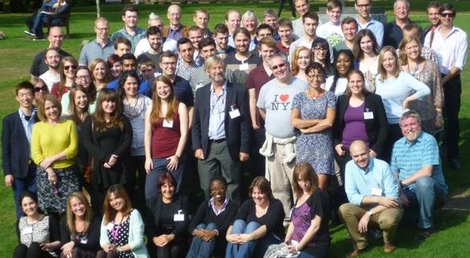
A Picture!

