Slide 1
WEBS6203
Interdisciplinary Thinking
W3 Processes
Su White
http://www.edshare.soton.ac.uk/13441/
These slides cover activities throughout the first week’s three meetings

Slide 2
Weekly focus
1 | Introductions and scoping
2 | Clarification and beginnings
3 | Process lecture: specifications and structures
4 | Independent study: Blogging and surgeries
5 | Independent study: Blogging and surgeries
6 | Independent study: Blogging and surgeries
7 | Focus on hand ins: Revisit specification for posters and reports
8 | Poster surgery
9 | Poster pitches and poster hand in
10 | Independent study: Peer review and revisions
11 | Q&A
Vacation 1-3
12 | Last minute surgery, report hand in
Exam period

Slide 3
How you will demonstrate your learning
Poster
Report
Provide a structured overview of your chosen areas
Communicate key points in visually compelling manner
reading
blogging
discussing
reviewing
thinking
reflecting
revising

Slide 4
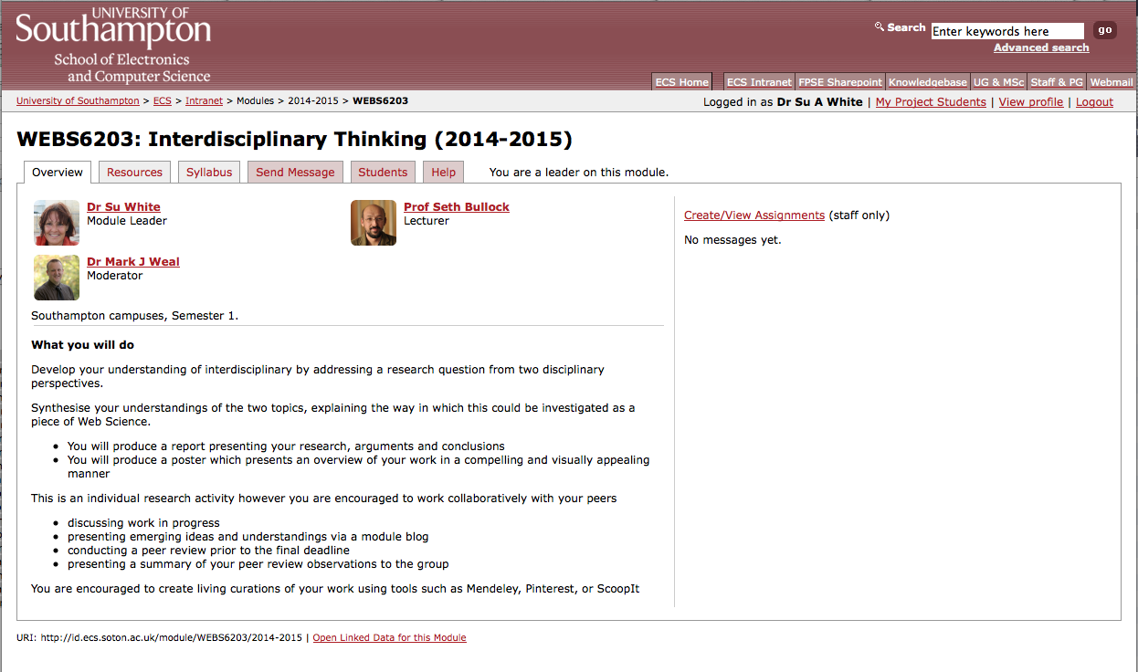
Use ECS notes as your reference point
https://secure.ecs.soton.ac.uk/module/1415/WEBS6203/33406/

Slide 5
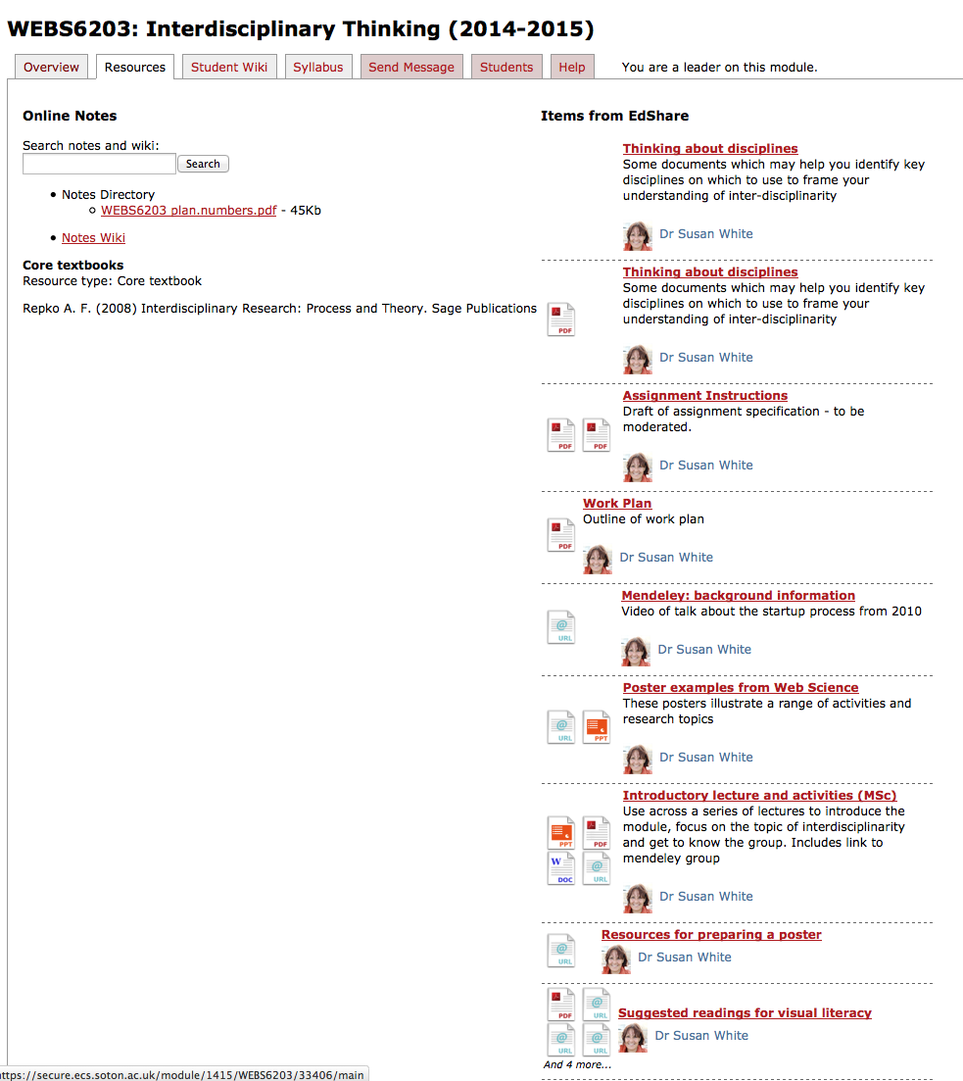
Support materials
Slides
HESA disciplines
Example posters and reports
Previous posters
Existing research
Work plan
Hand in
(fixed dates)
Module page
Overview
Processes
In the wild
WAIS/DTC
Supplementary
Visual literacies
Poster pointers
Research
Creation
Mendeley
Reflection
Blogs

Slide 6
Resources via the module page
Walk through

Slide 7
Blog contributions
You will receive an invitation to the blog
Make a simple contribution
Your Name
A photo – please ☺
Some reflection
Suggested format for your reflections
What?
  Reporting on a thought, event, stage of understanding
So What?
  What are the implications?
Now What….
  How are you going to progress things?

Slide 8
reminders
Overview of the process

Slide 9
What we expect you to do
1. DEFINE problems, issues, topics or questions that warrant interdisciplinary examination
2. PRESENT a clear rationale for taking interdisciplinary approach including the advantages to be gained
3. IDENTIFY relevant disciplines
4. CONDUCT a literature review (what is known on the topic from each of the disciplines)
5. DEVELOP a command of each relevant discipline set out the analytical structure central to each discipline, identify key underlying assumptions, and methods of evaluation.
6. STUDY the problem and generate insights including predictions from each of the relevant disciplines - in isolation!!
7. IDENTIFY conflicts between and/or areas of complementary between the insights offered from each discipline
8. CREATE common ground by developing a cohesive framework of analysis that incorporates insights from the relevant disciplines in a systematic manner
9. COMBINE disciplinary insights to construct new more integrated understanding of the problem
Repko & Welch 2005

Slide 10
The flow of activites
problem
Disciplinary insights
Integration
Understanding

Slide 11

The scope of interdisciplinarity

Slide 12
Selecting your topic:
What to do next
Think about your target contributory topics
Look into their foundational concepts
Consult textbooks (university library)
Look at programme specification (online, this university and others)
Watch a few video lectures –e.g. YouTube, ITunesU
Talk to your fellow students
Reflect on your other lecture content
Look at proceedings from previous web science conferences
Establish some shared working methods

Slide 13
Look at the posters & reports
Individually or in groups
Use this as a guideline

Slide 14
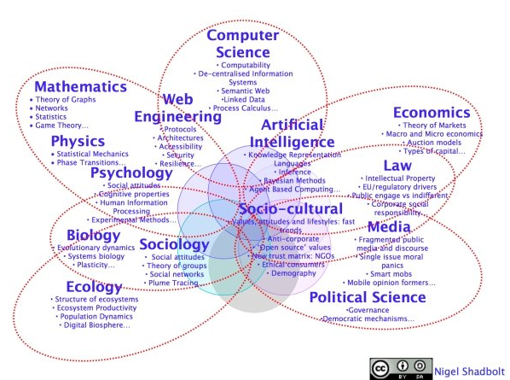
An idea of web science you may have seen…

Slide 15
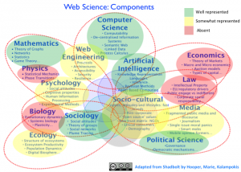
Another…

