Slide 1
WEBS2002
Interdisciplinary Project
Introduction:
Exploring Interdisciplinarity

Slide 2
What I said: Prepare yourself
Watch and read
Be ready for
You will get an email from me as a reminder
Watch the YouTube videos
Read one of the papers in the Mendeley group
Discussions of
  Interdisciplinarity
  research practice

Slide 3
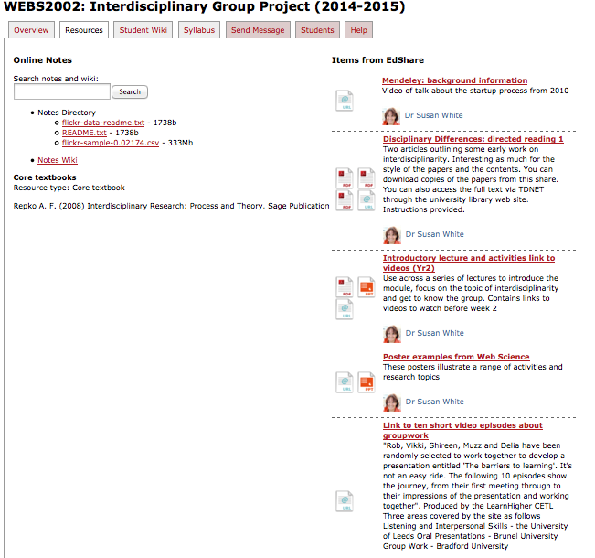
Watch the video
Interdisciplinarity collection on YouTube
Remember
all resources are in EdShare
they can be found via the module page: resources link
https://secure.ecs.soton.ac.uk/module/1415/WEBS2002/31055/resources

Slide 4
Read the papers 1
References is the Mendeley group
  A single reference point for all cited literature in this module
  Released progressively as we advance
Learn to use the Library portal to TDNET
You will (oftner) need to use VPN
https://secure.ecs.soton.ac.uk/module/1415/WEBS2002/31055/resources

Slide 5
Read the papers 2
You can access the papers directly through
  Module page
  EdShare
There is also a link to the background video telling the back story to creating Mendeley
https://secure.ecs.soton.ac.uk/module/1415/WEBS2002/31055/resources

Slide 6
In the discussion
Talking about the report
Talking about group working
Prepare using the structure of the scientific method
Negotiate with your group about the roles you will perform when writing the report
  Planning & structure - all
  Research – all
  Editor – 2x
  Others - negotiate
Watch the Ten short videos
http://www.edshare.soton.ac.uk/1852/
This is a link
You will see a preview of the content
At the bottom of the preview click VIEW

