Slide 1
EndNote Online - getting started
Notes:
This guide introduces the main features of EndNote Online - sometimes called EndNote Web, my.endnote.com or just EndNote.

Slide 2
Why use EndNote Online?
Available with Web of Science
No need for EndNote software
Basic tools available
Opportunity to share libraries
BUT - if you have EndNote X7 installed these libraries will be automatically synchronised with EndNote Online
Notes:
The full EndNote software is available on all university workstations - but if you want to work elsewhere and not purchase the software yourself, then EndNote Online provides basic bibliographic management tools and enables you to work from anywhere, so long as you have access to Web of Science. Note that you must log in to Web of Science through a University of Southampton workstation at least once per year to retain full access
EndNote Online is also useful if you are working with others as you can share references and whole libraries if you choose.
However, be aware that there is automatic synchronisation between EndNote Online and EndNote X7 if you set up this option in your preferences.

Slide 3
What is EndNote Online for?
Build a personal reference library
Search databases and export references
Insert citations and build bibliography
Synchronise with your desktop library
Share references with others
Notes:
EndNote is bibliographic management software that allows you to collect all the references from a range of resource types in a single location.
The results of a database search can be automatically exported to EndNote, and other notes, files and graphics can be added to individual records, allowing all information to be stored in a single location.
EndNote works alongside Word, inserts short citations within the text and generates full bibliographic references at the end of the current document. The appearance and management of citations and references is controlled through the EndNote Library.
Using EndNote, a document created with references in one referencing style can be automatically converted to a different referencing style if required.
All features of EndNote can be edited to suit personal preferences.
You will continue to have access to your references in EndNote Online even when you leave University of Southampton, although the tools to which you have access may be more limited.

Slide 4
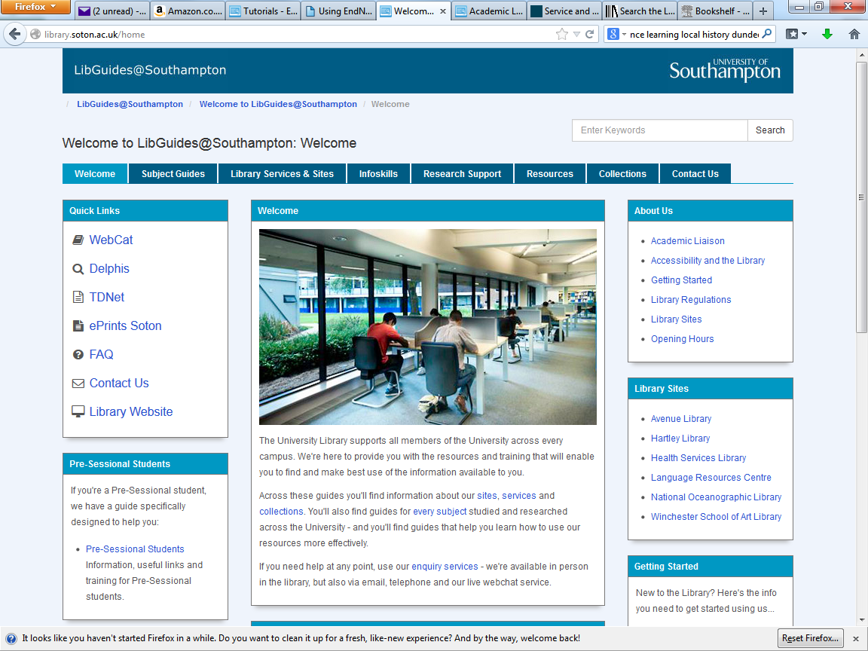
Go to library.soton.ac.uk
Choose the 'Resources' tab
Notes:
To start you must create a Web of Science id. Find this on the library guides, under the Resources tab.

Slide 5
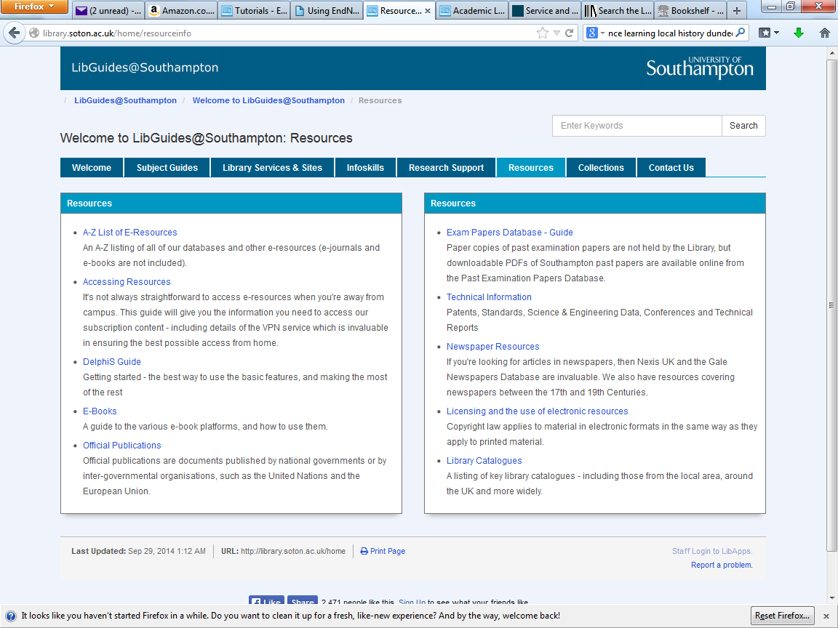
Go to the A-Z list
Notes:
Go to the A - Z list of E-Resources

Slide 6
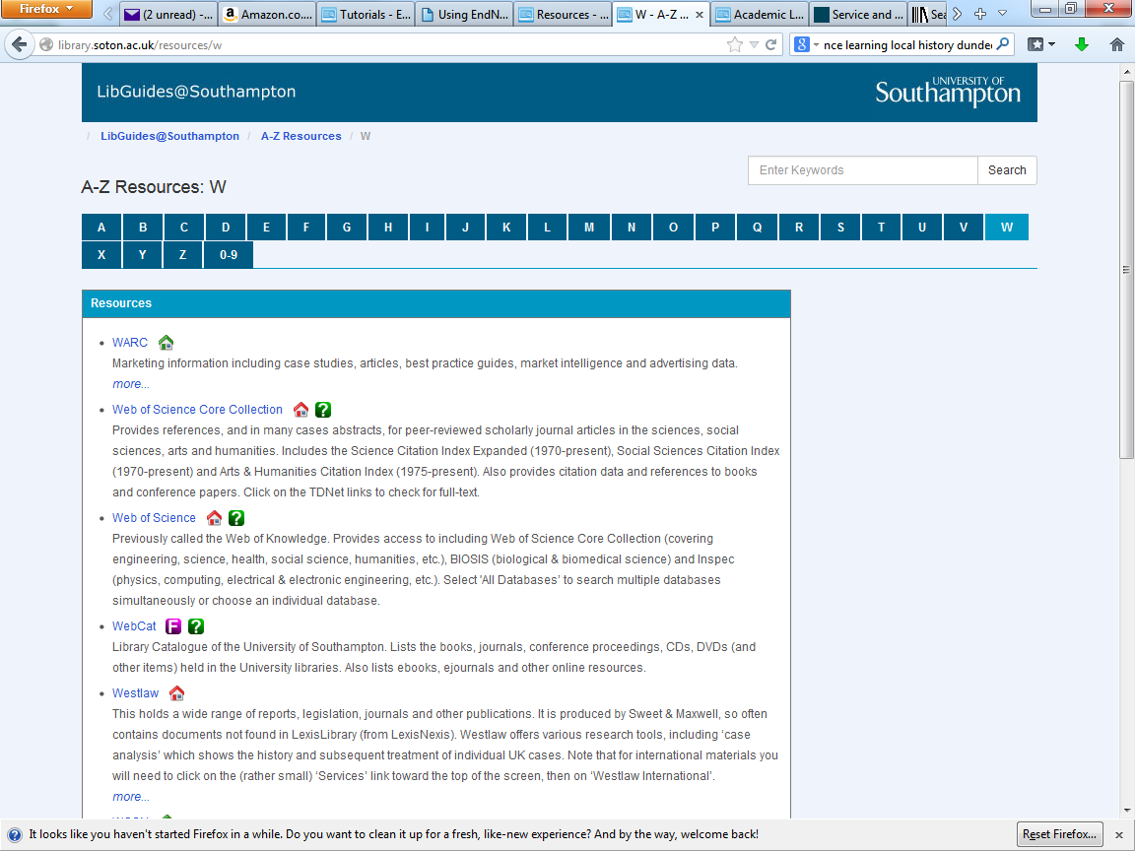
Choose the Web of Science
Notes:
Follow the Web of Science link.

Slide 7
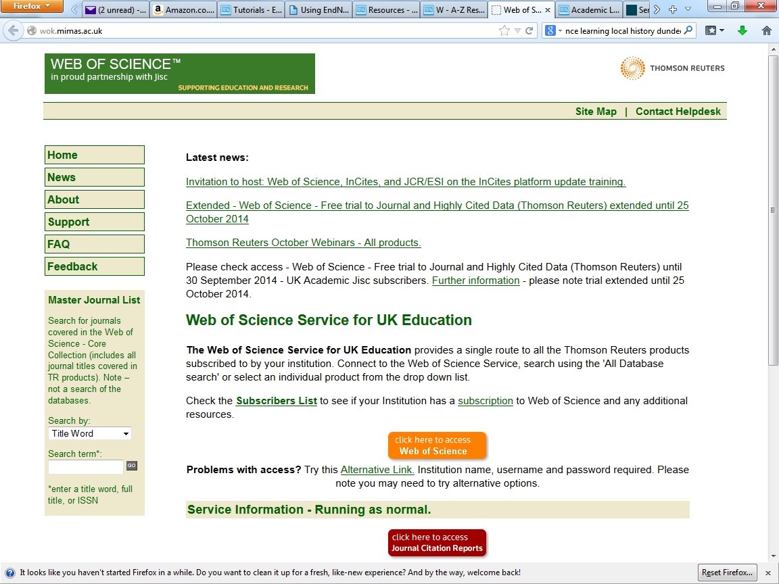
Open the Web of Science
Notes:
Open the Web of Science link.

Slide 8
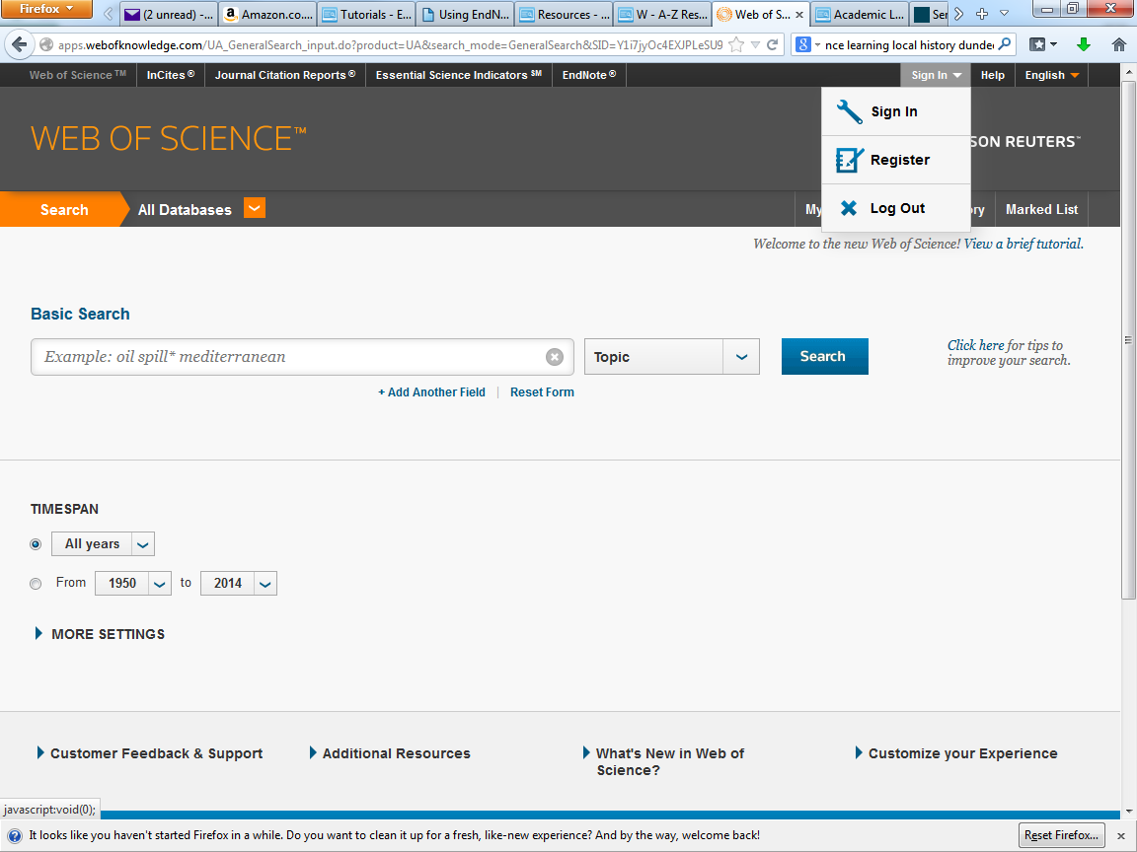
… or 'Sign In'
Register on the Web of Science database…
Notes:
If you have not previously created a user id on Web of Science, follow the Register link, otherwise, go to Sign In.

Slide 9
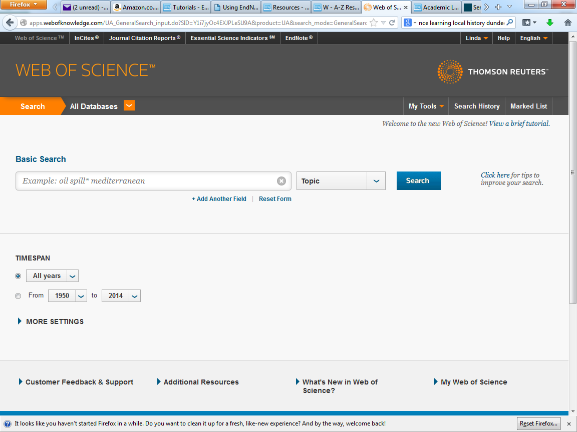
Select 'EndNote'
9
Notes:
Select the EndNote link.

Slide 10
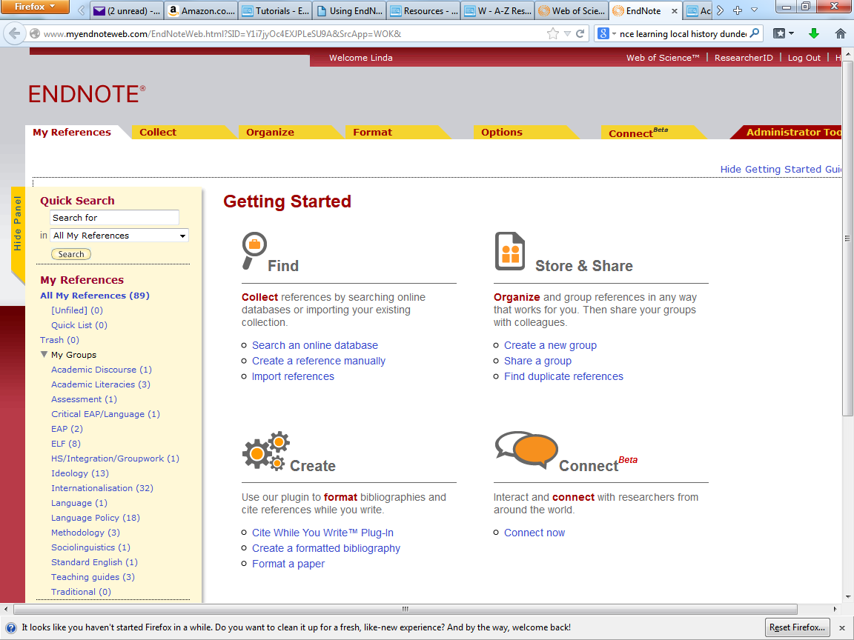
This is the EndNote Online home page
Notes:
Use the tabs and headings on the EndNote Online home page to access the various bibliographic tools.

Slide 11
Collect references

Slide 12
Search online databases
Notes:
This is for Web of Science
For Ovid Medline, use Medlars export option, and Medline OVID filter. Results saved as .txt automatically in downloads

Slide 13
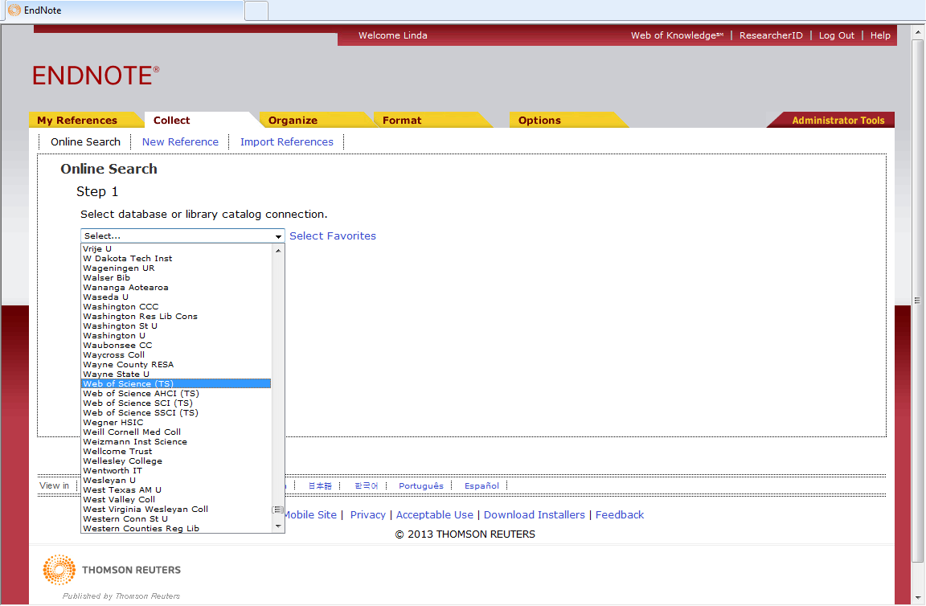
Use the 'Online Search' tab and select the required database…
Notes:
It is possible to carry out an online search from within EndNote Online. Go to the Online Search tab and select the required database from the drop down menu.

Slide 14
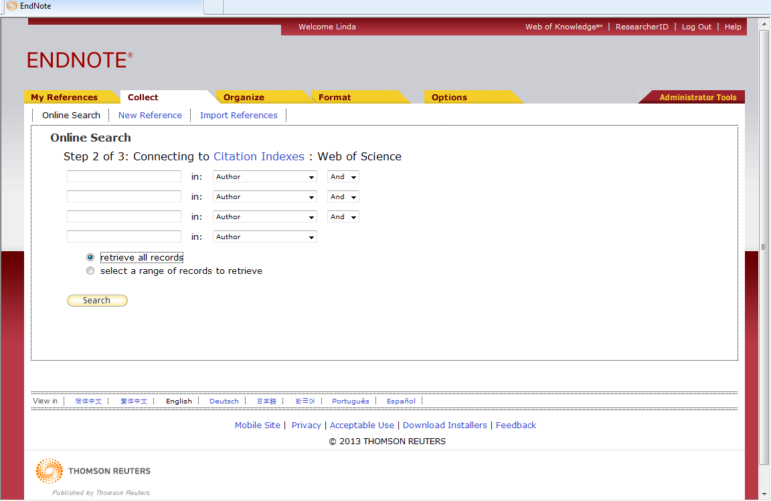
This method is only useful for very specific searches
Notes:
However using this method gives you little control over the records downloaded - individual selection is not possible.
The dropdown menus allow you to search in various fields, but only four lines are available and it is not possible to include additional limits. This method only works for very specific search terms which return a small number of records.
It is always preferable to carry out the search from the external database and then export to EndNote or EndNote Online.

Slide 15
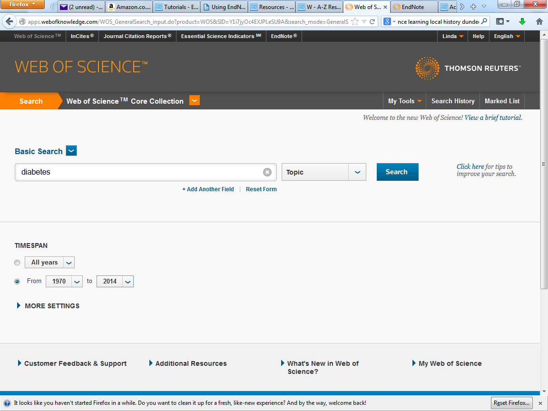
This is the Web of Science home page
Enter search terms - in this case 'diabetes' and click 'Search'
Notes:
It is preferable to use the external database which allows maximum flexibility in search terms, the opportunity to apply limits, and the ability to select specific records of interest from results retrieved.
This is a very simple search, in this case for a single term. Enter the search term(s) and click the Search button.

Slide 16
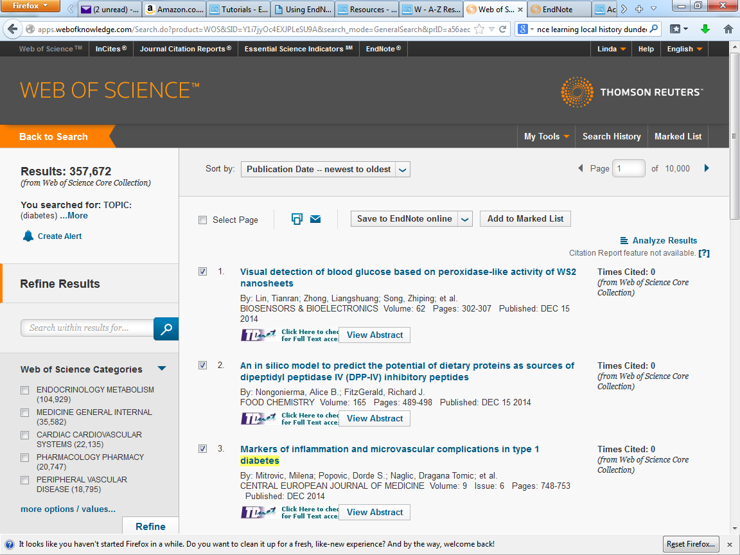
On the Results page, check required items and then click 'Save to EndNote online'
Notes:
Work through the results that have been retrieved, identifying just those that are relevant to you. It is generally better to select an individual database, rather than using the All databases tab. Cross database searches do not always export bibliographic data fully.
When all required results have been identified, click the Save to EndNote online link.

Slide 17
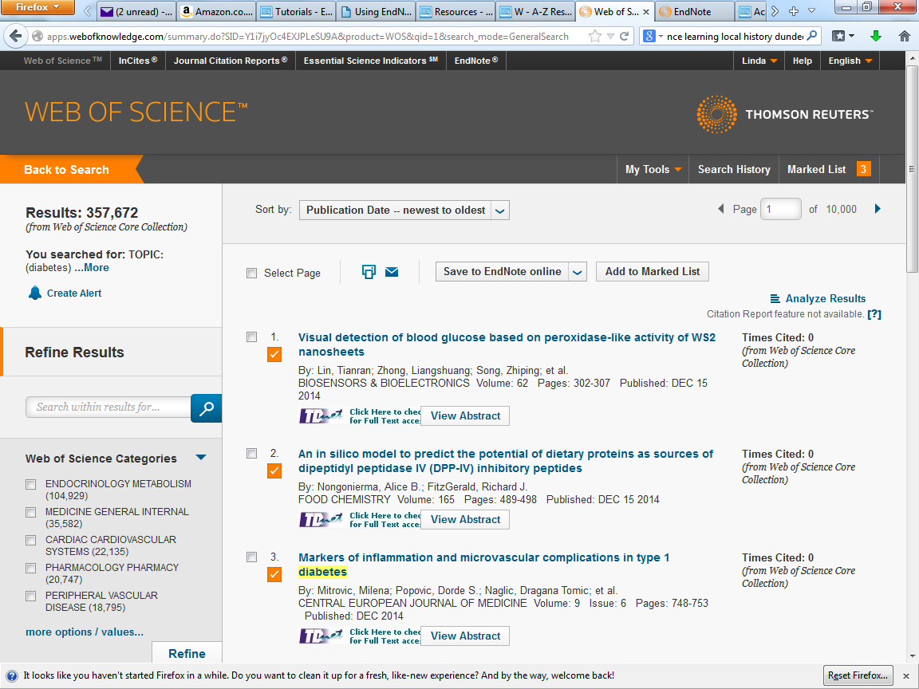
Select records and click the Marked List link
Then export the marked list
Notes:
If a large number of results is involved it is better to select records on each page and then use the Marked List that has been created to export the records

Slide 18
Click at any time to view Marked List
Marked records are identified
Notes:
Records added to the Marked List are identified by a tick underneath the check box. All selected records can be viewed at any time by clicking Marked List.

Slide 19
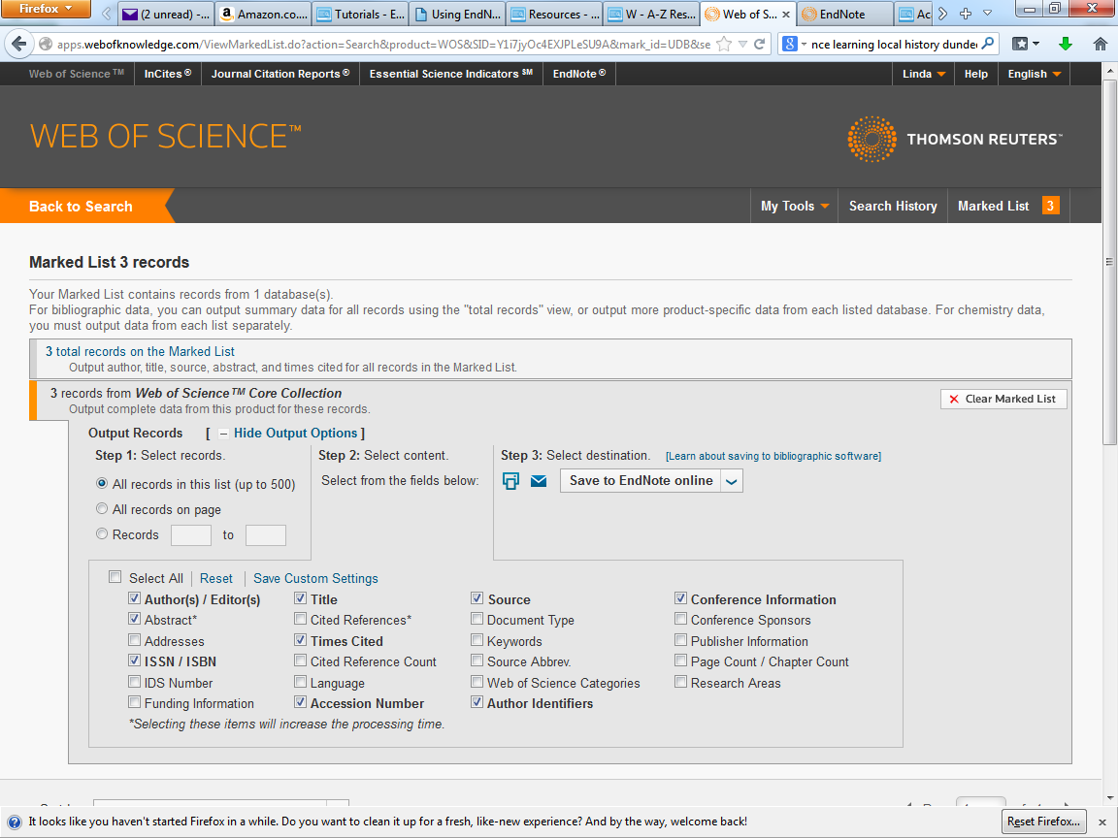
It is helpful to include the abstract in exported records
Select fields to be included in output and then choose 'Save to EndNote online'
Notes:
When you are ready to export the records, go to Marked List, and select the fields to be exported. It is helpful to include the abstract. Choose Save to EndNote online

Slide 20
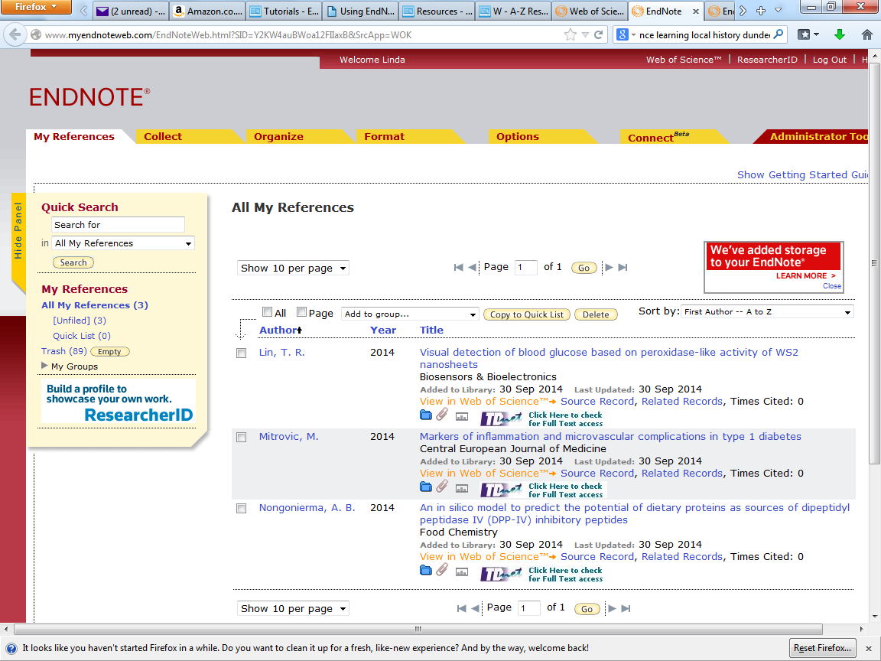
Click on the article title to view the full EndNote record
Notes:
In the EndNote online library, the new records will be added to Unfiled and also to All My References. Note that this does not overwrite existing Unfiled records.
Click on the article title to view the full EndNote Online record.

Slide 21
Follow the 'Source Record' link to view the Web of Science entry
Notes:
The Source Record link on the individual EndNote record links to the Web of Science database record.

Slide 22
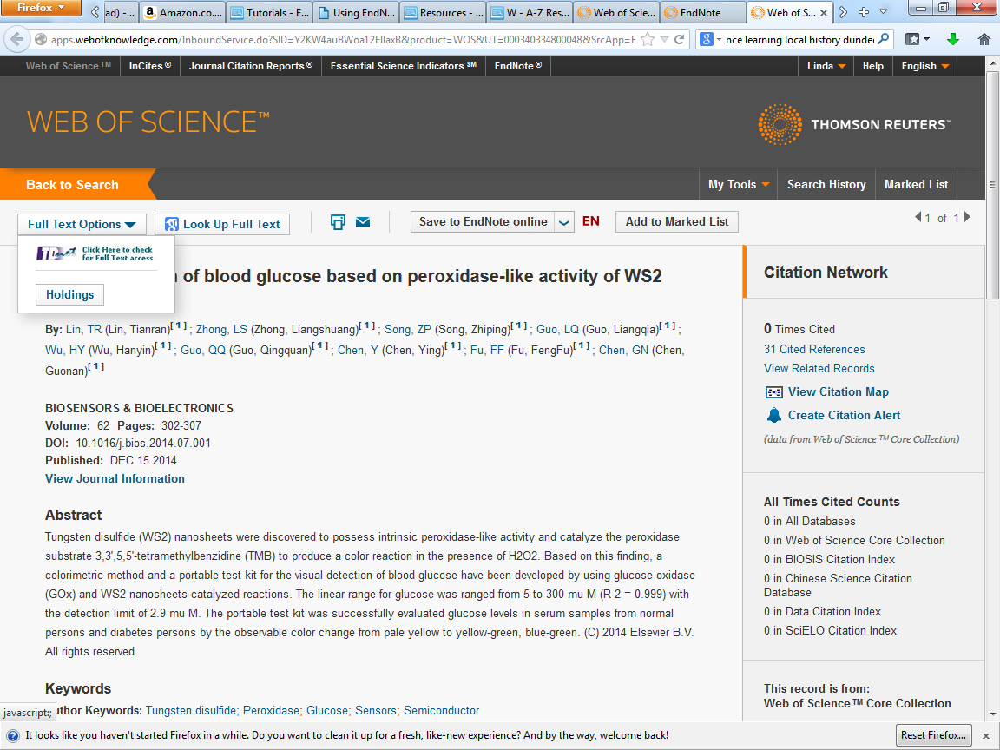
Check here for full text access
Notes:
Expand the Full text option to follow the TDNet link

Slide 23
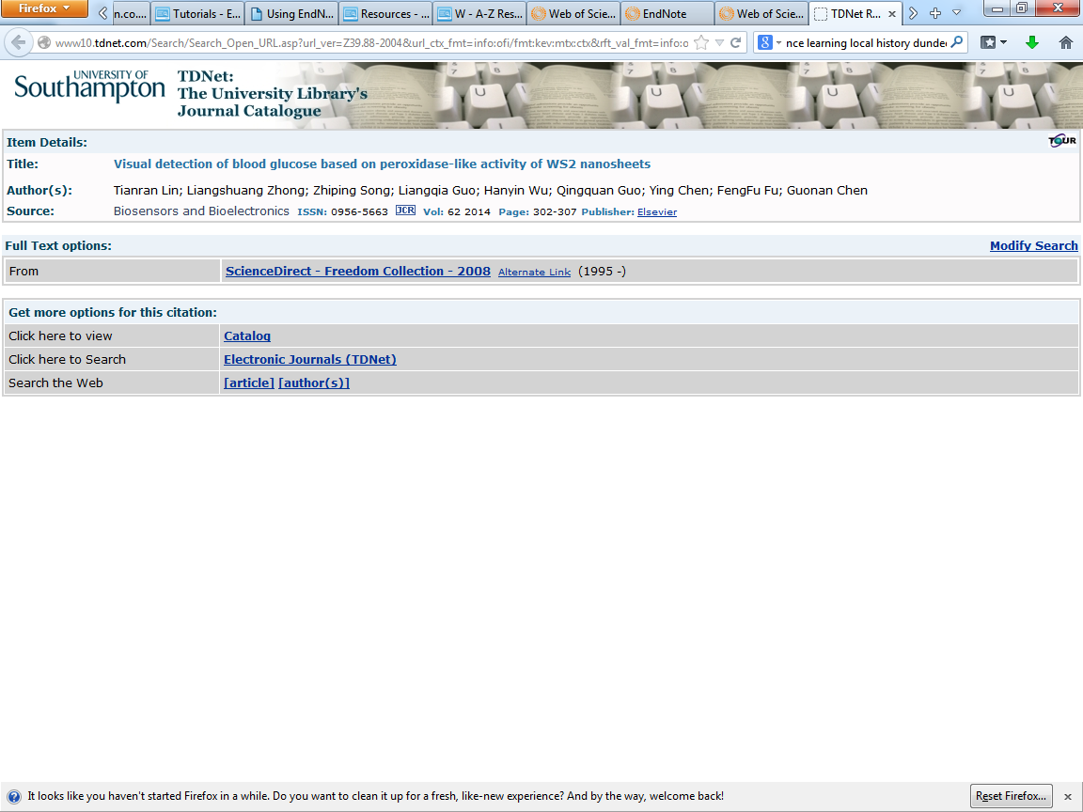
Notes:
Follow the Full Text options hyperlink.

Slide 24
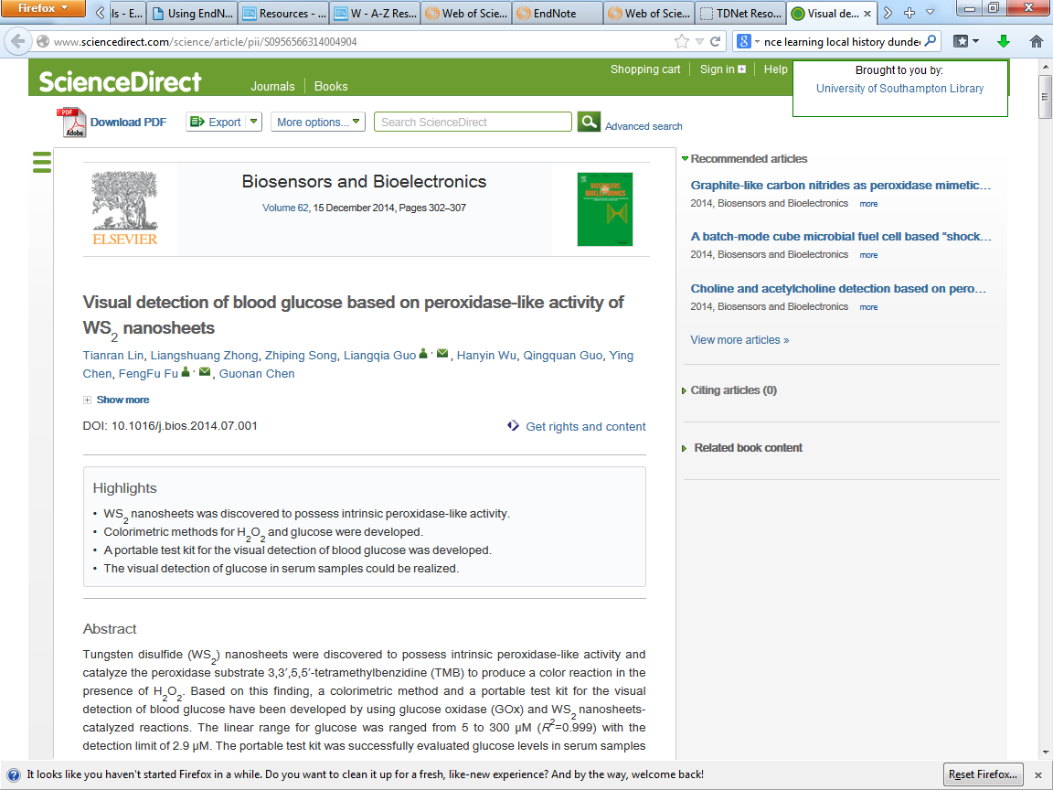
Notes:
Download the pdf, to attach to the EndNote record later.

Slide 25
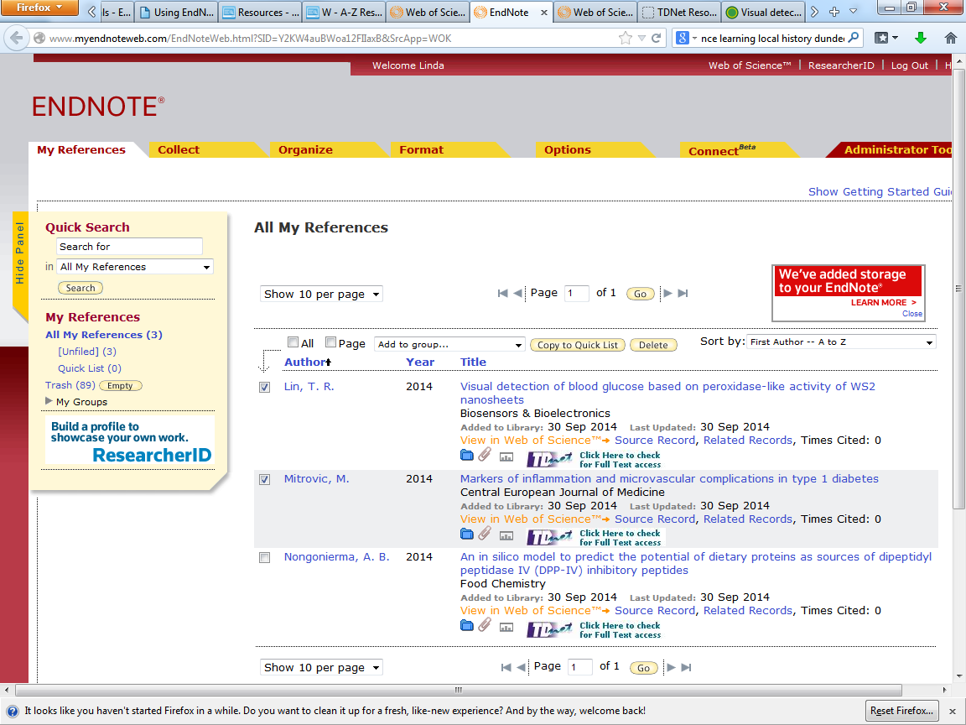
Check boxes for key references and click 'Copy to Quick List'
Notes:
It is possible to identify important records and add to a Quick List at any time. Check the required boxes and click Copy to Quick List

Slide 26

Selected references are added to the Quick List
Notes:
Selected records are added to the Quick List. These are copies of the entries in All My References.

Slide 27
Add references manually

Slide 28
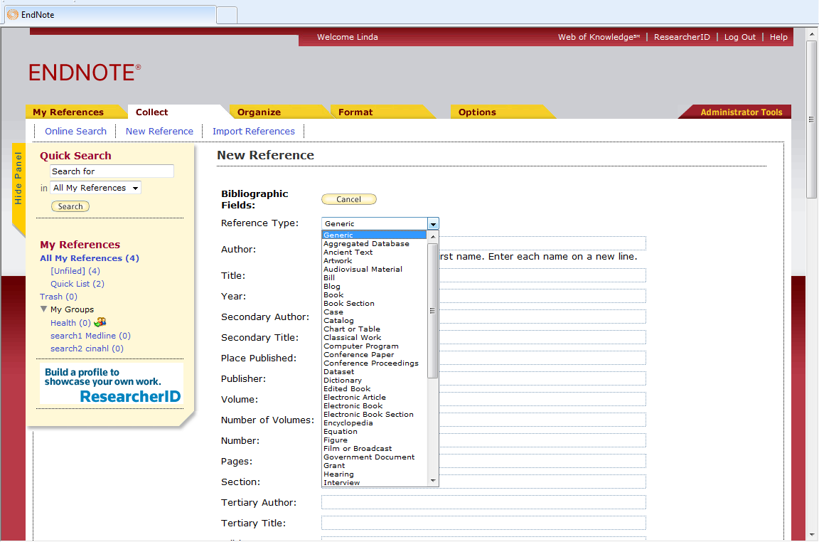
Go to 'Collect ➔ New Reference'
Choose the reference type from the dropdown menu
Notes:
Some records may need to be added manually to the EndNote Online library. Go to Collect, New Reference.
Choose the reference type from the dropdown menu.

Slide 29
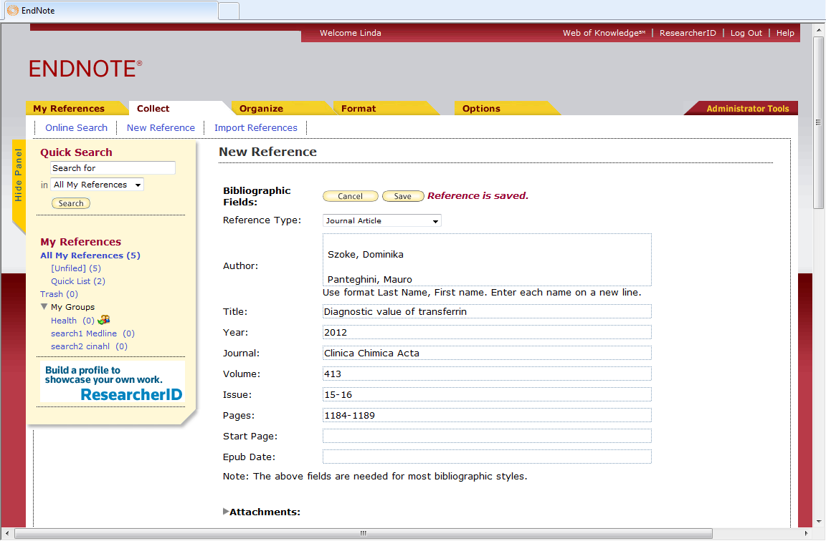
The reference is automatically saved as each field is completed
Notes:
Complete all necessary fields. Note that the reference is saved as each field is completed.

Slide 30
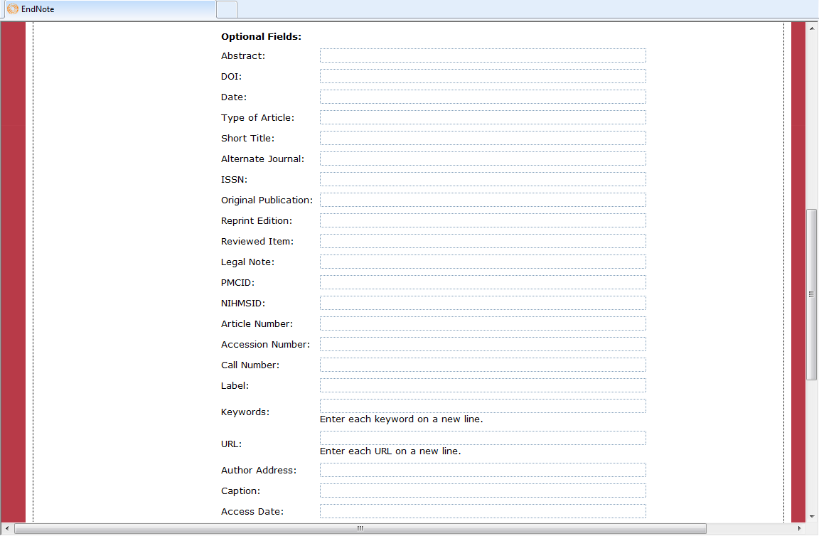
Scroll down to see more fields
Notes:
A full set of record fields is available, matching those available with EndNote X7.

Slide 31
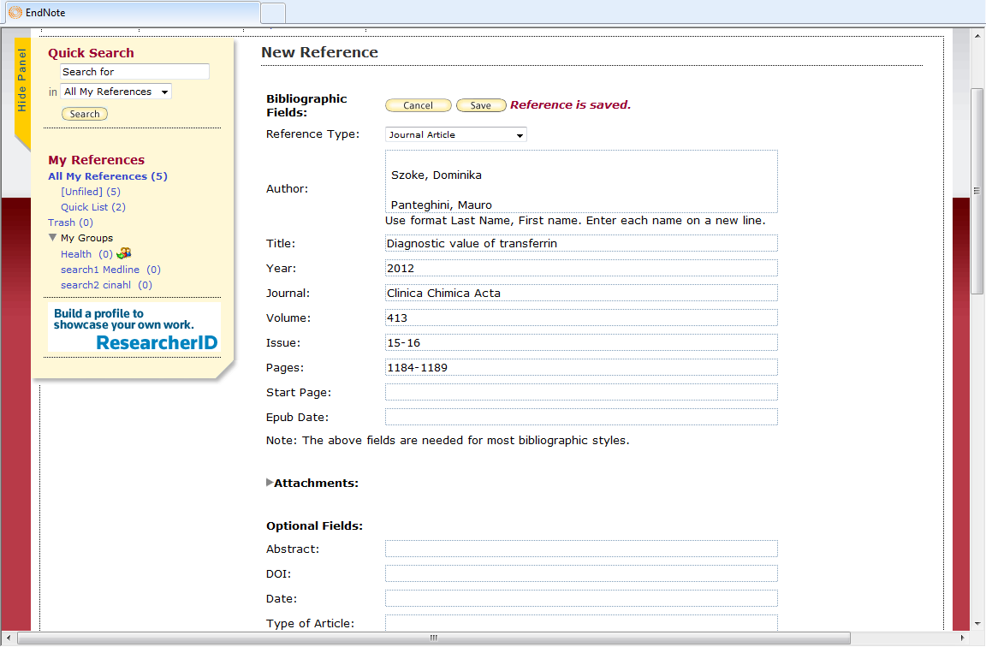
In the Author field, enter last name followed by a comma, then the first name(s)
Enter one author per line
Notes:
The structure of the Author field is particularly important.
Enter the surname, or name of an organisation, followed by a comma and then first names or initials.
If the comma is omitted, the author name will not display correctly in citations or bibliographies.
If there is more than one author, enter one author per line.
Click to Save and exit the record.

Slide 32
Search references

Slide 33
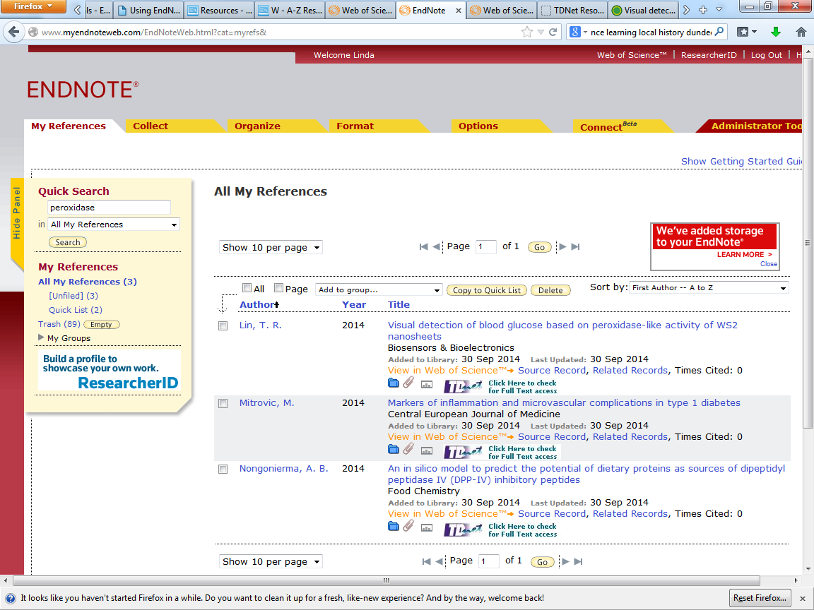
Use the 'Quick Search' box
Notes:
EndNote Online has a simple search facility: enter text in the search box, and choose to search all references or a single group.

Slide 34
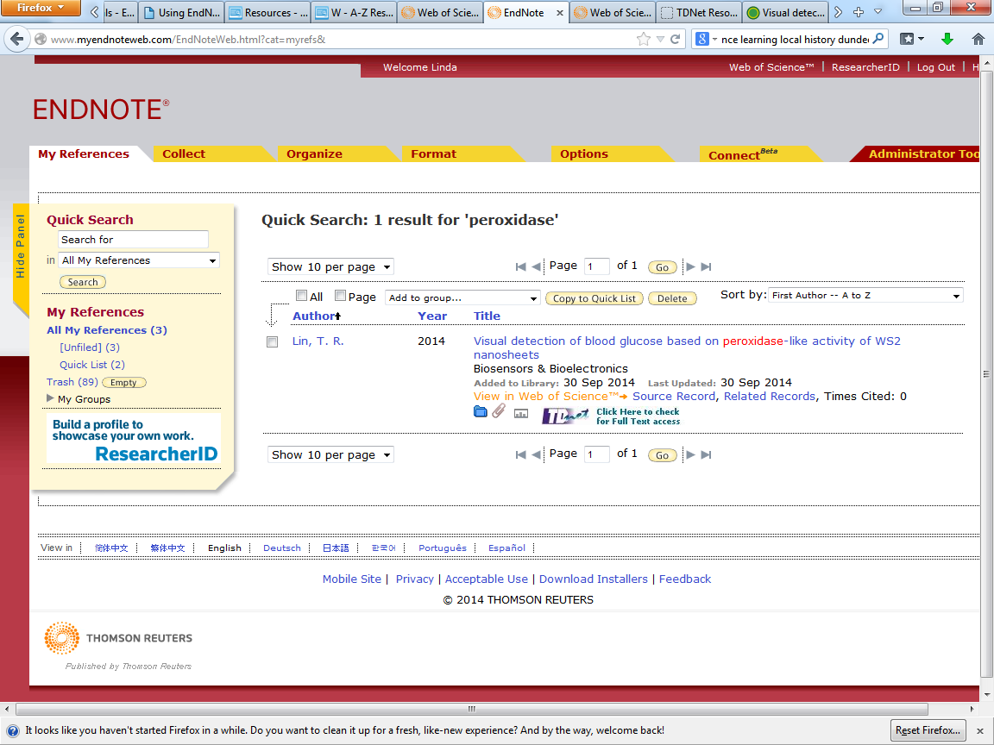
Results are displayed
Notes:
Records matching the search term are displayed.

Slide 35
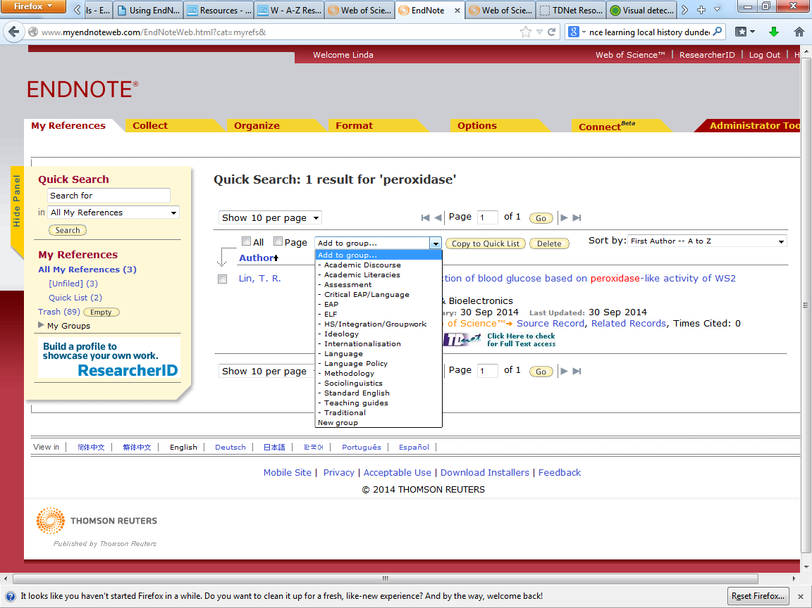
Some or all of these can be added to a separate group if required
Notes:
Any or all of these records can be added to an existing group, or a new group can be created

Slide 36
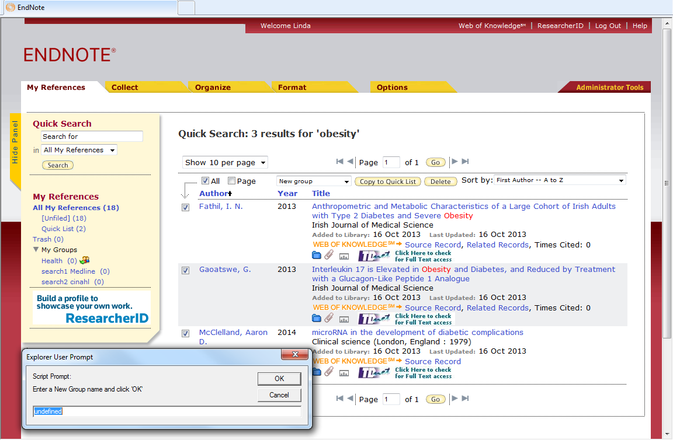
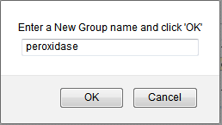
Enter a name for the new group and click 'OK'
Notes:
Enter the name of the new group and click OK. Mode of operation varies between browsers

Slide 37
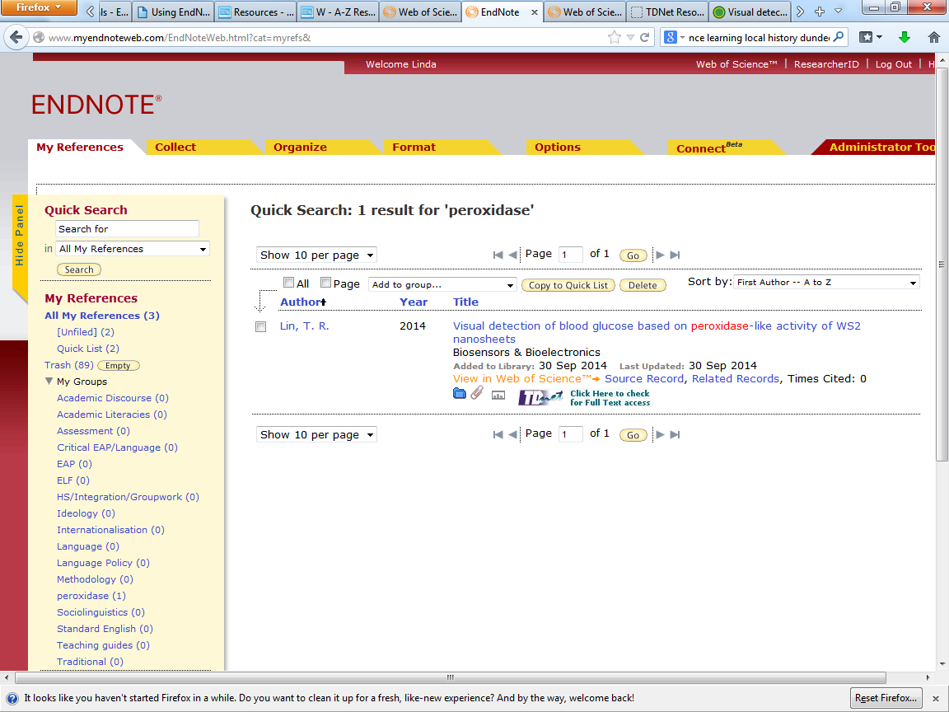
Selected references are copied to the new group
Notes:
The new group appears in My Groups.
References in this group are copies and remain in All My References.

Slide 38
Organise references

Slide 39
Create a new group

Slide 40
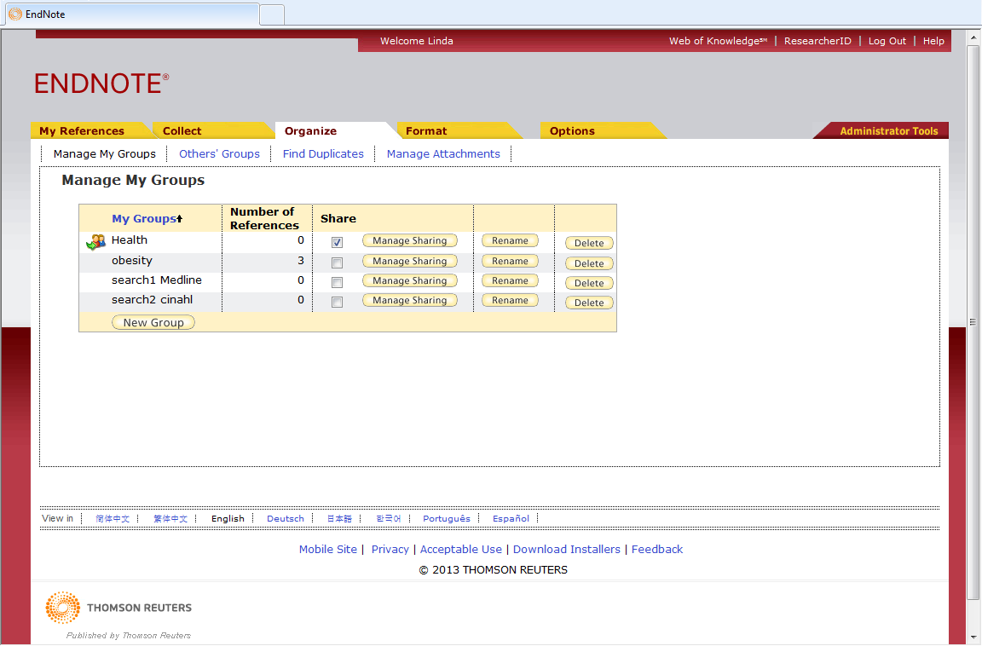
Go to 'Organize ➔ Manage My Groups'
Click 'New Group'
Notes:
When you have collected a significant number of references, it may be easier to arrange them in groups. The references will remain in All My References, but can be copied into as many groups as required
On the Organize tab, go to Manage My Groups, and click New Group.

Slide 41
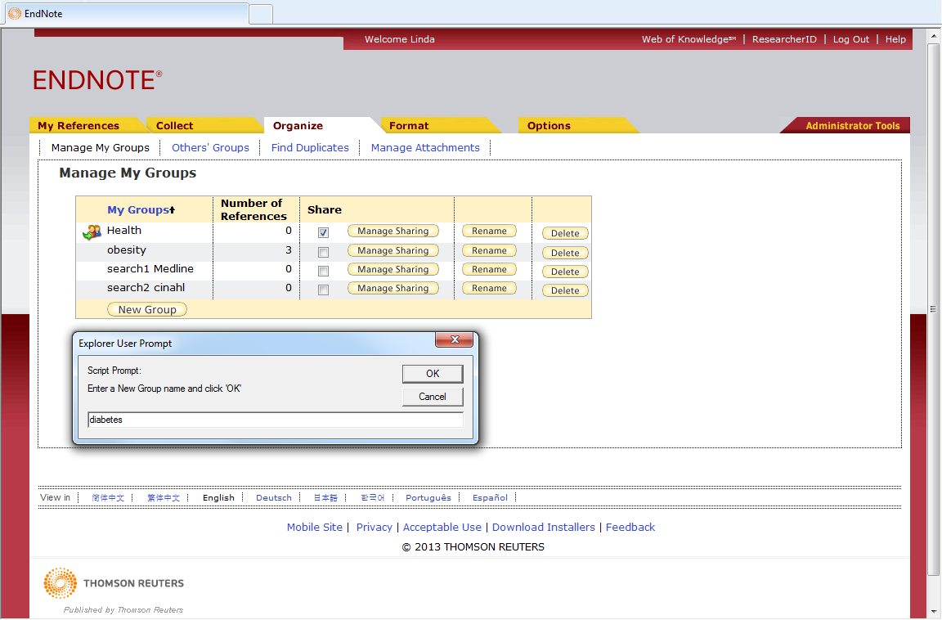
Give the group a name and click 'OK'
Notes:
According to the browser used, you may need to allow scripted windows (IE).
Type the name of the new group in the box and click OK

Slide 42
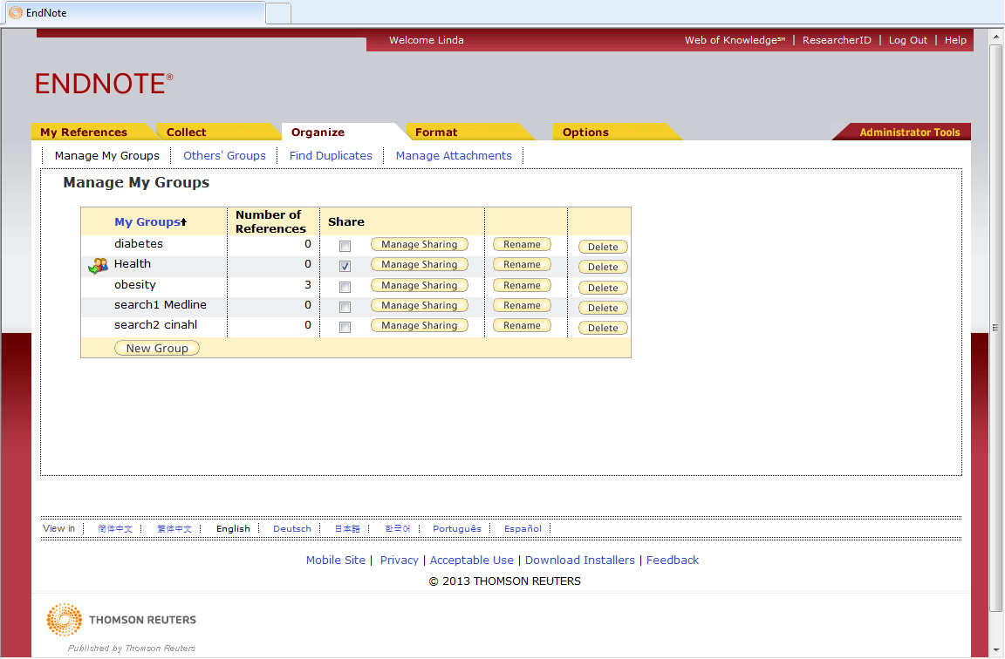
The new group appears in the list of My Groups
Notes:
The new group appears in the list of My Groups.

Slide 43
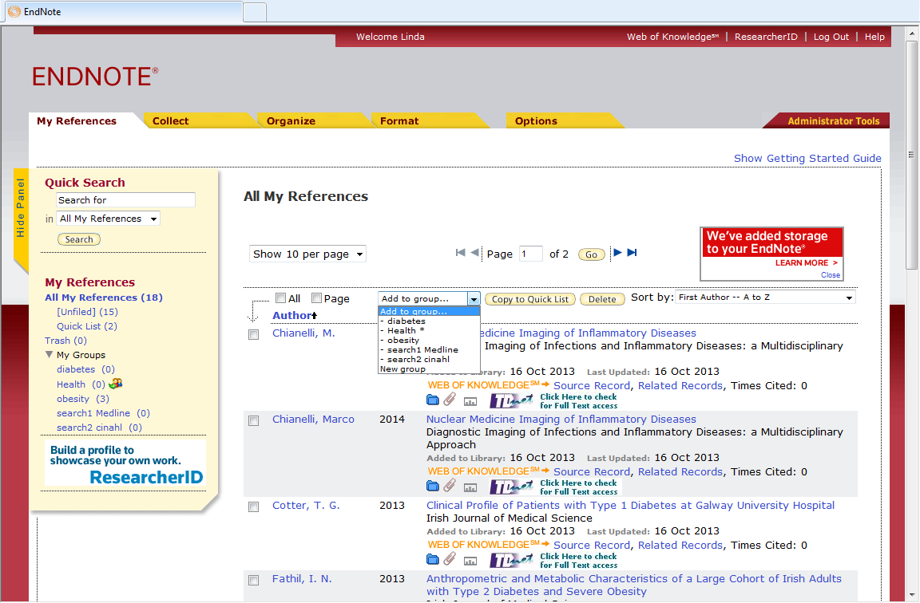
References can now be added to this new group
Notes:
Select references to be added to this group, and choose the required group from the Add to group … dropdown menu.

Slide 44
Share a group

Slide 45

Go to 'Organize ➔ Manage My Groups ➔ Manage Sharing'
Notes:
Any group within the library can be shared with colleagues. This is really useful when collaborating on a project. On the Organize tab go to Manage My Groups and select the Manage Sharing option.

Slide 46
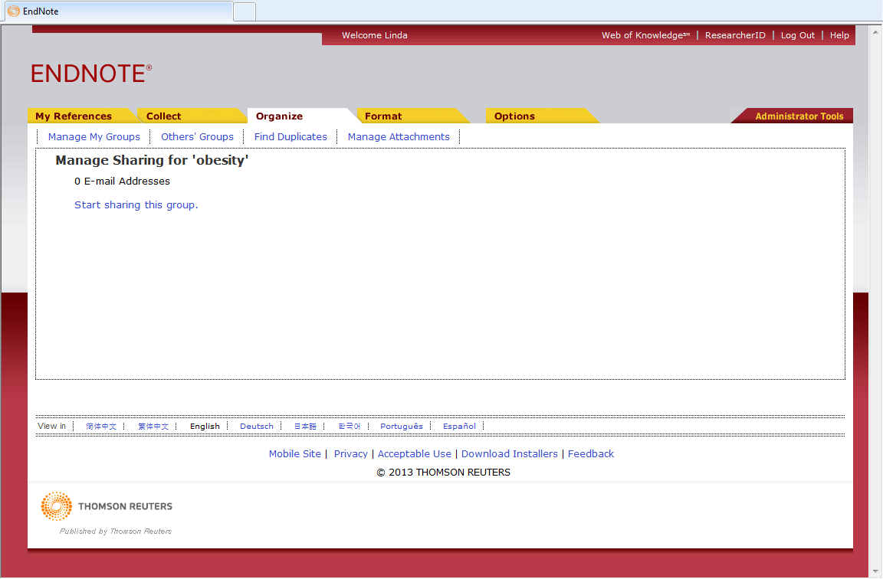
Click 'Start sharing this group'
Notes:
Click on Start sharing this group.

Slide 47
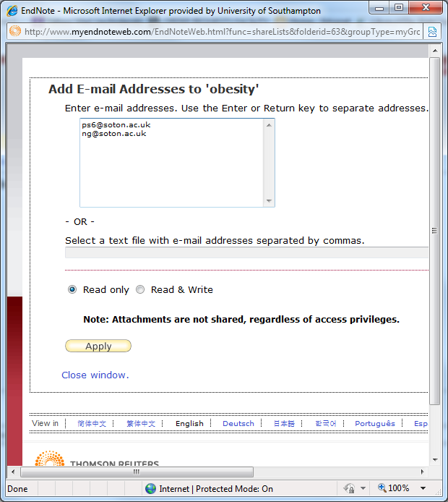
Add the email addresses of people who will share, and click 'Apply'
Notes:
Add the email addresses for all people you wish to share this group. Choose access privileges on this screen for the whole group - individual privileges can be modified on the main screen. Click Apply.

Slide 48
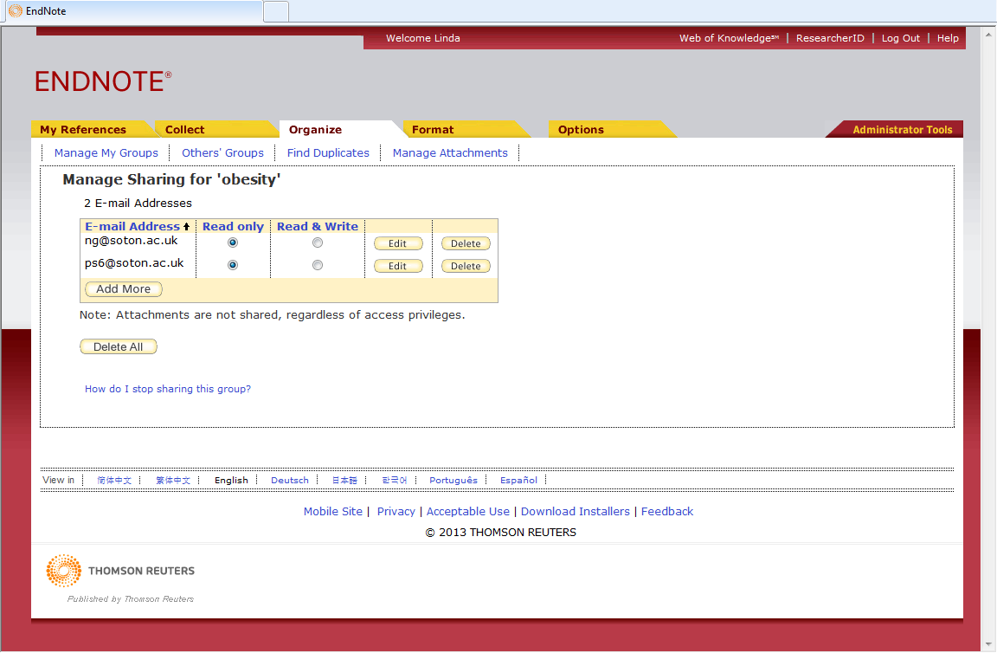
Modify individual privileges if required
Notes:
Different privileges can be set for various members of the group - note that copyright restrictions prevent attachments being shared.

Slide 49
Share someone else's group

Slide 50
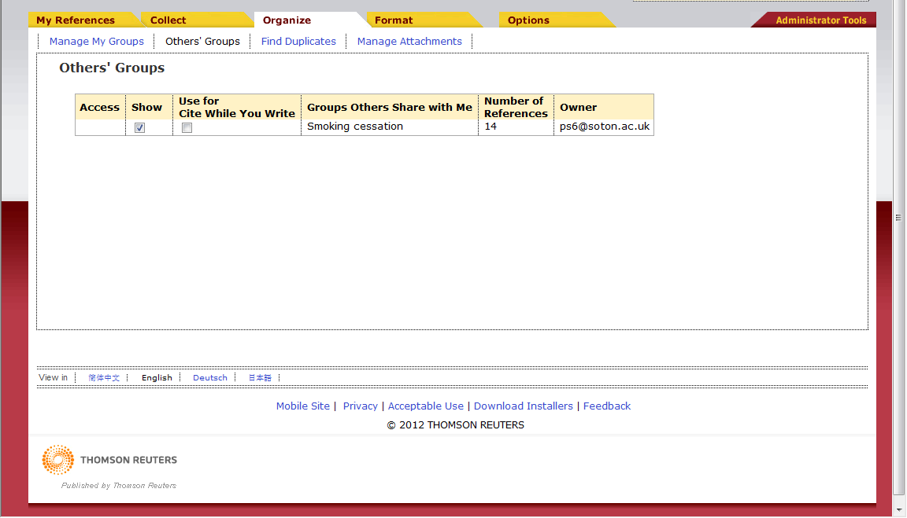
Access groups where others have given sharing permissions on the 'Others' Groups' tab
Notes:
To access groups where other users have given you sharing privileges, go to Others' Groups on the Organize tab. These references can also be used when writing documents if the Use for Cite While You Write box is checked.

Slide 51
Find duplicate references

Slide 52
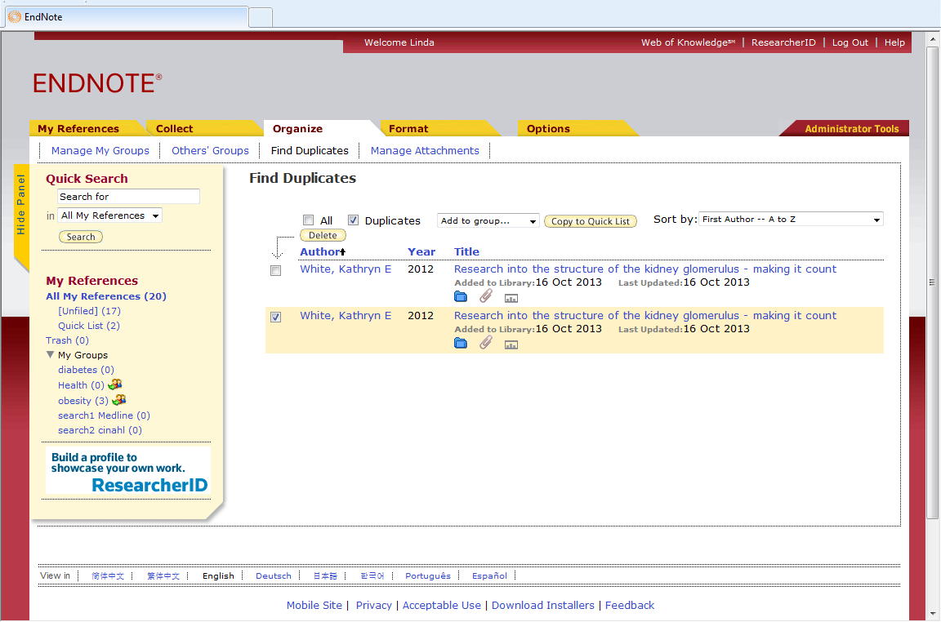
Go to 'Organize ➔ Find Duplicates'
Look at individual records to decide which to discard
Notes:
If carrying out a number of database searches, it is likely that some duplicates will appear. To identify these, go to Organise, Find Duplicates.
Duplicate records are displayed. Inspect the full record to decide which to discard. It is generally best to retain the record that was downloaded first, as this is the one likely to have been cited if any documents using the library have been created.
Check the boxes for records to discard and click Delete. These records are then deleted from All My References and any Groups to which they have been added.

Slide 53
Manage attachments
Notes:
There is a 5GB limit on attachments within an Endnote Online library - you may need to be selective.

Slide 54
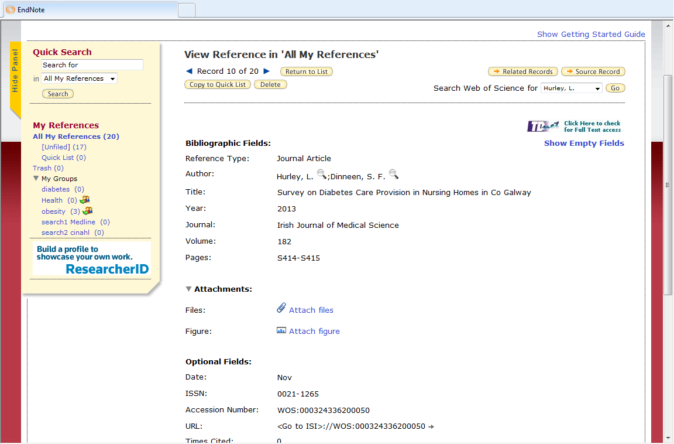
Attach Files or Figures to individual records
Click 'Attach Files' and browse for required item
Notes:
Files and figures can be attached to EndNote Online records. Note that if library items are shared with others, these attachments will not be visible. More than one file may be attached to a record, but only a single Figure.
Click to expand the Attachments section.
Click the Attach Files link and browse to find the required file.

Slide 55
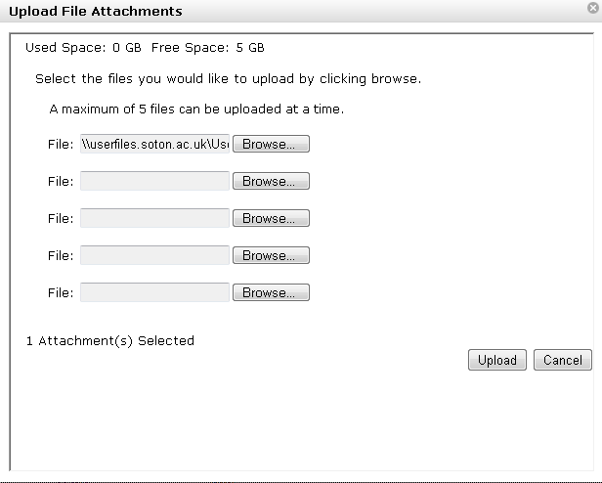
Browse to locate the required file
Click 'Upload'
Notes:
Browse to locate the required file(s) and then click Upload.

Slide 56

Further attachments may be made
Notes:
Other files of any type eg docx, pptx, jpg, may be added.

Slide 57
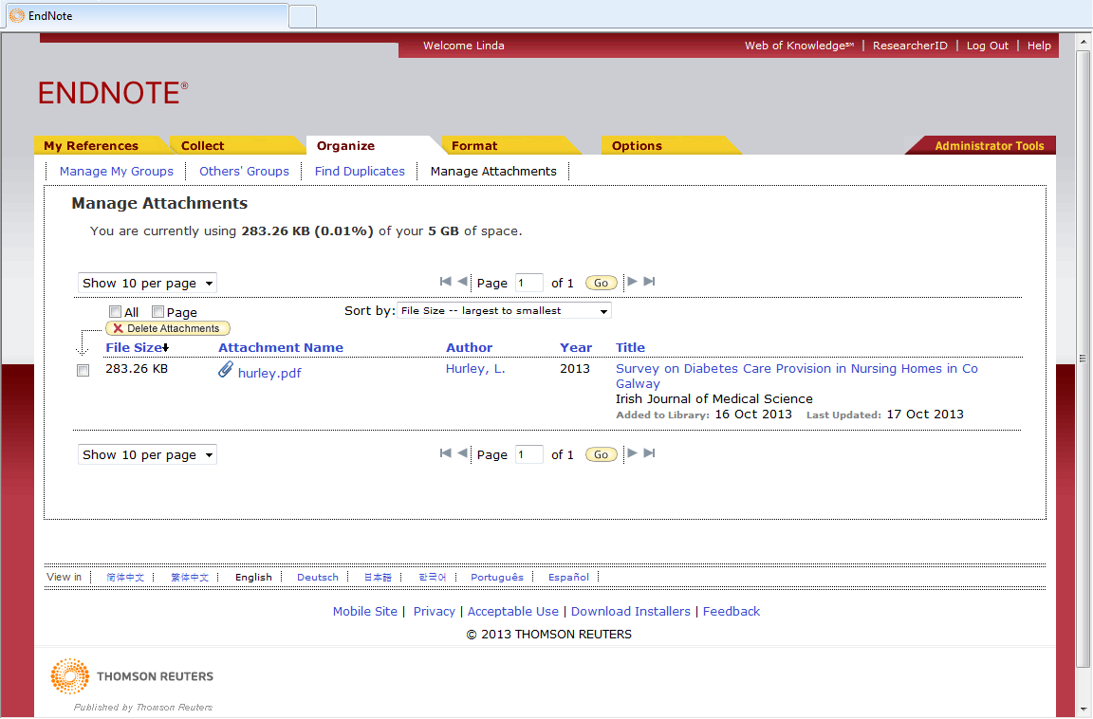
Click 'Manage Attachments' to view records with attached files
Check the required box(es) then click 'Delete Attachment'
Notes:
Go to Organize, Manage Attachments to view all records with file attachments. There is a 5GB limit on file attachments in EndNote Online, so as the library grows, it may be necessary to be selective.
Individual attachments can be deleted if necessary. To delete an individual attachment check the record box and click Delete Attachments. This does not delete the associated record.

Slide 58
Use references in your writing

Slide 59
Create a formatted bibliography

Slide 60
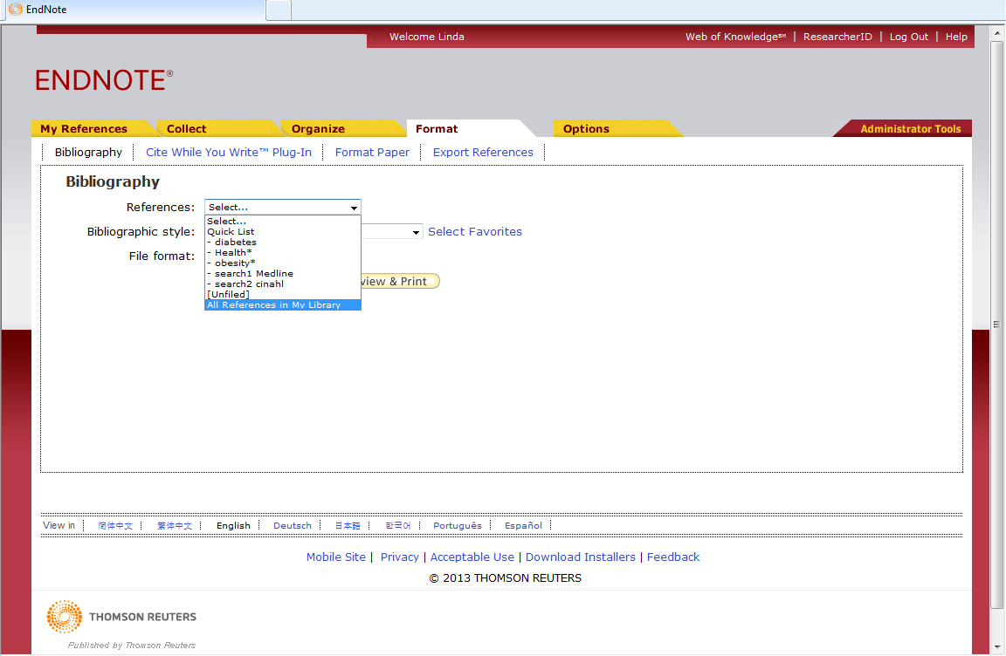
Go to 'Format ➔ Bibliography
Choose the group of references required
Notes:
It is possible to create a simple list of all or a group of your references.
Go to the Format, Bibliography tab. Identify the reference group you require from the dropdown list

Slide 61
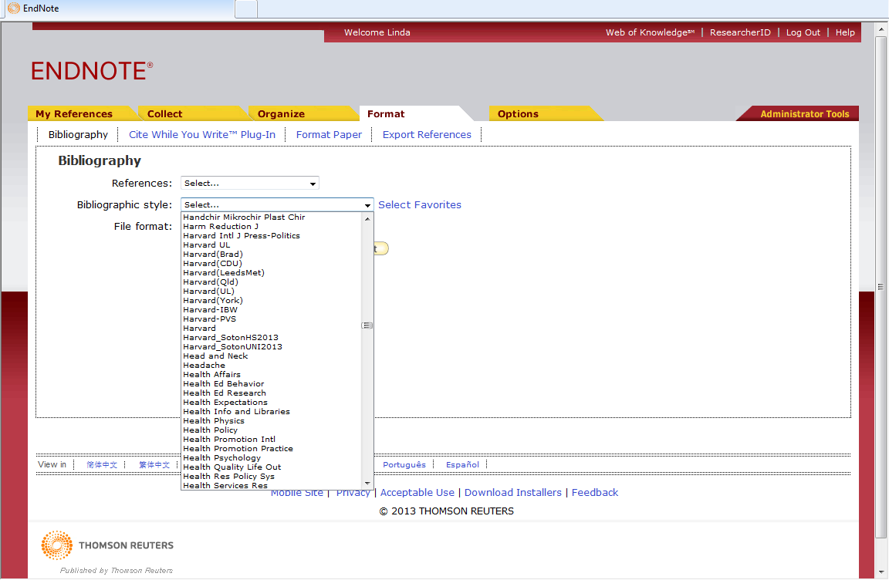
Choose the referencing style …
Notes:
Next choose the referencing style from the dropdown menu. Over 3000 styles are available, including custom styles used by various faculties in the University of Southampton.

Slide 62
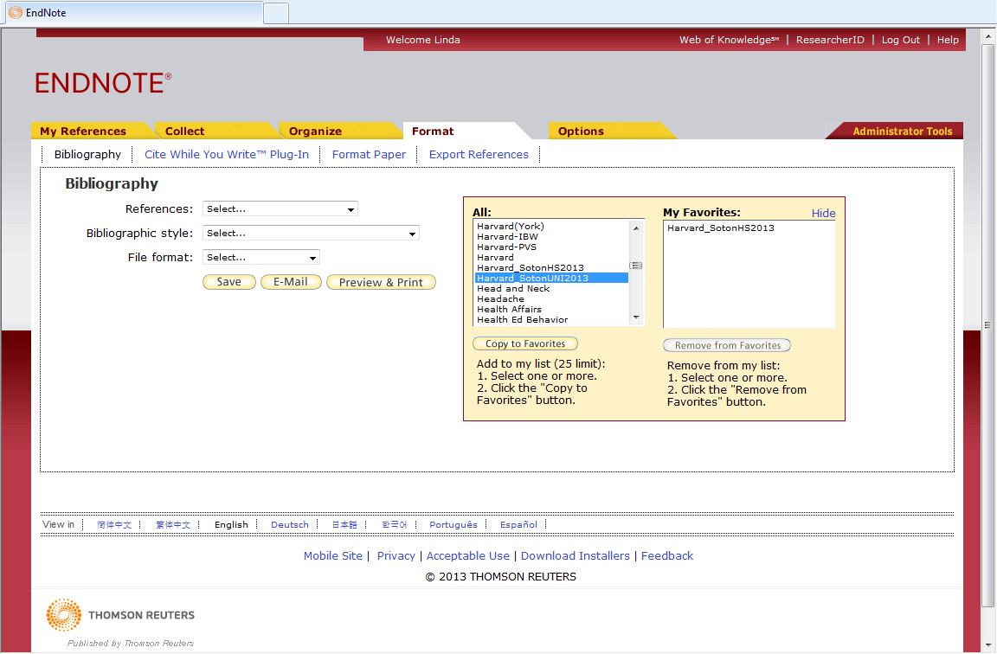
Create a list of favourite styles
Notes:
Create a favourites list of regularly used styles - these will then be the only styles listed in the Bibliographic style dropdown menu.
To add a favourite, select in the list All: and click Copy to Favorites. Hide the panel when finished.

Slide 63
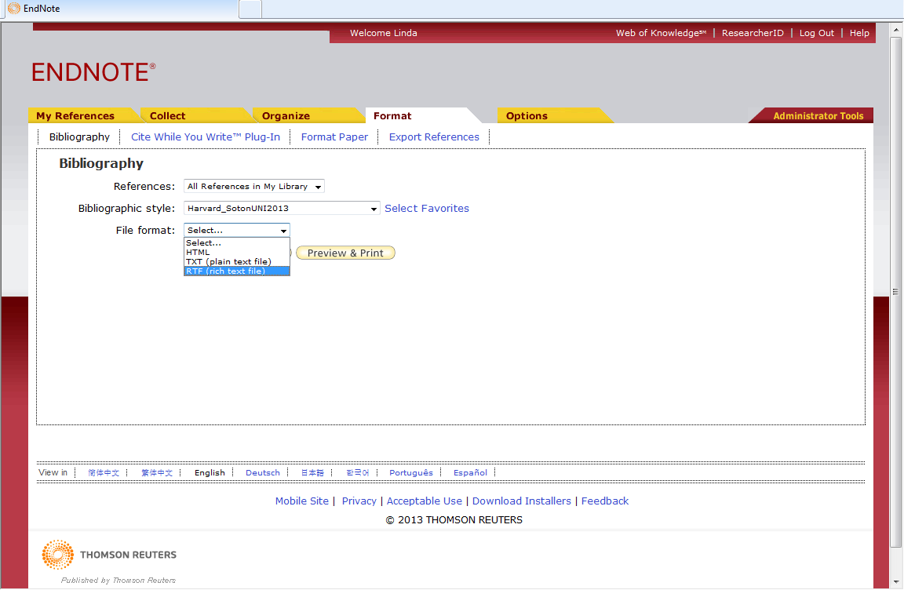
… and finally choose the output format
Then click 'Preview & Print'
Notes:
And finally select the output format. For Word documents it is usually best to use rich text format (.rtf)
Click Preview & Print.

Slide 64
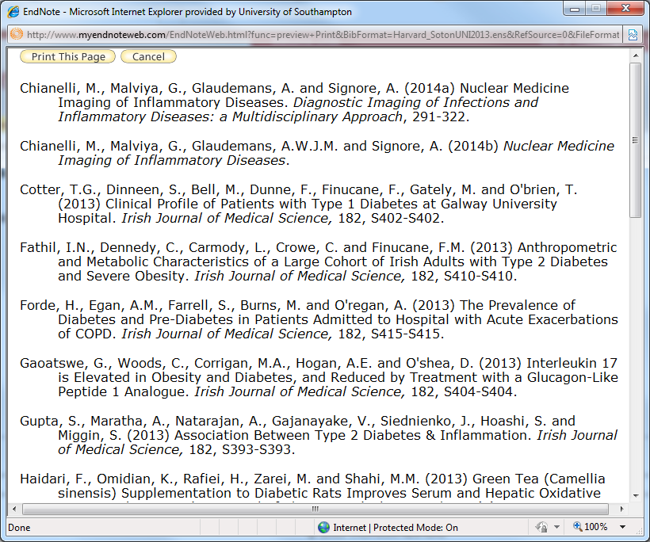
The bibliography is displayed in the required style
Notes:
The bibliography is then displayed in the required format and can be printed.

Slide 65
Use Cite While You Write

Slide 66
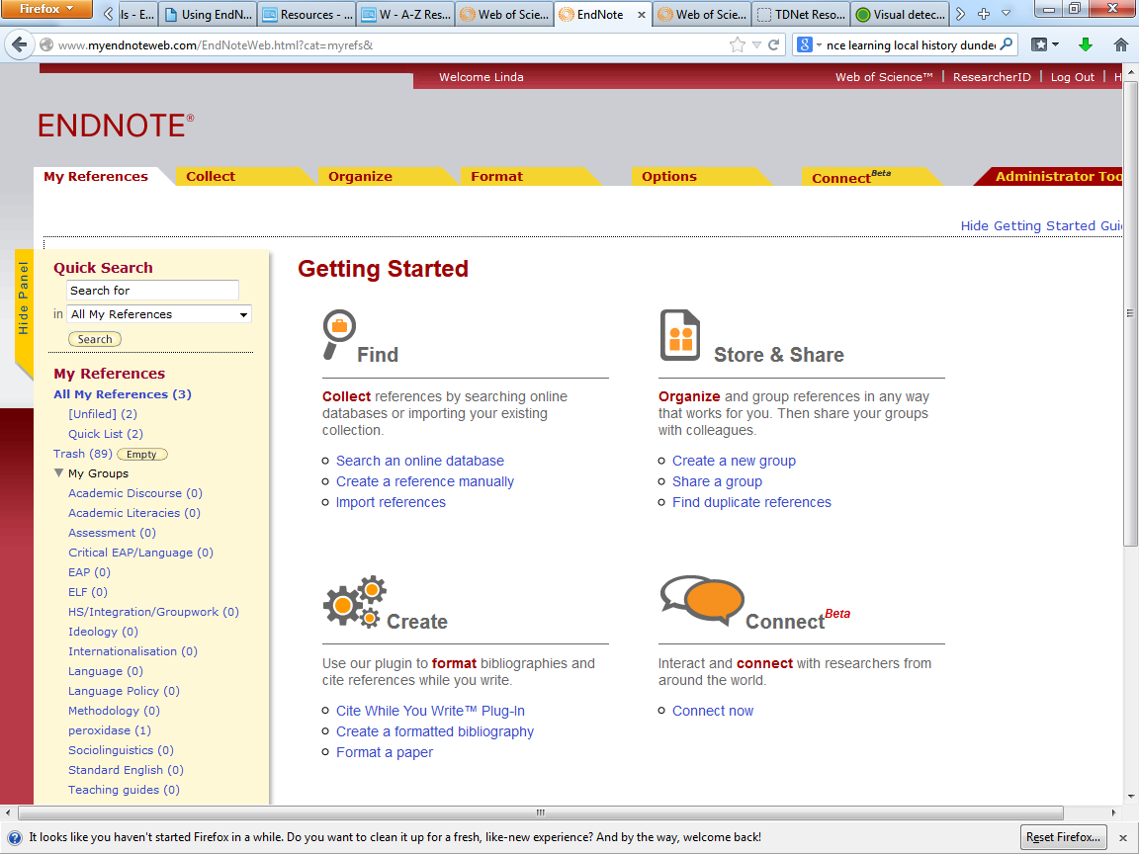
Install the Cite While You Write plugin from here
Notes:
If you are using EndNote Online on your own computer, you will need to install the correct version of the Cite While You Write plug in. Follow the on-screen instructions.

Slide 67
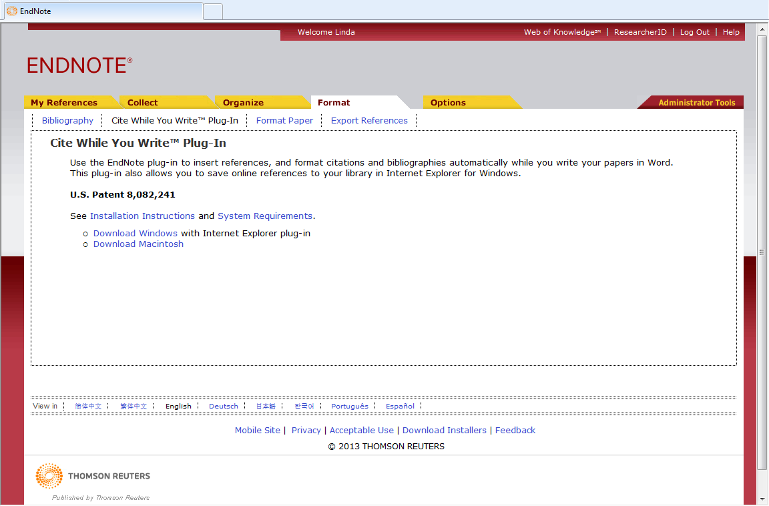
Choose the correct version and follow the link
Notes:
Choose the correct version according to platform and follow the hyperlink.

Slide 68
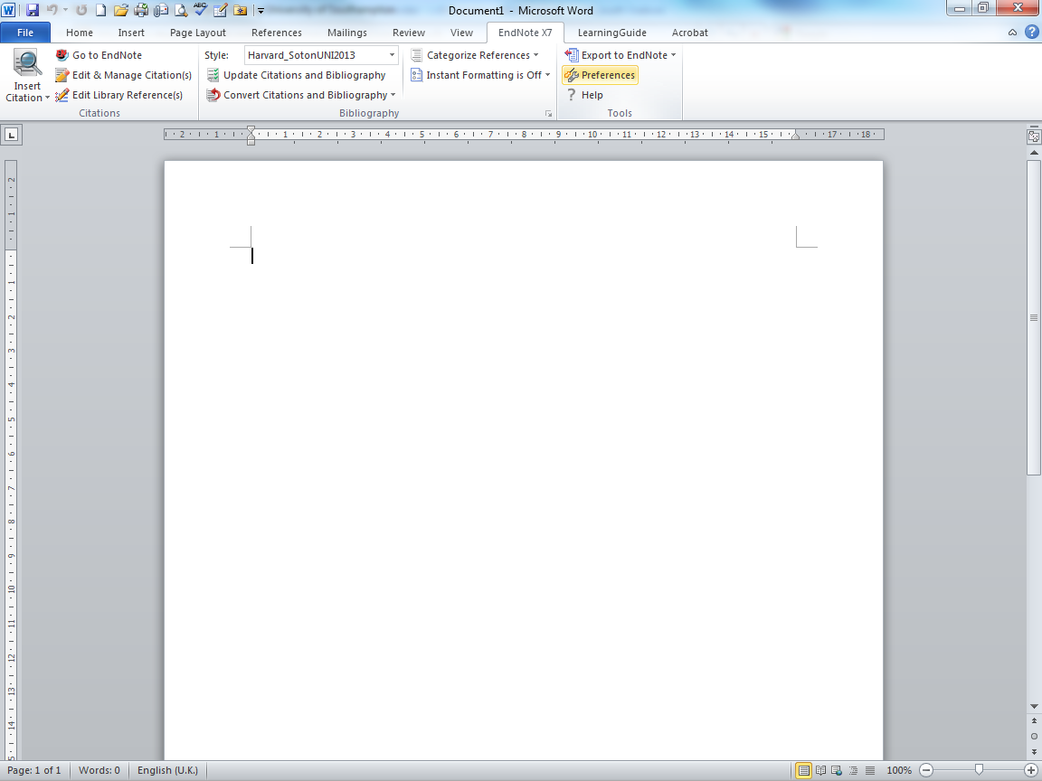
Change Preferences to work with EndNote Online
Notes:
If using EndNote online from a computer that has EndNote X7 installed, change the preferences on the EndNote X7 tab.

Slide 69
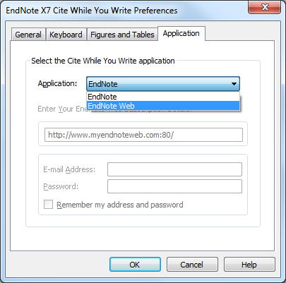
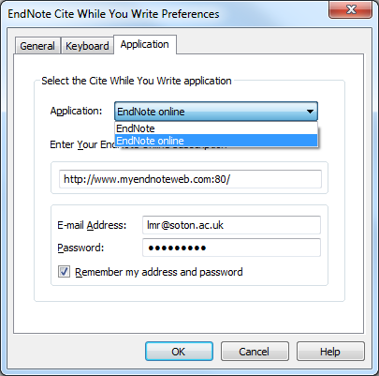


Go to the 'Application' tab and choose 'EndNote online'
You will need to log in with your Web of Knowledge email and password
Notes:
Go to the Application tab and choose EndNote Web. At this point you will be asked for your Web of Knowledge email and password.

Slide 70

Click the 'Find Citation' icon
Identify the point in the text to insert a citation
Notes:
EndNote inserts citations and creates a simultaneous bibliography at the end of the text. It is helpful to insert a page break.
In the Word document, select the point in the text to insert the reference.
Go to Find Citation to select the required reference.

Slide 71

Insert Author or keyword in the search box and click 'Find'
Select the required reference from those listed and click 'Insert'
Notes:
Use Author or Title keywords in the search box and click Find to show the required reference. All matching references are retrieved. Highlight the reference needed and click Insert.

Slide 72

The citation is displayed in the text, with the full reference at the end
Notes:
The citation is inserted at the selected point in the text, and a full bibliographic record created at the end of the document.

Slide 73

Change the reference style here if required
The bibliography is sorted as more citations are added
Notes:
Multiple references can be inserted at a single point in the text: locate the cursor immediately to the right of the close bracket then find the reference from the EndNote Web library as before.
The citation will be included within the brackets and the full reference at the appropriate location in the end of document bibliography. Note that the sort order for citations and bibliography is set within the referencing style.
The Reference style for the document can be changed within Word, or by using the Format tab in the Bibliography window.

Slide 74
Edit citations

Slide 75

Click in the citation, then go to 'Edit Citations'
Notes:
The common forms of editing are to add page numbers to a citation, to remove author and/or year from a citation, or to remove a citation altogether.
It is essential that all these changes are made using the relevant EndNote tools, so that linked field codes are also amended. Click in the citation to highlight it, then go to Edit Citations.

Slide 76

To add page numbers to a citation, type the exact letter string required in the SUFFIX box, then click OK
Notes:
To add page numbers to a citation, select the required citation, then type the exact letter string, including any required leading/following spaces in the Suffix box, note, not in the Pages box. Then click OK.

Slide 77

The suffix text is attached to the citation
Notes:
The suffix text is added to the citation.

Slide 78

To remove a citation completely, go to 'Edit Citation(s)'
Highlight the required reference, and choose 'Remove Citation' from the dropdown menu
Notes:
To remove a record completely, go to Edit Citation(s), select the reference to be removed, click Remove Citation and then OK.

Slide 79

The reference is deleted from both the citations and bibliography
Notes:
Both the citation and the full reference are removed from the document. Note that if the same source is cited elsewhere in the document, it will not be removed from the bibliography.

Slide 80
Manage the bibliography layout

Slide 81

Click to go to the 'Format Bibliography' tab
Notes:
To make changes to the bibliography layout, go to the Bibliography tab and click to expand.

Slide 82

Use the 'Layout' tab
Notes:
To make changes to the physical layout of the bibliography, click the Layout tab.

Slide 83

Reduce the hanging indent…
… and insert line spaces between references
Notes:
This window lets you manage indents, the line spacing within a reference, and the line spacing between references.
To insert a single space between references, go to the Space after drop down list and choose Single.
Remove the hanging indent by changing to 0cm. Click OK when all choices have been made.

Slide 84


Slide 85
Get more help
Find library guides at
http://library.soton.ac.uk/endnote
www.edshare.soton.ac.uk
EndNote Help pages
Contact libenqs@soton.ac.uk

