Slide 1
WEBS6203
Interdisciplinary Thinking
W1 Introduction
Su White
http://www.edshare.soton.ac.uk/13329/
These slides cover activities throughout the first week’s three meetings

Slide 2
Who should be here today ☺
Amos, Neil S | nsa1g14@soton.ac.uk
Baird, Edmund | eb16g11@soton.ac.uk
Bennett ,Nicholas | nb1g11@soton.ac.uk
Dinca, Flavia M | fmd2g11@soton.ac.uk
Fair, Nicholas S | nsrf1g12@soton.ac.uk
Gilbert, Paul J | pjg1g14@soton.ac.uk
Gray, Briony J | bjg1g11@soton.ac.uk
Hewitt, Sarah | sh9g14@soton.ac.uk
Kim, Taekyun | tk1c09@soton.ac.uk
Majekodunmi, Oluwadolapo A | oam1g14@soton.ac.uk
McDowell, Simon | sm15g14@soton.ac.uk
Melgarejo, Rafael | rm2e14@soton.ac.uk
Pattinson, Colin O | cogp1g14@soton.ac.uk
Taylor, Keisha C | kct1g14@soton.ac.uk
Thuermer, Gefion | gt2g14@soton.ac.uk
Tran, Kha L | klt1g14@soton.ac.uk
Tsakalakis, Niko | nt4g14@soton.ac.uk
Webster, Jack | jw30g11@soton.ac.uk

Slide 3
How this module is structured
An exercise in Interdisciplinary thinking
Developing and evolving your understanding
Rehearsing arguments
Exploring ideas
Explore and research topic areas
Identify a web science research question which can be considered from two distinct disciplinary perspectives
Decide on a comparative study

Slide 4
Weekly focus
1 | Introductions and scoping
2 | Clarification and beginnings
3 | Process lecture
4 | Independent study: Blogging and surgeries
5 | Independent study: Blogging and surgeries
6 | Independent study: Blogging and surgeries
7 | Focus on hand ins: Revisit specification for posters and reports
8 | Poster surgery
9 | Poster pitches and poster hand in
10 | Independent study: Peer review and revisions
11 | Q&A
Vacation 1-3
12 | Last minute surgery, report hand in
Exam period

Slide 5
How you will demonstrate your learning
Poster
Report
Provide a structured overview of your chosen areas
Communicate key points in visually compelling manner
reading
blogging
discussing
reviewing
thinking
reflecting
revising

Slide 6
What is our interdisciplinarity?
For the people in this room today
What academic perspectives shape each of our understandings of the world?
What do we each consider to be our ‘home’ discipline (s)?
What are the values, beliefs and working methods to which we each cleave?
Academic disciplines
Fields of study
Think
Then break into groups for activity

Slide 7
Class exercise: apologies for yet another introductory round
Small groups
Ask about disciplinary stories
Tell the class what you learnt
“This is my friend <xxxx>
They have a background in <xxxx>
They explained that the values and principles of their predominant field of study are …..
think
share
pair
Notes:
There is a handout, make notes during the feedback

Slide 8
Feedback round
“This is my friend <xxxx>
They have a background in <xxxx>
They explained that the values and principles of their predominant field of study are …..

Slide 9
Who should be here today ☺
Amos, Neil S | nsa1g14@soton.ac.uk
Baird, Edmund | eb16g11@soton.ac.uk
Bennett ,Nicholas | nb1g11@soton.ac.uk
Dinca, Flavia M | fmd2g11@soton.ac.uk
Fair, Nicholas S | nsrf1g12@soton.ac.uk
Gilbert, Paul J | pjg1g14@soton.ac.uk
Gray, Briony J | bjg1g11@soton.ac.uk
Hewitt, Sarah | sh9g14@soton.ac.uk
Kim, Taekyun | tk1c09@soton.ac.uk
Majekodunmi, Oluwadolapo A | oam1g14@soton.ac.uk
McDowell, Simon | sm15g14@soton.ac.uk
Melgarejo, Rafael | rm2e14@soton.ac.uk
Pattinson, Colin O | cogp1g14@soton.ac.uk
Taylor, Keisha C | kct1g14@soton.ac.uk
Thuermer, Gefion | gt2g14@soton.ac.uk
Tran, Kha L | klt1g14@soton.ac.uk
Tsakalakis, Niko | nt4g14@soton.ac.uk
Webster, Jack | jw30g11@soton.ac.uk

Slide 10
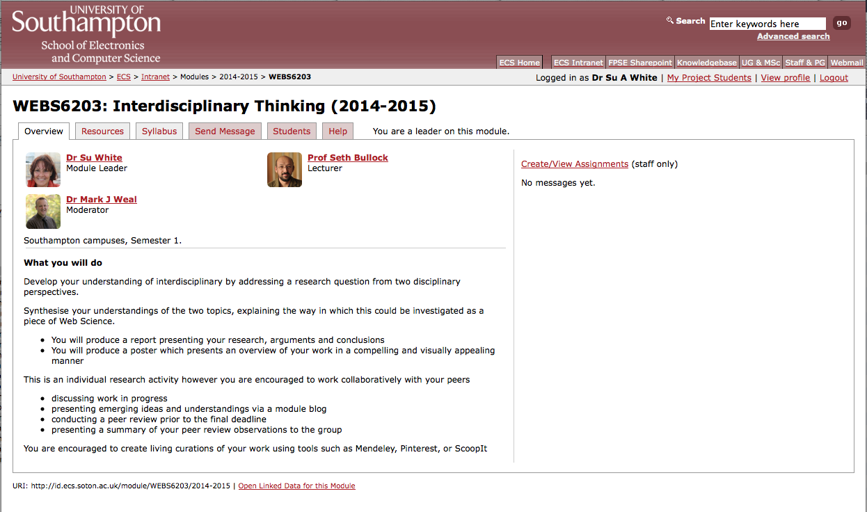
Use ECS notes as your reference point
https://secure.ecs.soton.ac.uk/module/1415/WEBS6203/33406/

Slide 11
What we expect you to do
1. DEFINE problems, issues, topics or questions that warrant interdisciplinary examination
2. PRESENT a clear rationale for taking interdisciplinary approach including the advantages to be gained
3. IDENTIFY relevant disciplines
4. CONDUCT a literature review (what is known on the topic from each of the disciplines)
5. DEVELOP a command of each relevant discipline set out the analytical structure central to each discipline, identify key underlying assumptions, and methods of evaluation.
6. STUDY the problem and generate insights including predictions from each of the relevant disciplines - in isolation!!
7. IDENTIFY conflicts between and/or areas of complementary between the insights offered from each discipline
8. CREATE common ground by developing a cohesive framework of analysis that incorporates insights from the relevant disciplines in a systematic manner
9. COMBINE disciplinary insights to construct new more integrated understanding of the problem
Repko & Welch 2005

Slide 12
The flow of activites
problem
Disciplinary insights
Integration
Understanding

Slide 13

The scope of interdisciplinarity

Slide 14
Selecting your topic:
What to do next
Think about your target contributory topics
Look into their foundational concepts
Consult textbooks (university library)
Look at programme specification (online, this university and others)
Watch a few video lectures –e.g. YouTube, ITunesU
Talk to your fellow students
Reflect on your other lecture content
Look at proceedings from previous web science conferences
Establish some shared working methods

Slide 15
Look at the posters
In new groups
Identify contributory disciplines

Slide 16
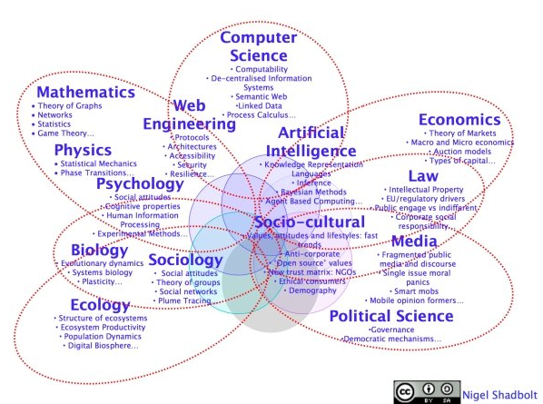
An idea of web science you may have seen…

Slide 17
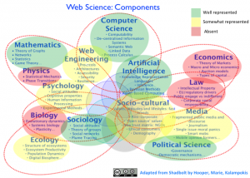
Another…

Slide 18
Hooper, Clare J., Georgeta Bordea, and Paul Buitelaar. "Web Science and the Two (Hundred) Cultures: Representation of Disciplines Publishing in Web Science." (2013).

