Slide 1
A helping hand for academics capturing their content on video ALT-C
Justin Steele-Davies, Joe Brett Sep 2014

Slide 2
Overview
Preparation for filming
Story boarding
Making filming less intimidating

Slide 3
Preparation for filming
Pre-meeting scope document

Slide 5
Preparation for filming
Pre-meeting scope document
One page of advice for filming

Slide 7
Preparation for filming
Pre-meeting scope document
One page of advice for filming
Storyboard (word or PowerPoint)

Slide 8
Notes:
This is what the team have drawn up to support what they do and allow them to communicate to each other what their roles will be on shoot.

Slide 9
Notes:
This is an example that academics and post grads could cope with. It is a tool they are familiar with.

Slide 10
Preparation for filming
Pre-meeting scope document
One page of advice for filming
Storyboard (word or PowerPoint)
Prompts / Visual aids

Slide 11
Prompts / Visual aids
Notes:
If you use the prompt as a visual aid, either directly like here or with photos / information for the editor this can speed up post production.

Slide 12
Preparation for filming
Pre-meeting scope document
One page of advice for filming
Storyboard (word or PowerPoint)
Prompts / Visual aids
Finally!
Presentation is a skill!
Notes:
Practice, Practice, Practice!

Slide 13
Example of finished product

Slide 14
Building up from the basics
Notes:
TV to display the power point / Auto Cue notes! This is important as it has no loud fan in it.

Slide 15
Camera placment
Notes:
Put the camera between the screen and the speaker, this means when they are looking at their notes they are looking at the viewer.
Point of note, the background here should be blank or at least tidy. We have used portable projection screens or white walls in the past.
The important thing here is that the webcam is placed in a way that it looks like the speaker is looking directly at the camera. That connection of having the speaker look at the camera is really important in helping to engage the viewer.
acknowledging that this isn’t necessarily a natural skill and that is the benefit of having someone to help the academic prepare for the experience. A little bit of time spent ‘training’ an academic can save a lot of time on the shoot (and of course gives them the confidence to continue doing this kind of presentation in the future on their own).

Slide 16
Sync prompts to recording
Notes:
There are many software's that do this now, Camtasia, Panopto, etc. Even better, if the prompts are the same as the visual aids you want the audience to see.

Slide 17
Anchor the presenter
Notes:
Many academics like to stand, this is a natural for their lecture performance, using a chair allows you to anchor them so that they are in shot. They can still move their hands around as well.

Slide 18
Slid interaction
Notes:
I want something here that bring the laptop up to the chair and have a stylus so people are writing on the screen.
It is a digression, and then goes back to the other slides.

Slide 19
Improve the video quality
Notes:
You can add consumer handy cams or professional cameras, this gives a lot more scope in post production with 1080 HD footage.

Slide 20
Add more mics
Notes:
Having boundary mics or tie clip mics positioned to for the presenter will improve the audio, which can become distracting for the audience if it is poor.
Also we have found that having a few separate audio recordings is very helpful if one of them has a problem you can switch source.

Slide 21
Let there be light
Notes:
Adding suitable lighting will improve the look of the speaker, getting rid of harsh shadows and giving them a bit more colour.

Slide 22
Special effects
Notes:
Greenscreen can be used to bring the speaker out of the background. This is a reasonably advanced technique, but allows you to move the person around more in post production.

Slide 23
Autocue like the news
Notes:
An autocue will allow the speaker to look directly at the lens without any obstructions. This helps to maximise viewer engagement. The autocue can allow for scripts to be used by allowing the speaker to scroll through the text and read it as it is scrolling.

Slide 24
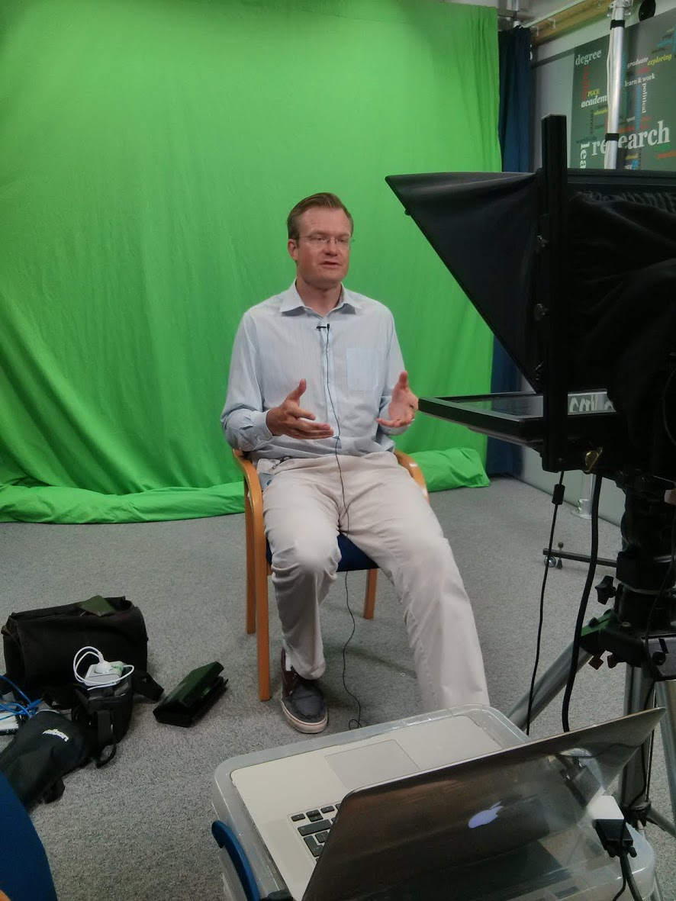
Notes:
This is what the top end configuration looks like.

Slide 25
Example of finished product

