Slide 1
Open Data
Christopher Gutteridge

Slide 2
Christopher Gutteridge
@cgutteridge
data.southampton.ac.uk
data.ac.uk
data.totl.net

Slide 3
Types of Data

Slide 4
Types of Data

Slide 5
Reasons to Openly Publish
Improve your reputation
Because somebody makes you

Slide 6
Reasons to Openly Publish
Improve your reputation (all the cool kids are doing it)
Because somebody makes you (a stick!)

Slide 7
(equipment demo)

Slide 8
Reasons to Openly Publish
Improve your reputation (all the cool kids are doing it)
Because somebody makes you (a stick!)
Because it actually achieves your personal (or business) goals. (a carrot!)

Slide 9
Old Web
Big stonking datasource
Website

Slide 10
Open World
App
API
Big stonking datasource
Website

Slide 11
Opener World
App
API
Big stonking datasource
App
Website

Slide 12
Visions of the future….

Slide 13
The dream…

Slide 14
… the nightmare

Slide 15
… the nightmare
Well, the missed opportunity,
anyhow!

Slide 16
Authority Aggregators
Data Source
Auth-ority
Website
Not Open
Open

Slide 17
Data Source
App
Auth-ority
API
Website
Website

Slide 18
Authority Aggregators
Data Source
App
Auth-ority
API
Website
Website

Slide 19
Authority Aggregators
Data Source
App
Auth-ority
API
Website
Website

Slide 20
Authority Aggregators
Data Source
App
API
Website
Website

Slide 21
Authority Aggregators
Data Source
App
Website
Website

Slide 22
Fail.
Data Source

Slide 23
Open World
Data Source
App
Auth-ority
API
Website

Slide 24
Open World
Data Source
App
API
Auth-ority
Website

Slide 25
Open World
Data Source
App
API
Auth-ority
Website
Some other Aggregator
Website

Slide 26
Open World
Data Source
App
API
Auth-ority
Website
Some other Aggregator
Website

Slide 27
Open World
Data Source
App
API
Website
Some other Aggregator
Website

Slide 28
Open World
Data Source
Some other Aggregator
Website

Slide 29
Open World: Provenance
Data Source
App
API
Auth-ority
Website
Some other Aggregator
Website

Slide 30
Open World: Provenance
Data Source
App
API
Auth-ority
Website
Some other Aggregator
Website

Slide 31
Open World: Provenance
Data Source
App
API
Auth-ority
Website
Some other Aggregator
Website

Slide 32
Open World: Provenance
Data Source
App
API
Auth-ority
Website
Some other Aggregator
Website

Slide 33
Useful aggregations for Equipment & Facilities data
UK Academia
South-coast public sector
Universities in N.Ireland + R. of Ireland
Hampshire Businesses

Slide 34
Other Useful “standard” Datasets
Staff Expertise
Vacancies
Organisational Structure
Buildings & Campuses
Publications
… research data (eeep!)

Slide 35
Plans for data.ac.uk (Spring 2013)
Provide subdomains for Cool URIs
Provide subdomains for data services
Provide aggregators for ac.uk data

Slide 36
Plans for data.ac.uk (Spring 2013)
☹
Provide subdomains for Cool URIs
Provide subdomains for data services
Provide aggregators for ac.uk data

Slide 37
Medium Future (Spring 2013)
Auto discovery of datasets
Semantic Web

Slide 38
Medium Future (Spring 2013)
☺
Auto discovery of datasets
Semantic Web
Queen Mary University of London is first Russell Group university to have auto-discoverable open equipment data: http://www.qmul.ac.uk/

Slide 39
/.well-known/openorg
http://www.soton.ac.uk/.well-known/openorg
or
<link rel=“openorg” href=“http://id.southampton.ac.uk/dataset/profile/latest”>

Slide 40
Making it happen…

Slide 41
What’s in it for me?

Slide 42
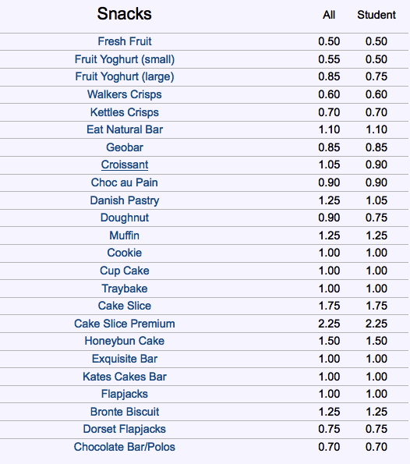
menu

Slide 43
≠

Slide 44
Tabular Data FTW
Understanding “Graph” data is a big cognitive load, compared with SQL/Excel.
Don’t expect any small company to be able to generate good RDF.
RDF is neat for aggregation, but make easy ways for people to get started.
Provide tabular-data routes in & out where possible!

Slide 45
What were working on (Spring 2014)
Observatory.data.ac.uk
Collect, publish and visualise current and historical data about *.ac.uk homepages.
Hub.data.ac.uk
Collect, publish and visualise *.ac.uk “Organisation Profile Documents” (OPDs)

Slide 46
Picture Credits
Croissants: jnunoferreira /Flickr / CC-by 2.0
Menu: data.soton.ac.uk / Open Government License

