Slide 1
Open and Linked Data

Slide 2
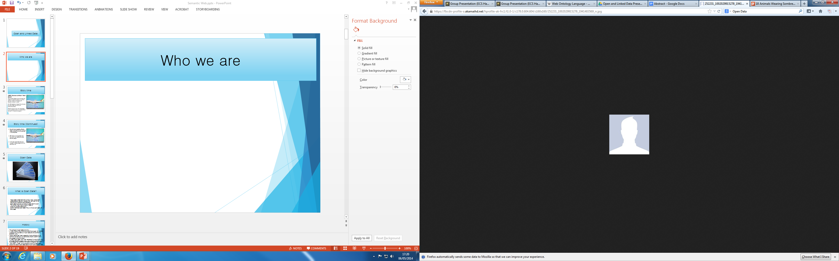


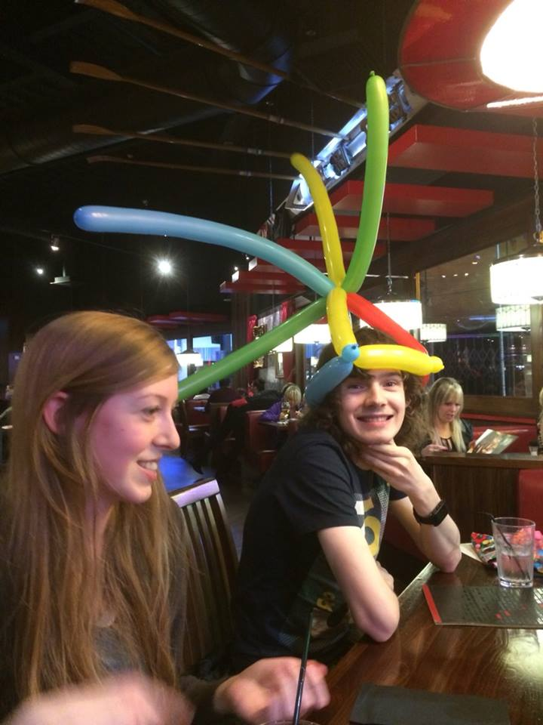



Who we are

Slide 3
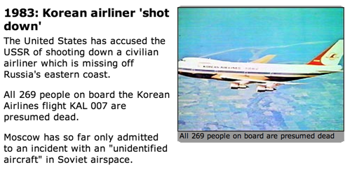
Story time
Notes:
a story

Slide 4
Story time (Continued)
To avoid future tragedies, Ronald Reagan announced that GPS would be made available for civilian uses once it was completed.
GPS industry has expanded since then and is now used by the most common people.
In this case, open data helps you navigate in foreign places as well as save man's life.
Notes:
So, other than make life less dangerous...

Slide 5
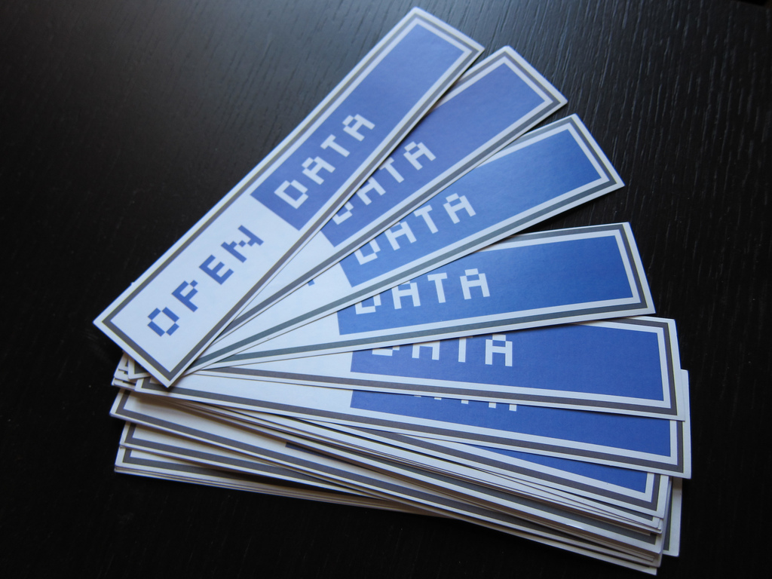
Open Data
Notes:
So, other than make life less dangerous...

Slide 6
What is Open Data?
“Open data is data that can be freely used, reused and redistributed by anyone - subject only, at most, to the requirement to attribute and sharealike.”
Open data must have a license to state that it’s open
This license might require users of data to;
credit the publisher(attribution)
publish results as open data if they've mixed open data with other data

Slide 7
History
The concept of open data is not new.
In 1942, Robert King Merton(American Sociologist 1910-2003) explained the importance of open data and its benefits for scientific world.
Merton claims that “each researcher must contribute to the common pot and give up intellectual property rights to allow knowledge to move forward”
In 1995 “Open Data” term firstly appeared in a document from American Scientific Agency they were trying to promote people to exchange their scientific information throughout the world
From 2007 – Today with the support of a lot of respectable people the idea of open data idea is much more possible than never before.

Slide 8
Why Open Data?
Open data can be used to design new products, provide community services, open up new business opportunities
Open data can help with decision making in your own life
Allow an individual to be more active in the society
Improve quality of service you offer the public
Makes government efficient and in turn reducing cost

Slide 9
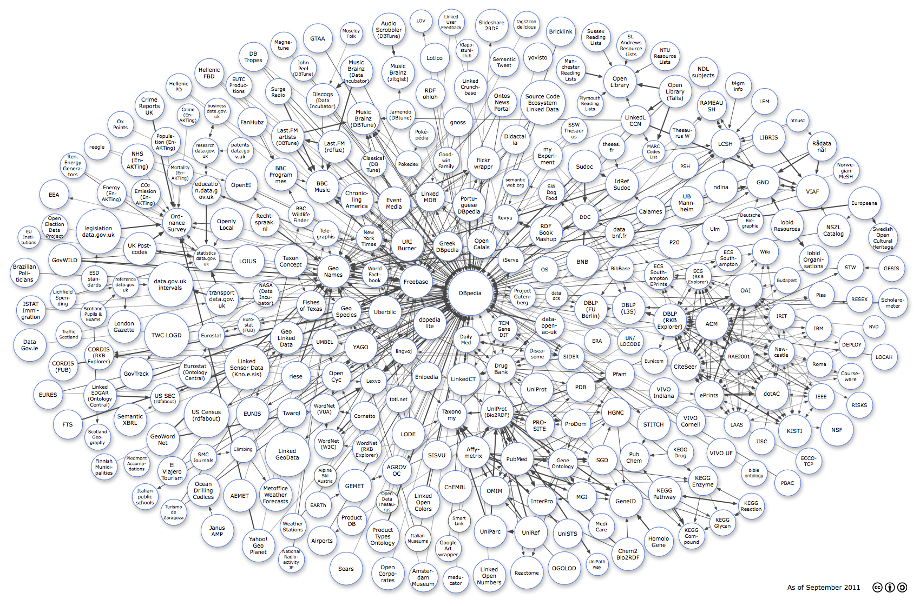
Linked Data + Semantic Web
Web 2.0 – Web as a network of data

Slide 10
History of the Semantic Web
'Semantic Nets' first invented for computers Richard H. Richens 1956
Introduction of Semantic Network Model by cognitive scientist Allan M. Collins, Linguist M. Ross Quillian and Psychologist Ellizabeth F. Loftus in early 1960s.
Tim Berners-Lee coined the term “Semantic Web”
“ a web of data that can be processed directly and indirectly by machines”
Notes:
The concept of the Semantic Network Model was formed in the early 1960s by the cognitive scientist Allan M. Collins, linguist M. Ross Quillianand psychologist Elizabeth F. Loftus in various publications s a form to represent semantically structured knowledge
It’s been defined as “ a web of data that can be processed directly and indirectly by machines”
10

Slide 11
Growth of Linked Data
2006
  -Sir Tim Berners Lee publishes 'rules' of linked data/semantic web
2007
  -Linked Open Data mailing list started
2008
  -Linked Data talks at WWW2008
2009
  -Sir Tim Berners Lee talks at TED on Linked Data
2010
  -Data.gov.uk linked data project announced
  -US Government makes ~400 datasets available as linked data
2011
  -Google, Yahoo, Microsoft agree on vocabularies for publishing
    structured data.
  -W3C Launch directory of linked data projects.

Slide 12
Implementation
Resource Description Framework (RDF)
  Metadata data model used for describing objects on the semantic web
RDF Schema (RDFS)
  Extension that allows for RDF Ontologies
Web Ontology Language(OWL)
  Language used for constructing web ontologies.
Definition: Ontology
  A formal representation of knowledge as a hierarchy of concepts within a domain, using a shared vocabulary to denote types, properties and interrelationships of those concepts.
Notes:
RDF gives uniform structure to data on web which can be processed and used
Rdf, owl and XML are language specially designed to write data on web which provides easy processing
Does not depend on keyword for searching
Helps to answer complex data query
12

Slide 13
Resource Description Framework (RDF)
Family of W3C (World Wide Web Consortium) specifications
Metadata data model – Model for data which describes data
Most common format for linked data
Variety of notations and serialization formats – e.g XML, Turtle
RDF Schema – Extension for modelling ontologies
@prefix rdf: <http://www.w3.org/1999/02/22-rdf-syntax-ns#> .
@prefix dc: <http://purl.org/dc/elements/1.1/> .
@prefix ex: <http://example.org/stuff/1.0/> .
<http://www.w3.org/TR/rdf-syntax-grammar>
  dc:title "RDF/XML Syntax Specification (Revised)" ;
  ex:editor [
    ex:fullname "Dave Beckett";
    ex:homePage <http://purl.org/net/dajobe/>
  ] .
Turtle:
<rdf:Description rdf:about="http://www.w3.org/TR/rdf-syntax-grammar">
<ex:editor>
<rdf:Description>
<ex:homePage>
<rdf:Description rdf:about="http://purl.org/net/dajobe/">
</rdf:Description>
</ex:homePage>
</rdf:Description>
</ex:editor>
</rdf:Description>
RDF/XML:

Slide 14
Web Ontology Language
(OWL)
Designed for creating ontologies.
Current specification is OWL2.
Main language is OWL2 Full.
Contains multiple sub-languages (OWL2 EL, QL, RL)
Ontology(<http://example.com/tea.owl>
Declaration( Class( :Tea ) )
)
OWL2 Functional:
<Ontology ontologyIRI="http://example.com/tea.owl" ...>
<Prefix name="owl" IRI="http://www.w3.org/2002/07/owl#"/>
<Declaration>
<Class IRI="Tea"/>
</Declaration>
</Ontology>
OWL2 XML:
<rdf:RDF ...>
<owl:Ontology rdf:about=""/>
<owl:Class rdf:about="#Tea"/>
</rdf:RDF>
RDF/XML:

Slide 15
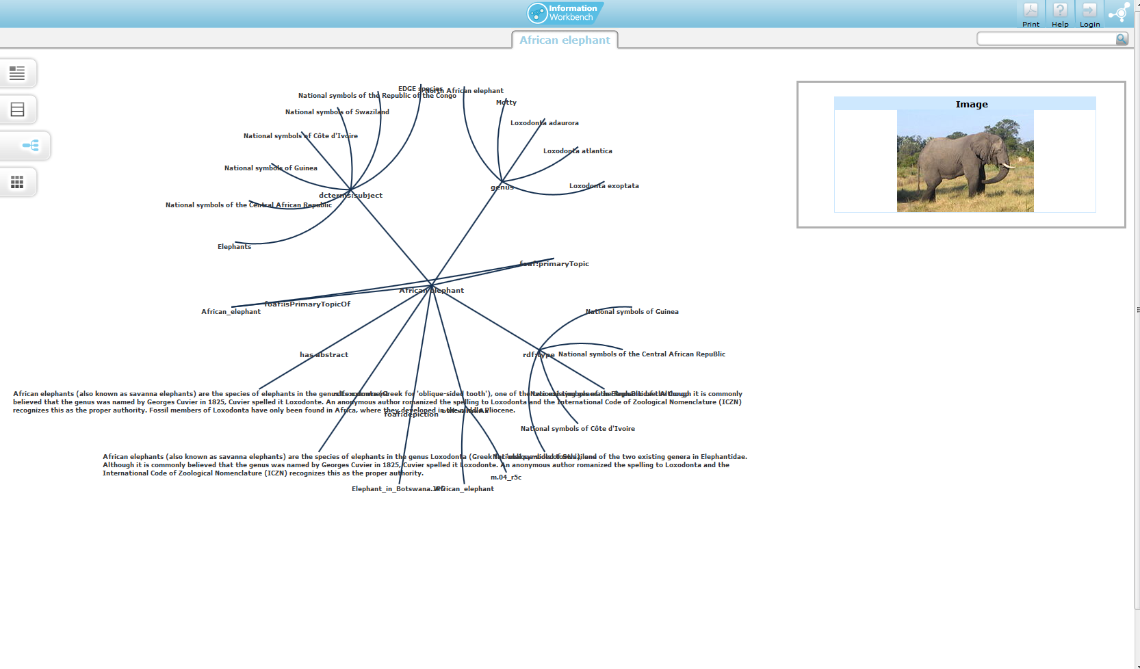
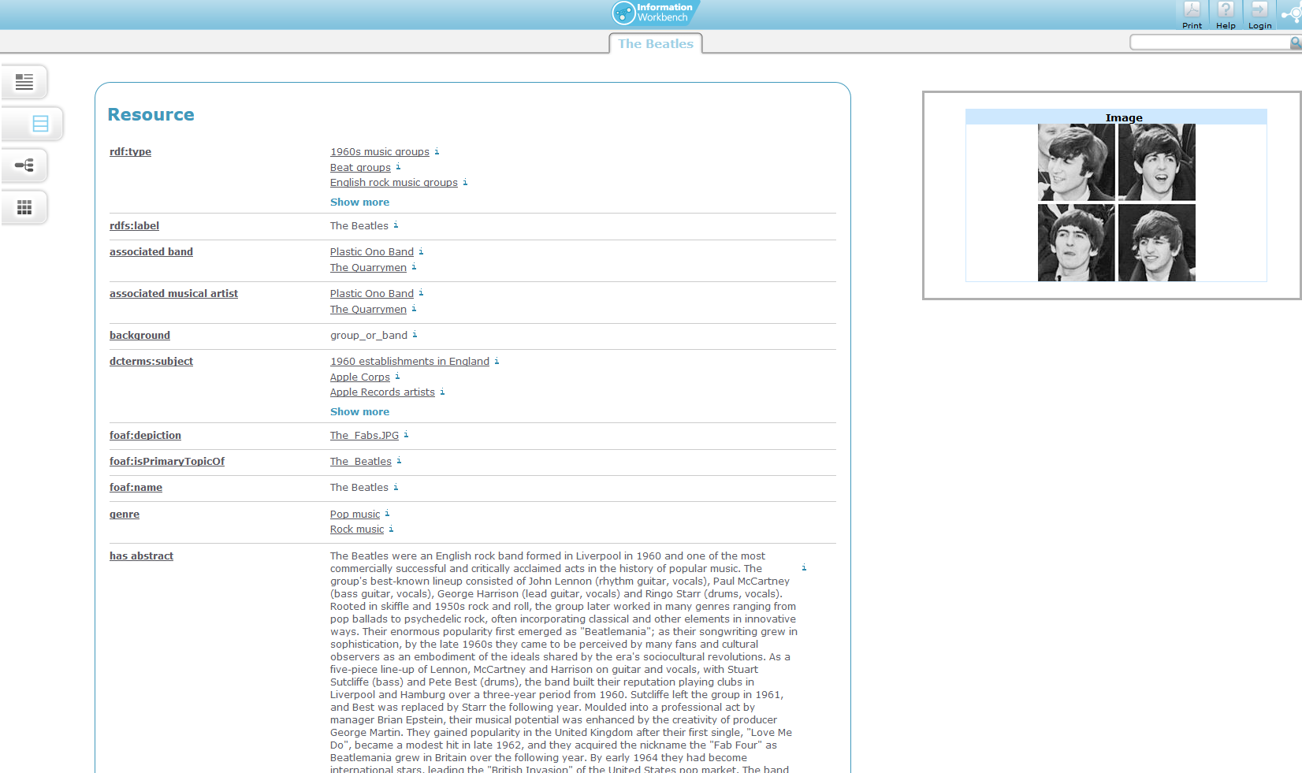
Impact of Open, Linked Data

Slide 16
Benefits
For All:
  Vast amounts of available data aids research and allows correlation of never-before correlated data – for free.
For Users:
  Easy access to a vast, reliable source of information.
  ‘Super Wikipedia’.
  Transparency in Corporations and Governments.
  Engage more with local councils, communities.
For Business and Commerce:
  Easy access to a vast, reliable source of information.
  Consumer info, Product Feedback, Market Research, etc.
  New business opportunities.

Slide 17
Benefits (Continued)
For Industry:
  Easy access to a vast, reliable source of information.
  Safety records, product details, supplier information, etc.
For Governments:
  Easy access to a vast, reliable source of information.
  Encourages government efficiency.
  Accessing huge amounts of data and metadata on citizens. (#NSA)
.

Slide 18
Issues
Social
  Anonymity
  Privacy – What privacy?
  Companies have less commoditized data.
Technical
  Link Maintenance
  Licensing
  Trust/Quality of Data
  User Interfaces and Interaction
  Schemas and Data Fusion
Notes:
When you sign up for an account on sites like MySpace, Digg, Slashdot, etc you are feeding them information about yourself during and after registration — with your activities and contributions. You can find information about your identity, interests, and habits in semantic web.
2. Contextual ads that examine a Website's content for hints of interests may be replaced with ads that target specific visitors based on their personal preferences, behaviors, lifestyle, friends, income, etc. In a similar way we will likely notice that e-commerce Websites will become better at figuring out just what it is we are going to want next.
3. Content scrapers of the Semantic Web and beyond will be equipped with the ability to readthe content within Web documents and feeds. Through natural language processing a semantic content scraper can read a blog entry (or several entries by different authors covering the same topic) and return a brand-new blog entry. The scraper would do so by extracting the facts and statements from the entries and regurgitating the information in another order or in entirely different wording.
5. Human might become too reliable on it, risk of suppressing creativity and curiosity
18

Slide 19
References
http://www.semanticfocus.com/blog/entry/title/5-problems-of-the-semantic-web/
http://www.w3.org/2001/sw/
http://www.scientificamerican.com/article/the-semantic-web/
http://segonku.unl.edu/beinghuman/?cat=24
http://www.paristechreview.com/2013/03/29/brief-history-open-data/
http://en.wikipedia.org/wiki/Open_Data
Brito, Jerry. "Hack, Mash, & Peer: Crowdsourcing Government Transparency". Colum. Sci. & Tech. L. Rev. 119 (2008).
http://opendatahandbook.org/en/what-is-open-data/
http://opendatahandbook.org/en/why-open-data/
http://www.w3.org/wiki/SweoIG/TaskForces/CommunityProjects/LinkingOpenData/NewsArchive
http://wwwconference.org/www2008/program/program-overview.html#Wed
http://tomheath.com/papers/bizer-heath-berners-lee-ijswis-linked-data.pdf
http://en.wikipedia.org/wiki/Resource_Description_Framework
http://en.wikipedia.org/wiki/RDF_Schema
http://en.wikipedia.org/wiki/Web_Ontology_Language
http://stackoverflow.com/questions/1740341/what-is-the-difference-between-rdf-and-owl
http://ontolog.cim3.net/cgi-bin/wiki.pl?OntologySummit2011_MakingTheCase_CommunityInput#nid2LX6
http://data.gov.uk/blog/the-benefits-of-linking-data
http://linkeddatabook.com/editions/1.0/
http://en.wikipedia.org/wiki/Semantic_network
http://data.gov.uk/blog/the-benefits-of-linking-data/
Notes:
19

