Slide 1
Tools and Techniques for
Agile Project Management
Group X

Slide 2
Pictures of group members here
Chris Bogdiukiewicz
Zhelyazko Dimitrov
Thomas Burrell
Spaceship
Emil Enache
Shakib-Bin Hamid
Thomas Forde

Slide 3
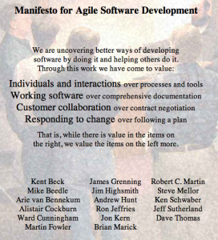
History and Origin
Agile Manifesto(2001)
based on 12 principles
sets the concepts of APM

Slide 4
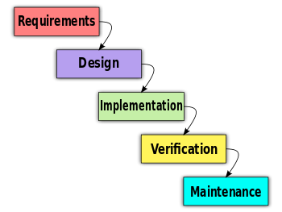
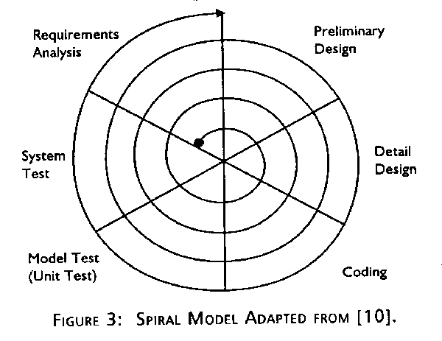
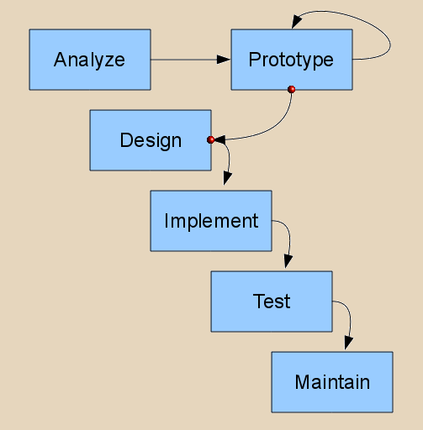
History and Origin
Waterfall Spiral Prototyping
source: http://users.csc.calpoly.edu/~jdalbey/308/Lectures/SoftwareProcessModels.html

Slide 5
Why Agile Project Management?
Reasons
It is hard to plan everything at the start
Projects fail to fulfil the forecasts
Results
project adapts to changes quickly
reduced development cost and time
high-quality product meeting the demands
source: http://www.techrepublic.com/blog/tech-decision-maker/the-roots-of-agile-project-management/

Slide 6
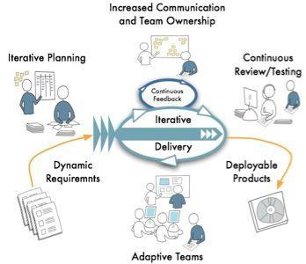
Scrum Structure
Sprint/iteration every 7-30 days
Daily Scrum meetings
Notes:
Talk about main stage difference between scrum and normal

Slide 7
Roles
Product Owner
Visionary
Scrum Master
Leads scrum
Problem solver
Development Team
Main workers
Notes:
Talk about the key team roles and the differences

Slide 8
Comparison with Other Models
Agile PM is best in fast-growing business where requirements are likely to change throughout the process.
Traditional methods are best in a stable environments with a fixed end product and a fixed process.
 | Agile Project Management | Traditional Methods
Leader | Self-directed | Team is conducted by a single project manager
Project Requirements | Developed during process | Project requirements develop
Testing | At the end of each sprint | At the end of the release

Slide 9
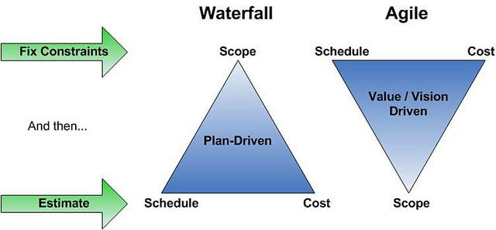
Waterfall vs Agile Methods
image source: http://www.absoluteagile.com.au/Service/AgileProjectManagement
Notes:
Agile prioritizes the project over the funding. Set project vs set costs

Slide 10
Traditional vs Agile
Notes:
Useability of traditional code vs agile

Slide 11
The Agile Process: Stage-by-Stage
identify project vision
create product mindmap
create release plan
plan next sprint
do sprint (daily meetings!)
sprint review
sprint retrospective

Slide 12
Artifacts 1
Product Vision Statement: quick summary
Product Backlog: list of project scope
Product Roadmap: high-level view of requirements

Slide 13
Artifacts 2
Release Plan: timetable of release
Sprint Backlog: goal and tasks for a sprint
Increment: working product functionality at end of each sprint

Slide 14
Roles of Team Members
Roles of Product Owner:
Visionary of the product
Decides to ship or continue development
Responsible for product backlog
May contribute as a development team member

Slide 15
Roles of Team Members
Roles of Scrum Master:
Facilitates effective communication
Removes obstacles to the agile process
Chief motivator of the team
Leads scrum
Scrum master does not overrule or manage the team and is not responsible for it.

Slide 16
Roles of Team Members
Roles of the Development Team:
Cross-functional and self-organising
Has autonomy regarding commitments
Usually 7±2 members in a team room
Preferably in a long commitment
Resources:
http://www.tutorialspoint.com/management_concepts/agile_project_management.htm
http://www.dummies.com/how-to/content/agile-project-management-for-dummies-cheat-sheet.html
http://www.mountaingoatsoftware.com/articles/the-need-for-agile-project-management/
http://scrummasterchecklist.org/pdf/ScrumMaster_Checklist_12_unbranded.pdf
http://agilemethodology.org

Slide 17
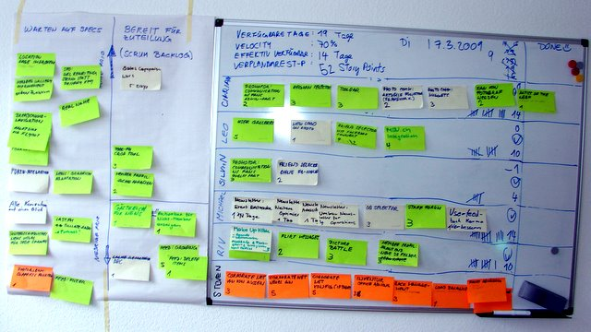
Basic Implementations
Without Software
Kanban
A Kanban Whiteboard
sources: http://reqtest.com/agile-blog/is-agile-just-scrum/

Slide 18
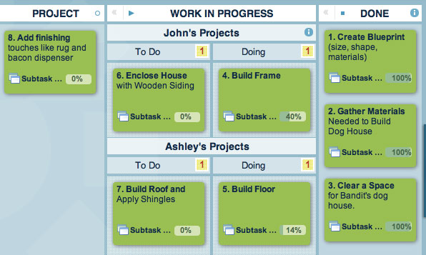
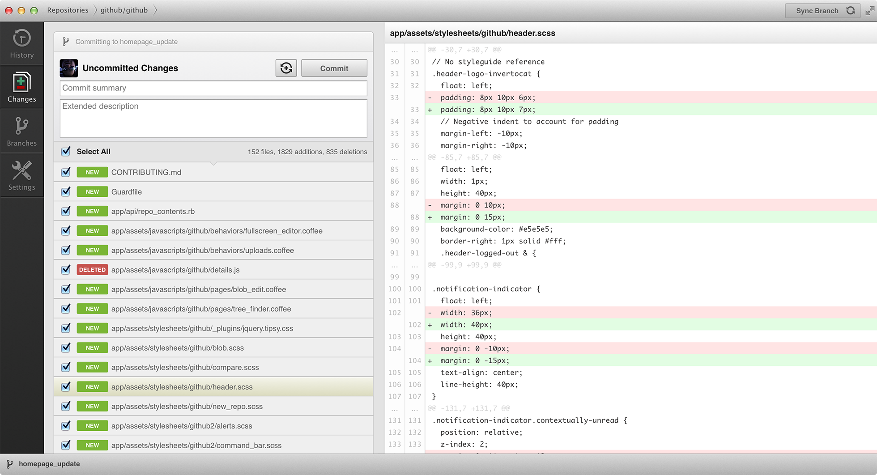
Basic Software
Communication
VOIP
Organisation
Kanban
Collaboration
Document Collaboration & Cloud
Code Repository
Leankit Kanban Software
Online Resources:
http://leankit.com/product-tour/
http://www.google.com/google-d-s/tour2.html
http://en.wikipedia.org/wiki/Voice_over_IP
Github Code Repository Interface

Slide 19
Custom Workflows
Bugs
Ideas
Testing
Stories
Whole Projects etc.
Example workflow for bug fixing:
Development
Bug Found
Issue Raised
Awaiting Review
Each have a specific workflow with different stakeholders at each stage

Slide 20
Story History
Ability to Record:
the actual workflow and item took
employees who worked on it
how long they took
issues and complications
connected or branching Items
comments and attachments

Slide 21
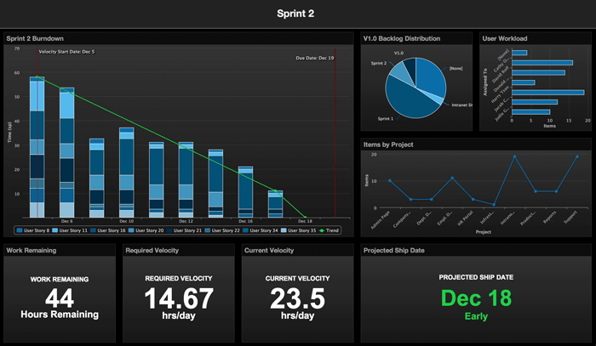
Burndown Charts
image source: http://www.axosoft.com/products

Slide 22
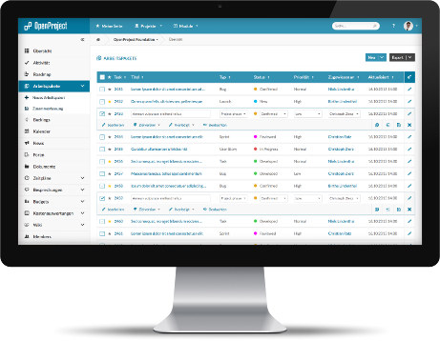
Software Packages
Jira & stash
Axosoft
Target Process
OpenProject(Open Source)
Online Resources:
http://www.axosoft.com/scrum
http://www.targetprocess.com/
https://www.openproject.org/
https://www.atlassian.com/software/jira
OpenProject

Slide 23
Conclusion
Why use Agile Project Management?
Types of Agile Project Management
Software to support Agile Project Management

Slide 24
Questions?

