Slide 1
Will MOOCs destroy face-to-face University Education?
By Jonathan Pepler, Edward Jones, Yin Li, Ed Crampin, Dragos Ristache, Alberto Lopez Mayo

Slide 2
Objectives
Study MOOC development
Origins of the MOOC
MOOC providers
MOOC adoption by universities
Compare to traditional ‘face-to-face’ courses
Weigh up pros and cons of each
Analyse the value of the MOOC in employability terms
Are undergraduates wasting their money?
Discuss the future development of MOOCs
How have universities reacted?
What are the implications of the rise in accredited courses online?

Slide 3
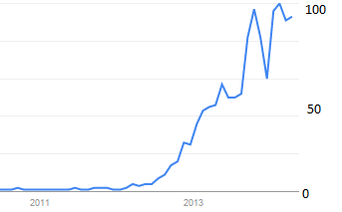
Short History of MOOCS
With every new technology (Radio, TV etc.) we made an effort to make it suitable for distance learning. Because of this internet courses seemed like a natural extension
The term was coined in 2008 by Dave Cormier. (Parr, 2013)
First class that is considered a MOOC: ‘Connectivism and Connective Knowledge/2008’; 25 fee paying students took the class and over 2300 online students took the class. (Parr, 2013)
In 2011 Sebastian Thrun and his colleagues at Stanford offered “Introduction to AI” which attracted more than 160,000 students. The course is now available at Udacity with over 60.000 students that took it. (Intro to Artificial Intelligence)
Google trends of MOOCS
Notes:
http://www.timeshighereducation.co.uk/news/mooc-creators-criticise-courses-lack-of-creativity/2008180.fullarticle
http://publications.cetis.ac.uk/wp-content/uploads/2013/03/MOOCs-and-Open-Education.pdf

Slide 4
What is a MOOC?
MOOC?
Massive Open Online Course
Open to anyone, in any number
Self-taught, based on set resources
Usually relies on peer review, social networking is important
Normally free, but has paid variants
Commonly no prerequisites, but also no accreditation
Most courses last around six weeks
Providers: Coursera, edX, Udacity, FutureLearn
Notes:
A MOOC is a Massive Open Online Course. A MOOC is essentially a class in a subject; it is run by an expert in the field of that subject, and taken by people interested in that subject. There are however, some important differences; it is entirely online, and there is no set path to completion of the MOOC. Although there are often video lectures, and other fixed resources made available, the learning is self-driven and organised by the community of students studying that course. Usually each week in a course new work is released, with a typical course lasting around six weeks. MOOCs encourage the networking of peers in order to further the individual's skills and knowledge. Another important difference is that there are no fees, expected prerequisites or even outcomes in a MOOC; due to this, there is usually no formal accreditation.

Slide 5
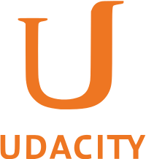
Statistics
edX
Launched May 2012
~ 60 courses
> 1 million users
~ $60 million funding
$1.00 funding per user per course
Coursera
Launched April 2012
~ 400 courses
> 4 million users
~ $83 million funding
$0.05 funding per user per course
Udacity
Launched February 2012
~ 30 courses
> 750,000 users
~ $21.1 million funding
$0.94 funding per user per course
Notes:
[4] http://www.educationdive.com/news/moocs-by-the-numbers-how-do-edx-coursera-and-udacity-stack-up/161100/

Slide 6
Coursera (Coursera.com)
For profit website founded by Andrew Ng and Daphne Koller
Over 500 Courses by over 80 institutions. (Partners | Coursera, 2014)
Notes:
https://www.coursera.org/about/partners

Slide 7
edX (edx.org)
Non-profit founded by Harvard and MIT
Sponsors: (edX School partners, 2014)
Notes:
https://www.edx.org/schools-partners

Slide 8
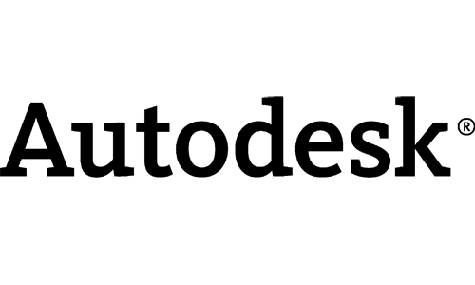
Udacity (Udacity.com)
All courses have a free ‘path’ and most of them have a paid one.
For profit that has a strong focus on Computer Science
Sponsors: (Course Catalog for online courses, 2014)
Notes:
https://www.udacity.com/courses

Slide 9
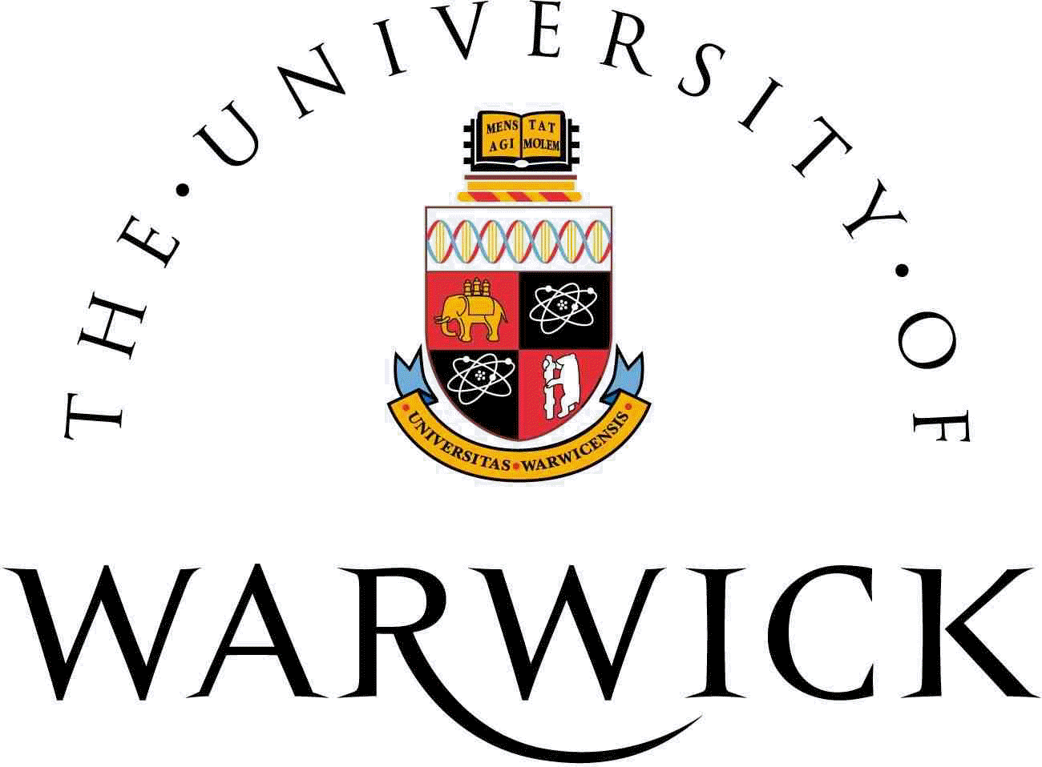
FutureLearn
Noncommercial owned by Open University, with partnerships with UK universities.
Notes:
https://www.futurelearn.com/partners

Slide 10
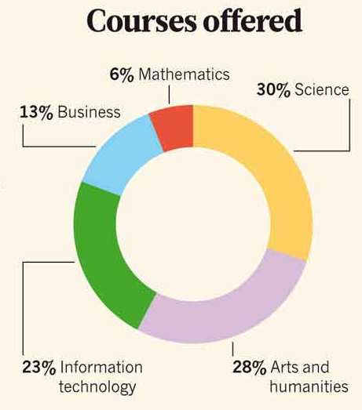
Statistics
Typical size is around 20,000 - although a couple have reached 200,000 or over (Jordan, n.d.)
Typical completion rates are below 10% (Jordan 2014, p.148)
A lot of money has been invested:
$60m invested by Harvard and MIT launching edX (Daly, 2013)
$21.1m venture capital funding for Udacity (Daly, 2013)
$85m venture capital total raised by Coursera since April 2012 (Helper, 2013)
Coursera pays around 6-15% of it’s gross revenue from a MOOC to the partner university (Daly, 2013)
(Waldrop, 2013)
Notes:
[1] http://www.katyjordan.com/MOOCproject.html
Reference this paper instead (http://oro.open.ac.uk/39592/)
[2] http://www.edtechmagazine.com/higher/article/2013/02/11-enlightening-statistics-about-massive-open-online-courses
[3] http://www.bizjournals.com/sanjose/news/2013/11/22/coursera-lands-20-million-in-new.html?page=all

Slide 11
MOOC Pros and Cons
Pros
No fixed schedule
Unparalleled accessibility
High quality material is created by world class institutions
More active learning
No course overcrowding
Cons
No standardised accreditation
Individual teaching and discussions become near impossible in such large groups
Possibility of hurting higher education facilities
Low completion rates

Slide 12
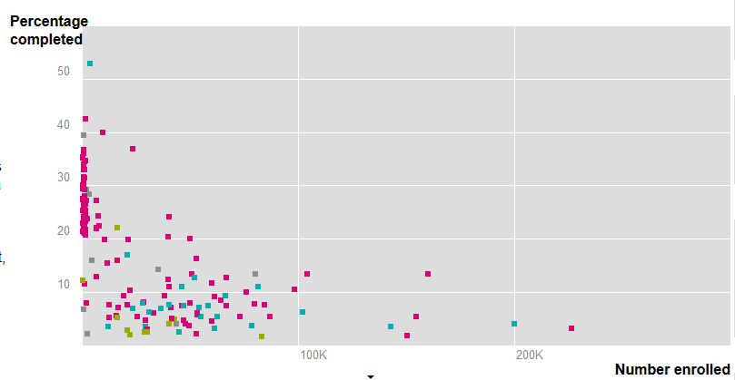

Slide 13
Face-to-face Course Pros and Cons
Pros
Smaller groups
Instructor is more available
More accountability
Accreditation is much more formalised
Cons
Expensive
Limited availability
Not as accessible
Teaching/learning style doesn’t fit everyone

Slide 14
The Value of MOOCs
Typically, courses are accredited by a governing body, which gives the degree worth to employers
Not many MOOCs are accredited, and so it can be hard for employers to judge their value
An experiment was conducted over a year ago by edX to see if the best performers in their MOOCs could get a job
Out of 868 students, 3 got an interview -- and none got a job (Kolowich, 2013)
Notes:
[2] http://www.edudemic.com/accreditation-of-moocs-and-online-learning/
[1] http://chronicle.com/blogs/wiredcampus/edx-drops-plans-to-connect-mooc-students-with-employers/48987

Slide 15
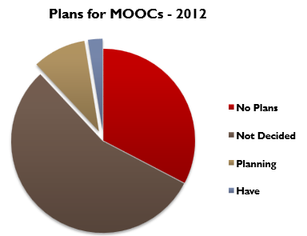
Universities Adopting MOOCs?
Often offered as ‘taster’ courses, to build skills and act as a prerequisite to a degree, or simply for personal enjoyment
Southampton currently offers three MOOCs through FutureLearn (What is a MOOC, 2013)
Growing movement to offer more expensive but accredited courses
Georgia Institute of Technology offer a full masters degree in computer science, for 20% of the cost of doing the degree locally (Onink, 2013)
In 2012, approximately 2.6 percent of universities offered MOOCS, and almost 10 percent had plans to offer in the future. (Allen, 2012)
Notes:
Piechart reference: http://www.onlinelearningsurvey.com/reports/changingcourse.pdf

Slide 16
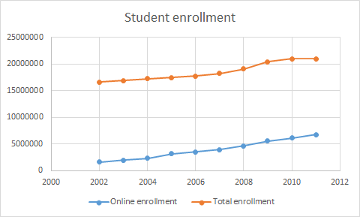
Students adopting MOOCS?
The number of students taking at least one online course has been steadily increasing since 2002. In 2011 the number of students taking an online course has increased by about 572,512, and will probably continue to grow for a couple of years.
83% of MOOC students have a secondary degree.
Over 40% of coursera students are under 30 with only 10% over 60.
About 50% of MOOC students have full time jobs.
(Data from Allen, 2013)

Slide 17
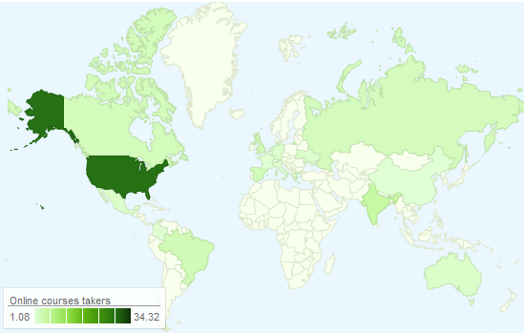
Who is taking MOOCS?
83% of MOOC students have a secondary degree and 79.4% have a Bachelor's.
Over 40% of coursera students are under 30 with only 10% over 60.
About 50% of MOOC students have full time jobs.
United States has about 34.32% of the students. (Christensen, 2013)
The two main reasons people are taking MOOCS is curiosity, and further gain knowledge and skill toward their degrees. (Christensen, 2013)

Slide 18
Relevance to the Undergraduate
MOOCs cannot replace a degree in the eyes of an employer
“We're not doing anything as rich and powerful as what a traditional liberal-arts education would offer you” -Sebastian Thrun, Udacity creator
79.4% of MOOC participants already have a Bachelor’s degree or above (Christensen et al, 2013)
MOOCs are helping to improve the quality of learning in higher education (Garcia, 2014)
MOOCs can supplement an undergraduates degree by allowing them to study areas that would not be otherwise be included in their curriculum
Notes:
[1] http://cit.duke.edu/blog/2012/09/moocs-what-role-do-they-have-in-higher-education/
[2] http://www.fastcompany.com/3021473/udacity-sebastian-thrun-uphill-climb
[3]http://papers.ssrn.com/sol3/papers.cfm?abstract_id=2350964
First point: talk about how they currently are nowhere near valued enough to “replace” a degree.
Second point: Thrun himself thinks they should move towards augmenting university education as opposed to replacing it
Third point: this statistic shows that, currently, MOOCs are used more as a way of carrying on education past the undergraduate level.

Slide 19
Expert Opinion
“MOOCs have the potential to contribute so much to education.” Dr. Lori Breslow MIT Teaching and Learning Laboratory[http://www.wise-qatar.org/edudebate-moocs-disruptive-learning]
“Not raw memorization of facts, but actually the understanding, application and correlation of those concepts at much higher levels of function. Very few of the MOOCs out there actually do that.” Jim Guilkey S4 NetQuest President and co-founder
[http://www.educationworld.com/a_tech/elearning-mooc-best-practices-trends.shtml]

Slide 20
Increase in accredited Courses
Five Coursera courses are accredited
Udacity in a partnership with AT&T and Georgia Tech are offering an accredited masters degree that will require you to apply and be admitted
Students from San Jose State University can take Udacity’s online course (made by the university) and receive full credit. (Harris,2013)
As time passed the current trends seems to show us that more and more courses will get accreditation, but a big problem that faces this accreditation is how much employers will consider it.

Slide 21
Conclusions
Recent developments suggest that initial ideas of overthrowing traditional universities were premature
MOOCs provide a great way to study how students learn best, which can only improve the undergraduate experience
They also help students with their academic curiosity during and after university.
Traditional university is here to stay, and so are MOOCs.
MOOCs will help students and people who want to learn in many ways (curiosity, more skill in their domain etc.), and it will enhance their university experience by having access to all this information and courses.

Slide 22
References
1.ALLEN, E., SEAMAN, J. (2013) Changing Course Ten Years of Tracking Online Education in the United States. Available from: http://www.onlinelearningsurvey.com/reports/changingcourse.pdf, [Accessed 30 April 2014]
2. CHRISTENSEN, G., STEINMETZ, A., ALCORN, B., BENNETT, A., WOODS, D. and EMANUEL, E. J. (2013) The MOOC Phenomenon: Who Takes Massive Open Online Courses and Why?, Working paper, Social Science Research Network, No. 2350964.
3. Course Catalog for online courses, (nd). Available from: https://www.udacity.com/courses#!/all, [Accessed 30 April 2014]
4.Course Catalog for online courses, (nd). Available from: https://www.udacity.com/courses#!/all, [Accessed 30 April 2014]
5. DALY, J. (2013) 11 Enlightening Statistics About Massive Open Online Courses, from http://www.edtechmagazine.com/higher/article/2013/02/11-enlightening-statistics-about-massive-open-online-courses, [Accessed 30 April 2014]
6. edX School partners, (nd), Available from: https://www.edx.org/schools-partners, [Accessed 30 April 2014]
7. GARCIA, L. N. (2014) The End of MOOCs and The Future of Higher Education, British Columbia: The Ubyssey. Available from: http://ubyssey.ca/features/information-driveway-moocs-462/ [Accessed 30 April 2014]
8.Google trends MOOC, (2014). Available from: http://www.google.com/trends/explore#q=MOOC, [Accessed 30 April 2014]
9. HELPER, L., (2013), Coursera lands $20 million in new funding, despite online education turmoil. Available from: http://www.bizjournals.com/sanjose/news/2013/11/22/coursera-lands-20-million-in-new.html?page=all, [Accessed 30 April 2014]
10. Into to Artificial Inteligence - Udacity, (nd), from https://www.udacity.com/course/cs271, [Accessed 30 April 2014]
11. JORDAN, K. (2014) Initial trends in enrolment and completion of massive open online courses. International Review of Research in Open and Distance Learning, 15(1) pp. 133–160.
12. JORDAN, K., n.d., MOOC completion rates. Available from: http://www.katyjordan.com/MOOCproject.html, [Accessed 30 April 2014] (this is for the graphs)
13. KOLOWICH, S. (2013) edX Drops Plans to Connect MOOC Students With Employers. Washington, D.C.: The Chronicle of Higher Education. Available from: http://chronicle.com/blogs/wiredcampus/edx-drops-plans-to-connect-mooc-students-with-employers/48987 [Accessed 30 April 2014]
14. ONINK, T. (2013) Georgia Tech, Udacity Shock Higher Ed With $7,000 Degree. Forbes. Available from: http://www.forbes.com/sites/troyonink/2013/05/15/georgia-tech-udacity-shock-higher-ed-with-7000-degree/ [Accessed 1 May 2014]

Slide 23
References
15. PARR, C., (2013) Mooc creators criticise courses’ lack of creativity. Available from: http://www.timeshighereducation.co.uk/news/mooc-creators-criticise-courses-lack-of-creativity/2008180.fullarticle [Accessed 30 April 2014]
16. Partners | Coursera, (nd), from https://www.coursera.org/about/partners, [Accessed 30 April 2014]
17. Partners -- FutureLearn, (nd), from https://www.futurelearn.com/partners, [Accessed 30 April 2014]
18. SHUMSKI, D., (2013) MOOCs by the numbers: How do EdX, Coursera and Udacity stack up?, Available from: http://www.educationdive.com/news/moocs-by-the-numbers-how-do-edx-coursera-and-udacity-stack-up/161100/, [Accessed 30 April 2014]
19. UNIVERSITY OF SOUTHAMPTON (2013) What is a MOOC? Available from: http://www.southampton.ac.uk/moocs/whatis.shtml [Accessed 30 April 2014]
20. WALDROP, M., (2013), Massive Open Online Courses, aka MOOCs, Transform Higher Education and Science. Available from: http://www.scientificamerican.com/article/massive-open-online-courses-transform-higher-education-and-science/, [Accessed 30 April 2014]
21. YUAN, L., POWELL, S., (2013) MOOCs and Open Education: Implications for higher education. Available from: http://publications.cetis.ac.uk/wp-content/uploads/2013/03/MOOCs-and-Open-Education.pdf, [Accessed 30 April 2014]

