Slide 1
Professional Development
COMP 1205
-
Digital Literacies

Slide 2
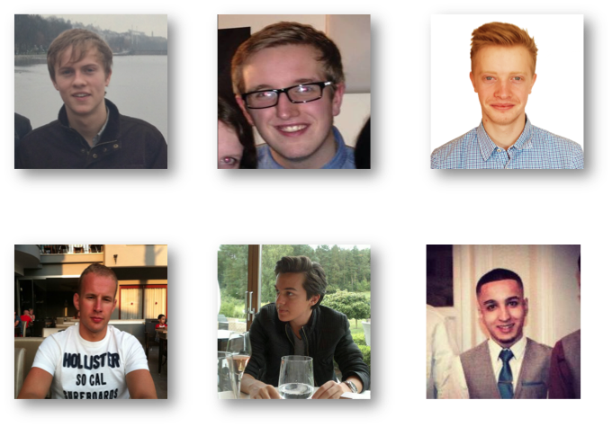
Alex Harriss
Nathan Salmon
George Clayton
Graeme Hawke
Joshua Stein
Mohammed Nabeel

Slide 3
What is Digital Literacy?
Digital Literacy is – in a nutshell – the ability to understand and evaluate information through the use of a digital medium.
JISC defines digital literacy as a set of “capabilities which fit an individual for living, learning and working in a digital society“^{[1]}.
While digital literacy may seem trivial for a majority of users, it is clear that a certain degree of dedication is required to become digitally literate in this day and age.
  The term digital native plays a big role in todays digital literacy rate.
[1] Beetham (2010). Available at: http://bit.ly/1n6554A

Slide 4
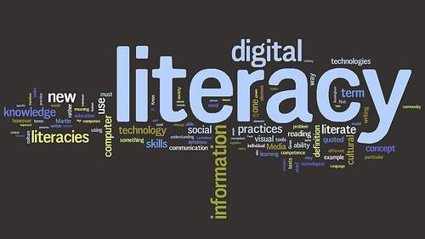
Digital Literacy Agenda
Why is the digital Literacy Agenda important?
Increasing the digital effectiveness of staff (academic and research)^{[2]}
Current projects that are trying to improve digital literacy
  Digidol^{[3]}
[2] JISC (2012). Available at: http://bit.ly/1fB32Ws
[3] JISC (2013). Available at: http://bit.ly/1pRRTF5
Notes:
Presentation Notes:
Point 1 - “you’d never construct things around people who can’t read because otherwise you’re excluding people who can’t read, you teach them to read”
Point 2 - Use of interactive discussion tools for language learning and to get teachers to interact with students. Lecturers now to go the new language centre in the library with classes to do tasks using blogs, discussion and encourage students to learn to type and chat in a different language.
Point 3 - Project Digidol aims to embed processes and practices that enable the development of Digital Literacy in all staff and students across all areas and levels of the University. It is understood that this will be as much about changing attitudes and beliefs, as it will be about realising practical knowledge and skills. Organisational change and effective change management will be key aspects of the project.

Slide 5
Digital Literacy Agenda
Why is it important for students?
What could students get from it?
PADDLE - Personal Actualisation and Development through Digital Literacy in Education^{[2, 5]}
[2] JISC (2012). Available at: http://bit.ly/1fB32Ws
[4] Anyangwe (2012). Available at: http://bit.ly/1iCVT8B
[5] JISC (2012). Available at: http://bit.ly/1o675d4
Notes:
Close the gap in skills between students of different backgrounds, modules, institutions and courses:
•The digital agenda attempts to close the division between students who are able to use digital literacy skills such as the ability to use online resources for technical essays or being able to find information they need online and those who’ve barely used a computer before. “you’d never construct things around people who can’t read because otherwise you’re excluding people who can’t read, you teach them to read” the digital literacy agenda strives to do the same for students who lack digital literacy skills, by teaching these skills.
90% of new jobs will require excellent digital skills
•Developing graduate skills in literacy for a digital industry^{[5]}
•These skills can become life-long practices in which students shall develop and keep^{[5]}
•PADDLE – Personal Actualisation and Development through Digital Literacy in Education:
empowering 70,000 learners and staff to take responsibility for developing their own digital literacy skills
embed digital literacy skills into their normal studies making it an institution-wide approach where digital literacy is integrated into all curriculum
Integrating skills into lessons so students learn how to use these skills throughout their courses

Slide 6


Implementing the agenda – the technology and practicalities
Don’t enforce ownership^{[6]}
Provide technical support for students’ laptops and other equipment^{[6]}
Online “social spaces” before enrollment^{[6]}
Virtual Learning Environments^{[6]}
[6] JISC (n.d.). Available at: http://bit.ly/1fvOQOH
Notes:
Don’t enforce ownership
Provide computers and other equipment
Provide technical support for students’ laptops and other equipment
Online “social spaces” before enrolement
At Southampton
Facebook pages
Forums
English literature
Virtual Learning Environments
Same content as lectures, assignments, grades
24/7 access to online resources
Blackboard
ECS intranet
VPN
Sussed
iTunes U
References:
http://www.jisc.ac.uk/supportingyourinstitution/studentjourney/~/media/documents/publications/respondingtolearners1.ashx

Slide 7
Implementing the agenda – the technology and practicalities
Giving students option in where they study^{[6]}
Giving everyone good internet access^{[6]}
Providing resources in multiple formats^{[6]}
Offering targeted support for specific groups of students^{[7]}
[6] JISC (n.d.). Available at: http://bit.ly/1fvOQOH
[7] Livengood, McGlamery (2012). Available at: http://bit.ly/SdrfI0
Notes:
Giving students option in where they study
Online or offline (attending or not attending lectures)
Especially essential for disabled users
Giving everyone good internet access
Providing resources in multiple formats
Lectures as videos, audio, transcribed
Different file formats
MP3, AAC, WMA
Offering targeted support for specific groups of students
Disabled
Foreign students with little technological background
Providing easier-to-grasp technology
Graduates found iPads easier-to-use for some tasks
References:
http://www.jisc.ac.uk/supportingyourinstitution/studentjourney/~/media/documents/publications/respondingtolearners1.ashx
http://www.editlib.org/p/39634

Slide 8
Key Issues of Implementing Digital Literacies in higher education
Issues with working from home^{[2]}
Hardware facilities^{[1]}
Academics^{[2]}
Financial constraints^{[2]}
[1] Beetham (2010). Available at: http://bit.ly/1n6554A
[2] JISC (2012) Available at: http://bit.ly/1nLyrYF
Notes:
Some of the key issues of implementing digital literacy in higher education.
Issues with working from home:
Teaching students to use Photoshop is a worthwhile skill, however it is unlikely that the students will have Photoshop at home. This makes it difficult for the students to do work outside of the education institutes.
Hardware Facilities:
Having the ability to use a PC is useful, however it is also a useful skill to know how to use a Mac or a Linux system. A lot of education institutes lack these facilities though making it hard to educate students these skills.
Academics:
There is an academic age gap. This means that some of the academics themselves are not very digital literate. This is because they have stuck to their subject areas and have not kept up with technologies. This is an issue as it is important for the academics to be digitally literate as well as the students.
Financial Constraints:
· UK further and higher education are facing the toughest financial constraints for a generation In 2010, there was a cut of 40% of the higher education teaching budget. This makes it hard to find funding to implement digital literacy into higher education.

Slide 9
Positives of Implementing Digital Literacies into Higher Education
It saves time
You learn faster
You save money
It makes you safer
Keeps you informed and connected
Improved decision making
Notes:
http://www.webpercent.com/articles/article_detail.cfm?AID=5

Slide 10
Conclusion
Due to the interest in digital literacy shown by various universities, one can understand the importance of digital literacy in todays day and age.
With the surge technology around the world, digital literacy will eventually be as important as actual literacy rates.

Slide 11
References
[1] Beetham, H 2010, 'Review and Scoping Study for a cross-JISC Learning and Digital Literacies Programme', JISC. Available at: http://bit.ly/1n6554A
[2] JISC (2012) ‘Delivering Digital Literacy – delivering the agenda within colleges and universities’ [podcast]. Available at: http://bit.ly/1fB32Ws
[3] JISC (2013). ‘Digidol – Developing Digital Literacy’. Available at: http://bit.ly/1pRRTF5
[4] Anyangwe E (2012). Available at: http://bit.ly/1iCVT8B
[5] JISC (2013). ’Personal Actualisation and Development through Digital Literacies in Education (PADDLE)’. Available at: http://bit.ly/1o675d4
[6] JISC (n.d.). ‘Responding to Learners’ Available at: http://bit.ly/1fvOQOH
[7] Livengood K, McGlamery M (2012). Available at: http://bit.ly/SdrfI0

