Slide 1
How the web is changing
the world:
Co-operation, Co-creation,
Crowd funding, Crowd sourcing
Group T
Team members:
Tudor Siminic
Tom Potter Carmelo Ienco
Adam Piekarski Petar Ivanov
Powerpoint Templates

Slide 2
Psychological side of view
“people select the response expressed with the higher—or in the case of more than two heads, highest—degree of conﬁdence" (prof. Asher Koriat, Institute of Information Processing and Decision Making)

Slide 3
(More than 50 million downloads in 28 days)

Slide 4
People’s level of satisfaction immediately increases when they are supported by other people

Slide 5
What is Kickstarter?

Slide 6
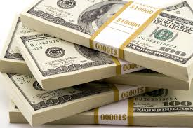
Funding
Who provides the funding?
All-or-nothing funding
Ownership

Slide 7
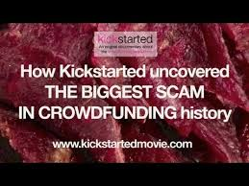
Successes and Failures
Successes
Scams

Slide 8
How Crowdfunding Sites Make Money
Success Fee
Membership fee
Equity interest
Advertising and
Promotional Upgrades

Slide 9
5% fee to funds raised, plus Amazon Payments processing fees
4% fee to funds if the project reaches its goal, 9% fee to funds if it does not, plus 3% credit card processing fee and $25 wire fee for non-US campaign.
7.9% fee + $0.30 per donation, or 9.25% total fee for non-profit projects.

Slide 10
Charity
Crowd-funding and sourcing can be charitable
Personal cause
Registered Charities
Other non-profit projects led for the benefit of others
Raises awareness as well as money

Slide 11
Gift Aid
HMRC returns basic tax rate on donations to charities
Online crowd funding platforms can claim this money
Individual donation: £100. With Gift Aid: £125

Slide 12
Founded 2001
£1.5 billion raised
5% fee. Reinvested

Slide 13
Social Media
Charitable pledges spread on social media
Facebook share, Twitter trends, Tumblr reblog
Supplements crowd funding platforms

Slide 16
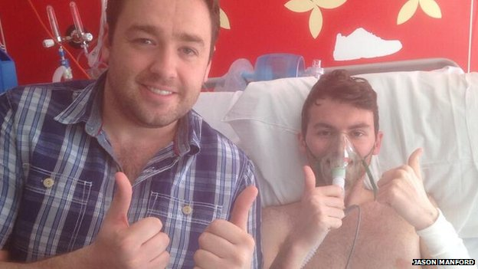
Stephen Sutton
19 Years Old
Diagnosed with terminal cancer
Raised over £3 million for Teenage Cancer Trust

Slide 17
Support
Jason Manford raised awareness via his Facebook
Organised comedy gig in support
Roger Daltry, Benedict Cumberbatch, Simon Pegg and Stephen Fry.
Alan Davies, Russell Brand, Bill Bailey, Sir Chris Hoy,Simon Cowell Raymond Blanc.

Slide 18
What is Open Source and how it is related
Author’s role
Licensing
A building block

Slide 19
Why open source
Better programs
Become a better programmer
Customization & Maintenance

Slide 20
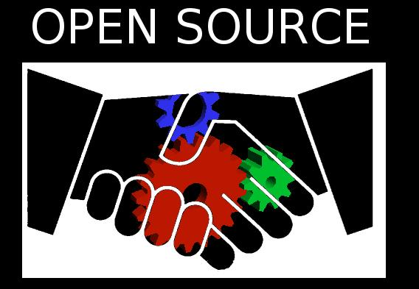
Why is open source ‘beyond just software’.
Attitude towards programming
Commitment

Slide 21
References
Hertwig, R., 2012. Tapping into the Wisdom of the Crowd - with Confidence. Science, 336(6079), pp.303–304
http://opensource.com/resources/what-open-source
https://www.indiegogo.com/
https://www.kickstarter.com/
http://www.justgiving.com/

