Slide 1
Digital Divide
Amogh Randhar, Andrés Martín Maqueda, Darron Tang, Jack Drake, Tom Aley, Vaidotas Šimkus
COMP1205 – Group Presentations
Group S

Slide 2
Who We Are
Darron Tang
Vaidotas Šimkus
Tom Aley
Jack Drake
Amogh Randhar
Andrés Martín Maqueda

Slide 3
ABSTRACT
In this presentation we explore the modern phenomenon known as Digital Divide, a world spread social problem that regards how despite the constant advancement of technology as a whole, such technological development is not reflected on and does not reach all communities and individuals. We consider the technological divide separating countries from each other and also the divide present within a same nation or society, which is particularly significant in more developed countries. For these, we cite as examples the cases of the US and the UK, while we contrast their situations with those of developing countries such as those in BRICS and Africa. In our work we include the view on the problem along with measures taken against it and solutions.

Slide 4
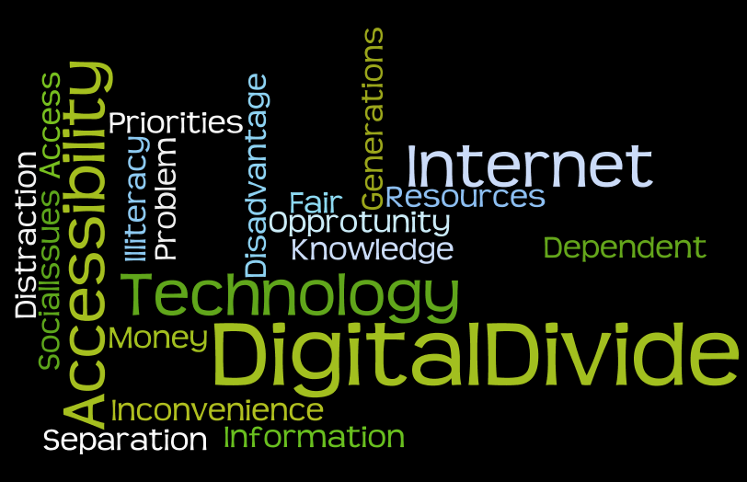
Introduction

Slide 5
Definition 1
Definition 1: “gap between those who already have access to Information and Communication Technology and the skills to make use of those technology and those who do not have the access or skills to use the same technology within a geographic area, society or community. It is an economic inequality between groups of persons.”
[http://en.wikipedia.org/wiki/Digital_divide]
Notes:
We will be discussing the digital divide in our presentation.
The definition of the digital divide has evolved over time from being simply a gap between two communities, societies or geographic areas access and skills with respect to ICT, to now include access to the internet also.

Slide 6
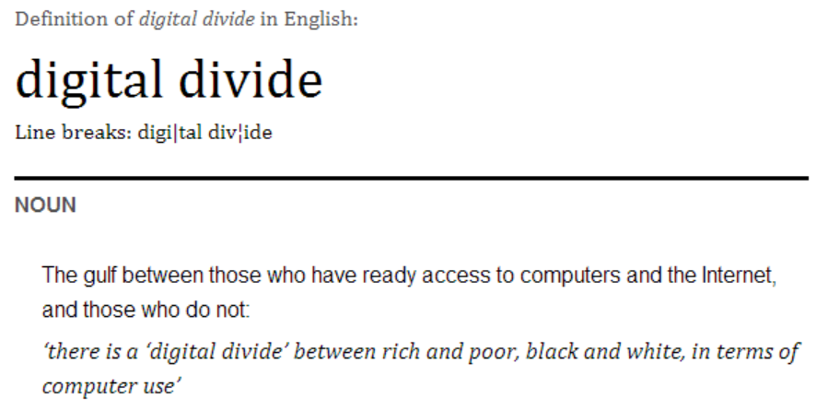
Oxford Dictionary Definition
[http://www.oxforddictionaries.com/definition/english/digital-divide]
Notes:
An up to date simple definition is just: The gulf between those who already have access to computers and the internet and those who do not.

Slide 7
Outline
Introduction
What Is Digital Divide ?
In Developed Countries
U.S.A
U.K
In Developing Countries
Overall Across Globe
BRICS
Africa
Reasons
Generation Gap
Solution Taken

Slide 8
Digital Divide – U.S.A

Slide 9
Overall internet usage in USA
In 2009 a study was taken on internet usage in the US
Of the people asked 82% of them used the internet
48% of people asked used the internet for at least an hour everyday

Slide 10
Usage by gender
Of the people asked 85% of men used the internet and 80% of woman used the internet
Gender is not a significant cause of the digital divide

Slide 11
Usage by Age
Of the people asked 97% of people aged 18-29 used the internet
Only 48% of people asked over 65 used the internet
Age is a big cause of the digital divide
This could be caused by young people growing up with new technology, while older people find it harder to adapt

Slide 12
Usage by Income
96% of people asked with over $75,000 salary use the internet
48% of people asked earning under $30,000 use the internet
This is another significant cause of digital divide
People earning less may choose not to get internet because they can't afford it
People earning more may be more successful due to their presence online

Slide 13
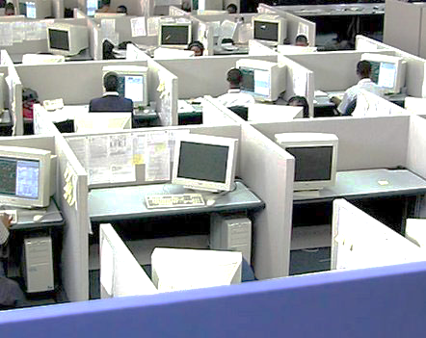
Usage by Employment Status
94% of people asked who are employed used the internet.
68% of people asked who are unemployed used the internet.
Almost everyone who is employed uses the internet. The internet has become a big part in running a business and usage of it in some kind is required in a lot of jobs.
Being unemployed gives people less reason to use the internet, as it isn't required for a job. Someone who is unemployed also may not be able to afford paying for internet.

Slide 14
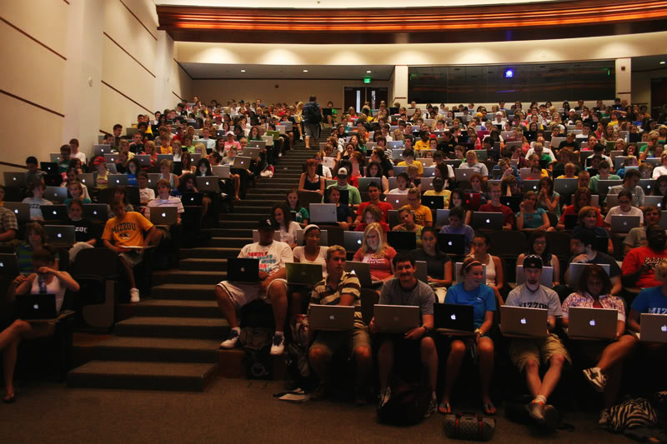
Usage by Education
96% of post-grads use the internet
68% of people asked who left education at high-school or lower use the internet
Internet usage is very helpful for education
Sometimes usage of it is even required by the education facility
People who leave education early have less reason to use the internet, and are more likely to have less income

Slide 15
The US internet usage is very high
You will notice that even in the groups that use less internet, the majority of people still use the internet
The internet has become a huge part of the US, and many peoples lives
Notes:
*Image from : http://www.google.co.uk/publicdata/explore?ds=d5bncppjof8f9_&met_y=it_net_user_p2&hl=en&dl=en&idim=country:USA:RUS:CHN#!ctype=l&strail=false&bcs=d&nselm=h&met_y=it_net_user_p2&scale_y=lin&ind_y=false&rdim=region&idim=country:USA:RUS:CHN:JPN:GBR&idim=region:SSA:SAS&ifdim=region&hl=en_US&dl=en&ind=false

Slide 16
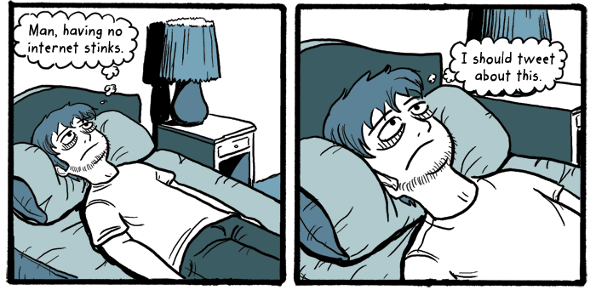
Digital Divide In The UK
An overview of the factors involved
Notes:
Onto the digital divide in the UK, an economically developed country.
Here is an overview of the factors involved…

Slide 17
Factors of the divide
Age and Disability
Provisions and Infrastructure
Income and Education
Social Inclusion/Exclusion
Notes:
There are a multitude of factors contributing to the digital divide in the UK, here I have listed four of the big categories of which I will introduce three: Provisions and infrastructure, Income and education and social inclusion/exclusion.

Slide 18
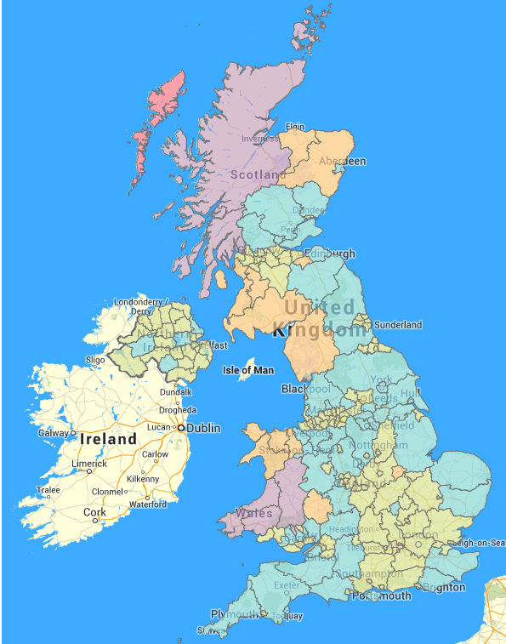
Provisions and infrastructure
Availability of information and communications technology
Rural vs Urban
Notes:
There is a significant bond between social exclusion and a lack of provisions and infrastructure. Quite simply, if there are not adequate means of getting involved in the digital age then those without the resources will not be part of it!
In order to get people online, they need access to the internet, so there must be an availability of information and communications technology, i.e. computers. Some areas have an abundance of appropriate technology available whereas others do not, hence rural vs urban.
To further this point, Approximately half of Scotland is rated at having an internet connection between 0 and 6 Mbits/s. That’s zero as in no connection!
This is the case for a vast section of wales also, but the more Urban areas rarely have less 10MBits/s showing a clear divide in the infrastructure.

Slide 19
Income & Education, the Socio-economic factors
The social divide
The democratic divide
Confused and adverse vs Advanced Users
Confused And Adverse: “High variability, but generally low usage of Internet. This user type shows confusion about Internet services. This category rarely uses the Internet for private purposes or for contacting authorities”
Advanced Users: “Frequent use of eGovernment services, not only for administrative tasks (e.g., to search for administrative information, to fill out forms, or to carry out administrative transactions) but also for other purposes. Advanced Users are the most frequent online shoppers. ”
Notes:
In terms of socio-economic factors, it is apparent that it’s not just down to availability of devices causing the digital divide in the UK, but also due to lack of knowledge or education and even down to unwillingness to adapt to the digital era.
With respect to the income factor, as you probably excepted, household income between £6000 and £11999 yields a much lower internet usage than higher incomes of say £32000 or more. The first income bracket only had a 14% internet use whereas the later had a 61% internet use.
Most convenient way to get online is through a personal computer or smartphone but hose on a low income may struggle to afford such luxuries.
Education is a strong factor because without the knowledge of how to be digitally literate, individuals will have a low usage of the internet. To emphasize how this can amplify the digital divide a study of Europe's internet usage showed that the UK had the second highest percentage of “Confused / Adverse” users and the highest percentage of Advanced Users, a clear divide when only 13.28% of the UK population were not even using the internet at the time of the study.
Included in these statistics was that the UK has 16.57% of its population that did not use eGovernment services. Such services were introduced in part to influence people to use the internet but it is sometimes the case that individuals choose to stick to the traditional methods showing an unwillingness to adapt.

Slide 20
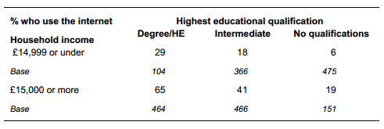
Internet access by educational qualification and household income:
Notes:
As you can see here, as household income decreases so does the % internet use.
As the Highest achieved qualification decreases, so does the % internet use.

Slide 21
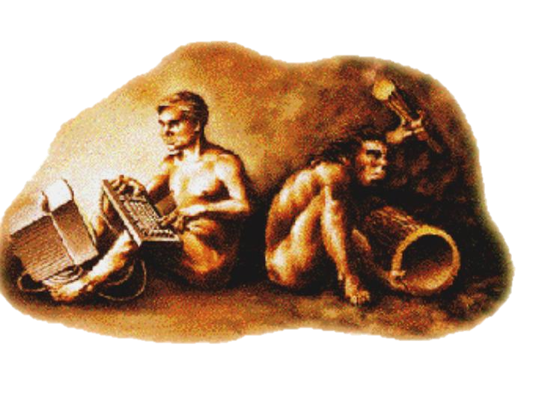
Digital Divide : Less Economic Developed Countries
Developing And Less Developed Countries

Slide 22
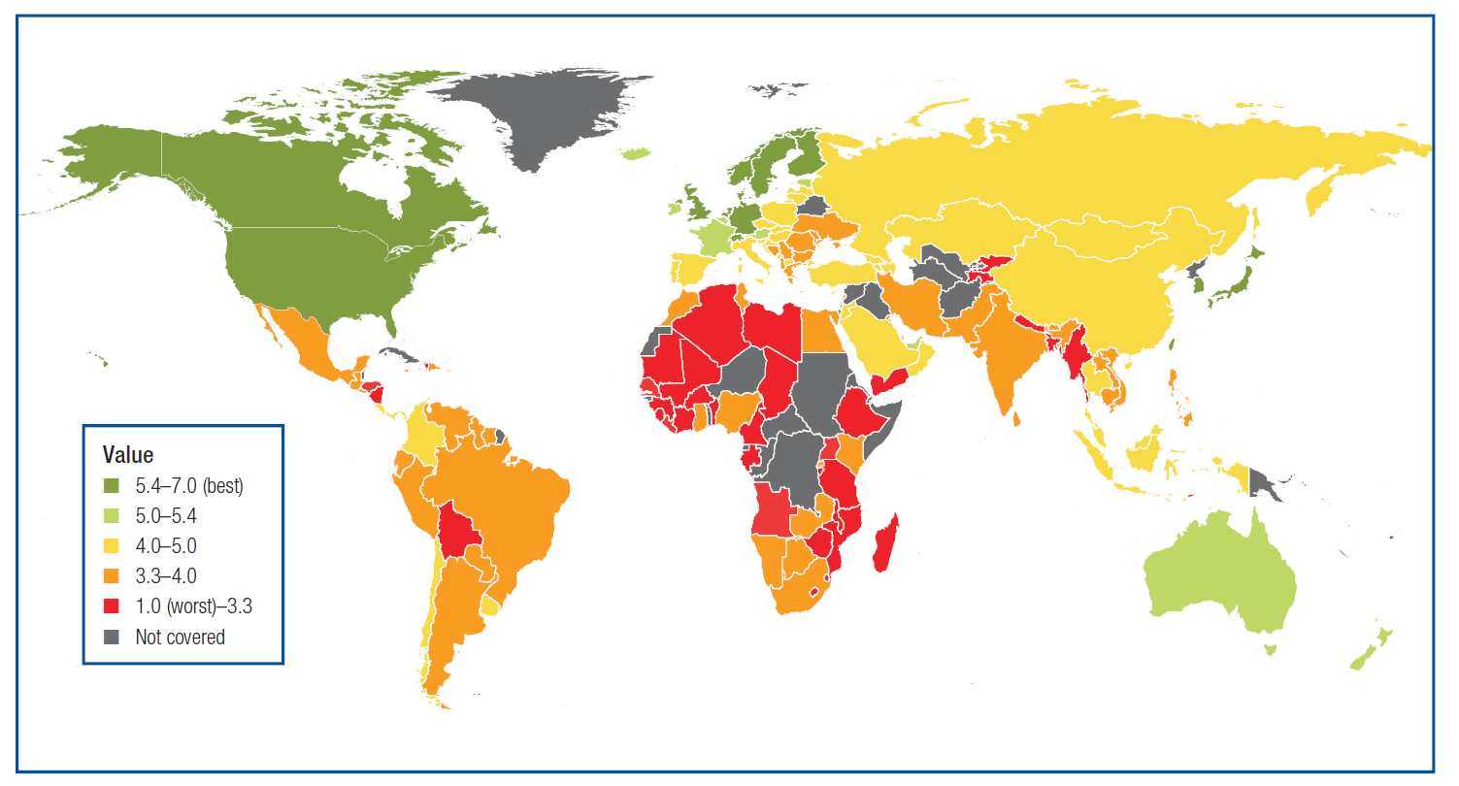
Internet Penetration In World
Image of 2012
http://www.unescap.org/news/first-ituun-escap-interactive-terrestrial-transmission-information-superhighway-maps-help
Notes:
Only 7 per cent of people in the Asia Pacific region have fixed broadband access and it is the most digitally divided region in the world, with Republic of Korea at 37.56% fixed broadband penetration, compared to Myanmar with only 0.01%.
"In Asia and the Pacific, what we call the 'digital divide' is in fact an income divide, a gender divide, an education divide and a knowledge divide," said by Noeleen Heyzer, executive secretary of ESCAP.
India might have the world's second highest number of Facebook users, but according to the Internet and Mobile Association of India (IAMAI), Internet penetration across the entire population is still below 10 percent.
Source :
Global Information Technology Report 2014
http://www.unescap.org/news/first-ituun-escap-interactive-terrestrial-transmission-information-superhighway-maps-help
Image of 2012

Slide 23
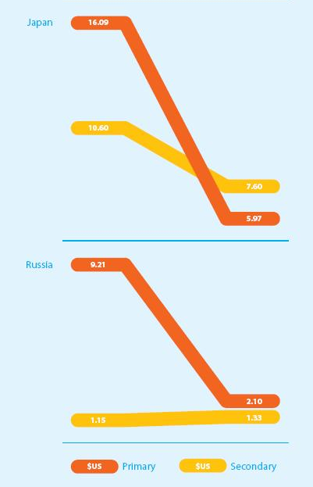
Cost of One Hour of Internet Access: Global Cities v. Regional Centres
Notes:
*Everything in Dollars
The urban digital divide between primary and secondary cities is closing, but in different patterns around the world. Today, in Brazil, India, and Indonesia the cost of internet access in primary cities is about the same as in secondary cities. The cost of access has also dropped in Russia cities, Japanese cities, and China’s secondary cities. But in China, Japan, and Russia there is still a digital divide between primary and secondary cities.
Source :
http://www.wiaproject.org/index.php/52/the-urban-digital-divide-i-global-cities-v-regional-centers-2

Slide 24
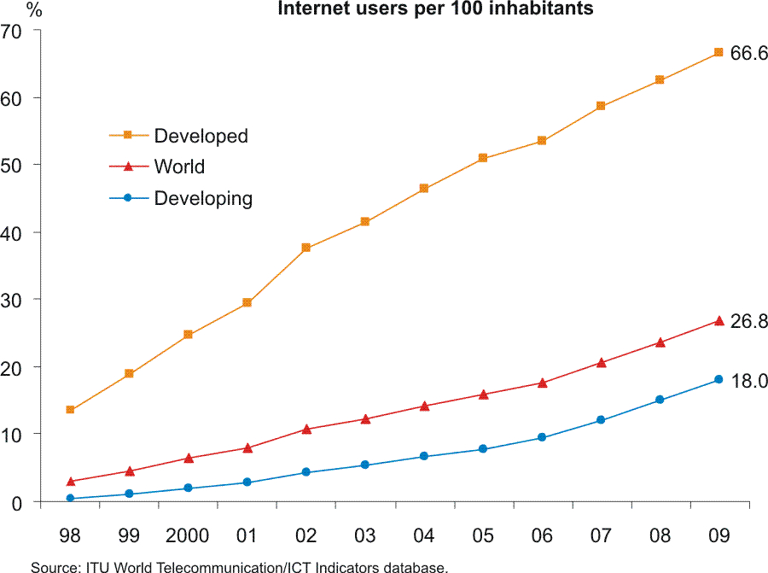
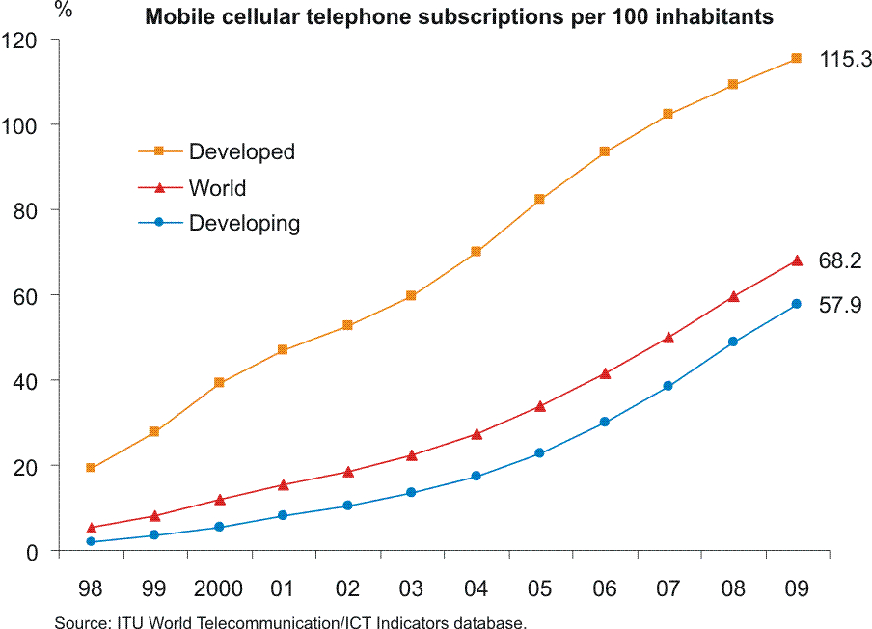
Digital Divide – Comparison
Developed vs Non-Developed
From the following two charts, we can see that while the adoption of ICT has been on the rise, the number of users from the developing nations still falls below the world average.
Notes:
*ICT = Information and Communications Technology
From the following two charts, we can see that while the adoption of ICT has been on the rise, the number of users from the developing nations still falls below the world average.
Furthermore this gap, or divide between that of the developed nations and that of the developing nations is very wide which can be seen clearly .
Even within the individual countries themselves, there is a disparity among certain groups in the society in their access to ICT.
For example, even in developed countries there is a Digital Divide among the older and the younger generation, which we will discuss in further detail under the topic of the Age Divide.
Source :
Servon, L.J. and Pinkett, R.D. (2004) Narrowing the Digital Divide: the potential and limits of the US community technology movement in Castells, M. (ed) The Network Society: a cross cultural perspective, Cheltenham: Edward Elgar Publishing Limited, pp. 319-323 ISBN 1843765055
One of the more evident constraints for the adoption and development of ICTs is financial restrictions. The countries that suffer the most financial hardships are Third World countries. Hence, there is a significant digital divide between the developed countries and the developing countries.
The access to technological and scientific information doesn't just give a nation power, but it allows that nation to educate its people. The digital divide is what makes these possibilities inaccessible to the Third World countries. If they are unable to attain the technology then they are unable to access the information and this places these developing nations at a major disadvantage (Spencer, 2004).
Source : Spencer, C (2004) “Information Technology: Third World: Impact: Media", Global Issues of the Twenty-First Century & United Nations Challenges, viewed 29/10/2010, http://www.global-challenges.org/35it-thirdworld.html

Slide 25
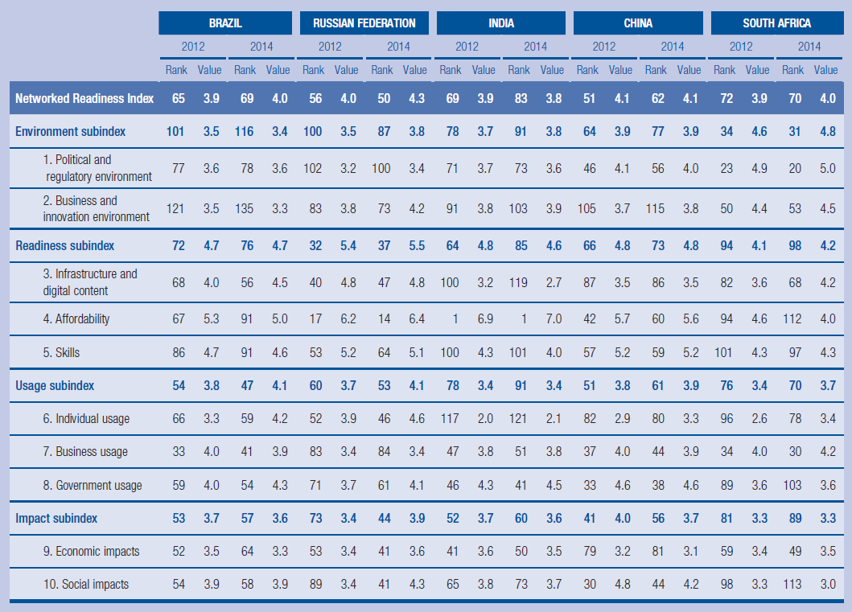
Development Data Comparison BRICS
Notes:
Source :
http://reports.weforum.org/global-information-technology-report-2014/

Slide 26
Poverty & Poor Infrastructure
Reasons
Rurality
Corruption & Bureaucracy
Educational Exposure & Technical Support
Illiteracy
Notes:
A few determinants of digital divide have been determined.
Poverty & Poor Infrastructure
Poverty is the core factor in the digital divide (Tiene, n.d.). In a world where the rich get richer and the poor get poorer, the developing countries certainly are not able to acquire sufficient funding to purchase the telecommunication infrastructure and equipment. Instead, they are more concerned with health care and the other social infrastructure such as water and electricity. Subsequently, the underdeveloped telecommunication infrastructure has limited their ICT availability and thus information-deprived.
Corruption & Bureaucracy
According to a survey carried out by the Global Information Infrastructure Commission on individuals around the world from private sector, it shows that an inefficient and corrupt bureaucracy can impede and deviate away much needed funds for bridging digital divide. Lack of government regulations and proper surveillance are so discouraging that they can be deterrence to potential funders and investors. These combined circumstances make the telecommunications environments so restrictive and stagnant that reformation is difficult to be materialized (Tiene, n.d.).
Educational Exposure & Technical Support
Providing education in ICT is a big hindrance because ICT is expensive and fund-exhausting. With the infrastructure already in a poor state, surges in electrical lines can damage hardware and or low bandwidth connection limits the Internet access very much. Usually, school budgets are overall quite restraining and getting funding for instructional technology is challenging. Thus, they usually purchase used equipment or rely on donated hardware that have low functionality.
In addition, lack of technical support to install the systems and repair the equipment can be problematic and troublesome. Especially with the deficiency of technical expertise, school teachers are often without guidance and little experience with technology as to how to utilize the existing equipment and integrate into the curriculum. Therefore, students are not able to receive sufficient technological skills.
Rurality
As urban centres are progressively building high-speed broadband networks, many rural and remote areas are neglected because the cost and difficulty associated with wiring the rural locations are often expensive and prohibitive.
Illiteracy
Able to access to technology and content are insufficient. With ability to access to internet, the individual need to know minimally
1)How to apply the technology 2)How to search and retrieve relevant information via the Web 3)Process the information in order to answer their information problem
In short, individuals should not only have the accessibility to the Internet, but the knowledge to utilize the Internet (Bertot, 2003). For example, literacy problem in Bangladesh has brought crisis of skilled computer user. They do not have the adequate knowledge to employ the information in the net which is designed in advance technology. In addition, the less educated community are not very computer friendly (Akbar, n.d.).
Source : http://wiki.nus.edu.sg/display/IS1103TP/Factors+behind+Global+Digital+Divide
References
Drew Tiene (n.d.). Addressing the Global Digital Divide and Its Impact on Educational Opportunity. Retrieved from http://english112ubc.pbworks.com/f/divide.pdf
John Carlo Bertot(2003). The Multiple Dimensions of the Digital Divide: More than the Technology ‘Haves’ and ‘Have Nots’. Government Information Quarterly. USA. Retrieved from http://www.learning-works.org/moodle/file.php/34/DD_multiple_dimensions_of_the_DD_more_than_the_technology_haveh_and_have_nots.pdf
Md Shahid Uddin Akbar(n.d.). Bridging Digital Divide : Bangladesh Aspect. Retrieved from http://unpan1.un.org/intradoc/groups/public/documents/apcity/unpan005828.pdf
Organisation for Economic Co-operation and Development (2001). Understanding Digital Divide. Retrieved from www.oecd.org

Slide 27
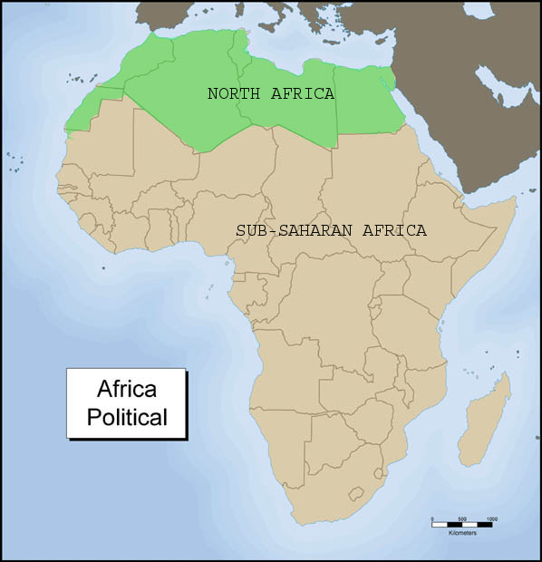
Least Developed Countries - Africa
An Overview of Africa

Slide 28
Least Developed Countries - Africa
Human Development Index of Sub-Saharan Africa: 0.475.
HDI is based on life expectancy, education and income of average citizens.
Note the inner divide within the continent.
Notes:
As we can imagine, the digital divide (Access to and usage of technology) in developing countries is different and more difficult to tackle.
The situation is, of course, conditioned by the country’s poverty.
Sub-saharian africa mean human development index is 0.475 as of 2013. Which would be in the “low” category. In this category there are 45 countries, and out of these 80% are African.
Image1: http://exploringafrica.matrix.msu.edu/images/subsaharan.jpg
Image2: http://upload.wikimedia.org/wikipedia/commons/thumb/0/0b/UN_Human_Development_Report_2013.svg/863px-UN_Human_Development_Report_2013.svg.png

Slide 29
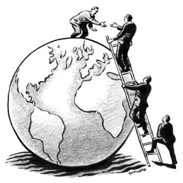
Washington Consensus
“Washington Consensus” was a phrase coined by John Williamson in 1990 to refer to policy advice being offered by the Washington-based institutions to Latin American countries as of 1989”.
Based on Neoliberalism
Free tarde
Privatisation
De-regularization
Liberalisation of foreign investment
Investment in basic healthcare, education and infrastructure.
Notes:
To address the problem, for a while in the 80s and 90s the objective was the deregularisation and privatization of the telecommunications sector, to let the industry develop freely. suggested by the Washington Consensus “a set of economic policies of institutions like the World Bank and the International Monetary Funds. Western institutions such as the World Bank demand such measures as a condition for providing loans and credits to developing countries.
Did this work? Well… kind of, a little, not really.
Image: http://si.wsj.net/public/resources/images/OB-DC623_erlamy_DV_20090210175107.jpg

Slide 30
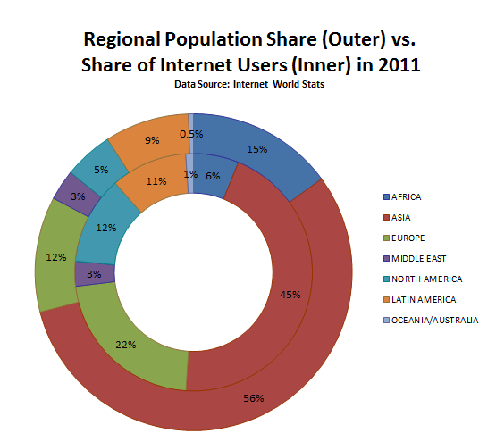
‘‘The implementation of privatization and deregulation in Africa has produced very weak results compared to Latin America and South East Asia in terms of growth of service provision of telecommunication services’’ (Stovring, 2004, p. 12).
Notes:
This approach was actually quite successful in other developing regions but have not succeeded in bridging the digital divide in Africa nearly as much.
‘‘The implementation of privatization and deregulation in Africa has produced very weak results compared to Latin America and South East Asia in terms of growth of service provision of telecommunication services’’ (Stovring, 2004, p. 12).
Stovring, J., 2004. ‘The Washington Consensus’ in relation to the telecommunication sector in African developing countries. Telematics and Informatics 21 (1), 11–24.

Slide 31
The country can provide
The people can access/afford
The people know how to use
Using Nigeria and Kenya as examples, the 2002 average cost of using a local dial-up Internet account for 20h per month is about $60 (including usage fee and local call time but excluding telephone line rental).
In Kenya 67% of the population lives on under $2 per day.
In Nigeria it’s 84%.
Notes:
The reason why these measures do not automatically close the divide is because of the poverty and social problems that hider the –peoples’- Access to technology. As I said before, there is a sequence of issues, what the country can provide and what the people can buy and then what the people have skills to use. The problem now is the second stage.
The costs of internet in Kenya and Nigeria for example are a good indicator of the vastness of this, they are more expensive than in some developed countries!
The mid-2002 average cost of using a local dial-up Internet account for 20 h per month is about $60 (including usage fee and local call time but excluding telephone line rental). In the US, the average cost is less than this cost including telephone charges’’ (Oyelaran-Oyeyinka and Nyaki Adeya, 2004, p. 71).
And meanwhile, 60$ per month of 30 days would mean 2$ per day. In Nigeria 84% of people live on under2$/Day (source,Wikipedia->worldbank) 67.21% in Kenya.
The existence of phone lines, mobile lines, and Internet connections does not mean that low and medium income classes can afford access.

Slide 32
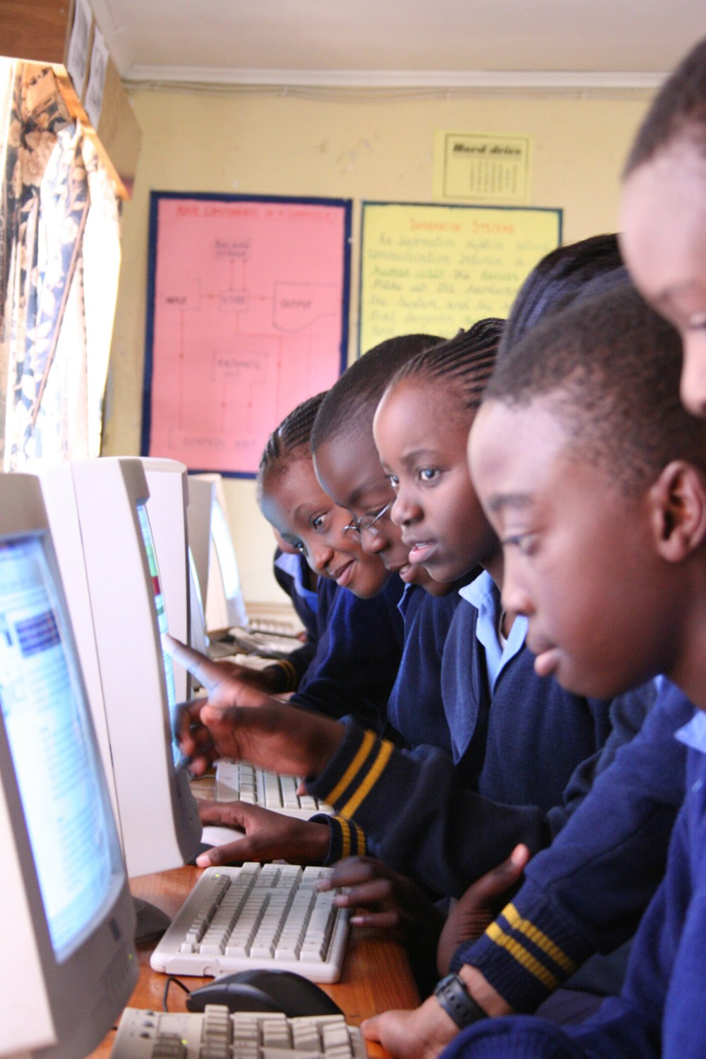
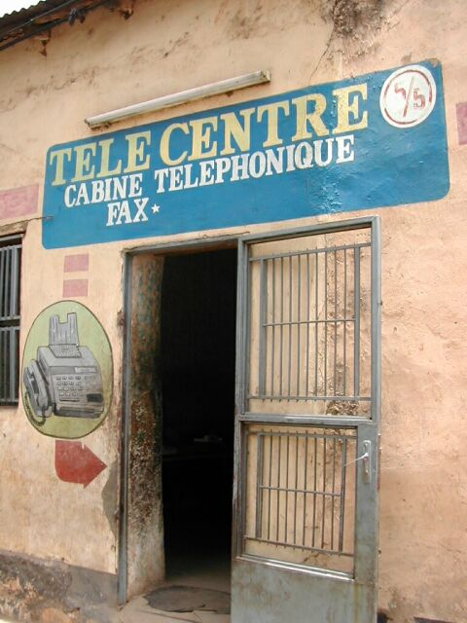
Telecommunication And PerCapita
Telecentres are one of the elements that reduce the digital divide in countries like this, where the widespread use of personal computers is yet a too ambitious goal.
They evidence another divide, the capital city VS the rest of the country.
Notes:
Many countries have tele-centres offer a low cost opportunity to phone or Internet connection. One tele-centre might include some telephones, a photocopier, and one or two computers. It is characteristic of developing countries the accumulation of most the country’s wealth in a single city, the capital. In Ghana, for example, 90% of these were located in Accra.
IMg1; http://souriresdenfants.free.fr/photos/mali/bamako/telecentre.jpg
Img2: http://upload.wikimedia.org/wikipedia/commons/d/d7/Global_Teenager_Project_Zambia.jpg

Slide 33
Digital Divide Between Generations

Slide 34
Digital Divide Between Generations
Facts about Net Generation
93% of those aged 12-17 go online.
63% of teen internet users go online every day.
Almost 75% of teens have social networking profiles.
86% of social network-using teens comment on a friend's wall.
83% comment on friends' pictures.
Over nine out of ten 18-29 year-olds own a cell phone.
95% of cell phone owners aged 18-29 send and receive text messages. 93% also take pictures with their cell phones.
Facts about baby boomers
Only 32% of the baby boomers use the Internet.
8.2% of all social network and blog visitors are over 65.
10% of people aged 60-69 have access to the internet but don’t use it.
Notes:
For those of you who didn’t know this, our (people born between 80s and 2000) generation is conveniently called the Net Generation. We were lucky enough to be born on the verge of digital technology and develop together with it. Therefore, as we can see from the facts digital technology has become extremely important in our day-to-day lives.

Slide 35
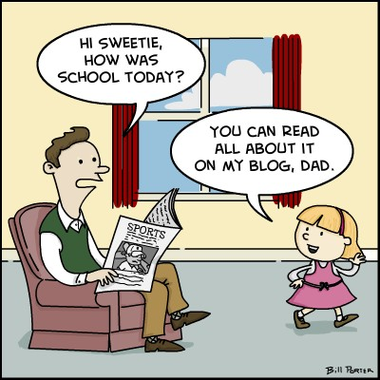
Digital Divide between generations
Notes:
The way we think is influenced by the appearance of technology as well. On the other hand, we can clearly state that Net Generation has influenced the way modern technology applications are designed, so that now even young children can easily use them without any problems. Unfortunately this has led to a consequence; Net Generation has become bounded with the technology so much, that product developers no longer care very much about the elderly and design their new applications and technologies to be used mainly by the youth.

Slide 36
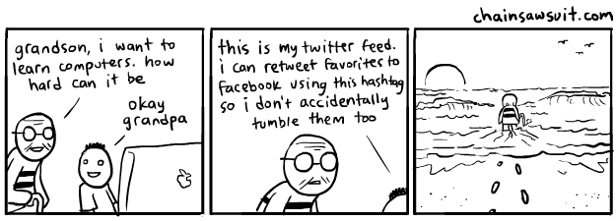
Digital Divide Between Generations
Notes:
That is one of the reasons why the digital gap between Net Generation and previous generations is widening. And subject to this, elder generations often do not see the benefits that technologies can provide, and therefore, are not keen on learning to use it. However, some of the baby boomers to stay relevant at work and connected with their families use technologies often and once learned, elderly can perform similarly to the youth.

Slide 37
What is being done to reduce digital divide
LEDCS
Close the Gap
“An international non-profit organisation that aims to bridge the digital divide by offering high-quality, pre-owned computers donated by large and medium-sized corporations or public organisations to educational, medical, entrepreneurial and social projects in developing and emerging countries. All the projects are demand-driven and share the common denominator of being non-profit-oriented initiatives.”
Notes:
They collect high-quality used IT equipment from donor companies and organisations then refurbish the equipment. Transport the equipment to projects and help install maintain and train people to use the equipment.
>275,000 computer assets donated.
280 donor companies
2500 organisations supported worldwide
40 countries
Picture source: http://www.close-the-gap.org/wp-content/uploads/2012/04/Sokoine-University-of-Agriculture-Morogo-Tanzania-2-1024x681.jpg

Slide 38
One Laptop Per Child
“We aim to provide each child with a rugged, low-cost, low-power, connected laptop. To this end, we have designed hardware, content and software for collaborative, joyful, and self-empowered learning. With access to this type of tool, children are engaged in their own education, and learn, share, and create together. They become connected to each other, to the world and to a brighter future.”
Notes:
Picture Source: http://tctechcrunch2011.files.wordpress.com/2008/01/olpc_xo_laptop.jpg

Slide 39
Modern Britain
Governmental Policy
Investing £530 million to stimulate commercial investment and bring high speed broadband to rural communities reaching 90% of UK homes and businesses
Investing a further £250 million to extend the benefits of superfast broadband to 95% of the UK and exploring approaches to deliver superfast broadband to the remaining hardest to reach areas, initially through a new £10 million competitive fund
Investing £150 million in ‘super-connected cities’ across the UK
Removing red tape to make it easier to put in broadband infrastructure
Notes:
Not economically viable for private sector companies to invest in infrastructure for the most rural areas, requires governmental assistance
The participating super-connected cities are:
Birmingham, Bristol, Brighton and Hove, Cambridge, Coventry, Derby, Leeds and Bradford (joint proposal), London, Manchester, Newcastle, Oxford, Portsmouth, Salford and York in England;
Aberdeen, Edinburgh and Perth in Scotland;
Cardiff and Newport in Wales;
Belfast and Derry/Londonderry in Northern Ireland.

Slide 40
References and Bibliography
Information:
http://www.gallup.com/poll/113638/nearly-half-americans-frequent-internet-users.aspx
Images:
http://www.rtaautomation.com/bacnet/Images/elderly-people-on-computer%20copy.jpg
https://pbs.twimg.com/profile_images/77875057/IMG_5065.JPG
http://1to10reviews.files.wordpress.com/2007/08/cubicle.jpg
http://forums.everythingicafe.com/data/MetaMirrorCache/i126.photobucket.com_albums_p91_youngbinks_AppleClass_1.jpg

Slide 41
References
BRANDTZAEG, P. HEIM, J. KARAHASANOVIC, A. (2011) Understanding the new digital divide—A typology of Internet users in Europe. International Journal of Human-Computer Studies [Online] Science Direct. Vol. 69, Issue 3, March 2011, Pages 123-138. [Accessed 29/04/2014 13:00]
EGEA, J. MENENDEZ, M. GONZALEZ, M. (2007) Diffusion and usage patterns of Internet services in the European Union. Information Research, Vol. 12 No. 2, January 2007. [Online] Available From: http://www.informationr.net/ir/12-2/paper302.html [Accessed 29/04/2014 13:00]
CHOUDRIE, J. GREY, S. TSITSIANIS, N. (2010) Evaluating the digital divide: the Silver Surfer’s perspective. [Online] Electronic Government, An International Journal, Vol. 7, No. 2, 2010. [Accessed Online 29/04/2014 13:00]
OFCOM. (2013) UK Fixed Broadband Map 2013. [Online] Available from: http://maps.ofcom.org.uk/broadband/ [Accessed 29/04/2014 13:00]
Gardner, J. & Oswald, A. (2001). Internet use: the digital divide. In A.Park, J.Curtice, K.Thomson, L.Jarvis, C.Bottomley & N.Stratford (Eds.), British Social Attitudes: the 18th Report: Public Policy, Social Ties (pp. 159–173). London : Sage
Bibliography:
Margetts, H., & Yared, H. (2003) Incentivization of e-government. In: Transforming performance of HM Customs and Excise through electronic service delivery. National Audit Office Report by the Comptroller and Auditor General, HC 1267 Session 2002-2003, 20 Nov. [Accessed Online 29/04/2014 13:00]
LOPEZ, A. VICENTE, M. (2011) Assessing the regional digital divide across the European Union-27. Telecommunications Policy. [Online] Science Direct Vol. 35, Issue 3, April 2011, Pages 220-237 Available from: http://www.sciencedirect.com/science/article/pii/S0308596110001527 [Accessed 23/04/2014 13:00]

Slide 42
References
United Nations Human Development Report (UNHDR), 2013. UNHDP 2013, United Nations Development Programme (UNDP), New York. Available at: http://hdr.undp.org/sites/default/files/reports/14/hdr2013_en_complete.pdf [Last accessed 13 April 2014].
Fuchs, C. & Horak, E., 2008. Africa and the digital divide. Telematics and Informatics, 25(2), pp.99–116. Available at: http://linkinghub.elsevier.com/retrieve/pii/S0736585306000359 [Last accessed 12 April 2014].
Williamson, John. “What Should the World Bank Think About the Washington Consensus?” World Bank Research Observer. Washington, DC: The International Bank for Reconstruction and Development, Vol. 15, No. 2 (August 2000), pp. 251-264. Available at http://www.iie.com/publications/papers/paper.cfm?ResearchID=351 [Last accessed 13 April 2014].

Slide 43
References
Harris, S. (2011). How seniors use social media. [Online] Available from: http://www.webmasterview.com/2011/12/how-seniors-use-social-media/ [Accessed Online 29/04/2014]
Holmes, L. (2012). Digital Divide between generations. [Online] Available from: http://digitaldivide2012.wordpress.com/2012/03/02/digital-divide-between-generations-by-lauren-holmes-2/ [Accessed Online 29/04/2014]
PETRUSA, J. (2010, August). 26 facts about millennials online social and mobile behaviors. [Online] Available from: http://itsjosipnotjoseph.com/2010/08/26-facts-about-millennials-online-social-and-mobile-behaviors/ [Accessed Online 29/04/2014]
IndependentAge. (2010). Older people, technology and community. [Online] Available from: http://www.cisco.com/web/about/ac79/docs/wp/ps/Report.pdf [Accessed Online 29/04/2014]
Taylor, T. (2010). 30 Statistics about Teens and Social Networking. [Online] Available from: http://facebook-parental-controls-review.toptenreviews.com/30-statistics-about-teens-and-social-networking.html [Accessed Online 29/04/2014]
Bibliography
Paul, G., Stegbauer, C. (2005). Is the digital divide between young and elderly people increasing? [Online] Available from: http://firstmonday.org/ojs/index.php/fm/article/view/1286/1206 [Accessed Online 29/04/2014]

Slide 44
References
http://www.close-the-gap.org/
one.laptop.org
Stimulating private sector investment to achieve a transformation in broadband in the UK by 2015, Department of Culture Media and Sport 2013. Available at https://www.gov.uk/government/policies/transforming-uk-broadband [last accessed 28 April 2014].

