Slide 1
Computer Ethics Professional bodies and accreditation Group R

Slide 2
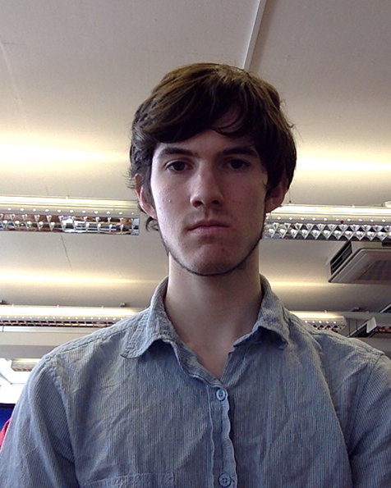
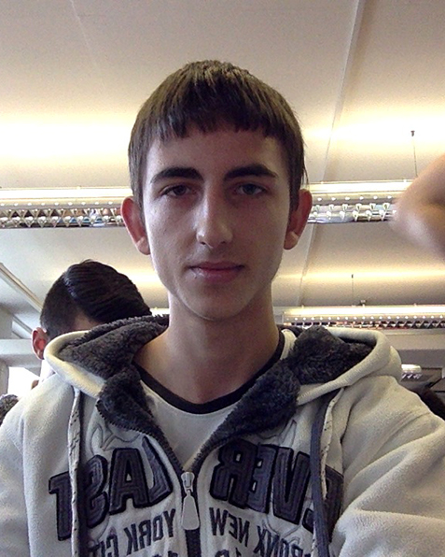
Adam Noakes
Adrian Manduc
Freddie Nash
Jianzu Guan
Anko Anchev
Dominic Smith
Bogomil Gospodinov

Slide 3
Ethics of Artificial Intelligence

Slide 4
Definition of Ethics
What is Ethics ?
- systematic conceptualization of right and wrong behaviour ^{[3]}
A more broad definition. ^{[1][3]}
Division of ethical theories ^{[2]}
Metaethics
Normative ethics
Applied ethics

Slide 5
Subfields of Ethics in Technology
Ethics of Artificial Intelligence
Roboethics - regulation and definition of proper, safe and ethical human design, construction and use of artificially intelligent beings ^{[5]}
Machine Ethics / Machine Morality / Computational Ethics – “giving machines [the idea of] ethical principles” and hardwiring into them “ethical decision making” functionality ^{[9]}

Slide 6
Roboethics – a human-centered ethics
Why Roboethics is considered important? – the reasons behind the concept ^{[7]}
How Roboethics was conceived? – notable events, scientists and documents ^{[5][7]}
What is Roboethics generally discussing? ^{[7]}
What are the important questions in the field? ^{[7]}

Slide 7
Machine ethics – the problem of machine autonomy
Why is Machine ethics important? ^{[9]}
What is Machine ethics all about? ^{[9]}
What is an Artificial Software Agent? ^{[10]}
What is an Artificial Moral Agent? ^{[10]}

Slide 8
Computer Ethics Institute (CEI)

Slide 9
CEI
Founded in 1985
Founders from IBM and The Brookings Institution
Mission: to facilitate the examination and recognition of ethics in the development and use of computer technologies.
Created the Ten Commandments of Computer Ethics

Slide 10
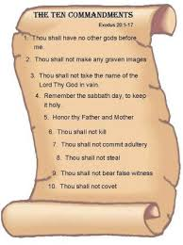
Ten Commandments
Created in 1992 by CEI
“a set of standards to guide and instruct people in the ethical use of computers” ^{[12]}
Received criticism for being “simplistic” and “overly restrictive” ^{[13]}

Slide 11
Ten Commandments
Thou shalt not use a computer to harm other people.
Thou shalt not interfere with other people's computer work.
Thou shalt not snoop around in other people's computer files.
Thou shalt not use a computer to steal.
Thou shalt not use a computer to bear false witness.

Slide 12
Ten Commandments
Thou shalt not copy or use proprietary software for which you have not paid.
Thou shalt not use other people's computer resources without authorization or proper compensation.
Thou shalt not appropriate other people's intellectual output.
Thou shalt think about the social consequences of the program you are writing or the system you are designing.
Thou shalt always use a computer in ways that ensure consideration and respect for your fellow humans.

Slide 13
Criticism of Ten Commandments
Most notably by Dr Ben Fairweather (De Montfort University) ^{[13]}
Thou shalt not use a computer to harm other people… What about animals?
Thou shalt not snoop around in other people's computer files… What about if it were to prevent terrorism?

Slide 14
Legal issues
Why you should know about legal issues?

Slide 15
Basic awareness of legal issue
Communications Act 2003 section 127
Malicious Communications Act 1988 section 1
Computer Misuse Act 1990
Data Protection Act 1998
Copyright design and patents Act 1988
Equalities Act 2010
Notes:
Communications Act 2003 section 127
http://www.legislation.gov.uk/ukpga/2003/21/section/127
Malicious Communications Act 1988 section 1
http://www.legislation.gov.uk/ukpga/1988/27/section/1
Computer Misuse Act 1990
http://www.legislation.gov.uk/ukpga/1990/18/contents
Data Protection Act 1998
http://www.legislation.gov.uk/ukpga/1998/29/contents
Copyright design and patents Act 1988
http://www.legislation.gov.uk/ukpga/1988/48/contents
Equalities Act 2010
http://www.legislation.gov.uk/ukpga/2010/15/contents

Slide 16
Basic awareness of legal issue
Defamation Act 1996
Digital economy act 2010
Electronic waste disposal
Health and Safety at Work etc. Act 1974
Harassment protection act 1997

Slide 17
Consequences
There can be consequences of breaching of these acts
If copyright is genuinely inadvertently infringed and infringement is detected, what can the infringer do to reduce the penalties?
Notes:
http://www.caret.cam.ac.uk/copyright/Page148.html

Slide 18
Professional Bodies

Slide 19
What Is A Professional Body?
“A group of people in a learned occupation who are entrusted with maintaining control or oversight of the legitimate practice of the occupation.” Wikipedia
“Organisations that set the benchmark standards for, and regulate the standards of entry into, particular profession(s) and are authorised to accredit, approve or recognise specific programmes leading to the relevant professional qualification(s) - for which they may have a statutory or regulatory responsibility.” QAA

Slide 20
What does this mean?
Determining who is officially of a certain profession.
These bodies are generally seen to be responsible for safe guarding the public.
Representing its members’ interests.
These bodies can act as a society for the profession it is representing.

Slide 21
Some professional bodies

Slide 22
Some Relevant Bodies

Slide 23
British computer society
Association for Computing Machinery
Institute of Electrical and Electronics Engineers
The Institution of Engineering and Technology

Slide 24
British Computer Society
Founded in 1957
Has at least 75,000 members
These members come from roughly 100 different countries
40 local branches across the country with offices in London, Swindon and Sri Lanka

Slide 25
What Do The BCS Do?
What they say they do
“We bring together industry, academics, practitioners and government to share knowledge, promote new thinking, influence the development of computing education, shape public policy and inform the public.”
- BCS Website 2014

Slide 26
Beyond the marketing
Have the ability to award professional qualifications (more on this later)
Provide accreditation to over 6000 courses to ensure courses are of the required standard
Giving IT practitioners across the country support by sharing best learning/working practices across industries and organisations
Promoting the IT profession

Slide 27
Educational Benefits
Access to 300 online technology, creative and business books.
9,000 journals and IT related articles

Slide 28
Social Benefits
Specialist Group Meetings
Local branch meetings
Specialist Talks and Discussions

Slide 29
Career Benefits
Access to the BCS Recruit
Post Nominals
“Continuing Professional Development”

Slide 30
Financial cost
There are financial costs to being a member of the BCS. Ranging from £32 per-year for student membership all the way up to £203 per-year depending on level of membership.

Slide 31
Non-Essential
Unlike other professions such as Law and Medicine, you are not required to be a ‘professional’ and member of the BCS to work in the Computing industry.
Many people argue that being chartered or a professional in the IT industry has little impact on your career.

Slide 32
Criticisms
The role professional bodies have to play in higher education in under increasing review. [1]
There is an ongoing need for higher education establishments to define the role professional bodies have to play.
Notes:
There are inconsistencies with the roles these professional bodies, including the British Computer Society have within the HE sector. This is because different professional bodies function in different ways and some are more hands on with their roles, others are not as hands on. This leads to people have differing experiences with PBs and thus forming different opinions on their effectiveness.

Slide 33
BCS Code of Conduct

Slide 34
BCS Code of Conduct
Maintained by the BCS Ethics Group ^{[14]}
Expected to be upheld by all BCS Membership holders ^{[14]} ^{[15]}
BCS Members are expected to report violations to the BCS ^{[15]}

Slide 35
BCS Code of Conduct
Public Interest
Equality
Wellbeing
Security
Privacy
Professional Competence and Integrity
Integrity
Accurate Representation
Fair Practice
Duty to Relevant Authority
Legal Practice
Responsibility
Accountability
Duty to the Profession
Reputable Conduct

Slide 36
BCS Accredited Courses
Provide a solid basis to support a future career with information technologies ^{[16]}
Completion indicates a wider appreciation for the profession ^{[16]}
Allows application for Chartered Registrations ^{[16]}
Chartered IT Professional
Charted Engineer
Incorporated Engineer
Chartered Scientist

Slide 37
Chartered Registrations
Difficult to attain ^{[17]}
Considered a label of excellence in the profession ^{[17]}
Attractive to potential employers ^{[18]}
Represents a commitment to ethical practice ^{[14]} ^{[17]}
Require frequent revalidation to hold certificate of current competence ^{[17] [19]}
Active role in the industry
Continued Professional Development

Slide 38
Other organisations
Differences in benefits gained
Differences in expectations

Slide 39
References
[1] Paul, R & Elder, L 2006, The Miniature Guide to Understanding the Foundations of Ethical Reasoning. , Foundation for Critical Thinking Free Press, United States. ISBN 0-944583-17-2
[2] The Internet Encyclopedia of Philosophy (IEP) 2014, Ethics, viewed 29 April 2014, http://www.iep.utm.edu/ethics/
[3] Washington Ethical Society (WES) 2014, What does “ethics” mean?, viewed 29 April 2014, http://www.ethicalsociety.org/article/19/
[4] Luppicini, R & Adell, R, ed. (2008). Handbook of Research on Technoethics. Hershey: Idea Group Publishing.
[5] Veruggio, G 2007, The Roboethics Roadmap. Scuola di Robotica. p. 2. Reviewed 28 April 2014, http://ethicbots.na.infn.it/meetings/kom/veruggio.pdf , http://ieeexplore.ieee.org/xpl/login.jsp?tp=&arnumber=4115667&url=http%3A%2F%2Fieeexplore.ieee.org%2Fxpls%2Fabs_all.jsp%3Farnumber%3D4115667
[6] Veruggio, G & Operto F ‘Roboethics: Social and Ethical Implications of Robotics’, in Springer Handbook of Robotics, e-book, SpringerLink, viewed 29 April 2014, pp. 1499-1524, http://link.springer.com/referenceworkentry/10.1007%2F978-3-540-30301-5_65#page-1

Slide 40
References
[7] Veruggio, G 2005, ‘The Birth of Roboetics ‘ in ICRA 2005, IEEE International Conference on Robotics and Automation Workshop on Robo-Ethics, 18 April, Barcelona, Scuola di Robotica, Genova. http://www.roboethics.org/icra2005/veruggio.pdf
[8] Veruggio, G & Operto, F 2006, ‘Roboethics: A Bottom-Up Interdisciplinary Discourse in the Field in Applied Ethics in Robotics’, International Review of Information Ethics: Ethics in Robotics, vol. 6, pp.2-8, viewed 29 April 2014, http://www.i-r-i-e.net/inhalt/006/006_full.pdf#page=4
[9] Anderson, M & Anderson, SL, eds. (July 2011). Machine Ethics. Cambridge University Press. ISBN 978-0-521-11235-2.
[10] Nagenborg, M 2007, ‘Artificial moral agents: an intercultural perspective’, International Review of Information Ethics, vol. 7, viewed 29 April 2014, http://www.i-r-i-e.net/inhalt/007/13-nagenborg.pdf
[11] Wallach, W & Allen, C 2008, Moral Machines: Teaching Robots Right from Wrong. USA: Oxford University Press. ISBN 978-0-19-537404-9.
[12] Barquin, Ramon C. (May 7, 1992). "In pursuit of 'Ten Commandments' for Computer Ethics". Computer Ethics Institute. Retrieved 2013-08-17.
[13] CCSR:Commentary on the 'Ten Commandments for Computer Ethics‘

Slide 41
References
[14] Ethics Group (BCS 2015), http://www.bcs.org/category/8620 (access 2014-05-02)
[15] Code of Conduct (BCS 2014), http://www.bcs.org/category/6030 (accessed 2014-05-02)
[16] Academic Accreditation (BCS 2014), http://www.bcs.org/category/5844 (accessed 2014-05-02)
[17] Chartered IT Professional Status (BCS 2014), http://www.bcs.org/category/10972 (accessed 2014-05-02)
[18] Employers value professional standards (BCS 2013-06-21), http://www.bcs.org/content/ConWebDoc/50833 (accessed 2014-05-02)
[19] Revalidation (BCS 2014), http://www.bcs.org/category/17167 (accessed 2014-05-02)

