Slide 1
Rights and Equality in the Workplace
13th May 2014
Notes:
Background photo © John Blower
https://flic.kr/p/aUpo8B
Slide design, template and formatting by George Cooper

Slide 2
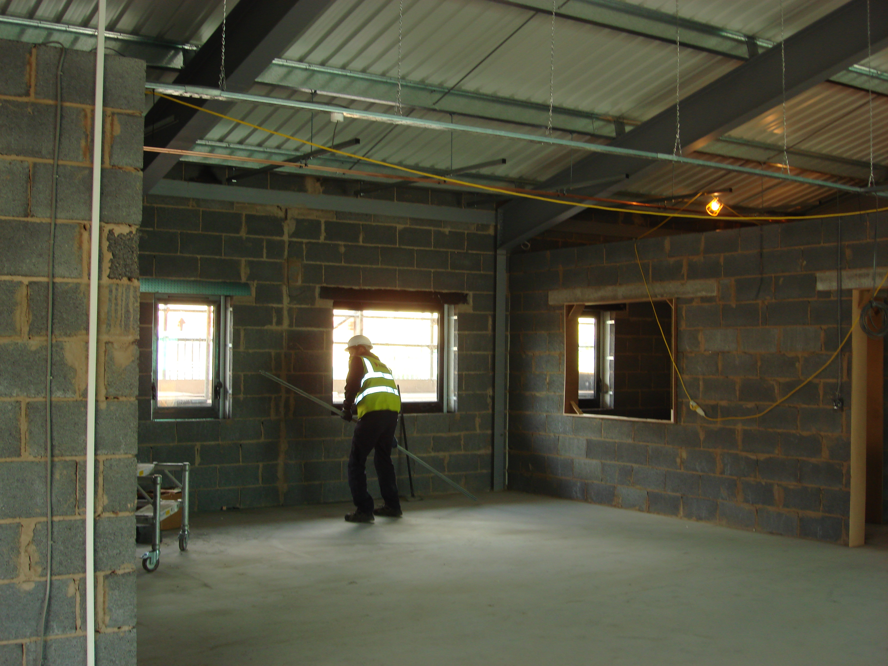
Introduction
George Cooper
Notes:
Background photo © John Blower
https://flic.kr/p/aUpo8B

Slide 3
Outline
Equality
Labour law
Employment law
Trade unions
Health and Safety
Notes:
Photo by ‘Epic Fireworks’
https://flic.kr/p/7ZqW2p

Slide 4
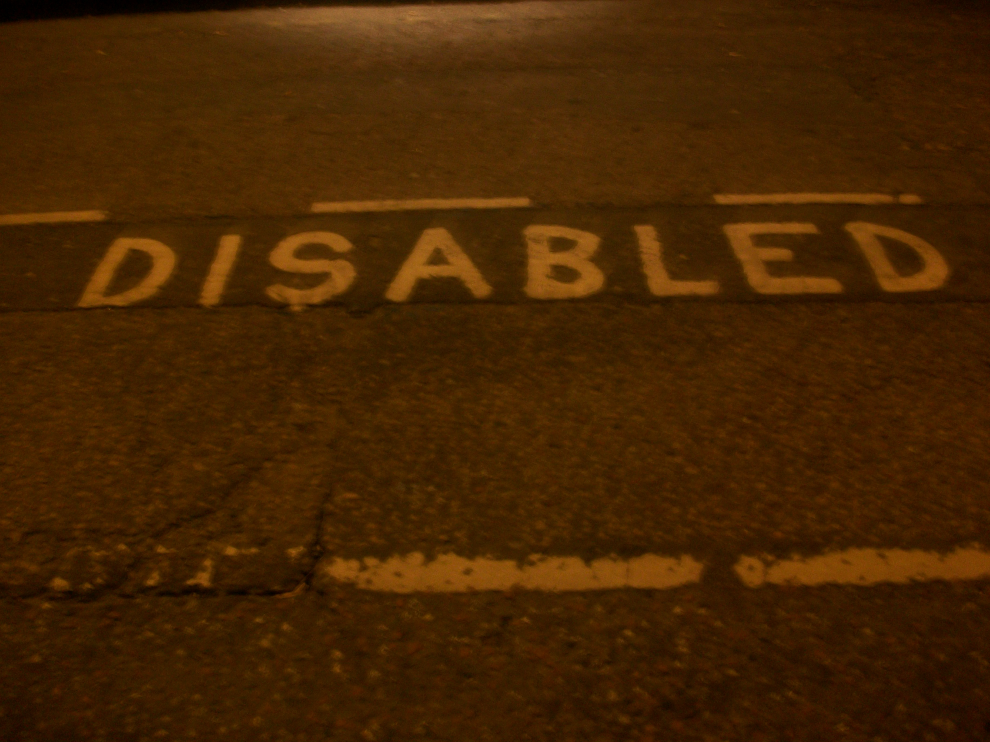
Equality
Rachael Day
Notes:
Background photo © Darius Norvilas
https://flic.kr/p/6Db471

Slide 5
Equality
“The Equality Act 2010 legally protects people from discrimination in the workplace and in wider society” [1]
Types of illegal discrimination [2]:
Sex
Race
Age
Religion
Disability
Notes:
Background photo © Darius Norvilas
https://flic.kr/p/6Db471

Slide 6
Forms of discrimination [3]
Direct
Treating someone less favourably because of gender, age, sexual preference etc.
Indirect
Policy applies to all workers but disadvantages some
Notes:
Background photo © Darius Norvilas
https://flic.kr/p/6Db471

Slide 7
Forms of discrimination
Harassment
Unwanted behaviour caused by discrimination creating an unpleasant environment
Victimisation
Unfair treatment who has complained about any of the above
Notes:
Background photo © Darius Norvilas
https://flic.kr/p/6Db471

Slide 8
Rights [4]
Laws protect workers regarding:
Termination
Employment Terms & Conditions
Pay and benefits
Promotion opportunities
Training
Recruitment
Redundancy
Notes:
Background photo © Darius Norvilas
https://flic.kr/p/6Db471

Slide 9
Disabled Workers
Have the same rights
Employers should make ‘reasonable adjustments’ to accommodate special requirements
Eg Braille formats
Notes:
Background photo © Darius Norvilas
https://flic.kr/p/6Db471

Slide 10
Action [5]
If an employee feels they have been discriminated against they should:
Complain directly to the party in question
Use an intermediate party to help (mediation)
Make a claim in court.
Notes:
Photo by ‘Epic Fireworks’
https://flic.kr/p/7ZqW2p

Slide 11
Labour Law
Conor Keegan
Notes:
Photo by ‘Alan Cleaver’
https://www.flickr.com/photos/alancleaver/4320245924

Slide 12
Labour Law
Laid out by the Working Time Regulations
1998
Working time restrictions
Minimum wage
Notes:
Photo by ‘Alan Cleaver’
https://www.flickr.com/photos/alancleaver/4320245924

Slide 13
Working Time [6]
Maximum 48 hours per week
Can be opted out of
not for Self Employed
11 consecutive hours rest per 24 hours
20 minute break minimum per 6 hours
28 days paid holiday per year
This includes public holidays
Notes:
Photo by ‘Alan Cleaver’
https://www.flickr.com/photos/alancleaver/4320245924

Slide 14
Minimum Wage [7]
Laid out by national minimum wage act
1998
If not finished compulsory education, there is no entitlement to Minimum Wage
Fluctuates every year in response to inflation
Notes:
Photo by ‘Alan Cleaver’
https://www.flickr.com/photos/alancleaver/4320245924

Slide 15
Minimum Wage [7]
£6.32
Age 21+
Wages per hour (2014)
Notes:
Photo by ‘Alan Cleaver’
https://www.flickr.com/photos/alancleaver/4320245924

Slide 16
Minimum Wage [7]
£5.03
Age 18-20
Wages per hour (2014)
Notes:
Photo by ‘Alan Cleaver’
https://www.flickr.com/photos/alancleaver/4320245924

Slide 17
Minimum Wage [7]
£3.72
Age under 18
Wages per hour (2014)
Notes:
Photo by ‘Alan Cleaver’
https://www.flickr.com/photos/alancleaver/4320245924

Slide 18
Minimum Wage [7]
Up to age 19 or
19+ in first year of
apprenticeship
£2.68
Apprentices
Wages per hour (2014)
Notes:
Photo by ‘Alan Cleaver’
https://www.flickr.com/photos/alancleaver/4320245924

Slide 19
Contracts
Terms of employment and required work
Signed by an employee at the time of hiring
The terms can be changed
reasonable notice is to be given to employee
A contract cannot be breached
by either party
…without a mutual decision being made
all the terms are agreed to in writing
Notes:
Photo by ‘Alan Cleaver’
https://www.flickr.com/photos/alancleaver/4320245924

Slide 20
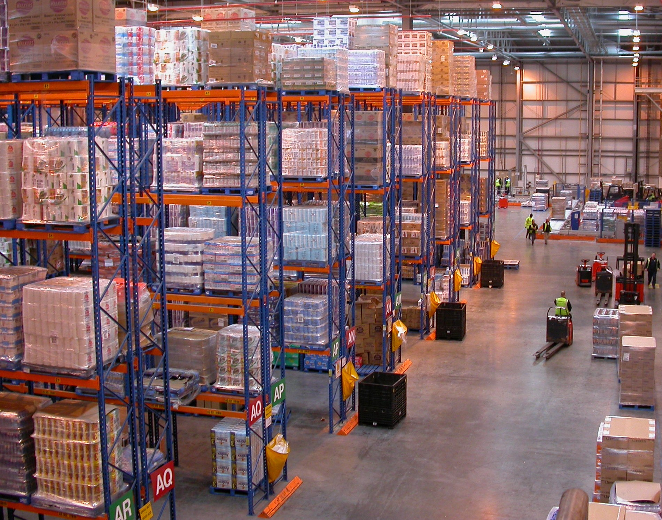
Employment Law
Ioana Maria Tamas
Notes:
Photo by ‘Nick Saltmarsh’
https://www.flickr.com/photos/nsalt/2829985075

Slide 21
Employment Law
Several acts in place
Brought in and reviewed at different times
Notes:
Photo by ‘Nick Saltmarsh’
https://www.flickr.com/photos/nsalt/2829985075

Slide 22
Employment Law
1996
Employment rights act
Notes:
Photo by ‘Nick Saltmarsh’
https://www.flickr.com/photos/nsalt/2829985075

Slide 23
Employment Law
1999
Employment relations act
Notes:
Photo by ‘Nick Saltmarsh’
https://www.flickr.com/photos/nsalt/2829985075

Slide 24
Employment Law
2002
Employment act
Notes:
Photo by ‘Nick Saltmarsh’
https://www.flickr.com/photos/nsalt/2829985075

Slide 25
Employment Law
2008
Employment act
Notes:
Photo by ‘Nick Saltmarsh’
https://www.flickr.com/photos/nsalt/2829985075

Slide 26
Employment Rights Act 1996 [8]
Wages protection
Time off work
Public duties
Looking for work/training
Suspension from work
Maternity/medical grounds
Termination of employment
Notice periods/written reasons for dismissal
Redundancy payments
Notes:
Photo by ‘Nick Saltmarsh’
https://www.flickr.com/photos/nsalt/2829985075

Slide 27
Employment Regulations Act 1999 [9]
Compensation for unfair dismissal
Union recognition
Pay, hours and holiday rights
Rights to representation
Notes:
Photo by ‘Nick Saltmarsh’
https://www.flickr.com/photos/nsalt/2829985075

Slide 28
Employment Act 2002 [10]
Dispute resolution
Employment tribunals reform
Increased maternity/paternity leave
Adoption leave and pay
Right to request flexible working
Notes:
Photo by ‘Nick Saltmarsh’
https://www.flickr.com/photos/nsalt/2829985075

Slide 29
Employment Act 2008 [11]
Compensation for financial loss
Unlawful underpayment / no payment
Extend minimum wages legislation
To Cadet Force
Adult Volunteers
Voluntary workers
Notes:
Photo by ‘Nick Saltmarsh’
https://www.flickr.com/photos/nsalt/2829985075

Slide 30
Dismissal
Notice periods vary for length of employment
Up to one month – no notice
One month to two years – one week
Over two years – one week per year
(maximum of twelve weeks)
Notes:
Photo by ‘Nick Saltmarsh’
https://www.flickr.com/photos/nsalt/2829985075

Slide 31
Fair Reasons
Misconduct
Incapability
Redundancy
Legal requirement
Retirement at age sixty five or above
Notes:
Photo by ‘Nick Saltmarsh’
https://www.flickr.com/photos/nsalt/2829985075

Slide 32
Automatically Unfair Reasons [12]
Pregnancy, parental/adoption leave
Acting as an employee representative
Acting as a trade union representative
Optional pension scheme trustee
Joining/not joining trade union
Becoming part/fixed time employee
Discrimination
Whistleblowing
Notes:
Photo by ‘Nick Saltmarsh’
https://www.flickr.com/photos/nsalt/2829985075

Slide 33
Tribunals [13]
Any UK employer can make claims to an Employment Tribunal
Frequent matters:
Unfair dismissal
Redundancy payments
Discrimination
Notes:
Photo by ‘Nick Saltmarsh’
https://www.flickr.com/photos/nsalt/2829985075

Slide 34
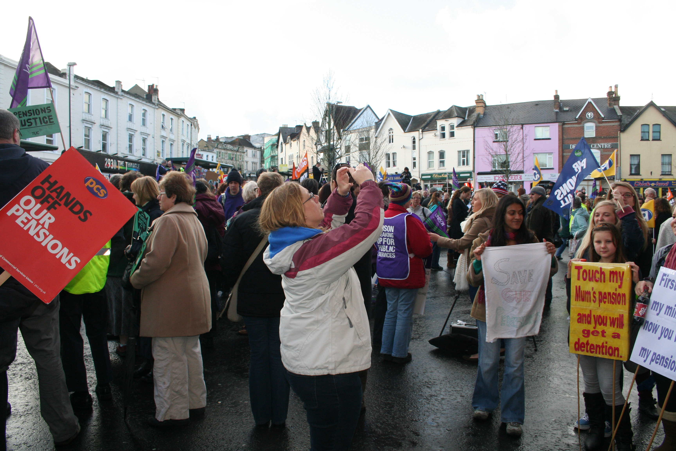
Trade Unions
Vlad Catrici
Notes:
Background photo © ‘waldopepper’
https://flic.kr/p/5oa2e3

Slide 35
Origins
Origins in 18th Century Britain
Many employees began organising themselves in the expansion in the industrial society
This could achieve collective bargaining
Notes:
Photo by ‘Epic Fireworks’
https://flic.kr/p/7ZqW2p

Slide 36
What is a Trade Union?
Organisation of workers
They are united to achieve common goals
Protecting trade integrity
Achieving higher pay and benefits such as healthcare
Safety standards
"an organization consisting predominantly of employees, the principal activities of which include the negotiation of rates of pay and conditions of employment for its members.“ [14]
Notes:
Photo by ‘Epic Fireworks’
https://flic.kr/p/7ZqW2p

Slide 37
Example of action
Lecturer strikes
31st October 2013 UNISON and Unite organised a Higher Education strike
Staff offered a 1% pay rise
Would have suffered 13% real pay cut since October 2008 [15]
Notes:
Photo by ‘Epic Fireworks’
https://flic.kr/p/7ZqW2p

Slide 38
How do they relate?
Trade unions acknowledge other problems in the workplace such as:
Racism
Sexism
General discrimination
Lack of facilities for impaired employees
They also:
Give Independent advice
Promote equality and fairness
Notes:
Photo by ‘Epic Fireworks’
https://flic.kr/p/7ZqW2p

Slide 39
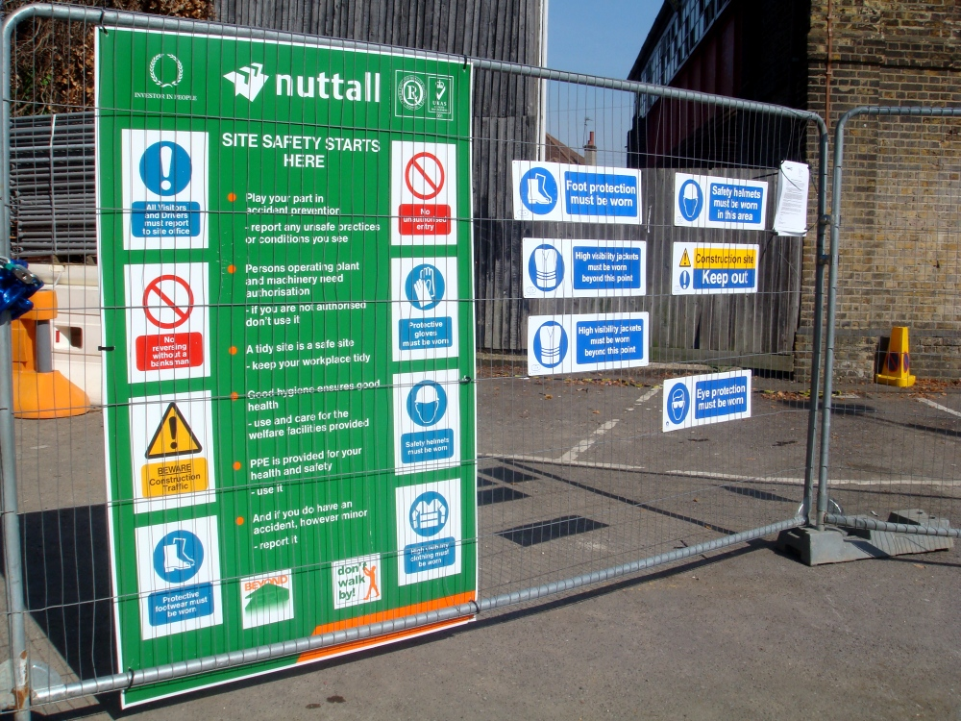
Health and Safety
Ethan Harris
Notes:
Background photo © ‘waldopepper’
https://flic.kr/p/5oa2e3

Slide 40
Health and Safety Regulation 1992 [16]
Display Screen Equipment
Employers must:
Analyse workstations to reduce risk
Provide information and training
Provide an eye test on request
Review assessment when user/Display Screen Equipment (DSE) changes
DSE assessors may be employed
To provide training
Assess risk
Notes:
Background photo © ‘waldopepper’
https://flic.kr/p/5oa2e3

Slide 41
PAT Testing
Portable appliance testing
Examination of electrical equipment to ensure they are safe to use
Not required by law
Employers should take a risk based approach based on equipment use
Notes:
Background photo © ‘waldopepper’
https://flic.kr/p/5oa2e3

Slide 42
Emergency Procedures
Special procedures needed for emergencies
Serious injury
Explosion
Flood
Poisoning
Electrocution
Fire
Radioactivity leak
Chemical spills etc
Notes:
Background photo © ‘waldopepper’
https://flic.kr/p/5oa2e3

Slide 43
Emergency Procedures
If you have more than 25 tonnes of a dangerous substance:
Fire & Rescue must be informed
Warning signs must be put in place
Notes:
Background photo © ‘waldopepper’
https://flic.kr/p/5oa2e3

Slide 44
Fire Safety
The employer, landlord, owner or occupier responsible for fire safety must:
Carry out out and review fire risk assessment
Tell staff about identified risks
Install and maintain fire safety measures
Plan for emergency
Provide fire safety training and instruction
Notes:
Background photo © ‘waldopepper’
https://flic.kr/p/5oa2e3

Slide 45
Fire Safety
Applies to all non domestic premesis
Fine or prison if responsible person fails to follow fire safety regulations
Can employ a professional risk assessor
Notes:
Background photo © ‘waldopepper’
https://flic.kr/p/5oa2e3

Slide 46
Risk Assessment
You should carry out a risk assessment before you do work which presents risk of ill health or injury
Assessment should cover all who might be harmed
Templates can be used
Legally required to be produced
Notes:
Background photo © ‘waldopepper’
https://flic.kr/p/5oa2e3

Slide 47
Review
George Cooper
Notes:
Background photo © John Blower
https://flic.kr/p/aUpo8B

Slide 48
Review
Equality
Protection in place via Equality Act 2010
Direct, Indirect, Harassment, Victimisation
Rights
Action can be taken if breached
Notes:
Photo by ‘Epic Fireworks’
https://flic.kr/p/7ZqW2p

Slide 49
Review
Labour law
Laid out by Working Time Regulations 1998
Protection to workers
Sets limits on working hours
There exists a minimum wage
Contracts
Notes:
Photo by ‘Epic Fireworks’
https://flic.kr/p/7ZqW2p

Slide 50
Review
Employment law
Provides more protection
Covered by several acts
Reviewed regularly to ‘keep up with the times’!
Notes:
Photo by ‘Epic Fireworks’
https://flic.kr/p/7ZqW2p

Slide 51
Review
Trade unions
Provide protection to workers
Many workers join together to act as one body
Can help improve working conditions
Notes:
Photo by ‘Epic Fireworks’
https://flic.kr/p/7ZqW2p

Slide 52
Review
Health and Safety
Protect employee health
Is regularly reviewed
Is a legal requirement
Risk assessments identify problem areas
Notes:
Photo by ‘Epic Fireworks’
https://flic.kr/p/7ZqW2p

Slide 53
Any questions?
Notes:
Background photo © John Blower
https://flic.kr/p/aUpo8B

Slide 54
References
[1]https://www.gov.uk/equality-act-2010-guidance
[2]https://www.gov.uk/discrimination-your-rights/types-of-discrimination
[3]http://www.acas.org.uk/index.aspx?articleid=1814
[4]https://www.gov.uk/discrimination-your-rights/discrimination-at-work
[5]http://www.nidirect.gov.uk/discrimination-at-work
[6] http://www.legislation.gov.uk/uksi/1998/1833/contents/made
[7] https://www.gov.uk/national-minimum-wage-rates
[8] http://www.legislation.gov.uk/ukpga/1996/18/contents
[9]http://www.legislation.gov.uk/ukpga/1999/26/contents
[10]http://www.legislation.gov.uk/ukpga/2002/22/contents
[11]http://www.legislation.gov.uk/ukpga/2008/24/contents
[12]https://www.gov.uk/dismiss-staff/unfair-dismissals
[13]http://www.justice.gov.uk/tribunals/employment
[14] "Trade Union Census“, Australian Bureau of Statistics
[15] http://www.ucu.org.uk/6794
[16] http://www.hse.gov.uk/MSd/dse/index.htm
Notes:
Photo by ‘Epic Fireworks’
https://flic.kr/p/7ZqW2p

