Slide 1
Serious games
Gaming as a driver for applications online by Group M

Slide 2
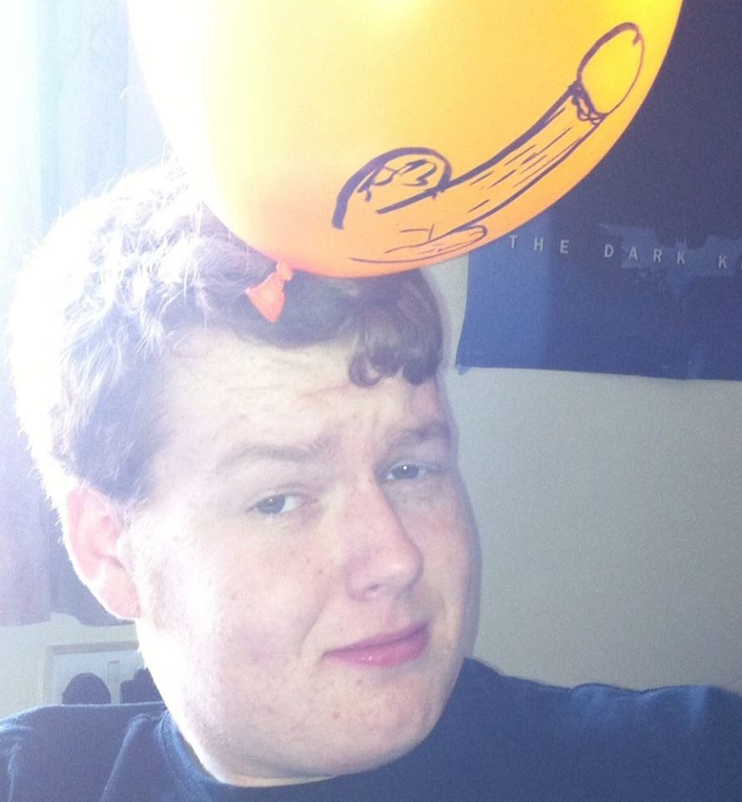
Who we are
Io Swift Wolf
Andrei Lupu
Liam Hegarty
Liam Hegarty
Sanjeet Mukherjee
Max Hayman

Slide 3
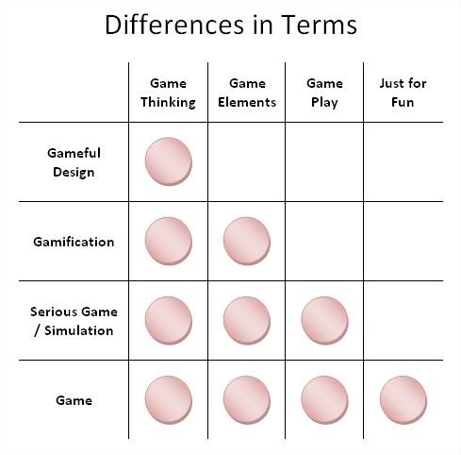
What is Gamification?
Gamification is the application of game design and game elements on typically day-to-day activities.
In order to raise worker motivation and productivity, baspects of game design could be worked into the workplace.

Slide 4
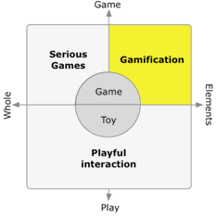
Examples of Gamification
Examples of these aspects include achievements, such as points, prizes and milestones.
In addition, it may invoke friendly competition among co-workers to do better at their work.
Employees with higher rankings would also be the recipient of social prestige.

Slide 5
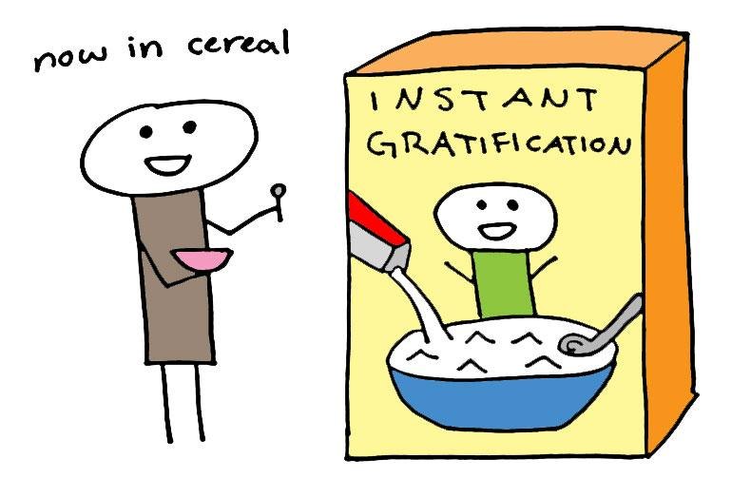
Instant Gamification
Gamification allows the audience to see progress immediately, which is a very important part of retaining focus: instant gratification.

Slide 6
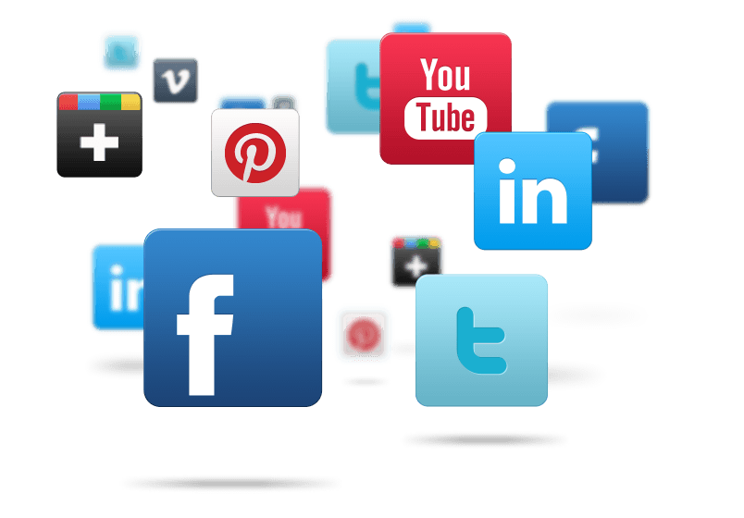
How to do Gamification?
A task should be presented in such a way that it takes advantage of the competitive nature of people, using tools such as social media or unlocking rewards.
Compete with friends and gather followers on social media for extra competition.
Notes:
Gamification plays on (pun intended) the competitive nature of people today, especially since the rise of social media and casual gaming.
Since everything is advertised, people are often competing for popularity via 'likes' and 'follower' based systems.
This is extended by the enormous popularity of meaningless yet highly competitive casual games such as flappy birds and farmville.

Slide 7
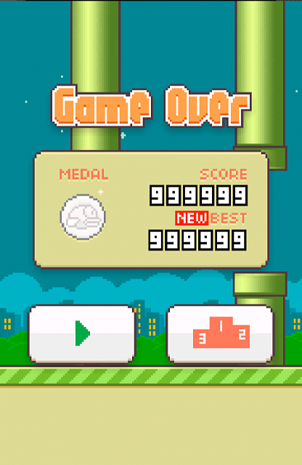
How can we can use it?
It’s uses can include to aid teaching, to motivate or drive sales, and to harvest user data. It models the idea of a carrot on a stick.
In most cases Gamification tries to tap into our natural tendencies to collect and reach milestones.
Notes:
The point of Gamification isn’t to make every aspect of our lives fun. The idea is not to attempt to make day to day life like a video game
In most cases Gamification tries to tapped into our natural tendencies to collect, reach milestones and to be encouraged my positive feedback. With the added bonus of in most cases bringing along some amount of social prestige by giving the user public badges and/or a leveling scheme!
NB: This slide has the flappy bird picture
With the implementation of leaderboards, these games encourage competition among friends in friend groups as well as self-improvement
via perseverence. //(because even if you've failed at life, at least you can get a score of 50 in fappy bird).

Slide 8
How Use Gamification
Gamification can be used to teach, motivate, drive sales, or harvest user data. In teaching, an unlock system could be used, where completing lessons unlocks bonus content and further lessons.
This has been used for several decades, in the form of prerequisites, but it could be shaped to be more engaging using a more obvious way to measure progression.
Notes:
Gamification can be used to teach, motivate, drive sales, or harvest user data. In teaching, an unlock system could be used, where completing lessons
unlocks bonus content and further lessons. This has been used for several decades, in the form of prerequisites, but it could be shaped to be
more engaging using a more obvious way to measure progression.
PRESENTER SWITCH!!

Slide 9
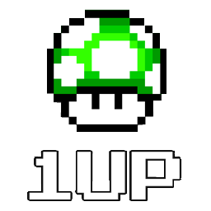
How Use Gamification
Gamification can be used as an analysis for employees. If a level system is used, employees of a higher level would stand out in terms of general performance. Whilst having the added bonus of added motivation for employees.
This would make it easier to identify and reward those employees that are the most productive.
Notes:
In professional environments, gamification can be used as an analysis for employees. If a level system is used, employees of a higher level would
stand out from lower level employees in terms of general performance. This could be used as grounds for corporate advancement as well as
indications of character and employability.

Slide 10
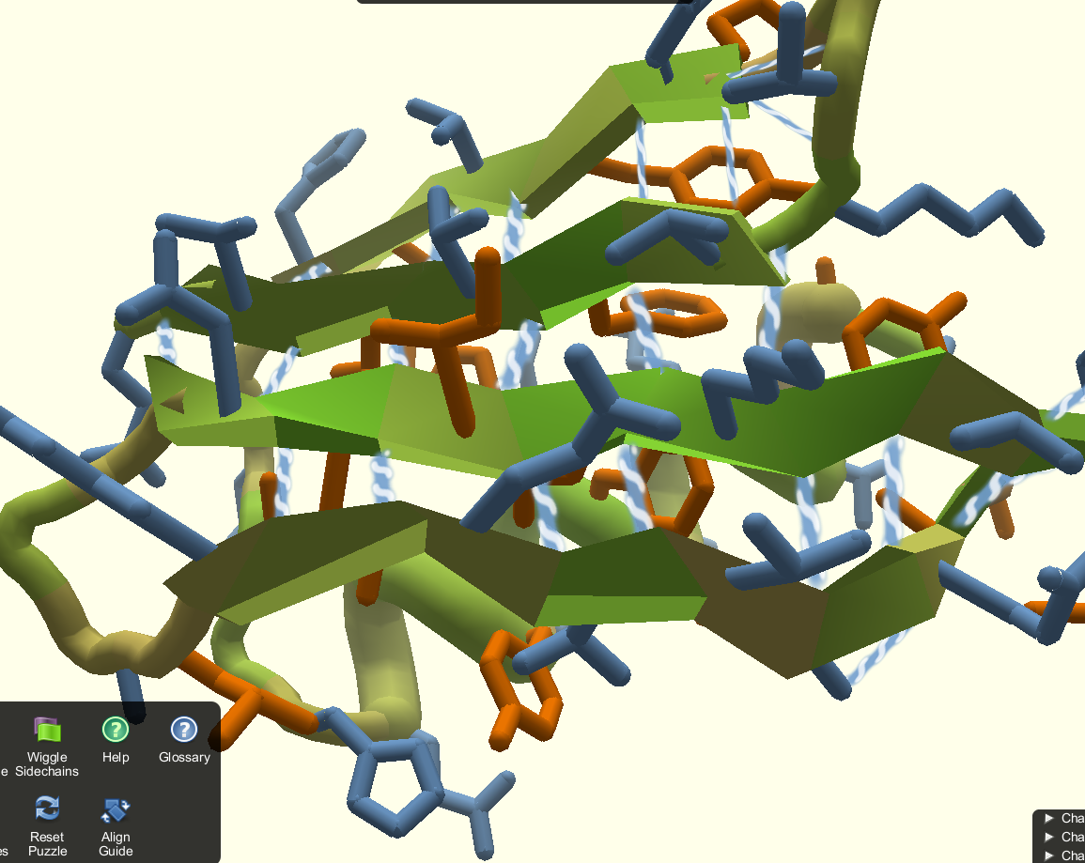
Foldit
The idea of gamification can be used in meaningful ways, rather than just building a useful science tool, the developers of Foldit, designed a program that adopted the concept of gamification in order to attract more people to the cause of protein folding!

Slide 11
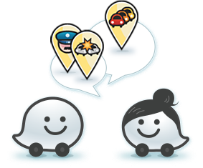
Waze
Waze is a community-based traffic and navigation app. It uses the idea of gamification to encourage
people to report traffic, speed cameras and
other things. The more a person
uses the app the more points they
get and ultimately saving everyone
time and money on their daily commute.

Slide 12
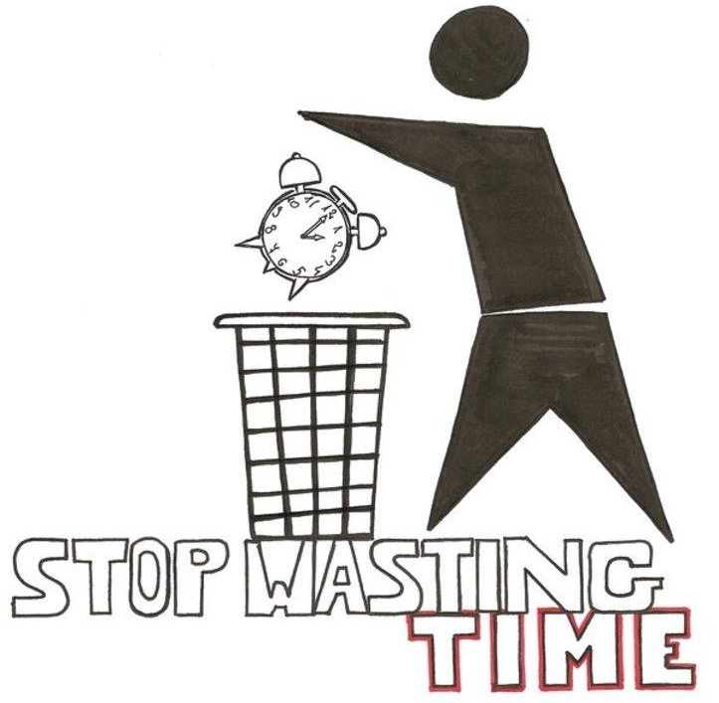
Whats bad about it?
If someone plays 4 hours playing flappy bird and beats their high score, this will give them a false sense of accomplishment telling them that their efforts had paid off
On the other hand, for an activity like losing weight and/or getting fit, it takes a long time with very few visible results.
Notes:
-Dissent among the ranks
-Mutiny
-Degradation of inter-office relations
-Might be abandoned in favour of candy crush or some crap, so no/little effect on performance
-basically a shit investment

Slide 13
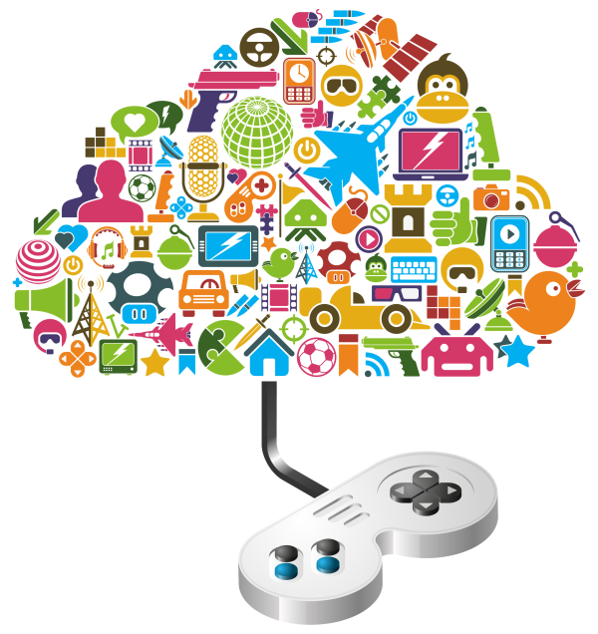
Trouble with Gamification
A big problem with Gamification is that it rarely creates an intrinsic interest in a task.
It’s very good at attracting the user’s attention, often in a recurring way, but tends to be poor at actually engaging the user in a deeply meaningful way.
It may lead to a drop in quality of work as employees rush their work to get a better “highscore”.
Notes:
A big problem with Gamification is that it rarely creates an intrinsic interest in a task, it’s very good at attracting the user’s attention, often in a recurring way, but tends to be poor at actually engaging the user in any deeply meaningful way!

Slide 14
Summary
Gamification is the use of game thinking and game mechanics in non-game contexts.
Although Gamification can be effective with low level monotonous task it fails to motivate effectively with more important and complex high level tasks.

Slide 15
FIN

