Slide 1
Crime ONLINE: Cyber security
Group H: Ben Ellerby, Darius Keeley, Zoe Lanham, Lewis Phenix and Yan Zhang
Tutor: Gennaro Parlato

Slide 2
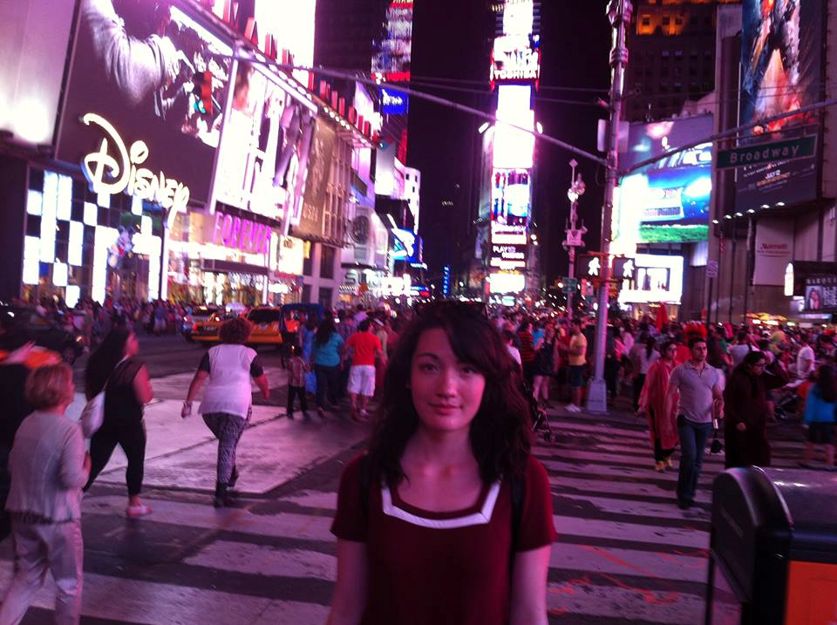
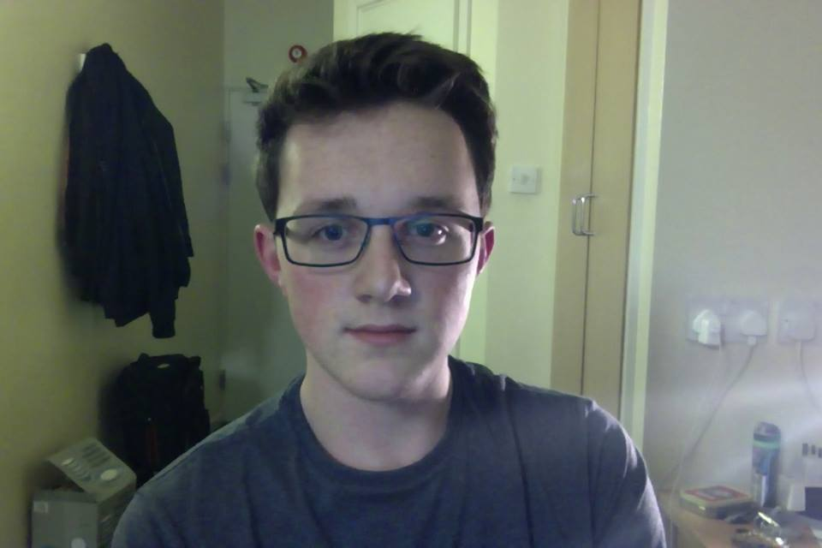
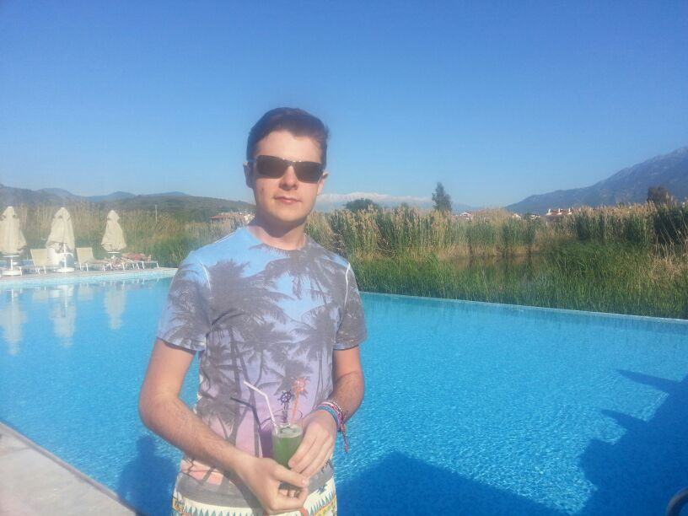
PRESENTERS
Zoe Lanham
Ben Ellerby
Lewis Phenix
Darius Keeley
Yan Zhang

Slide 3
What is this presentation about?
Overview on legislation used to protect and address breaches in Cybersecurity for individuals, organisations and businesses.
Heartbleed^{[1]}: important to know the legal action that can be taken
Basic protection:
Sophos^{[2]}
MailScanner^{[3]}

Slide 4
What is cybercrime?
“crimes in which computer networks are the target or a substantial tool”^{[4]}
Categories^{[5]}:
new offences that use new technologies
old offences that use new technologies

Slide 5
Background information: COMPUTER MISUSE ACT 1990
Three main sections^{[6]}:
Hacking is the offence committed when there is unauthorised access to a program/ data contained on a computer
An offence is also committed if the previous offence is committed in order to commit another offence.
A person can also be charged with an offence if they gain unauthorised access to a computer

Slide 6
Background information: Convention on Cybercrime
Also known as the Budapest Convention
First international treaty on crimes committed via the Internet and other computer networks.
Main objective: pursue a common criminal policy aimed at the protection of society against cybercrime.^{[7]}

Slide 7
Background information: National cybercrime unit
Their aims^{[8]}:
Track down cyber criminals
Identify criminal's weaknesses and reduce opportunities for them to attack
Help National Crime Agency to pursue cyber-criminals
Try to improve the UK's protection against cyber attacks in companies and law enforcement

Slide 8
MAIN SECTIONs
Copyright and Intellectual Property Infringement
Fraud and Theft
Sexual and Pornographic Offences
Computer Misuse
Cyber Terrorism

Slide 9
Theft and fraud legislation
What is Fraud?
‘abuse of position, or false representation, or prejudicing someone's rights for personal gain'.^{[9]} (The Serious Fraud Office)
deception for gain
Failure to disclose information.
False representation.
Abuse of position

Slide 10
Theft and fraud legislation
What is Theft?
“A person is guilty of theft if he dishonestly appropriates property belonging to another with the intention of permanently depriving the other of it...” (The Theft Act 1968)
The act of stealing.
Note that Identify Theft and Fraud are different.
Identity Related Crimes

Slide 11
Theft and fraud legislation
The Acts
The Fraud Act 2006
The Theft Act 1968
The Computer Misuse Act 1990

Slide 12
Theft and fraud legislation
The Fraud Act 2006
How does it help?
Outlaws the use of false representation and dishonesty for unlawful gain.
Combats:
Many cybercrimes (e.g. Auction Fraud)
The tools of cybercriminals; e.g. phishing, pharming etc.
Notes:
Why wh

Slide 13
Theft and fraud legislation
The Theft Act 1968
How does it help?
Outlaws the dishonest appropriation of property, financial and otherwise (e.g. personal data).
Combating cybercrimes such as:
ID-Theft
Many white collar banking crimes.
Extortion (i.e. Ransomware schemes)
Theft of classified information.

Slide 14
Theft and fraud legislation
The CMA 1990
How does it help?
Many crimes are covered by both the preexisting legislation and the CMA 1990.
A person can be prosecuted under multiple acts for the same crime.
It is usually the means by which a crime is committed that the CMA is concerned with.

Slide 15
CYBER TERRORISM
What is Cyber Terrorism?
no clear definition
"Politically motivated use of computers and information technology to cause severe disruption or widespread fear" -- oxforddictionaries.com
"Terrorist activities intended to damage or disrupt vital computer systems" -- merriam-webster.com
"[...] premeditated, politically motivated attack against information, computer systems, computer programs, and data which result in violence against non-combatant targets by sub national groups or clandestine agents" -- Pollitt, 1997

Slide 16
CYBER TERRORISM
Computer Misuse
What falls under misuse?
Hacking
Malware
Denial of Service (DoS)
Phishing

Slide 17
CYBER TERRORISM
Legislation
Police and Justice Act 2006^{[10]}
Amendments to CMA 1990
Generalisations of "unauthorised modification of computer files"
Unauthorised access to computer material
Unauthorised acts with intent to impair operation of computer, etc.
Making, supplying or obtaining articles for use in computer misuse offences

Slide 18
Copyright and Intellectual Property Infringement Legislation
What is Copyright?
Given by the Copyright, Designs and Patents Act 1988:
“Copyright is a property right which subsists in accordance with this Part in the following descriptions of work—
original literary, dramatic, musical or artistic works,
sound recordings, films [F1or broadcasts], and
the typographical arrangement of published editions. ”

Slide 19
Copyright and Intellectual Property Infringement Legislation
It gives the creators of the listed works the right to have control over the ways in which their works are used.
Creations have to be sufficiently complex and published.
The rights go to the author or commissioner of the work.
Yet, can be sold, traded and licensed.
70 Years
70 Years
50 Years
25 Years**
Literacy, dramatic, musical and artistic works*
Films
Sound Recordings and Broadcasts
Typographical Arrangement of Published Editions
*NB: The Copyright (Computer Programs) regulations
1992 extended the act to include computer games.
**From date of publication

Slide 20
Copyright and Intellectual Property Infringement Legislation
Copyright Infringement
Authorisation needed for:
Copy the work in any way.
Issue copies of the work to the public.
Rent or lend the work to the public. (With the exception of the public lending scheme)
Perform show or play the work in public.
Broadcast the work / communicate it electrically to the public.
Make an adaption of the work (e.g. book -> dramatic work)
As advised by the Intellectual Property Office’s Copyright Infringement Advice Page ^{[11]}

Slide 21
Copyright and Intellectual Property Infringement Legislation
Relevance To Cybercrime:
There are many ways computers and the Internet can be used to infringe copyright:
Piracy: The distribution of protected works to the public.
Movie, TV and Music Piracy.
Use of unlicensed software.
Peer-To-Peer File Sharing.
Internet Streaming: Very unclear
Stream uploaders likely infringing copyright yet viewers may not be.
CatchUp TV: ordered to shut down by UK High Court.
Project Free TV etc: Court ordered to be blocked by many ISPs
Notes:
. The publisher is usually breaching copyright yet there is much debate as to the streaming temporary copy. (Note: the popular CatchUp TV service was ordered removed by the UK High Court and many streaming services such as CatchUpTV have been orderedblocked by ISPs).

Slide 22
Copyright and Intellectual Property Infringement Legislation
Jurisdiction
The Internet has complicated copyright law and jurisdiction.
Web
Upload…
Download…
Country 1
Country 2
Doc
Doc
Legal ✔
Illegal
✗

Slide 23
Copyright and Intellectual Property Infringement Legislation
The Berne Convention
Attempts to maintain copyright on an international level
Non-residents from other member countries treated the same as citizens (in terms of copyright).
Foreign works must be protected the same as domestic ones.
Works must receive “automatic protection”

Slide 24
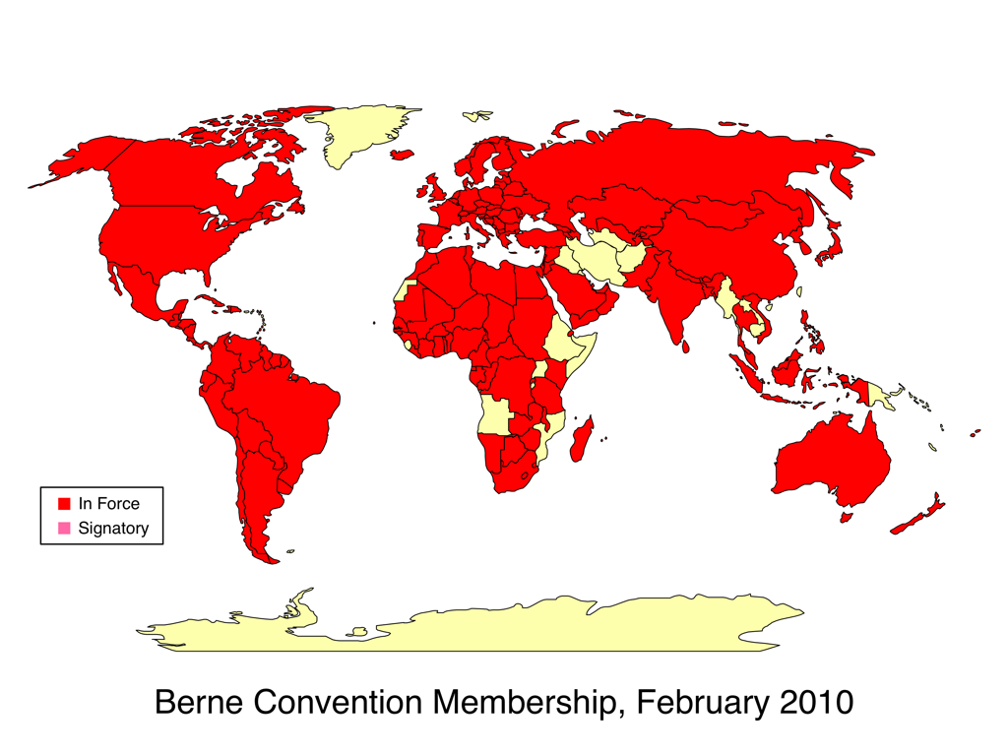
Berne Convention Map^{[11]}

Slide 25
Copyright and Intellectual Property Infringement Legislation
The Digital Economy Act 2010
Given assent in 2010
Many controversial sections delayed (likely till 2015).
Under the system an internet user would be sent a warning letter if it was detected they downloaded a protected work illegally.
2 letters more letters…
Download history shared with copyright holder. And possible access block.
A further court order would be needed before prosecution.
2015

Slide 26
Sexual and Pornographic Offences
Sexual Offences Act 2003
Meeting children after online grooming is illegal

Slide 27
Sexual and Pornographic Offences
Protection of Children Act 1978
Distribution of indecent pictures of children is illegal
Companies can be charged with this crime

Slide 28
Sexual and Pornographic Offences
Obscene Publications Act 1959 and 1964
Publication of socially or morally unacceptable material is illegal

Slide 29
Case Study: The Silk Road
Opened in February 2011
1 Million users
$1.2 billion in sales
1.2 million transactions
Closed in October 2013

Slide 30
How The Silk Road Worked
Used TOR browser to secure anonymity.
Used the bitcoin currency.

Slide 31
How the FBI brought the site down
Located six of the website’s servers.
Acted as an administrator on the server.
Exposed buyers’ and sellers’ accounts.
Arrested Ross Ulbricht
Seized 26,000 BTC

Slide 32
CYBER CRIME IN THE UK
Cost of £27 billion to the UK economy in 2011 [13]
£22 billion of that to companies
$2.2 billion to the government
£3.1 billion to citizens

Slide 33
Cost OF DIFFERENT CYBER CRIMES TO THE UK ECONOMY[12]

Slide 34
CYBER CRIME IN THE UK
37% of adults reported negative experiences online in 2011 [13]
31% of adults received a computer virus
One act of cybercrime costs a company on average £130,000 [14]

Slide 35
References
[1]http://heartbleed.com/
[2]http://www.sophos.com/en-us.aspx
[3]http://www.mailscanner.info/intro.html
[4]Paper: The Internet and its Opportunities for Cybercrime
Electronic copy available at: http://ssrn.com/abstract=1738223
[5]https://www.gov.uk/government/uploads/system/uploads/attachment_data/file/228826/7842.pdf
[6]http://www.jisclegal.ac.uk/Portals/12/Documents/PDFs/crimeOverview.pdf
[7]http://conventions.coe.int/Treaty/en/Summaries/Html/185.htm

Slide 36
References
[8] http://www.nationalcrimeagency.gov.uk/about-us/what-we-do/national-cyber-crime-unit
[9]http://www.sfo.gov.uk/fraud/what-is-fraud.aspx
[10] Police and Justice Act 2006 c48 Part 5, http://www.legislation.gov.uk/ukpga/2006/48/part/5/crossheading/computer-misuse
[11] http://www.ipo.gov.uk/types/copy/c-manage/c-useenforce/c-infringe.htm
[12] http://cyber.law.harvard.edu/copyrightforlibrarians/File:Map1.png
[13]https://www.gov.uk/government/uploads/system/uploads/attachment_data/file/60942/THE-COST-OF-CYBER-CRIME-SUMMARY-FINAL.pdf

Slide 37
References
[14]https://www.gov.uk/government/uploads/system/uploads/attachment_data/file/246749/horr75-summary.pdf
[15]http://www.checkpoint.com/products/downloads/whitepapers/ponemon-cybercrime-2012.pdf
[16] http://www.usatoday.com/story/news/nation/2013/10/21/fbi-cracks-silk-road/2984921/
[17] https://www.andrew.cmu.edu/user/nicolasc/publications/Christin-WWW13.pdf
All sources last accessed: 14:26 02/05/2014

