Slide 1
Trolling, Banter, Cyber Hate, Online Bullying
Umar Anwar, Kevin Timpati, Phinephas Asare, Will Donaghy, Thomas Lam, Chris Ankle, Matthew Tierney

Slide 2
Introduction
Trolling
Banter
Cyber-Hate
Online Bullying

Slide 3
Banter
What is it?
Banter is defined as a form of social interaction either online or in the real world , it manifests as the exchange of teasing and mocking remarks but delivered in a playful, light-hearted and good-humoured manner.
“The playful and friendly exchange of teasing remarks”
“Exchange remarks in a good-humoured teasing way”
Banter. (n.d.). Retrieved from Oxford dictionaries: http://www.oxforddictionaries.com/definition/english/banter

Slide 4
Banter
Example of it?
A few examples of banter that I discovered are:
“Machine wash warm. Inside out with like colours. Use only non-chlorine bleach. Tumble dry medium. Medium hot iron. Do not iron print. —Or— GIVE IT TO YOUR WOMAN It's her job.”
Chivers, T. (2012, March 6). If you like 'banter', you are an idiot . Retrieved from The telegrah: http://blogs.telegraph.co.uk/news/tomchiversscience/100141906/if-you-like-banter-you-are-an-idiot/

Slide 5
Banter - Be Aware
- As fun as banter can be sometimes, it’s very easy to go too far.
- As Internet users, we must be wary of what we classify as ‘banter’.
- Socially, in person we can show banter from our expression of speech and body gestures but online, it can be taken a different way.

Slide 6
Trolling - What is it
Definition:
“In Internet slang, a troll is a person who sows discord on the Internet by starting arguments or upsetting people or off-topic messages in an online community with the deliberate intent of provoking readers into an emotional response or of otherwise disrupting normal on-topic discussion.”
Timothy Campbell, “Internet Trolls”, 2001 http://web.archive.org/web/20011026130853/http://members.aol.com/intwg/trolls.htm, accessed 28 April 2014.

Slide 7
Trolling - Examples
An example of trolling is if an internet “troll” were to post homophobic slurs such as “god hates fags” on a gay pride video.

Slide 8
Trolling - What to do
Do not reply
Report the troll
Ignore the posts
Do not take it to heart

Slide 9
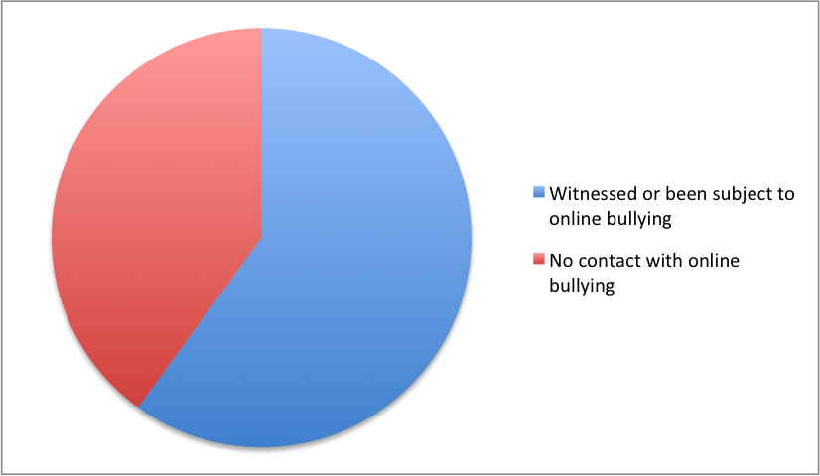
Online bullying
What is it?
“Cyberbullying is the use of the Internet and related technologies to harm or harass other people, in a deliberate, repeated, and hostile manner.”
U.S. Department of Health & Human Services. (). What is Cyberbullying.Available: http://www.stopbullying.gov/cyberbullying/what-is-it/. Last accessed 28th April 2014.
Stats:
The latest study claimed the effect of cyber bullying was worse than non-electronic forms, with some respondents showing greater mental strain and lower job satisfaction
3 in 5 say that they have witnessed or been subject to online bullying.
ACAS. (). Cyber bullying in the workplace is on the rise. Available: http://www.acas.org.uk/index.aspx?articleid=4023. Last accessed 28th April 2014.
Notes:
Suicide is the third leading cause of death among young people, resulting in about 4,400 deaths per year,according to the CDC. For every suicide among young people, there are at least 100 suicide attempts. Over 14 percent of high school students have considered suicide, and almost 7 percent have attempted it.
Bullying and Statistics. Bullying and Suicide. Available: http://www.bullyingstatistics.org/content/bullying-and-suicide.html. Last accessed 1st May 2014

Slide 10
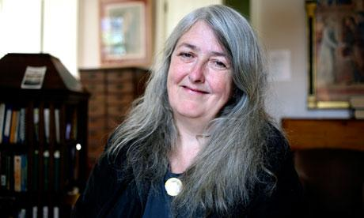
Online bullying - Example
January 2013 - Mary Beard suffered online bullying after she appeared on Question Time.
Beard is a classics professor and after her appearance on the show, hateful messages were posted on a website called ‘Don't Start Me Off’. Some of the comments referred to her as a ‘witch’ while others were aggressive and sexual.
Rather than meant as a misfired joke, these comments were deliberately meant to be hurtful and are therefore considered as bullying.
The website was taken down as a result of the hateful comments.
Dowell, B. (2013). Mary Beard suffers 'truly vile' online abuse after Question Time. [online] the Guardian. Available at: http://www.theguardian.com/media/2013/jan/21/mary-beard-suffers-twitter-abuse [Accessed 1 May. 2014].

Slide 11
Online bullying - Ways to address
Employers should have a bullying and harassment policy in place that makes it very clear that this behaviour is not acceptable and stating the consequences of this behaviour in the workplace.
All employees should have to sign this policy when starting with the company.
Train managers to understand what constitutes as bullying, so that in future they may be able to spot signs that an employee is a victim to online bullying.
It is in the interest of your organisation for you to take steps to make clear what sort of behaviour would be considered sexual harassment.
Block the cyber bully's email address or cell phone number, or change email address or phone number.

Slide 12
Online bullying - Laws
There is not a specific law which makes online bullying illegal, however it can be considered a criminal offence under certain acts:
The Equality Act 2010:
As well as employees who have been subject to online bullying the equality act now uses a single definition of harassment so that employees will now be able to complain of behaviour that they find offensive even if it is not directed at them.

Slide 13
Cyber - Hate
What is it?
“Cyber-hate is a way of communication with the use of inappropriate language and materials used by one person that are expressed to another individual.”
Notes:
Nowadays it has become more and more common for people to be harassed over the internet through the use of Cyber-hate. This is a crucial matter as it is easier to affect people emotionally.

Slide 14
Cyber - Hate Examples
Methods of Cyber-Hate:
Social networking
Instant messaging
Mobile and smart phones
Examples include:
- Contains offensive content such as racism or sexism.
- Often, cyber-aggression is the result of individuals in a workplace being offended/upset/or feeling threatened by organizational problems.
- The threat of being fired can lead to someone picking on another member of staff to try and take the heat of them and drop someone else in the firing line.
http://youtu.be/gTix7FDHZcA?t=2m5s
Notes:
- Hate email or text to threaten/frighten a member of staff.
- Contains offensive content such as racism or sexism.
- Messages can be sent to all colleagues singling out one member of the workplace so that everyone knows a piece of information or looks down on that member of staff. These messages can be sent in the form of spam.
- Often, cyber-aggression is the result of individuals in a workplace being offended/upset/or feeling threatened by organizational problems.
- The threat of being fired can lead to someone picking on another member of staff to try and take the heat of them and drop someone else in the firing line.

Slide 15
Ways to address Cyber - Hate
Ensuring that users agree to a policy that has been put into place, which will allow for more of a secure social environment.
The outcome will result in:
- Less Cyber-hate related posts being made
- People that decide to act upon this behaviour will suffer consequences stated in agreement
- Could remove account or block it depending on the way the matter is addressed, whether it is by social or technological interventions, or by legal action.

Slide 16
Overview
The internet can be a fun place
Be aware of extreme content by users
Remember to ignore

Slide 17
Group F

