Slide 1
Creative commons, open source, open
movements
Notes:
needs a nice picture

Slide 2
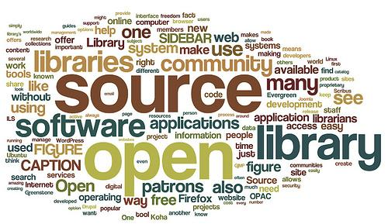
Introduction
IP/copyright in the UK
Creative Commons
Open source software
Open movements
http://johnpoelstra.com/wp-content/uploads/2012/06/opensource.jpg

Slide 3
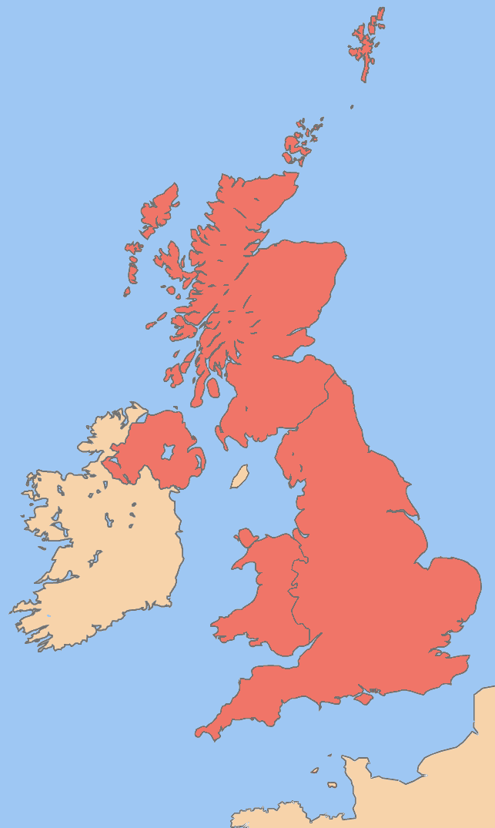
IP in the UK
1624 Statute of Monopolies
1710 Statute of Anne
1988 Copyright, Design and Patents Act
http://upload.wikimedia.org/wikipedia/commons/4/4f/Uk_map.png
http://www.ipo.gov.uk/
Notes:
-IP in UK governed by Intellectual Property Office
-IPO operates according to 1988 Copyright, Design and Patents Act
-What is IP?
-Intellectual property is something you create that’s unique. (https://www.gov.uk/intellectual-property-an-overview)
-Intellectual property rights are legally recognised rights to these creations. (http://en.wikipedia.org/wiki/Intellectual_property)
-IPR consist of four main types: Patents, Trademarks, Designs, Copyright.
-Historic background
-The British Statute of Anne (1710) and the Statute of Monopolies (1624) are seen as the origins of copyright and patent law respectively. (http://en.wikipedia.org/wiki/Intellectual_property)
-The term ‘intellectual property’ began to be used in 19th century.
-And became commonplace in the majority of the world in the 20th century.
-Quick definitions of the four types of IPR (http://www.ipo.gov.uk/types.htm)
-A patent protects the features and processes that make things work. Allows inventors to profit from their inventions.
-Trademarks are signs that distinguish goods and services in the market.
-Designs protect the appearance of a product/logo.
-Copyright is an automatic right which applies when the work is fixed, that is written or recorded.

Slide 4
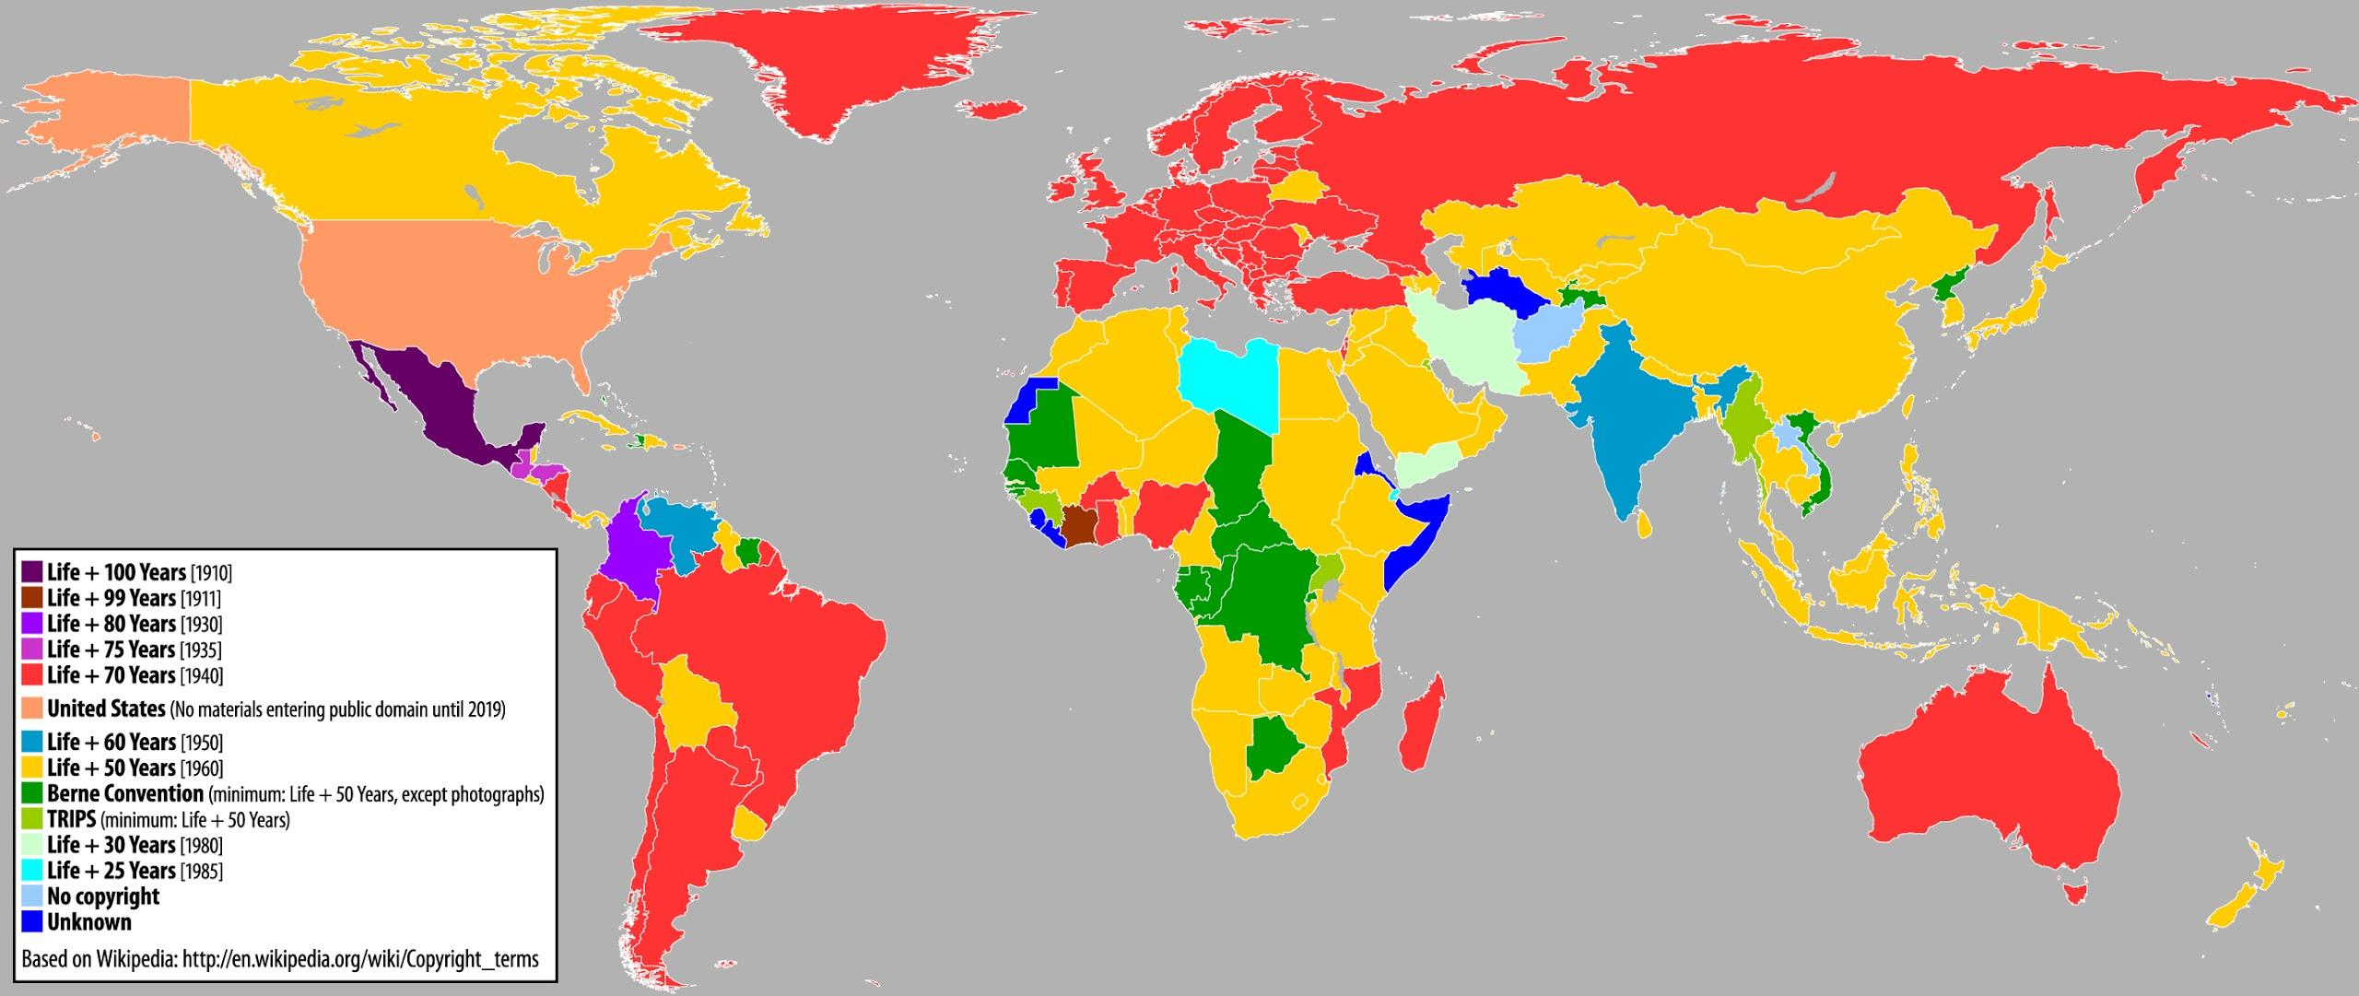
Copyright
http://www.publicdomainday.org/sites/www.publicdomainday.eu/files/World_copyright-terms.jpg
Notes:
- different types of license give different types of rights over the product <-wrong slide?
-copyright is the most widespread form of protection for IP
-all work that 'exhibits a degree of labour, skill or judgement' is automatically qualified for copyright protection upon publication
-copyright is given to the author upon publication but can be sold or licensed
-the copyright of work produced by an employee during their employment belongs to the employer
- The Copyright, Designs and Patents Act 1988 to be mentioned(multiple sections to be observed)

Slide 5
Protected Rights under Copyright
copy the work
issue copies, lend or rent the work to the public
show, perform or play the work in public
adapt the work or do any of the above with adaptations of the work
Notes:
-owning copyright gives you exclusive rights
-this means it is illegal for anyone without the copyright to do any of the following
-copy the work
-issue copies, lend or rent the work to the public
-show, perform or play the work in public
-adapt the work or do any of the above with adaptations of the work

Slide 6
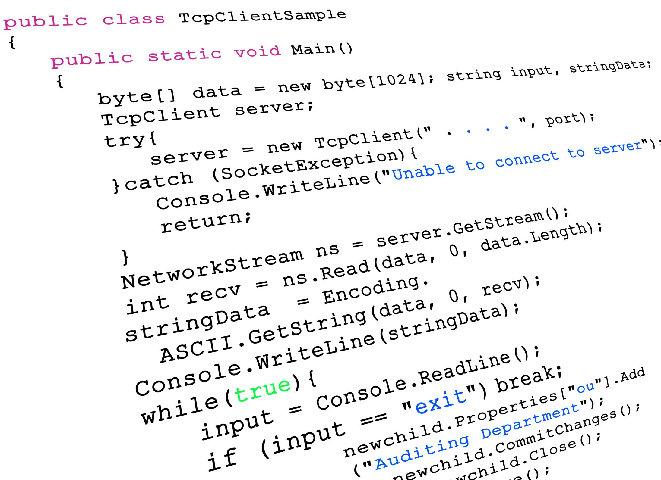
Copyright of Software
http://upload.wikimedia.org/wikipedia/commons/4/4f/Uk_map.png
http://blog.ecollegefinder.org/wp-content/uploads/2012/01/101474454.jpg
Notes:
-software was officially added to the works protected by copyright by the 1992 Copyright (Computer Programs) Regulations
-this protects source code, machine code, firmware, design materials and functional specifications
-sale of software is a form of licensing the copyright, as it gives the user the right to store the program on their computer (which is considered copying) and to use the program for personal use
-databases are also protected by are also protected by copyright to prevent their contents being copied or edited

Slide 7
Creative Commons
The mission:
Creative Commons develops, supports, and stewards legal and technical infrastructure that maximizes digital creativity, sharing, and innovation.
The vision:
Our vision is nothing less than realizing the full potential of the Internet — universal access to research and education, full participation in culture — to drive a new era of development, growth, and productivity.
http://mirrors.creativecommons.org/presskit/icons/cc.large.png
Notes:
-Creative Commons is a non-profit organisation which provides licenses to people who want their work to be shared but with limited restrictions on its use
-the licenses are less strict than copyright and are highly flexible
-their range of licenses can be combined in many ways to suit the distributed
-“The Honest Musician’s Fear of Accidental Plagiarism” good introduction ,as an example, for the Creative Commons

Slide 8
CC Licenses
CC BY CC BY-SA
CC BY-ND CC BY-NC
CC BY-NC-SA CC BY-NC-ND
Images from http://creativecommons.org/licenses/
Notes:
-Creative Commons licenses can be applied to any work that could be covered by copyright
-it can be applied to software and source code, but the licenses were not designed for such uses
-attribution (by) means that others can copy and use the work, but they must give credit to the creator
-non commercial (nc) prevents any users from using the work for commercial purposes
-share alike (sa) forces anyone copying or redistributing your work to use the same license as you have used
-no derivatives (nd) prevents others from altering or adapting your work
-for example: cc by is the least restrictive license allowing free distribution and use with credit, while cc by-nc-nd is the most restrictive as it can’t be altered or distributed commercially

Slide 9
Open Source

Slide 10
What is Open Source?
Software in which the source code is available with a license that allows the modification and distribution of the software for any purpose
Often developed in a collaborative manner
Opposite of closed source software in which the code is legally owned by the authors. Users are required to accept a licensing agreement to not alter the source code
Open Source Initiative formed in February 1998 [3]
Notes:
- Open source communities are often huge with collaborating members contributing to modifications of well known software
- Formed by Eric S. Raymond and Bruce Perens who accumulated about 20 years of evidence from case histories of closed and open development that already existed

Slide 11
Open Source Initiative
Non-profit corporation
“Open source is a development method for software that harnesses the power of distributed peer review and transparency of process” [4]
Community-recognized body for reviewing and approving licenses that follow the Open Source Definition
Open source Initiative (1998)
Notes:
- Purpose: To educate the public about the benefits of open source software
- Open Source Definition defines criteria that must be met in order for an open source license to be applied

Slide 12
Why open Source?
More control over software
Better security
Code can be improved or modified to suit the needs of the user
No license restrictions in terms of use of the software
Software can be constantly updated to fix bugs/exploits
Users can examine the code to improve their programming knowledge
$60 billion per year savings for consumers (Standish Group report, 2008) [2]
No vendor 'lock in'
Notes:
- Open source software is freely accessible to the public and therefore huge savings are achievable
- Vendor lock in is where a consumer sticks with a particular vendor because switching to other vendors is so costly. Open source software does not have this problem
- Often better quality due to the contribution by the public, who often use the open source software itself and are able to identify possible improvements
- Often more secure as errors/bugs in the code are identified by members of the community who’s personal motive would be to remove exploitable bugs (as they do not wish to be vulnerable)

Slide 13
Open Source Criteria [3]
1. Free Redistribution
2. Source Code
3. Derived Works
4. Integrity of The Author’s Source Code
5. No Discrimination Against Persons or Groups
6. No Discrimination Against Fields of Endeavour
7. Distribution of License
8. License Must Not Be Specific to a Product
9. License Must Not Restrict Other Software
10. License Must be Technology-Neutral
Notes:
1. Free Redistribution: No restriction for selling or giving away the open source software as a component of other software
2. Source Code: Software must include source code and must allow distribution in both compiled and source form, else the program must have a well publicized means of obtaining the source code
3. Derived Works: The license must allow modifications, and must allow them to be distributed under the same terms as the license of the original software.
4. Integrity of The Author's Source Code: The license may restrict source-code from being distributed in modified form only if the license allows the distribution of "patch files" with the source code for the purpose of modifying the program at build time.
5. No Discrimination Against Persons or Groups: The license must not discriminate against any person or group
6. No Discrimination Against Fields of Endeavor: The license must not restrict anyone from making use of the program in a specific field of endeavor (areas of industry)
7. Distribution of License: The rights attached to the program must apply to all to whom the program is redistributed without the need for an additional license
8. License Must Not Be Specific to a Product: The rights attached to the program must not depend on the program's being part of a particular software distribution. If the program is part of a distribution, all parties to whom the program is distributed to should have the same rights granted in the the original license
9. License Must Not Restrict Other Software: The license must not place restrictions on other software that is distributed along with the licensed software. For example, the license must not insist that all other programs distributed on the same medium must be open-source software.
10. License Must Be Technology-Neutral: No provision of the license may be predicated on any individual technology or style of interface.

Slide 14
Popular Open Source Licenses [3]
Mozilla Public License 2.0
Common Development and Distribution License
Eclipse Public License
MIT License
BSD 3-Clause “New” or “Revised” License
GNU General Public License (GPL)
Apache License 2.0
BSD 2-Clause “Simplified” or “FreeBSD” License
GNU Library or “Lesser” General Public License (LGPL)
Notes:
- 71 approved Open Source Initiative licenses
- These licenses are thought to be the most popular, widely used or have strong communities (2006 proliferation report)
- These licenses all follow a general open-source criteria layout although there are some differences between,
eg. Apache License 2.0 links with code using a different license and changes are released under a different license. While the GNU General Public License doesn’t
- Certain licenses such as the GNU General Public License are copyleft licenses. Specific type of license where the distributed modified version of the open source software must be licensed under the same license for the original software, eg, license something using the GNU General Public License will mean any modified versions must also use this license

Slide 15
Open Source Licensing
Open source licenses grant people the right to redistribute, copy and modify source code.
These licences may impose obligations
Author still holds the copyrights to their software
Users may use the copyrights provided they adhere to any obligations
Ownership of copyrights is separate from ownership of the work
Contributions of code to an open source project is done under explicit and implicit licenses
Placing content in the public domain waives an authors copyrights in that work [4]
Notes:
obligations : (modifications to the code that are distributed must be made available in source code form, an author attribution must be placed in a program/ documentation using that open source)
When an author contributes code to an open source project (e.g., Apache.org) they do so under an explicit license (e.g., the Apache Contributor License Agreement) or an implicit license (e.g., the open source license under which the project is already licensing code).
Placing code (or content) in the public domain is a way of waiving an author's (or owner's) copyrights in that work. No license is granted, and none is needed, to copy, modify or redistribute a work in the public domain

Slide 16
Open Source Legislation
In 2008, a US federal court ruled that free software licences set conditions on the use of copyrighted work [4]
If users do not adhere to the obligations set out in the licence they are breaking copyright law.[4]

Slide 17
Open Movements

Slide 18
What are Open Movements?
Definition: “A term used as a catch-all to refer to attempts to make information freely-available. This includes, amongst others, Open Source Software, Open Educational Resources and Open Access.”[5]
Notes:
-Open Access Week
-Free Software Movement 1980s
-other stuff to be added

Slide 19
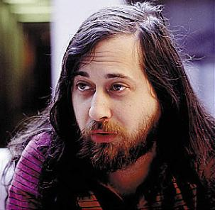
Free Software Movement[7]
Founded in 1983 by Richard Stallman with the launch of the GNU project
Social movement
Goal - obtaining and guaranteeing certain freedoms for software users:
freedom to run the software,
freedom to study and change the software
freedom to redistribute copies with or without changes.
http://en.wikipedia.org/wiki/File:Richard_Matthew_Stallman2.jpeg

Slide 20
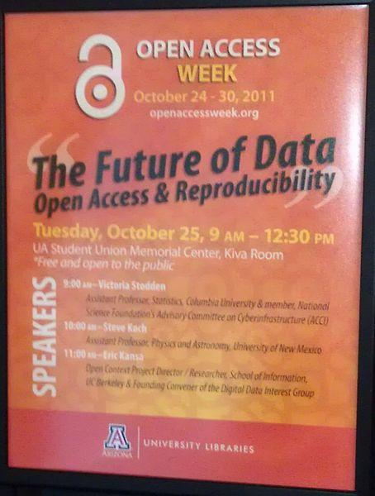
Open Access Week[8]
Open Access Week is an annual scholarly communication event focusing on open access and related topics. It takes place globally during the last full week of October in a multitude of locations both on- and offline.
http://en.wikipedia.org/wiki/File:U_Arizona_Open_Access_Week_October_25,_2011.jpg

Slide 21
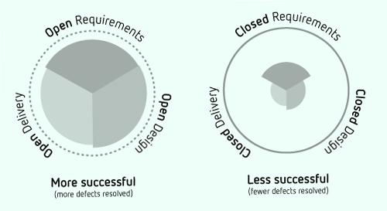
Why is the open source movement so popular?
supporting the local community
not proprietary, resulting in lower costs[6]
rapid technological innovation through sharing
provides flexibility not available in closed products[6]
Globalization of Market[6]
http://www.noupe.com/wp-content/uploads/trans/wp-content/uploads/2010/11/Open-Source-Success.jpg

Slide 22
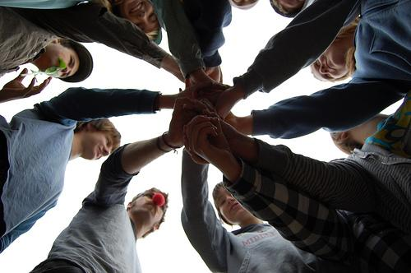
What are the benefits?
People who develop open source software are doing this because they want to be part of the people who realised the next generation of technology that is free and available to use by everyone.
The success of the Open-source movement is due to the Open Source community’s level of dedication, passion,commitment and trust within its foundation.
http://lifedev.net/wp-content/uploads/2008/08/open-source-ideas.jpg

Slide 23
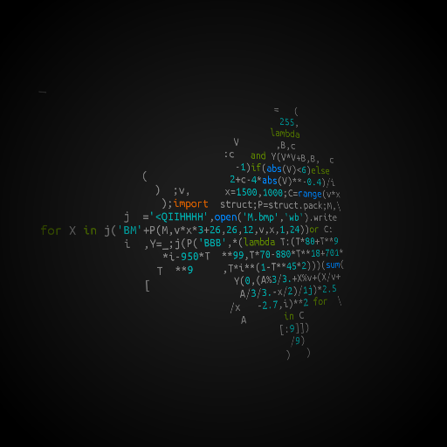
What are the results of Open Movements?
Linux
PHP
Wikipedia
Perl
MySQL
Apache
Others
http://instacod.es/file/57623

Slide 24
References
creativecommons.org
http://opensource.org/
http://news.bbc.co.uk/1/hi/technology/7561943.stm
http://en.wikipedia.org/wiki/Open-source_software
https://openeducationalresources.pbworks.com/Glossary
http://en.wikipedia.org/wiki/Open-source_movement
http://en.wikipedia.org/wiki/Free_software_movement
http://en.wikipedia.org/wiki/Open_Access_week

Slide 25
Questions?

