Slide 1
What is Web Science?
Topics:
1. Collaboration of Technology and People
2. The Web is a Network of People using Computers
3. Web Science involves processing and understanding the information available on the web in a scientific manner.
4. Web Science views the Web differently to the way avid users do.
5. Political Engagement
6. Viral Phenomena
7. Cyborgs and Online LifeStyles
8. Privacy and Censorship

Slide 2
What is Web Science?
Topics (Continued) :
9. Copyright, DRM and IP
10. Web Economics
11. Trust
12. Dark Web / Under Web (Drugs, Assassins etc)
13. Social shaping of Technology
14. Network analysis
15. Citizen Journalism
16. Religion

Slide 3
1. Collaboration of Technology and People
Technology allows people to work together more easily with things such as social networking, instant messaging and web sharing.
The internet allows you to share knowledge and ideas almost instantly and very easily
Groups can easily and cheaply communicate and work on a project no matter how far away people are
Things such as email allow companies to be more productive due to communication being easier

Slide 4
2. The Web and Web Science
The Internet is a worldwide system of interconnected computer networks
The World Wide Web is a system of interlinked hypertext documents accessed via the Internet
Web Science is the study of the Web as a global socio-technical system
Web Science focuses on the interchange of data, information and knowledge, including
The exchange of digital forms of intellectual property
The online trading of physical economic goods

Slide 5
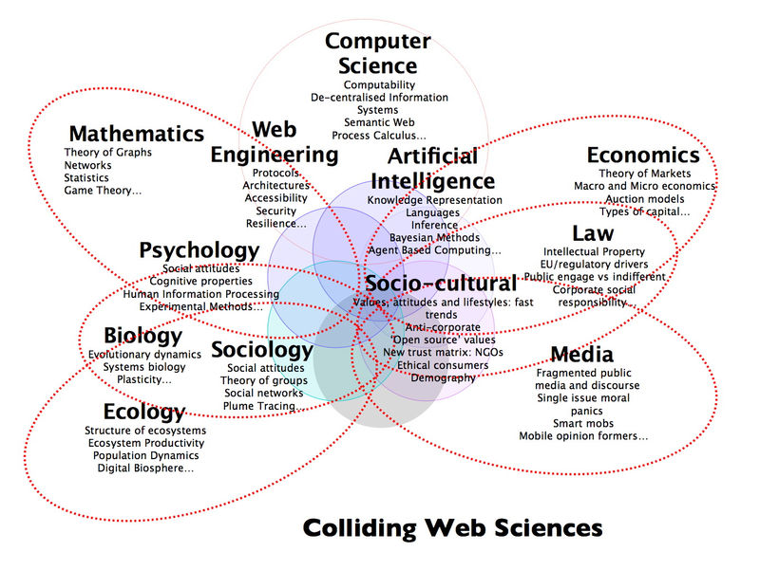
Web Science is Interdisciplinary
Image source http://c21org.typepad.com/.a/6a00d8341cb3ca53ef0105365806c2970b-800wi

Slide 6
3. What Does Web Science Involve?
There is a large aspect of human behaviour as well as the technical aspect
Areas of focus include the Web’s:
Architectural principles
Development and growth
Capacity for furthering global knowledge and communication
Inherent values of
Trustworthiness
Privacy
Respect for social boundaries

Slide 7
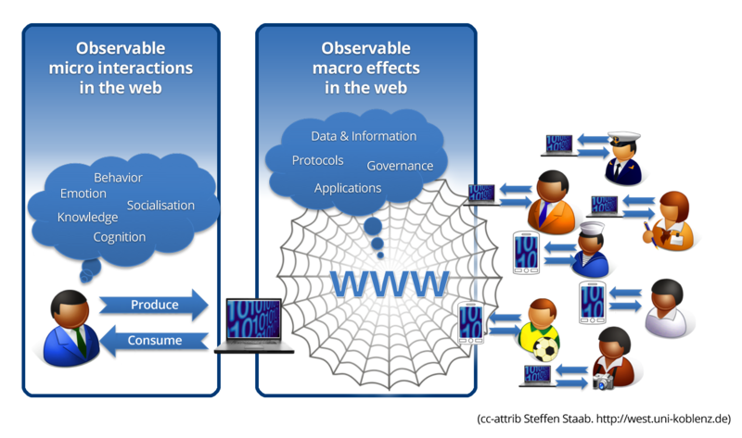
Human Behaviour and the Web

Slide 8
4. Web Science Views Things Differently
Web Science looks at the Web differently to the way that users do
Users focus on narrow aspects of the Web that interest them, and only look at the end result – the page they see
Web Science zooms out and focuses on the Web as a whole and looks at both the content and behind the scenes stuff
Interdisciplinary means web science isn’t just laboratory research – it includes social and political aspects which are vital to directing the Web’s future

Slide 9
5. Political Engagement
The development of the web has enabled us to gain a greater insight into politics around the world.
This has empowered people and given individuals a voice
Web science looks to understand political communications.
Many feel that the use of the web in making political decision could be far more effective.
For example, the web could be used to give individuals a vote on individual issues rather than one general election every few years.

Slide 10
6. Viral Phenomena
Memes Articles Videos Marketing Charity
Every organisation wants information about their product to ‘go viral’
Items which go viral tend to be amusing, or provide the viewer with some other positive emotion.
Emotions are naturally contagious, and sharing content online allows us to fulfil our desire to share our emotions.
Johan Berger has carried out a lot of research into the factors which make us more likely to share content online.

Slide 11
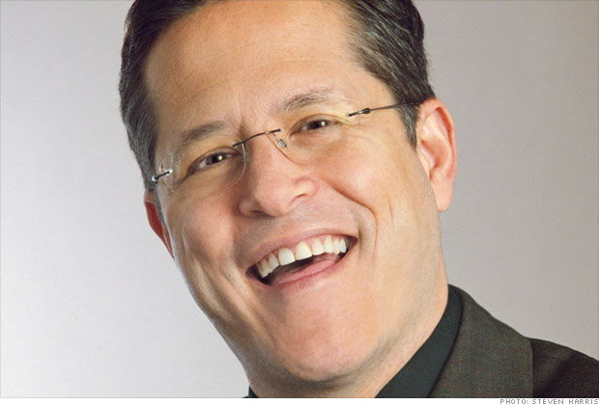
7. Cyborgs & Online LifeStyles
Web science looks to understand how we use the internet to portray ourselves online.
Most internet users attempt to separate personal and professional online profiles.
There is a tendency, however, to mix them together so that clients and colleagues will not judge a person for the fullness of their existence.
Public figures often maintain many online profiles to appeal to all audiences.
Richard Laermer:
$$5×$$
$$6×$$

Slide 12
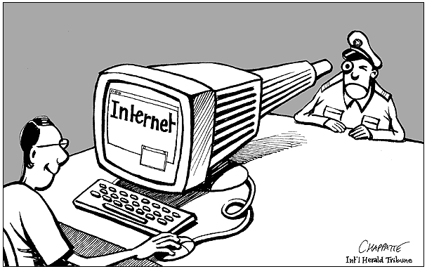
8. Privacy and Censorship

Slide 13
Why have it?
Moral Censorship
Military Censorship
Political Censorship
Religious Censorship
Corporate Censorship

Slide 14
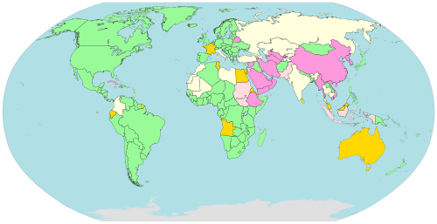

Slide 15
A general view
A BBC World Service poll of 27,973 adults in 26 countries, including 14,306 Internet users, was conducted between 30 November 2009 and 7 February 2010. The head of the polling organization felt, overall, that the poll showed that:
(78%) Internet users felt that the Internet
had brought them greater freedom
(53%) felt that the internet should never
be regulated by any level of government
Access to the Internet was a fundamental right
(50% strongly agreed, 29% somewhat agreed,
9% somewhat disagreed, 6% strongly disagreed,
and 6% gave no opinion)

Slide 16
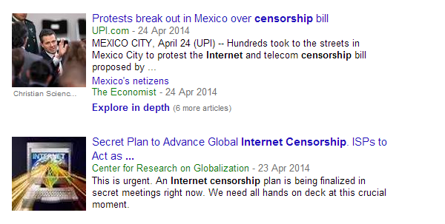
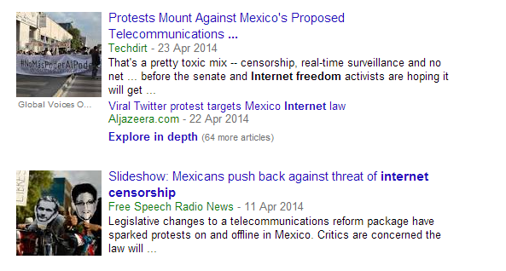

Slide 18
9. Copyright, DRM and IP

Slide 19
File sharing
The controversy over file-sharing and copyright has been flaring since the appearance of Napster in 1999, but more recently, in 2007 the Recording Industry Association of America (RIAA) undertook a campaign of suing people for downloading or uploading copyrighted material without permission.
Recording Industry Association of America (RIAA)
Motion Picture Association of America (MPAA)

Slide 20
DRM digital rights management
First-Gen DRM: control copying
Second-Gen DRM: control executing, viewing, copying, printing, altering

Slide 21
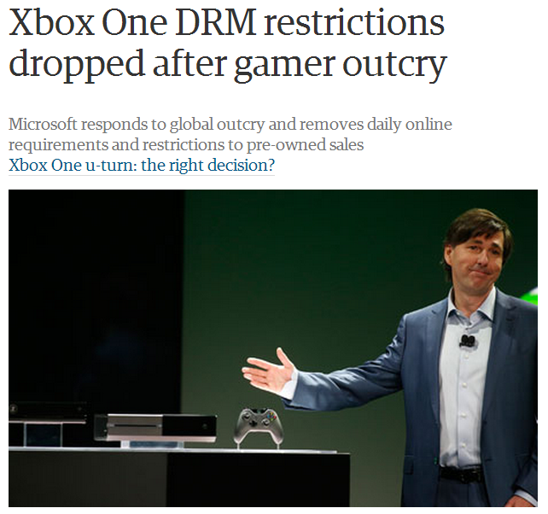

Slide 22
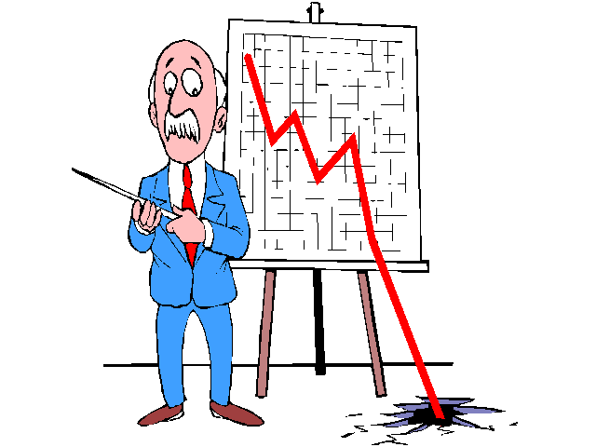
10. Web Economics

Slide 23
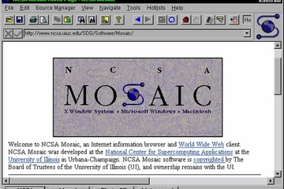
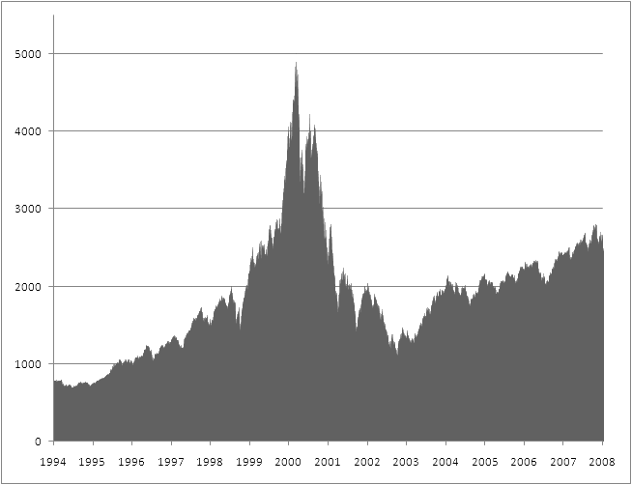
Dot-com bubble
A rapid rise in equity markets fuelled by investments in internet-based companies. During the dotcom bubble of the late 1990s, the value of equity markets grew exponentially, with the technology-dominated Nasdaq index rising from under 1,000 to 5,000 between 1995 and 2000.

Slide 24
2012 Approximate Earnings
$21,800,000,000
$19,166,000,000
$7,200,000,000
$6,290,000,000
$3,214,000,000

Slide 25
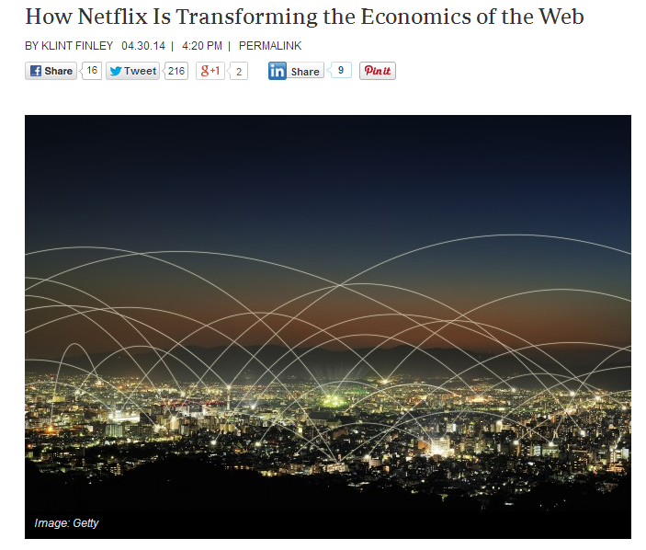
In order to ensure that its video streams arrive in homes without too many hiccups, Netflix is following in the footsteps of Google and Facebook, building a straighter path into ISPs

Slide 26
“But "bubble" isn't the right metaphor for today's tech industry. When it comes to startups, it's more like roulette, and the players have chips to burn.”

Slide 27
11. Trust
There is a big difference between the true identity of a person and the “internet” identity
When talking to a person online, you can not be sure if the other person is who they claim to be, unless you can see them on video
Dating sites and Facebook profiles are a perfect example, people making fake profiles using other peoples photos and information to trick others

Slide 28
12.Dark Web/Under Web
Just like every city has a dark place where bad things happened (drugs selling, fights, illegal acts) the same thing is with the web
This place is called the Dark Web
For it to function, networks which offered animosity must exist, such as
TOR network and Bitcon
Sites similar to eBay and Amazon can be accessed only by using the TOR network, where you can buy drugs, guns or black market products
Atlantis stayed opened for 6 months until it was closed for “security issues” but Silk Road is still running, having an exceptional security, police being unable to find the owner

Slide 29
13. Social shaping of Technology
The Social shaping of Technology refers direction or trajectory of innovations programs which had implications on social groups.
Technology has and will always change the social aspects of our lives
Examples:
New innovations can save us a lot of time (computers when doing calculations, microwaves ovens)
Internet allows us to talk to people from all around the world, thus learning about other cultures, meeting other people or saving a long distance relationship.
The development of computer technology has followed trajectories that are close to natural laws, the most famous being Moore’s law, describing how the number of components on a state-of-the-art microchip doubles in a fixed, predictable period of time

Slide 30
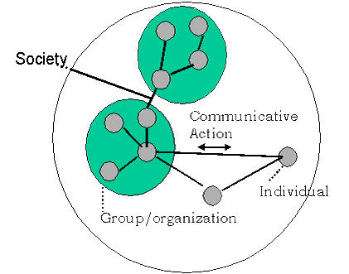
14. Netwrk Analysis
Social Network Analysis - study of social structure of relationships

Slide 31
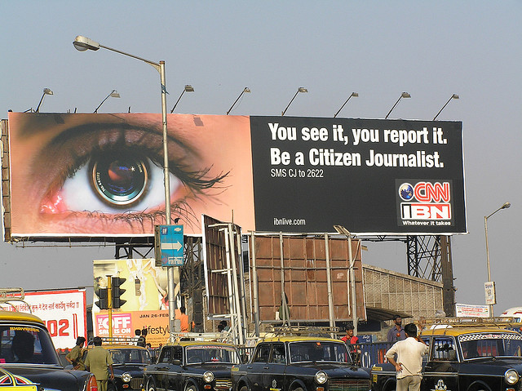
15. Citizen Journalism
What is Citizen Journalism?
Usage of technologies - such as digital audio and video, online tools!
Downsides?

Slide 32
16. Religion
There are many sites dedicated to religion on the internet.
Many of these websites are discussion groups or for giving people religious advice
For example, many churches have websites which attempt to form a Christian community online
Websites are used by many new religious movements, such as the Church of Scientology, which allows you to take a personality test and then asks you to go to your local Church of Scientology to get and review the results.
Some believe that the internet is “killing” religion, with studies showing a rise in religious affiliation along with the rise in internet use.

Slide 33
Summary
Web science is the collaboration of Technology and People
It is the study of socio-technical systems
Web sciences recognises the interaction between people and technology
The web is a network of people using computers
It studies the way the this network has changed the way we communicate.
Web science involves processing the information available on the web in a scientific manner
Web science views the web differently to the way avid users do.

Slide 34
Sources Used
2, 3, 4
http://www.southampton.ac.uk/webscience
http://www.southampton.ac.uk/webscience/undergraduate/courses/i201_bsc_web_science_computer_science.page#modules
https://www.futurelearn.com/courses/web-science
http://en.wikipedia.org/wiki/Web_science
http://en.wikipedia.org/wiki/Sociotechnical_system
http://www.bbc.co.uk/schools/gcsebitesize/ict/datacomm/0internetrev1.shtml
http://en.wikipedia.org/wiki/World_Wide_Web
http://dtc.webscience.ecs.soton.ac.uk/about-webscience-main-site/
about-web-science/
5, 6, 7
http://m.fastcodesign.com/3024276/evidence/these-scientists-studied-why-internet-stories-go-viral-you-wont-believe-what-they-f
http://www.forbes.com/sites/meghancasserly/2011/01/26/multiple-personalities-and-social-media-the-many-faces-of-me/

Slide 35
Sources Used
8, 9, 10
http://en.wikipedia.org/wiki/Internet_censorship
http://www.incomediary.com/top-earning-websites
http://en.wikipedia.org/wiki/Web_science
http://en.wikipedia.org/wiki/Digital_economy
http://www.wired.com/2014/04/netflix-economics/
http://online.wsj.com/news/articles/SB10001424052702304163604579531460215555456?mg=reno64-wsj&url=http%3A%2F%2Fonline.wsj.com%2Farticle%2FSB10001424052702304163604579531460215555456.html
11,12,13
http://www.pcworld.com/article/2105784/mcafee-shines-a-light-on-the-dangers-of-the-dark-web.html
http://mcaf.ee/qw7fe
http://eprints.lse.ac.uk/28638/1/Introductory%20essay%20(LSERO).pdf
http://www.channel4.com/news/drugs-dark-web-atlantis-silk-road-police-fbi

Slide 36
Sources Used
16
http://www.technologyreview.com/view/526111/how-the-internet-is-taking-away-americas-religion/

