Slide 1
Green IT – Solutions And Benefits (Group J)
Todd Lynes
Max Sharpington
Jayden Patten
Sean Knowelden
Connor Valerio

Slide 2
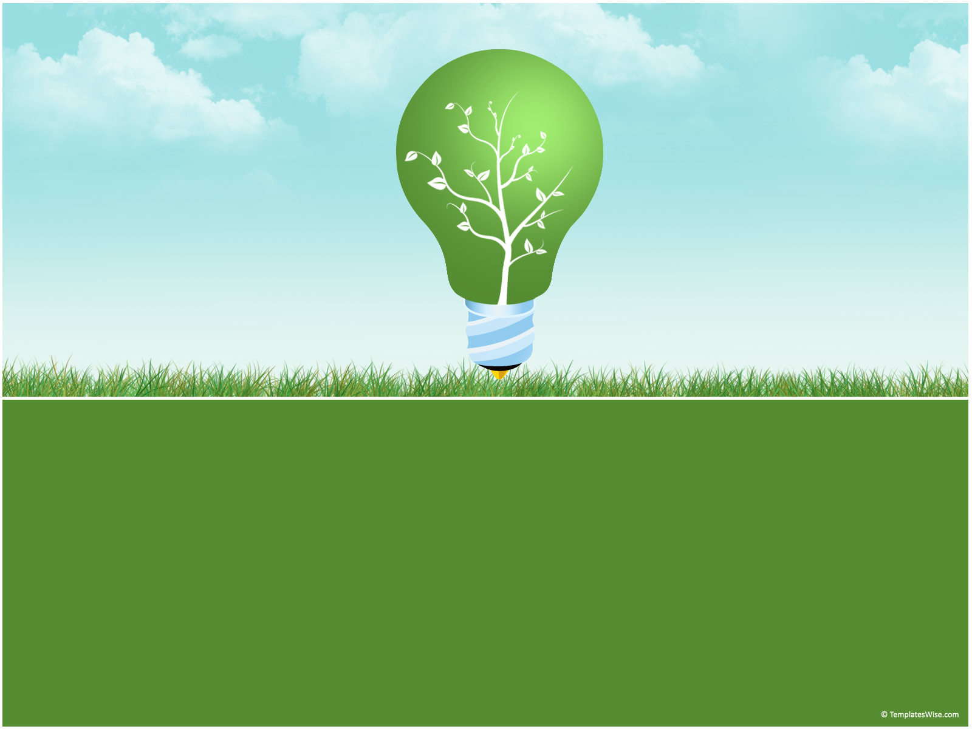
Green IT – Solutions And Benefits
By Todd Lynes, Max Sharpington, Jayden Patten, Sean Knowelden & Connor Valerio

Slide 3
Applying Green IT
Todd Lynes

Slide 4
Managing Expectations
Reality of green IT

Slide 5
Misconceptions
There remain a number of misconceptions about sustainability, some of the more common being:
It is expensive to implement
It relates simply to saving the planet and is not a business issue
It is driven by compliance
It is just about energy savings
It is just about the datacentre
It is just about what goes on within IT

Slide 6
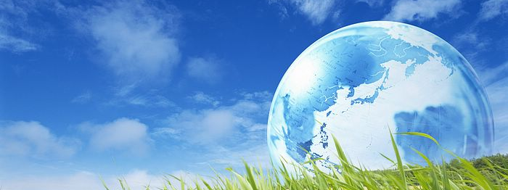
A McKinsey & Company study estimates carbon dioxide (CO2) emissions from data centres will quadruple to exceed emissions from the airline industry by 2020, owing to the rapid growth in global demand for computing power. (Source: DEA-543 © 2012 General Electric Company).
Data centres alone create more c02 than the Airline industry

Slide 7
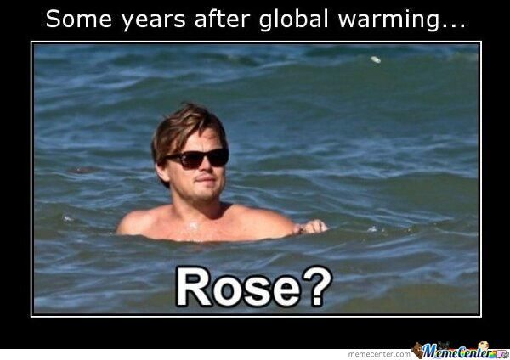

Slide 8
Symantec green it report [2009] findings
The key findings of the 2009 Worldwide Green IT Report are:
Green IT is now an “essential”
Green IT budgets are rising
IT is willing to pay a premium for green equipment
IT is at the heart of enterprise green efforts
Green IT initiatives are more of a priority

Slide 9
Implementations
How is green IT implemented?

Slide 10
What to Implement
Offsets
Technology

Slide 11
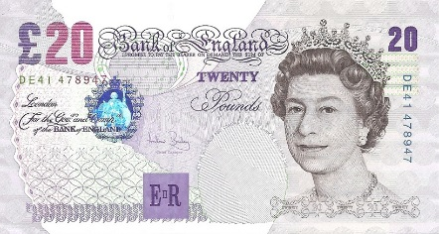
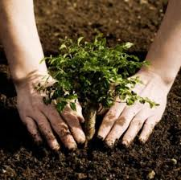
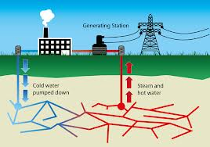
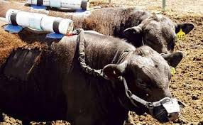
Easy option - offsetting
Easy to implement as you just purchase an offset from a seller, equal to the amount of electricity used.

Slide 12
Problems with Employing Green IT
It’s not all sunshine and wind turbines…
Max Sharpington

Slide 13
Cost
More energy efficient items usually cost more.
Standard replacement cycle 2-3 years, will the cost savings pay off the increased initial price?
Increasingly Green solutions require increasingly drastic redesigns of not just the devices used, but the office/business environment.

Slide 14
Other priorities
Businesses want money
Resistance to change
Split company responsibility (IT wants cheap products, facilities want low power consumption)

Slide 15
Green Electricity
Supplies of Green Electricity limited
People dislike Nuclear/Wind Farms.

Slide 16
Disposal
20-50 million tons of e-waste generated each year (UNEP)
Can reuse/refurbish/recycle

Slide 17
Legal Constraints in Green IT
Jayden Patten

Slide 18
CRC Energy Efficiency Scheme
Sets out emission allowances to companies
Companies can pay to increase their allowance
£12 per tonne of CO2
Managed by the Environment Agency
Applies pressure to companies search for less – energy intensive IT equipment.

Slide 19
Evolution Of Crc Scheme
10/11, 11/12 –Yearly emissions of companies displayed in a league table format
Now replaced with an annual report.
In phase 2 of the scheme, companies will qualify only if they consumed more than 600 megawatt hours of electricity.

Slide 20
WEEE
Waste Electrical and Electronic Equipment
Concerns the disposure of electronic items by companies In the UK.
Part of a wider directive in the EU to control the disposal of waste.
Somewhat unsuccessful during it’s lifetime, with many of the EU states missing their targets.

Slide 21
RoHS
Restriction of Hazardous Substances.
Limits the sale of electrical items with a higher than normal percentage of dangerous materials (e.g. lead).
Forces sale of IT equipment that contains fewer hazardous materials

Slide 22
Main Restricted Substances
Lead
Mercury
Cadmium
Hexavalent Chromium
Polybrominated Biphenyls
Polybrominated Diphenyl Ether

Slide 23
Lack of direction
Very few concrete laws on the topic of Green IT
No main figure in government that specifically deals with the issues
E.G. the WEEE scheme being run by DEFRA, who are more focused on rural affairs.

Slide 24
Technological Advances in the field of IT
Sean Knowelden

Slide 25
Technological Advances in the field of IT
Computers are getting more power intensive as they get more powerful - To put the matter concretely, if a modern-day MacBook Air operated at the energy efficiency of computers from 1991, its fully charged battery would last all of 2.5 second (MIT Technology)
The electrical efficiency of computing has also doubled every year and a half since the dawn of the computer age

Slide 26
Dynamic Voltage Scaling/ Algorithm Efficiency
New technology of UnderVolting, interesting contrast to OverVolting (Often called OverClocking)
When computers use less power on less intensive tasks, use less power overall
More efficient Algorithms – google for example, a typical search is equivalent to about 0.2 grams of CO2

Slide 27
Technology in the workplace
Liquid cooling mechanisms are often far more efficient than air conditioning/ large fans
Mitsubishi have developed water-cooling systems powered by the heat given off by the computer systems themselves
Systems are being developed to automatically turn off computers after a time of inactivity or after being left unused for a period of time.

Slide 28
Specific companies with an environmental goal
SquareSpace servers use only green energy suppliers
Make sure to recycle all their E-waste
Offset their Carbon
Employees even cycle or bus to work!
As environmental issues become more prevalent, this sort of company may not be so unique…

Slide 29
Money Spent vs. Money saved
Connor Valerio

Slide 30
Is it all worth it? What is epeat?
It is evident that some businesses must think so…
According to ‘infoworld’, 22% of computers shipped in 2007 (around 109 million) were registered EPEAT. This was a dramatic increase from around 10% in 2006.
EPEAT is ‘the Electronic Product Environmental Assessment Tool’.
Products in EPEAT database have reduced cadmium, lead and mercury.
Also made to be recycled and upgraded more easily!
Depending on the level of criteria they meet, hardware is awarded a bronze, silver or gold rating.

Slide 31
How exactly will it benefit businesses and organisations?
As mentioned earlier, the standard replacement cycle is every 2-3 years…
Green technologies are known to have an extended life period in comparison to their usual counterparts.
Initial extra expense, justified considering long term costs of employee health care, lower maintenance costs & life-cycle impacts of greener products.
Can increase a business’s image/reputation
Business’s can use their carbon emission statistics as a way of promoting their products/services

Slide 32
How easy is it?
According to ‘Computer Weekly’, implementing desktop virtualisation systems can save a lot of money…
Desktop virtualisation systems which reside on a back end server, can be used to provide user’s with a personalised image of their desktop
Savings include £78,000 per year for every 1000 PCs
Allows for consolidation of 250 dual-core servers into 25 by using desktop virtualisation.
Using this method can also provide power & cooling savings of around £140,000.

