Slide 1
Sustainability
responsibilities and legislation
Group I

Slide 2
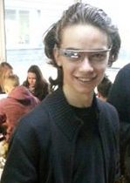
Sabin Marcu
Tianyu Zhou

Slide 3
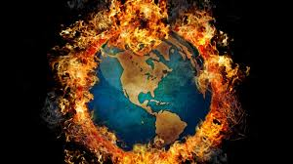
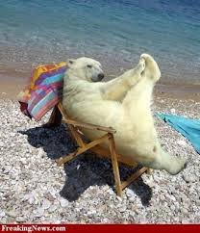
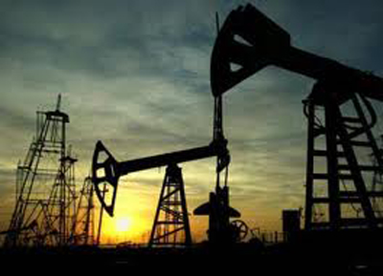
What will happen without sustainability

Slide 4
Global Warming
Sea level will increase because of ice melting. Data shows that from 1993, the sea level increase around 3.3 mm per year.
It will bring problems to people’s life and the ecosystem

Slide 5
Can IT cause global warming?
Of course it can!
IT system need to run by using electricity and most of the electricity is produced by burning fossil fuels.
Can anyone guess how many tons of CO2 our university produce every year?

Slide 6
Just a general introduce
For every year:
each server produces 8 tons of CO2
each PC and laptop produces 4 tons of CO2
each printers and photocopiers produces 10 tons of CO2
each router produces 20 tons of CO2
each Ethernet switch produces 5 tons of CO2

Slide 7
Energy Poverty
Most of the traditional energy is nonrenewable, so after intensive consumption of energy, there will be a shortage of resources.
Such as fossil fuels (oil, coal, natural gasses).

Slide 8
Back to IT
Each IT product need electricity which is produced by burning of fossil fuels.
To produce IT products, we need metal and ore, especially silicon.
To deal with the old PC, we also require special staff.

Slide 9
Legal Aspect of the GreenIT issue

Slide 10
Climate Change Act (2008)
Act of the Parliament of the United Kingdom
The goal is to have 80% lower carbon emissions (than 1990) for all six Kyoto greenhouse gases by 2050
Based on the Private Member’s Bill (2005)
Aided by the Climate Change and Sustainable Energy Act (2006)

Slide 11
CRC Energy Efficiency Scheme
CRC is a scheme designed to reduce emissions and encourages organisations to develop energy management strategies.
Organisations that meet the qualification criteria (over 6000 MWh per year) are required to participate, and must buy allowances for every tonne of carbon they emit. (£12 for each tonne)
It is basically forcing companies to either reduce energy usage, and in turn, CO₂ emissions, or pay for each tonne produced. Considering our numbers earlier, an estimate of payment can be quite high.

Slide 12
WEEE (Waste Electrical and Electronic Equipment Directive)
European Law since February 2003
Sets collection, recycling and recovery targets for electrical goods
Minimum rate of 4kg / head of population / year by 2009
The “3 Rs”: reduce, reuse, recycle.

Slide 13
RoHS (Restriction of Hazardous Substances Directive)
European Law since February 2003
Restricts the use of six hazardous materials in the manufacture of various types of electronic and electrical equipment

Slide 14
The materials restricted are :
Lead (Pb)
Mercury (Hg)
Cadmium (Cd)
Hexavalent chromium (Cr⁶⁺)
Polybrominated biphenyls (PBB)
Polybrominated diphenyl ether (PBDE)
The maximum permitted concentrations of these materials is 0.1% (or 0.01% for cadmium) in each homogeneous material.
This means that any object can contain a lot more than 0.1% concentration of any such materials.

Slide 15
ISO 14001 and IEEE 1680
ISO 14001 maps out a framework that a company or organization can follow to set up an effective environmental management system.
Its main aim is to assist companies in continually improving their environmental performance, complying with any applicable legislation (see CRC) at the same time.
IEEE 1680 is a standard set by IEEE for the environmental performance criteria for desktop computers, notebook computers, and monitors.
It is a standard for green computing at desktop level.

Slide 16
EN 16001 and ISO 50001
EN 16001 is an European Union standard elaborated and published on the 1st of July 2009
Its primary objective is diminishing the emissions of greenhouse gasses.
Based on EN 16001 (and others), ISO 50001 was released in June 2011
Is an upgrade on ISO 140001 and ISO 9100
However, while ISO 140001 focuses on environmental impacts of an organisation, ISO 50001 focuses on energy efficiency
Also, ISO 50001 helps in reducing energy costs for companies (in turn, reducing CO₂ pollution)

