Slide 1
Group C: Banter, jokes, freedom of speech and defamation
By: Lendina Hykaj
Aliyu Aliyu
Zia Ahmed
Baran Sezgin
Timur Aliev
Panashe Makanza

Slide 2
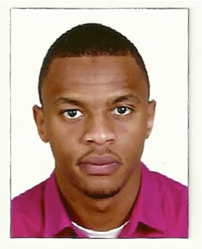
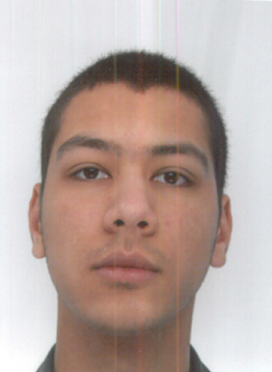
Members
Aliyu Aliyu
Panashe Makanza
Lendina Hykaj
Zia Ahmed
Baran Sezgin
Timur Aliev

Slide 3
Presentation Plan
Definitions
Freedom of Speech
Defamation
Defamation Law and Internet Service Providers
Political Interference
Cyber-crime

Slide 4
Definitions
Banter: the playful and friendly exchange of teasing remarks.
Freedom of Speech: is the political right to communicate one's opinions and ideas using one's body and property to anyone who is willing to receive them.
Defamation: is the communication of a false statement that harms the reputation of an individual business, product, group, government, religion, or nation.

Slide 5
Freedom of Speech
Humans Right Act: the right to freedom of expression is now expressly guaranteed.
It includes the right to hold and express opinions yourself as well as to receive and impart information and ideas to others.
It applied not only to information that is favorable but also to those that offend the State or certain people.
Notes:
Before the Human Rights Act came into force, the right to freedom of expression was a negative one: you were free to express yourself, unless the law otherwise prevented you from doing so.
However, with the incorporation of the European Convention on Human Rights (ECHR) into English and Welsh domestic law, the right to freedom of expression is now expressly guaranteed.

Slide 6
Freedom of Speech
Everyone has the right to freedom of expression.
The right to freedom of expression in Article 10 is not an absolute right. It is a qualified right.
However this right is subject to formalities, conditions, restrictions or penalties as are prescribed by law.
Notes:
The freedom to hold opinions and to receive and impart information and ideas without interference by a public authority.
Rhetorical question..
"There is freedom of speech, but I cannot guarantee freedom after speech”- Idi Amin of Uganda.

Slide 7
Defamation
An online threat made by
an individual online cannot
be pushed ahead with a case
unless it carries real menace.
Libel is a published false statement, which might damage a person’s reputation.
EXAMPLES
Injunctions:the media
organisations or social
media users can face
prosecution for contempt
of court.
Offensive comments: the punishment varies depending on the comment,
Naming a victim of a
sex attack on the internet
is an offence
Jurors are not allowed to
look up information on the
internet and go by what they see

Slide 8
Defamation Law and Internet Service Providers
Defamation Act 2013: The aim of the Bill is to reform the law of defamation to ensure that a fair balance is struck between the right to freedom of expression and the protection of reputation.
ISPs should be held liable for libel if they fail to act after being notified about it.
ISPs should be allowed to scrutinise material that is claimed to be libellous before they take action so as to accommodate freedom of expression.
There should be a balance between freedom of expression and protection of reputation.

Slide 9
Political interference
Political Anger and Patriotism expressed through “Hacktivism “phenomenon in China
The Great Firewall of China
Twitter ban in Turkey.
Blogger arrests in Russia
Notes:
Hacktivism in China – ways of expressing anger, patriotic feeling and protest in China. These actions are suppressed by the government in real world, leaving citizens only one choice – the web
The great firewall of china – the government controls access to certain resources, that might bring unnecessary questions and ideas in people’s minds. E.g. some of western news websites are blocked.
Twitter ban in Turkey - an attempt to hide proves of illegal actions from high-ranking officials http://www.nytimes.com/2014/03/21/world/europe/turkish-officials-block-twitter-in-leak-inquiry.html?action=click&amp;module=Search&amp;region=searchResults%230&amp;version=&amp;url=http%3A%2F%2Fquery.nytimes.com%2Fsearch%2Fsitesearch%2F%3Faction%3Dclick%26region%3DMasthead%26pgtype%3DHomepage%26module%3DSearchSubmit%26contentCollection%3DHomepage%26t%3Dqry249%23%2Fturkey%2520twitter
On of the most famous Russian bloggers was arrester and charged for statements run counter the present government’s position

Slide 10
Cyber-Crime
Firstly, one should consider the main types of cybercrime;
Theft
Bullying
Trespassing
Violence
Obscenity
One needs to understand that the internet has provided criminals with another platform to commit serious crime to a larger number of people all around the world.
Social networking has developed an opportunity for online predators to conduct hateful behaviours within the virtual world engaging virtual characters and avatars that provide no specification of the person themselves (for example age, sex etc ).
Notes:
It is also worth asking what makes hate a ‘cyber-crime’ because cyberspace is not simply an extension of real space. Certainly, some cybercrimes use computers to assist traditional offending, with the opportunity, for their authors, to widen the crime spectrum by going global (Wall, 2007: 44-45). Hence the terms of cyber-trespass, cyber-theft, cyber-violence, and cyber-obscenity (which includes hatred) to underline the continuity between offline and online illegal behaviors (Wall, 1999; 2001: 3-7). On the other hand, some hateful behaviours can happen in virtual worlds engaging virtual characters or avatars.

Slide 11
Distributed Denial of Service
Distributed Denial of Service (DoS) attacks are also an effective means to slow down or shut down a website of an organisation representing a hated group (religious, gay and lesbian websites...)
Cyberspace is not simply a medium of direct communication between people who choose to reveal who they are offline.
Notes:
12. Immediately after 9/11, an attack was launched against a muslim usenet group (Leyden, 2001) and the website of Al-Jazeera was targeted in 2003 (Gray, 2003). In 2007, the Gay Gamer site was object of a DoS attack by a homophobic group (Crecente, 2007). More recently, although more controversially because some countries like France do not recognize it as a religious group13,

Slide 12
Thank you for listening! Any questions?

