Slide 1
Open Innovation and Novel Business Practices
Group B

Slide 2
Group members
Caroline
Chris
Dan
Ivonne
Jason
Marcos
Victor

Slide 3
“Open Innovation is the use of purposive inflows and outflows of knowledge to accelerate innovation. With knowledge now widely distributed, companies cannot rely entirely on their own research, but should acquire inventions or intellectual property from other companies when it advances the business model.”
-Henry Chesbrough

Slide 4
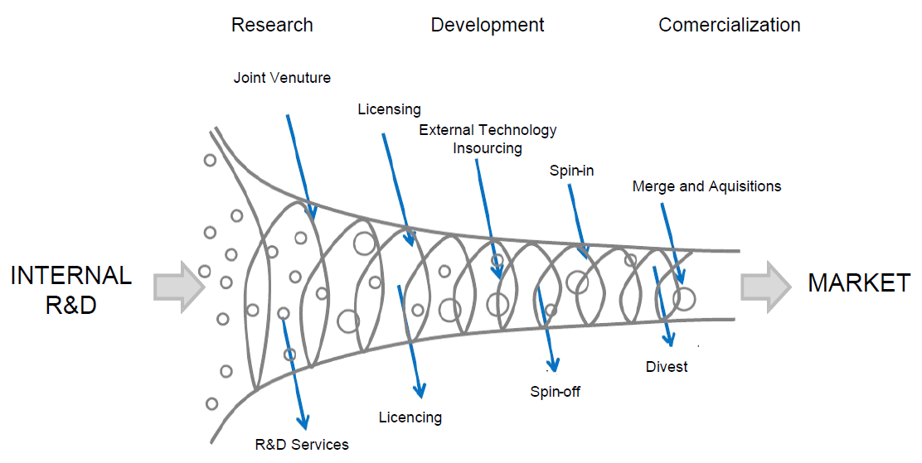

Slide 5
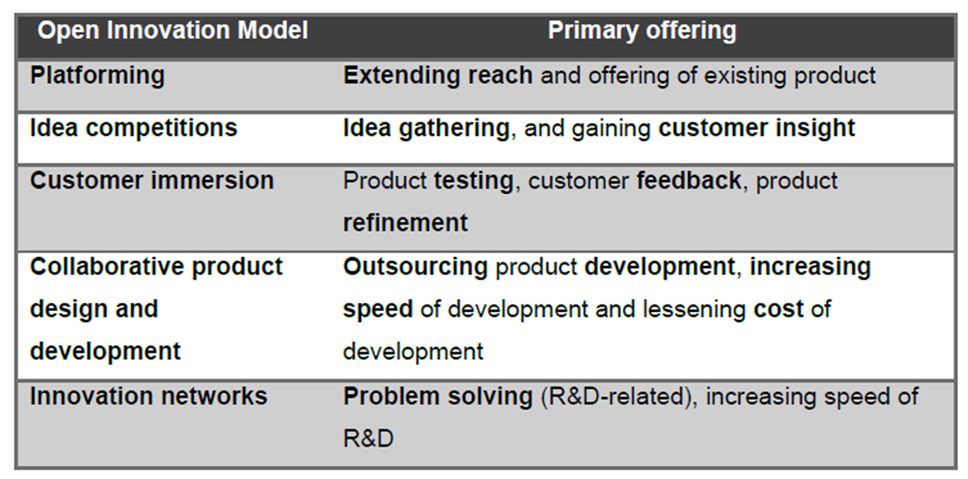

Slide 6
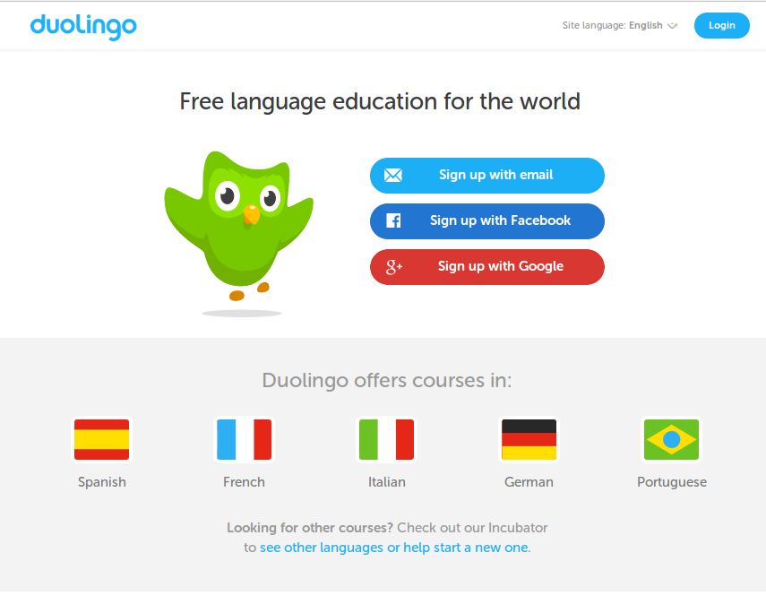
Case study 1: Duolingo

Slide 7
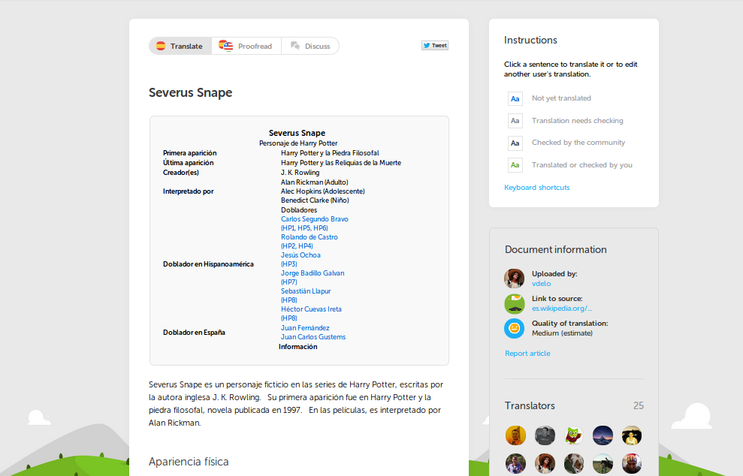
User translations of articles

Slide 8
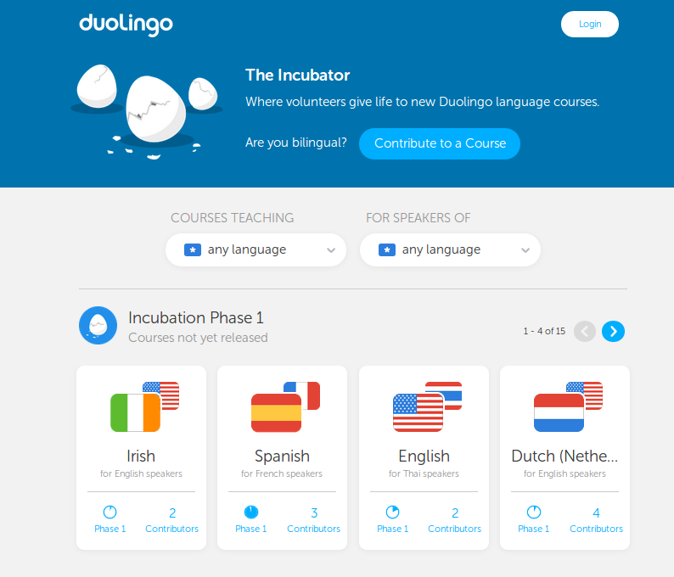
User-generated content

Slide 9
Case study 2: LEGO
Claim that they have manufactured 400 billion LEGO elements
There are 62 LEGO bricks for every person in the world
Bankruptcy
In 2004 LEGO reported a record deficit of US $205 million, with debts adding up to US $1 billion

Slide 10
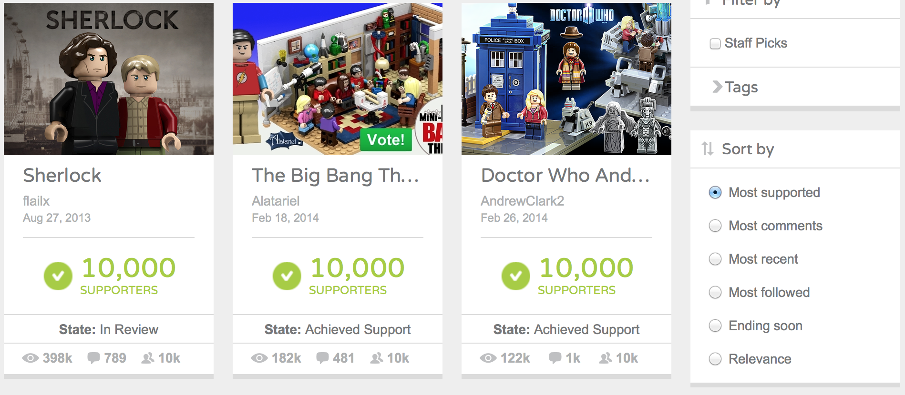
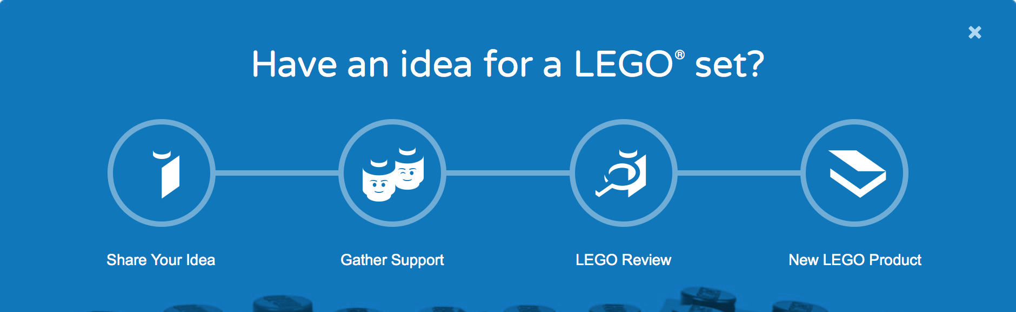
LEGO Cuusoo
Allows users to submit and vote for their favourite ideas

Slide 11
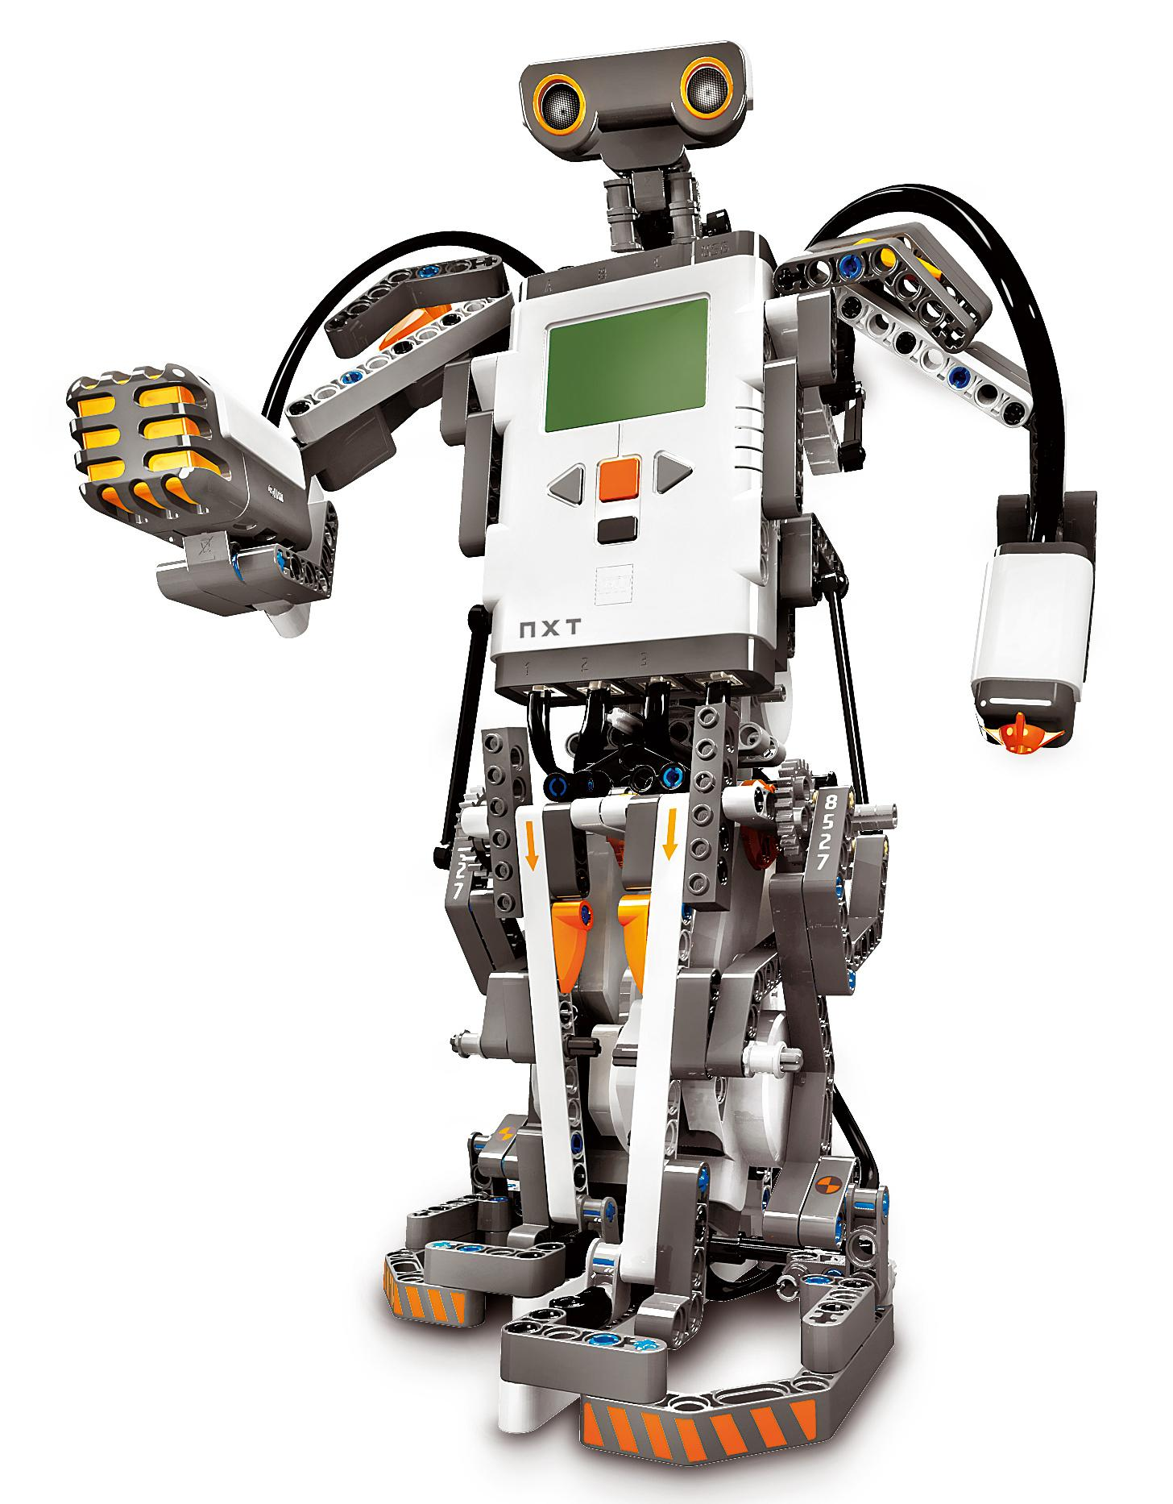
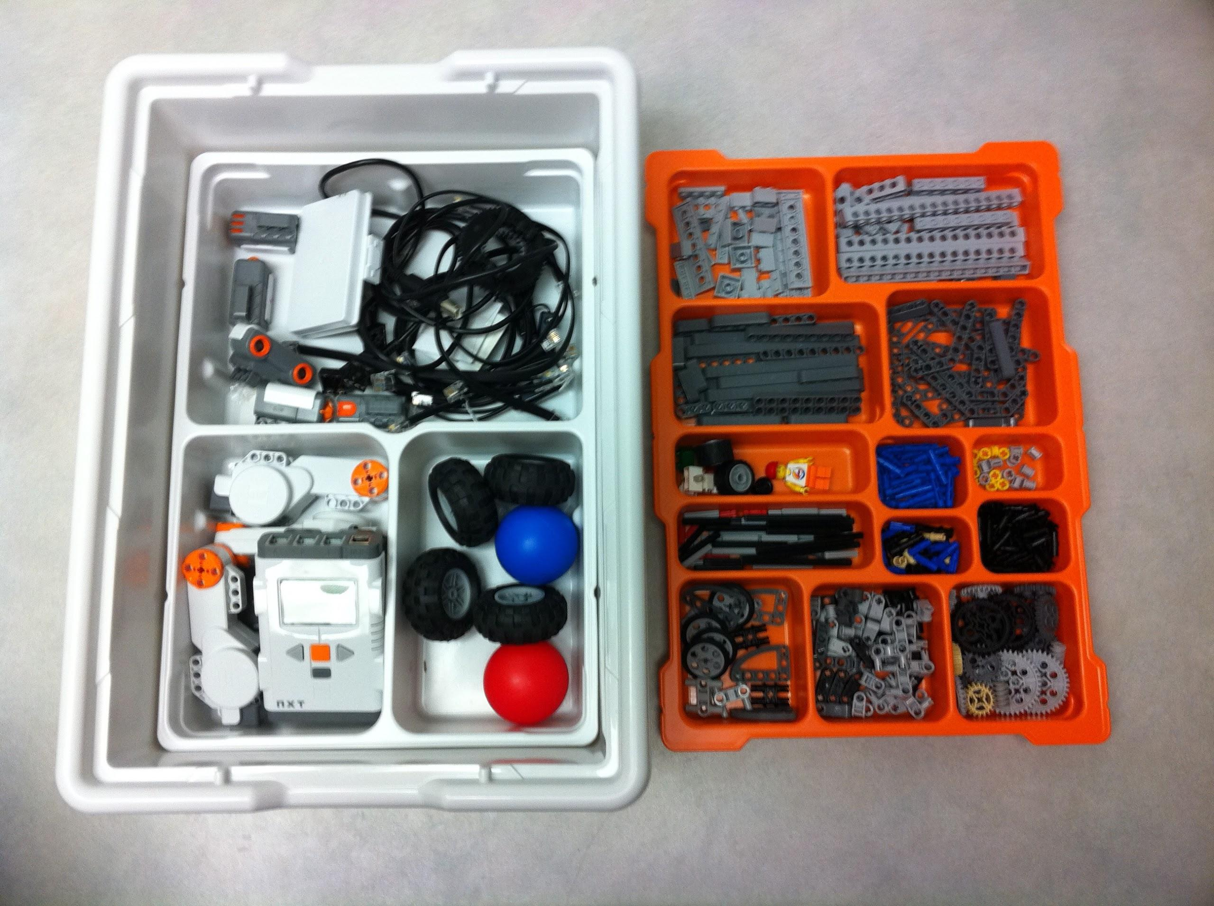
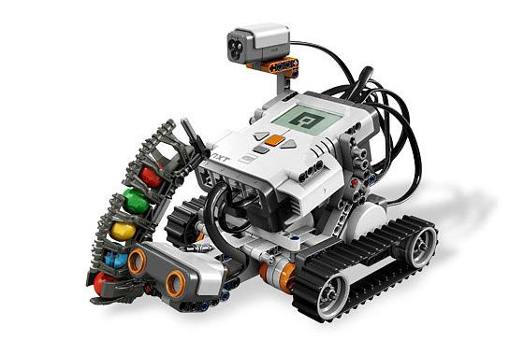
LEGO Mindstorms
Line of Lego sets combining software and hardware to create programmable robots

Slide 12
LEGO Architectures
Sets represent models of famous architectural buildings such as the Eiffel Tower
Notes:
http://brianboidin.wordpress.com/2012/04/11/lego-architecture/
http://www.highsnobiety.com/2013/01/25/lego-architecture-tokyo-imperial-hotel/

Slide 13
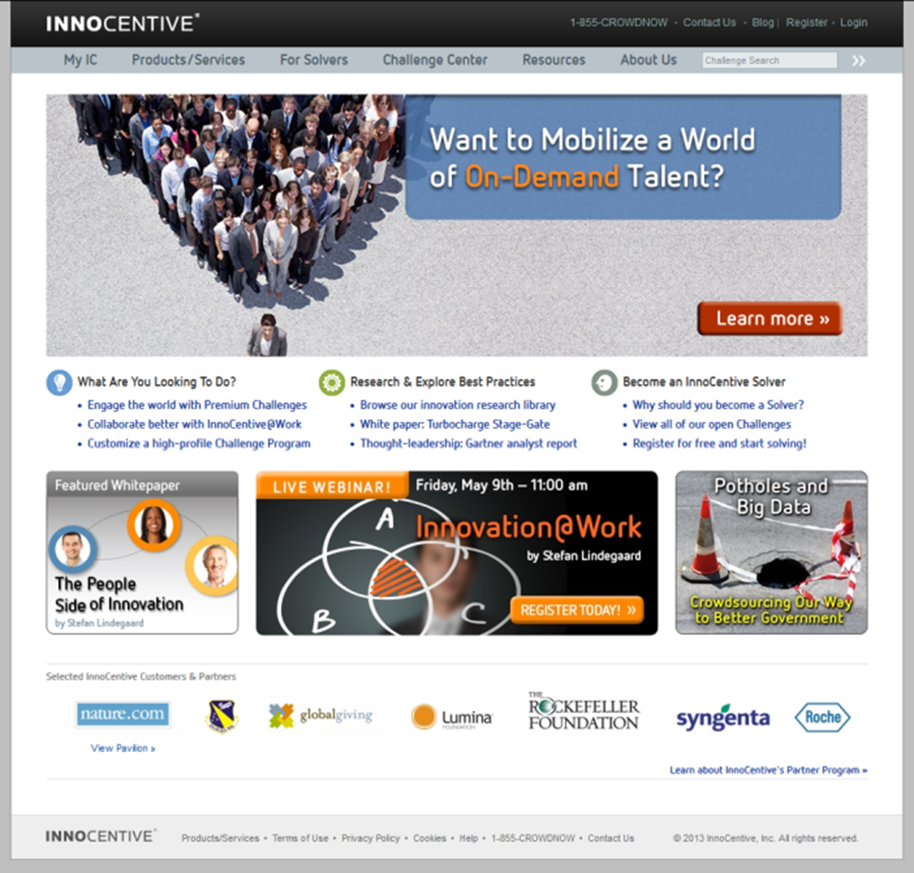
Case study 3: Innocentive

Slide 14
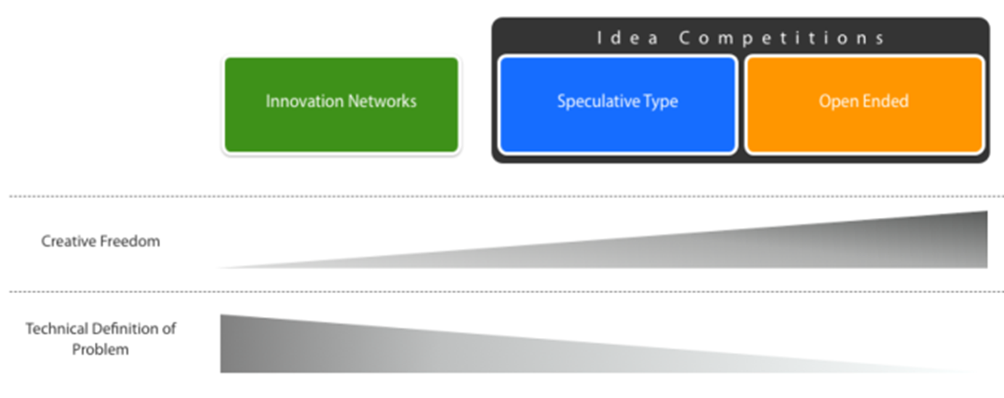
An innovation network
Different from idea competitions

Slide 15
Match solvers to problems faced by seekers posed as challenges
Solutions of note
Prize4Life Awards $1 Million Prize for Major Milestone in ALS Research
Oil Industry Outsider Solves Oil Spill Recovery Challenge
Solver Lights Up African Villages
TB Alliance Works to Eradicate One of the World’s Deadliest Diseases
Helps seekers to solve R&D problems
Allows expert to solve challenging problems, make an impact, and promote themselves

Slide 16
Conclusion
Open Innovation increases development speeds and consumer involvement.
Open Innovation business models encourage collaboration.

Slide 18
Using Open Innovation
Content - Duolingo
Design - LEGO
Research - InnoCentive

Slide 19
References
Chesbrough, H. (2006). Open innovation: a new paradigm for understanding industrial innovation. Open innovation: researching a new paradigm, pp.1--12. Available at: ftp://ftp.ige.unicamp.br/pub/CT010/aula%204/Chesbrough.pdf
Chesbrough, H. (2011). Everything You Need to Know About Open Innovation. [online] Forbes. Available at: http://www.forbes.com/sites/henrychesbrough/2011/03/21/everything-you-need-to-know-about-open-innovation/ [Accessed 30 Apr. 2014].
De.slideshare.net, (2014). Open Innovation - global trends and examples. [online] Available at: http://de.slideshare.net/guest2de8ca/open-innovation-global-trends-and-examples [Accessed 30 Apr. 2014]
MIT Sloan Management Review, (2013). Using Open Innovation to Identify the Best Ideas | MIT Sloan Management Review. [online] Available at: http://sloanreview.mit.edu/article/using-open-innovation-to-identify-the-best-ideas/ [Accessed 30 Apr. 2014]
Scholar.sun.ac.za, (2014). [online] Available at: https://scholar.sun.ac.za/bitstream/handle/10019.1/2891/Marais,%20S.J.pdf?sequence=1 [Accessed 1 May. 2014]
Schutte, C. (2014). The Development Of Open Innovation Models To Assist The Innovation Process. [online] Academia.edu. Available at: http://www.academia.edu/219234/The_Development_Of_Open_Innovation_Models_To_Assist_The_Innovation_Process [Accessed 30 Apr. 2014]
Duolingo.com, (2014). Duolingo | Learn Spanish, French, German, Portuguese, Italian and English for free. [online] Available at: https://www.duolingo.com/en [Accessed 30 Apr. 2014]
The Independent, (2014). Duolingo: The future of language learning that puts a personal tutor in everyone's pocket. [online] Available at: http://www.independent.co.uk/life-style/gadgets-and-tech/features/duolingo-the-future-of-language-learning-that-puts-a-tutor-in-your-pocket-9110192.html [Accessed 30 Apr. 2014]
Incubator.duolingo.com, (2014). Duolingo. [online] Available at: http://incubator.duolingo.com/ [Accessed 30 Apr. 2014]
BrainsFlash, (2012). Lego Architecture. [online] Available at: http://brianboidin.wordpress.com/2012/04/11/lego-architecture/ [Accessed 30 Apr. 2014]

Slide 20
Brickipedia, (2014). Mindstorms. [online] Available at: http://lego.wikia.com/wiki/Mindstorms [Accessed 30 Apr. 2014]
Commons.wikimedia.org, (2010). File:Lego Mindstorms kit.jpg - Wikimedia Commons. [online] Available at: http://commons.wikimedia.org/wiki/File:Lego_Mindstorms_kit.jpg [Accessed 30 Apr. 2014]
Advance, R. (2014). 8547 LEGO� Mindstorms NXT V2 - Robot Advance. [online] Robot-advance.com. Available at: http://www.robot-advance.com/art-8547-lego-mindstorms-nxt-v2-193.htm [Accessed 30 Apr. 2014]
Ideas.lego.com, (2012). LEGO Ideas - Home Page. [online] Available at: https://ideas.lego.com/ [Accessed 30 Apr. 2014]
Laird, M. (2014). Branding by LEGO: Child’s play, or is it? - McGrath Rainey Laird. [online] McGrath Rainey Laird Agency | MRLA. Available at: http://mrlagency.co.uk/branding-childs-play/ [Accessed 1 May. 2014].
Innocentive.com, (2014). Crowdsourcing | Open Innovation | Prize Competitions | InnoCentive. [online] Available at: https://www.innocentive.com/innovation-solutions/products-services-overview [Accessed 30 Apr. 2014]
Innocentive.com, (2014). Crowdsourced Problem Solving | Earn Recognition & Financial Awards. [online] Available at: https://www.innocentive.com/for-solvers/why-solve [Accessed 30 Apr. 2014]
Innocentive.com, (2014). InnoCentive Customer Success Stories. [online] Available at: https://www.innocentive.com/about-innocentive/innovation-solutions-of-note [Accessed 30 Apr. 2014]
Innocentive.com, (2014). Innovation Management | Crowdsourcing | Challenges | Competitions. [online] Available at: https://www.innocentive.com/ [Accessed 30 Apr. 2014]
Lindegaard, S. (2010). The open innovation revolution. 1st ed. Hoboken, NJ: Wiley

