Slide 1
Making Links
An introduction to hypertext
Dr Nicholas Gibbins - nmg@ecs.soton.ac.uk
2013-2014

Slide 2
What is hypertext?

Slide 3
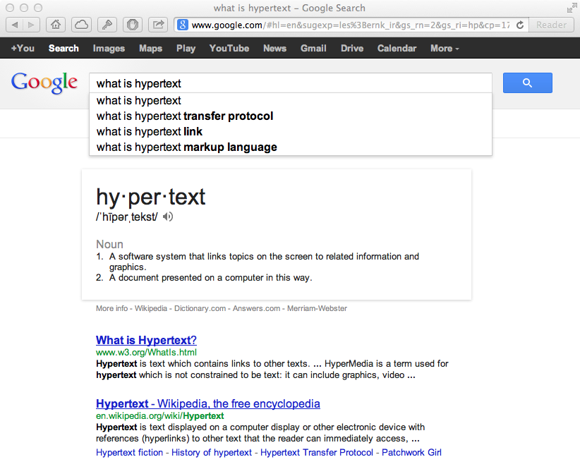

Slide 4
What is Hypertext?
Nelson, T.H. (1965) A file structure for the complex, the changing and the indeterminate.
Proceedings of the 20th ACM National Conference.

Slide 5
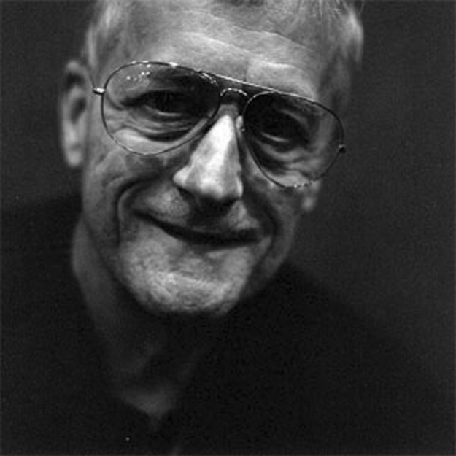
What is Hypertext?
[hypertext is] a combination of natural language text with the computer’s capacity for branching, or dynamic display
Nelson, T.H. (1967) "Getting it out of our system": Information Retrieval: A Critical
Review, Schechter, G. (ed.). Washington, DC: Thompson Books.

Slide 6
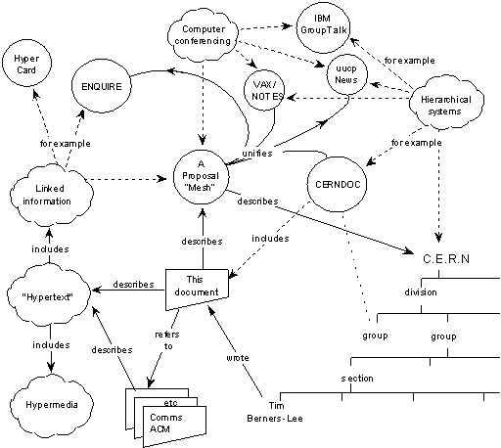
What is Hypertext?

Slide 7
What is Hypertext?
The reaction of the hypertext research community to the World Wide Web is like finding out that you have a fully grown child.
And it’s a delinquent.
Nelson, T.H. (1997) After-dinner speech at Hypertext ‘97, Southampton, UK.

Slide 8
What is Hypertext?
Non-linear writing
  Interlinked texts
  Multiple reading sequences
Annotation and commentary
Association of ideas
Notes:
Associative relationships, Non-linearity, networks
Not flat, linear presentation of information, read sequentially
but a network of nodes connected by links
Author creates connections and (perhaps) the nodes,
but reader interactively follows own trail in preferred order and to depth of detail desired,
... and makes new connections?
Contrast paper documents - sequential reading.
Exceptions
Encyclopaedias?

Slide 9
Hypertext Pioneers
Notes:
The history of hypertext is closely related to the history of information science and information management

Slide 10
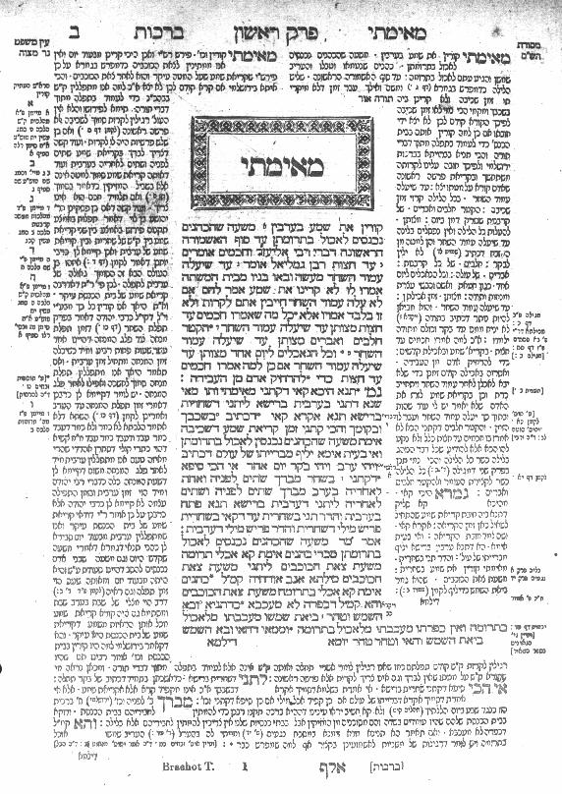
The Talmud
Central text of Rabbinical Judaism
Encoding of oral tradition
Commentaries on original text
Commentaries on commentaries
Notes:
Central text: the law (Mishnah c. 220 CE), legal analysis (Gemara, c. 450CE)
LH: medieval commentaries (Tosaphot, C12-13)
RH: early medieval commentaries by Rabbi Shlomo ben Yitzhak (Rashi, C11-12)
Outer columns: modern commentaries, cross references

Slide 11
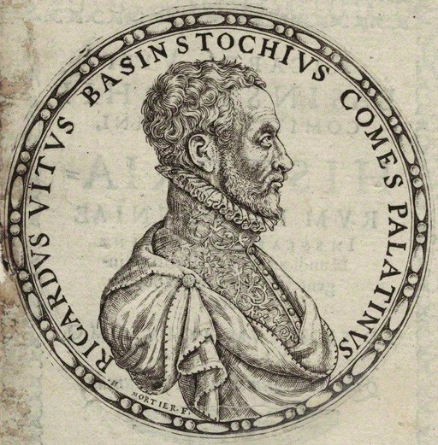
Richard White of Basingstoke
Author of Historiarum libri cum notis antiquitatum Britannicarum (1597-1607)
"as bees take honey from different flowers, so we must take materials from all sorts of different authors and, once they have been systematically collected, store them away, as it were, in the proper combs.”
One of the earliest scholars to make use of endnotes
Notes:
Facts mainly taken from Annio di Viterbo’s Antiquitatum Variarum (1498) (thus largely fabricated)

Slide 12
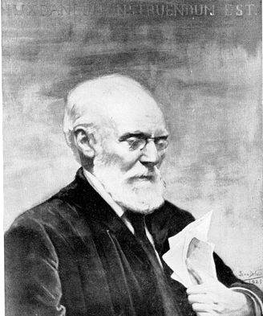
Paul Otlet
Belgian lawyer, internationalist and ‘father of Information Science’
Created the Universal Decimal Classification for libraries
(still in use around the world)
With Henri La Fontaine, established the Répertoire Bibliographique Universel in 1895
Notes:
UDC is Dewey based – Melville Dewey agreed to modifications, as long as UDC was not translated into English
RBU – fee-based service
15 million 3x5 index cards by 1934
“What works have been written by this or that author?” and “What has been written on this or that subject?”
Universal Iconographic Repertory from 1906
La Fontaine was Belgian delegate at the Versailles Peace Conference

Slide 13
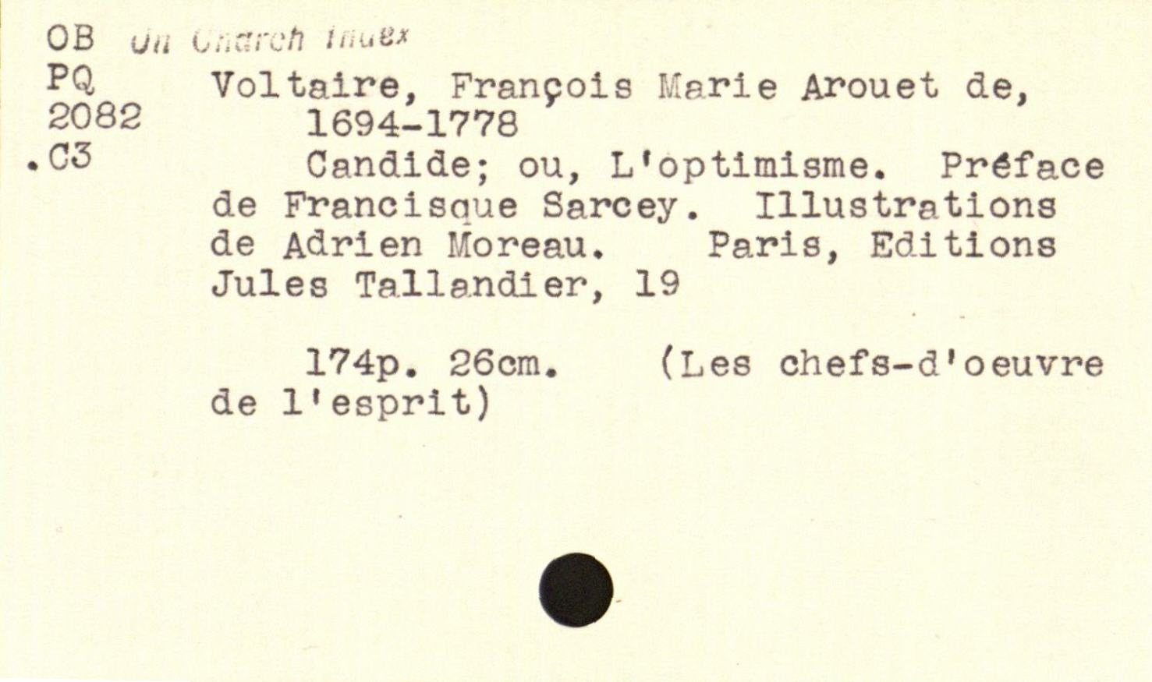
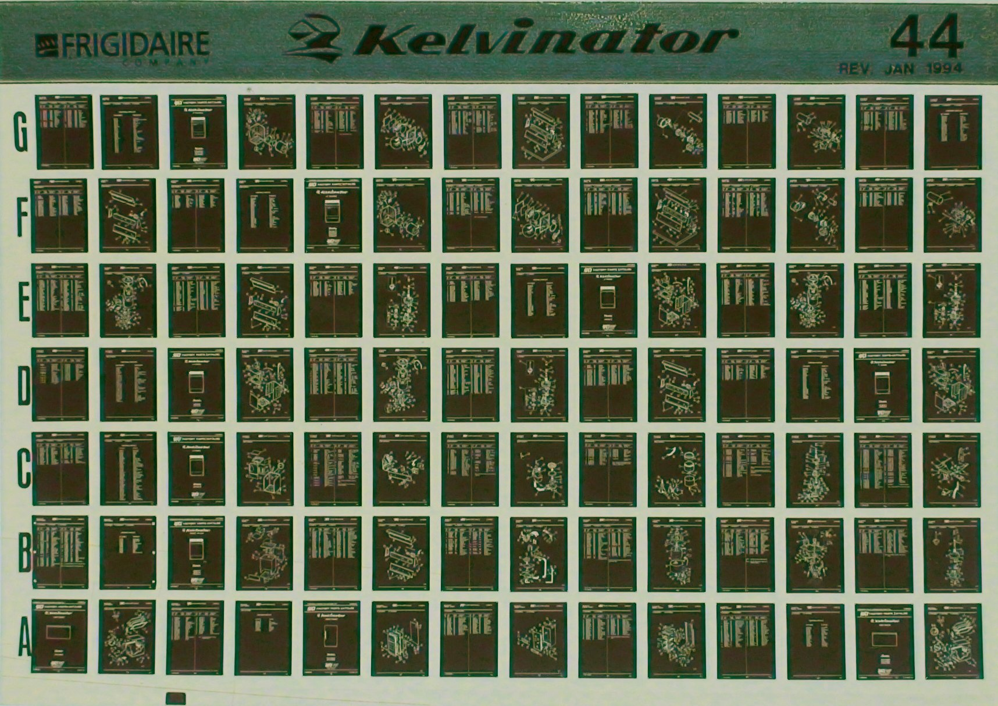
Notes:
Invented standard 3” x 5” index card
Standard microfiche proposed in 1906

Slide 14
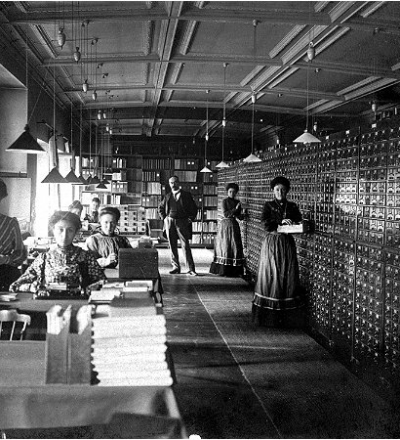
The Mundaneum
A central repository for all the world’s knowledge
Founded in 1910 by Otlet and La Fontaine
Built on the earlier Repertoire Bibliographique Universel
Closed in 1934, damaged in 1940 under Nazi occupation
Rayward, W.B. (1994) Visions of Xanadu: Paul Otlet (1868-1944) and Hypertext. Journal of
the American Society of Information Science, 45(4), pp. 235-250.
Notes:
Indexed using UDC
100,000s of files, 1,000,000s of images
Cards contain both bibliographic and substantive information

Slide 15
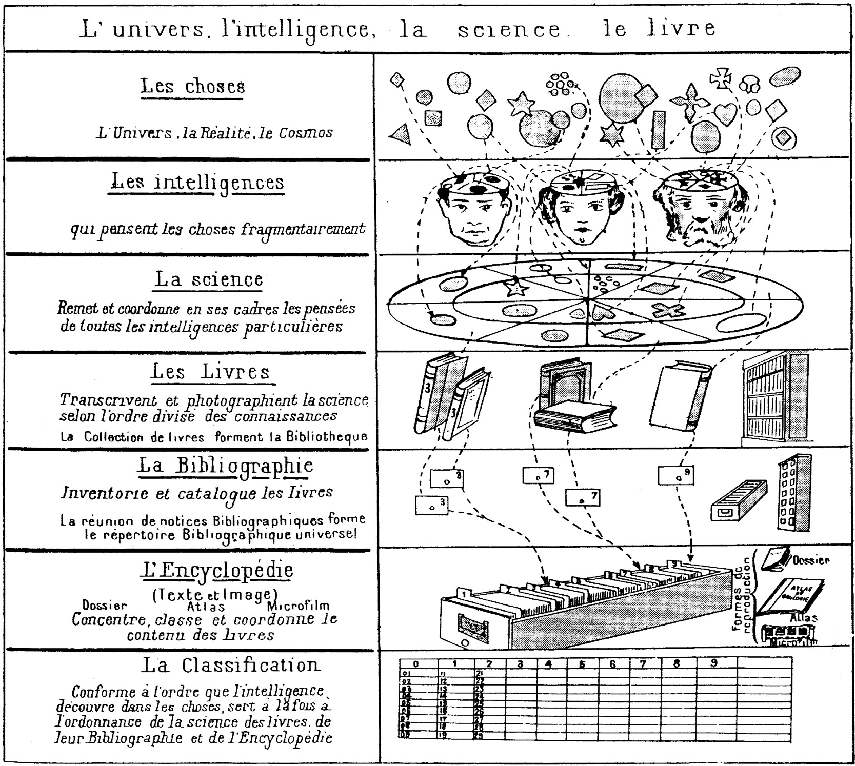
Otlet, P. (1934) Traité de Documentation. Brussels: Editiones Mundaneum, p.41.
Notes:
THINGS: the universe, reality, the cosmos
Our MINDS think about fragments of thing
SCIENCE manages and coordinates our thoughts
BOOKS transcribe science by areas of knowledge (a collection of books forms a library)
The BIBLIOGRAPHY inventories and catalogues books (the collection of bibliographic entries forms the Universal Bibliographic Index (RBU))
The ENCYCLOPEDIA concentrates, classifies and coordinates the content of books
CLASSIFICATION serves science, books, the bibliography and the encyclopedia at the same time, following the patterns that minds discover in things,

Slide 16
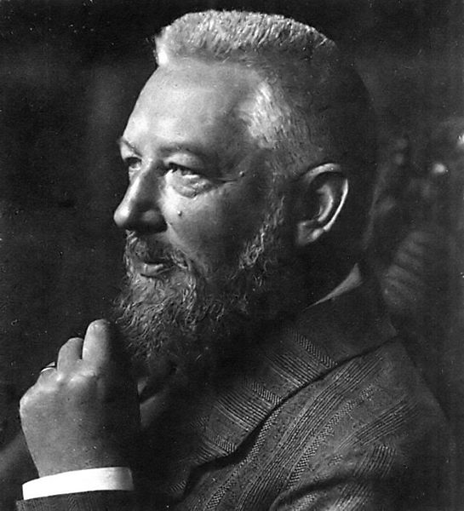

Wilhelm Ostwald
German chemist and Nobel Prize winner
Inspired by Otlet, established Die Brücke (The Bridge) using his prize money
International Institute for the Organizing of Knowledge Work
Reduce literature to small units of recorded knowledge (‘monos’) that could be arranged and linked with other units
Hapke, T. (1998) Wilhelm Ostwald, the “Brücke” (Bridge), and Connections to Other Bibliographic Activities at the Beginning of the Twentieth Century. Proceedings of the 1998 Conference on the History and Heritage of Science Information Systems. pp.139-147.
Notes:
Ostwald process – manufacture of nitric acid – Nobel in 1909
Mono – small card/leaflet in a standardised format (weltformat)
Gehirn der Welt - World Brain
Linked via classification

Slide 17
Die Brücke
Die Brücke is planned as a central station, where any question which may be raised with respect to any field of intellectual work whatever finds either direct answer or else indirect, in the sense that the inquirer is advised as to the place where he can obtain sufficient information
Ostwald, W. (1913) Scientific Management for Scientists. Scientific American, 108(1), pp. 5-6.

Slide 18
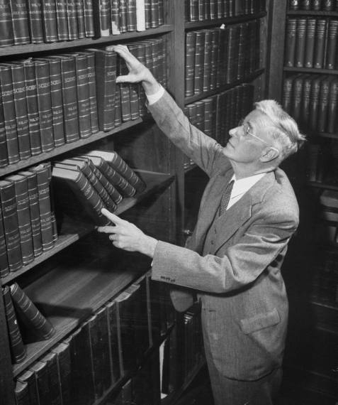
Vannevar Bush
Prewar work on analogue computing – the Differential Analyser
Director of the US Office of Scientific Research and Development during WWII
De facto director of the Manhattan Project until 1943
Notes:
While a professor at MIT, had Claude Shannon as a PhD student (information theory)

Slide 19
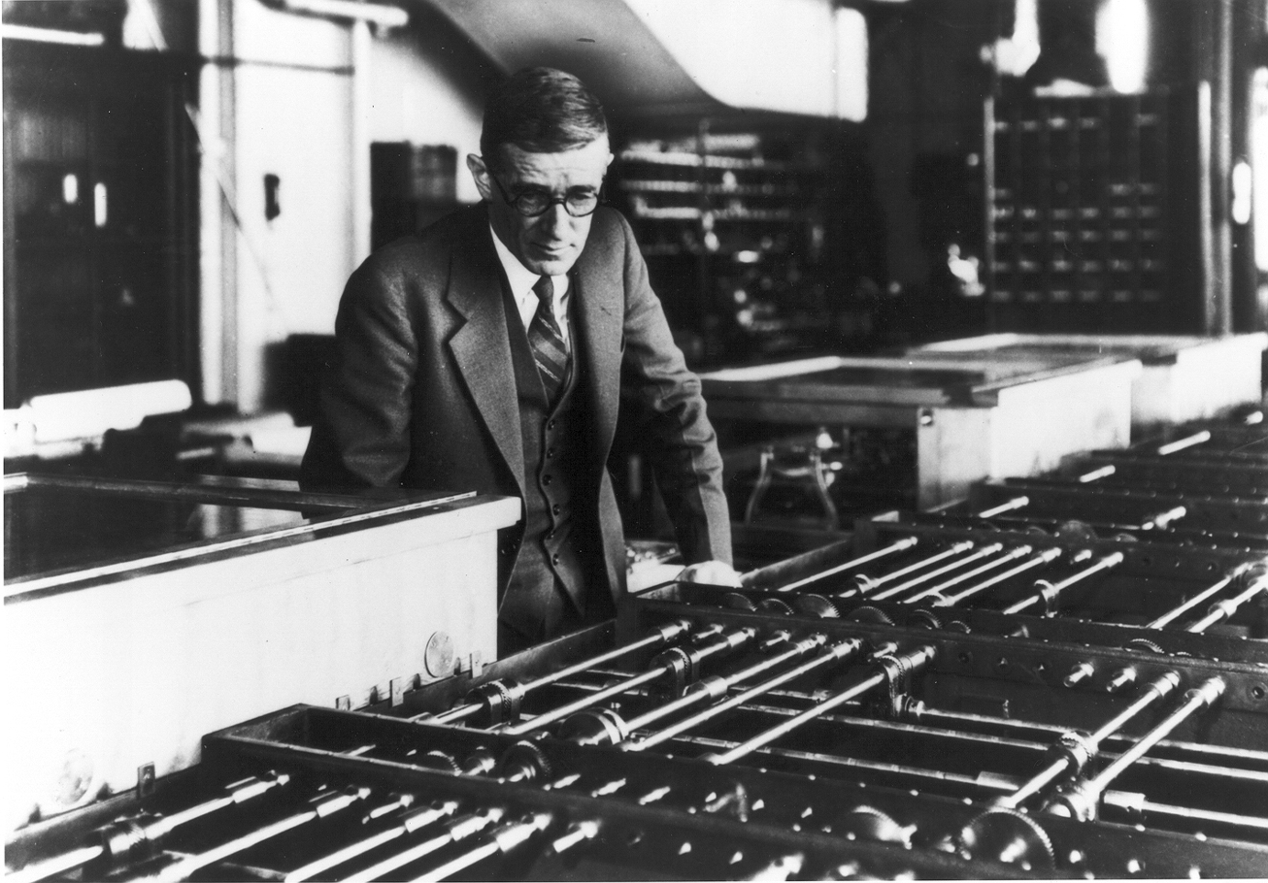
Notes:
Differential Analyser – analogue computer built in 1931
Work on the Differential Analyser informed developments in military fire control.

Slide 20
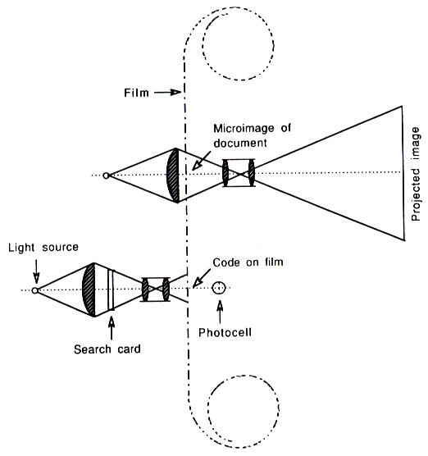
The Rapid Selector
Buckland, M.K. (1992) Emanuel Goldberg, electronic document retrieval, and Vannevar Bush's Memex. Journal of the American Society of Information Science, 43(4), pp. 284-294.
Notes:
Photoelectric microfilm selector developed at MIT in 1938
Based on earlier (patented!) work by Emanuel Goldberg of Zeiss Ikon (US Patent 1838389) from 1931 (the Statistical Machine)

Slide 21
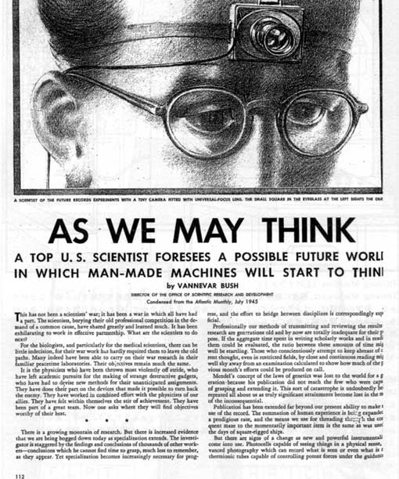
As We May Think
“The difficulty seems to be, not so much that we publish unduly in view of the extent and variety of present-day interests, but rather that publication has been extended far beyond our present ability to make real use of the record.”
Bush, V. (1945) As We May Think. The Atlantic Monthly, 176, pp.101-108.
Notes:
July 1945

Slide 22
As We May Think
“Our ineptitude in getting at the record is largely caused by the artificiality of systems of indexing. […] Having found one item, moreover, one has to emerge from the system and re-enter on a new path.”
“The human mind does not work that way. It operates by association. With one item in its grasp, it snaps instantly to the next that is suggested by the association of thoughts.”
“…the speed of action, the intricacy of trails, the detail of mental pictures, is awe-inspiring beyond all else in nature.”

Slide 23
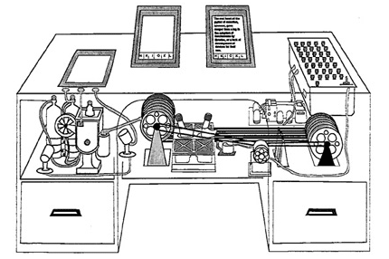
The Memex
An electro-mechanical analogue device for organising knowledge: microfilm, photocells and typewriter.
Allows user to create:
Associative trails – arbitrary sequences of pages
Skip trails – relevant summaries
Commentaries on works
Notes:
Ideas first formulated c. 1932.

Slide 24

A Salient Prediction
“Wholly new forms of encyclopedias will appear, ready made with a mesh of associative trails running through them, ready to be dropped into the memex and there amplified.”

Slide 25
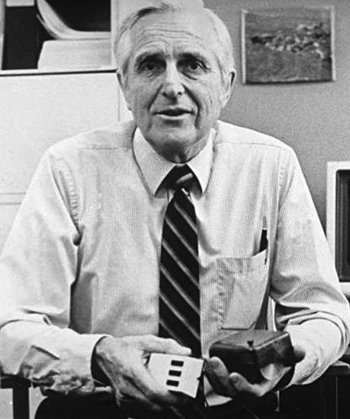
Doug Englebart
Member of the Stanford Research Institute
Founder of the Augmentation Research Center
ARC played a key role in the early history of the Internet
Notes:
ARC played key role in early history of the Internet
First message on ARPANET was between ARC computer and UCLA (15th October 1969)
ARC-run ARPANET reference library service turned into InterNIC (domain name and IP address allocations until 1998 -> ICANN)
When ARC folded in the 70s, many researchers went to Xerox PARC (NLS

Slide 26
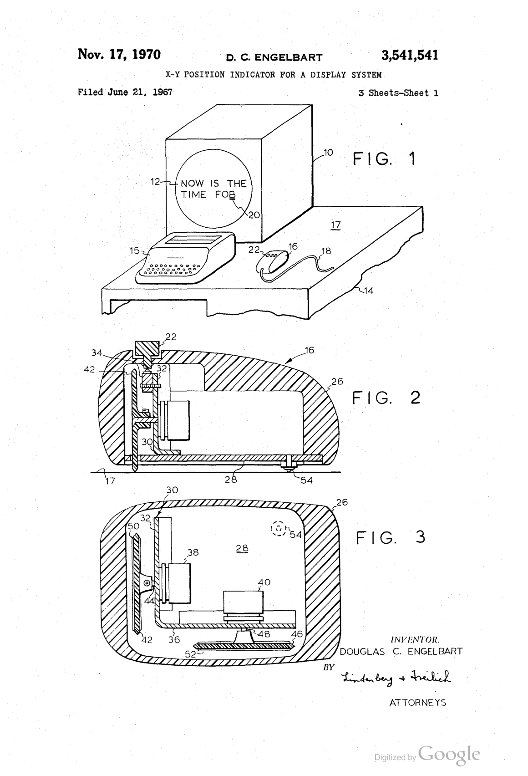
Notes:
Invented the computer mouse

Slide 27
Augmenting Human Intellect
a new stage of human evolution, characterized by
"automated external symbol manipulation”
“we are concentrating fully upon reaching the point where we can do all of our work on line — placing in computer store all of our specifications, plans, designs, programs, documentation, reports, memos, bibliography and reference notes, etc., and doing all of our scratch work, planning, designing, debugging, etc., and a good deal of our intercommunication, via the consoles”.
Engelbart, D.C. and English, W.K. (1968) A research center for augmenting human intellect.
Proceedings of the 1968 Fall Joint Computer Conference, San Francisco, CA. pp. 395-410

Slide 28
NLS – the oN-Line System
Timesharing computer with multiple consoles
UI features:
  Windowed display
  Mouse
  Chorded keyboard
  Videoconferencing
  Links in content

Slide 29
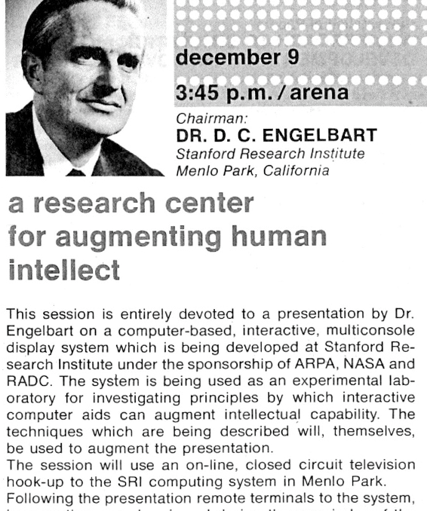
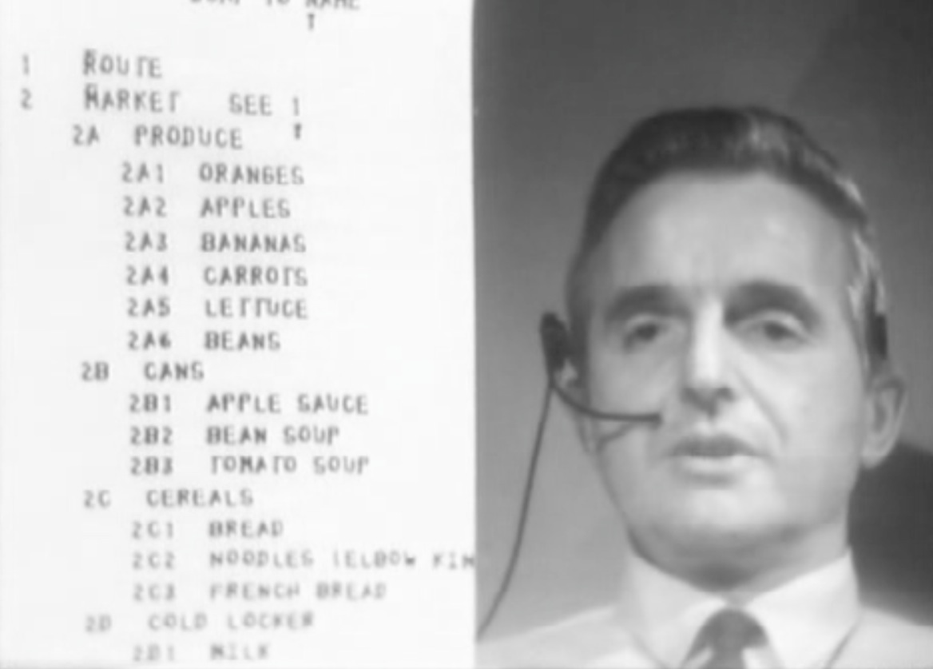
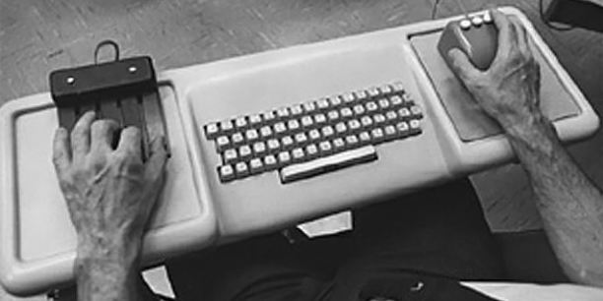
The Mother of all Demos
http://sloan.stanford.edu/MouseSite/1968Demo.html
Notes:
First demonstrated in December 1968 at the Fall Joint Computer Conference in San Francisco
Hypertext, the mouse, chording keyboard, videoconferencing, CSCW, computer generated slides.

Slide 30
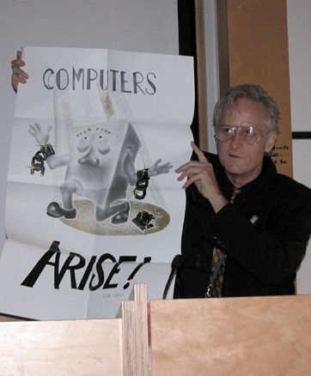
Ted Nelson
Sociologist, philosopher and film maker
Coined the term “hypertext”
“A user interface should be so simple that a beginner in an emergency can understand it within ten seconds.”
“Most people are fools, most authority is malignant, God does not exist, and everything is wrong.”
Notes:
Son of Ralph Nelson and Celeste Holm

Slide 31
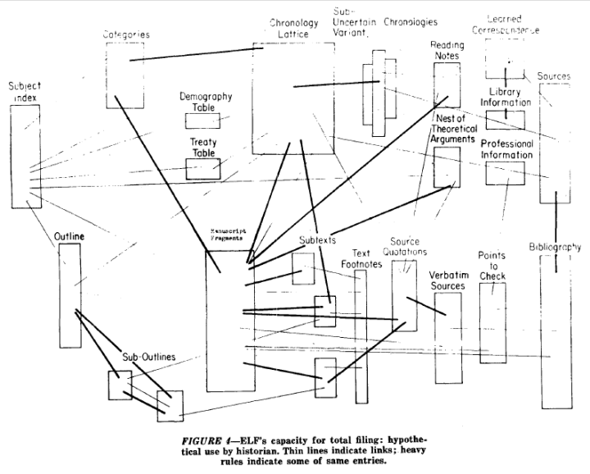
Notes:
A File Structure for the Complex, the Changing and the Indeterminate."
Proceedings of the ACM 20th National Conference (1965), pp. 84-100

Slide 32
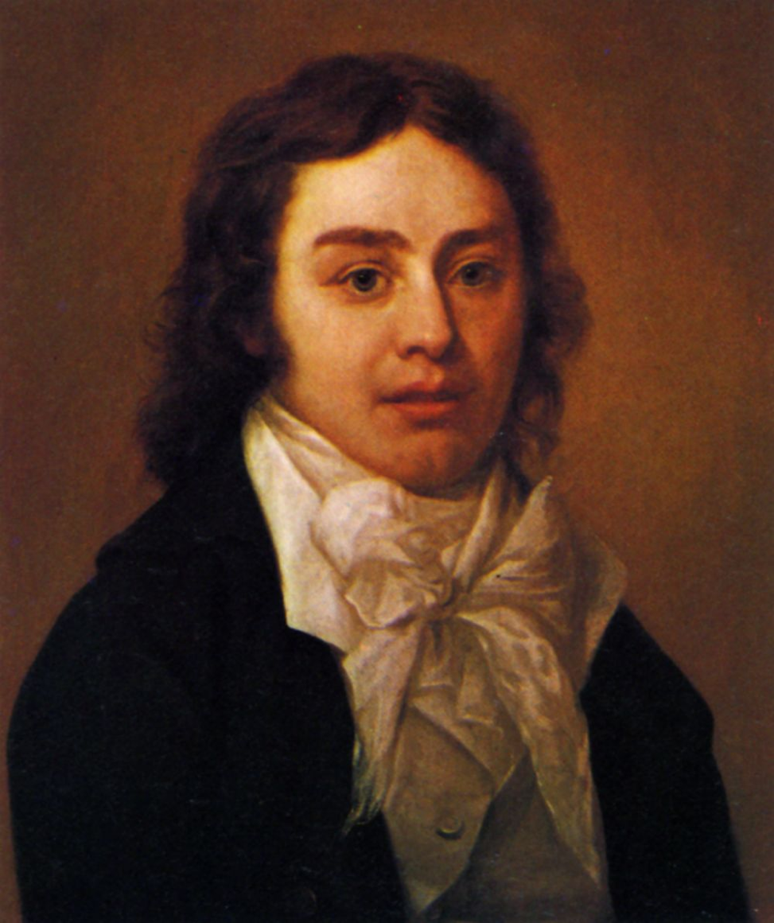
A Vision in a Dream
In 1797, Samuel Taylor Coleridge wrote the poem Kubla Khan after awaking from an opium dream:
In Xanadu did Kubla Khan
A stately pleasure-dome decree: Where Alph, the sacred river, ran Through caverns measureless to man
Down to a sunless sea.
He was interrupted by a visitor from Porlock, and never completed the poem…

Slide 33
Project Xanadu
Founded in 1960, still ongoing (famously never finished)
Hugely influential, nonetheless
Described in Dream Machines, and Nelson’s subsequent book Literary Machines
Nelson, T.H. (1993) Literary Machines. Sausalito, CA: Mindful Press.
Notes:
"longest-running vaporware story in the history of the computer industry” – Gary Wolf in WiReD
First demo version in 1972
With Roger Gregory, Mark Miller, Stuart Greene in 1979
1983-1992 – With Autodesk
1992- Xanadu Operating Company
Open-sourced in 1998
2007 - XanaduSpace
Literary machines – first published 1980

Slide 34
Project Xanadu Mission Statement
DEEP INTERCONNECTION WITH INTERCOMPARISON AND RE-USE
Since 1960, we have fought for a world of deep electronic documents-- with side-by-side intercomparison and frictionless re-use of copyrighted material.
We have an exact and simple structure. Our model handles automatic version management and rights management through deep connection.
Today's popular software simulates paper. The World Wide Web (another imitation of paper) trivializes our original hypertext model with one-way ever-breaking links and no management of version or contents.
WE FIGHT ON.

Slide 35
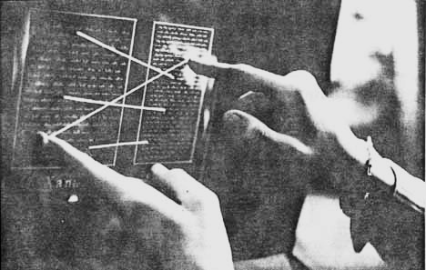
Nelson, T.H. (1972) As We Will Think. Proceedings of Online 72 Conference, Uxbridge, England.

Slide 36
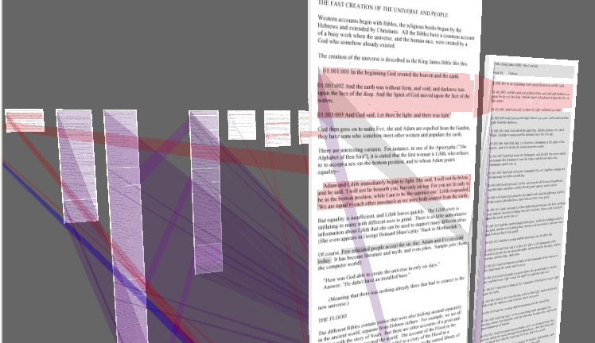
XanaduSpace

Slide 37
Nelson on the Web
The Xanadu project did not ‘fail to invent HTML’. HTML is precisely what we were trying to PREVENT - ever-breaking links, links going outward only, quotes you can't follow to their origins, no version management, no rights management.

Slide 38
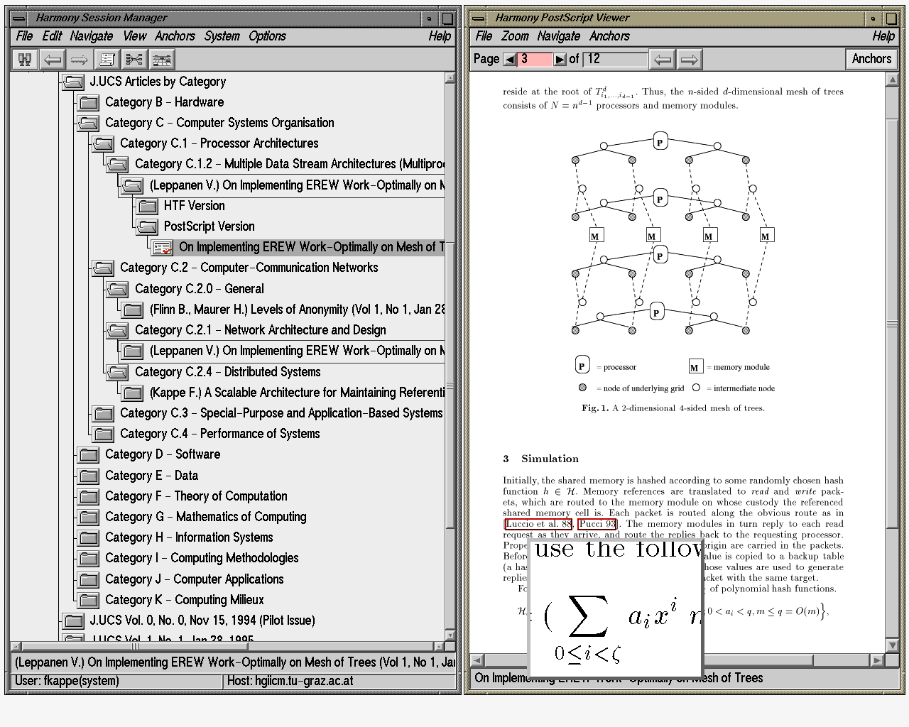
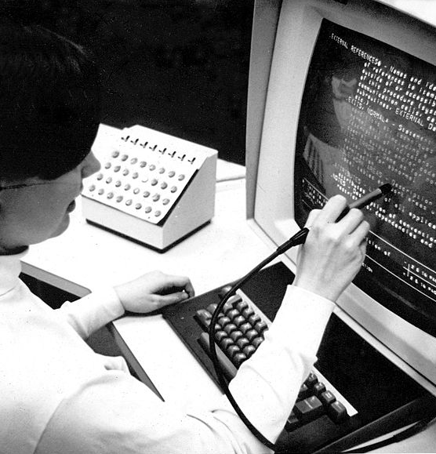
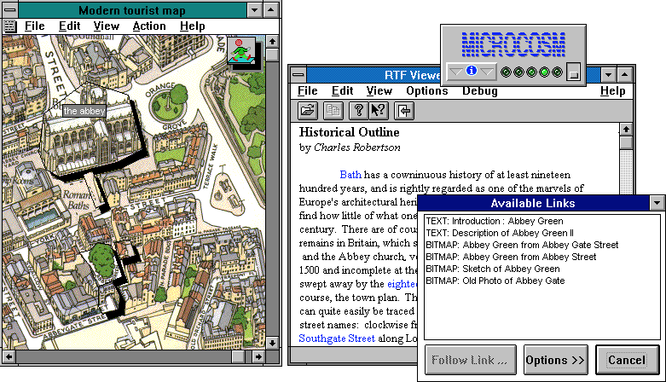
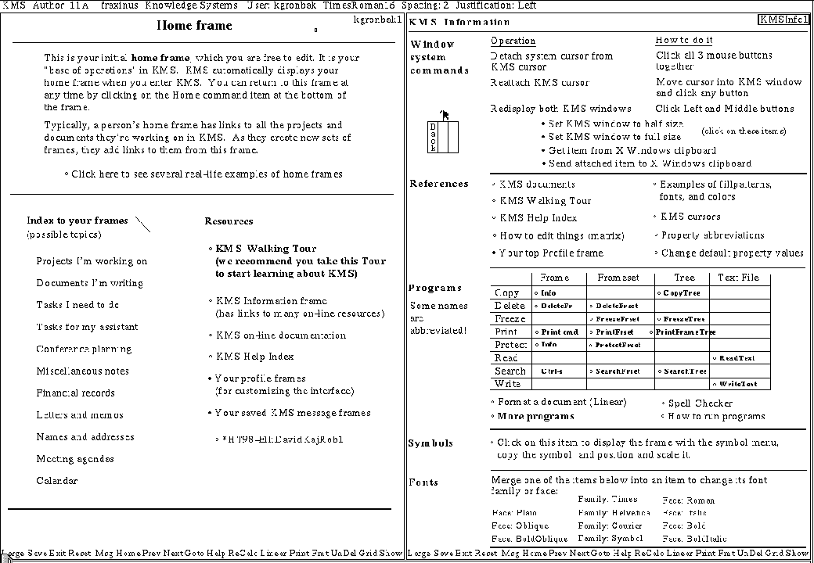
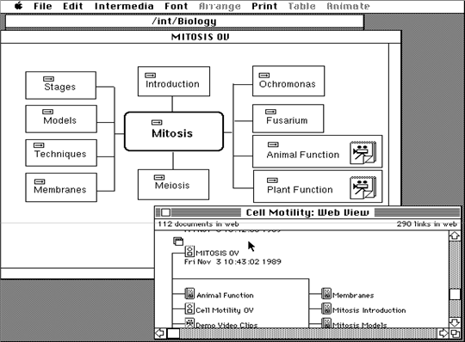
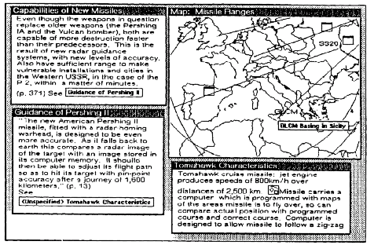
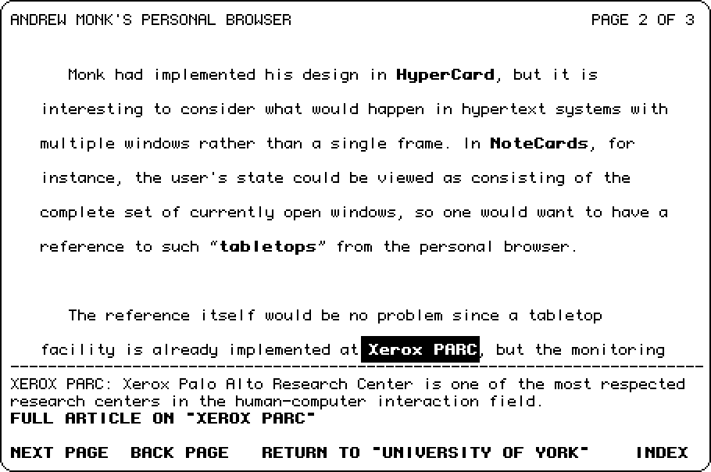
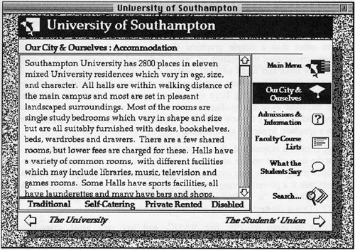
Notes:
Hypertext Editing System (1967)
Knowledge Management System (1983)
Hyperties (1983)
Intermedia (1985)
Notecards (1985)
Hypercard (1987)
Hyper-G (1989)
Microcosm (1989)

Slide 39
…and then the
Web happened

Slide 40
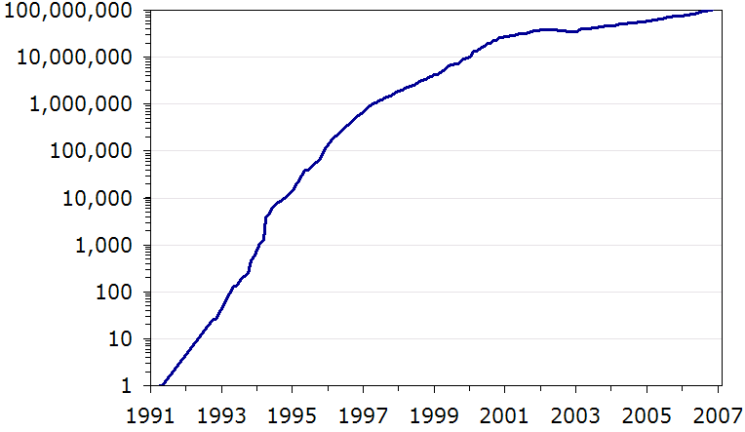
Web Growth
Nielsen, J. (2006) 100 Million Websites, Alertbox.
http://www.useit.com/alertbox/web-growth.html

Slide 41
BREAK

Slide 42
Writing Hypertext

Slide 43
A Working Definition
By ‘hypertext’, I mean non-sequential writing - text that branches and allows choices to the reader, best read at an interactive screen. As popularly conceived, this is a series of text chunks connected by links which offer the reader different pathways.
Nelson, T.H. (1981) Literary Machines, Sausalito, CA: Mindful Press.

Slide 44
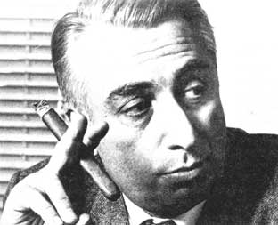
The Death of the Author
We know now that a text is not a line of words releasing a single ‘theological’ meaning (the ‘message’ of the Author-God) but a multi-dimensional space in which a variety of writings, none of them original, blend and clash.
To give a text an Author is to impose a limit on that text, to furnish it with a final signified, to close the writing.
Barthes, R.G. (1967) The Death of the Author. Aspen, no. 5-6.
Notes:
Post-structuralist
Text chunk == lexia

Slide 45
Hypertext and the Death of the Author
  “It is tempting to see hypertext as realizing Barthes' utopian dreams of a writing liberated from the Author. The ability for each reader to add to, alter, or simply edit a hypertext opens possibilities of collective authorship that breaks down the idea of writing as originating from a single fixed source.
  Similarly, the ability to plot out unique patterns of reading, to move through a text in an aleatory, non-linear fashion, serves to highlight the importance of the reader in the “writing” of a text - each reading, even if it does not physically change the words - writes the text anew simply by re-arranging it, by placing different emphases that might subtly inflect its meanings.”
Keep,C., McLaughlin, T. and Parmar, R. (1993-2000) The Electronic Labyrinth.
http://elab.eserver.org/
Notes:
Aleatory: dependent on the throw of a die

Slide 46
Forking Paths
“In all fictional works, each time a man is confronted with several alternatives, he chooses one and eliminates the others; in the fiction of Ts’ui Pên, he chooses— simultaneously—all of them. He creates, in this way, diverse futures, diverse times which themselves also proliferate and fork. Here, then, is the explanation of the novel’s contradictions.
Fang, let us say, has a secret; a stranger calls at his door; Fang resolves to kill him. Naturally, there are several possible outcomes: Fang can kill the intruder, the intruder can kill Fang, they both can escape, they both can die, and so forth. In the work of Ts’ui Pên, all possible outcomes occur; each one is the point of departure for other forkings.”
Borges, J.L. (1941) The Garden of Forking Paths, Translated from Spanish by Yates, D.A.

Slide 47
Ergodic Literature
“ Ergodic […] derives from the Greek words ergon and hodos, meaning "work" and "path." In ergodic literature, nontrivial effort is required to allow the reader to traverse the text. If ergodic literature is to make sense as a concept, there must also be nonergodic literature, where the effort to traverse the text is trivial, with no extranoematic responsibilities placed on the reader except (for example) eye movement and the periodic or arbitrary turning of pages. ”
Aarseth, E. (1997) Cybertext: Perspectives on Ergodic Literature. Baltimore, MD: The John
Hopkins University Press.
Notes:
Typically, the nontrivial effort manifests itself as a choice (possibly random) that is applied to the text.
Extranoematic: A process that occurs outside of the confines of human thought

Slide 48
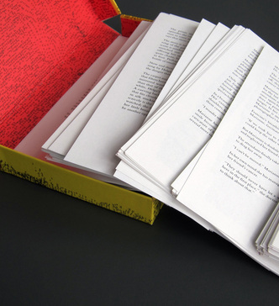
Composition No. 1, Roman (1962)
150 loose leaf pages
  Pages are to be shuffled before reading
Saporta, M. (1963) Composition No. 1, Roman. Translated from French by Howard, R.,
New York: Simon and Schuster.

Slide 49

Hopscotch (1963)
Structured as 155 chapters
  Chapters 57-155 designated as ‘expendable’
Two readings of the book:
  Chapters 1-56 in order
  All chapters, following the reading order given in the instructions: 73-1-2-116-3-…
Cortázar, J. (1966) Hopscotch. Translated from Spanish by Rabassa, G. New York: Pantheon Books.

Slide 50
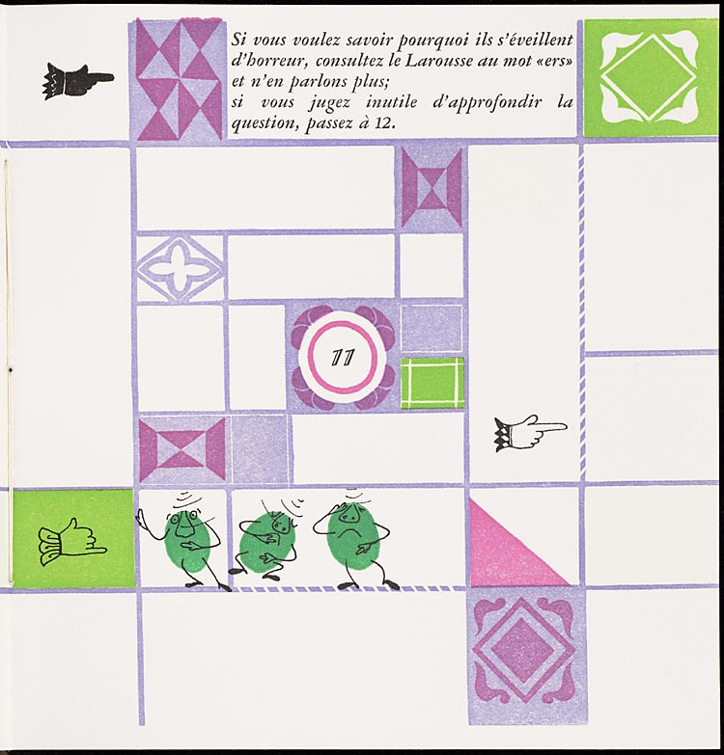
Un conte à votre façon (1967)
Numbered double-page spreads
  Story on verso pages
  Explicit choices on recto pages
Queneau, R. (1982) Un conte à votre façon, Paris: Kickshaws.
Notes:
“A story your way”
Do you wish to hear the story of the three alert peas?

Slide 51
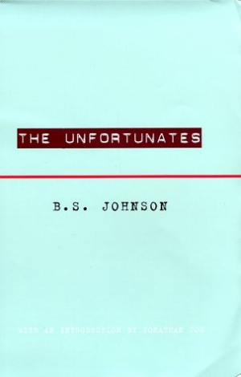
The Unfortunates (1969)
27 chapters, bound as pamphlets
  Designated first chapter
  25 chapters, to be read in any order
  Designated last chapter
Johnson, B.S. (1969) The Unfortunates, London: Secker and Warburg.

Slide 52
Story, Narrative and Text
Narrative theory identifies three levels in fiction:
  Story: the content of a tale; the underlying events related in a tale (also referred to as fabula)
  Narrative: a recounting of a story; the reorganisation of events by time or point-of-view (also referred to as plot)
  Text: the signs (words, images) that are processed by the reader
Non-linearity may be introduced at any or all of these levels
Lowe, N.J. (2009) A Cognitive Model, In Reading Hypertext, Bernstein, M. and Greco, D. (eds),
Watertown, MA: Eastgate Systems
Notes:
Story = Fabula
Narrative = Plot

Slide 53
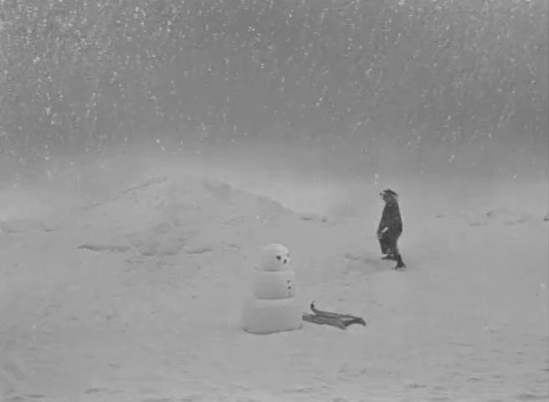
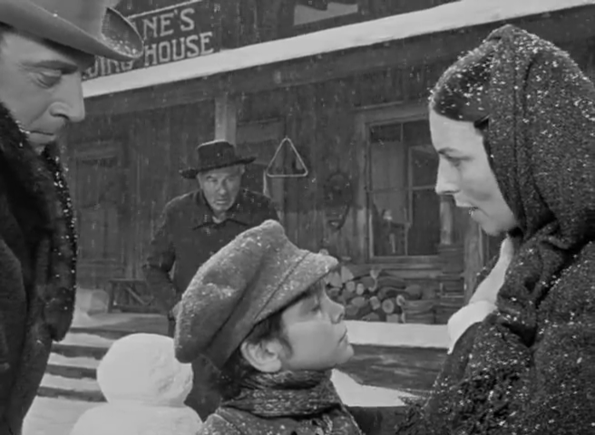
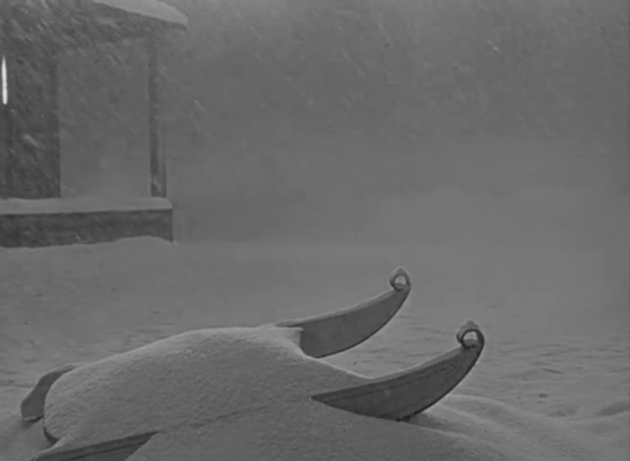
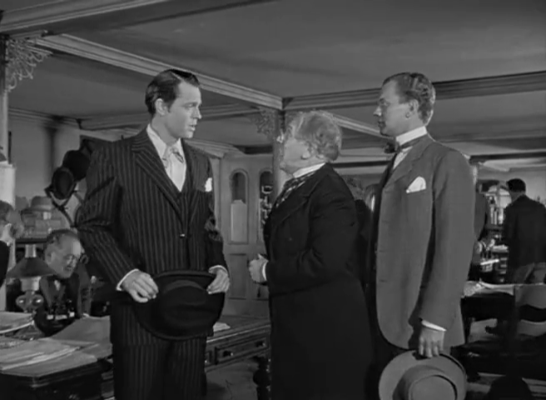
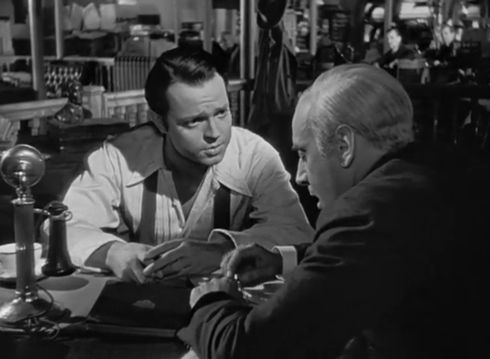
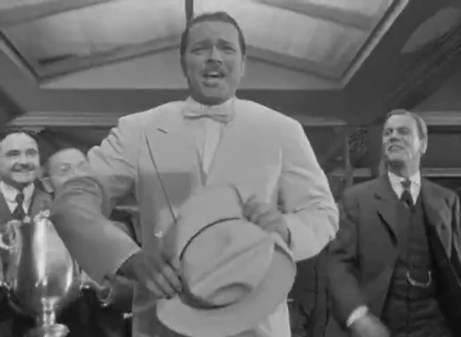
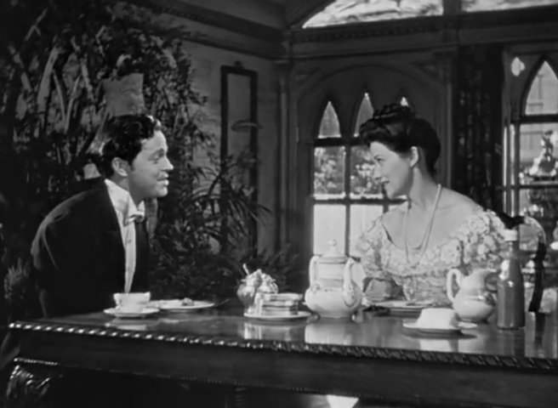
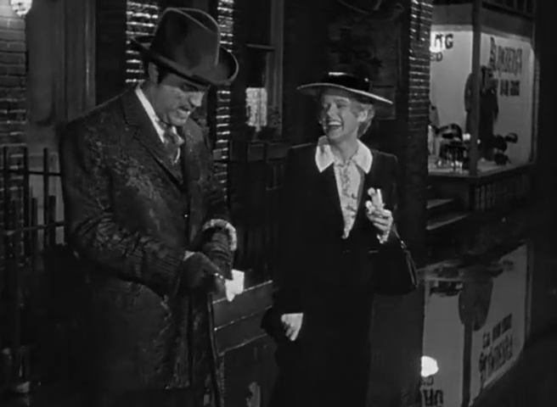
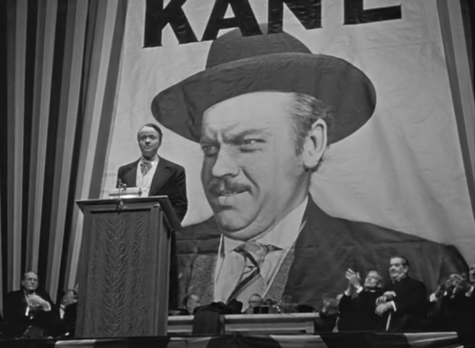
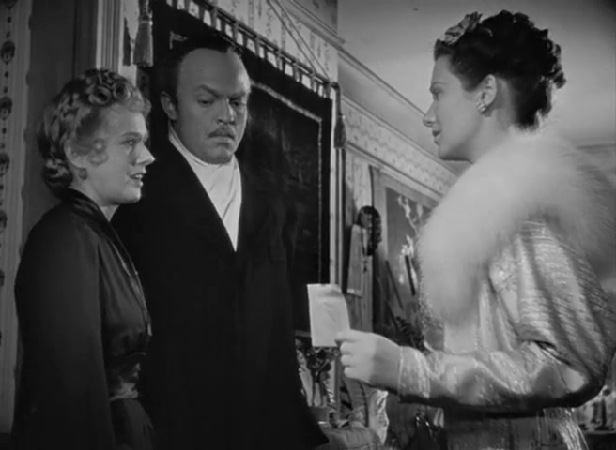
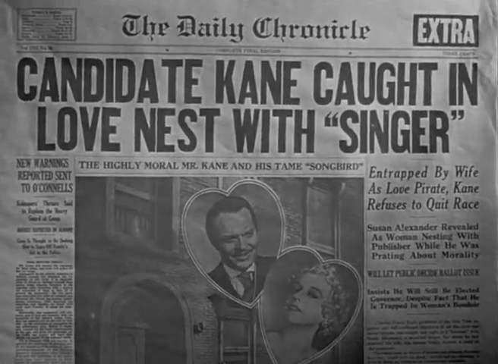





























Story versus Narrative: Citizen Kane

Slide 54
Story versus Narrative: Citizen Kane
Notes:
Other notable examples of non-linearity in film:
Citizen Kane (Orson Welles) – told as flashback/recounting
Short Cuts (Robert Altman) – multi-threaded narrative
Pulp Fiction (Quentin Tarantino) – multi-threaded and flashbacks
Timecode (Mike Figgis) – multiple simultaneous viewpoints
Film does not generally expect the audience to choose – non-ergodic.

Slide 55






Narrative versus Text: Psycho
Psycho (1960)
Psycho (1998)
Notes:
Psycho

Slide 56



Hypertext Fiction
A selection:
  Michael Joyce (1987) - afternoon, a story
  Stuart Moulthrop (1992) - Victory Garden
  Geoff Ryman (1996) - 253

Slide 57

afternoon, a story (1987)
"I want to say I may have seen my son die this morning.”
Non-linear narrative with default path
Notecard-like lexias
No explicit anchors; all words are anchors
Built as demonstration of the hypertext authoring system Storyspace
Joyce, M. (1990) afternoon, a story. Watertown, MA: Eastgate Systems.
Notes:
Follows the story of Peter, who begins his afternoon with the suspicion that the car crash he saw earlier might have involved his ex-wife.

Slide 58

Victory Garden (1992)
Follows a central character (Emily) and the interactions of those connected with her, set during Gulf War I.
Multiple non-linear narratives with default paths
Anchors indicate branches to other narratives
(initially hidden, but can be made explicit)
Provides a taxonomic overview map
Moulthrop, S. (1992) Victory Garden. Watertown, MA: Eastgate Systems.

Slide 59

253 (1996)
Descriptions of the 253 occupants (passengers plus driver) of a London Underground train
Extensive cross-referencing and footnotes support a non-linear narrative
Each description is 253 words long
Originally published on the Web
Ryman, G. (1998) 253: the print remix. London: Flamingo.

Slide 60
Hypertext Fiction
Academic study concentrates on literary hypertext
(c.f. literary fiction)
  Typified by non-linear narratives, rather than non-linear stories
What about the hypertext equivalent of genre or popular fiction?
What about other media?

Slide 61

Lucky Les (1967)
Third person narrative
Coarse-grained, non-linear story
  Multi-page lexias corresponding to episodes in Les’ life
  Each episode concludes with an explicit choice for the reader
Hildick, E.W. (1967) Lucky Les: the adventures of a cat of five tales, Leicester: Brockhampton
Press.
Notes:
B.F. Skinner – programmed instruction

Slide 62


Choose Your Own Adventure (1979-)
Second person narrative
Again, non-linear story
  Single page lexias
  Numbered pages
  with explicit
  choices
See also interactive
fiction (Colossal Cave/
Advent, etc)
Montgomery, R.A. (1979) Journey Under the Sea. New York: Bantam Books.
Notes:
Ludic hypertext

Slide 63

Life’s Lottery (1999)
Increasing sophistication – not a children’s book!
  Lexias vary in size from a paragraph of a few sentences to several pages
  Non-linear story, but with an additional narrative if lexias are read in order, rather than by following the directions in the lexias
Newman, K. (1999) Life’s Lottery, London: Simon and Schuster.

Slide 64


Fighting Fantasy (1982-)
Combines CYOA-style second person narrative with Dungeons & Dragons-style rules
  Non-linear story
  Numbered paragraphs
  (more finely-grained
  narrative)
  Mixture of explicit
  and random choices
  (aleatory reading)
  External state
  (hit points, inventory, etc)
Jackson, S. & Livingstone, I. (1982) The Warlock of Firetop Mountain. Harmondsworth: Puffin.
Notes:
1980s fantasy boom – hypertext books!
Largely a paper-based fusion of role-playing games and computer adventure games
Ludic hypertext

Slide 65

Being Elizabeth Bennet (2007)
Second person narrative
  Again, non-linear story
  Simple rules
  No aleatory aspects
Mimicry aimed at a different demographic to that of other gamebooks.
Campbell Webster, E. (2007) Being Elizabeth Bennet. London: Atlantic.
Notes:
See also do-over novels: Heather McElhatton’s A Million Little Mistakes
Arguably an alternative narrative in which the eponymous protagonist, having decided that she’s too clever and too confident for Mr. Darcy, sits down to write a comedy of manners beginning “It is a truth universally acknowledged…”

Slide 66

Hypercomics (1986-)
Early hypertext comics based on gamebooks
  Dice Man 1-5 (1986)
  You are Maggie Thatcher (1987)
Typically second person narrative
  Numbered frames/pages
  Explicit choices in captions
  Ludic elements
Talbot, B. et al, (1986) House of Death. Dice Man, no. 1, IPC Magazines.

Slide 67

Meanwhile (2010)
Visual grammar for linking:
Tabs for inter-page navigation
Shiga, J. (2010) Meanwhile. New York: Amulet Books.
Notes:
Comment on visual grammar
Non-linear story

Slide 68

Kinoautomat (1967)
Czech experimental interactive film
First shown at Expo 67 in Montreal
Film is stopped at intervals and audience is asked how they think the film should be continued
Audience votes on two options (red/green) with the majority determining the future path of the film (ergodic)
Činčera, R., Roháč, J. and Svitáček, V (1967) Kinoautomat: Človĕk a jeho dům.
Notes:
Satire of democracy – audience choice doesn’t actually affect the outcome.

Slide 69

Tamara (1981)
Play takes place in a large house
Actors perform simultaneously in up to nine different rooms
Spectators must choose which actor(s) they follow (ergodic)
Multiple narratives
Krizanc, J. (1989) Tamara: A play. London: Methuen Drama.
Notes:
Based on 1927 diary entries of the housekeeper at Il Vittoriale, the villa of Gabriele D'Annunzio.
Tamara de Lempicka invited to paint D’Annunzio’s portrait.
Play ran for ten years in Los Angeles

Slide 70
Summary

Slide 71
Summary
Hypertext existed before the Web!
  Earliest non-digital precursors from information science
  Fifty year history of digital hypertext systems
Hypertext is inherently non-linear
  For hypertext fiction, this may manifest in story, narrative or text
  Non-linearity may equally apply to poetry, comics, film and drama

