Slide 1
Vocabularies and Applications
COMP6028 Semantic Web Technologies
Dr Nicholas Gibbins - nmg@ecs.soton.ac.uk
2013-2014

Slide 2
Overview
Social Networking
Bibliographic Metadata
News Aggregation
Cultural Heritage
Knowledge Organisation
Provenance
Web Annotation
Semantic Web Services
Research Information
Business Intelligence
Collaborative Working
Public Sector Information
Geographic Information
e-Science

Slide 3
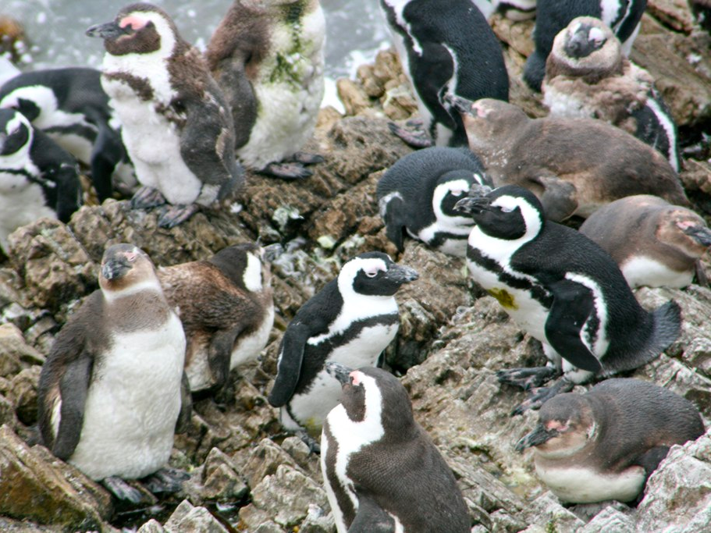


Social Networking
?
?
http://www.flickr.com/photos/bigblackbox/4269397346/

Slide 4

Friend of a Friend (FOAF)
Semantic Web realisation of “six degrees of separation”
Fully distributed system
  Each user writes an RDF file describing themselves and who they know (using the FOAF schema)
  Files are harvested and aggregated
  Data is presented in a variety of interfaces
Avoids siloing of existing social networking systems
Data from many providers (LiveJournal, etc)
http://www.foaf-project.org/

Slide 5
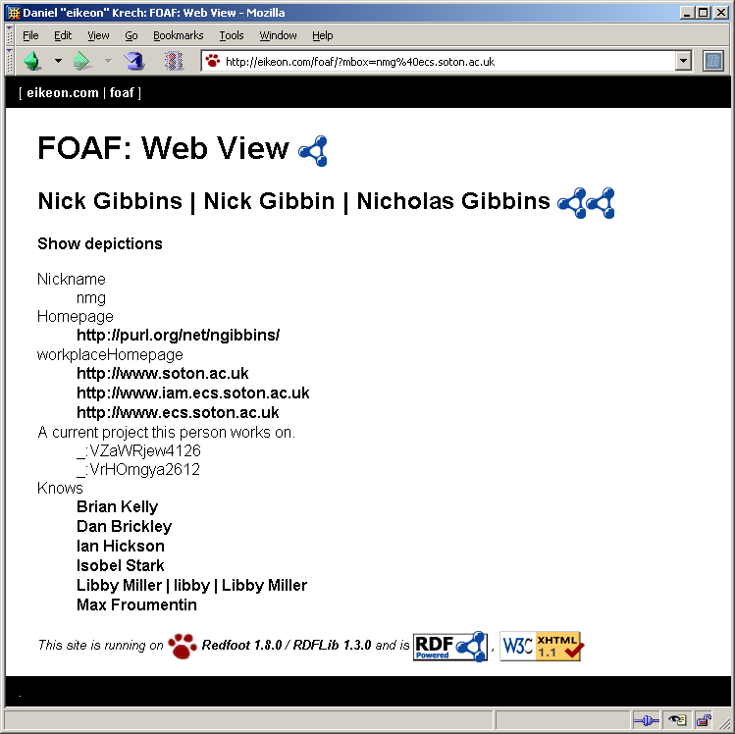
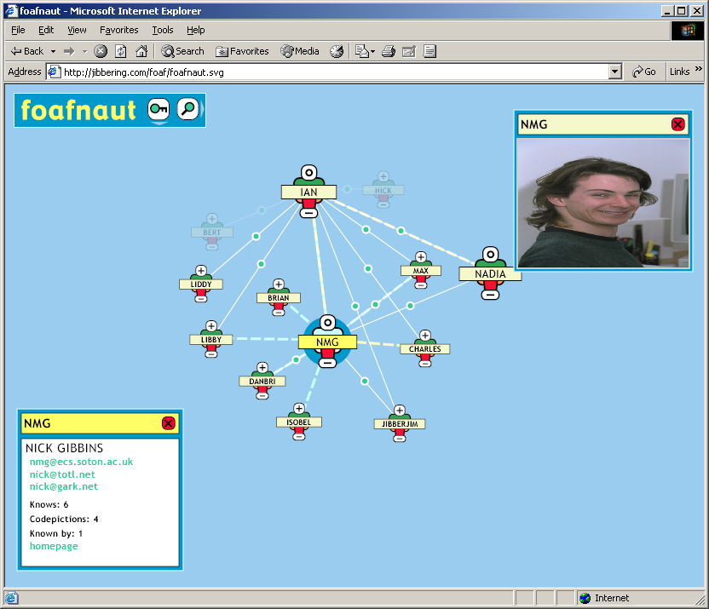
Multiple Interfaces

Slide 6
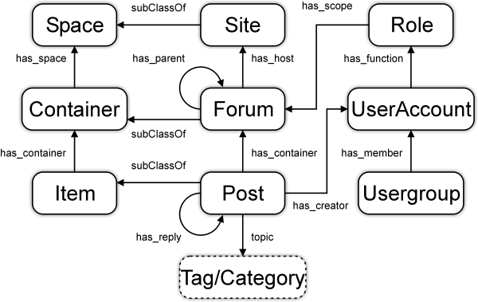

Semantically-Interlinked Online Communities
Ontology for describing wikis, bulletin boards, blogs, etc
Designed to interoperate with FOAF
http://rdfs.org/sioc/spec/
Notes:
SIOC – Semantically-Interlinked Online Communities

Slide 8

Bibliographic Metadata
http://www.flickr.com/photos/celesterc/1069893367/

Slide 9

Dublin Core
A standard set of 15 metadata elements for cross-domain information resource description
Formally endorsed by ISO, NISO and CEN
Representation language-neutral
  Plain XML serialisations in addition to RDF/XML
  Predates RDF
  (started in 1995)
Possibly the most widely used Semantic Web vocabulary
  Libraries (electronic and physical)
  Museums
  Web archives
    Open Directory Project
    UK Mirror Service
    MusicBrainz
  …
http://dublincore.org/

Slide 10
Dublin Core Element Set
Title
Creator
Subject
Description
Publisher
Contributor
Date
Type
Format
Identifier
Source
Language
Relation
Coverage
Rights

Slide 11

Bibliographic Ontology
More detailed bibliographic ontology
Describes types of publication
  Conference paper
  Journal article
  …
Builds on Dublin Core
http://bibliontology.com/

Slide 12
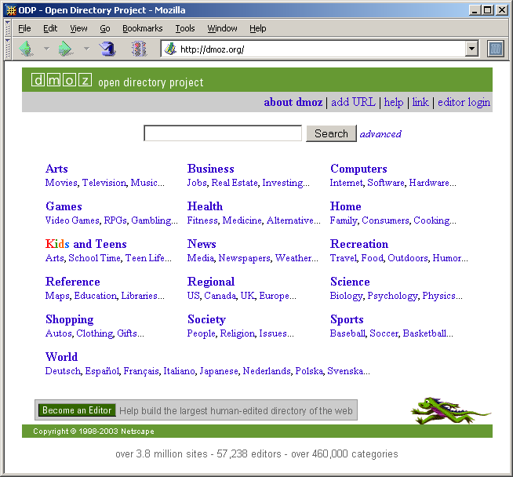
Open Directory Project
An open replacement for Yahoo and similar commercial Internet directories
Involves the Internet community by encouraging users to help build a subject taxonomy and classify web sites against it
http://dmoz.org/

Slide 13
Open Directory Project
Designed for reuse
  Directory data – information about web sites and the subject taxonomy – is provided for free in RDF format
  ODP data is integrated into many other internet services – more specialised subject portals, search engines, etc
Vocabularies used
  Dublin Core for bibliographic metadata
  Custom schema for expressing topic hierarchies

Slide 14
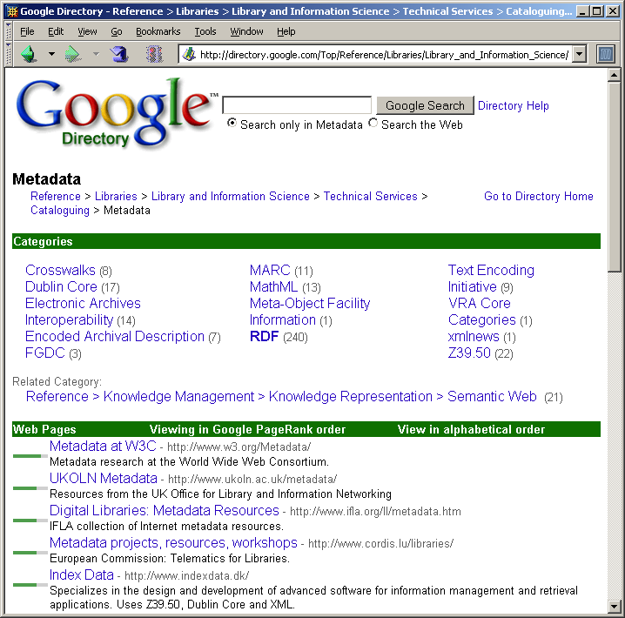
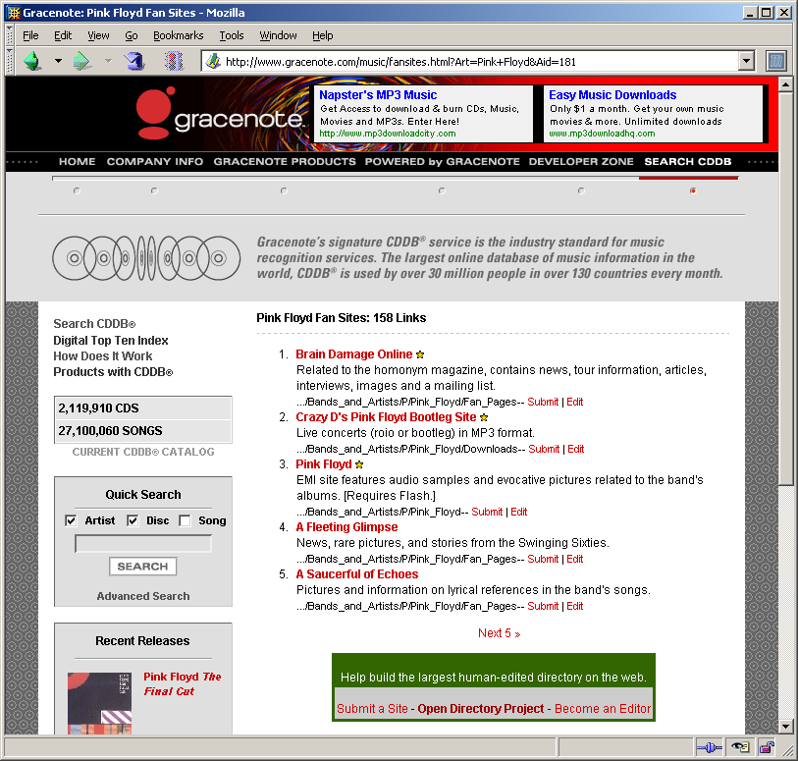
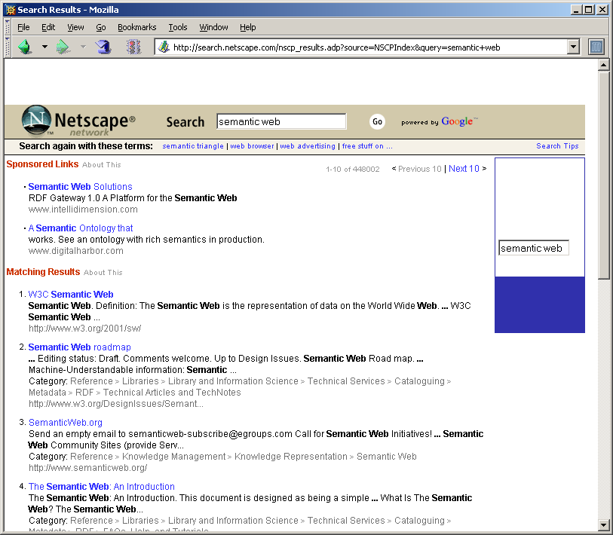
Open Directory Project users

Slide 15
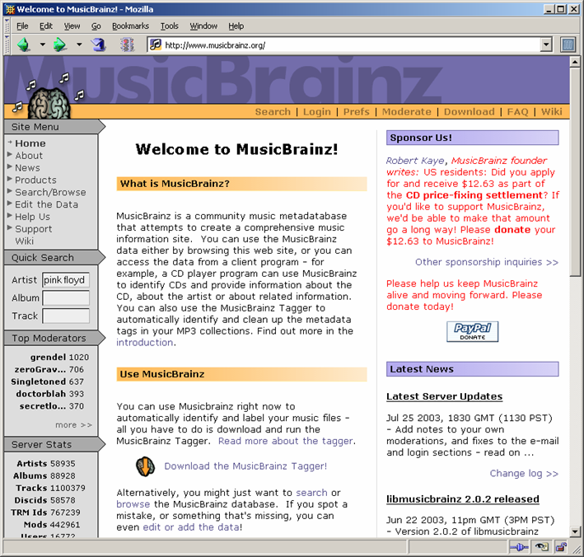
MusicBrainz
An open replacement for the CDDB Internet CD database
Complementary to freedb.org
Community-maintained service
  Submissions and moderations
Vocabularies used:
  Dublin Core
  Custom ontology for metadata specifically relating to audio recordings
http://www.musicbrainz.org/

Slide 16
Publishing Standards for Industry Standard Metadata
Set of metadata vocabularies for automating publishing production processes and content exchange
Simplified profile of RDF/XML
  Lower hurdle to adoption
Commercial users include Time, Inc., Lexis-Nexis and McGraw-Hill
Vocabularies used:
  Dublin Core
  Custom ontologies for
    Controlled vocabularies
    Relational information
    Resource types
    Rights management
http://www.idealliance.org/

Slide 17

BBC Programmes
Simple ontology for describing programmes
  Brands
  Series (seasons)
  Episodes
  Broadcast events
  Broadcast services
Data describing all BBC programmes
http://purl.org/ontology/po/
http://www.flickr.com/photos/nicecupoftea/4104234460/
http://www.bbc.co.uk/programmes/developers

Slide 18
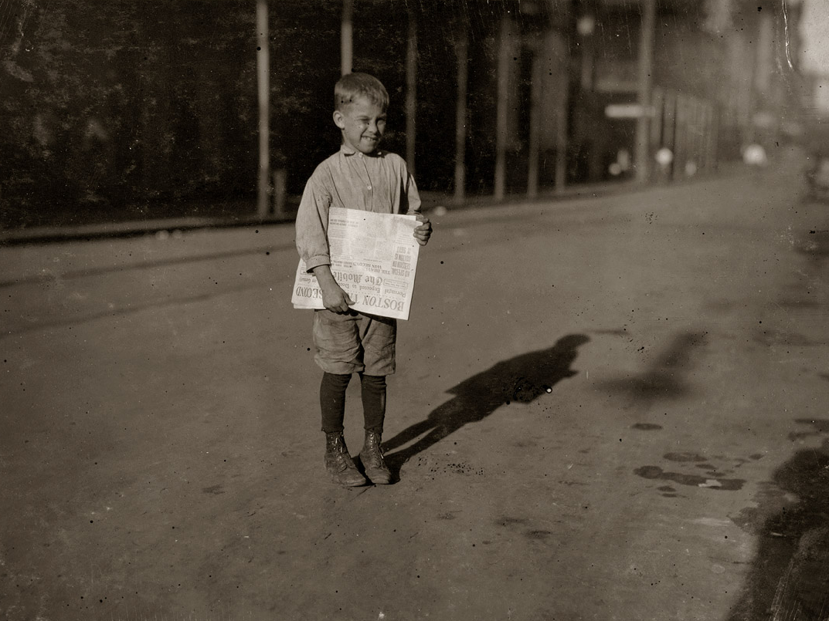
News Aggregation
http://www.shorpy.com/node/26

Slide 19
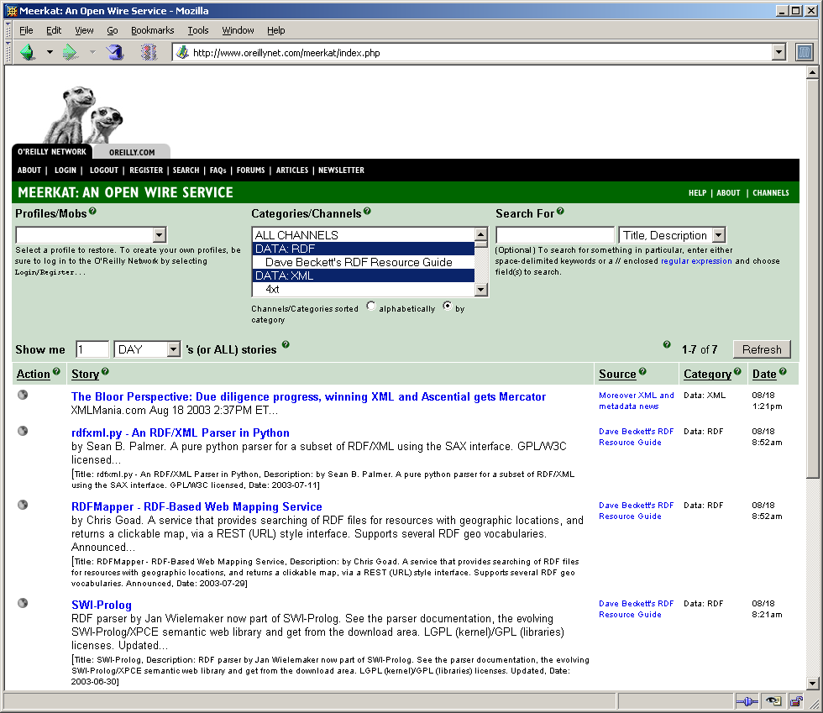
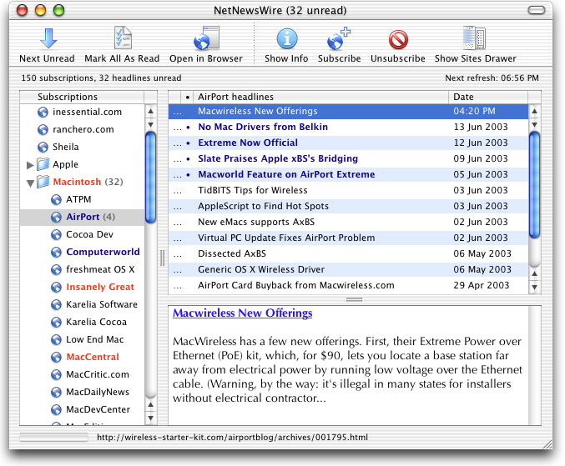
Newsfeed aggregation

Slide 20
RDF Site Summary (RSS)
Newsfeeds as time-ordered lists of articles
RDF Site Summary (RSS 1.0) is a vocabulary for expressing such lists
  Sites export their current headlines as RSS
  Aggregation tools poll news sites for change to RSS
Broad support from traditional news sources
(BBC, Yahoo, InfoWorld, etc)
Strong grassroots support in the weblogging community
Ongoing work (via Atom)
http://www.purl.org/rss/1.0/spec

Slide 21

Cultural Heritage
http://www.flickr.com/photos/juanillooo/476627356/

Slide 22
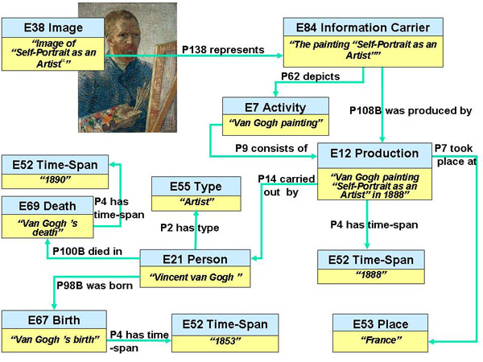
CIDOC CRM
Ontology for heterogeneous cultural heritage information
Represents more than just bibliographic information
Event-based model
(compare with DC’s attribute-based approach)
http://www.cidoc-crm.org/

Slide 23
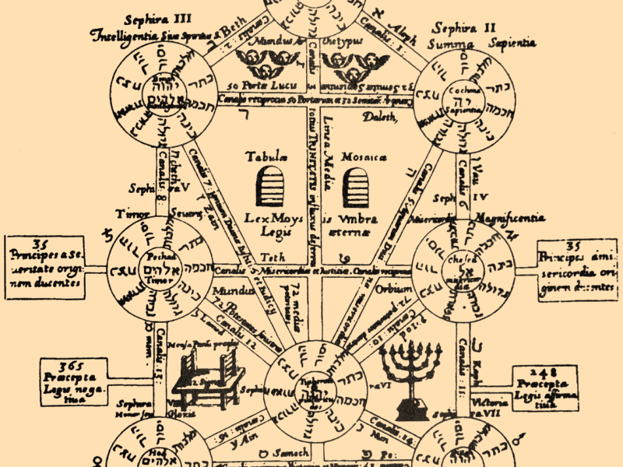
Knowledge Organisation

Slide 24
Simple Knowledge Organisation System
Standard vocabulary to support thesauri, classification schemes, subject heading lists, taxonomies, and other types of controlled vocabulary
Semantic relationships: broader, narrower, related terms
Labels, preferred labels, alternative labels
Notes, documentation, scope notes
Mappings between vocabularies
http://www.w3.org/TR/skos-reference/

Slide 25
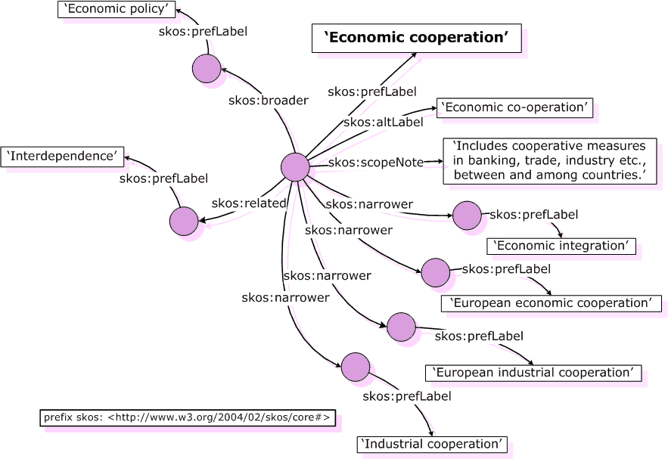
SKOS Example

Slide 26
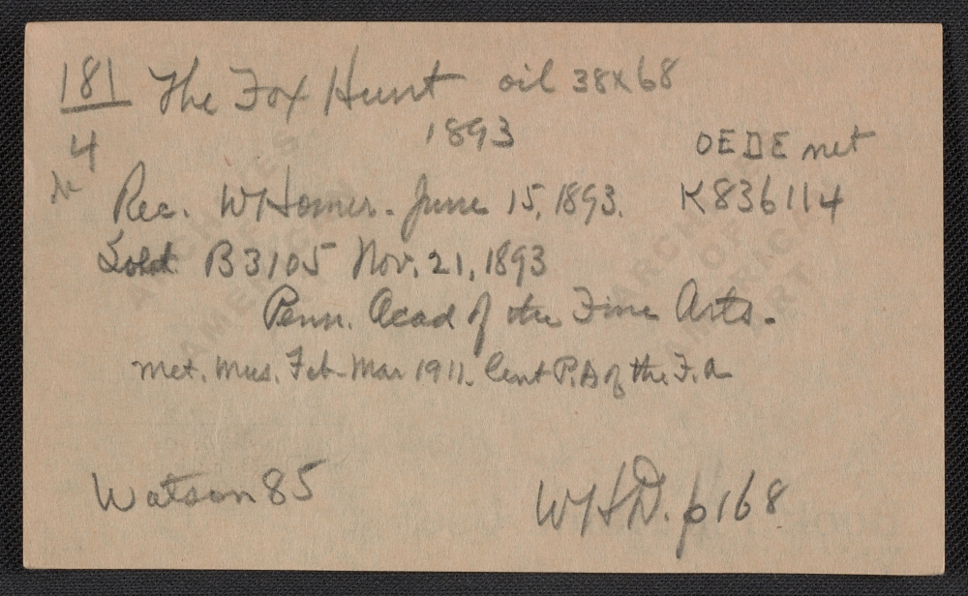
Provenance

Slide 27
Provenance
The provenance of a digital object represents its origin
Provenance facilitates:
  understanding how data was collected so it can be meaningfully used
  determining ownership and rights over an object
  making judgements about information to determine whether to trust it
  verifying that the process and steps used to obtain a result complies with given requirements
  reproducing how something was generated.

Slide 28
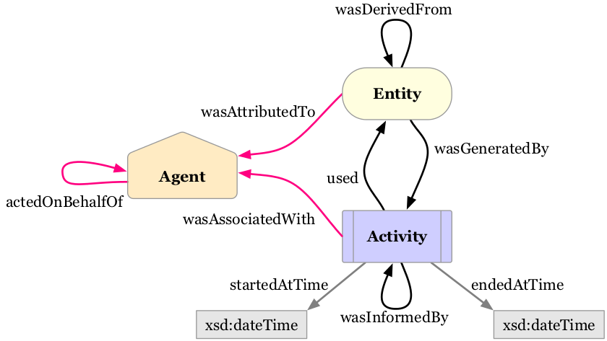
PROV-O
A specification and ontology for expressing provenance records
Records contain descriptions of the entities and activities involved in producing and delivering or otherwise influencing a given object
Became a W3C Recommendation in April 2013
http://www.w3.org/TR/prov-primer/

Slide 29
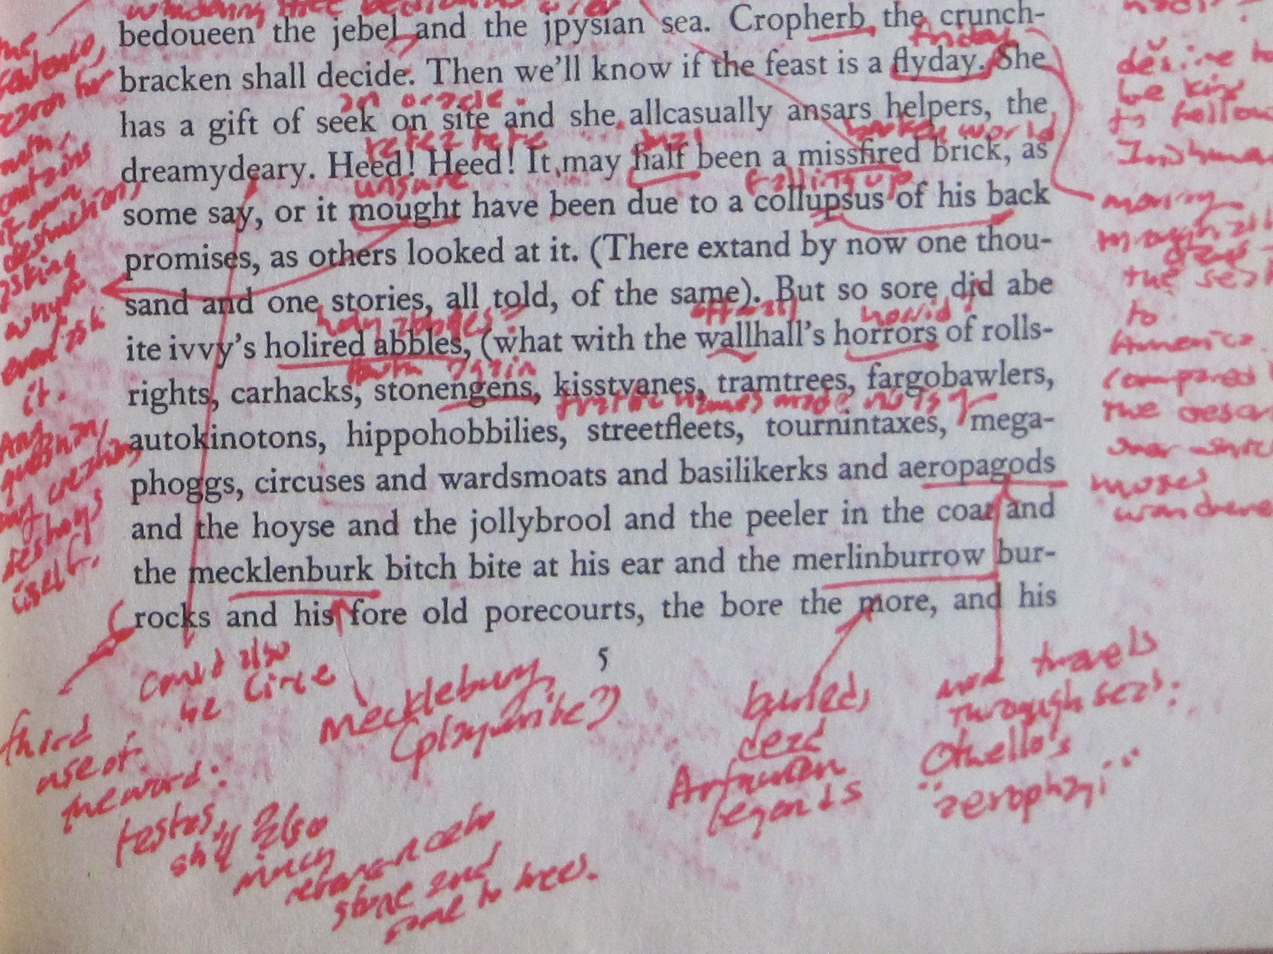
Web Annotation
http://www.flickr.com/photos/medievalkarl/4473939932/

Slide 30
Annotea
Shared annotations for the Web
  User wishes to annotate a document
  Annotea-enabled browsers create RDF that associates a region in the document with the annotation
  RDF published to a server (cf. link server)
  Annotea-enabled browsers can query server to obtain annotations for pages
    Amaya
    Mozilla (Annozilla)
http://www.w3.org/2001/Annotea/

Slide 31
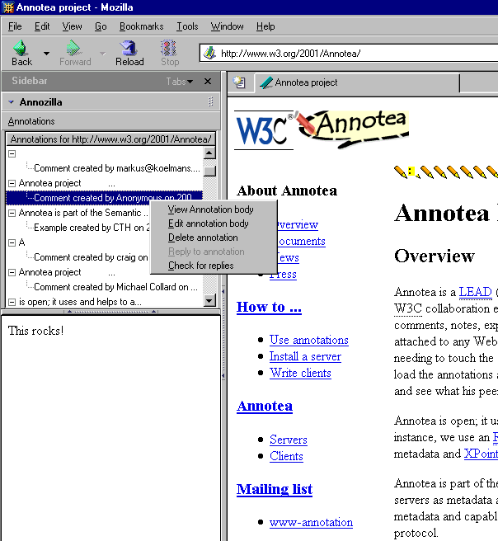
Annotea
icons indicating annotation locations
annotation summaries
annotation text

Slide 32
Annotea
Vocabularies used
  Dublin Core for bibliographic metadata about the annotation
  Custom schema for relating annotation to annotated document
XPath and XPointer used to identify region of document to be annotated

Slide 33
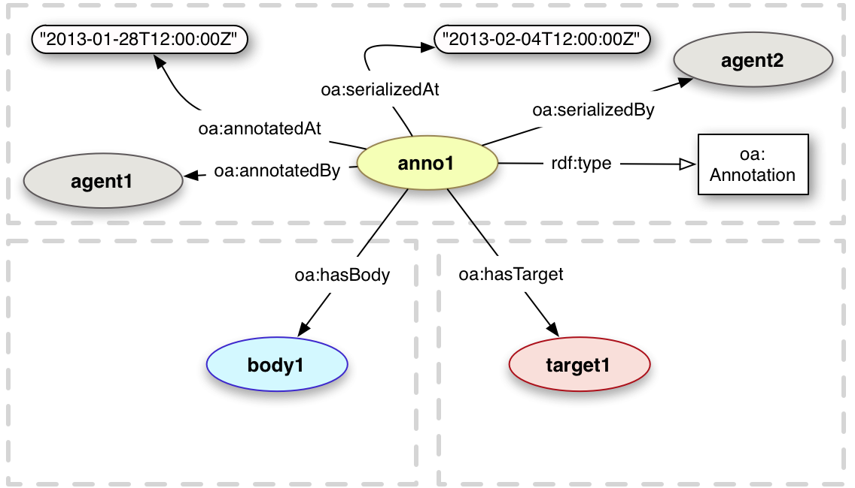
Open Annotation Data Model
A framework for creating associations between resources
W3C Community Draft (Feb ‘13)
  Ongoing work on annotation within W3C (possible working group)
Vocabularies used:
  FOAF
  Dublin Core
  Provenance
  SKOS
http://www.openannotation.org/spec/core/

Slide 34
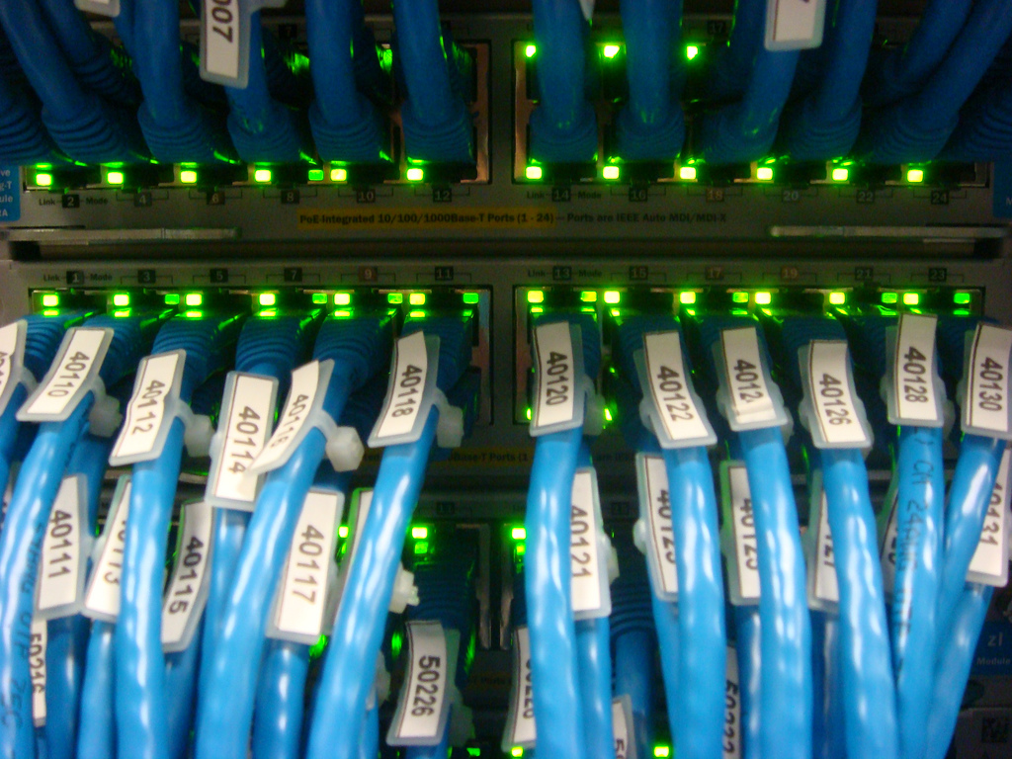
Semantic Web Services
http://www.flickr.com/photos/sugree/3024637789/

Slide 35
Web Services
Web services are characterised as:
  Distributed
  Heterogeneous
  Loosely-coupled
Loose coupling is key issue
  Allows opportunistic, ad-hoc reuse of component services
Requirements:
  Service description
  Service discovery
  Service invocation

Slide 36
Semantics of Service Descriptions
Web Service service descriptions deal primarily with the signature of a service
  “this service takes a string and returns two numbers”
We need richer service descriptions
  “this service takes a town name and returns its latitude and longitude”
  “this service takes the name of a football team and returns its last score”

Slide 37
Semantic Web Services
Combine Web Services and Semantic Web
  Ontologies of services
  Ontologically-informed service parameters
  (alternatively, web services for the Semantic Web)
OWL-Services (was DAML-Services) and WSMO define vocabularies for describing web services
  Complements existing web services languages – SOAP, WSDL, UDDI
  Semantic Annotations for WSDL (SA-WSDL)

Slide 38

Research Information
http://www.flickr.com/photos/thomasclaveirole/454394799/

Slide 39
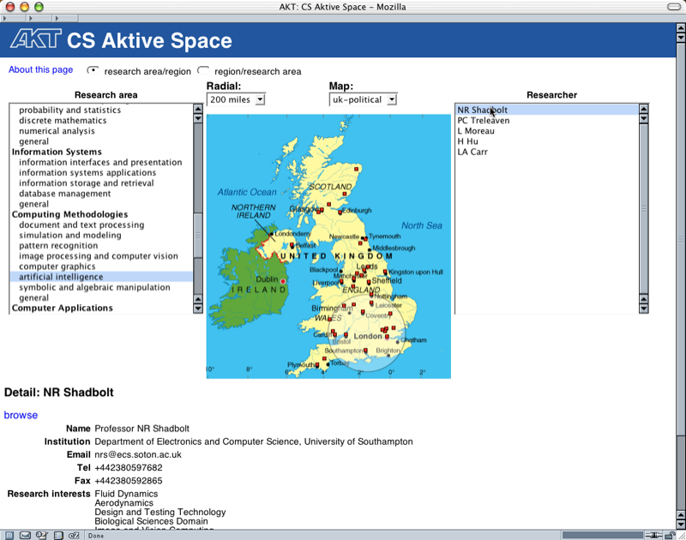
CS AKTive Space (2003)
Repurpose information gathered about CS researchers to help them understand and explore their community
Data sources:
  2001 Research Assessment Exercise submissions
  Research Council project data
  Detailed data on personnel, projects and publications harvested for leading CS departments in the UK
Notes:
Award-winning Semantic Web application
ISO 3166
UN LOCODE
IATA

Slide 41



System Architecture
Open University
Oxford
Citeseer
Warwick
Edinburgh
data sources
Birmingham
Sheffield
Cambridge
ECS
harvesting
services
Web
Harvester
Custom DB
Harvesters
KB
application
services
NL
Analysis
Network
Analysis
Geographical
Visualisation
user interface

Slide 42
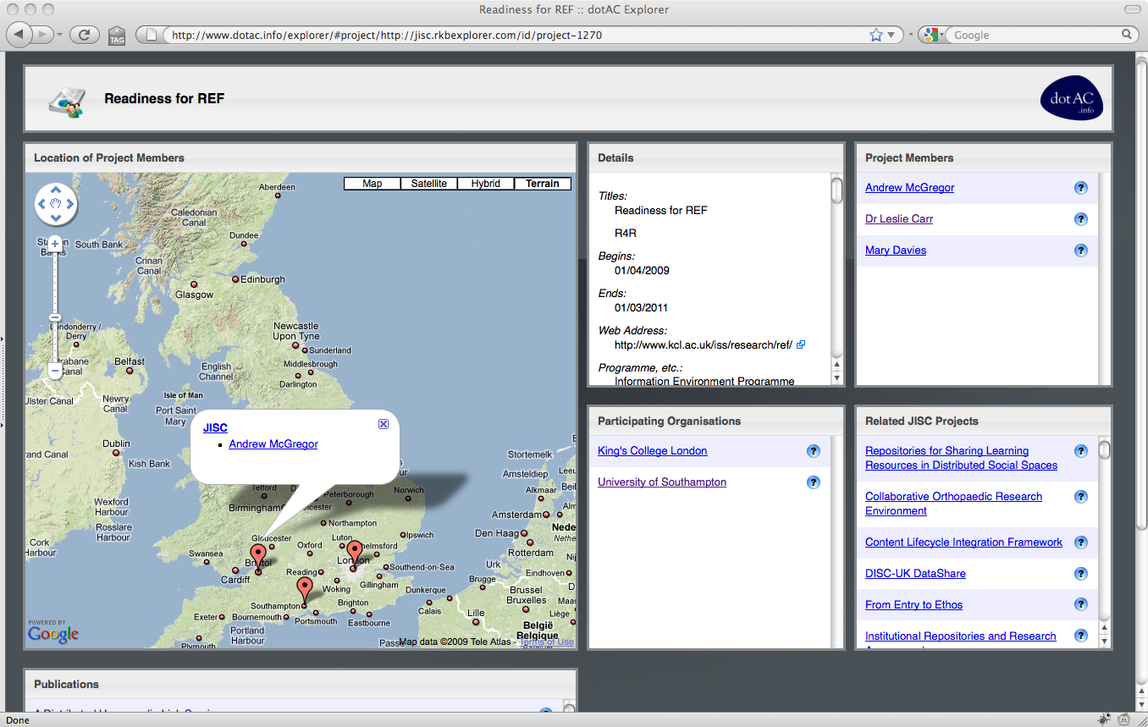
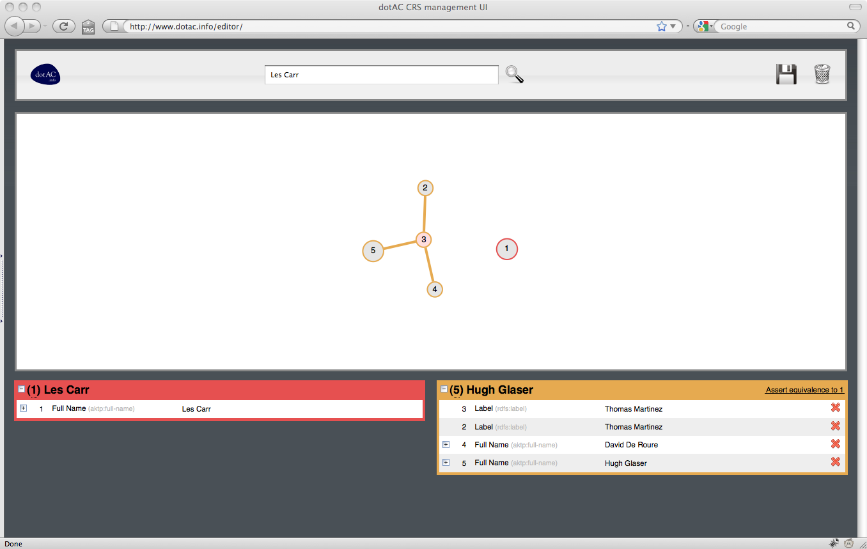
dotAC (2009)
CS AKTive Space revisited
  All UK Higher Education
  Sustainable data from HEIs and research councils
  Mapping from CERIF
Extra services
  Network analysis for related resources
  (communities of practice)
  Coreference management – identify duplicates in data
http://dotac.info/

Slide 43

Business Intelligence
http://www.flickr.com/photos/tetsu-k/393957103/

Slide 44
AKTive Futures (2004)
How do we produce a portal for end users within the “strategic decision making” process of an organisation?
Inform strategic planning and market intelligence
  Identify relevant drivers
  Visualise trends in heterogeneous data
  Present information contextually

Slide 45
Climate and environment
Storms ahead: weather extremes
Bio-diversity
Global transport and industrialisation
Abrupt climate change
Sea level rises
Water shortages
Kyoto to ‘Contraction and
Convergence’
Augmented reality, pervasive and mobile computing
‘Ambient’ computing
The Grid
Broadband Mobile
Wireless
Bio-inspired computing
Hybrid iDTV/web
Remote sensing
Bio-everything
Bio-tech
Bio-remediation
Bio-terror
Bio-error
Bio-agriculture
Bio-medical
Bio-informatics
Genomics
Proteomics
Bio-systems
Nano-science
to nanotech
Nanobots or goo?
Materials science
Nano-machines
Sensors:RFIDS – MEMS
Drug delivery
Nano-filtration
Energy
Post oil?
Large to small scale
networks
Hydrogen fuel cells:
mobility
‘Hydrogen highway’
Costs and pricing
Demand cuts
Wind, tidal, solar
Geo-political economy
US-dominated agenda
International institutions
North vs South
China, India and Asia
European social agenda
Scramble for oil in Africa
US interventionist
Middle East
US ‘technological sublime’
Knowledge, Innovation
The Semantic Web
Private research
Public knowledge
Artificial intelligence
Intellectual property vs open source
E-science
Socio-cultural
Values, attitudes and
lifestyles: fast trends
Anti-corporate
‘Open source’ values
New trust matrix: NGOs
Ethical consumers
Family life
Young vs old
Boomers age
Hypermobility, transport
and urban/rural futures
Health ‘economy’
‘Care world’
Culture of fear
and anxiety
Media
Conflicts over
‘simple/certain’ vs
‘complex/uncertain
Plural
Fragmented public
media and discourse
Single issue moral
panics
Smart mobs
Mobile opinion formers
Terrorism, total surveillance and security
Global terror
Future of ‘remote wars’
Everyone is watching
Human rights
Privacy and trust
Sustainability agenda
Anti-science: the values
debate
Socio-political conflict
over economics and business
EU/regulatory drivers
Public engage vs indifferent
Corporate social
responsibility
Demographics, migration and ageing
Cures for everything?
Longer and better?
Ageing West, pensions crisis, inter-generational tension
Acceleration of migration

Slide 46
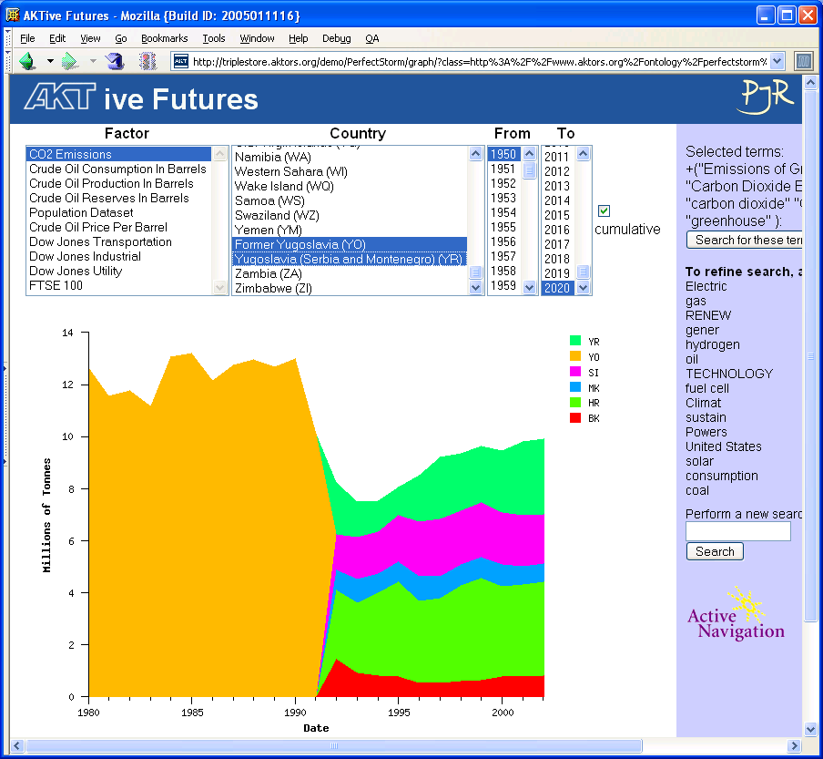

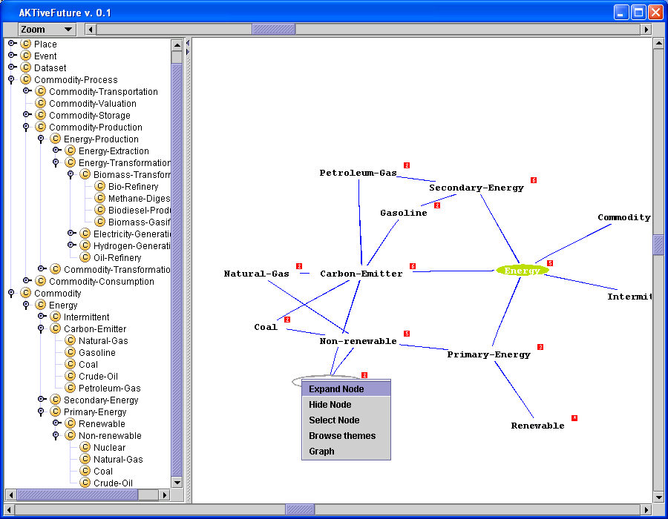
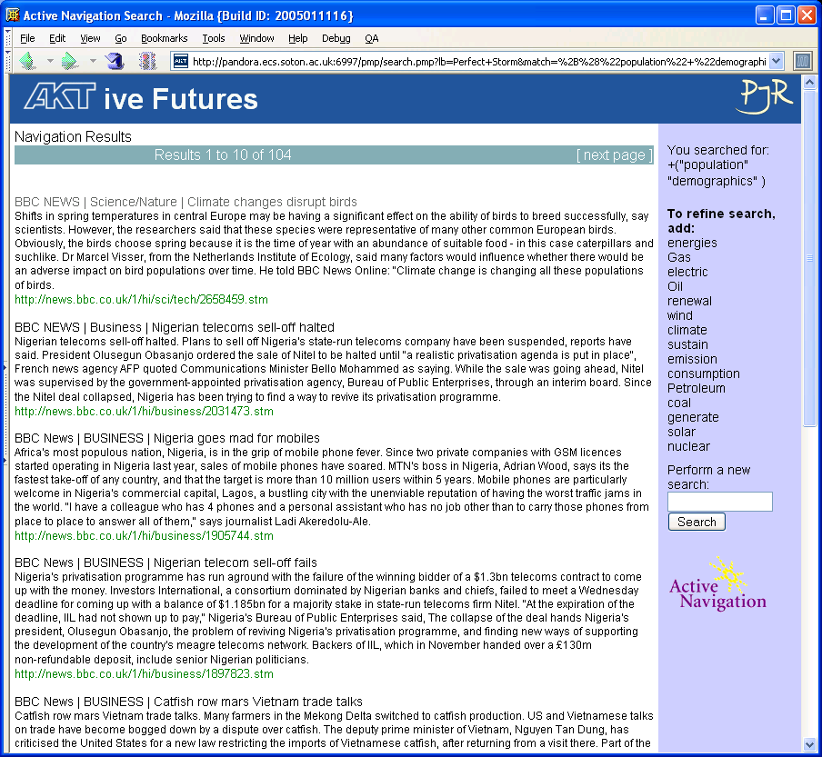
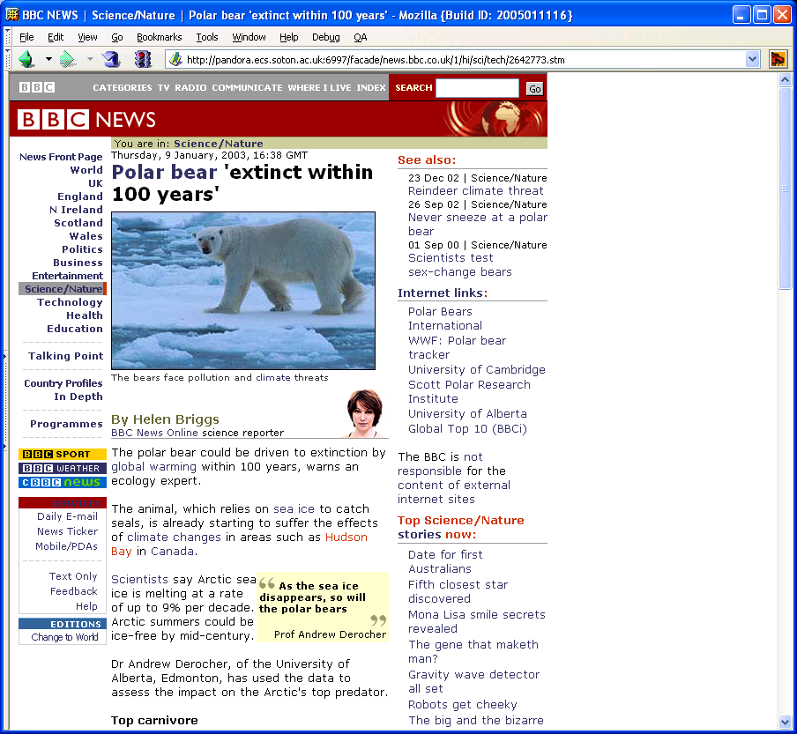
System Architecture
Ontology
Structured data
Annotation with contextual events
Knowledge
Base
Harvesters
Concept
browser
World Wide Web
lexicon
Linkbase
Unstructured text
Linking overlay on web pages

Slide 47






Market Blended Insight (2006-2010)
Application of Semantic Web technologies to marketing strategies for the B2B sector
Real data, real B2B processes to ensure real scenarios for the undertaken research
Workflow:
  Identify market segments
  Identify value chains and key relationships
  Identify opportunities and channels of communication
  Refine and iterate
http://mbi.ecs.soton.ac.uk/

Slide 48
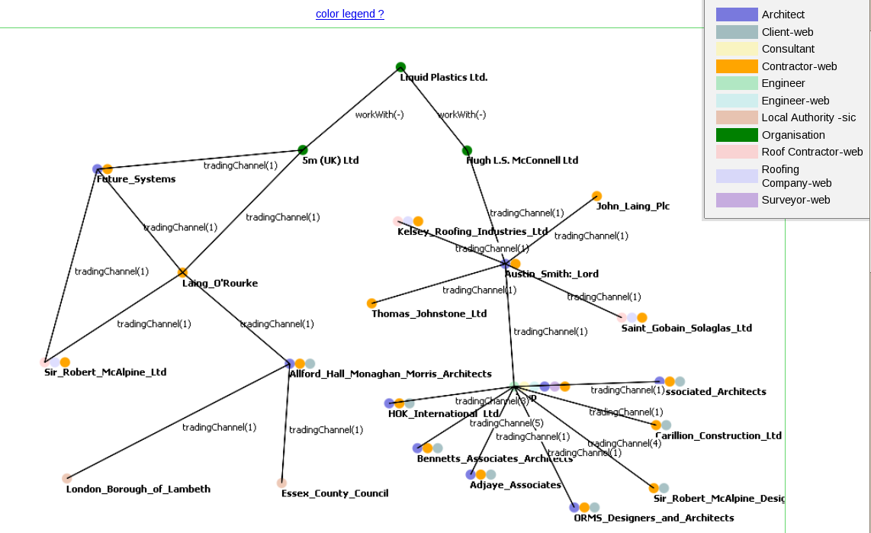
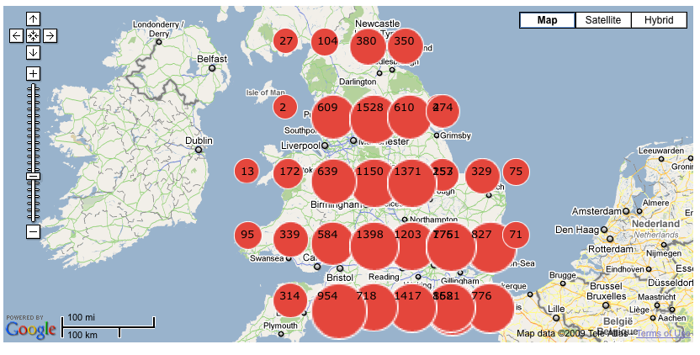
Data Sources and Visualisations
UK businesses: ~4M companies
Ordnance Survey Address Layer
UK SIC(92) industrial classifications
Other sources:
  Local publications
  Trade publications
  Contact data for ~300K companies, extracted from company web sites
  London Gazette (all UK insolvencies)
Notes:
Trade publications – Architects Journal
Local publications – myCamden website

Slide 49

Good Relations
Standardised vocabulary for product, price, and company data
Represents:
  Prices
  Accepted payment methods
  Opening times
  Delivery methods and charges
  Warranty promises and scope
Integrates with:
  UNSPSC vocabulary for offerings
  SIC codes for company type
http://purl.org/goodrelations/

Slide 50

Collaborative Working
http://www.flickr.com/photos/projectbamboo/2951082320/

Slide 51
Scenario
Meeting rooms linked over network
Potentially labs too – and smart spaces in general
Events in rooms provide annotation, e.g.
  Use of documents
  Moving through agenda
  Slide transitions
  People arriving and leaving
  Note taking

Slide 52
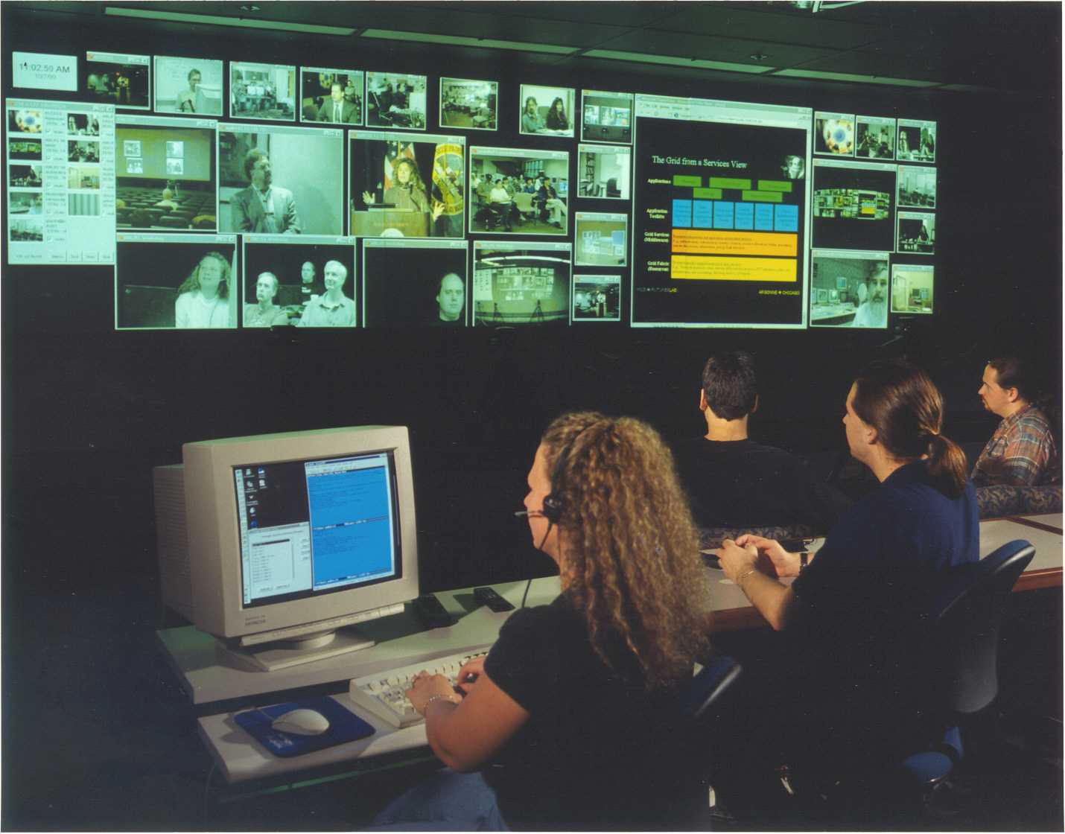


Slide 53

Semantic Web meets CSCW
Ontologies to enhance media-rich annotations of group problem solving
Planning and knowledge based task support to enhance issue-based process/activity discussions
Scholarly discourse and argumentation to enhance collaborative meeting structures
Presence and visualisation to enhance group peripheral awareness at a distance
http://www.aktors.org/coakting/

Slide 54
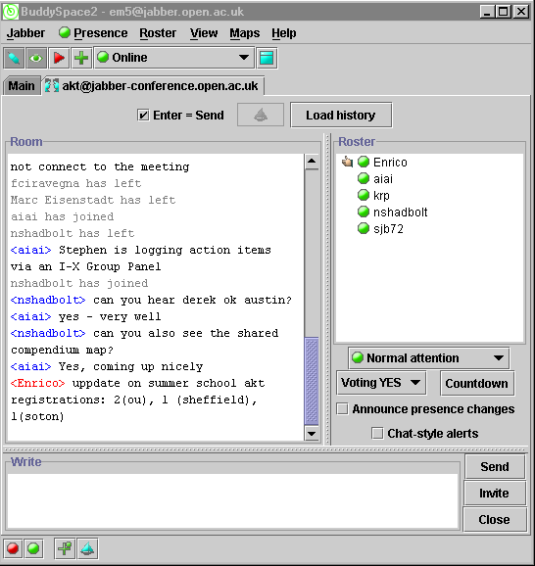
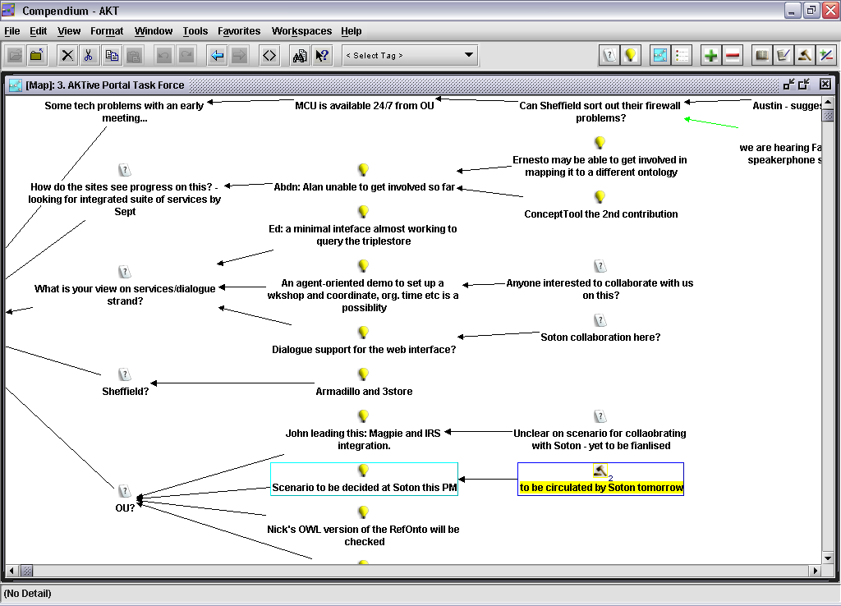
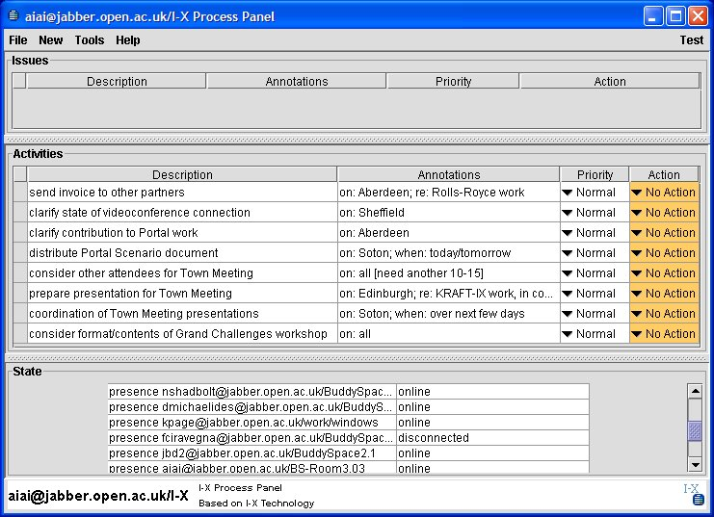
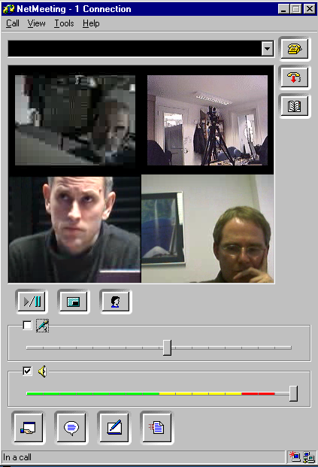
BuddySpace
awareness of
colleagues’
availability/ sense of
‘presence’
virtual meetings
NetMeeting
mapping real time
discussions/ group
sensemaking
recovering information
from meetings
recovering information
from meetings
Compendium
following through decisions/
coordinating activities
synthesising artifacts
I-X Process panels

Slide 55
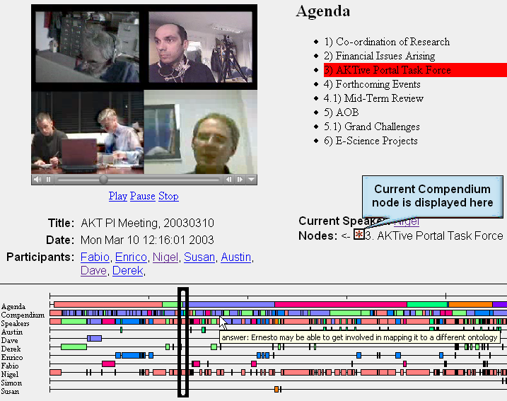
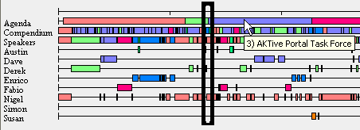

Slide 56
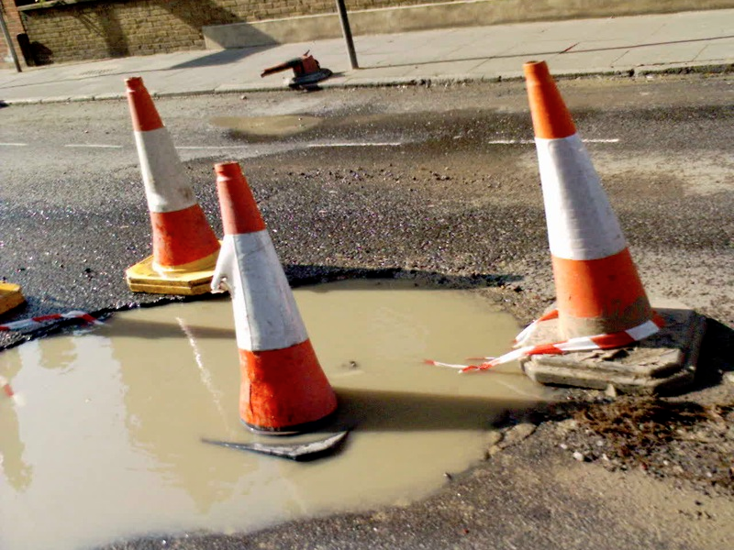
Public Sector Information
http://www.flickr.com/photos/emsef/1398072554/

Slide 57









AKTive PSI (2005)
Use advanced knowledge management technology to improve the delivery of policy and public services across Government
Build up a detailed picture of life in two London Boroughs, using as broad a collection of Public Sector Information as possible

Slide 58
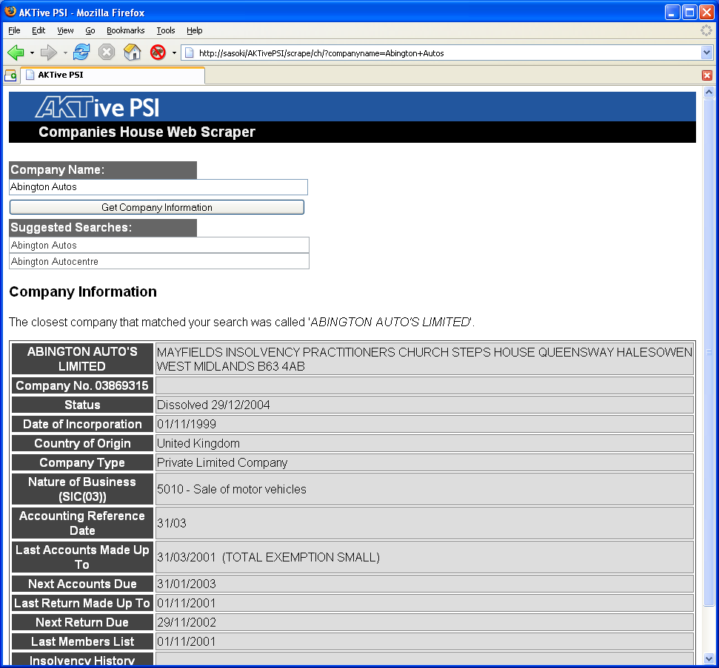
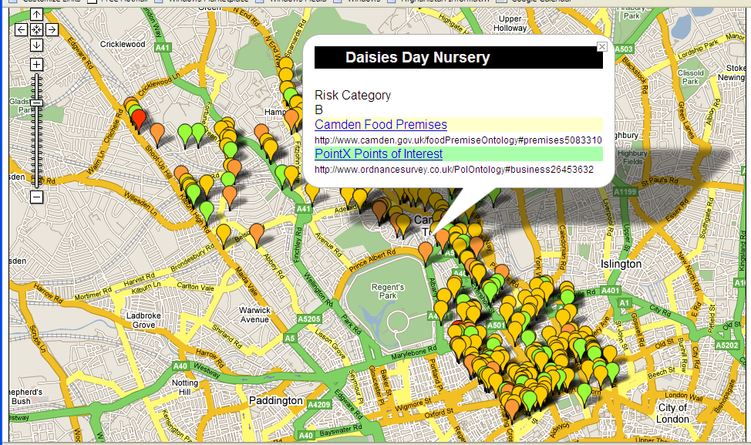
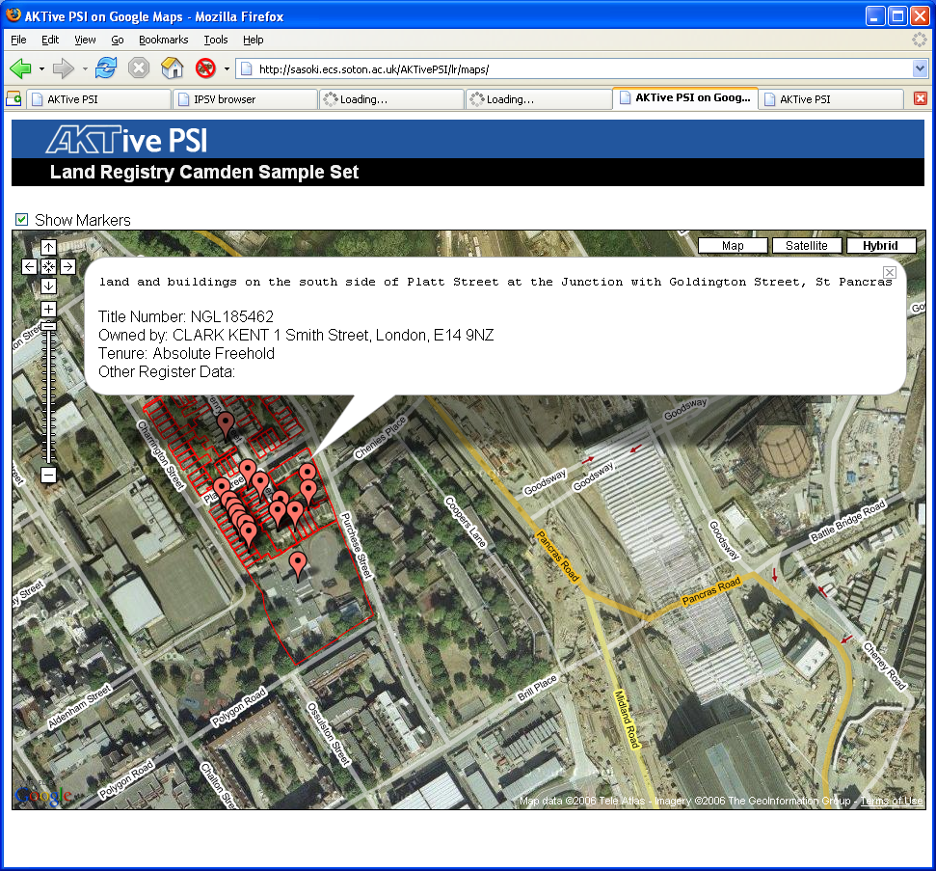
Visualisations and Mashups

Slide 59
Integrated Public Sector Vocabulary
Taxonomy for classifying public sector information resources
Developed with the backing of the ODPM and the Cabinet Office e-Government Unit
Available in a variety of formats, but RDF/XML is the definitive format
Uses Dublin Core and SKOS
http://www.esd.org.uk/standards/ipsv/

Slide 60
IPSV Top Level Headings
Business and industry
Economics and finance
Education and skills
Employment, jobs and careers
Environment
Government, politics and public administration
Health, well-being and care
Housing
Information and communication
International affairs and defence
Leisure and culture
Life in the community
People and organisations
Public order, justice and rights
Science, technology and innovation
Transport and infrastructure

Slide 61
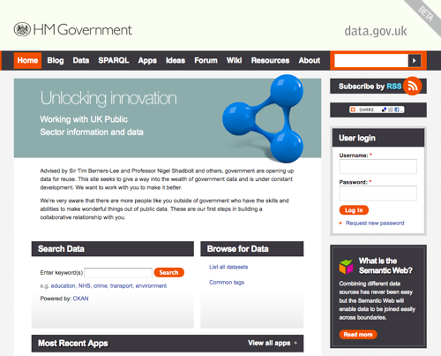
data.gov.uk (2010)
In 2009, Tim Berners-Lee and Nigel Shadbolt appointed as advisors to HMG on opening up public data
data.gov.uk website went public on 21 Jan 2010
  2890 datasets from central and local government
  Uses SW technologies to represent data

Slide 62
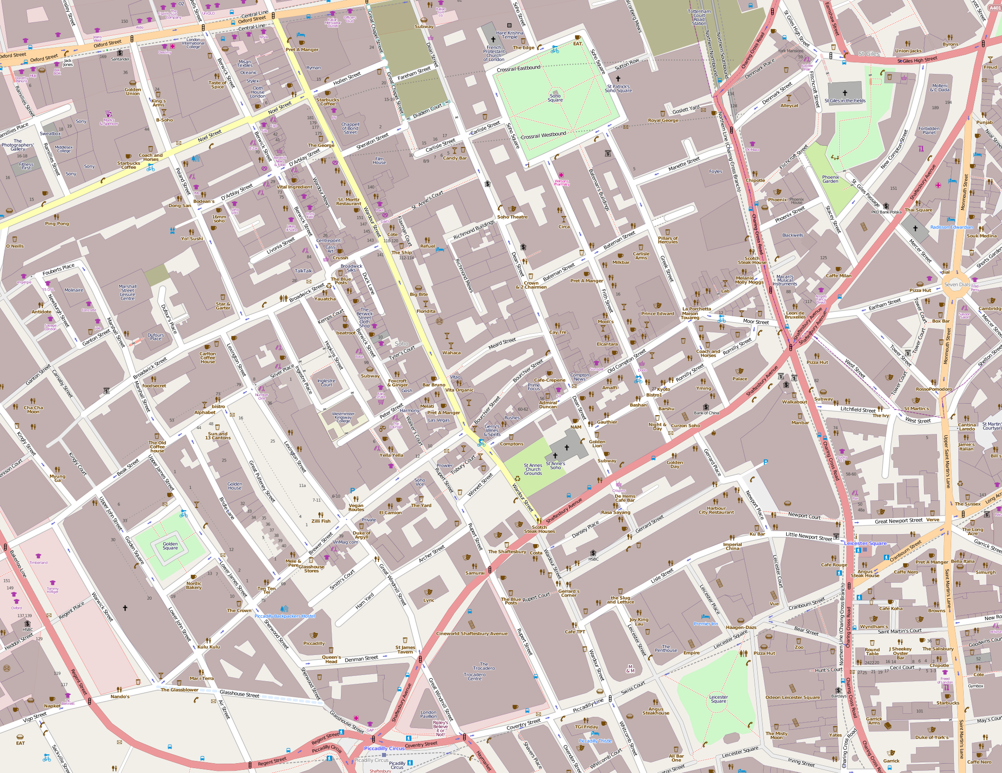
Geographic Information

Slide 63
Ordnance Survey Linked Data
Opened up datasets as part of UK public sector data initiative:
  1:50,000 Gazetteer
  250,000 place names
  Code-Point
  1,700,000 postcode units
  Boundary Line
  Electoral and administrative boundaries
Output formats:
  JSON
  RDF
SPARQL query
http://data.ordnancesurvey.co.uk/

Slide 64
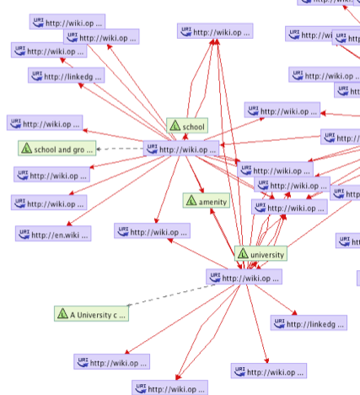
Open Streetmap Linked Data
OSM Semantic Network
  SKOS vocabulary built from map feature tags
LinkedGeoData.org
  Interlinks OSM data with other linked open data

Slide 65

e-Science

Slide 66
e-Science
e-Science characterised as:
  Large-scale science
  Distributed global collaborations
  Very large data collections
  Very large scale computing resources
Data integration will be a major issue
  Capture, publish, reuse data
  Agreed vocabularies for data exchange

Slide 67
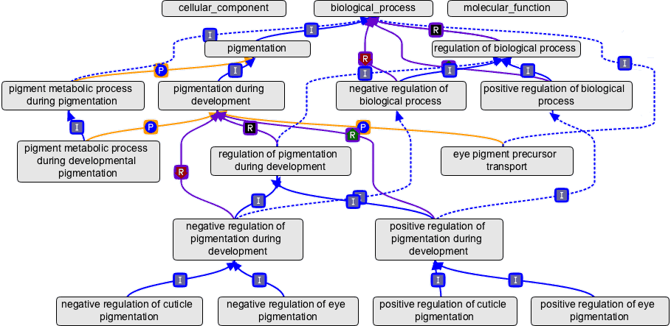
Gene Ontology Consortium
Controlled vocabularies for the consistent description of gene products
Simplified profile of RDF/XML
Multi-view ontology
  Molecular function
  Biological process
  Cellular component
http://www.geneontology.org/

Slide 68
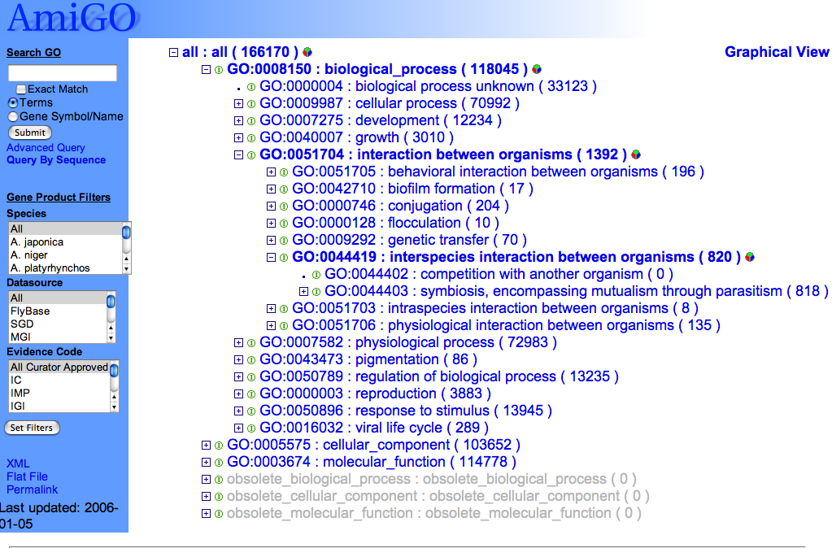
http://www.godatabase.org/

Slide 69
[Term]
id: CL:0000540
name: neuron
def: "The basic cellular unit of nervous tissue. Each neuron
consists of a body\, an axon\, and dendrites. Their purpose
is to receive\, conduct\, and transmit impulses in the
nervous system." [MESH:A.08.663]
xref_analog: FBbt:00005106
xref_analog: FBbt:00005146
is_a: CL:0000393 ! electrically responsive cell
is_a: CL:0000404 ! electrically signaling cell
relationship: develops_from CL:0000031 ! neuroblast
Notes:
this is the related term in the cell type ontology

Slide 70

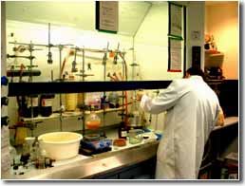
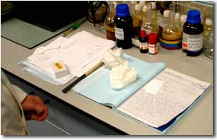
The Smart Tea Project
Improving the information environment for chemists – both within and beyond the lab
Supporting chemists in the preparation, execution, analysis and dissemination of their work
http://www.smarttea.org/

Slide 71
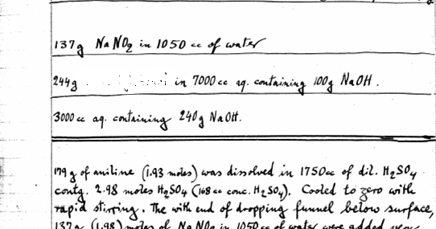
Data Capture: The Lab Notebook
Notes:
Quantities

Slide 72
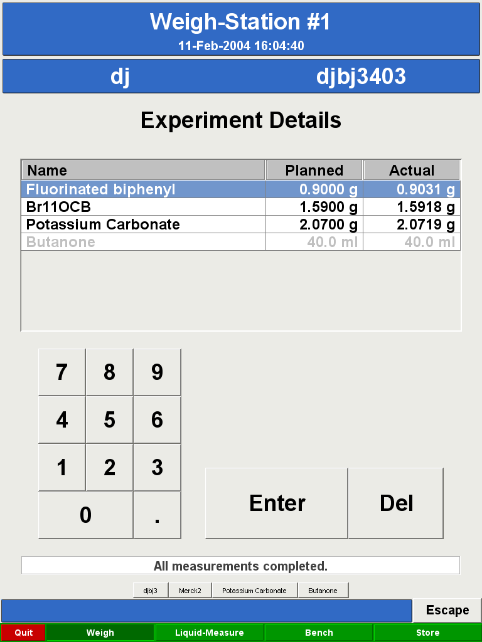



Slide 73


Slide 74





Publish and Reuse
http://ecrystals.chem.soton.ac.uk

Slide 75
Exchange Vocabularies
BioPax Ontology (biological pathways)
  Metabolic and signalling pathways, molecular interactions
Gene Ontology (genes and gene products)
  Molecular function, cellular component, biological process
NCI Cancer Ontology
  Diseases, drugs, anatomy, genes
(and many others from other disciplines)

Slide 76

Advanced Visualisations

