Slide 1
COMP1205 Week 7
Professional Development
Legal, professional and ethical perspectives
Introduction and overview Dr Su White
http://www.edshare.soton.ac.uk/12464/

Slide 2
Overview: timescales and topics
Timescales and Topics
W7: Uni w24 w/c 10/3
W8: Uni w25 w/c 17/3
W9: Uni w26 w/c 24/3
W10: Uni w31 w/c28/4
W11: Uni w32 w/c 5/5
W12: Uni w33 w/c 12/5
Vacation Easter
Presentations
Presentations
Presentations Hand in
Overview
& Intro
Presentation task briefing
Legal & workplace 1
Legal and workplace 2
Peer marking
(audience)
Peer marking
(audience)
Security guest lecture
Overview of entire module by multiple choice exam
Ethics and Professionalism are threads which run throughout the module

Slide 3
Launching you forward

Slide 4
Overview: working method
Formal/timetabled
Informal/un-timetables
Lecture
The big picture
Pacing
Blackboard
Links and references
Out of class
Take the quizzes
Watch videos
Read overviews
Work through tasks
Think and discuss
Prepare assessments
Prepare for examination
Objective: knowledge, skills and understanding
Notes:
Knowledge, skills and understanding
You need build all of these

Slide 5
Rationale of the structure
Guidance and prompting
Plus… directing you to a realistic/sustainable approach
This is not the same as coding, maths or other ‘hard’ subject areas
But it is very relevant to your degree…
… and the approach is relevant to future study and work
Find out, think about, re-present
Work in groups
Find your strengths
Overcome your weaknesses
Enjoy yourselves

Slide 6
High Level Objectives
Why we are here
To produce the best informed most widely educated CS and IT graduates in the country!
To help you learn how to argue and express yourself with informed insight on current professional and legal issues
To help you better understand how you address ‘fuzzy’ tasks which complement your technical skills
Make it a worthwhile use of your time (for you and me!)

Slide 7
Work smarter not harder
Work smarter not harder
Approaches
Intellectually
Understand your motivations
Imaginatively
Develop and use your creativity and imagination
Make your tasks enjoyable
Intuitively
Learn to know what works for you
Pareto principle
20% of the effort produces 80% of the result
… but think about it logically, rationally
One touch
Capture all the necessary information in a single touch
Follow up: Dan Pink – RSA Animate, see refs and links

Slide 8
Try to balance your workload

Slide 9
One way or another

Slide 10
And remember…
Your mind is like a parachute
It works best when open

Slide 11
Legal & professional
Legal & professional
How you will know, how we will know
Why does it matter?
Your degree is accredited
Employers expect awareness
Choose the workplace which suits you
Think forward
NOTE
You are not expected to
be a lawyer
You are expected to
demonstrate and awareness of laws which impact on the workplace
Self check
Confidence
“I have watched the videos”
“I have read the notes”
“I have tackled the tasks”
“I have worked out how it is relevant to my plans”
“I have prepared for the exam”
Online exam
Multiple choice questions

Slide 12
professional and legal issues might include
creative commons
e-commerce
environment
intellectual property
freedom of information
green ICT
professionalism
code of conduct
open data
open source
digital futures
accessibility
employment rights
employment rights
e-government
equality
globalisation
security
file-sharing
defamation
academic ethics
semantic web
inclusivity
outsourcing
linked data
computer crime
localisation
professional bodies
civic duty
free speech
libel
digital rights management
health and safety
social enterprises
surveillance
hacking
responsibility
pornography
data protection
privacy
digital divide
censorship
copyright
discrimination
ethics
morals

Slide 13
Take ownership
What do you want to do?
What CS/IT areas really interest you?
Identify the topics where you plan to be an expert

Slide 14
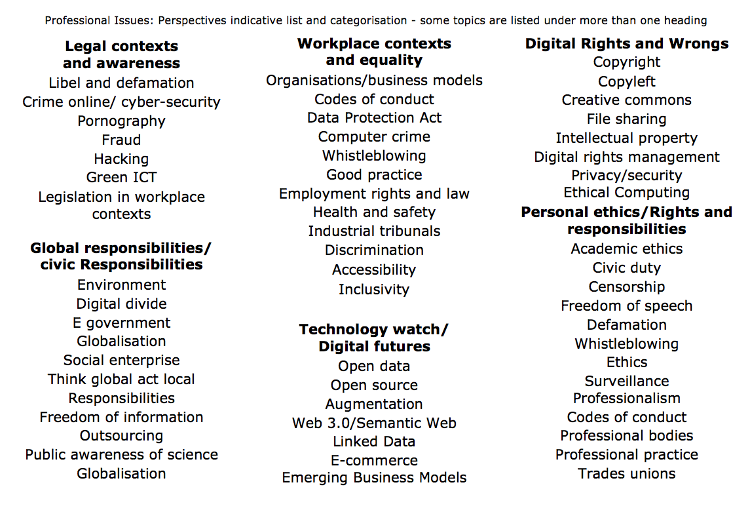

Slide 15
Reminder: rationale of the structure
Guidance and prompting
Plus… directing you to a realistic/sustainable approach
This is not the same as coding, maths or other ‘hard’ subject areas
But it is very relevant to your degree…
… and the approach is relevant to future study and work
Find out, think about, re-present
Work in groups
Find your strengths
Overcome your weaknesses
Enjoy yourselves

Slide 16
Before next week
Quiz
Quiz notes
You will be invited to respond to a short survey/quiz (midweek)
Designed to find calibrate
The progress you have made so far
Your familiarity with topics we are going to study
Your familiarity with the topics within the exam
The way which you are relating COMP1205 to the rest of your studies
Your responses will be anonymous
But
I can send you reminders … If you have not completed the task
The quizzes are designed help you understand the breadth of the topics we are going to study in a quick and easy way

Slide 17
Before next week
Independent Study
Watch, visit, study, review
Watch
RSA Animation on Motivation
http://youtu.be/u6XAPnuFjJc
Data Protection Act (from the ICO)
“The lights are on” http://youtu.be/wAe4358amJc
“Data Day Hygiene” http://youtu.be/CdYWoLC7TNI
Tick Tock http://youtu.be/Tdff6UPzvDQ
Visit and study
Information Commissioners Office http://ico.org.uk/what_we_cover/legislation
Review
This week’s slides and instructions
Use your judgment to decide how carefully you work on a video, reading or task remember keeping up to date makes it more likely you will pass the exam also they are designed to prepare you for next week’s class

Slide 18
This week… and next
Timescales and Topics
W7: Uni w24 w/c 10/3
Overview
& Intro
W8: Uni w25 w/c 17/3
Guest Lecture Security
Review the slides
Watch the videos
Visit the ICO website
Take the quiz
Legislation in the IT workplace
Security
Privacy
Guest Lecture
Professor Michael Butler
Presentation Briefs
Think about

Slide 19
Overview: timescales and topics
Timescales and Topics
W7: Uni w24 w/c 10/3
W8: Uni w25 w/c 17/3
W9: Uni w26 w/c 24/3
W10: Uni w31 w/c28/4
W11: Uni w32 w/c 5/5
W12: Uni w33 w/c 12/5
Vacation Easter
Presentations
Presentations
Presentations Hand in
Overview
& Intro
Presentation task briefing
Legal & workplace 1
Legal and workplace 2
Peer marking
(audience)
Peer marking
(audience)
Security guest lecture
Overview of entire module by multiple choice exam
Ethics and Professionalism are threads which run throughout the module

