Slide 1
COMP1205 Week 8
Professional Development
Legal, professional and ethical perspectives
Presentation Briefing
Dr Su White
http://www.edshare.soton.ac.uk/10709

Slide 2
Notes
A number of activities take place during the lecture
I do not expect to cover all the slides
Please study them in your own time
They contain extensive advice
As well as containing a copy of these slides, the EdShare content includes details of
The group allocations
The briefing allocations
A complete set of the topic briefs
Notes:
Each group will make a 10 minute presentation on their allocated topic shown in the table
below.
• Detailed briefs for each presentation are available at http://www.edshare.soton.ac.uk/10709/
The brief provides guidance and background references to help with your preparation.
• Every group participant will make a contribution.
• Presentations should be compiled using PowerPoint and will be submitted via the hand in
machine in the week prior to the presentations (week 10, after Easter)
• Each slide set must have a first slide including the title and group number, and a second slide
with a titled photograph of each participant.
• Presentations will be made during week 11 & 12
• If you do not participate in the presentation you will not be awarded any marks, unless this
has been specifically negotiated because of individual circumstances
• Contributions will be marked by course lecturers using the mark sheet shown at the end of
this document. This will produce a group mark.
• You will be given immediate direct verbal feedback as a group after the presentation and
during the allocated presentation slot.
• You will also gain a further contributory individual mark by participating in the review
process, for which you will be allocated a slot.
• You will use the standard mark sheet to create your review mark.
• You will submit your marks online via an interactive form.
• You are welcome to attend any of the presentations; many of them are relevant to your
studies.

Slide 3
Overview: timescales and topics
Timescales and
Topics
W7: Uni w24
w/c 10/3
W8: Uni w25
w/c 17/3
W9: Uni w26
w/c 24/3
W10: Uni w31
w/c28/4
W11: Uni w32
w/c 5/5
W12: Uni w33
w/c 12/5
Vacation
Easter
Presentations
Presentations
Presentations
Hand in
Overview
& Intro
Presentation task briefing
Legal & workplace 1
Legal and workplace 2
Peer marking
(audience)
Peer marking
(audience)
Security guest lecture
Overview of entire module by multiple choice exam
Ethics and Professionalism are threads which run throughout the module

Slide 4

Some general interest questions
How often have you made a formal presentation before?
  0-3 times?
  4-10 times?
  More than 10 times?
Remember: We all have different experience
Image: http://www.ventiq.com/
Notes:
After this discussion, print outs of groups are distributed and students re-organise themselves into groups seeing who they will be working with, and identifying the missing folk in their group

Slide 5

Beginning a journey…
Image: http://www.paulsbodine.com/

Slide 6
our objectives
To introduce you to some guidelines for making presentations
To prepare you (mentally) for the task of making a short presentation
To set you off to learn yourself how to make an excellent presentation

Slide 7
Rationale 1
Learning by doing
Simple approaches first
Practice to perfection
But accept mistakes …
which lead to learning ☺
Realistically
are you likely to be able to do
a perfect job first time?

Slide 8
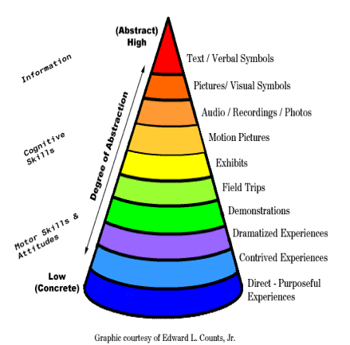
Rationale 2

Slide 9
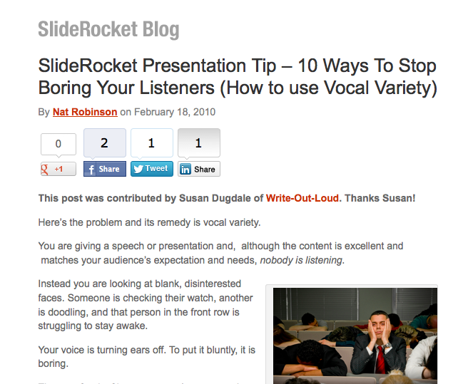
Do your own background reading e.g. SlideRocket

Slide 10
Some general interest questions
How often have you made a formal presentation before?
  0-3 times?
  4-10 times?
  More than 10 times?

Slide 11
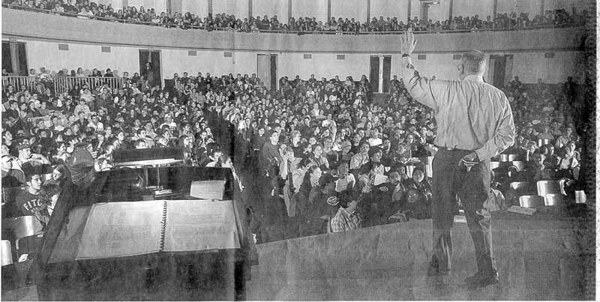
Think About Your Audience

Slide 12
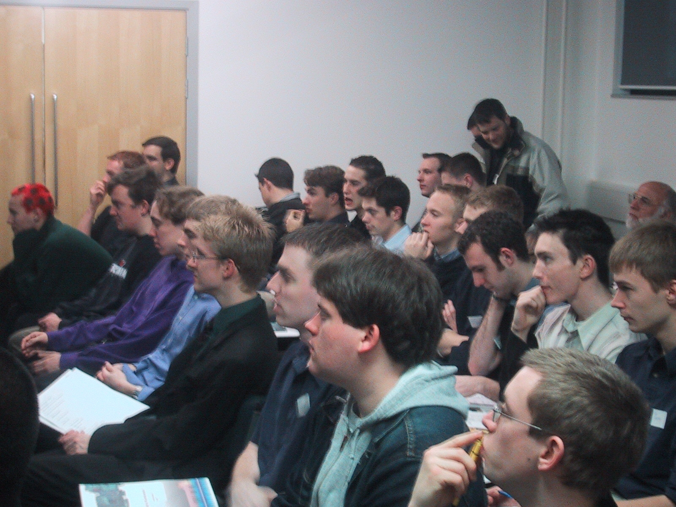
An audience….

Slide 13
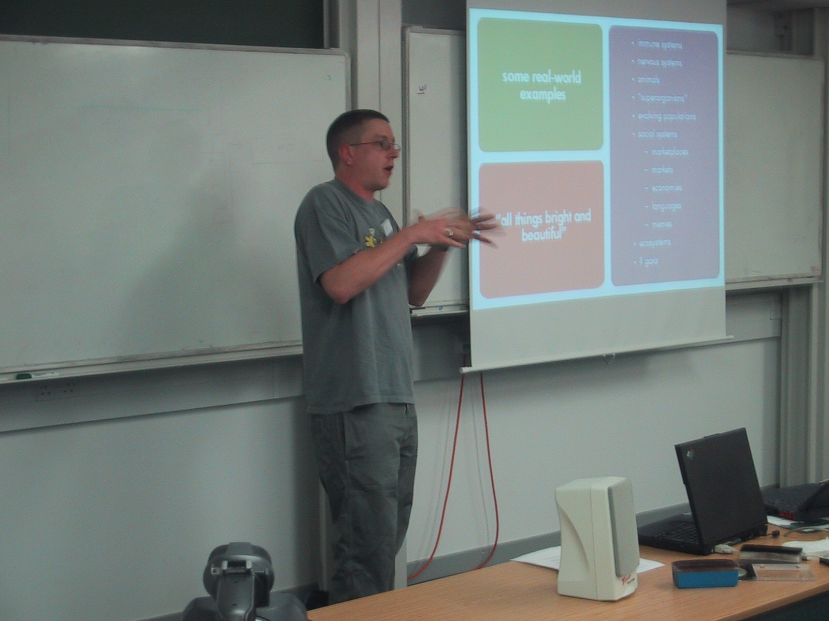
A keynote

Slide 14
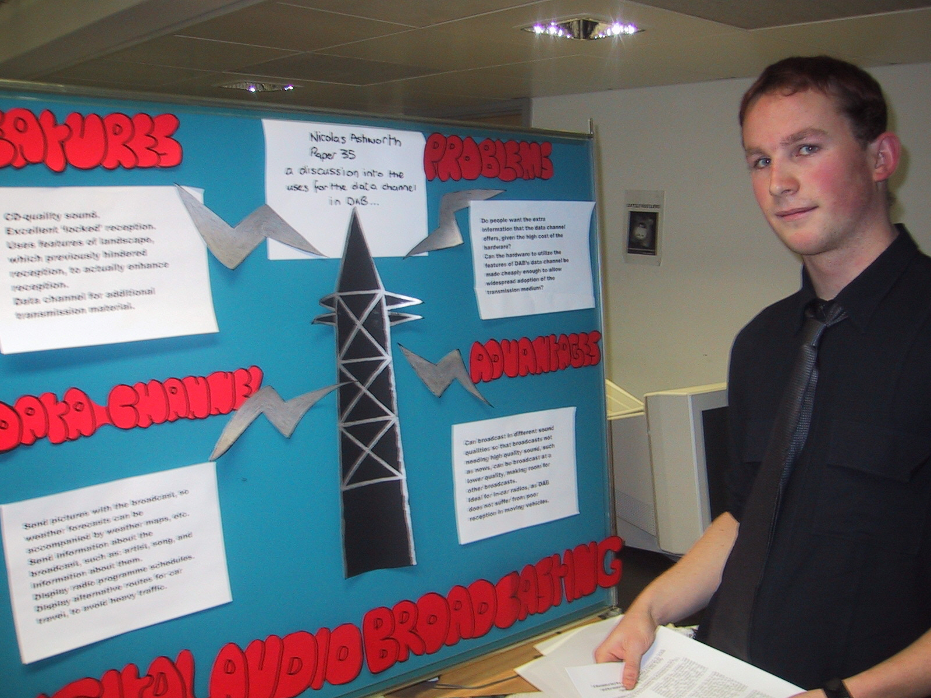
Another sort of presenting

Slide 15
Follow up thoughts and Activities
It is suggested you work through the following slides

Slide 16
Build on what you know already….
As a consumer of presentations
Think about a memorable presentation
What made it good?
Three things….
That you like to see in presentations
That make presentations a disaster
Chat with your friends about this
Use this knowledge in your group

Slide 17
Pragmatics
Prepare your slides
How will you say things?
  Can you keep it simple?
Any supporting information?
  Prepare hand outs
Make a dry run
Imagine the audience is in front of you
Will you keep to time?

Slide 18
focus
discuss with group/friends:
how can I learn to make good presentations?

Slide 19
learning and help
we will each need different kinds of help
we each learn and work in different ways
learning by doing
(present and attend lots)
language centre, assistive technology centre
self help (books, guides, the web)
peer help (colleagues, friends)

Slide 20

What is the purpose of a presentation?

Slide 21
What we expect
Discuss and agree an approach to the topic
Discuss and agree an approach to the topic
Allocate roles
advise double up roles
Research the topic
Construct an argument
Present the argument
Harness the information
Prepare a draft
Review/revise
Practice, practice, practice
Demonstrate competence
Research
Collate
Assemble
Review
Revise
Plan
The assessment criteria are always designed to steer you
towards learning from the tasks you undertake

Slide 22

What activities are included?
Individually/pairs/small groups
Generate a list
Discuss feedback:
In class
Or as an individual reflection…

Slide 23
What is important…
Based on module needs and past experience

Slide 24
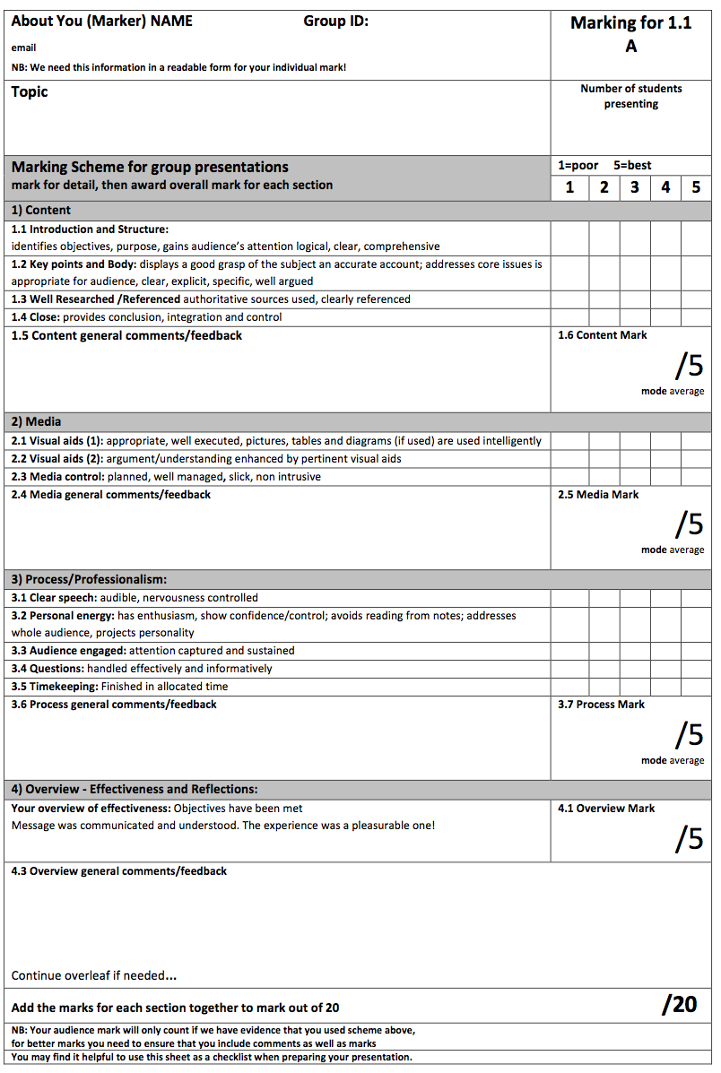
Assessment Criteria
The criteria are designed to steer you towards learning from the task you undertake

Slide 25

Practical Questions…
What are we marked on?
Four categories in the mark sheet
Content
Media
Process
Overview

Slide 26
1. Content
1.1 Introduction and structure:
Identifies objectives, & purpose,
gains audience’s attention
logical, clear, comprehensive
1.2 Key points and body:
displays a good grasp of the subject
an accurate account;
addresses core issues
is appropriate for audience,
clear, explicit, specific, well argued
1.3 Well researched/referenced:
authoritative sources used,
clearly referenced
1.4 Close:
provides conclusion,
demonstrates integration and control

Slide 27

Will you get the balance right?
It needs to be interesting and informative, well

Slide 28
2. Media
2.1 Visual aids (1):
appropriate, well executed
pictures, tables and diagrams (if used) are used intelligently
2.2 Visual aids (2):
argument/understanding enhanced by pertinent visual aids
2.3 Media control:
planned
well managed
slick, non intrusive

Slide 29

Good media means preparation

Slide 30
3 Process & Professionalism
3.1 Clear speech:
audible,
nervousness controlled
3.2 Personal energy:
has enthusiasm
shows confidence/control
avoids reading from notes
addresses whole audience
projects personality
3.3 Audience engaged
attention captured and sustained
3.4 Questions
handled effectively and informatively
3.5 Timekeeping:
Finished in allocated time

Slide 31
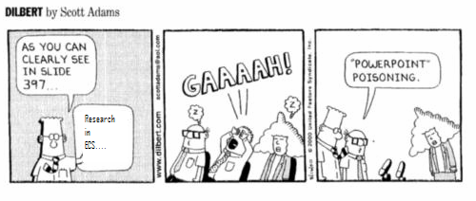
Will you have enough slides?
Each must present, practice the timings, present your argument

Slide 32
Overall Effectiveness
Your overview of effectiveness:
Objectives have been met
Message was communicated and understood.
The experience was a pleasurable one!

Slide 33


How will it be?
For them… for us…

Slide 34

Warning
Tasks which are superficially simple …
…often require attention to detail
Ultimately someone may have to assume responsibility

Slide 35
Advice for the actual presentation…
Be yourself
Plan and rehearse
Talk to your audience
  Tell a story
  Start middle end
Use cues
  Pen to point
  Think about fonts
  Diagrams
  Pictures
Eye contact
Project voice
Try out different methods
Order is important

Slide 36

Will you impress them?

Slide 37
Focus
know your audience
general questions:
What is the purpose of the presentation?
What do you want to communicate?
What do the audience expect to get out of it
How long have you got?

Slide 38
Some final words….
Have a conversation with your audience
It’s OK to be imperfect
It’s OK to use humour (if you can)
It’s OK to respond to a question
“I don’t know”
It can be a good idea to try to explain things in different words
You will get better with practice

Slide 39

The voice of experience
Remember your own advice
Draw on your wisdom
Learn from your audience

Slide 40
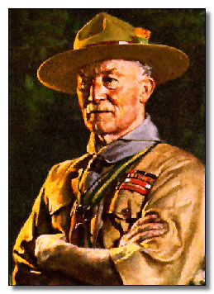
Remember….
Be prepared

Slide 41
Presentation advice
for
orientation
for
reference
acknowledge
critique
confirm
provenance
check:
slides
backup
practice
performance
critique
timings
objectives
Images
Charts
Handouts
Diagrams
Videos
tables
…
Web
Email
Consistency
Clarity
Size
and scale
Typeface
Colour (s)
Footers
layout
smile
multimode
Project
your voice
Identify/respect
your audience
connect
Don’t
read slides
don’t
crowd
Relax
Connect
Conversation
Take
control
converse
Be aware
Avoid
tics
Before
..and after
(?during?)
video
recording
Checklist
Critical friend
Improve
each time

Slide 42
Advice…
Be yourself
Plan and rehearse
Talk to your audience
  Tell a story
  Start middle end
Use cues
  Pen to point
  Think about fonts
  Diagrams
  Pictures
Eye contact
Project voice
Try out different methods
Order is important

Slide 43
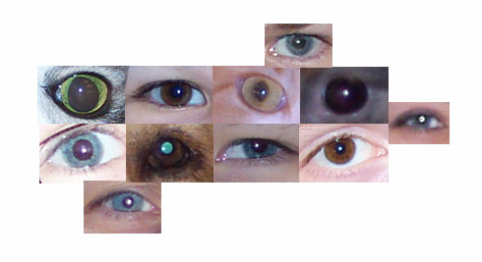
Seeing with new eyes
“The real voyage of discovery consists not in seeking new lands, but in seeing with new eyes”
  Marcel Proust

Slide 44
Presentation FAQs
Detailed briefs for each presentation are available at
http://www.edshare.soton.ac.uk/10709/
Each group will make a 10 minute presentation on their allocated topic shown in the table in EdShare and sent to you by email
The brief provides guidance and background references to help with your preparation
Presentations should be compiled using PowerPoint and will be submitted via the hand in machine in the week prior to the presentations (week 10, after Easter)
Each slide set must have a first slide including the title and group number, and a second slide with a titled photograph of each participant
Presentations will be made during
weeks 11 & 12
Every group participant will make a contribution
If you do not participate in the presentation you will not be awarded any marks, unless this has been specifically negotiated because of individual circumstances
Contributions will be marked by course lecturers using the mark sheet shown at the end of this document.
This will produce a group mark
You will be given immediate direct verbal feedback as a group after the presentation and during the allocated presentation slot
You will also gain a further contributory individual mark by participating in the review process, for which you will be allocated a slot
You will use the standard mark sheet to create your review mark
You will submit your marks online via an interactive form
You are welcome to attend any of the presentations; many of them are relevant to your studies

Slide 45
Further refs
Pragmatic rather than academic
SlideRocket
http://www.sliderocket.com/blog/2013/02/presentation-skills-infographic/
Warning – attribute what I thought was a quote by Confucius to Benjamin Franklin!
Did a bit of searching and its still disputed…
http://dakinburdick.wordpress.com/2012/03/14/tell-me-and-i-forget/

Slide 46
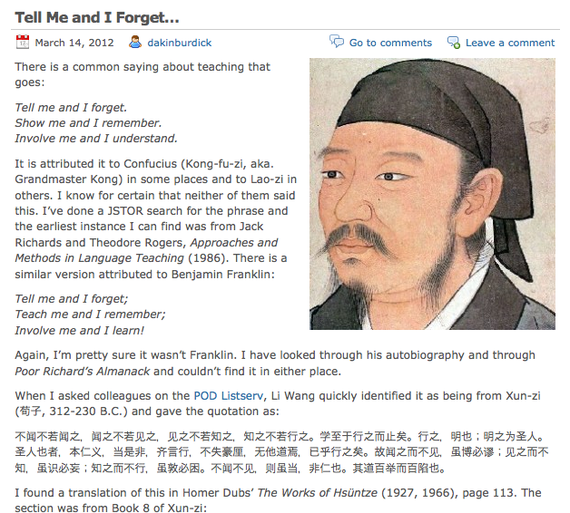
Why its not Benjamin Franklin…
http://dakinburdick.wordpress.com/2012/03/14/tell-me-and-i-forget/

Slide 47
Dale’s cone of experience
Dale’s Cone of Experience Overview
http://rapidbi.com/created/Coneofexperience-dale.html
Dale, E. (1946) Audio-visual methods in teaching. New York: The Dryden Press.
Dale, E. (1954) Audio-visual methods in teaching, revised edition. New York: A Holt-Dryden
Book, Henry Holt and Company.
Dale, E. (1969) Audiovisual methods in teaching, third edition. New York: The Dryden Press;
Holt, Rinehart and Winston.

Slide 48
Thank you ;-)
Su White
saw@ecs.soton.ac.uk
+44 (0)23 8059 4471
http://www.ecs.soton.ac.uk/~saw

Slide 49
Optional task group discussion
Note – identify three things you would like to know about presentations?
discuss- what are your strengths?
Quick review of the preferred skills
in your team (ref back to team lecture)
Plan for your team assignment
  meetings,
  roles
  group deadlines
  working methods
  e.g. shared files, online meetings, etc.

Slide 50
Reminders:
Module overview
Build up your knowledge step by step

Slide 51
Work smarter not harder
Work smarter not harder
Approaches
Intellectually
  Understand your motivations
Imaginatively
  Develop and use your creativity and imagination
  Make your tasks enjoyable
Intuitively
  Learn to know what works
  for you
Pareto principle
  20% of the effort produces 80% of the result
  … but think about it logically, rationally
One touch
  Capture all the necessary information in a single touch
  Follow up: Dan Pink – RSA Animate, see refs and links

Slide 52
The presentation topics relate to the syllabus..
You will become a specialist
Use your presentation to understand content, context and perspectives as well as develop skills
Many of the other presentations will have content which relates to the exam topics, pay attention ☺

Slide 53
professional and legal issues might include
creative
commons
e-commerce
environment
intellectual
property
freedom
of
information
green
ICT
professionalism
code of
conduct
open
data
open
source
digital
futures
accessibility
employment
rights
employment
rights
e-government
equality
globalisation
security
file-sharing
defamation
academic
ethics
semantic
web
inclusivity
outsourcing
linked
data
computer
crime
localisation
professional
bodies
civic
duty
free
speech
libel
digital
rights management
health
and
safety
social
enterprises
surveillance
hacking
responsibility
pornography
data
protection
privacy
digital
divide
censorship
copyright
discrimination
ethics
morals

Slide 54
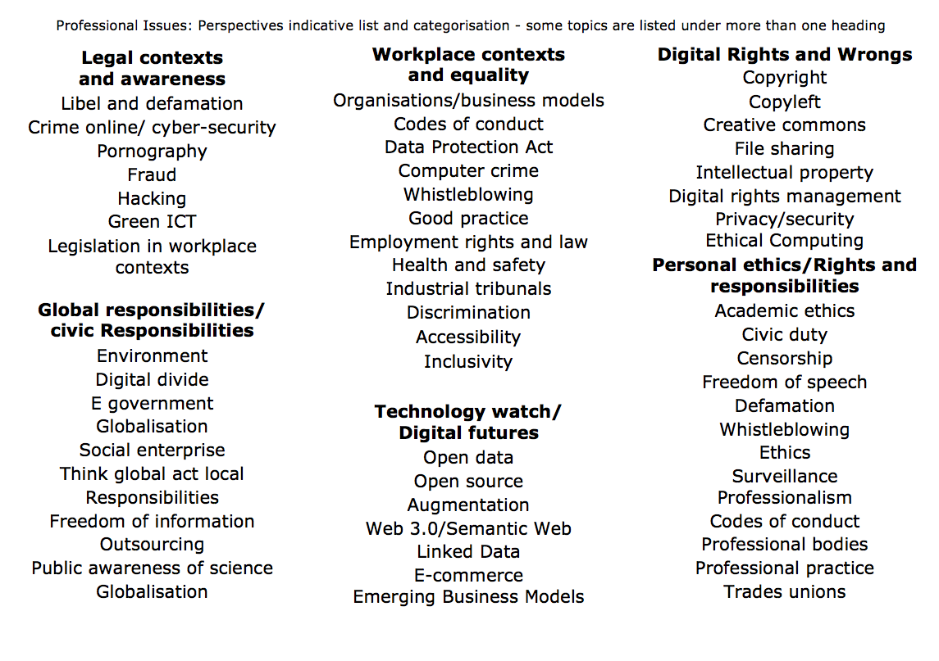

Slide 55
Overview: working method
Formal/timetabled
Informal/un-timetables
  Lecture
    The big picture
    Pacing
  Blackboard
    Links and references
  Out of class
    Take the quizzes
    Watch videos
    Read overviews
    Work through tasks
    Think and discuss
    Prepare assessments
    Prepare for examination
Objective:
knowledge, skills and understanding
Notes:
Knowledge, skills and understanding
How you work to understand the big picture..

Slide 56
Reminder: rationale of the structure
Guidance and prompting
Plus… directing you to a realistic/sustainable approach
This is not the same as coding, maths or other ‘hard’ subject areas
But it is very relevant to your degree…
… and the approach is relevant to future study and work
Find out, think about, re-present
Work in groups
Find your strengths
Overcome your weaknesses
Enjoy yourselves

Slide 57

Before next week
Quiz
Quiz notes
You will be invited to respond to a short survey/quiz (midweek)
  Designed to find calibrate
    The progress you have made so far
    Your familiarity with topics we are going to study
    Your familiarity with the topics within the exam
    The way which you are relating COMP1205 to the rest of your studies
  Your responses will be anonymous
  But
  I can send you reminders
  …
  If you have not completed the task
  The quizzes are designed help you understand the breadth of the topics
  we are going to study in a quick and easy way

