Slide 1
COMP1205 Week 9
Professional Development
Legal, professional and ethical perspectives
Legislation 1
Dr. Su White
http://www.edshare.soton.ac.uk/12511

Slide 2
EdShare notes
The EdShare content for this lecture may also include additional reference material
Please also refer to the Blackboard site when undertaking revision
Notes:
Each group will make a 10 minute presentation on their allocated topic shown in the table
below.
• Detailed briefs for each presentation are available at http://www.edshare.soton.ac.uk/12511/
The brief provides guidance and background references to help with your preparation.
• Every group participant will make a contribution.
• Presentations should be compiled using PowerPoint and will be submitted via the handin
machine in the week prior to the presentations (week 10, after Easter)
• Each slide set must have a first slide including the title and group number, and a second slide
with a titled photograph of each participant.
• Presentations will be made during week 11 & 12
• If you do not participate in the presentation you will not be awarded any marks, unless this
has been specifically negotiated because of individual circumstances
• Contributions will be marked by course lecturers using the mark sheet shown at the end of
this document. This will produce a group mark.
• You will be given immediate direct verbal feedback as a group after the presentation and
during the allocated presentation slot.
• You will also gain a further contributory individual mark by participating in the review
process, for which you will be allocated a slot.
• You will use the standard mark sheet to create your review mark.
• You will submit your marks online via an interactive form.
• You are welcome to attend any of the presentations; many of them are relevant to your
studies.

Slide 3
Overview: timescales and topics
Timescales and Topics
W7: Uni w24 w/c 10/3
W8: Uni w25 w/c 17/3
W9: Uni w26 w/c 24/3
W10: Uni w31 w/c28/4
W11: Uni w32 w/c 5/5
W12: Uni w33 w/c 12/5
Vacation Easter
Presentations
Presentations
Presentations Hand in
Overview
& Intro
Presentation task briefing
Legal & workplace 1
Legal and workplace 2
Peer marking
(audience)
Peer marking
(audience)
Security guest lecture
N.B. Overview of entire module assessed by multiple choice exam
Ethics and Professionalism are threads which run throughout the module

Slide 4
What is important…
Based on module needs and past experience

Slide 5
You are not learning to be a lawyer
But with this module
develop some legal awareness
think about your rights
think about your responsibilities
Law in the workplace
Contracted to/retained by your employer
Employed in your organisation
Membership benefit
Professional bodies
Trades Unions

Slide 6
Understand the extent of the area
legal
ethical
workplace

Slide 7
Example: power & responsibility
Info Security
Data Privacy
common factors

Slide 8
professional and legal issues might include
creative commons
e-commerce
environment
intellectual property
freedom of information
green ICT
professionalism
code of conduct
open data
open source
digital futures
accessibility
employment rights
employment rights
e-government
equality
globalisation
security
file-sharing
defamation
academic ethics
semantic web
inclusivity
outsourcing
linked data
computer crime
localisation
professional bodies
civic duty
free speech
libel
digital rights management
health and safety
social enterprises
surveillance
hacking
responsibility
pornography
data protection
privacy
digital divide
censorship
copyright
discrimination
ethics
morals

Slide 9
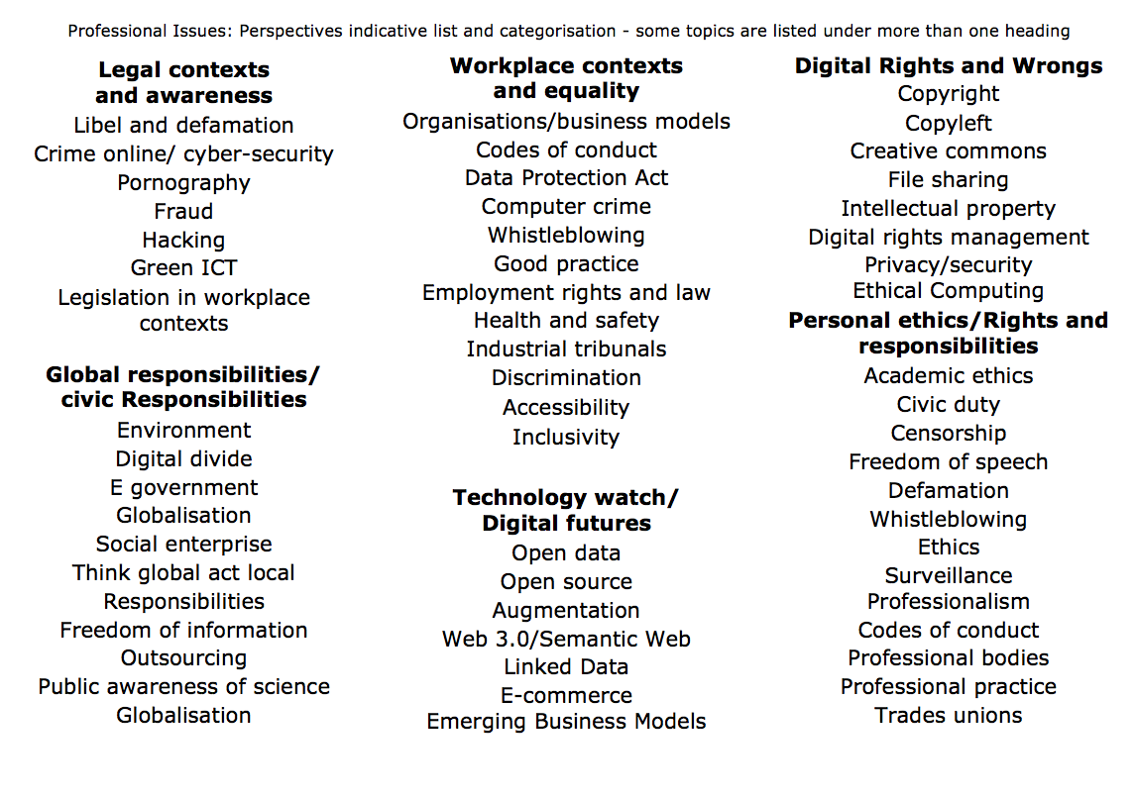

Slide 10
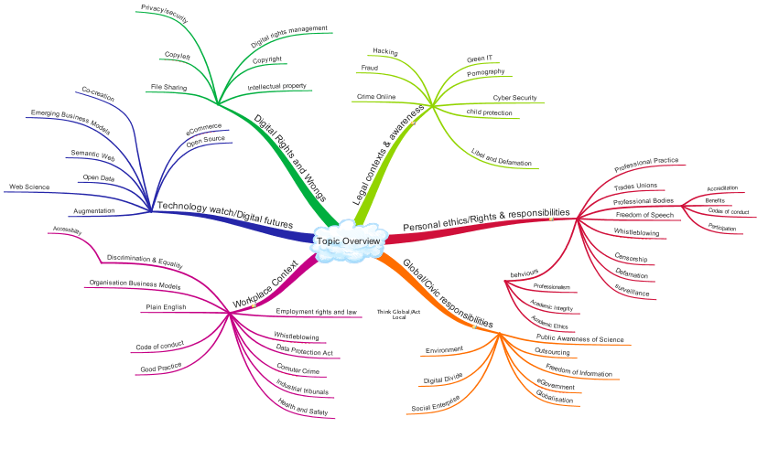
Legal areas
Information, Data and Living in a Connected World
Workplace perspectives: Rights and Responsibilities

Slide 11
Key topics for legislation
Privacy
Security
Slander, Libel and Defamation
Digital rights and ownership
Intellectual Property
Possible Perspectives
As an individual professional
As an employee
As an individual
As a citizen
You may have personal ethical views or have accepted/committed to to legal and ethical responsibilities

Slide 12
Types of law in the UK
Part of the big picture

Slide 13
Overview: Types of law in the UK
Statute law
Common law
International law

Slide 14
UK: Statute Law
Statute law
Made by government
legislation.gov.uk
Context
UK does not have a constitution
Contraints
International treaties
EU law
Acts of Parliament
Debated
House of Commons
House of Lords
Enacted
Royal Consent

Slide 15
Statutes are made by parliament
Example Digital Economies Act 2010

Slide 16
UK: Common Law aka Case Law
Common Law
Precedent of cases
Made by judges
Judgments and interpretation of statute law
Historical roots
In addition to what is covered by statute
Judges rôle
Interpret statutes
Follow precedent
Rule on ‘points of law’
Cannot create new areas of law

Slide 17
Common law examples
Where no statute exists
Confidentiality
Employees have duty of confidentiality to their employers
Extends beyond end of employment
Precedent established in previous court cases

Slide 18
International law: treaties
Government treaties
For example, trademarks, IP

Slide 19
European Legislation
Directives
Instruments
Regulations
Directives
Member states must update laws
Specifies outcome, not implementation
Can be implemented in parts
Example areas
Modernisation of professional qualifications
Restriction of hazardous substances
Energy efficiency/green IT
Packaging and packaging waste

Slide 20
Focus: criminal vs civil
Criminal law
Behaviour forbidden/outlawed by state
In case law it can be identified as
Civil law
Rights & obligations
Business contracts
Implied contracts
Product liability
Vicarious liability
Employers may be liable for acts by empoyees e.g. slander, defamation, libel
R versus xxxxx

Slide 21
Civil and criminal law can both be relevant
Historically information was not regarded as property
But…
Scanning a book and publishing it on the internet?
Are the author’s and publishers right
Criminal?
Civil?

Slide 22
Key Areas
Communications Act 2003 section 127 (Came into force 25th July 2003 replaced s43 Telecommunications Act 1984)
Computer Misuse Act 1990
Copyright design and patents 1988
Data Protection Act 1998
Defamation Act 1996
Disabilities Discrimination Act
Digital economy act 2010
Electronic Commerce (EC Directive) Regulations 2002
Electronic waste disposal
Equalities Act 2010
Health and Safety at work 1974
Harassment protection act 1997
Human rights act 1998
Malicious Communications Act 1988 section 1
Postal Services Act 2000 section 85 (commenced 26th March 2001)
Regulation of Investigatory Powers Act 2000

Slide 23
Ways of looking at UK law as an IT professional
The focus for this module

Slide 24
Data and Information perspectives

Slide 25
Workplace Perspectives: detail W10

Slide 26
Via the presentations…
You provide references, you research topics, relevant in different ways

Slide 28
Topic Areas (see how they relate)

Slide 29
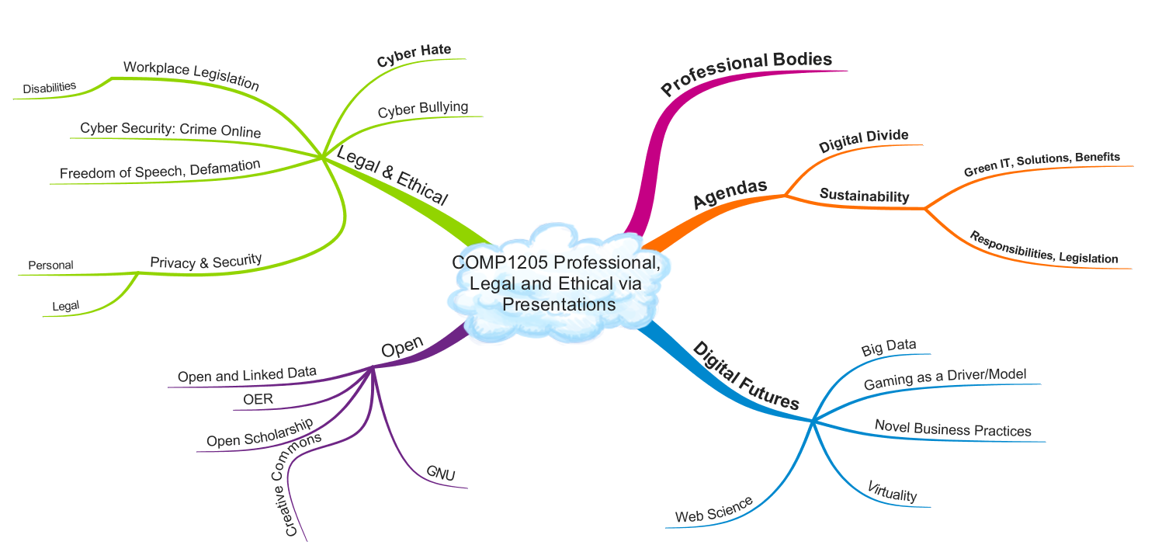
Reworking the table overview

Slide 30
TAKING AN IT perspective
Walkthough some new areas

Slide 31
IT contexts
UK criminal law
By statute
examples
Digital Economies Act 2010
Computer Misuse Act 1990
Design Copyright and Patents Act 1988
UK Civil law
By case history
Issues:
buggy software
Rights:
when purchased software fails
when purchased software makes me lose money

Slide 32
New technologies -> disruption
Existing legislation
Was not prepared for new contexts
But…
Are there actually new crimes…
or are there just new ways of committing old crimes
New legislation
Moral panic
May need refinement
Appeals, civil action to augment legislation
Examples
Malicious hacking
Technological attack (viruses)
Perceived social threat

Slide 33
Response to disruption
Computer misuse act 1990
Fraud, hacking, viruses
other computer-related crime
Motivation
Overcome loopholes in existing legislation
Principles
Conduct which is criminal remains criminal when enabled by new means e.g. computer technology
Conduct which is not generally considered to be criminal does not become criminal because of the computer context

Slide 34
Computer misuse act 1990
Causing an computer to perform any function with intent to secure access to any program or data held within a computer
The access intended to be secured is unauthorised
The act is performed with knowledge lack of authorisation at the time of the alledged crime
Further offence
If (having gained unauthorised access) faciliate the commission of an offence
Consequence
Illegal
To use a computer to help set up a crime
Either by yourself
Or by any other person

Slide 35
Computer misuse act
A person is guilty of an offence if….
The commit any act which causes the unauthorised modification of the contents of a computer
At the time of the act they have
the requisite intent
and
the requisite knowledge

Slide 36
Computer fraud
Fraud
Gaining financial gain by deception
Theft
Taking with intent to permanently deprive
Using a computer to obtain money illegally is fraud
Computer fraud often conducted by insiders
Acting without authorisation

Slide 37
Data protection ACt
Revisiting the week 7 independent tasks
DPA: http://www.edshare.soton.ac.uk/10483/
Links from week 7 (see Blackboard)

Slide 38
Revision resources
DPA - http://www.edshare.soton.ac.uk/10483/
Links from week 7 (see Blackboard)

Slide 39
First calibrate your existing knowledge…
Use this as a model for the way you approach any of the legal topics

Slide 40
Who?
According to the Data Protection Act (1998) "a person who (either alone or jointly or in common with other persons) determines the purposes for which and the manner in which any personal data are, or are to be, processed" is the definition of:
A data subject
A data processor
A data controller
The Data Protection Commissioner
Notes:
According to the Data Protection Act (1998) "a person who (either alone or jointly or in common with other persons) determines the purposes for which and the manner in which any personal data are, or are to be, processed" is the definition of: A data subject A data processor A data controller The Data Protection Commissioner Which of the following rights does an individual NOT have under the Data Protection Act (1998)? The right to prevent data about the individual being used for direct marketing The right to have inaccurate data corrected or erased The right to prevent data about the individual being held The right to find out what data is being held about the individual

Slide 41
What?
In the Data Protection Act, processing is defined as ___________ information.
Obtaining
Recording
Holding
Carry out any operation on
all of the above
None of the above

Slide 42
Rights
Which of the following rights does an individual NOT have under the Data Protection Act (1998)?
The right to prevent data about the individual being used for direct marketing
The right to have inaccurate data corrected or erased
The right to prevent data about the individual being held
The right to find out what data is being held about the individual

Slide 43
Why questions?
To evaluate your knowledge and understanding
To remind you about the stage test
To focus you on the topic under discussion ☺
You might want to find out the answers to these questions

Slide 44
Data Protection Act (1998)
Where to find the answers…

Slide 45
Where? …basics
Government Legislation
Data Protection Act
Read and understand
Set book (library)
Bott Chapter 14:
Data Protection,
Privacy
Freedom of Information
Other Sources
Information Commissioners Office
.gov.uk

Slide 46
Data Protection Act 1998

Slide 47
ICO web site
http://www.ico.gov.uk/

Slide 48
Gov.uk

Slide 49
Further sources?
Search youtube data protection act (sort of ironic?), copyright would be more so…
See also Holt and Newton (2004) for more background

Slide 50
YouTube –use your critical faculties
http://bit.ly/9DHj2c

Slide 51
BCS – book details + download

Slide 52
Google it!

Slide 53
DPA - extent
From Edwards and Rodrigues, The right to privacy and confidentiality for children: the law and current challenges (2008)

Slide 54
Checklist (from ICO)
Do I really need this information about an individual?
Do I know what I'm going to use it for?
Do the people whose information I hold know that I've got it, and are they likely to understand what it will be used for?
If I'm asked to pass on personal information, would the people about whom I hold information expect me to do this?
Am I satisfied the information is being held securely, whether it's on paper or on computer?
And what about my website? Is it secure?

Slide 55
Checklist continued
Is access to personal information limited to those with a strict need to know?
Am I sure the personal information is accurate and up to date?
Do I delete or destroy personal information as soon as I have no more need for it?
Have I trained my staff in their duties and responsibilities under the Data Protection Act, and are they putting them into practice?
Do I need to notify the Information Commissioner and if so is my notification up to date?

Slide 56
Data must be
* Fairly and lawfully processed
* Processed for limited purposes
* Adequate, relevant and not excessive
* Accurate and up to date
* Not kept for longer than is necessary
* Processed in line with your rights
* Secure
* Not transferred to other countries without adequate protection

Slide 57
Think about these pointers
Sources
Via a library search
Through selective searching (government and official sites)
Through popular sources/feeds
Use this approach
For private study
For group preparation
you may be expected to demonstrate familiarity with sources of information in the exam

Slide 58
There are some related resources in EdShare
http://www.edshare.soton.ac.uk/9625

Slide 59
Related topics…
Privacy and Ownership
Privacy
DPA ✓
Surveillance
Freedom of Information
Human Rights Act
Pointers plus private study
You need to do this private study for the exam

Slide 60
Use the DPA example/model
This class has identified four topics which come within the frame of privacy
Use the range of sources shown for the DPA
identify information on each topic
Surveillance
Freedom of Information
Human Rights Act
Questions
Books
Guidance from official web sites – e.g. .gov.uk
The source legislation – http://legislation.gov.uk from the national archive
Business advice – business link – http://www.businesslink.gov.uk/
Public Services Portal – http://www.direct.gov.uk/
Library Searches http://www.soton.ac.uk/library/
YouTube searches http://www.youtube.com/
Professional bodies – e.g. British Computer Society http://www.bcs.org/

Slide 61
Conducting private study
Find Information
Google searches for orientation
Keywords
Keywords + ‘tutorial’
Keywords + ‘quiz’
Keywords + ‘ac.uk’ | ‘.edu’
Critical reading of responses
Targeted searches to gather information
Further work to organise information
Organise/review
You might want to work alone
You might like to work together
Study groups
Revision groups
Student wiki

Slide 62
Think about a bigger picture…

Slide 63
Starting points

Slide 64
Starting points

Slide 65
Data and Information

Slide 66
Think about a bigger picture…

Slide 67
Reminders: Module overview
Build up your knowledge step by step

Slide 68
Work smarter not harder
Work smarter not harder
Approaches
Intellectually
Understand your motivations
Imaginatively
Develop and use your creativity and imagination
Make your tasks enjoyable
Intuitively
Learn to know what works for you
Pareto principle
20% of the effort produces 80% of the result
… but think about it logically, rationally
One touch
Capture all the necessary information in a single touch
Follow up: Dan Pink – RSA Animate, see refs and links

Slide 69
The presentation topics relate to the syllabus..
You will become a specialist
Use your presentation to understand content, context and perspectives as well as develop skills
Many of the other presentations will have content which relates to the exam topics, pay attention ☺

Slide 70
Overview: working method
Formal/timetabled
Informal/un-timetables
Lecture
The big picture
Pacing
Blackboard
Links and references
Out of class
Take the quizzes
Watch videos
Read overviews
Work through tasks
Think and discuss
Prepare assessments
Prepare for examination
Objective: knowledge, skills and understanding
Notes:
Knowledge, skills and understanding
How you work to understand the big picture..

Slide 71
Reminder: rationale of the structure
Guidance and prompting
Plus… directing you to a realistic/sustainable approach
This is not the same as coding, maths or other ‘hard’ subject areas
But it is very relevant to your degree…
… and the approach is relevant to future study and work
Find out, think about, re-present
Work in groups
Find your strengths
Overcome your weaknesses
Enjoy yourselves

Slide 72
Before next week
Quiz
Quiz notes
You will be invited to respond to a short survey/quiz (midweek)
Designed to find calibrate
The progress you have made so far
Your familiarity with topics we are going to study
Your familiarity with the topics within the exam
The way which you are relating COMP1205 to the rest of your studies
Your responses will be anonymous
But
I can send you reminders … If you have not completed the task
The quizzes are designed help you understand the breadth of the topics we are going to study in a quick and easy way

Slide 73
Overview: timescales and topics
Timescales and Topics
W7: Uni w24 w/c 10/3
W8: Uni w25 w/c 17/3
W9: Uni w26 w/c 24/3
W10: Uni w31 w/c28/4
W11: Uni w32 w/c 5/5
W12: Uni w33 w/c 12/5
Vacation Easter
Presentations
Presentations
Presentations Hand in
Overview
& Intro
Presentation task briefing
Legal & workplace 1
Legal and workplace 2
Peer marking
(audience)
Peer marking
(audience)
Security guest lecture
Overview of entire module by multiple choice exam
Ethics and Professionalism are threads which run throughout the module

Slide 74
Thank you ;-)
Su White
saw@ecs.soton.ac.uk
+44 (0)23 8059 4471
http://www.ecs.soton.ac.uk/~saw

Slide 75
Tasks: Other key areas
Copyright Design and Patents Act
Review the slides, make notes
Related slides – rights and ownership online http://www.edshare.soton.ac.uk/9939/

