Slide 1
Open Data.
Kieron O’Hara 31 January 2014
Notes:
Please use the dd month yyyy format for the date for example 11 January 2008. The main title can be one or two lines long.

Slide 2
Accountability Through Transparency: a Long History
“The mother of Michael [Theodora, Regent of Byzantium 842-855], before she retired to a cloister, attempted to check or expose the prodigality of her ungrateful son by a free and faithful account of the wealth which he had inherited.”
Gibbon, Decline and Fall of the Roman Empire

Slide 3
Doesn’t Always Work
“Whatever might have been the maternal care of Theodora in the education of Michael III, her unfortunate son was a king before he was a man. … The millions of gold and silver which had been accumulated for the service of the state were lavished on the vilest of men who flattered his passions and shared his pleasures; and, in a reign of 13 years, the richest of sovereigns was compelled to strip the palace and the churches of their precious furniture.”

Slide 4
Growing Openness in UK
Open government initiative (Archy Kirkwood [Lib], 1980s)
Right of access to records, repeal of OSA
Freedom of Information (David Clark [Lab], 2000, 2005)
Publication of information on request
Transparency agenda (Francis Maude [Tory], 2010- )
Routinely publishing data about public services
All these in parallel with the development of ICT and the Internet

Slide 5
Open Data
Use of technology to maximise reuse of data
Online
Machine readable
Open licence
Ideally non-proprietary open formats (CSV, RDF etc)
No restrictions on use
No access/query controls

Slide 6
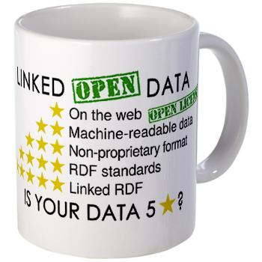
The Berners-Lee Progression

Slide 7
Open Government Data
Lots of data
Good provenance
Fair quality
Relevant to people’s concerns
Serve accountability
Right to data
Important plank of coalition policy
PM’s commitments May 2010/July 2011

Slide 8
The Open Data Context
Innovative services built on data
Creative apps mashing up input data
Consumed by citizens, consumers, voters, community groups
No rent-seeking
Everyone has access to the same data
No exclusive use agreements
Only creativity can be monetised

Slide 9
Rights to Data
Government legitimacy
Government funding
Freedom of Information
Derivative from freedom of speech
What is the point of FoS if I am badly informed?
EU PSI Directive
“Member States shall ensure that, where the re-use of documents held by public sector bodies is allowed, these documents shall be re-usable for commercial or non-commercial purposes in accordance with the conditions set out in Chapters III and IV. Where possible, documents shall be made available through electronic means.”

Slide 10
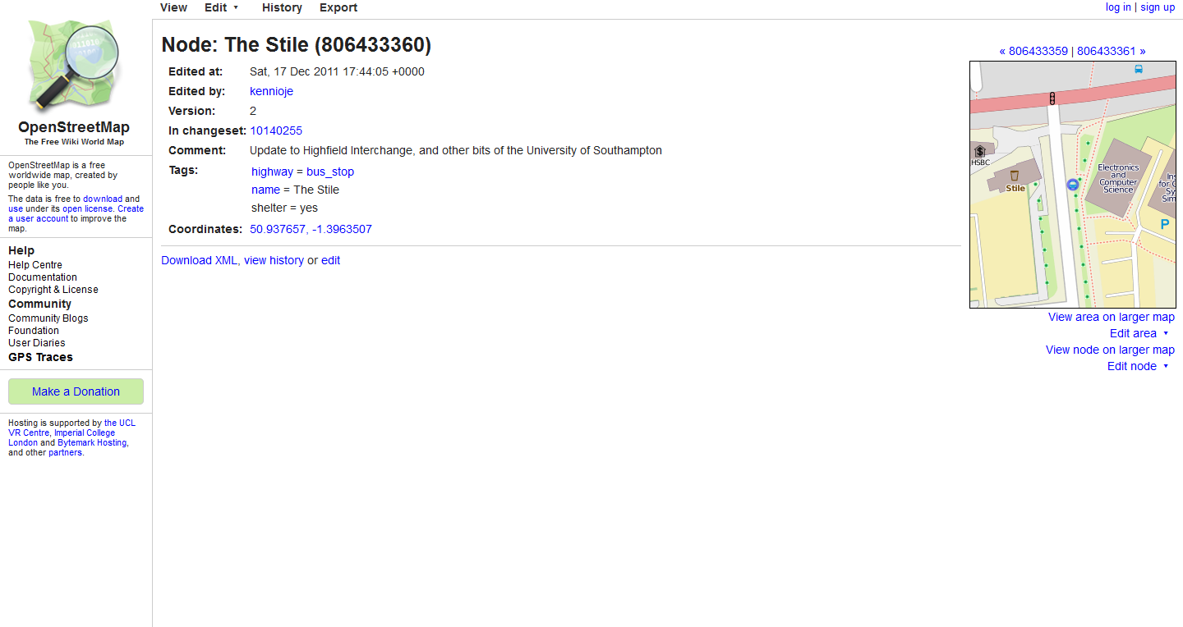
Crowdsourcing Data Quality

Slide 11
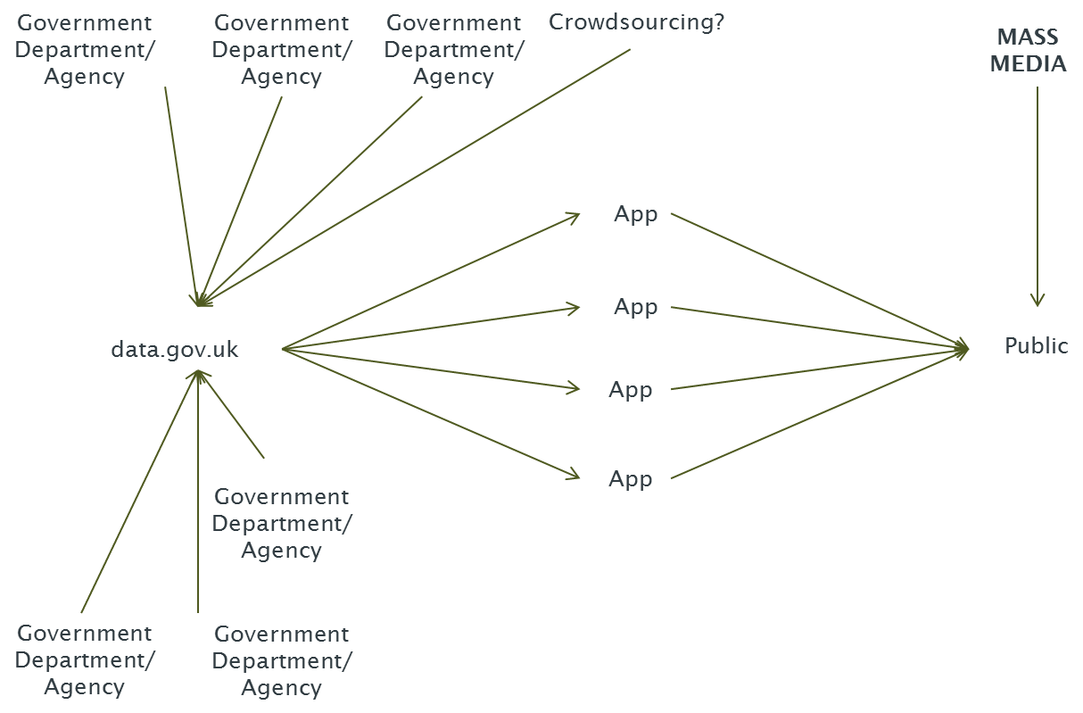
Open Government Data Infosphere

Slide 12
Aims and Ambitions
Make government more accountable and approachable
Stimulate growth (economic and social)
Reform public services
Providing choice
Opening up public sector contracts
Improve:
Public sector outcomes
Productivity
Ambition: to make the UK the most transparent and accountable government in the world

Slide 13
Digital Era Governance
Change of public management regime
Level of autonomous citizen competence
Cf. Scott, Seeing Like a State, 1999
Level of institutional and policy complexity
Level of social problem-solving
From Dunleavy et al, Digital Era Governance, 2006
+ve influence
-ve influence

Slide 14
A New Vision of Government
Not privatisation, nor outsourcing
Publishing, not managing
Decentralising service design
Allow mashups with personal data
And release personal data (cf. midata)
Avoid prescription
Leverage autonomous citizen competence

Slide 15
The Effect of Linked Open Government Data?
Decentralise public management regime
Level of autonomous citizen competence
Level of institutional and policy complexity
Level of social problem-solving

Slide 16
Will Open Data Pose a Threat to Privacy?
Public data do not include personal data
BUT
Where the state and the citizen interact, there will be issues
Demand-driven transparency
Health data
Education data
Crime data …
Must ensure transparency of gov’t ≠ transparency of citizen

Slide 17
Managing Privacy Concerns
Multi-stakeholder approach
Consult concerned parties in the domain in good faith
Demonstrable concern – not an add-on
Sector panels
Open data must be non-personal data (DPA)
Valuable data is derived from personal data
Anonymisation, aggregation
Deanonymisation
Lack of empirical evidence
Penetration testing
Best anonymisation practice (cf. UKAN network)

Slide 18
Other Criticisms
Expensive/distraction
No-one uses it
Cost/benefit ratio is poor
Chilling effect
Not demand sensitive
Quality
Performance data
Accountability mechanisms lacking
60s-style Corporatism

Slide 19
Readings
Cabinet Office, ‘Open Data: Releasing the Potential’, White Paper, 2012
Shadbolt & O’Hara, ‘Linked Data in Government’, IEEE Internet Computing, 2013
Ubaldi, ‘Open Government Data: Towards Empirical Analysis …’, OECD Working Paper on Public Governance 22, 2013
O’Hara, ‘Transparent Government, Not Transparent Citizens’, Cabinet Office, 2011
UCL Constitution Unit, https://www.ucl.ac.uk/constitution-unit/research/foi
Public Administration Select Committee, oral evidence to Statistics and Open Data inquiry, Nov 2013 (http://data.parliament.uk/writtenevidence/WrittenEvidence.svc/EvidenceHtml/3823, 3631, 3628 – and cf.4041)
Zuiderwijk et al, ‘Sociotechnical impediments of open data’, Electronic Journal of e-Government, 2012
Lessig, ‘Against Transparency’, New Republic, 2009
Public Accounts Committee, ‘Implementing the Transparency Agenda’, 2012

Slide 20
Task
Consider the principles governing when data can be released or not.
It’s hard to get data about court outcomes in criminal justice – why?
Actually, it’s hard to get data about the cases that are being heard.
Are there any reasons in general why the public record shouldn’t be online? Where does the public interest balance lie?
Please create a briefing document for the WSI forthcoming campaign on Opening Criminal Justice

Slide 21
Disclaimer
Texts, marks, logos, names, graphics, images, photographs, illustrations, artwork, audio clips, video clips, and software copyrighted by their respective owners are used on these slides for non-commercial, educational and personal purposes only. Use of any copyrighted material is not authorized without the written consent of the copyright holder. Every effort has been made to respect the copyrights of other parties. If you believe that your copyright has been misused, please direct your correspondence to: kmo@ecs.soton.ac.uk stating your position and I shall endeavour to correct any misuse as early as possible.

