Slide 1
What do you hope to get out of this course?

Slide 2
How would you like to learn on FutureLearn?

Slide 3
Why you have chosen this course?

Slide 4
Subject areas of interest

Slide 5
Have you taken a course delivered mostly or fully online before
(including MOOCs)?

Slide 6
If yes, what sort of online course?

Slide 7
Where do you expect to do the course?

Slide 8
Country

Slide 9
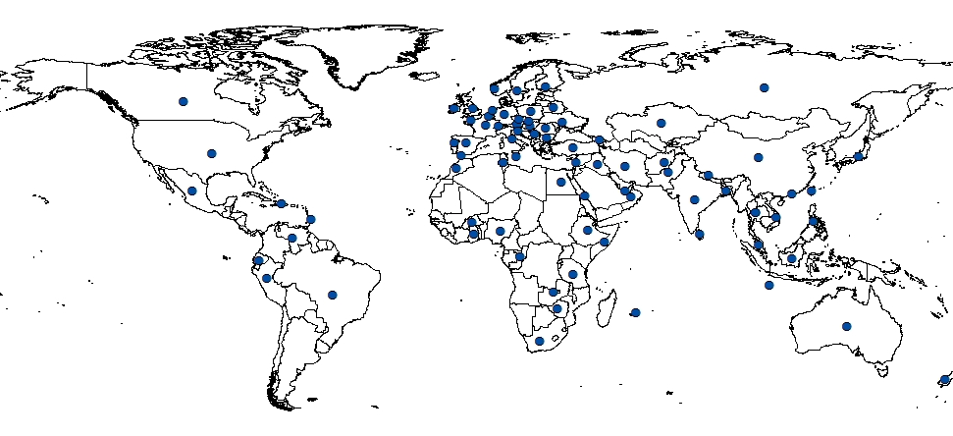

Slide 10
World Region

Slide 11
Age group

Slide 12
Gender

Slide 13
Employment status

Slide 14
Area of Employment

Slide 15
Level of education

Slide 16
Where did you hear about the course?

Slide 17
Disability

