Slide 1
EndNote X7 - basic graduate session - Mac
Notes:
This guide introduces the main features of EndNote.

Slide 2
What is EndNote for?
Build a personal reference library
Search databases and export references
Customise EndNote
Insert citations and build bibliography
Notes:
EndNote is bibliographic management software that allows you to collect all the references from a range of resource types in a single location.
The results of a database search can be automatically exported to EndNote, and other notes, files and graphics can be added to individual records, allowing all information to be stored in a single location.
EndNote works alongside Word, inserts short citations within the text and generates full bibliographic references at the end of the current document. The appearance and management of citations and references is controlled through the EndNote Library.
Using EndNote, a document created with references in one referencing style can be automatically converted to a different referencing style if required.
All features of EndNote can be edited to suit personal preferences.

Slide 3

Create or open a library
Go to the Endnote icon on the taskbar
Notes:
Go to the EndNote icon on the taskbar
When you first load EndNote the welcome screen invites you to create a new library or open an existing library.
To create a new library, click on the picture.

Slide 4

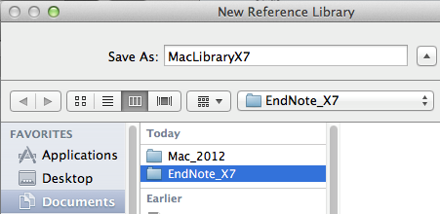
Go to 'File' and choose 'New'
It is best to save all libraries in a folder called 'EndNote' or 'EndNote X7'
Notes:
The system will ask you where to save the new library: it is best to create a new folder called EndNote or EndNote X7 and save the library within that.

Slide 5
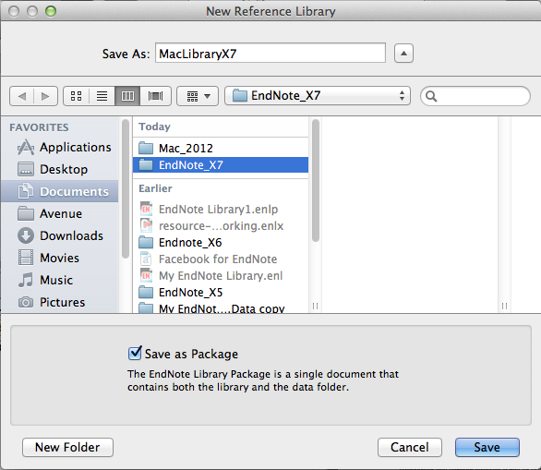
Choose the 'Save as Package' option to combine both elements of the EndNote library
Notes:
The Endnote library is saved in two parts: a data folder, and a library file with a .enl extension. Choosing the ‘Save as package’ option combines these two into a single file with a .enlp extension

Slide 6
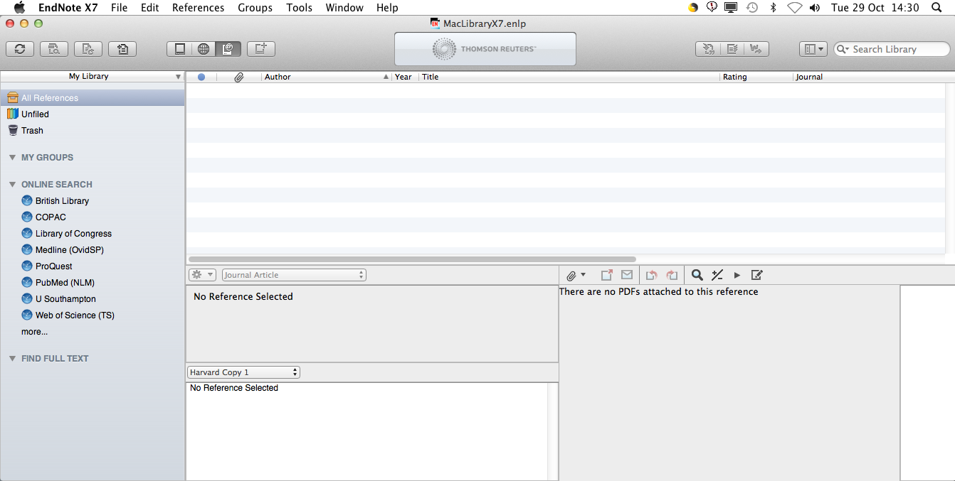
It is usually best to keep all references in one main library
Smaller libraries for particular topics can be created using the 'Groups' option
Notes:
It is best to keep all references in a single library: smaller libraries for particular purposes can be created using the Groups option, which is described later.

Slide 7
Add a new reference

Slide 8

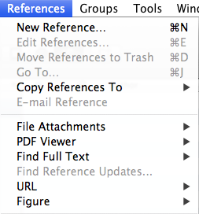
Add a new reference
Click on the 'New Reference' icon…
… or go to 'New Reference' on the dropdown menu
Notes:
To add a new reference, click on the New Reference icon on the toolbar, or go to New Reference… on the References dropdown menu.

Slide 9
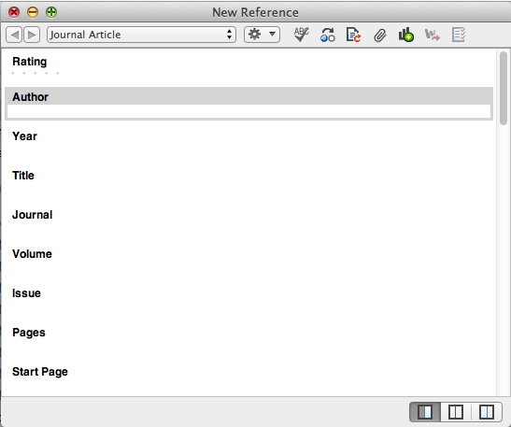
Scroll down to see more fields
Notes:
EndNote records are constructed from many fields - scroll down to see more of these.
Selection and order of fields is determined by the reference type.
Check the appearance of the bibliographic record.
Changes can be made at any time.
To edit an existing record, double click on the EndNote library entry.

Slide 10
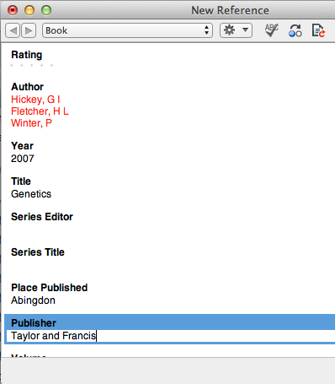
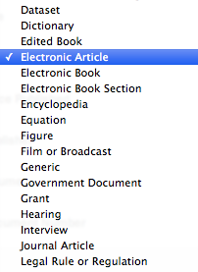
Click the record's 'close' icon to save the completed or edited record automatically
Choose the reference type from the dropdown menu
The reference type can be changed at any time
Notes:
Use the dropdown menu to change the reference type. You can change the reference type at any time.
Choose the 'best fit' for the medium and complete all useful fields.
Reference type definitions in EndNote may not always fit with UK practice, for example in Law.
Custom types are available to create unusual reference types.
When all details are completed, click the record's Close icon (the red circle)
This will save the record details automatically.

Slide 11
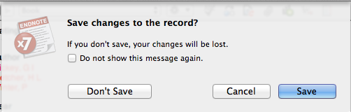

Slide 12
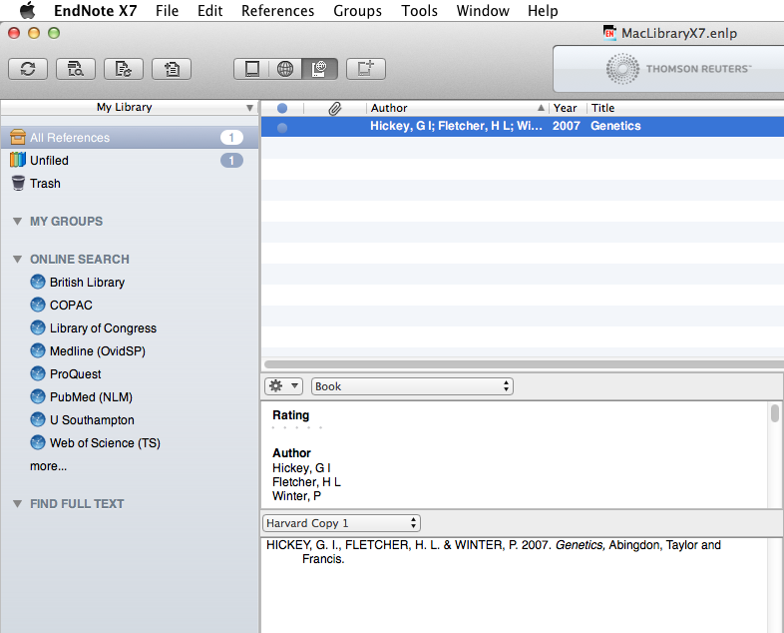

Slide 13
More about record fields

Slide 14
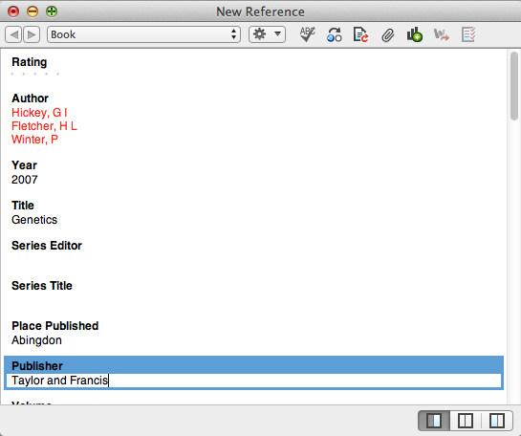
Enter one author per line, surname first, followed by a comma
Author, Journal and Keyword fields are indexed
Notes:
Note some important points about the various record fields:
Use one author or editor per line, as EndNote counts the number of lines in order to establish the number of authors.
Enter the surname, followed by a comma, which is an important character, then first names or initials - EndNote will format this field according to the instructions given. Corporate authors must always be terminated by a comma.
The author, journal title and keywords fields are indexed and displayed in red.
Use only the record fields required: the bibliographic templates can be modified to include additional fields if required.
The URL field provides an automatic hyperlink.
Some fields, such as Notes and Research Notes, are free format and can be used for text or graphics. Files in other formats can also be attached to the records.
It is best to use Research Notes for your own comments
When using the keywords field, terms can be created in advance, to ensure consistency. New terms can be added at any time.

Slide 15
When all chosen fields have been completed, click the record close icon
Notes:
When all chosen fields have been completed, Click the RECORD Close icon - the red circle.

Slide 16
Click 'Save' to confirm any changes to the record
Notes:
You will be prompted to save any changes to the record, including edits and file attachments etc.

Slide 17
The record is added to the library
The Preview pane shows the full bibliographic reference in the chosen reference style
Notes:
The record is then added to the library and the bibliographic record displayed in the Preview pane, in accordance with the chosen reference style.

Slide 18
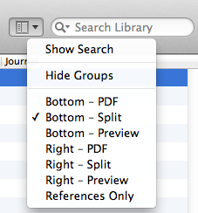
Use this menu to control the library layout
Notes:
There are various options for the overall layout of the EndNote Library.

Slide 19
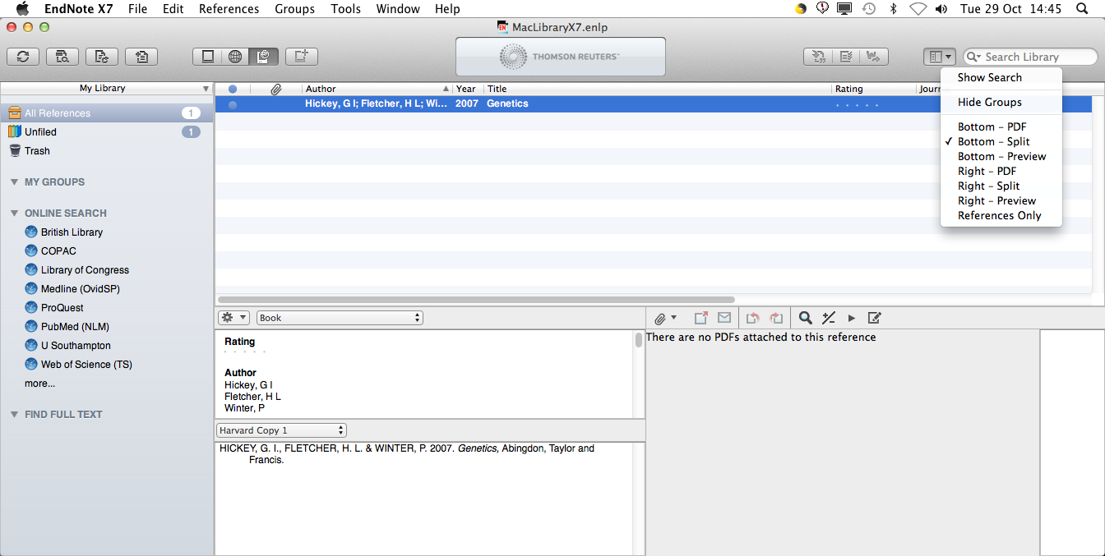
Choose to view the full reference entry, a preview in the chosen reference style and/or full text of an attached pdf
Notes:
The various options allow viewing of the full EndNote record, a preview of the entry in the selected reference style, an attached pdf or a combination of these, at the right of the screen or below the main library.

Slide 20
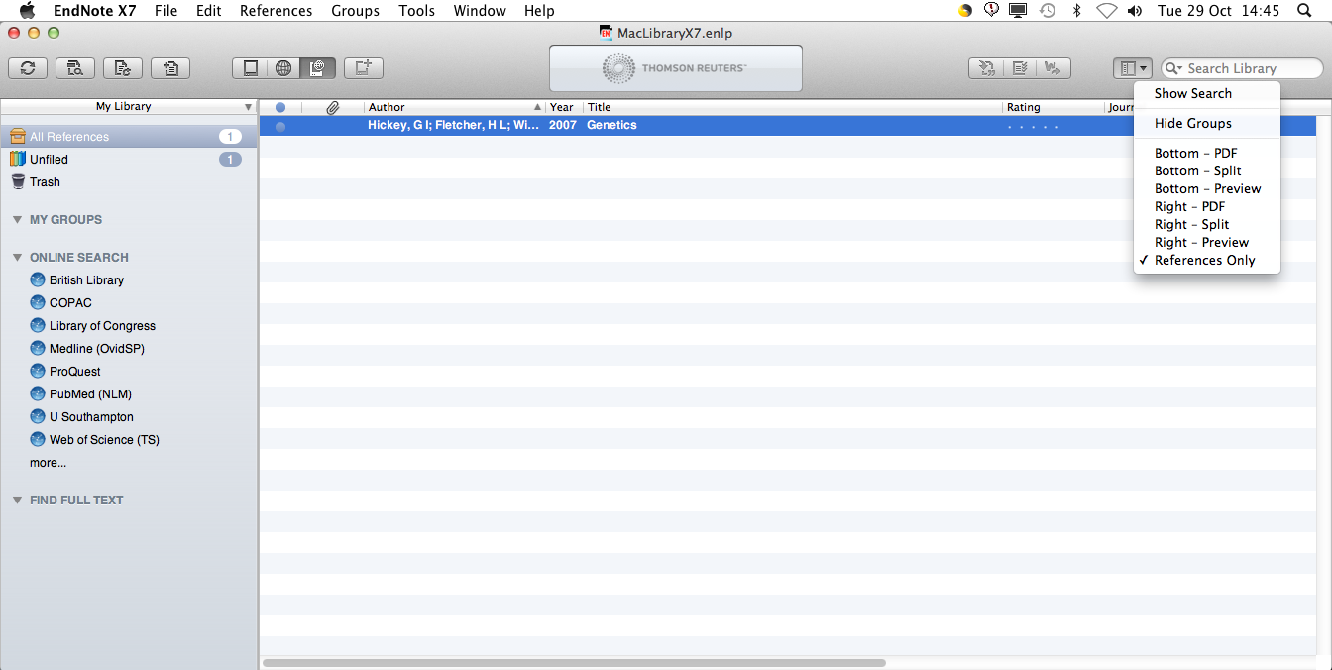
…or simply view the list of references
Notes:
It is also possible just to view the library pane.

Slide 21
Change the reference style

Slide 22
Add all styles to the list

Slide 23
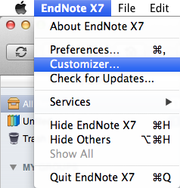
Go to the Endnote X7 dropdown menu and choose 'Customizer'
Notes:
When EndNote is installed on a Mac, only a basic set of Styles, Filters, and Connection Files is downloaded.
To make sure all files are available, go to the EndNote dropdown menu, and choose the Customizer option.

Slide 24
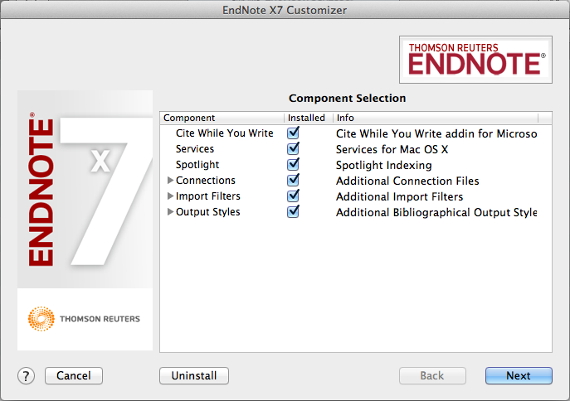
Check the boxes for 'Connections, Import Filters and Output Styles' and choose 'Next'
Notes:
Check the boxes for Connections, Import Filters and Output Styles and click Next.

Slide 25
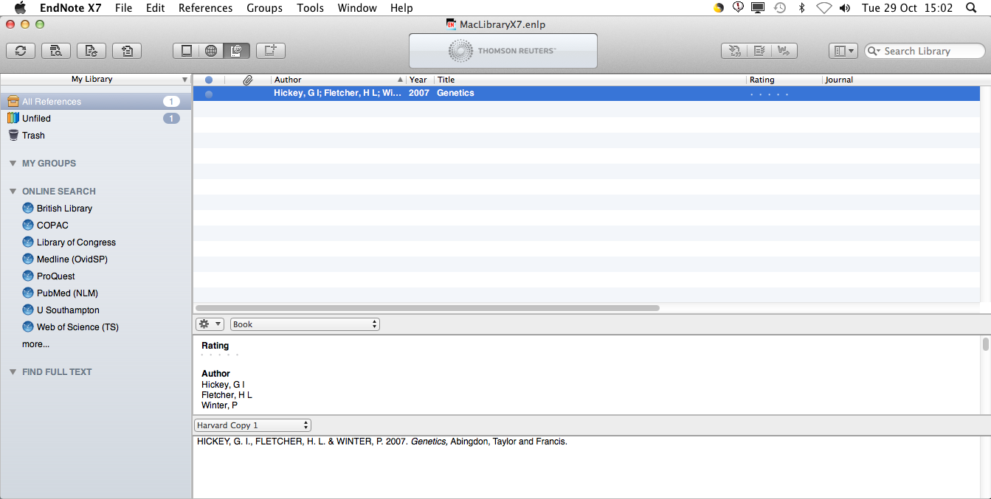
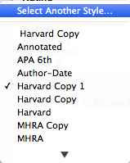
The default style is 'Annotated'
Go to the dropdown menu and choose 'Select Another Style'
Notes:
The default reference style is 'Annotated'
Use this process to select another style - changes can be made at any time.
Go to the dropdown menu beside the current reference style, and choose Select Another Style..

Slide 26
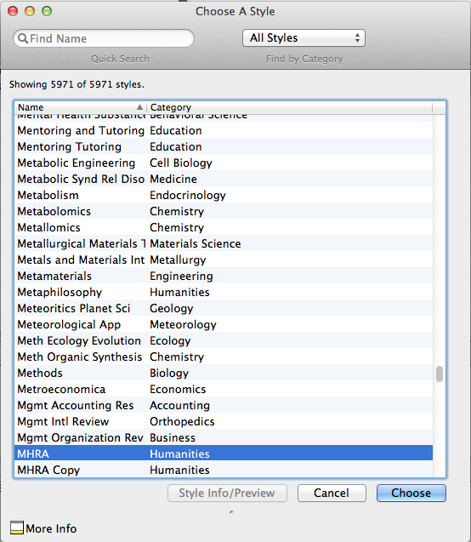
EndNote has nearly 6000 reference styles
Scroll down to select the required reference style and click 'Choose'
Notes:
The Choose a Style window opens.
There are nearly 6000 choices, including general reference styles, journal house styles and academic libraries.
Select a new style, in this case 'MHRA' and click Choose.

Slide 27
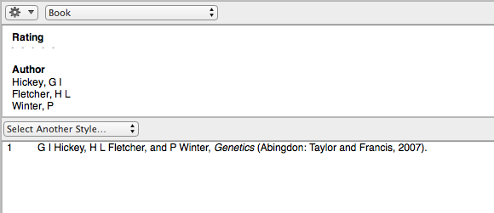
The library is now formatted in the selected Reference Style
Notes:
The EndNote Library is displayed in the new reference style.
The reference style can also be modified - changes will be saved to an EndNote folder in 'My Documents' so that they are automatically accessed next time the EndNote library is opened.

Slide 28
Download custom styles

Slide 29
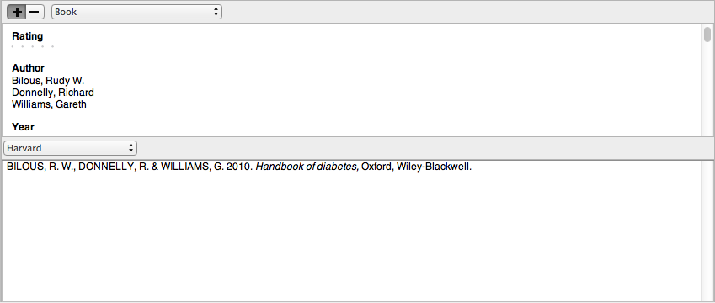
It may be necessary to edit the existing reference style
Notes:
Some faculties require variations to standard referencing styles. Harvard in particular is used in a number of slightly differing formats. There are some Southampton specific EndNote styles: Harvard_SotonHS2013, Harvard_SotonUNI2013 and Vancouver_SotonMED2013.
These styles are also available on EndNote Online

Slide 30
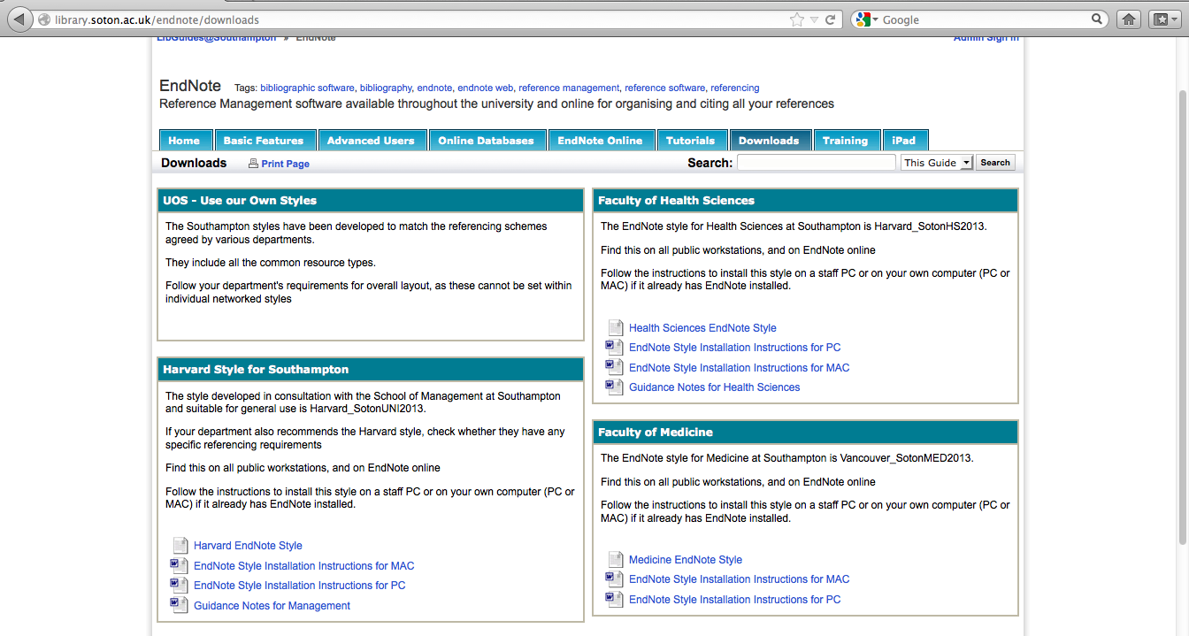
http://library.soton.ac.uk/endnote/downloads
Notes:
Find Southampton styles on the library guide, together with download instructions.

Slide 31
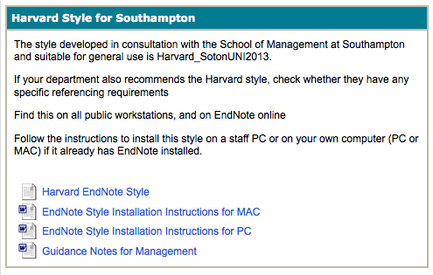
Notes:
There are additional guidance notes for some styles.

Slide 32
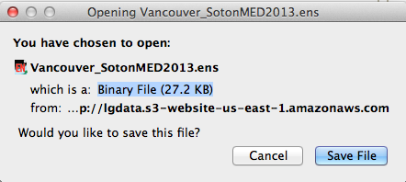
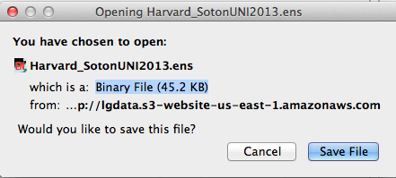
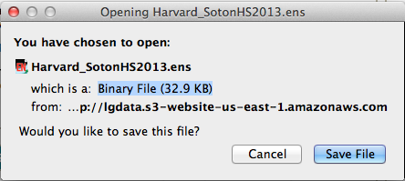
Save the file
required
Notes:
It is best to use Firefox as your browser: in each case choose Save File

Slide 33
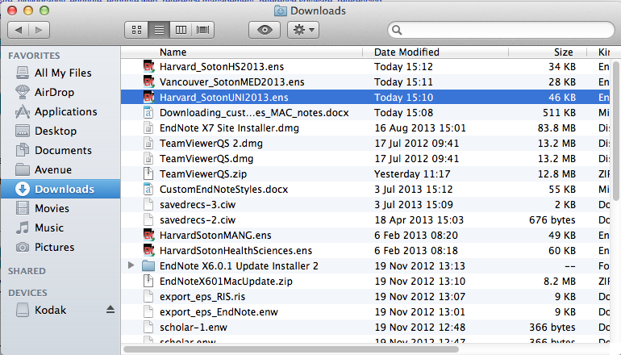
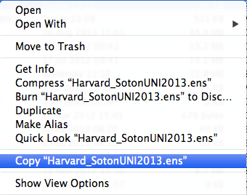
Copy the Style file
Notes:
Select the file required from Downloads and ctrl + click to choose Copy "style" from the menu.

Slide 34
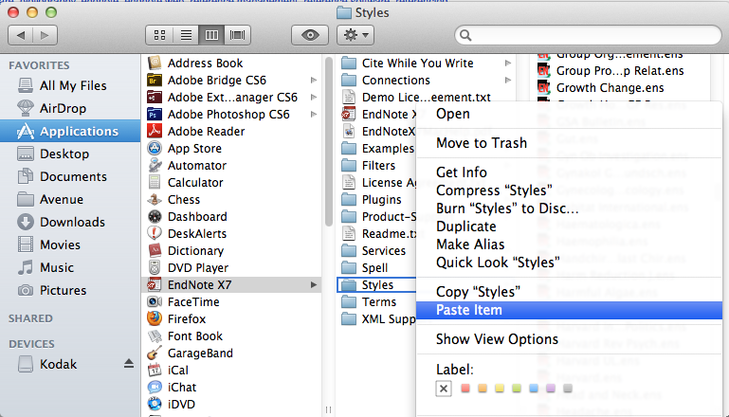
Paste in 'Applications ➔ EndNote X7 ➔ Styles'
Notes:
Paste the file in Applications, EndNote X7, Styles. Note that the file must be pasted ON the folder rather than in the contents window.

Slide 35
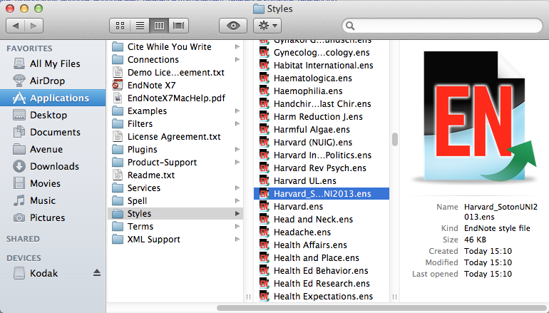
The file is added to available styles

Slide 36
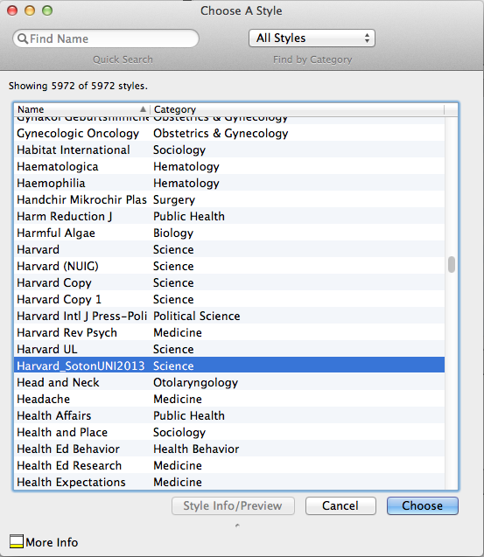
The downloaded style is added to the 'Choose another Style' list
Notes:
It also appears in the Choose another style… list

Slide 37
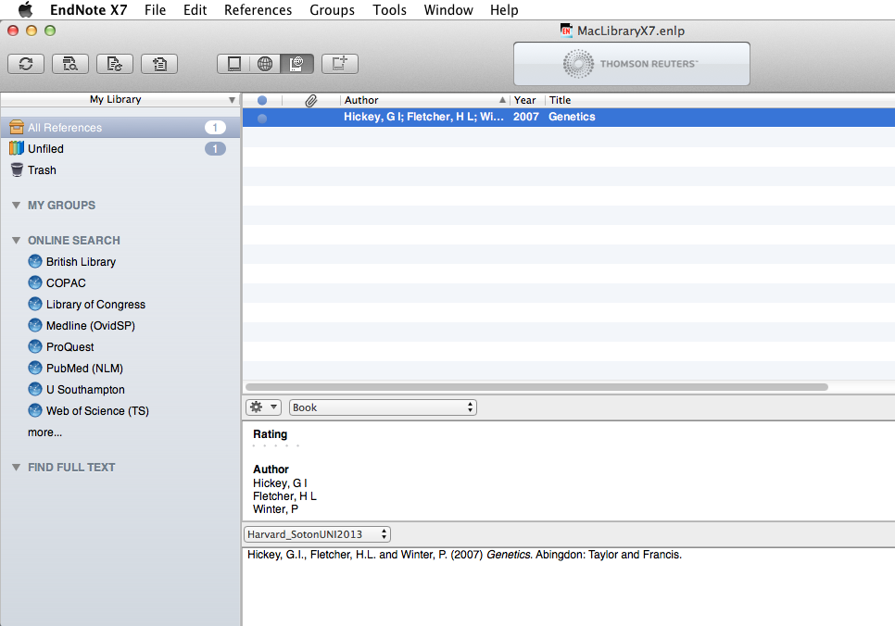

Slide 38
Edit the reference style

Slide 39
It may be necessary to edit the existing reference style
Notes:
Some faculties require variations to standard referencing styles. Harvard in particular is used in a number of slightly differing formats. There are some Southampton specific EndNote styles: Harvard_SotonHS2013, Harvard_SotonUNI2013 and Vancouver_SotonMED2013.
These styles are also available on EndNote Online

Slide 40
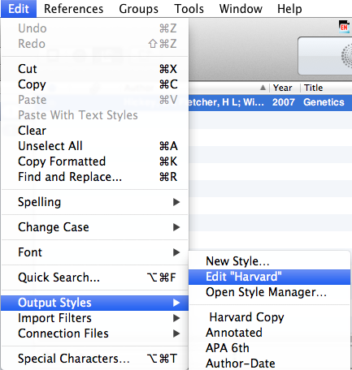
Go to Edit  Output Styles  Edit 'Harvard'
Notes:
To edit the referencing style, go to Edit, Output styles, Edit 'Reference Style', in this case, Harvard.

Slide 41
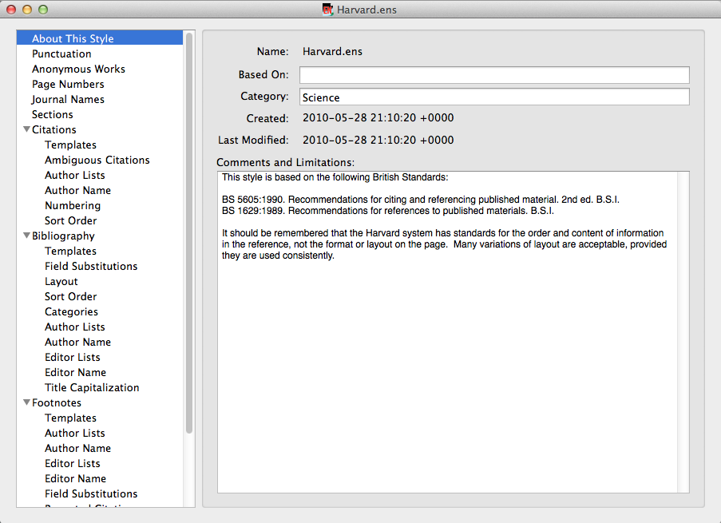
This window controls all aspects of the referencing style
Notes:
This window controls all aspects of the referencing style: there are sections for in-text citation, full bibliographic references, and also for footnotes, which are used by some referencing styles.

Slide 42
Edit the reference style - citations

Slide 43
Go to Edit  Output Styles  Edit 'Harvard'
Notes:
To edit the referencing style, go to Edit, Output styles, Edit 'Reference Style', in this case, Harvard.

Slide 44
Any element of the citation, bibliographic record or footnote can be edited using this page
Notes:
This window allows you to edit all aspects of the Endnote bibliographic record. The main groups are Citations which are the short references within the written text, Bibliography which is the list of full references at the end of the document, and Footnotes, which are used at the bottom of individual pages in some referencing systems.

Slide 45
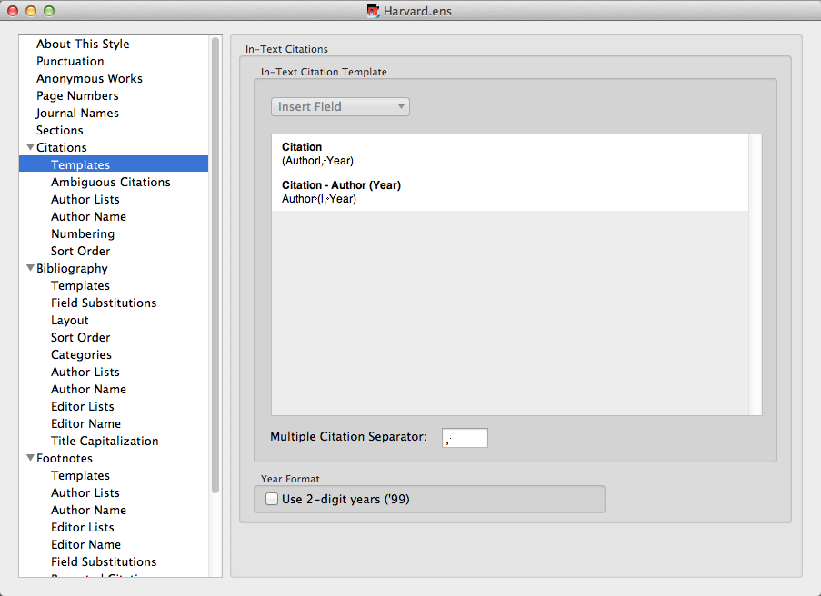
When all changes have been made, click the record 'close' icon
Notes:
Click Citations then Templates to see how this tool works. The operation of other fields is similar to those described in the Format Bibliography section.
In this example, EndNote picks up the contents of the 'Author' field from the record, adds a comma, then the contents of the 'Year' field and encloses everything in brackets.
The vertical line lines tie the following punctuation to the next field, so that if the field is empty, you do not get stray punctuation in the record.
Make any changes you require, and then click the close record icon.

Slide 46
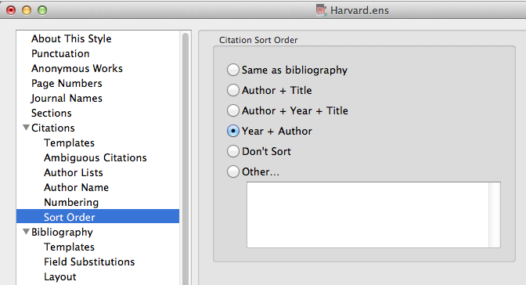
Choose preferred citation sort order here
Notes:
Use this option to edit the in-text citation sort order.
The default order is 'Don't sort'
If you have multiple citations at single points in the text, you may wish to arrange these either alphabetically or chronologically. Choose the relevant option from the list.

Slide 47
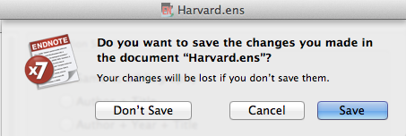
Click 'Save'
Notes:
Click Save to save the changes.

Slide 48
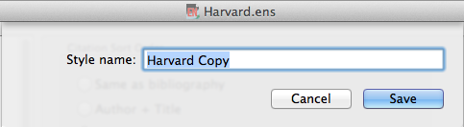
Save with the default Style name or use your own
Notes:
You will be prompted to save the edited style with a new name.
This edited style will then appear in EndNote's reference style list and can be applied to any EndNote library. This style is stored in your EndNote Styles folder.

Slide 49
Edit the reference style - bibliography

Slide 50
Go to Edit  Output Styles  Edit 'Harvard'
Notes:
To edit the referencing style, go to Edit, Output styles, Edit 'Reference Style', in this case, Harvard.

Slide 51
Any element of the citation, bibliographic record or footnote can be edited using this page
Notes:
This window allows you to edit all aspects of the Endnote bibliographic record. The main groups are Citations which are the short references within the written text, Bibliography which is the list of full references at the end of the document, and Footnotes, which are used at the bottom of individual pages in some referencing systems.

Slide 52
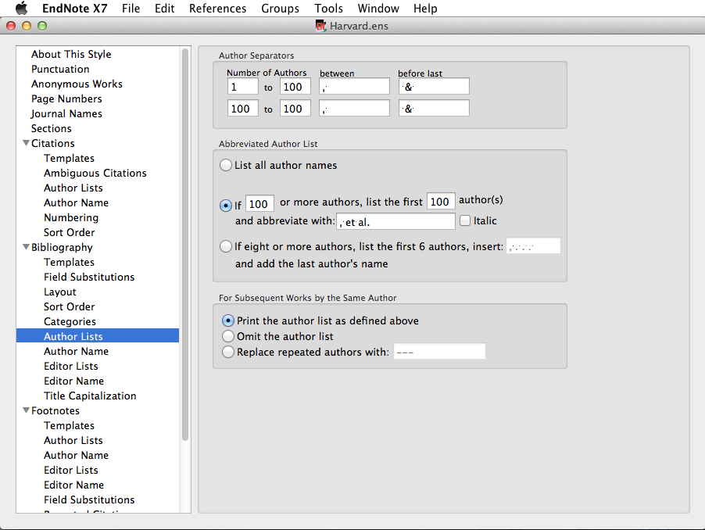
'Author Lists' lets you control how many authors are displayed
Notes:
The Author Lists section allows you to control how many authors are displayed, and the separating punctuation.
Any changes to Author Lists must be replicated in Editor Lists.

Slide 53
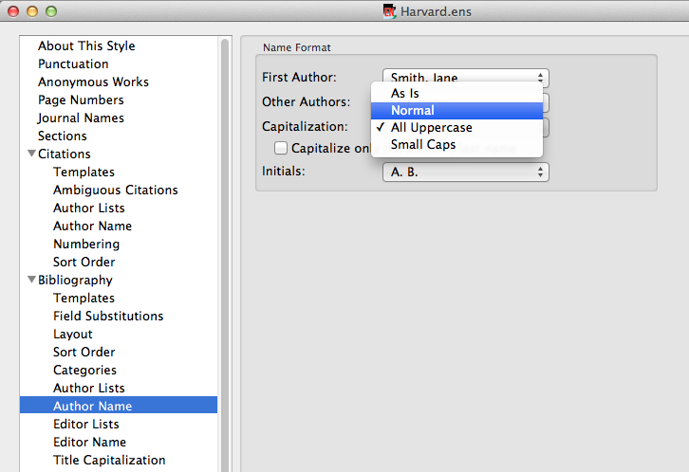
'Author Name' allows choices about capitalisation - choose 'Normal' for names in lower case but with initial capital letters
Notes:
Changes to Author Name must be replicated in Editor Name.
These windows allow you to make choices about capitalisation - the default is All Uppercase. Choose Normal for names in lower case but with initial capital letters.

Slide 54
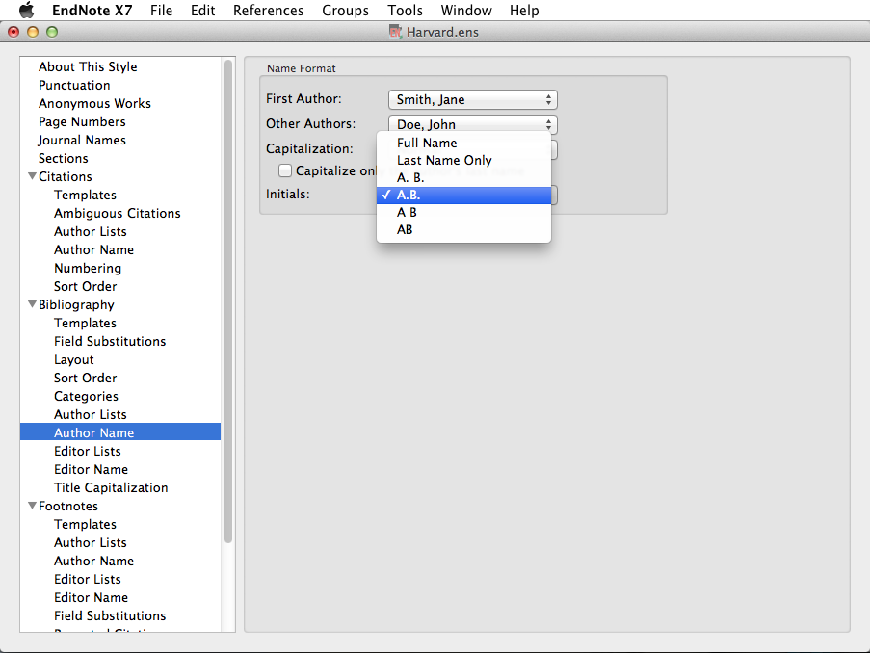
Make choices about the punctuation of initials
Notes:
Choices can also be made about the display of initials: with or without full-stops, with or without spaces between.

Slide 55
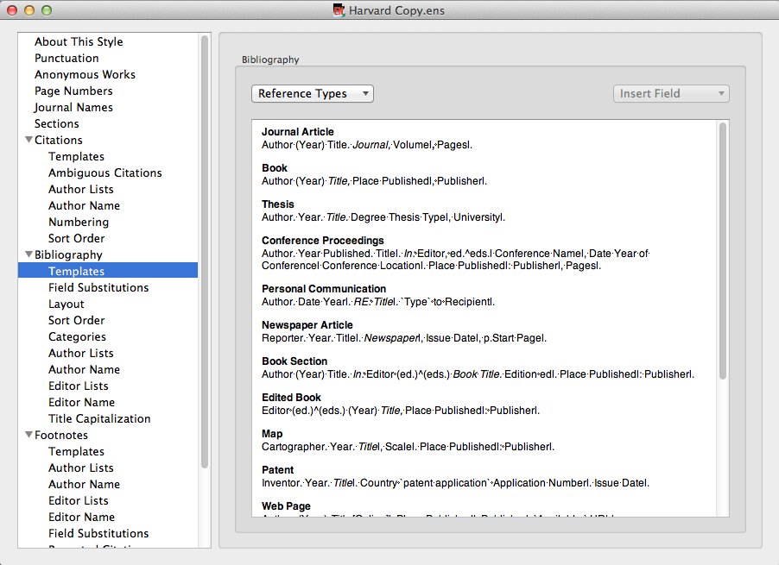
'Generic' is used for any Reference Type without a specific template
Further Reference Type templates can be created, or existing templates edited
The templates show which fields will be used from the EndNote record, and how they will be displayed, for a range of Reference Types
Notes:
The Templates window shows how the bibliographic record will be displayed for a wide range of reference types. More can be added, by clicking the Reference Types button and creating a template on the principles of existing types.
Generic is used for any reference type which does not have a specific template.
In the templates, where the name of an EndNote record field appears, this will be replaced by the contents of that field, according to the format in the template (bold, italic etc) Other characters are displayed as typed. Field Names are case-sensitive.
The vertical bar links punctuation to the next field, so that if there is no data in a given record field, stray punctuation is eliminated. The ^ means that Endnote will choose whether to display the singular or plural option according to the number of authors/editors.

Slide 56
Click the record's 'close' icon to save the changes automatically
Here the Year field has been edited to include brackets for all Reference Types, including Generic, likely to be used
Notes:
Existing reference type templates can be edited, for example, displaying the year in brackets or inserting the issue number in the journal article template.
It is not necessary to edit Reference Types that will not be used, but Generic must always be included.
In this case the Year field has been edited for some Reference types.
When all changes have been made, click the record Close icon.

Slide 57
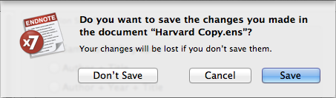
Click 'Save'
Notes:
You will be prompted to save the edited style with a new name.

Slide 58
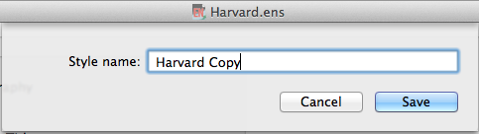
Save with the default Style name or use your own
Notes:
The original reference style remains unchanged, but a variation is created.
This edited style will then appear in EndNote's reference style list and can be applied to any EndNote library. This style is stored in My Documents, so can be accessed at any time.

Slide 59
Templates - how they work

Slide 60
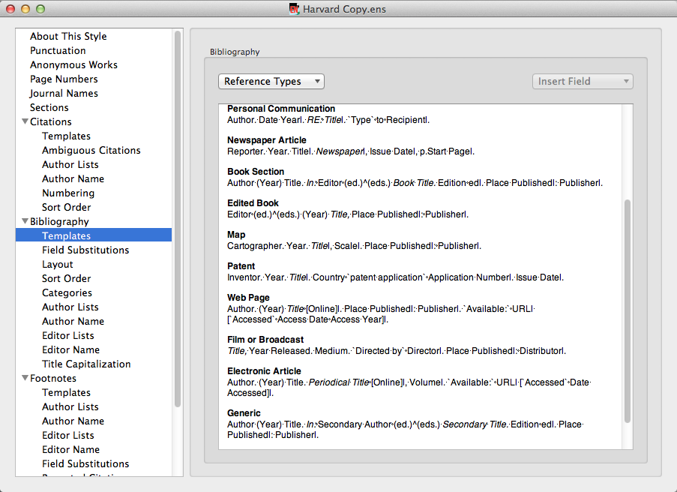
Templates control the appearance of the bibliographic record
A number of templates are already created: use the Reference Types list to create others
Generic is used if there is no template for a given reference type
Notes:
Bibliographic templates control the display of records when EndNote is used with Word documents for citations and references.
Depending on the Reference Style, there are already a number of templates created.
Additional templates can be created by choosing from the Reference Types list.
'Generic' is used when a specific template has not been created for a Reference Type that has been used to create an EndNote record.

Slide 61
Field Names are replaced by the contents of that field in the individual EndNote record
Other characters are displayed 'as is'
Notes:
Templates are created on the basis of Field Names: wherever a Field Name appears, it is replaced by the contents of that field in the bibliographic record. Words or characters that are not field names are displayed 'as is'.
If a template field contains no data, it is omitted from the record: the vertical lines tie the punctuation to the following field so that stray commas and colons do not appear.

Slide 62
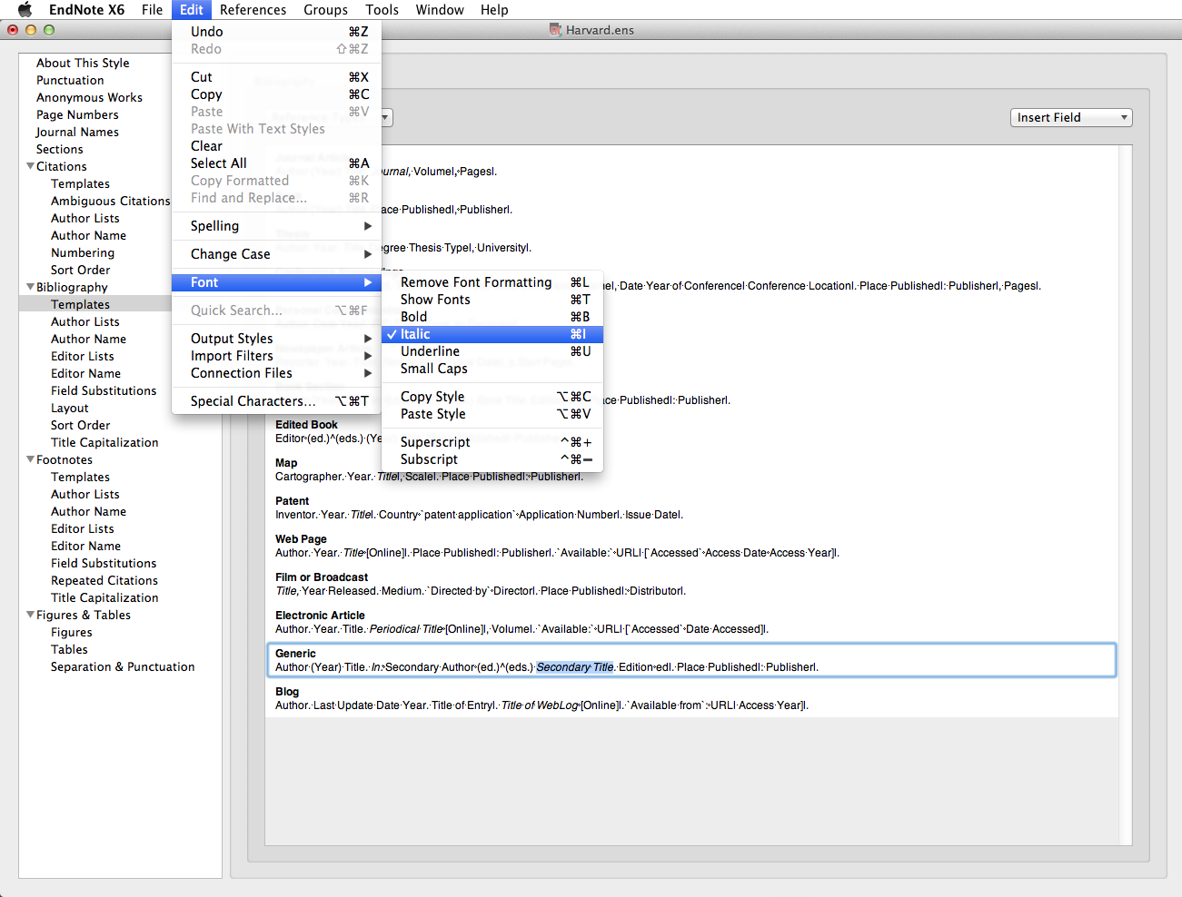
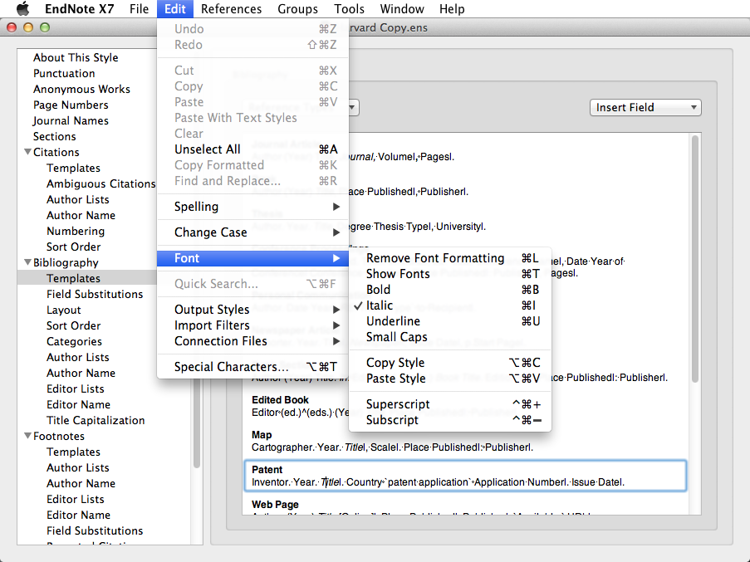
Apply Bold, Italic Underline, Superscript or Subscript to the Field Name using 'Edit  Font …
Fields are displayed with the format used for the Field Name
Notes:
Bold, Italic, Underline, Superscript or Subscript may be required formats within a citation or bibliographic template. To change the format, go to Edit, Font…
A field is displayed in the format used for the Field Name - hence Journal and Title often appear in italics within the templates.
When an item has editors, EndNote will choose between singular and plural: the circumflex is used.
Templates can be edited at any stage, and the edited reference style applied to the EndNote Library and relevant Word documents.

Slide 63
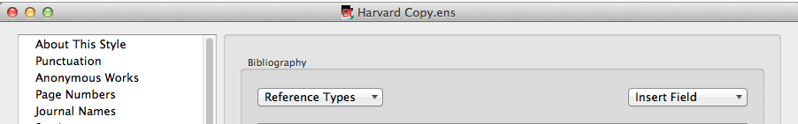
Special characters in templates
EndNote uses special characters to force particular actions within templates
These can be found on the keyboard, or accessed from the 'Insert Field' dropdown menu
Notes:
Some of the templates contain special characters: these are needed for example to avoid stray punctuation in bibliographic records or to manage different numbers of authors/editors.
Use keyboard characters or go to the Insert Field dropdown menu.

Slide 64
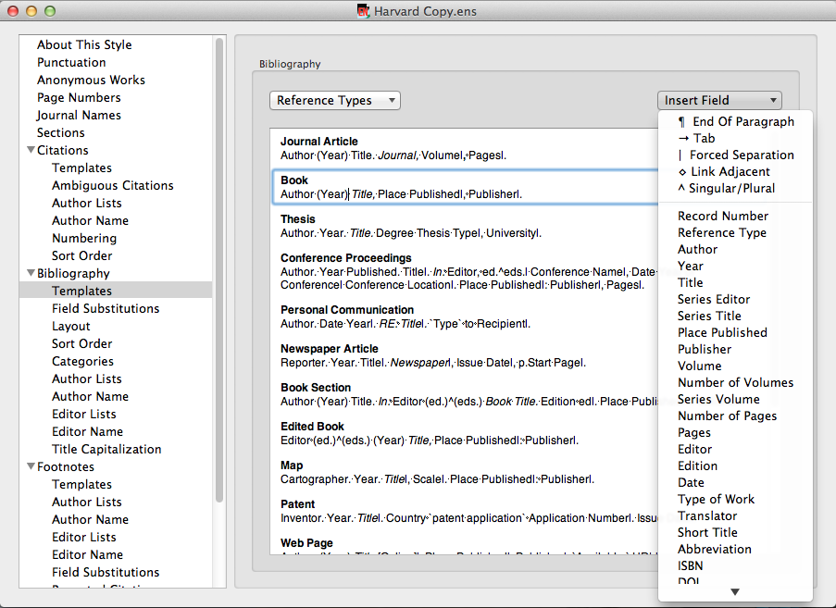

A forced separation | ties following punctuation to the next field
Notes:
Use the forced separation to tie punctuation to the following field: if this field is empty in the EndNote record, the punctuation will not be displayed: in this example, no publisher, no comma.

Slide 65

Use 'Link Adjacent Text'  to tie a word or phrase to the following field
Notes:
The diamond ties plain text to the next field: in this example, the words 'Type to' will only appear if there are details in the Recipient field. The grave accents indicate a phrase to be tied to the following field rather than a single character or word or a word that could be mistaken for a Field name.

Slide 66

Use Singular/Plural ^ to choose text for editors or pages
Notes:
The circumflex ^ is used to allow a choice between text linked to the associated field, in this case dependent on the number of entries in the Editor field.

Slide 67
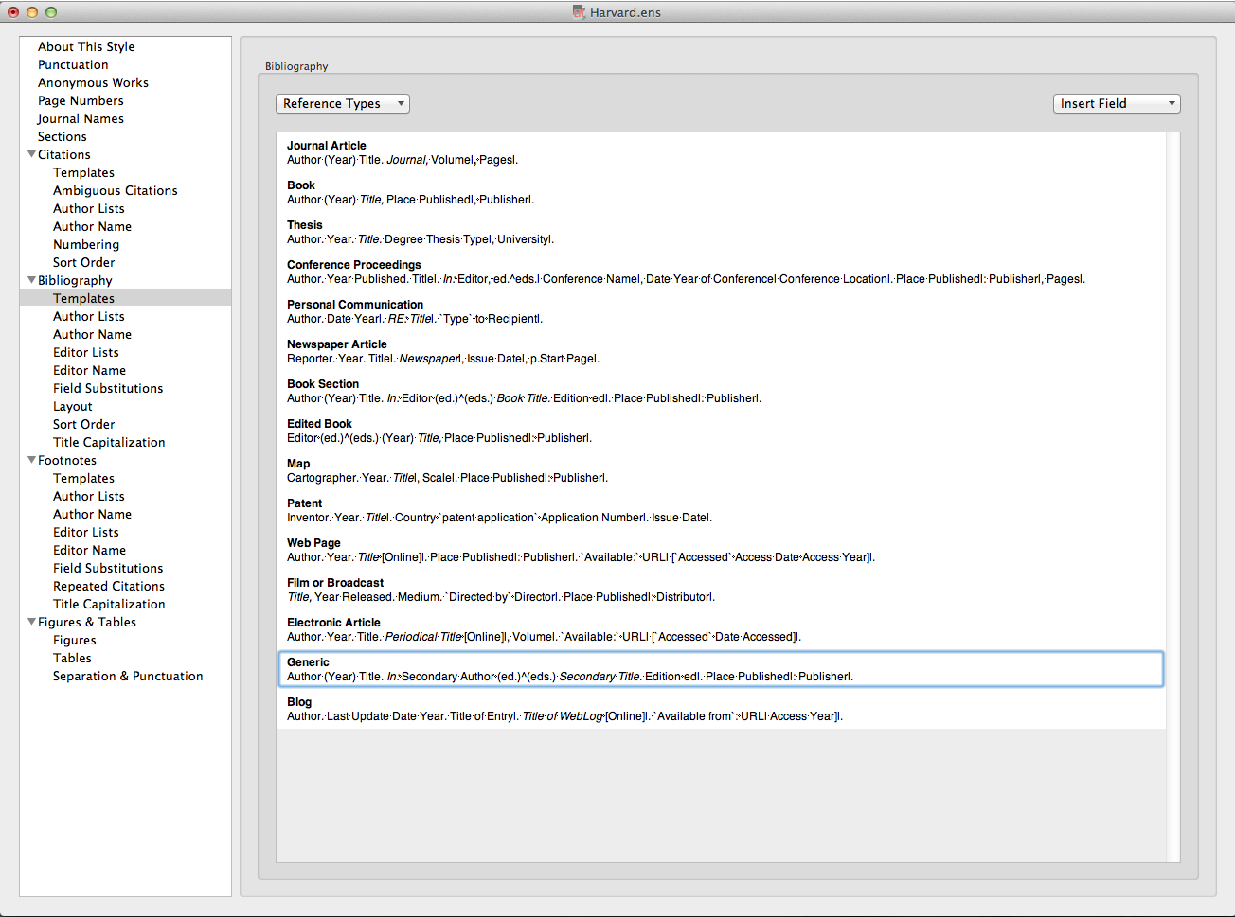

`Directed•by`◊Director
Use accent grave ` at start and end of text which might be confused with a field name
Notes:
Accents grave are used to identify phrases which need to be linked to preceding or following fields, and also to ensure that any text which also appears in an EndNote record as a field name is displayed in the bibliographic record 'as is'

Slide 68
Apply an edited reference style

Slide 69
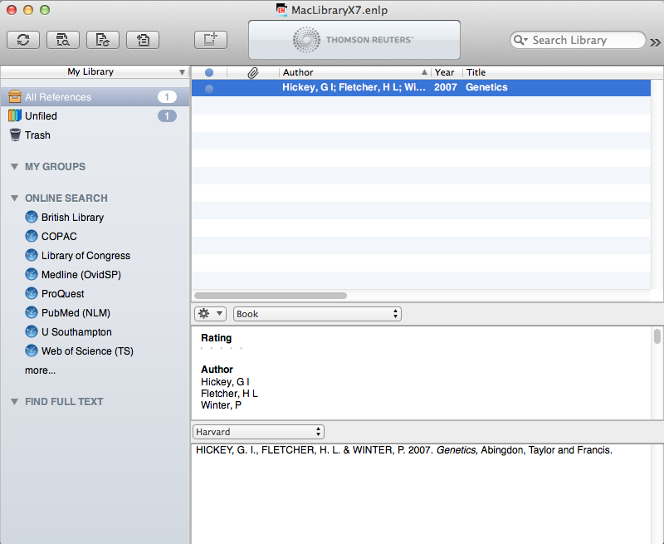
Changes to a Reference Style are not automatically applied:
Notes:
Changes to the Referencing Style are not automatically applied to the EndNote Library.

Slide 70

Go to the Reference Style dropdown menu and choose 'Select Another Style'
Notes:
To apply changes, go to the Reference Style dropdown menu and choose Select another Style.

Slide 71

The edited reference style now appears in the Style list
Select the style and click 'Choose'
Notes:
The edited style is now one of the choices - select and click Choose.

Slide 72

Changes to the Referencing Style are applied
Further edits to the style can be made at any time
Notes:
The edits are now applied to the EndNote Library.
Further changes can be made at any time, and the same copy style updated and then applied again to the library concerned. If references from the Library have already been used in a document, new changes can only be applied by using the Format Bibliography option in Word.

Slide 73
Set some EndNote preferences

Slide 74

To manage the appearance of the EndNote Library, go to EndNote X7  Preferences…
Notes:
Preferences controls how the EndNote Library itself appears, rather than the individual records. To see the options, go to EndNote X7, Preferences.

Slide 75

The 'Display Fields' option controls the order and selection for display within the EndNote library
Notes:
Various preferences can be set: Display Fields allows the selection and ordering of significant fields from the record: the columns can be renamed if required.

Slide 76

Use the 'Change Case' option to keep abbreviations in all upper case, or for any names with irregular characters or non-standard capitalisation
Notes:
The Change Case option is an important tool: it permits the general rules for bibliographic display to be overridden in special cases e.g. abbreviations, non-English language names and characters. Any character string added to the list will be displayed 'as is' wherever it occurs.

Slide 77

Notes:
To ensure maximum retrieval of full text journal articles when searching databases, make sure the PubMed LinkOut option is checked in Find Full Text preferences. Check the box to use this process automatically in future

Slide 78

For best results, uncheck the 'Author' option
Notes:
Set the criteria for comparing records to eliminate duplicates. Databases display author names differently, so to make this effective, uncheck the Author option. It is possible to choose automatic discard, but you may wish to carry out the process manually

Slide 79

Insert EndNote credentials and click 'Enable Sync' to synchronise your desktop library with EndNote Online
Notes:
Insert your EndNote Account details and click Enable Sync. This will synchronise All References and Custom Groups with EndNote Online. Check the Sync Automatically option to have EndNote synchronise in the background every 15 mins and when the library is closed. You can synchronise manually at any time.

Slide 80
Manage the library layout

Slide 81

Click to display record fields as columns in the EndNote Library
Notes:
CMD + click in the Title Bar to see the current fields displayed in the EndNote Library. Up to 10 can be chosen: simply click the field name on the list.

Slide 82


Select and drag any column to a new location
Notes:
The order of the fields displayed in the library window can be changed by select and drag.

Slide 83
Sort references into groups

Slide 84

Click to Create a Custom Group
Notes:
The best way of managing a large EndNote Library is to create sublibraries, or groups. Up to 5000 groups can be attached to a single library.
Groups can be custom groups or Smart groups.
Any item in the main library may be included in a custom group.
Smart groups are given set criteria - any item fulfilling these criteria is automatically added to the group. The criteria can be modified at any time. The criteria for a new Smart group will be applied to the existing EndNote Library, and to any items that are added subsequently.
All entries are included in the main EndNote library: they may be copied into more than one group, or be entries in more than one Smart group.
Deleting a record from a main library removes it from all groups: deleting a record from a custom group does not remove it from the main library or from other groups. However, deleting an item from a Smart group will also remove it from All References
To create a Custom group, go to Groups, Create Group.

Slide 85

The group can be named, and managed by cmd + click
Notes:
Name the group. The new group is displayed in the My Groups panel. Options to manage the group are available with cmd +click.

Slide 86

Drag selected records on to the group name to add the records to the group
Notes:
Select the records to be added to the group, and drag on to the group name. Make multiple selections with 'cmd + click'

Slide 87

Add or remove records in Custom Groups at any time
Notes:
Custom groups can be populated manually at any time. Records deleted from groups are not deleted from the main library.

Slide 88
Working with Smart Groups

Slide 89

Go to 'Groups ➔ Create Smart Group'
Notes:
In the Groups drop down menu, go to Groups, Create Smart Group.

Slide 90

Name the Smart Group
Notes:
Smart Groups operate with set criteria. Items may not be added or removed manually.

Slide 91

Set criteria for any field in the EndNote Record
Notes:
Set criteria for any field in the EndNote record. This includes text from any attached PDF files, or sticky notes. Up to 9 lines can be created.

Slide 92

Combine search lines with And, Or, Not
Notes:
Use Boolean operators to combine lines. Combine search lines with And, Or, Not.

Slide 93

Click 'Create' to save the group
Notes:
When all choices have been made, click Create.

Slide 94

References are copied to the Smart Group
Notes:
EndNote searches the library for any record fitting the set criteria. These are then copied to the Smart Group.. Any record subsequently added to the library will be copied to the smart group if it fits the criteria.
If individual items are deleted from the Smart Group, they will also be deleted from All References and from any other groups. Deleting a complete Smart Group does not delete individual records from All References, as it is essentially the criteria that have been deleted.

Slide 95

Manage the Smart Group with cmd + click
Notes:
Use CMD + click to manage the Smart Group.

Slide 96
Export database information to EndNote
Export references to a new or existing library or group
Use Firefox to export directly to EndNote - it is a more complex two-stage process in Safari
A number of databases export URL links as part of the record
The export process is common to all databases on a given platform
There is a separate process for searching any library catalogue
Notes:
Information can be exported directly from many databases into a new or existing library or group. The information from the database will populate the relevant fields in the EndNote record. This can include the abstract, and in many cases a URL link to the original database entry.
The EndNote export process uses connection files and import filters: all these are installed on public workstations. If you have purchased a copy of EndNote then additional files and filters can be downloaded from the supplier's website. Use Firefox as the internet browser - most databases will download automatically into EndNote. With Safari it is a two stage process, and for some platforms this browser does not work at all.
Some databases will provide automatic hyperlinks back to the original database record.
Every database operates on a 'platform' - all databases on a given platform export records in the same way.
Bibliographic information can also be downloaded from library catalogues including University of Southampton and this uses a slightly different process -see the separate section.

Slide 97
Search Web of Knowledge

Slide 98

This is the Web of Knowledge home page
Enter a search term - in this case 'diabetes' and click 'Search'
Notes:
This procedure applies to any database on the Web of Knowledge platform.
It is best, but not essential, to open the EndNote library before starting the search.
Use the library website to access the Web of Knowledge platform. In this case a cross-database search has been chosen.
The instructions here are for exporting required articles to EndNote rather than conducting an effective search strategy.
Enter a search term, in this case 'diabetes' and click Search.

Slide 99

Open the Marked list to view the selected records
On the Results pages, click required items, then add to marked list
Notes:
When the search process is complete, click on the number of results to display the records. Check the boxes for any required records, and add to the marked list.
Added items will be denoted by a red tick, and the total number of entries on the marked list shown.
Click the Marked List tab to view at any time.

Slide 100

It is helpful to include the abstract in exported records
Select fields to be included in output, then click 'EndNote'
Notes:
Select the fields to be included in the output (check the 'abstract' box as well) and then click the EndNote option.
Note that my.endnote.com takes you to EndNote Online instead.

Slide 101

Click 'Choose'
Notes:
The first time you export from this platform you will be asked to set preferences in Firefox. Click Choose.

Slide 102

In the Applications folder, go to EndNote X7, and click 'Open'
Notes:
Go to Applications, EndNote X7, EndNote X7 and click Open

Slide 103

Click to save choices
Notes:
Check the box to save the preferences for future searches on the Web of Knowledge platform. Click OK.

Slide 104

Click on any imported reference to view details of the record
A temporary group 'Imported References' is created. The references have already been added to the main library
Selected references are imported to the open EndNote Library
Notes:
The records will import directly into the EndNote library. These become a temporary group of Imported References, but are already added to the main library of All References. The temporary group will be overwritten at the next import activity, or when the library is closed.
Double click on any of the imported references to view.

Slide 105

Click the URL link to return to the database entry
Notes:
The link in the URL field goes to the database entry in Web of Science.

Slide 106


Slide 107
Find full text of articles

Slide 108

Go to 'EndNote X7  Customizer…'
Notes:
To use the 'Find Full Text' option, the links must be enabled. Go to EndNote X7, Customizer…

Slide 109

Check 'Services' and follow 'Next'
Notes:
Services for Mac OS X must be enabled. Check the box and click Next to install.

Slide 110

Then go to 'EndNote X7 ➔ Preferences'
Notes:
There are also parameters to be set in EndNote. Go to EndNote X7, Preferences

Slide 111

Use the 'Find Full Text' option and check the boxes
Notes:
In the Find Full Text window, check all the searching options to enable maximum PDF retrieval. Note that the university may have subscription access to individual journals, so check via TDNet for any PDFs not found by this method.

Slide 112

To search the whole library for free full text, select a single item, then go to 'Edit  Select All'
Notes:
The Find Full Text option currently works between EndNote and Web of Knowledge/PubMed to automatically download PDF files and attach these to the EndNote record for any papers which are either publicly available, or supplied free of charge through the database platform. This does not currently include papers from journals for which the university pays a subscription.
To search all records in the EndNote Library, select one entry, then go to Edit, Select All.

Slide 113

Select 'Find Full Text  Find Full Text …'
Notes:
In the dropdown menu, select Find Full Text, then Find Full Text …

Slide 114

EndNote searches Web of Knowledge for full text and attaches items found to the individual records
Notes:
EndNote works through the library, searching for full text and reports progress in the left hand pane. Any full text PDFs located are automatically attached to the File Attachments field of the individual EndNote record and denoted by a paperclip in the library or group window.

Slide 115

The .pdf file appears in the 'File Attachments' field
Notes:
Access the full text directly from the EndNote Library record.

Slide 116
Attach PDF files to records

Slide 117

Go to 'File Attachments  Attach File…'
Notes:
PDF and other types of file such as word, Excel, graphics, can be attached to the EndNote record, using the File Attachments field. Open the PDF location and select and drag onto the record.
Note that it is helpful to rename PDF files when saving from online resources so that they can be more readily identified for addition to the EndNote records.

Slide 118

Notes:
The pdf is attached to the record

Slide 119

Notes:
When you close the record you will be prompted to save changes. Changes include File Attachments.

Slide 120
Use the PDF viewer

Slide 121

Select the required record click to view pdf in new window
Notes:
When a pdf file is attached to an Endnote record, the file name will be shown on the PDF panel. Click the Display icon to view the pdf in a new browser window.

Slide 122

The Edit icon opens an additional toolbar
Use the PDF toolbar to navigate and annotate the document
Notes:
Use the PDF toolbar to copy, print, scroll through the document pages, magnify or rotate pages. PDF edit functions are available on an additional toolbar, opened from the Edit icon.

Slide 123

Highlight sections of the document
Notes:
Sections of the document can be highlighted: select and drag over relevant sections, then click on the highlight tool on the PDF toolbar.

Slide 124

Click to add a sticky note
Notes:
Click the sticky note icon, and then the location in the document where the note is to be placed.

Slide 125

Choose a colour for the sticky note
Notes:
Different colour sticky notes can be selected for different themes if required.

Slide 126

Add comments to the sticky note
Notes:
Double click the sticky note. A timed and dated Notes window displays. Add further comments at any time.

Slide 127

Click to save changes and return to the EndNote Library
Notes:
Click the minimise icon to return to the EndNote library: you will be prompted to save highlight and note changes.

Slide 128

Notes:
Highlights are saved and can be viewed on screen: they will also show if the document is printed.

Slide 129


Use Quick Search…
… or search a specific field
Notes:
Use the Quick search facility to search all fields of the EndNote record, and /or pdf text and sticky note comments: alternatively open the Search panel and search specific fields of the record.

Slide 130
View the Search results
Notes:
Search results are returned.

Slide 131
Export from Google Scholar

Slide 132

Go to the Settings option
Notes:
The Google Scholar home page layout changes frequently: look for a cogwheel, 'settings', or 'advanced options'.

Slide 133

Choose the EndNote option in the Bibliography Manager
Notes:
In Bibliography Manager, choose to show links for Endnote.

Slide 134

Click the link to export to EndNote
Notes:
Each search result shows a link to export to EndNote. There is no way of creating a list of items to export.

Slide 135

Notes:
The record is imported as a temporary reference, and is also added to All References.

Slide 136
Export from DelphiS

Slide 137

Search DelphiS…
Notes:
Carry out a search on DelphiS in the usual way

Slide 138

Click to add items to folder, and go to Folder View
Notes:
Click on the Folder icon to add selected items. When all required items have been added, go to Folder View or the Folder link on the top bar.

Slide 139

Select all, and click 'Export'
Notes:
Check the Select all box (or deselect any items no longer required) then go to Export.

Slide 140

Click 'Save'
Notes:
The default is to export to EndNote: click Save.

Slide 141

Notes:
Records are displayed as a temporary group of imported references. And are added to All References.

Slide 142
Search and export from library catalogues

Slide 143

In the 'Online Search' pane, click 'more'
Notes:
Most library catalogues, including Southampton's own, do not have a bibliographic export facility. However the catalogues can be searched and results downloaded by initiating the search via EndNote. Note that this is a less sophisticated search than those commenced from within an individual database.
To make the connection with the University of Southampton catalogue, in the Online Search section of the lefthand panel, click More…

Slide 144

Select 'U Southampton' and click 'Choose'
Use the same procedure for other library catalogues
Notes:
In the Choose a Connection window, scroll down to select U Southampton and click Choose.
Search catalogues of other libraries in the same way.

Slide 145

The Search tab is now linked to the library catalogue and appears in the Online Search list
Notes:
The new connection will now appear in the Online Search list.
The search tab above the library pane is directed to the selected library catalogue.

Slide 146

Click to carry out the search
Select as many search fields, criteria and search terms as required. More lines can be added if necessary
Notes:
A range of search fields, search criteria and search terms can be selected. Each search box should contain a single word only, unlike database searches.

Slide 147

If the number of hits is too large, it may be necessary to refine the search
Click 'OK' to add the retrieved records to the EndNote Library
Notes:
The Confirm Online Search window shows the number of records retrieved. Refine the search if necessary.
Click OK to add the retrieved records to the EndNote Library.

Slide 148

Imported records display as a temporary group and are also added to the main library
Notes:
Imported records display as a temporary group and are also added to the main library.
Double click on any record to view. All fields in the catalogue record will be imported to the EndNote Library.

Slide 149
Manage duplicates

Slide 150

Go to 'Edit, Select All'
Notes:
To manage duplicates in any folder, go to Edit, Select All

Slide 151

Go to 'References, Find Duplicates'
Notes:
On the References drop down menu, choose Find Duplicates.

Slide 152

Choose which record to keep, or Skip to keep both
Notes:
Fields with differences are highlighted. Choose which reference to keep or click Skip to keep both. It is generally best to keep the earlier record, as this may have already been cited. If there are more than two entries for an item, EndNote will display in pairs, so that unwanted records can all be eliminated.

Slide 153
Use EndNote with Word

Slide 154

To set up Cite While You Write, go to 'Customizer'
Notes:
You will need to add the Cite While You Write plugin before you start. On the EndNote menu, go to Customizer

Slide 155
Check the Cite While You Write option and click 'Next'
Notes:
Check the Cite While You Write addin box, click Next and follow subsequent instructions.

Slide 156
Insert citations in a document

Slide 157

Use EndNote with Word
The EndNote toolbar is displayed in Word
Move from the Word document to the Endnote library
Insert citations from either toolbar
Notes:
Always open EndNote first and then Word. This causes the EndNote tab to display in Word. The CWYW option must be enabled in EndnoteX7 Customizer
Some icons occur on both toolbars allowing operation from either window.
The icon with the grey down arrow is used to insert citations.

Slide 158


Click the EndNote icon to go to the EndNote Library
Identify the point in the text to insert a citation
… or search for a specific citation
Notes:
EndNote inserts citations and creates a simultaneous bibliography at the end of the text. It is helpful to insert a page break.
In the Word document, select the point in the text to insert the reference.
Go to EndNote to select the required reference.
Alternatively use the Search facility on the Citations dropdown menu, if for example you cannot remember the author.

Slide 159

Insert the reference from this toolbar
Click to highlight the required reference
Notes:
Click to highlight the required reference in the EndNote Library.
Click the down arrow on the EndNote toolbar and then return to Word automatically.

Slide 160

… or return to Word and click to insert the citation
The citation is displayed in the text, with the full reference at the end
Notes:
Alternatively, return to Word and use the Citations dropdown menu on the EndNote toolbar there.
The citation is inserted at the selected point in the text, and a full bibliographic record created at the end of the document.

Slide 161

A document citation folder is created
Notes:
EndNote creates a new folder of references cited in the current document.

Slide 162

Citations and references are displayed according to choices made within the edited reference style
Notes:
Multiple references can be inserted at a single point in the text: locate the cursor immediately to the right of the close bracket then select the reference from the EndNote library as before.
The citation will be included within the brackets and the full reference at the appropriate location in the end of document bibliography. Note that the sort order for citations and bibliography is determined by editing parameters in the referencing style.
Select multiple references from the library with cmd + click

Slide 163
Edit citations

Slide 164

Go to the Citations dropdown menu

Slide 165

Click in the citation to highlight and then go to 'Edit and Manage Citations'
Notes:
The common forms of editing are to add page numbers to a citation, to remove author and/or year from a citation, or to remove a citation altogether.
It is essential that all these changes are made using the relevant EndNote tools, so that linked field codes are also amended. Click in the citation to highlight it, then go to Edit and Manage Citations.

Slide 166

Highlight the specific citation
Change selection to remove author or year from the citation or show only in the bibliography
Click OK to complete the action
Notes:
Highlight the specific citation to be edited in the top panel.
To include an item in the bibliography without citing in the text, insert in the document, and then edit the citation to Show Only in Bibliography. Click OK. The citation disappears from the text but remains in the bibliography. This is useful for example for an edited book, where individual chapters by different authors are cited in the document. There is also an option for Author (Year) format in the text if required.

Slide 167

To remove a reference from the document, go to 'Tools' and 'Remove Citation'
Notes:
To remove a record completely, go to Tools, select the reference to be removed, click Remove Citation and then OK.
Both the citation and the full reference are removed from the document. Note that if the same source is cited elsewhere in the document, it will not be removed from the bibliography.

Slide 168


Slide 169

To add page numbers to a citation, type the exact letter string required in the SUFFIX box, then click 'OK'
Notes:
To add page numbers to a citation, use the same Edit & Manage Citations tool. Select the required citation, then type the exact letter string, including any required leading/following spaces in the Suffix box, note, not in the Pages box. Then click OK.

Slide 170

The suffix text is attached to the citation
Notes:
The suffix text is added to the citation.

Slide 171
Manage the bibliography layout

Slide 172


Go to 'CWYW Tools'  'Bibliography Settings…'
Notes:
Use the CWYW Tools drop-down menu. Choose Bibliography Settings.

Slide 173


… or remove the hanging indent
Insert a line space between references if required …
Notes:
Use the Layout tab. This window lets you manage indents, the line spacing within a reference, and the line spacing between references.
To insert a single space between references, go to the Space after drop down list and choose Single
Remove the hanging indent by changing to 0cm.

Slide 174

Click OK when all choices have been made
Notes:
Click OK when all choices have been made.

Slide 175
Working with EndNote Online
Notes:
This process enables several users e.g. members of a research team, to have access to a common EndNote library. There are two stages to this process: identifying users and access rights and transferring the library between the web and the desktop.

Slide 176

Use to find the Web of Knowledge
http://library.soton.ac.uk
Notes:
Go the Resources & Training tab on the Library Guide, then select A-Z list of E-Resources and open the Web of Knowledge via the W listing.

Slide 177

Open the Web of Knowledge
Notes:
Follow the Web of Knowledge link.

Slide 178

… or 'Sign In'
Register on the Web of Knowledge database…
Notes:
If you have not previously created a user area on Web of Knowledge, follow the Register link, otherwise, go to Sign In.

Slide 179

Sign in to Web of Knowledge
Notes:
Enter your Web of Knowledge username and password

Slide 180

Select 'EndNote'
180
Notes:
Select the EndNote link.

Slide 181

Download the Cite While You Write plug-in for Mac here
Notes:
To use EndNote Online with Word, you must download the Cite While You Write plug-in.

Slide 182

Notes:
Initially there are no references to show in All My References
After synchronisation, the library looks like this.

Slide 183

Go to 'EndNote X7 ➔ Preferences'
Notes:
In the EndNote Library, go to EndNote X7, Preferences

Slide 184

Use Web of Knowledge details
Notes:
Go to the Sync option, and enter email address and password as used with Web of Knowledge. Choose whether to Sync automatically - this will synchronise every 15 minutes and when the library is closed. Click Enable Sync. Note that it is only possible to Sync with a single desktop X7 library.
EndNote Web will synchronise All References and ordinary Groups. It will not sync Smart Groups as these are not a web option..
Note that the first synchronisation will take a long time, regardless of the number of references in the library - subsequent syncs will be much quicker.

Slide 185

Confirm your Web credentials
Notes:
On future visits you may be asked to confirm your EndNote Web credentials.
Important - if you are working with EndNote Online on a computer that does not have EndNote X7, make sure that the Word EndNote toolbar Cite While You Write options are set to EndNote Web, otherwise the software will look for an X7 upgrade and not function.

Slide 186

Sync the library at any time
Notes:
Click the Sync icon to start the procedure at any time.

Slide 187

Click 'Save'
At the first Sync you will be prompted to create a back up Library
Notes:
It is recommended that you create a backup copy of the library before syncing.
Save the compressed library in an appropriate location.
If the same record has been edited in both libraries since the last sync, EndNote will post this as a conflict and ask you which record to keep.

Slide 188
All references and normal groups are copied
Notes:
All references and normal groups are copied, with attachments.

Slide 189
Using Word with EndNote Online

Slide 190

Click to download the CWYW plugin
Notes:
Download the Macintosh plug in from the Format tab

Slide 191

Change to the Online toolbar: go to 'Tools, CWYW Preferences'
Notes:
If using EndNote X7, go to Tools, Cite While You Write Preferences.

Slide 192

Go to the 'Application' tab
Notes:
Make choices on the General tab, or to switch to EndNote Online, go to the Application tab

Slide 193

Switch to EndNote online
Notes:
Switch to EndNote online and click OK. Your Web of Knowledge ID and password are required.

Slide 194

Click to find citations
Notes:
The Endnote online toolbar is displayed. Use 'Insert Citation(s)' to locate required references.

Slide 195

Enter a search term and choose required record
Click 'Insert' or choose citation format
Notes:
Enter a search term in the Find Citation box, and choose the required entry. Click Insert for normal citations, or to change the format, use the dropdown menu.

Slide 196

Notes:
Entries are inserted according to the reference style chosen.

Slide 197

Use the layout tab to modify the bibliography
Notes:
Use the Configure Bibliography window to reformat the document with a chosen reference style, or go to the Layout tab for other options.

Slide 198

Use the Edit & Manage Citations tab to make changes
Notes:
To make changes to any citation in the document you must use the Edit & Manage Citation(s) option.

Slide 199

Use the Suffix box to add page numbers
Notes:
To add a page number to a specific reference, select the reference and then enter the exact character string (including any leading spaces) in the Suffix box, NOT the Pages box. Click OK

Slide 200
To remove a citation, go to 'Edit & Manage Citation(s)
Notes:
EndNote tools must be used for any editing of in-text citations, including removal. Go to Edit & Manage Citation(s) on the EndNote toolbar

Slide 201

Click to remove citation
Notes:
Select the citation to be edited and click the tools icon on the right hand side. Choose Remove Citation from the dropdown menu and click OK.

Slide 202


Notes:
The citation and full reference is removed from the document. Because the bibliographic reference is generated by the citation, a reference will only be removed when its last citation has been deleted from the document

Slide 203

Click 'Configure Bibliography' to modify layout
Notes:
To change the layout of the bibliography, go to Configure Bibliography on the EndNote toolbar.

Slide 204
Remove the indent…
Create a space between references
Notes:
Use this window to reduce the hanging indent to 0,and/or create spacing between reference entries.

Slide 205
Click OK when all choices have been made

Slide 206


Slide 207
Get more help
Find library guides for PC and Mac at
http://library.soton.ac.uk/endnote
www.edshare.soton.ac.uk
EndNote Help pages
Contact libenqs@soton.ac.uk

