Slide 1
Trailblazers
The History of Hypertext
Dr Nicholas Gibbins - nmg@ecs.soton.ac.uk
2013-2014

Slide 2
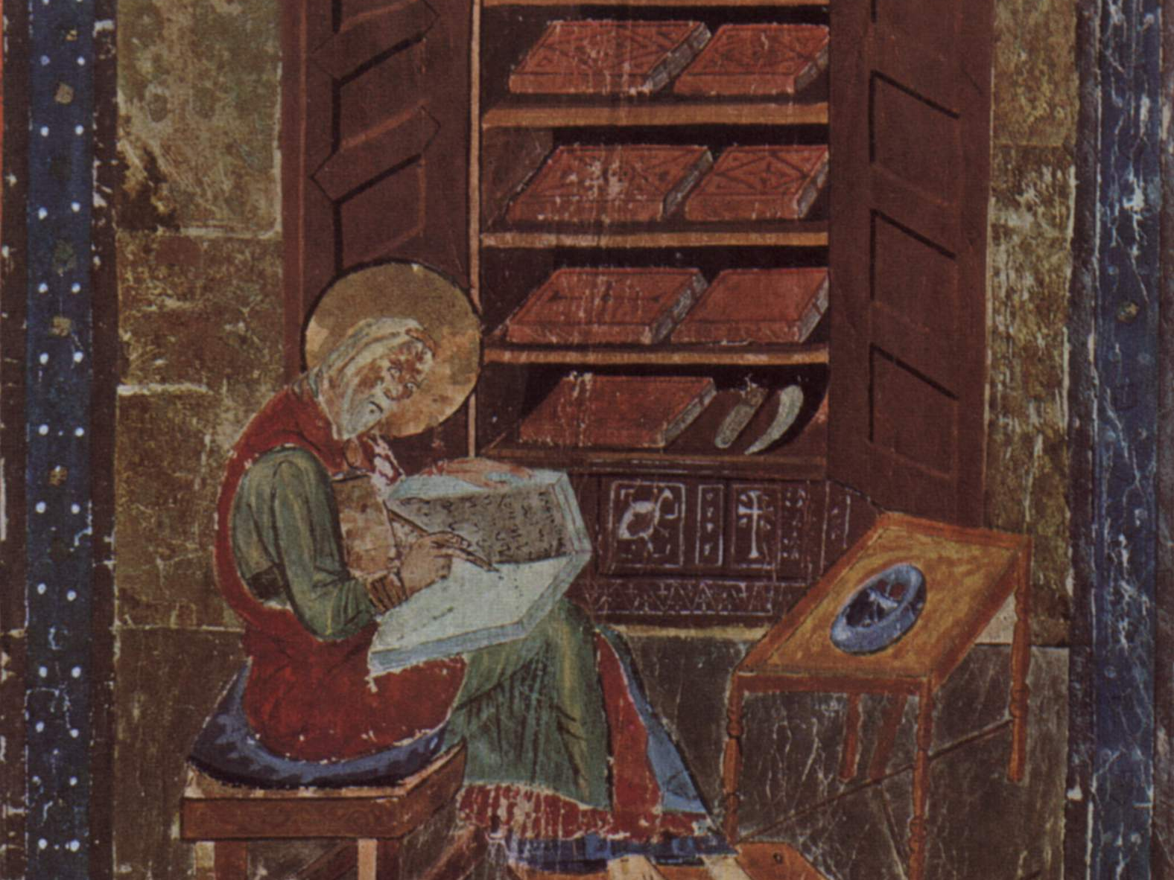
Hypertext Prehistory
St Cuthbert Gospel, C7th England

Slide 3
Revisiting Nelson’s Definition
Nelson, T.H. (1965) A file structure for the complex, the changing and the indeterminate.
Proceedings of the 20th ACM National Conference..

Slide 4
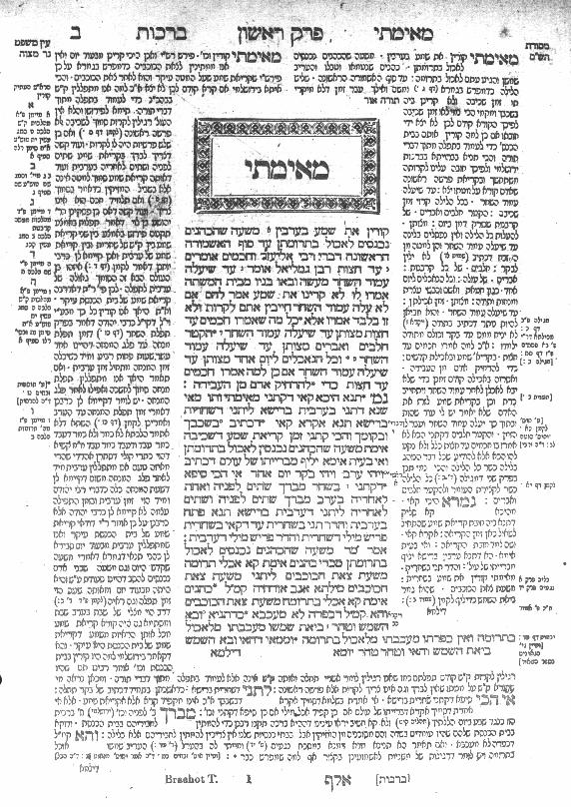
The Talmud
Central text of Rabbinical Judaism
Encoding of oral tradition
Commentaries on original text
Commentaries on commentaries
Notes:
Central text: the law (Mishnah c. 220 CE), legal analysis (Gemara, c. 450CE)
LH: medieval commentaries (Tosaphot, C12-13)
RH: early medieval commentaries by Rabbi Shlomo ben Yitzhak (Rashi, C11-12)
Outer columns: modern commentaries, cross references

Slide 5
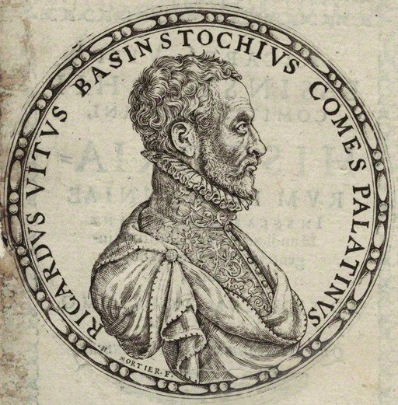
Richard White of Basingstoke
Author of Historiarum libri cum notis antiquitatum Britannicarum (1597-1607)
"as bees take honey from different flowers, so we must take materials from all sorts of different authors and, once they have been systematically collected, store them away, as it were, in the proper combs.”
One of the earliest scholars to make use of endnotes
Notes:
Facts mainly taken from Annio di Viterbo’s Antiquitatum Variarum (1498) (thus largely fabricated)

Slide 6

Hypertext Pioneers
http://www.flickr.com/photos/intherough/3470183543/
Notes:
The history of hypertext is closely related to the history of information science and information management

Slide 7
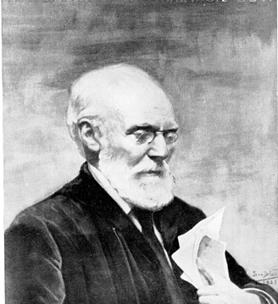
Paul Otlet
Belgian lawyer, internationalist and ‘father of Information Science’
Created the Universal Decimal Classification for libraries
(still in use around the world)
With Henri La Fontaine, established the Répertoire Bibliographique Universel in 1895
Notes:
UDC is Dewey based – Melville Dewey agreed to modifications, as long as UDC was not translated into English
RBU – fee-based service
15 million 3x5 index cards by 1934
“What works have been written by this or that author?” and “What has been written on this or that subject?”
Universal Iconographic Repertory from 1906
La Fontaine was Belgian delegate at the Versailles Peace Conference

Slide 8
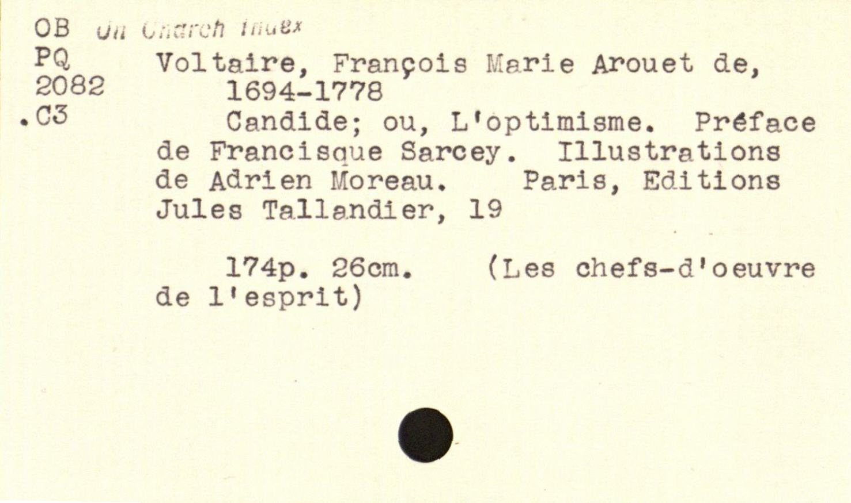
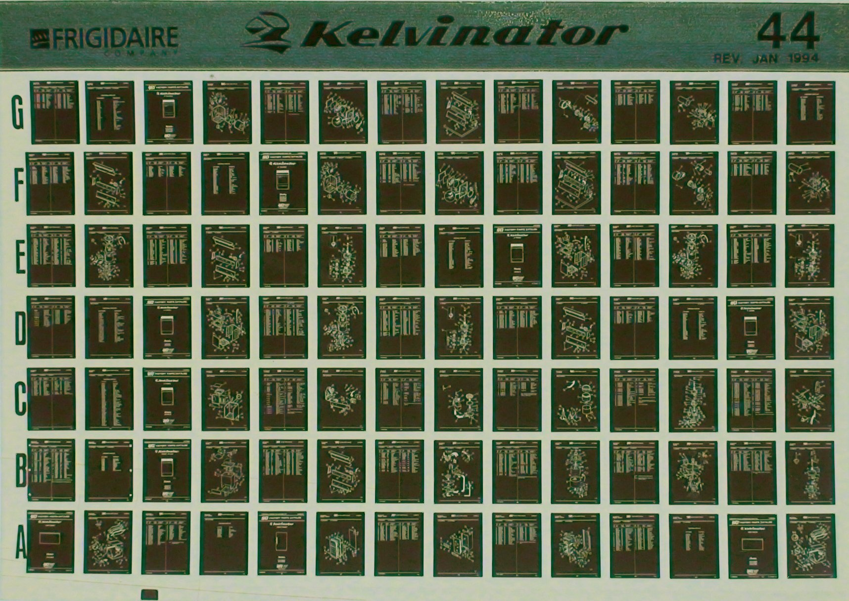
Notes:
Invented standard 3” x 5” index card
Standard microfiche proposed in 1906

Slide 9
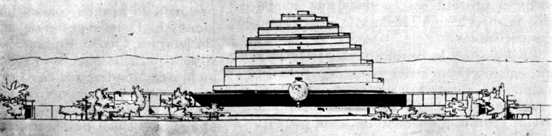
The Mundaneum
A central repository for all the world’s knowledge!
  Founded in 1910 by Otlet and La Fontaine
  Built on the earlier Repertoire Bibliographique Universel
  Planned at the centerpiece of a ‘world city’, designed by Le Corbusier in 1929 and to be built outside Geneva

Slide 10
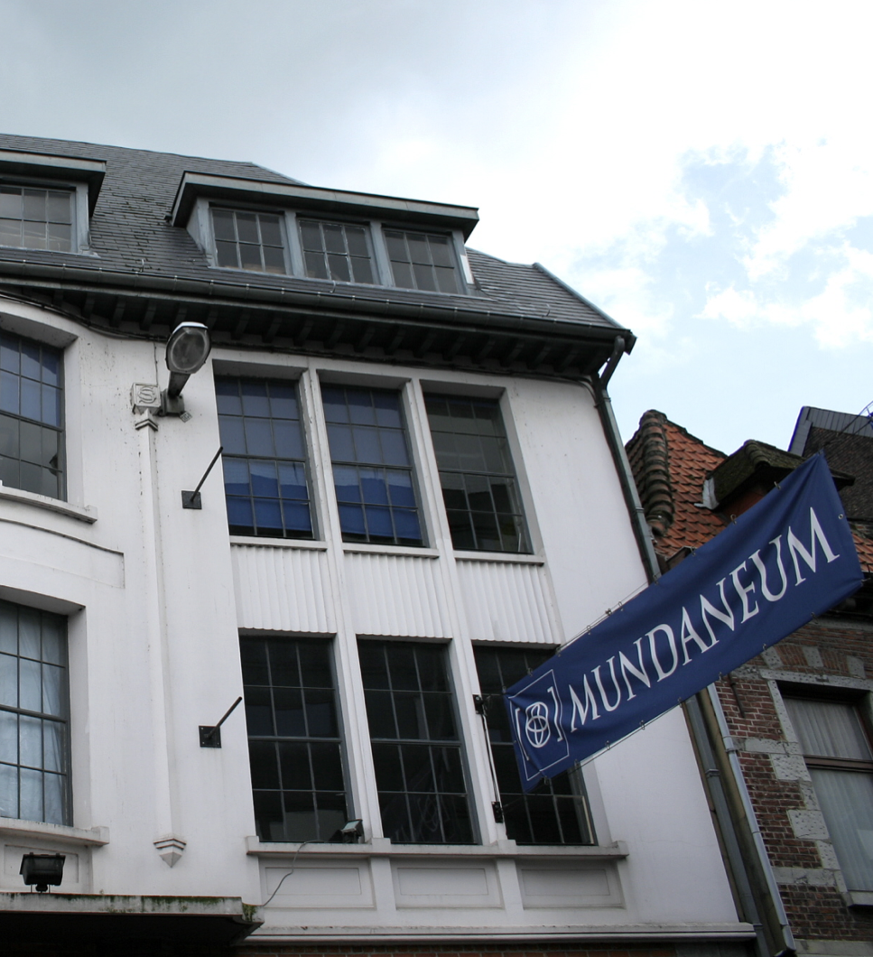
The Mundaneum
After Swiss plans fell through, project relocated to Brussels
Closed in 1934, damaged in 1940 under Nazi occupation
Rayward, W.B. (1994) Visions of Xanadu: Paul Otlet (1868-1944) and Hypertext. Journal of
the American Society of Information Science, 45(4), pp. 235-250.
Notes:
Indexed using UDC
100,000s of files, 1,000,000s of images
Cards contain both bibliographic and substantive information

Slide 11
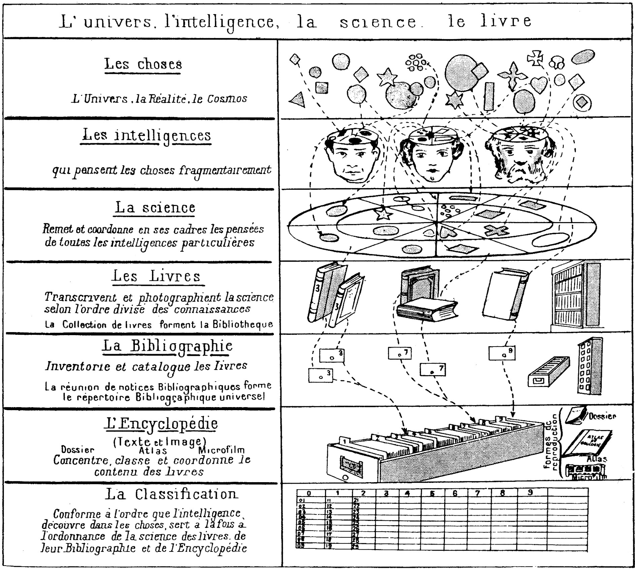
Otlet, P. (1934) Traité de Documentation. Brussels: Editiones Mundaneum, p.41.
Notes:
THINGS: the universe, reality, the cosmos
Our MINDS think about fragments of thing
SCIENCE manages and coordinates our thoughts
BOOKS transcribe science by areas of knowledge (a collection of books forms a library)
The BIBLIOGRAPHY inventories and catalogues books (the collection of bibliographic entries forms the Universal Bibliographic Index (RBU))
The ENCYCLOPEDIA concentrates, classifies and coordinates the content of books
CLASSIFICATION serves science, books, the bibliography and the encyclopedia at the same time, following the patterns that minds discover in things,

Slide 12
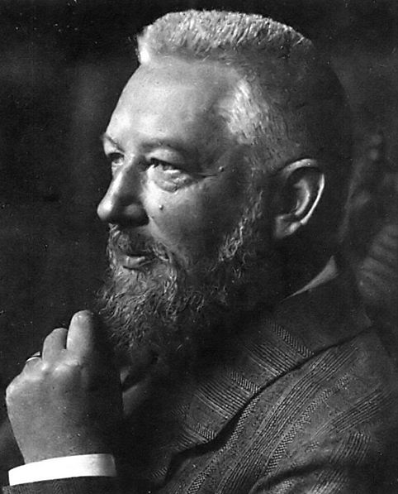

Wilhelm Ostwald
German chemist and Nobel Prize winner
Inspired by Otlet, established Die Brücke (The Bridge) using his prize money
International Institute for the Organizing of Knowledge Work
Reduce literature to small units of recorded knowledge (‘monos’) that could be arranged and linked with other units
Hapke, T. (1998) Wilhelm Ostwald, the “Brücke” (Bridge), and Connections to Other Bibliographic Activities at the Beginning of the Twentieth Century. Proceedings of the 1998 Conference on the History and Heritage of Science Information Systems. pp.139-147.
Notes:
Ostwald process – manufacture of nitric acid – Nobel in 1909
Mono – small card/leaflet in a standardised format (weltformat)
Gehirn der Welt - World Brain
Linked via classification

Slide 13
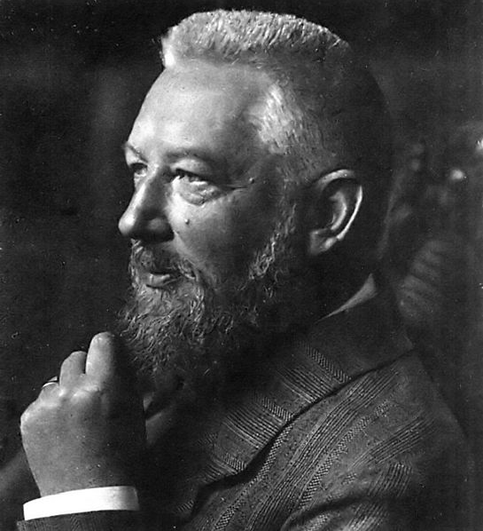
Die Brücke
Die Brücke is planned as a central station, where any question which may be raised with respect to any field of intellectual work whatever finds either direct answer or else indirect, in the sense that the inquirer is advised as to the place where he can obtain sufficient information
Ostwald, W. (1913) Scientific Management for Scientists. Scientific American, 108(1), pp. 5-6.

Slide 14
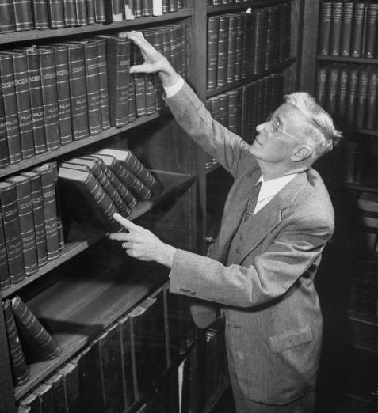
Vannevar Bush
Prewar work on analogue computing – the Differential Analyser
Director of the US Office of Scientific Research and Development during WWII
De facto director of the Manhattan Project until 1943
Notes:
While a professor at MIT, had Claude Shannon as a PhD student (information theory)

Slide 15
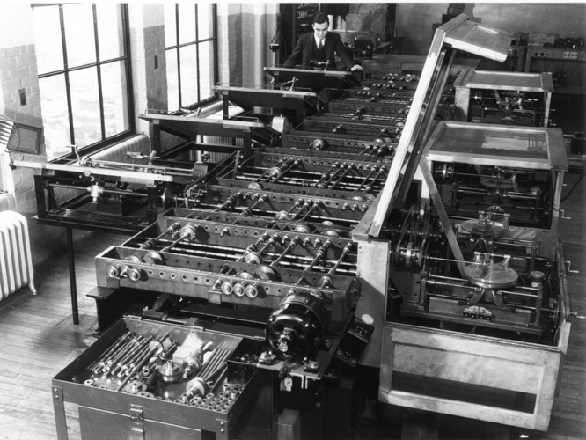
Notes:
Differential Analyser – analogue computer built in 1931
Work on the Differential Analyser informed developments in military fire control.

Slide 16
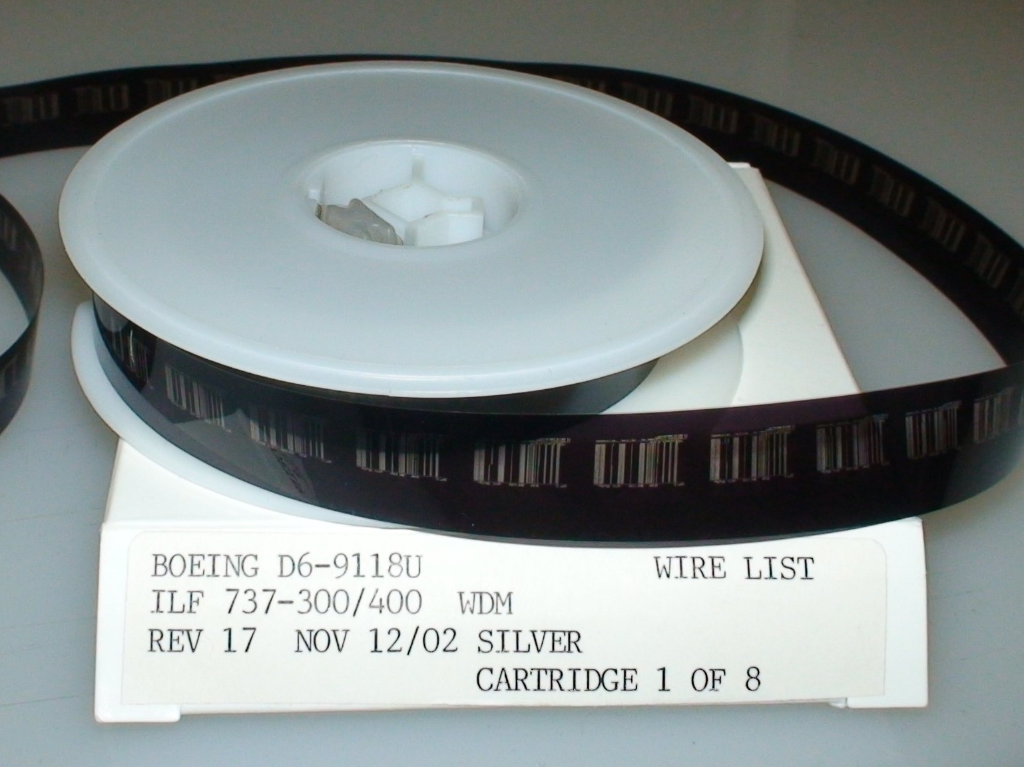
Wikimedia Commons

Slide 17
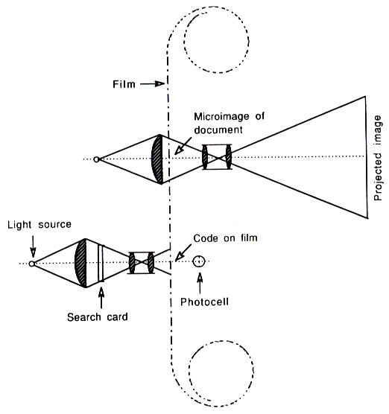
The Rapid Selector
Buckland, M.K. (1992) Emanuel Goldberg, electronic document retrieval, and Vannevar Bush's Memex. Journal of the American Society of Information Science, 43(4), pp. 284-294.
Notes:
Photoelectric microfilm selector developed at MIT in 1938
Based on earlier (patented!) work by Emanuel Goldberg of Zeiss Ikon (US Patent 1838389) from 1931 (the Statistical Machine)

Slide 18
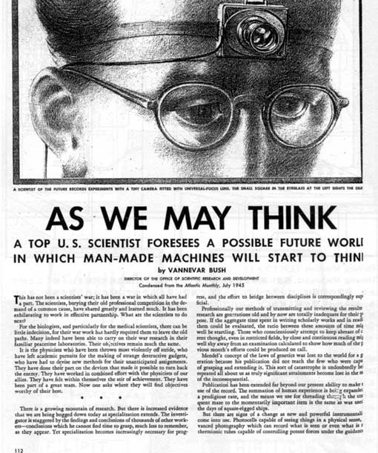
As We May Think
“The difficulty seems to be, not so much that we publish unduly in view of the extent and variety of present-day interests, but rather that publication has been extended far beyond our present ability to make real use of the record.”
Bush, V. (1945) As We May Think. The Atlantic Monthly, 176, pp.101-108.
Notes:
July 1945

Slide 19
As We May Think
“Our ineptitude in getting at the record is largely caused by the artificiality of systems of indexing. […] Having found one item, moreover, one has to emerge from the system and re-enter on a new path.”
“The human mind does not work that way. It operates by association. With one item in its grasp, it snaps instantly to the next that is suggested by the association of thoughts.”
“…the speed of action, the intricacy of trails, the detail of mental pictures, is awe-inspiring beyond all else in nature.”

Slide 20
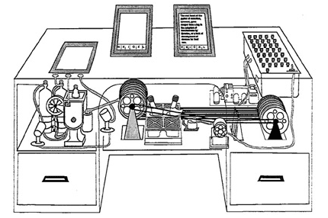
The Memex
An electro-mechanical analogue device for organising knowledge: microfilm, photocells and typewriter.
Allows user to create:
Associative trails – arbitrary sequences of pages
Skip trails – relevant summaries
Commentaries on works
Notes:
Ideas first formulated c. 1932.

Slide 21

A Salient Prediction
“Wholly new forms of encyclopedias will appear, ready made with a mesh of associative trails running through them, ready to be dropped into the memex and there amplified.”

Slide 22
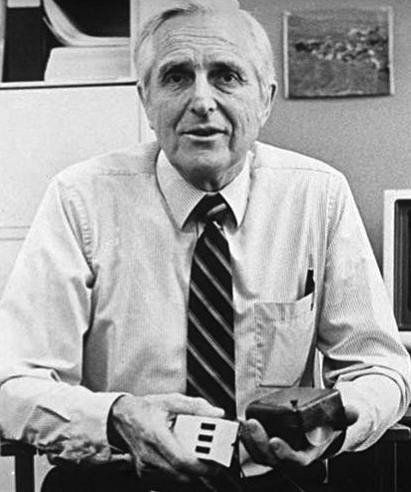
Doug Englebart
Member of the Stanford Research Institute and founder of the Augmentation Research Center
ARC played key role in early Internet history
Notes:
ARC played key role in early history of the Internet
First message on ARPANET was between ARC computer and UCLA
ARC-run ARPANET reference library service turned into InterNIC (domain name and IP address allocations until 1998 -> ICANN)
When ARC folded in the 70s, many researchers went to Xerox PARC (NLS

Slide 23
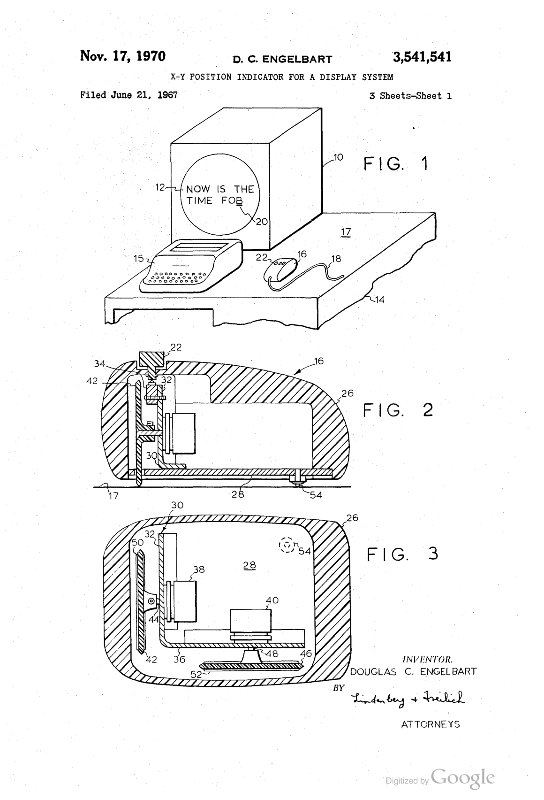
Notes:
Invented the computer mouse

Slide 24
Augmenting Human Intellect
a new stage of human evolution, characterized by
"automated external symbol manipulation”
“we are concentrating fully upon reaching the point where we can do all of our work on line — placing in computer store all of our specifications, plans, designs, programs, documentation, reports, memos, bibliography and reference notes, etc., and doing all of our scratch work, planning, designing, debugging, etc., and a good deal of our intercommunication, via the consoles”.
Engelbart, D.C. and English, W.K. (1968) A research center for augmenting human intellect.
Proceedings of the 1968 Fall Joint Computer Conference, San Francisco, CA. pp. 395-410

Slide 25
NLS – the oN-Line System
Timesharing computer with multiple consoles
UI features:
  Windowed display
  Mouse
  Chorded keyboard
  Videoconferencing
  Links in content

Slide 26
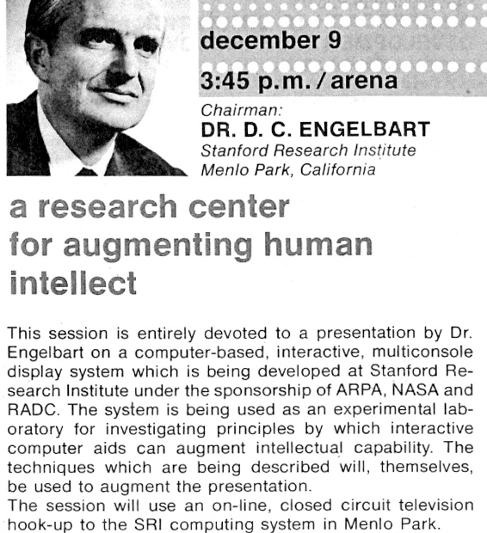
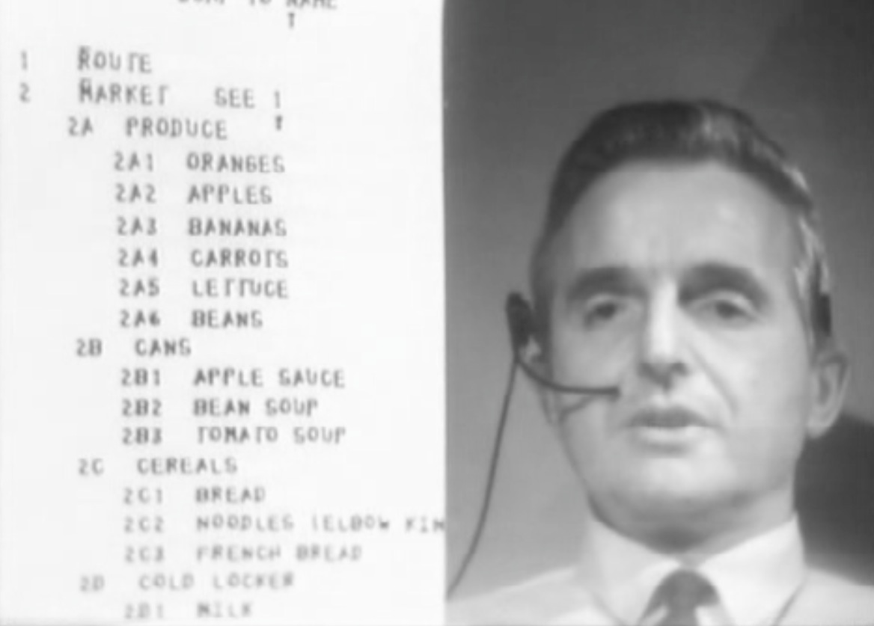
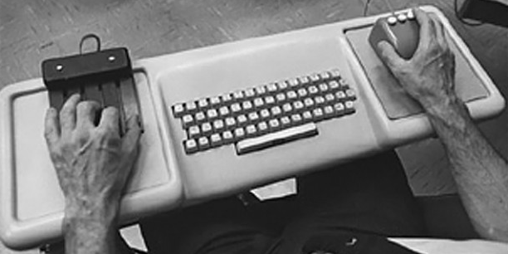
The Mother of all Demos
http://sloan.stanford.edu/MouseSite/1968Demo.html
Notes:
First demonstrated in December 1968 at the Fall Joint Computer Conference in San Francisco
Hypertext, the mouse, chording keyboard, videoconferencing, CSCW, computer generated slides.

Slide 27
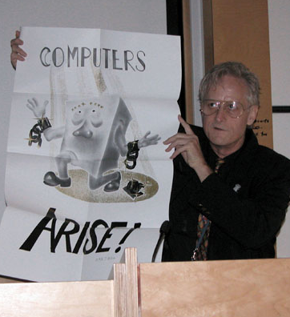
Ted Nelson
Sociologist, philosopher and film maker
Coined the term “hypertext”
“A user interface should be so simple that a beginner in an emergency can understand it within ten seconds.”
“Most people are fools, most authority is malignant, God does not exist, and everything is wrong.”
Notes:
Son of Ralph Nelson and Celeste Holm

Slide 28
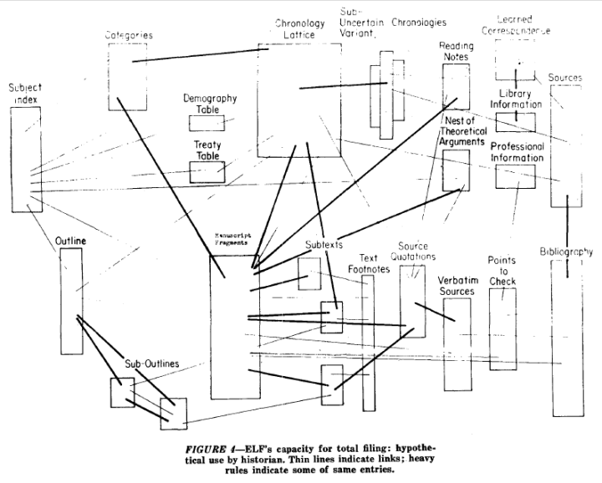
Notes:
A File Structure for the Complex, the Changing and the Indeterminate."
Proceedings of the ACM 20th National Conference (1965), pp. 84-100

Slide 29

Computer Lib/Dream Machines
“No one's life has yet been simplified by a computer.”
Two books in a dos-a-dos binding:
Computer Lib is a clarion call for people to understand computers deeply
Dream Machines is a sketch of the flexible media potential of computers
Nelson, T.H. (1974) Computer Lib/Dream Machines. Chicago, IL: Nelson, T.H.
Notes:
"Down with Cybercrud"
anti centralisation
democratisation of computing – computer experts intentionally obscure

Slide 30
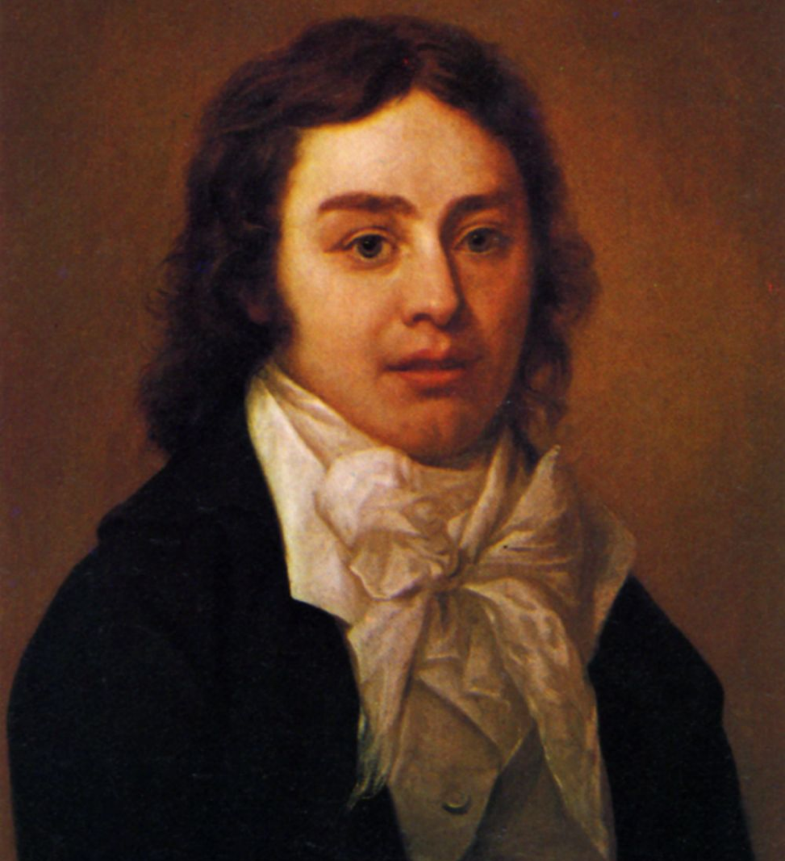
A Vision in a Dream
In 1797, Samuel Taylor Coleridge wrote the poem Kubla Khan after awaking from an opium dream:
In Xanadu did Kubla Khan
A stately pleasure-dome decree: Where Alph, the sacred river, ran Through caverns measureless to man
Down to a sunless sea.
He was interrupted by a visitor from Porlock, and never completed the poem…

Slide 31
Project Xanadu
Founded in 1960, still ongoing (famously never finished)
Hugely influential, nonetheless
Described in Dream Machines, and Nelson’s subsequent book Literary Machines
Nelson, T.H. (1993) Literary Machines. Sausalito, CA: Mindful Press.
Notes:
"longest-running vaporware story in the history of the computer industry” – Gary Wolf in WiReD
First demo version in 1972
With Roger Gregory, Mark Miller, Stuart Greene in 1979
1983-1992 – With Autodesk
1992- Xanadu Operating Company
Open-sourced in 1998
2007 - XanaduSpace
Literary machines – first published 1980

Slide 32
Project Xanadu Mission Statement
DEEP INTERCONNECTION WITH INTERCOMPARISON AND RE-USE
Since 1960, we have fought for a world of deep electronic documents-- with side-by-side intercomparison and frictionless re-use of copyrighted material.
We have an exact and simple structure. Our model handles automatic version management and rights management through deep connection.
Today's popular software simulates paper. The World Wide Web (another imitation of paper) trivializes our original hypertext model with one-way ever-breaking links and no management of version or contents.
WE FIGHT ON.

Slide 33
Project Xanadu
Intercomparison of parallel documents
World-wide publishing without barriers
Links that don't break
Versioning
Transclusion
Transcopyright

Slide 34
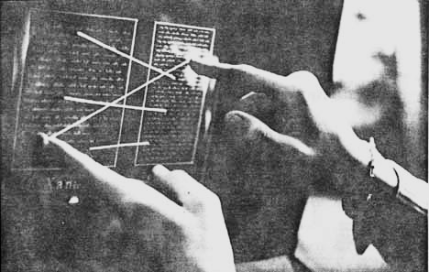
Nelson, T.H. (1972) As We Will Think. Proceedings of Online 72 Conference, Uxbridge, England.

Slide 35
Every Xanadu server is uniquely and securely identified.
Every Xanadu server can be operated independently or in a network.
Every user is uniquely and securely identified.
Every user can search, retrieve, create and store documents.
Every document can consist of any number of parts each of which may be of any data type.
Every document can contain links of any type including virtual copies ("transclusions") to any other document in the system accessible to its owner.
Links are visible and can be followed from all endpoints.
Permission to link to a document is explicitly granted by the act of publication.
Every document can contain a royalty mechanism at any desired degree of granularity to ensure payment on any portion accessed, including virtual copies of all or part of the document.
Every document is uniquely and securely identified.
Every document can have secure access controls.
Every document can be rapidly searched, stored and retrieved without user knowledge of where it is physically stored.
Every document is automatically moved to physical storage appropriate to its frequency of access from any given location.
Every document is automatically stored redundantly to maintain availability even in case of a disaster.
Every Xanadu service provider can charge their users at any rate they choose for the storage, retrieval and publishing of documents.
Every transaction is secure and auditable only by the parties to that transaction.
The Xanadu client-server communication protocol is an openly published standard. Third-party software development and integration is encouraged.

Slide 36
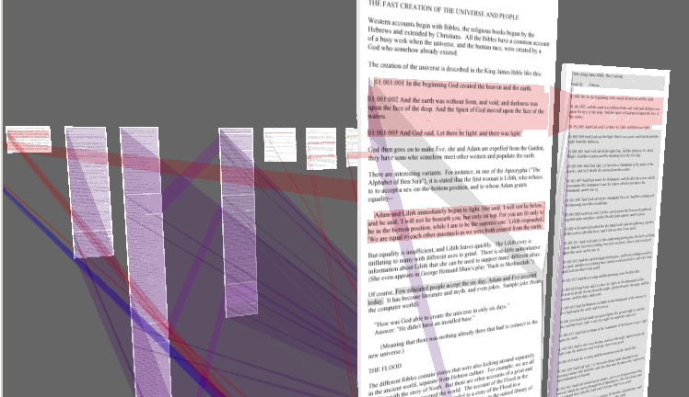
XanaduSpace

Slide 37
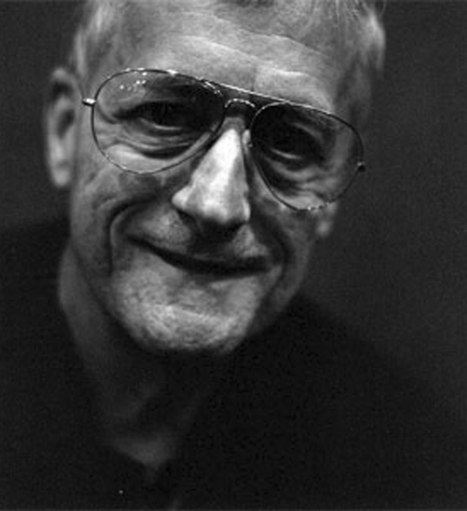
Nelson on the Web
The Xanadu project did not ‘fail to invent HTML’. HTML is precisely what we were trying to PREVENT - ever-breaking links, links going outward only, quotes you can't follow to their origins, no version management, no rights management.

Slide 38

Hypertext Systems
http://www.flickr.com/photos/mwichary/2355783479/

Slide 39
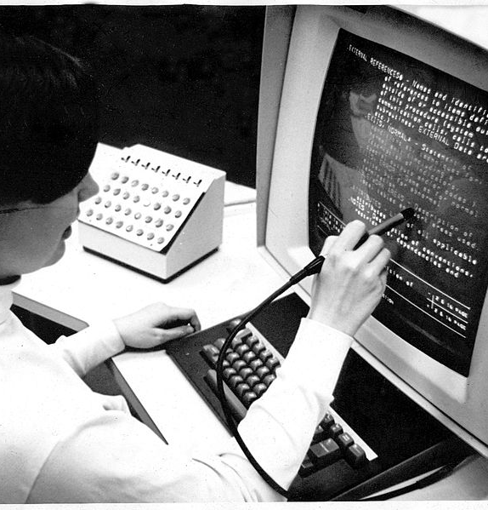
HES/FRESS (1967)
Hypertext Editing System developed at Brown University
Used by NASA to produce and manage documentation for the Apollo programme
Carmody, S. et al (1969) A Hypertext Editing System for the /360. Pertinent Concepts in Computer Graphics: Proceedings of the Second University of Illinois Conference on Computer Graphics, pp.291-330.
Notes:
Ted Nelson was involved with this project
File Retrieval and Editing System

Slide 40
ZOG (1975)
Developed at Carnegie Mellon University
Features:
Early proponent of the “card” or “frame” model of hypertext
(c.f. index cards)
One-way links, embedded in frames
Commercialised as KMS
Robertson, G. et al (1981) The ZOG approach to man-machine communication. Int. J. Man-Machine Studies, 14, pp.461-488.

Slide 41
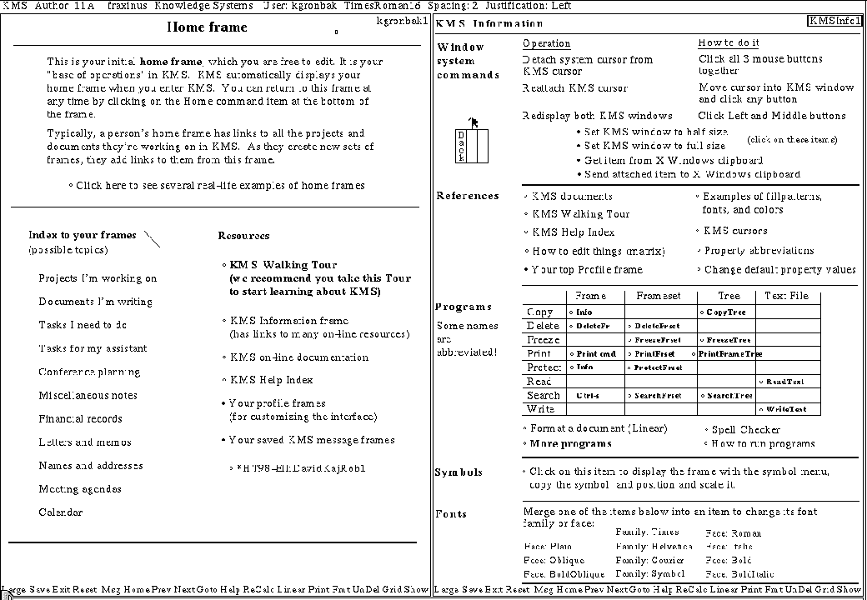
Knowledge Management System (1983)
Akscyn, R.M. et al (1988) KMS: A distributed hypermedia system for managing knowledge in organizations. Communications of the ACM, 31(7), pp. 820-835.
Notes:
Frame-based, with hierarchy of frames
Typical side-by-side display
Interpreted scripting language

Slide 42
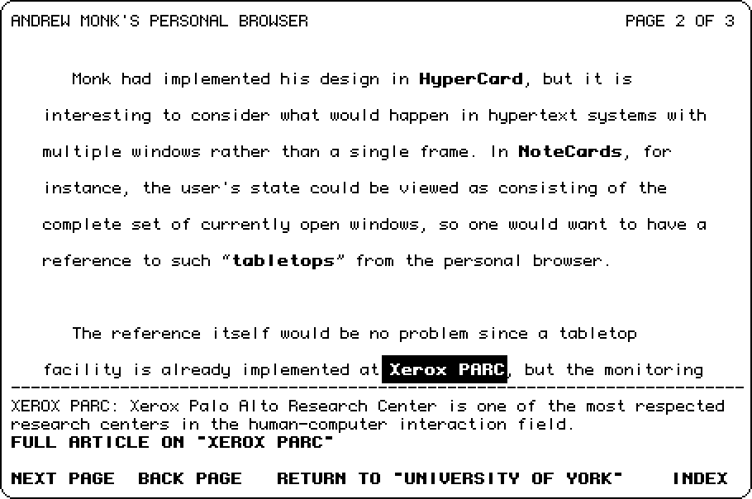
Hyperties (1983)
Developed by Ben Schneiderman at the University of Maryland
Features:
Link previews
Links point to whole documents

Slide 43
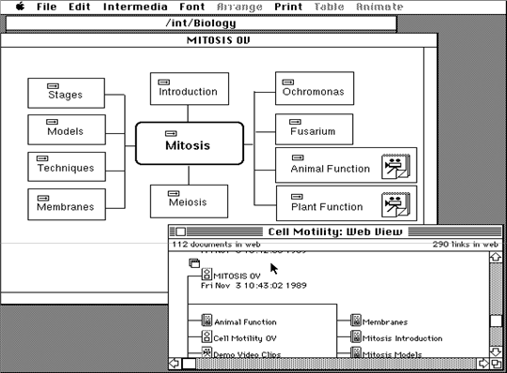
Intermedia (1985)
Developed at Brown University
Features:
A/UX-based
Bidirectional linking
Graphics
Garrett, L.N. et al (1986) Intermedia: issues, strategies, and tactics in the design of a hypermedia document system. Proceedings of the 1986 ACM conference on Computer-supported cooperative work, pp.163-174.

Slide 44
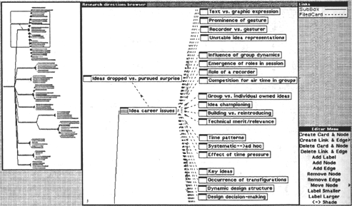
NoteCards (1985)
Developed at Xerox PARC (Trigg, Moran and Halasz)
Features:
Hierarchical browser
Programmable API
Graphics
Halasz, F.G. et al (1986) NoteCards in a Nutshell. SIGCHI Bulletin, 18(4), pp.45-52.

Slide 45
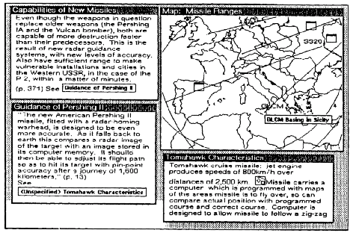
NoteCards: Showing card with iconic anchors

Slide 46
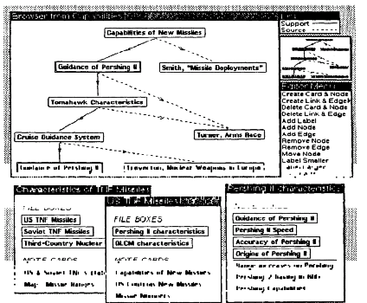
NoteCards: Showing browser

Slide 47
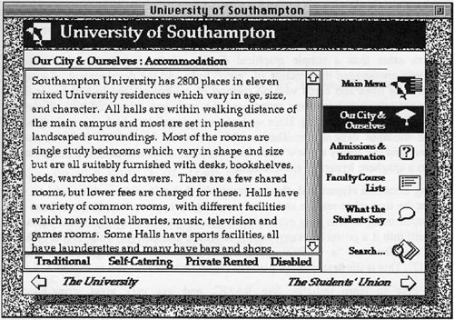
Hypercard (1987)
Developed by Apple Computer Inc., and bundled with new Mac SEs.
Features:
OO programming language (Hypertalk)
Graphics
Widely used for application development

Slide 48
Conklin on Hypertext

Slide 49
Hypertext: An Introduction and Survey
“The concept of hypertext is quite simple: windows on the screen are associated with objects in a data base and links are provided between these objects, both graphically (i.e. as labelled icons) and in the data base (i.e. as pointers).”
Conklin, J. (1987) Hypertext: An introduction and survey. IEEE Computer, 20(9), pp.17-41.

Slide 50
Macro Literary Systems
Large on-line libraries in which inter-document links are machine supported; all publishing, reading, collaboration, and criticism takes place within the network
e.g. Memex, NLS/Augment, Nelson's Xanadu

Slide 51
Problem Exploration Tools
Tools to support early unstructured thinking on a problem when many disconnected ideas come to mind
  Early authoring and outlining
  Problem solving
  Programming and design
e.g. IBIS
Notes:
IBIS – Conklin’s own work
typed links for recording and structuring discussions

Slide 52
Structured browsing Systems
Smaller-scale systems for teaching, reference, and public information, where speed of access and ease of use is crucial
  Typically designed only for reading, not for authoring
e.g. ZOG/KMS, Hyperties

Slide 53
General Hypertext Technology
Research platforms to allow experimentation with a range of hypertext applications; most commonly applied to reading, writing, collaboration
e.g. NoteCards, Intermedia, HES/FRESS

Slide 54
The Essence of Hypertext
Nodes
  The power to chunk information
Links
  Importance of speed of link resolution
  Direction/arity?
  Names?
  Properties?
  End as region or node?
  Reference by name or by value
  Display characteristics?

Slide 55
The Essence of Hypertext
Trees (strict hierarchies) or networks of links
Clusters of Links (webs/linkbases?)
Clusters of Nodes (Composites)
History
Trails
Authoring and Annotating!
Browsers (meaning node level)

Slide 56
Disadvantages of Hypertext
Disorientation: the tendency to lose one's sense of location and direction in a non-linear document; “Lost in Hyperspace”
Cognitive overhead: the additional effort and concentration necessary to maintain several tasks or trails at one time.

Slide 57
Halasz on
Hypertext

Slide 58
Reflections on Notecards
In 1989, Halasz identified seven issues for the next generation of hypertext systems:
  Search and query
  Composites
  Virtual Structures
  Computation over networks
  Versioning
  Support for collaboration
  Extensibility
Halasz, F. (1989) Reflections on Notecards: seven issues for the next geeneration of hypermedia systems, Communications of the ACM, 31(7), pp. 836-852.
Notes:
Member of the Notecards team at Xerox

Slide 59
The seven issues
Issue 1: Search and query in a hypermedia network
  Link Navigation is not always the best way to find things
  Better might be Content Based or Structural Search
Issue 2: Composites - augmenting the basic model
  A way of representing and dealing with sets (or sub-networks) of nodes and links as unique entities separate from their components
Issue 3: Virtual structures
  Virtual Structures would be created by a query and would be equivalent to virtual tables in a relational database

Slide 60
The seven issues
Issue 4: Computation in (over) hypermedia networks
  The idea is to provide APIs to allow cards to be orchestrated and scripts to be executed when certain events occur
Issue 5: Versioning
  Halasz argued that versioning was a natural feature of OSs that got lost with DOS. Versioning of HTs is difficult.
Issue 6: Support for collaborative work
Issue 7: Extensibility and tailorability
  The ability to change the system to extend and change behaviours, have different appearances and use different hypertext models
Notes:
Issue 4 – Trellis (more later)

Slide 61
Halasz on
Hypertext
(part 2)

Slide 62
Seven Issues Revisited
Halasz gave a keynote at Hypertext ‘91 in San Antonio that reconsidered and amended his seven issues:
  Ending the tyranny of the link
  Open Systems
  User interfaces for large information spaces
  Very large hypertexts
http://www2.parc.com/spl/projects/halasz-keynote/

Slide 63
Ending the Tyranny of the Link
Hypermedia that includes non-network structures as well as virtual structures on an equal footing with network structures.
Wider variety of hypermedia “data models”
Provides increased opportunity for integration with a variety of complementary systems and technologies

Slide 64
Open Systems
“The monolithic hypermedia system of the
1980s is no longer a viable species (!)”
Introduction of open hypermedia systems:
Decompose HT system into separate components
Define communications protocols and formats for coordination

Slide 65
User Interfaces for Large Information Spaces
Interfaces that allow users to manipulate large network structures on a workstation screen is a long-standing problem for many hypermedia systems
Many previous systems used some form of network browser, but not always successfully

Slide 66
Very Large Hypertexts
Very large: >10's or 100's of thousands of documents (!)
Large hypertexts uncommon at this time
One of the main selling points in the hypertext vision has been its proficiency in helping to manage VERY LARGE document collections
Challenge is to build a useable industrial-strength hypertext system capable of handling 10,000 documents (!)

Slide 67
…and then the
Web happened

Slide 68
1990
Three new Hypertext systems made their first appearance
  The World Wide Web
  Hyper-G
  Microcosm
The above list is roughly in ascending order of their compliance with Halasz’s seven issues…
…and in descending order of their uptake

Slide 69
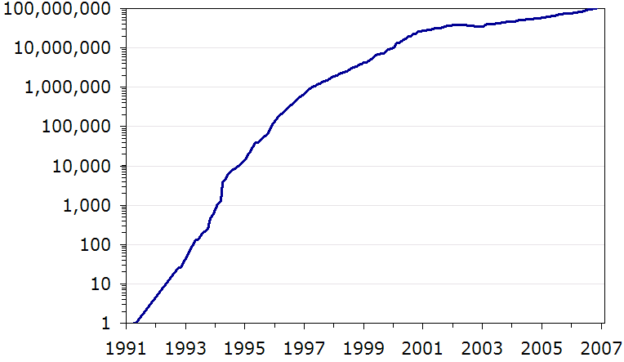
Web Growth
Nielsen, J. (2006) 100 Million Websites, Alertbox.
http://www.useit.com/alertbox/web-growth.html

Slide 70
What is (was) the Web?
The idea of a boundless information world in which all items have a reference by which they can be retrieved - address system (URIs)
A network protocol to fetch addressed items - (HTTP)
A mark-up language (HTML) which every client must understand how to render - and which can contain hotlinks to given addresses

