Slide 1
What is science?

Slide 2
What is science?
Formal
Systematic
Rigorous
Empirical (based on observation not personal opinion)
Consistent
Proven knowledge

Slide 3
(the) Scientific Revolution
16 & 17thC (note earlier Islamic revolution)
Renaissance
…Enlightenment
Copernicus, Galileo, Newton, Harvey
    earth revolves around the sun
    laws of motion, gravity
    blood circulates around arteries and veins

Slide 4
Scientific attitude
  Direct observation (empiricism)
  Demarcation (break with natural law, testing)
  Reject idealism (Plato – senses are illusory)
  Reject essentialism (Aristotle –things have essence that explains what they do)
  Causality (laws)
  Idea of progress

Slide 5
Logical positivism/ logical empiricism
Empiricism (observation/experience as the basis of knowledge - verificationism)
plus
Rationalism (mathematics, logic, reason)
Note: Comte defined positivism – a philosophy of science which encompasses scientific method (observe, measure, test)

Slide 6
Induction
Move from singular statements (x occurred at time y) to universal statements (encompass all events at all times)
allows us to generalise from singular to universal law (provided we have enough observations under a variety of conditions)
Deduction allows us to move from law/theory to prediction and explanation

Slide 7
The problem of induction
Hume (how do we know n+1 will happen)
Wittgenstein (the problem of sameness: how do we know that n+1 is really the same as n)

Slide 8


Bertrand Russell’s inductivist turkey

Slide 9
Falsification (Popper)
an alternative to inductivism
Science makes definite claims about the world
Science = hypotheses in search of falsification (e.g. looking for the black swan)
Science progresses by trial and error (test hypotheses, and eliminate those we reject, refine/make new hypotheses)

Slide 10

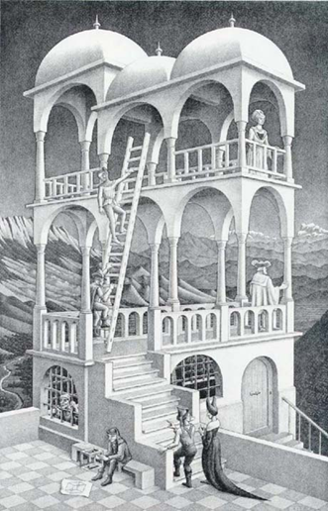
What do you see?

Slide 11
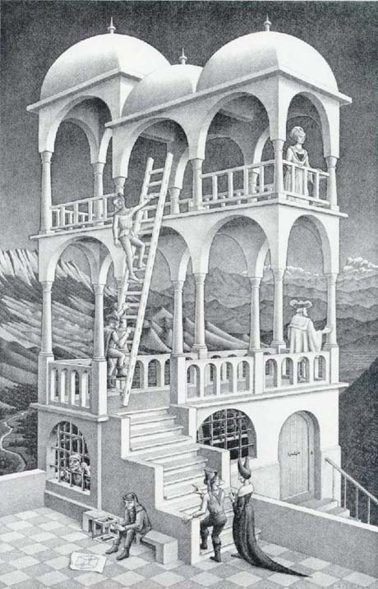

The problem of observation
Seeing is meaning making not just optic nerve response (fallibility of observation)
Observation is theory dependent
  Concept (e.g. count crime)
  Hypothesis (direction of causality?)
  Value (what is important)
  Interests (economic benefit?)
  Cultural specificity (belief systems)

Slide 12
Lakatos: Proofs and Refutations (1976)
challenges falsification/Popper
theory is really a series of slightly different theories and techniques that develop over time – around a ‘hard core’ of shared common ideas (research programmes)
Hard core protected from falsification – we simply resolve inconsistencies (CERN speed of light story?)
Positive heuristic – methodological rules for the kind of science you should do, paths to follow etc.

Slide 13
Kuhn: Scientific Revolutions (1962)
challenges inductivism – science as a social activity
Normal (mature) science = theories and techniques structured into a single shared paradigm (typically contains explicit laws, standard applications, measures and techniques)
Science as puzzle solving within the paradigm
Encounters crisis (falsification it cannot reconcile, anomalies that cannot be explained )
Rival paradigm ‘appears’ and we abandon the old and adopt new paradigm (which in turn becomes normal science)

Slide 14
argues that scientific revolutions are necessary
periods of normal science allow puzzle solving to go on (if scientists were permanently critical nothing would get done)
revolution necessary to progress

Slide 15
Merton: Functionalism (1957)
Science = an institution that serves a social function
Norms – particular behaviours are promoted and rewarded
  Universalism: truths hold independent of teller
  Communism: common ownership of knowledge
  Disinterestedness: report what(ever) you find
  Organised scepticism: disbelieve until established

Slide 16
Feyerabrand Against Method (1975)
‘anarchist’ view of science
“all methodologies have their limitations and the only rule that survives is ‘anything goes’” (actually not ‘anything’, but you don’t have to be steeped in current methodology)
Incommensurability: meaning depends on context (quantum and classical mechanics coexist and have to be interpreted in their own terms)
Science is not superior knowledge
Embrace freedom (from methodological constraints of ‘petrified science’)

Slide 17
Some of the other ‘isms’
Scientism: rejection of logical positivism
Objectivism : knowledge ‘out there’ vs ‘what I know’ (individualism)
Realism: science aims for truth/ tells us what the world is really like vs relativism (multiple possible truths)

Slide 18
Social studies of science and technology
Who are scientists?
Social context(s)
Social construction
Actor networks

Slide 19
Invisible colleges
scientific elites (the people who really matter – the prolific, the prize-winners)
Do prestigious institutions attract more productive staff?
Feminist critique
  leaky pipeline
  sexism in science
  standpoint theory – feminist privileged perspective on gender relations (in science and technology)

Slide 20
Bloor: The Strong Programme (1976)
a (relativist) sociology of science
Science created from social context/interests
  what are the conditions that bring about knowledge claims (causality)
  Failed/successful knowledge claims are equal (impartiality)
  We can use the same explanations for success or failure (symmetry)
  We should apply the same ideas to thinking about sociology (reflexivity)

Slide 21
What about technology?
Is it just the application of science (move from basic to applied science)
Or science determines technology (the technology we have is only limited by the bounds of our scientific methods and knowledge)
Or is technology the application of science in the service of power (Heidegger)

