Slide 1
Recap
Social construction of technology
  technologies are created (conditioned) by social factors
  they are the outcome of social processes
Technological shaping of society (determinism)
  technologies shape the social (c.f. Susan Greenfield )
  technological change follows a fixed, linear path (determined by technological ‘logic’ / economic laws)

Slide 2
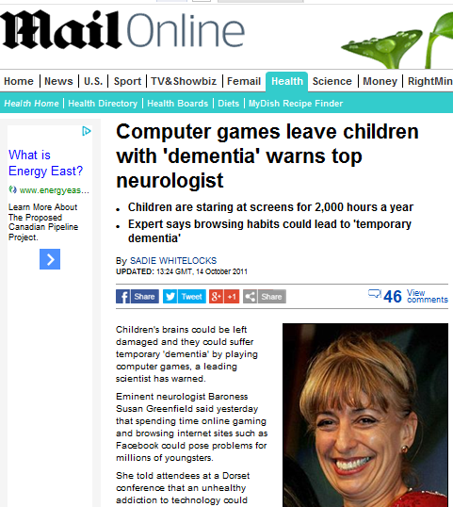
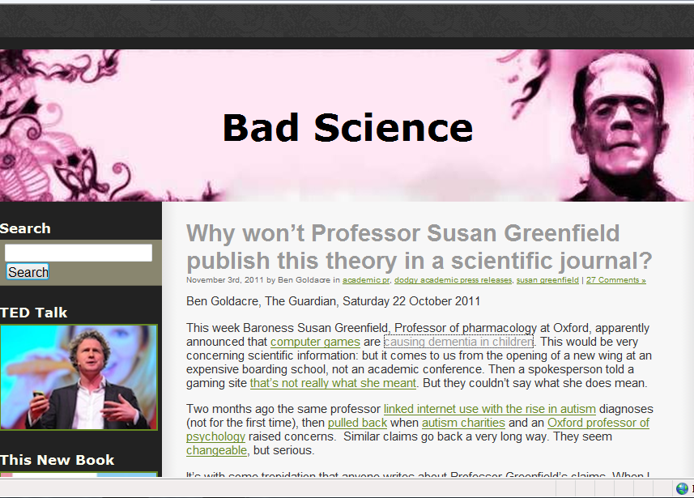

Slide 3
Pre-modern
Modernity
Post modernity

Slide 4
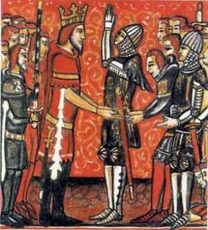
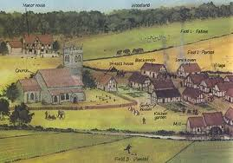
Pre-modern
Traditional (agrarian/feudal)
Pre-ordained position
Natural (Divine) law
Natural and ‘man-made’ are the same

Slide 5

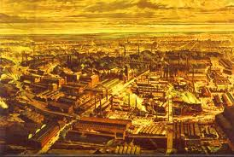
Modernity
Capitalist (industrial)
Social order (division of labour) is socially created
Nature/society and nature/science are distinct

Slide 6
Technology and Modernity
Technology made modernity possible
Modernity and technology = “tangled”
Reference: Misa T, Brey P, Feenberg A. (eds) Modernity and Technology. MIT Press, 2003
‘Information society’ is the product of ‘information technology’

Slide 7

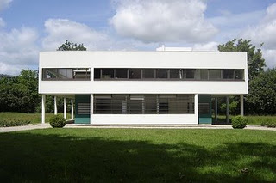
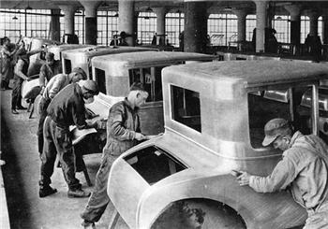
Modernity – cultural shift
Art (reject realism)
Architecture (e.g. Le Corbusier)
Production (e.g. model T)

Slide 8
Renaissance
C12th (medieval renaissance)
C15/16^{th ‘}bridge to modernity’
  Humanism (resurgence of the classics, rhetoric, dissemination, political citizenry)
  Art (da Vinci, Michelangelo… perspective & light)
  Science (reason and evidence, questioning)
  Religion (reformation, challenge to Catholicism)
  Technology (windmills, spinning wheels, Arabic numbers)

Slide 9
Enlightenment
C18th : philosophy, maths (Spinoza, Locke, Newton…)
‘emancipation from ignorance’ (Kant)
Emergence of civil society/public sphere
  Democracy (equality, freedom)
  Literacy (debate, critique and discussion)
  Question religious/monarchical authority
Reason / science & rationality
‘progress’ / Industrial revolution

Slide 10
Industrial revolution
Mechanisation
  Technologies (e.g. textile, mining, steam engine)
Population growth
Urbanisation
Productivity increases -> Trade expansion

Slide 11
Scientific attitude
  Direct observation (empiricism)
  Demarcation (break with natural law, testing)
  Reject idealism (Plato) and essentialism (Aristotle)
  Causality (laws)
  Idea of progress

Slide 12
Impact
Economic complexity/inter-related institutions and phenomena
Rise of democracy and nation state
We can transform the world (science is central to this)

Slide 13
Theorising modernity
  Modernity as a way of organising social life
  Weber (rationalisation)
  Marx (changed economic structure – new productive power relations - capitalism)
  Giddens (dynamism and globalisation)
  Beck (reflexive – dealing with risk)
  Castells (networked society)

Slide 14
Weber
Rationalisation is the key to modernity
  Technological
  standardization of knowledge and production
  Rational calculation (e.g. of profit)
  Administrative order (bureaucracy, division of labour)
  Modernity as liberating (progress, reason, freedom) but also the “iron cage” of modern bureaucratic organizational forms

Slide 15
Marx
Shared Weber’s view of rationalisation and technological progress
“The hand-mill gives you society with the feudal lord; the steam-mill society with the industrial capitalist.” (1847)
but also saw the ‘dark side’ to modernity - technological and market alienation (in labour process and from the result/product of labour)
the culture of the working class produced by technology

Slide 16
Giddens
Modernity resting on 4 institutions: industrialism, capitalism, surveillance, military.
Key features
  Separation of time and space,
  Disembedding of social life (e.g. timetables, money)
  Reflexive appropriation of knowledge

Slide 17
Beck
simple modernization = the transformation of agrarian society into industrial society.
(late) modernity = reflexive modernization -modern society confronts itself with the negative consequences of simple modernization; less about distribution of goods – more about distribution of risks.

Slide 18
Castells
information age = economic organization via the network (subjects and organizations) continually modified and adapting to (market) environments
opposition (and new forms of social struggle) between
  the Net (abstract universalism of global networks)
  and
  the Self (strategies for people to affirm their identities)

Slide 19
Studies of the history of technology
Focus on how a technology (e.g. PC) evolved and reflects the contexts in which it is developed/used.
Often
Time specific (e.g. focus on a particular development stage)
Space specific (e.g. in a geographical area).
Look at
organizational, policy, and legal context
actors, groups, organizations (e.g. engineers, industry, govt)
discourses
behaviours

Slide 20
Social Studies of Technology
Focus on context in which technologies are developed (e.g. laboratory life)
next few lectures explore these ideas

Slide 21
Both SST and historically focussed perspectives assume that technology is socially shaped
But
society also shaped by technology

Slide 22
Technology … Modernity
Technology as the driver of modernity
Institutions and culture of modernity are not just shaped or influenced by technology, they are also constituted by it.
BUT
technology is seldom discussed/central in theories of modernity.

Slide 23
Why is this ?
Technology…
  as ‘background’ (as catalyst or means by which modern institution operates (e.g. military) ;
  Is un(der)specified and vague; it’s part of phenomena under study (e.g. for Weber it’s is part of rationalisation, for Marx it enables new productive forces) but not discussed in detail
  Essentialism & reification - technology has fixed, context-independent properties that apply to all technologies; autonomous force.

Slide 24
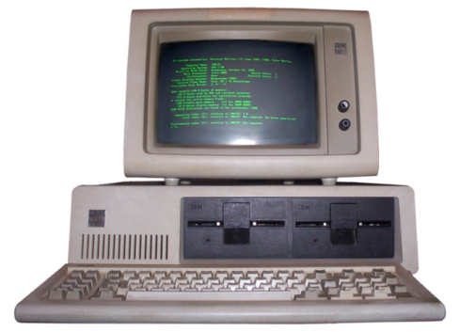
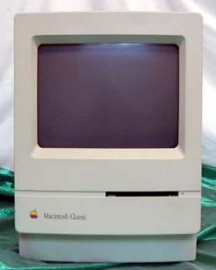
Using modernism and post modernism to understand computer technologies
Sherry Turkle (1995) Life on the Screen: Identity in the Age of the Internet - Explores rival computer design in mid-1990s
IBM-DOS PC users = modernist : wanted detailed understanding and control over (by typing inscrutable computer codes at the “command line”) and liked operational transparency and conceptual openness.
Apple Mac users used postmodernist images to describe their relationship to their machines - factory sealed beige boxes (+ a special factory tool to open them) which discouraged reductive understanding and detailed control. They surfed the conceptual “surface” of their machines with mouse clicks, windows, and icons.

Slide 25
Surveillance in modern society
Lyon D. (2003) in Misa et al (eds) Modernity & Technology.
Modernity characterised by surveillance (practices and technologies)
  technological developments: information infrastructures (surveillance networks) trigger surveillance (e.g. cross checking, verification)
  proliferation of surveillance data flows between networks
  surveillance practices (e.g. police broker information for insurers industry) to manage risks (e.g. predict terrorism)
  mutual shaping / amplified modernity via digital technology and consumerism -> postmodernity)

Slide 26
Miller D, Slater D (2000) The Internet: An Ethnographic Approach. Oxford: Berg
ethnographic study of fast adoption of internet in Trinidad demonstrates that the concepts of "modernity" and "technology" are context-dependent rather than global
"the context of a technology is also partly a consequence of that technology“

Slide 27
We need to bridge the gap between technology and modernity

Slide 28
Technologies interact deeply with society and culture, but the interactions involve mutual influence, substantial uncertainty, and historical ambiguity, eliciting resistance, accommodation, acceptance, and even enthusiasm. In an effort to capture these fluid relations, we adopt the notion of co-construction.
Misa TJ. Modernity and Technology. 2003:3

