Slide 1
Making Links
Fundamentals of
Hypertext and Hypermedia
Dr Nicholas Gibbins - nmg@ecs.soton.ac.uk
2012-2013

Slide 2
Overview
Basic hypertext terminology
Hypertext writing
History of hypertext
Open hypermedia
Spatial/temporal/conceptual hypermedia
The future of hypertext

Slide 3
What is hypertext?

Slide 4
What is Hypertext?
Nelson, T.H. (1965) A file structure for the complex, the changing and the indeterminate.
Proceedings of the 20th ACM National Conference..

Slide 5

What is Hypertext?
[hypertext is] a combination of natural language text with the computer’s capacity for branching, or dynamic display
Nelson, T.H. (1967) "Getting it out of our system": Information Retrieval: A Critical
Review, Schechter, G. (ed.). Washington, DC: Thompson Books.

Slide 6
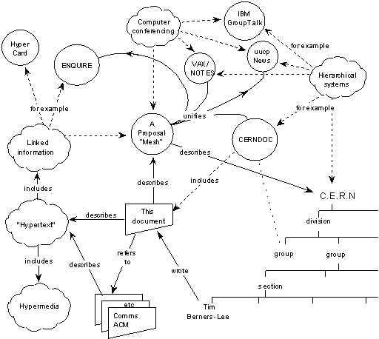
What is Hypertext?

Slide 7
What is Hypertext?
The reaction of the hypertext research community to the World Wide Web is like finding out that you have a fully grown child.
And it’s a delinquent.
Nelson, T.H. (1997) After-dinner speech at Hypertext ‘97, Southampton, UK.

Slide 8
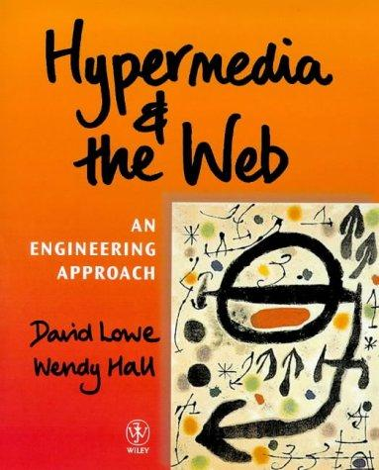
What is Hypertext?
“An application which uses associative relationships among information contained within multiple media data for the purpose of facilitating access to, and manipulation of, the information encapsulated by the data.”
Lowe, D and Hall, W. (1999) Hypermedia and the Web: An Engineering Approach.
Chichester, UK: John Wiley.

Slide 9
What is Hypertext?
Non-linear writing
  Interlinked texts
  Multiple pathways, multiple reading sequences
Annotation and commentary
Association of ideas
Writing and reading not separated
Interactive
Notes:
Associative relationships, Non-linearity, networks
Not flat, linear presentation of information, read sequentially
but a network of nodes connected by links
Author creates connections and (perhaps) the nodes,
but reader interactively follows own trail in preferred order and to depth of detail desired,
... and makes new connections?
Contrast paper documents - sequential reading.
Exceptions
Encyclopaedias?

Slide 10
What is Hypermedia?
Hypertext + Multimedia = Hypermedia
  Multiple media: video, audio, images, emails, databases, spreadsheets

Slide 11
Hypertext terminology

Slide 12
Nodes, Links and Anchors
A node represents a ‘chunk’ of information that corresponds to a natural ‘semantic unit’
  e.g. screen, page, frame …
  The act of chunking information is part of authoring process
Notes:
Nodes:
Should not be too long
One/multiple nodes on screen?
Composite (virtual) nodes ... a research question
can a node stand for a sub-hyperspace of nodes and links?

Slide 13
Nodes, Links and Anchors
A link represents an association between nodes
  Machine-supported fast
  inter-node connections
Notes:
Nodes:
Should not be too long
One/multiple nodes on screen?
Composite (virtual) nodes ... a research question
can a node stand for a sub-hyperspace of nodes and links?

Slide 14
Nodes, Links and Anchors
An anchor represents a link on a node
  e.g. buttons, bolded text, “hotspots”, images …
  the whole node might be an anchor but should be able to designate a sub-region as a source or destination of a link
Notes:
Nodes:
Should not be too long
One/multiple nodes on screen?
Composite (virtual) nodes ... a research question
can a node stand for a sub-hyperspace of nodes and links?

Slide 15
Links on the Web
Links are part of the source node
  <a href=“”>
  Embedded links (c.f. first class links)
Links can only be followed in the forward direction
Links can only connect a pair of nodes
Link anchors must be specified explicitly
Links (usually) contain no additional information

Slide 16
Embedded vs. First class links
Links are embedded in web pages
To create a link from a web page, the web page must be edited
Only the owner of a web page may create/edit links within it
Separating links from nodes allows richer linking
  Multiple different link overlays (linkbases)
  Personalisation, task-orientation, etc

Slide 17
Bidirectional links
Not generally possible to see what links to a given web page (without using a global index such as Google)
Web links can only be followed from the source document (in which the link is embedded) to the destination, not the other way
Separating links from nodes means that it is as easy to traverse links backwards as forwards

Slide 18
N-ary links
Web links connect only two documents together
With first class links, we can have links that connect many source nodes to many destination nodes

Slide 19
Generic (functional, dynamic) links
Web links have explicitly specified anchors
  Source anchor is the location in which the <a> is embedded
  Destination anchor is given by the fragment identifier on the URI reference: http://example.org/index.html#foo
Richer location specifiers (locspecs) in anchors
  Put a link on all occurrences of the word ‘hypertext’

Slide 20
Typed links
Web links may contain some additional information
  <a href=“” rel=“” rev=“”>
  In practice, most Web authors don’t use rel/rev
  In practice, most Web browsers ignore rel/rev
Links are more than just navigation – underlying associative relationship

