Slide 1
An Introduction to Learning Technology
Hugh Davis:
@HughDavis
April 2013

Slide 2
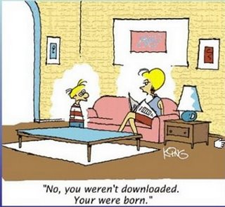
How is the Web Changing the World?
What we learn?
How we learn?
What learning is?

Slide 3
What its all about
Enhancement
(Improving Learning)
Scale
(Universities will only get bigger)
Flexibility
(Any time, any place learning)

Slide 4
What keeps me awake at night?
On–line learning strategy
MOOCs
Videoing lectures
Flipped classroom
Objective assessment
Feedback
e-Assignment
What’s the right VLE
eResources – which ones and where should we keep them
Gameification
Mobile apps
Social networking/learning
Informal learning
Digital literacies
Learning and engagement analytics

Slide 5
What is the study of Learning Technology?
How to implement and successfully deploy technologies to assist with my problems
Some of the same old problems will apply –
Engineering design principles
Standards
Evaluation
Human Factors
Who pays?

Slide 6
Why don’t we do it all using technology?
student expectations
staff beliefs
staff skills
money
course development methods
politics of sharing / re-use

