Slide 1
CINAHL Keyword Searching
Notes:
Finding enough information for your assignments can be hard enough, ensuring that it is the right sort of information makes it even tougher.
Doing a degree with the Faculty of Health Sciences means a steep change when it comes to information literacy skills. Learning what resources the University and NHS have that you can use, how to find them quickly and use them effectively are skills that you will be learning in the library sessions and using the online help available.
These transferable skills will equip you for your time here at the university and provide the next step up that you need to learn and produce academic work of an acceptable standard.

Slide 2
This presentation will take you through the procedure of finding reliable information which can be used in your academic work using a bibliographic database.

Slide 3
Bibliographic databases
Each database is produced by a different organisation and has a different emphasis; this means that you can choose which ones to use depending on what topic you are looking at.
They will not immediately give you the full-text of the article, but they do give you the references of articles so you will need to use one of the full-text links or the link to TDNet, our journal catalogue to see if the University buys the journal.
CINAHL is one of the best databases covering Health subjects and the one which we will be teaching you to use. Another useful database MEDLINE has the same interface.
Notes:
You use databases all the time, Amazon is a retail database as is Sainsbury’s, it is just a way of organising information to enable it to be repackaged; so you can buy from the store more easily.
Bibliographic databases organise information about articles, conferences and books so you can find the evidence base you need and read around your subject more easily.
The library buys lots of databases for you to use but you need to know the right ones to use and where to find them, it’s no good using a database which covers history if you want references about strokes!
The database we are going to use today to answer the question we will be using about “falls in the elderly” is called CINAHL, but first we have to give some thought as to what we are going to put into the database.

Slide 4
In order to search effectively:
You need a question and a search strategy
Can you write your question in one sentence?
Have you listed all the relevant terms/ideas to show you have really thought about your research project?
Notes:
If you want to buy a pair of jeans on the internet before you start searching you need to decide what style you want, what colour you want and what size etc. You use the same process when searching for journal references on a bibliographic database – it’s called creating a search strategy.
Start by looking at your assignment title or research topic and underline or highlight the key words or phrases.
Are there any alternative words or phrases which mean the same or are related to your basic term/s.
A good example is the word “teenager” What other ways are there to describe this? Write these down either in a mindmap or table.

Slide 5
Consider the following question:
“What research evidence is there to support the theory that exercise or exercise programmes help in the prevention of falls in the elderly?”
Notes:
You will be given assignments to do over the next three years that require you to show a evidence base of previous information. We are going to use this example as it covers very general topics which all of you will understand.

Slide 6
The key topics are obvious
“What research evidence is there to support the theory that exercise or exercise programmes help to prevent falls in the elderly?”
falls
elderly
exercise
prevention
But how else can these topics be described and do we need to include them all?
Notes:
Back to our example, it is pretty obvious what the key ideas are, the next thing we need to do is to think of some alternatives.

Slide 7
old
elderly
aged
trip
falls
accident
stumble
physical activity
exercise
work out
stop
prevent
avoid
Notes:
These are the alternatives we have thought of and this is going to be our basic search strategy for our question.

Slide 8
Search 1
fall*
or
trip*
or
accident*
8
Notes:
This is our search strategy for the topic “falls”, they all mean roughly the same thing - synonyms
What do the asterixes mean?
This is called Truncation, truncation provides us with additional flexibility in searching. It means that we can use the stem of the word, add an asterix the computer will then return multiple forms of a word.
For example:
child* will find child, children, childhood, etc.
Why have we combined them with OR? This is an example of a Boolean operator and it is a very powerful word for joining ideas together.
or is used to join synonyms together i.e. teenager or adolescent or young person or juvenile.
You will need to include both asterisks and Boolean operators in your search strategy

Slide 9
Search 2
elder*
or
old*
Notes:
This is our search strategy for the topic “elderly”
Notice that we have combined them with OR again.

Slide 10
Search 3
exercis*
or
activ*
10
Notes:
This is our search strategy for exercise.

Slide 11
Search 4
prevent*

Slide 12
To find them go to the library web pages:
www.soton.ac.uk/library
Notes:
Now we have our search strategy, what do we do with it?
We need to find the best bibliographic database to help us, and CINAHL is the best one to use as it is a general health related query.
So how do we find CINAHL, (Cumulative Index of Nursing and Allied Health Literature)?
Use the URL above to find the University Library webpages.

Slide 13
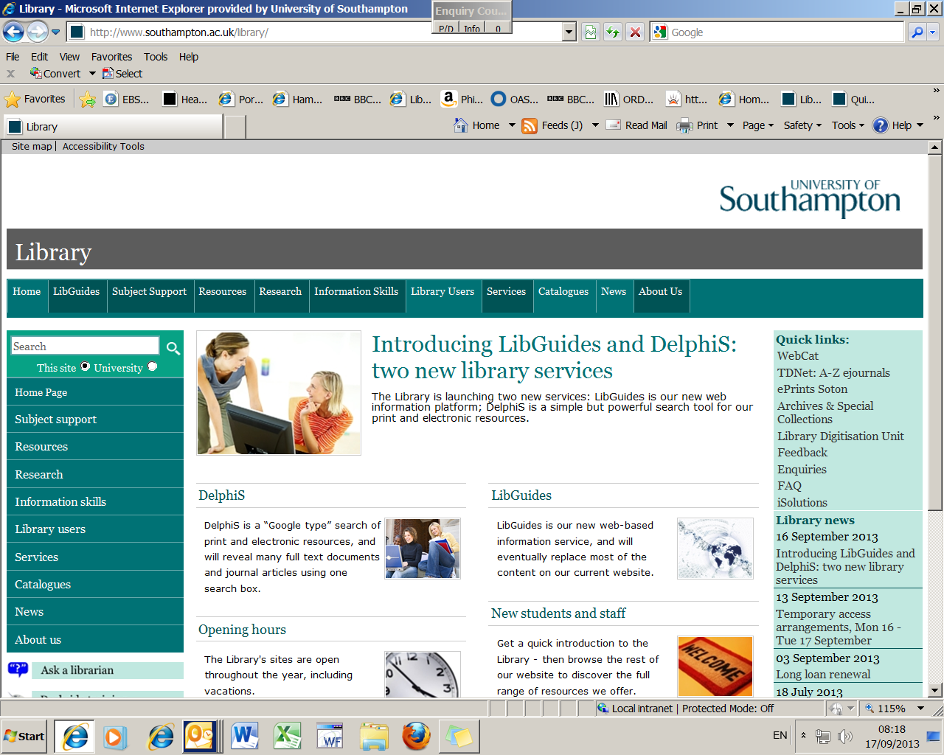
Notes:
Select the Subject support pages or if you are going in via Sussed, choose Library and then Subjects.

Slide 14
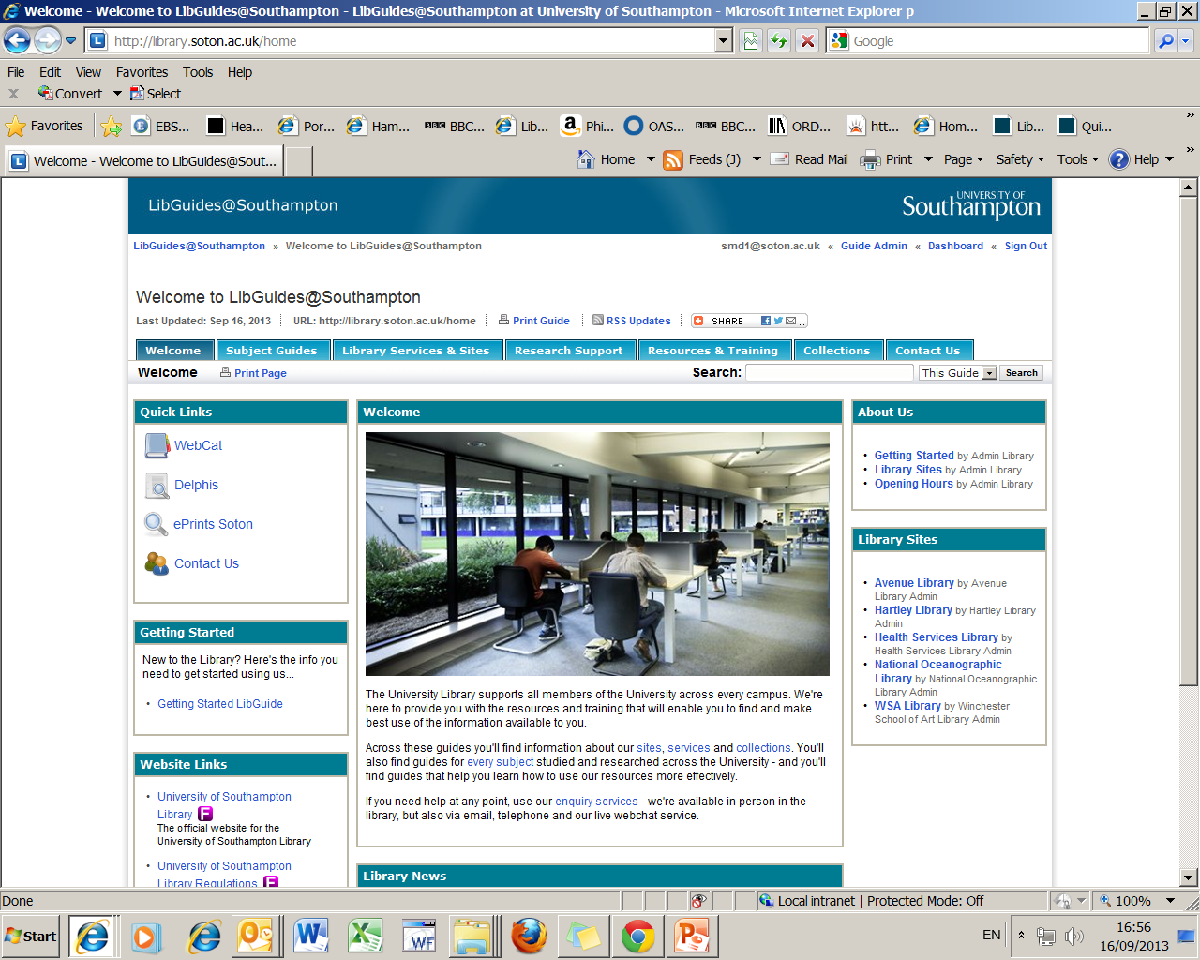

Slide 15
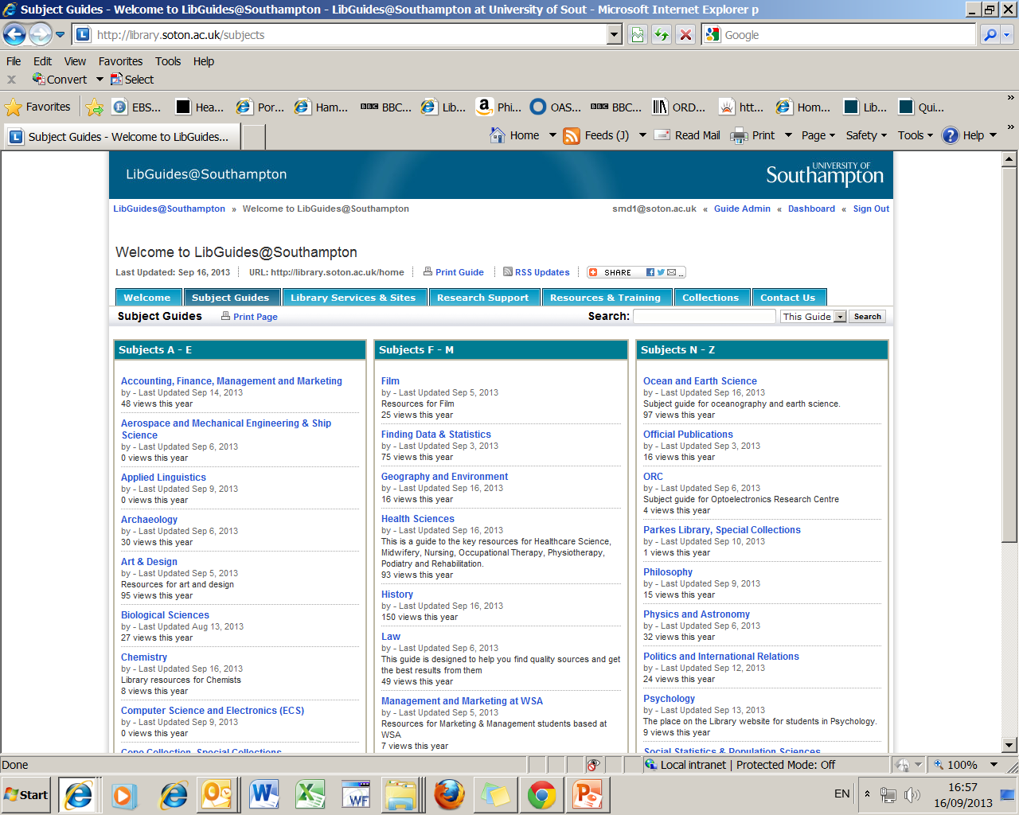
Select the relevant subject link
Notes:
Select the correct subject link – they all take you to the same place the library Health Sciences web pages

Slide 16
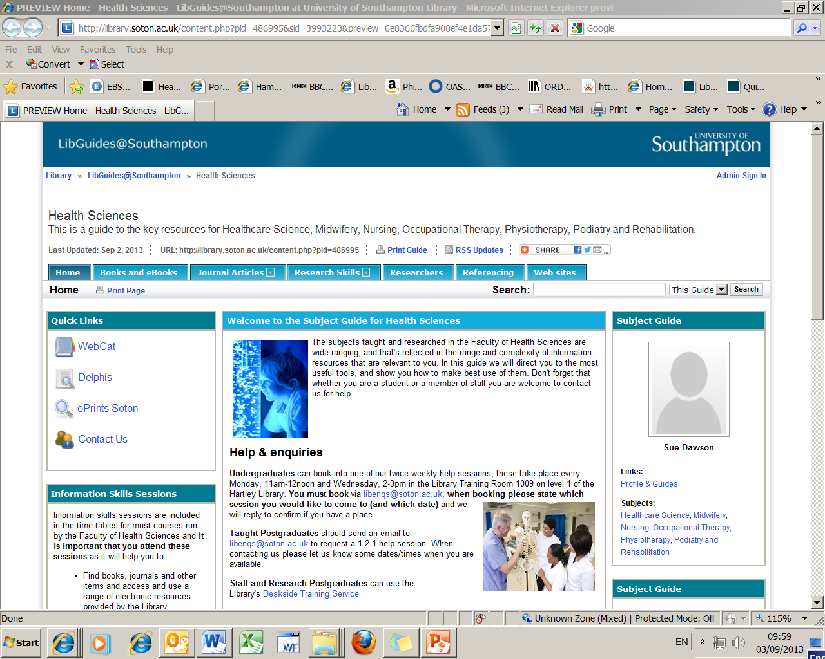
Scroll down to the Key Databases section
Notes:
There is a lot of information on this page, but for now we are just selecting Databases and Indexes

Slide 17
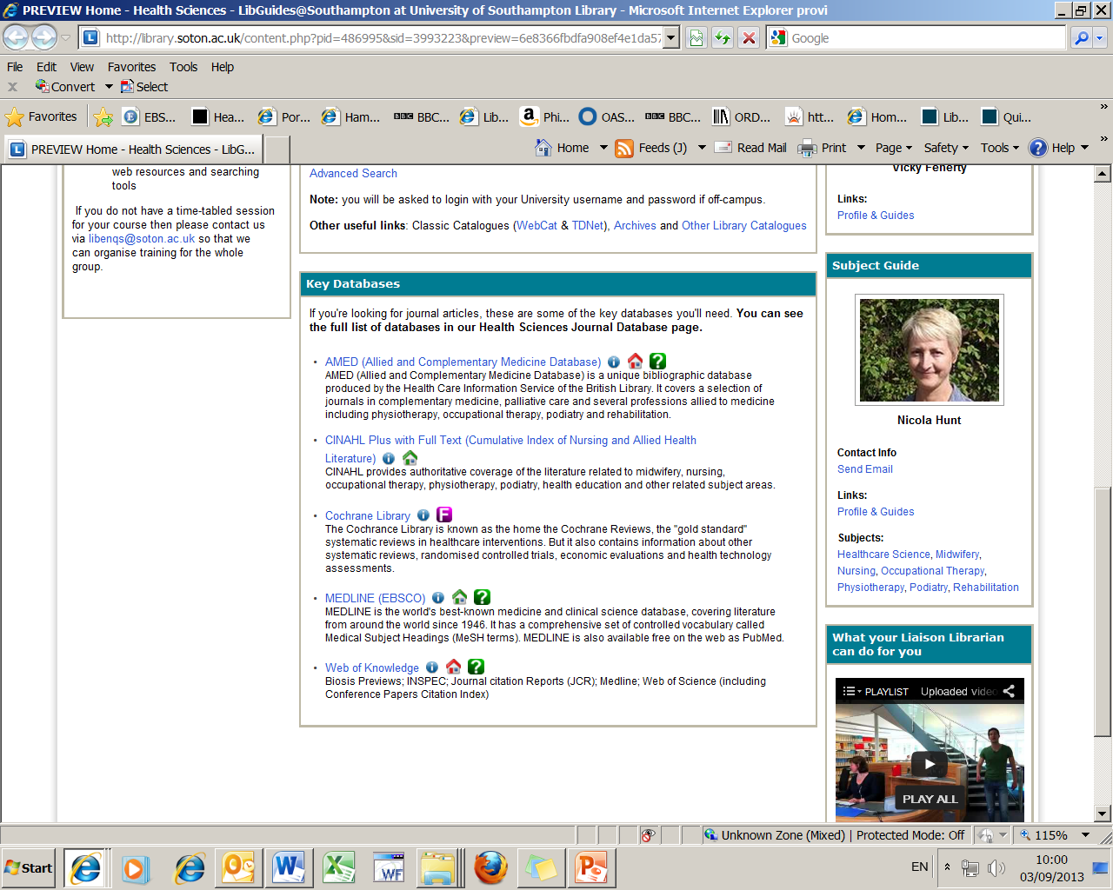
Don’t forget that there are other databases available
on our Journal Database tab at the top of this page
Link to CINAHL

Slide 18
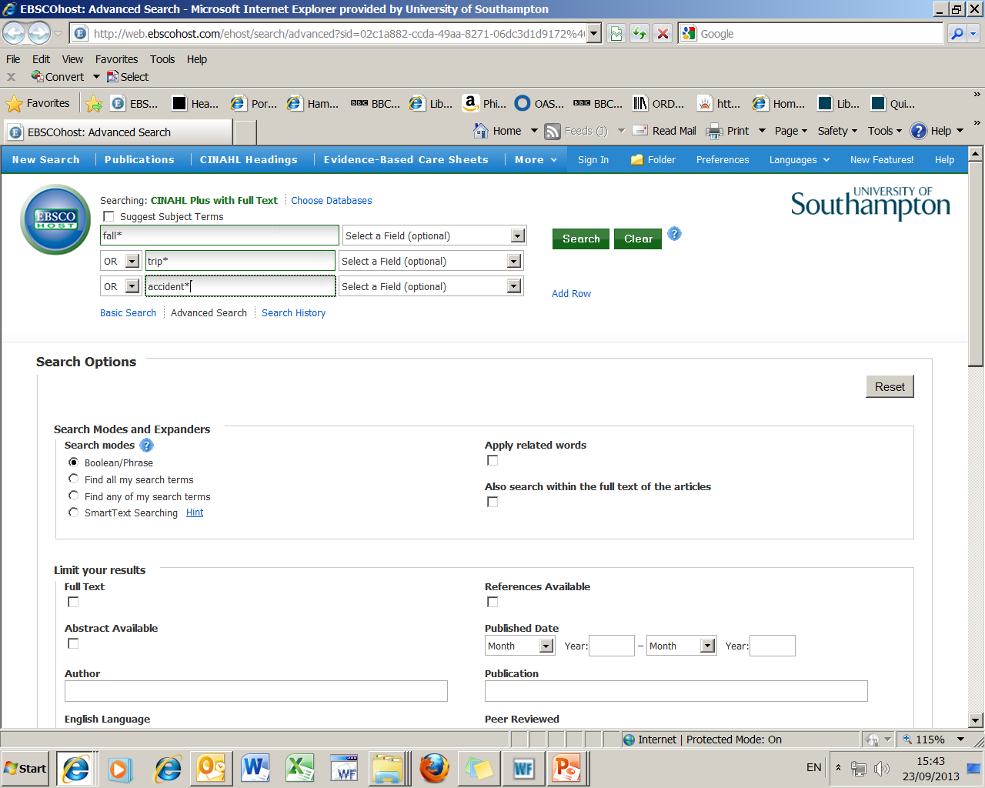
1. Enter your search term/s
3. Activate your search
2. Remember to change the drop-down
option from AND to OR
Notes:
Type in your search strategy and change the dropdown boxes to OR and don’t forget to include the asteriks. Then select the “Search” button on the right

Slide 19
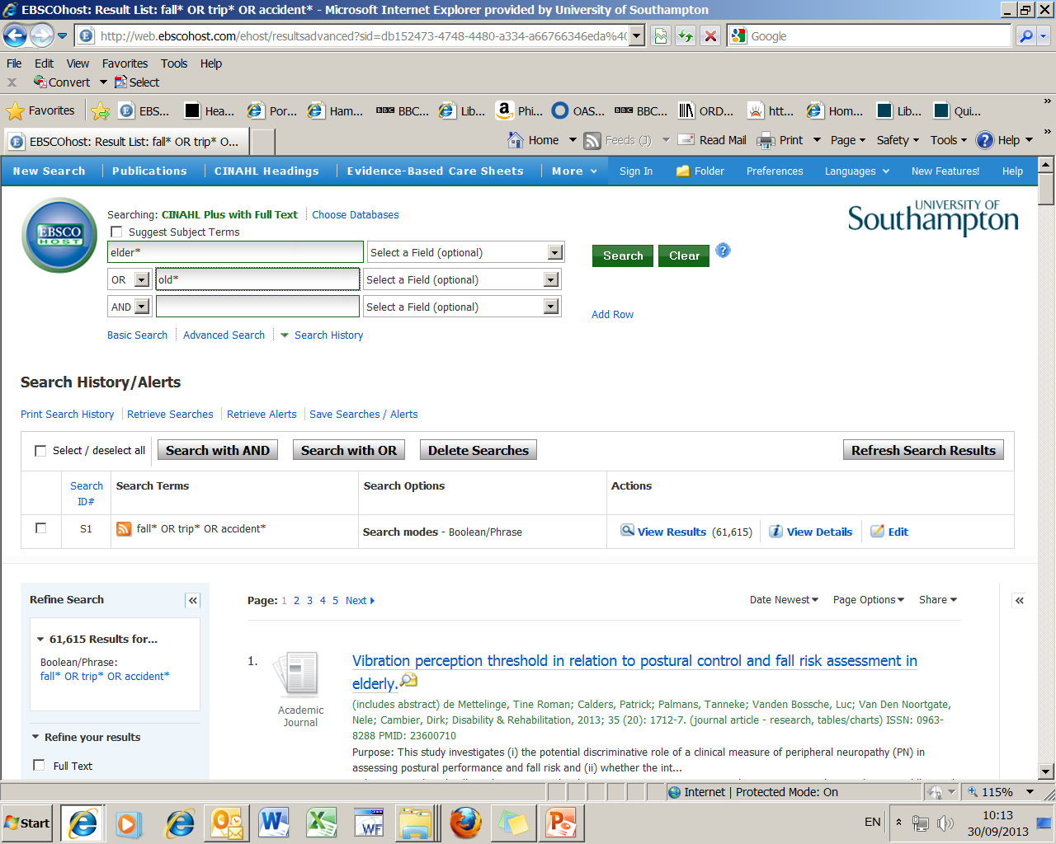
2. Enter next search term/s
4. Activate your search
3. Remember to change the
drop-down option from
AND to OR
1. Results of first search
Notes:
You can see that in this example we have found over 50,000 articles that have the words fall or falling or falls or trip or trips or tripping or tripped or accident or accidents or accidental or accidentally.
Once we have carried out our first search we need to start on the next search need to carry on with our next search for the term elderly, do the same process as we did before and select “Search” again

Slide 20
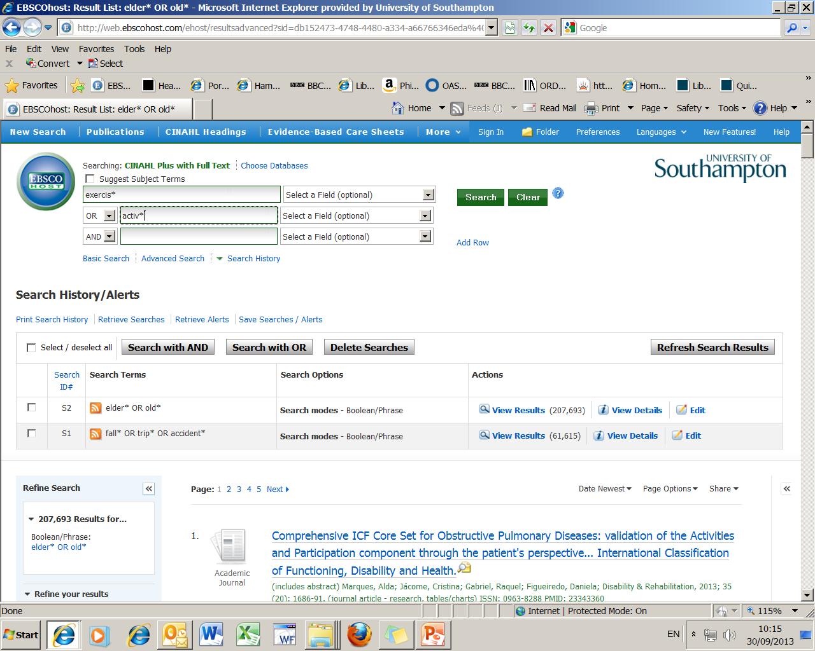
2. Enter the next set of
search term/s
4. Activate your search
3. Remember to change
the drop-down
option from AND to OR
1. Results of second search
Notes:
In our next search there are over 500 000 articles with the words - old or older or olds or elder or elderly or aged.
We now use our 3rd idea and write in our search strategy for exercise in the search boxes above and select “Search”

Slide 21
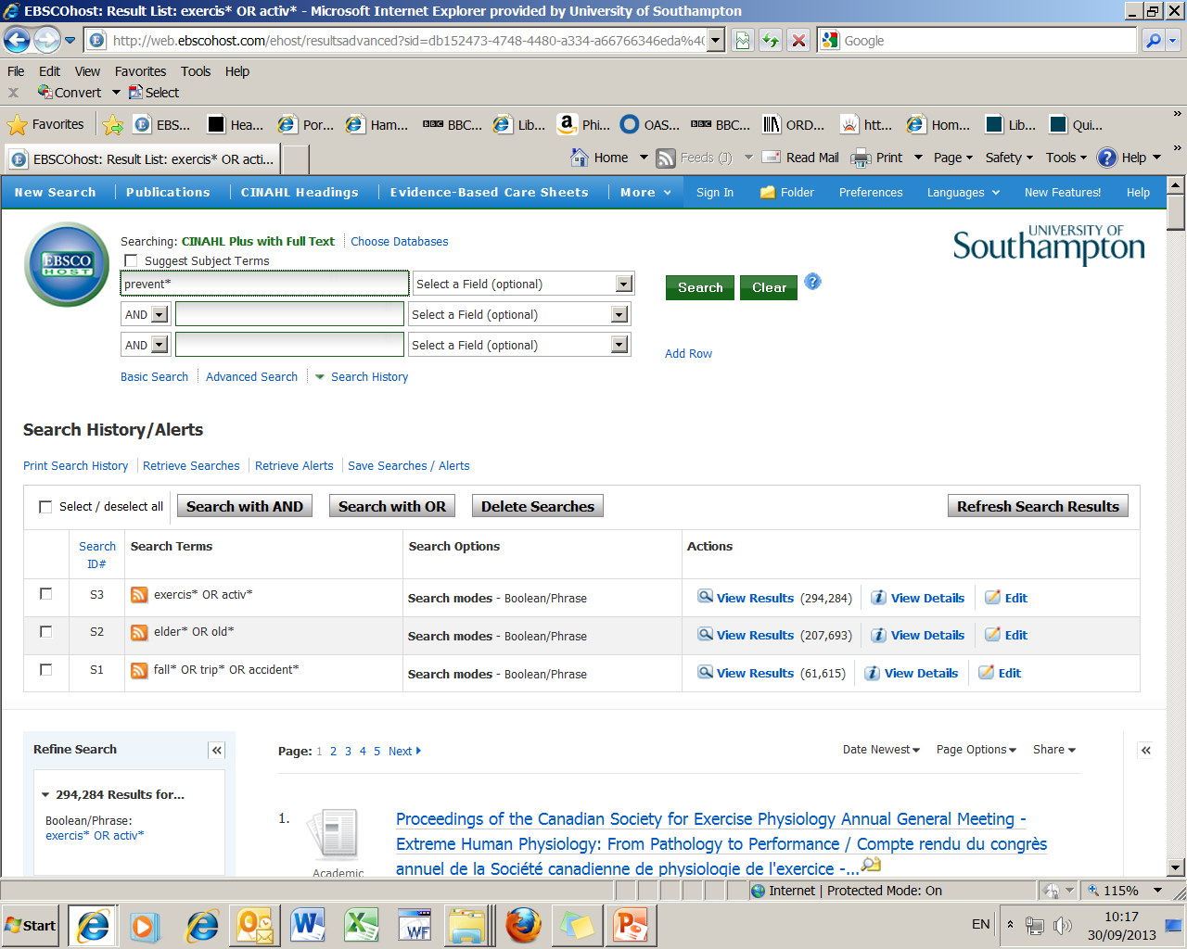
2. Enter the final
search term/s
3. Activate your search
1. Results of third search

Slide 22
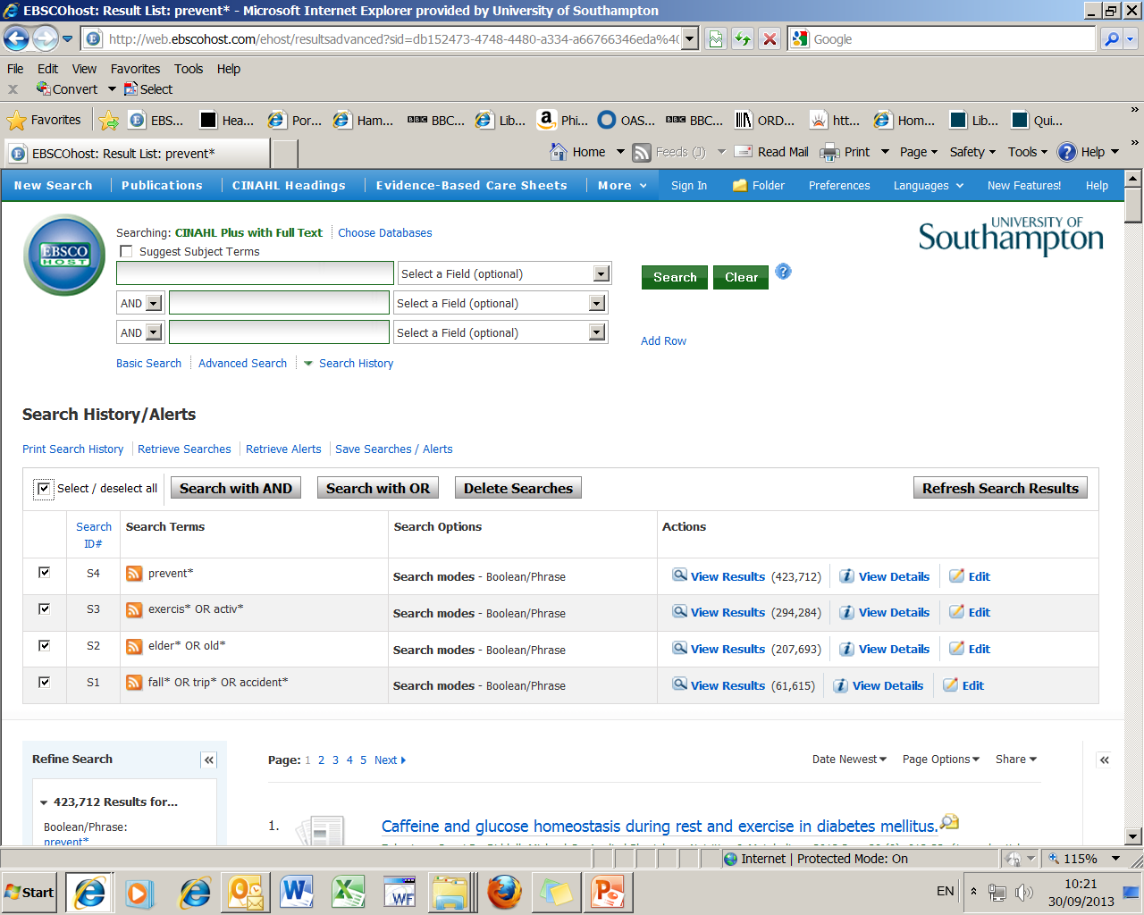
3. Then choose AND because we want
the results to include all the concepts
1. Results of final search
2. To combine searches
tick boxes
Notes:
We now have four searches completed, we now need to use another Boolean operator “and”, this is used to combine different concepts/subjects.
In our search, we want to find articles with all four of the ideas above so we have to tell the database what we want by selecting the searches on the far left and then “Searching with AND”

Slide 23
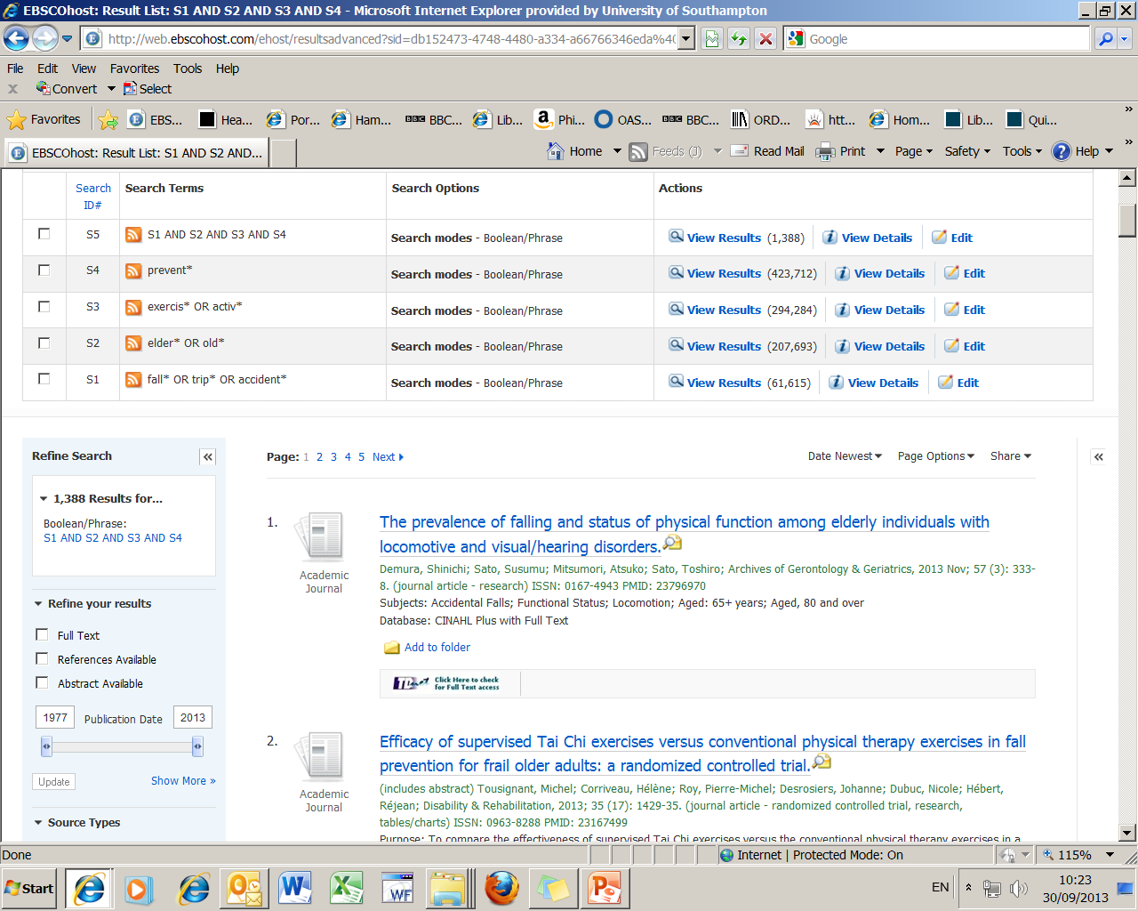
1. Result of the four combined searches
2. To reduce the number of results
use the Show More link
Notes:
We can see that by using “And” to combine our ideas together we have narrowed down our search but there are still too many to look at and we can narrow down this again by using some limits.
On the left there is small link “Show More” activating this link will show me all the types of limits I can apply

Slide 24
Refining (limiting) your search
You can choose limits such as:
Date of publication
Language
Age Group/s
Gender
Publication type i.e. journal
Journal subset i.e. English & Ireland journals

Slide 25
We will narrow our search:
1. By year of publication
2. Geographical Subset – Great Britain
3. Abstract available
4. English language

Slide 26
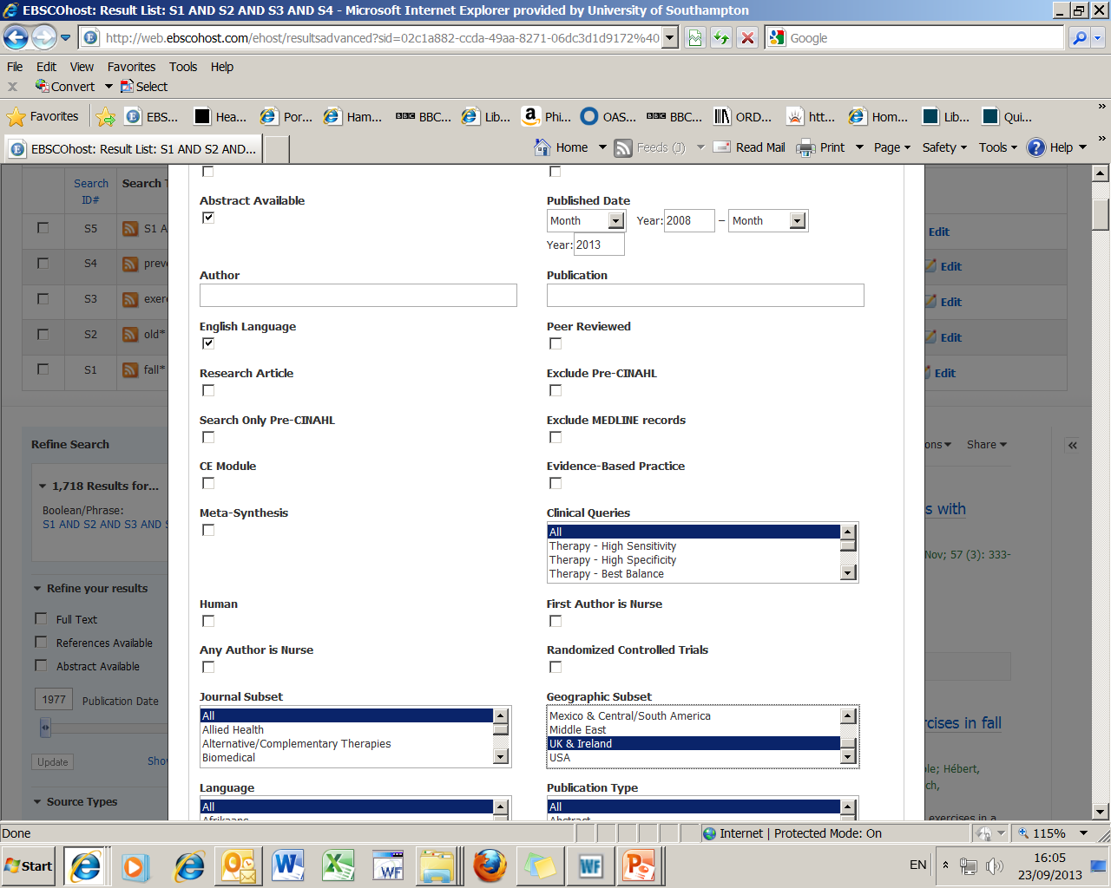
We will be using these
then activate the
button at the top
or bottom of the page
Notes:
You can select as many limits as you want, but be careful, if you select too many you can end up with no results at all.
Limiting your articles to the last 5 years is useful but you can go back further if you want to see how evidence has changed over time.
Research articles is a very useful limit too as you know from our search question that we need to write about research that has been done.

Slide 27
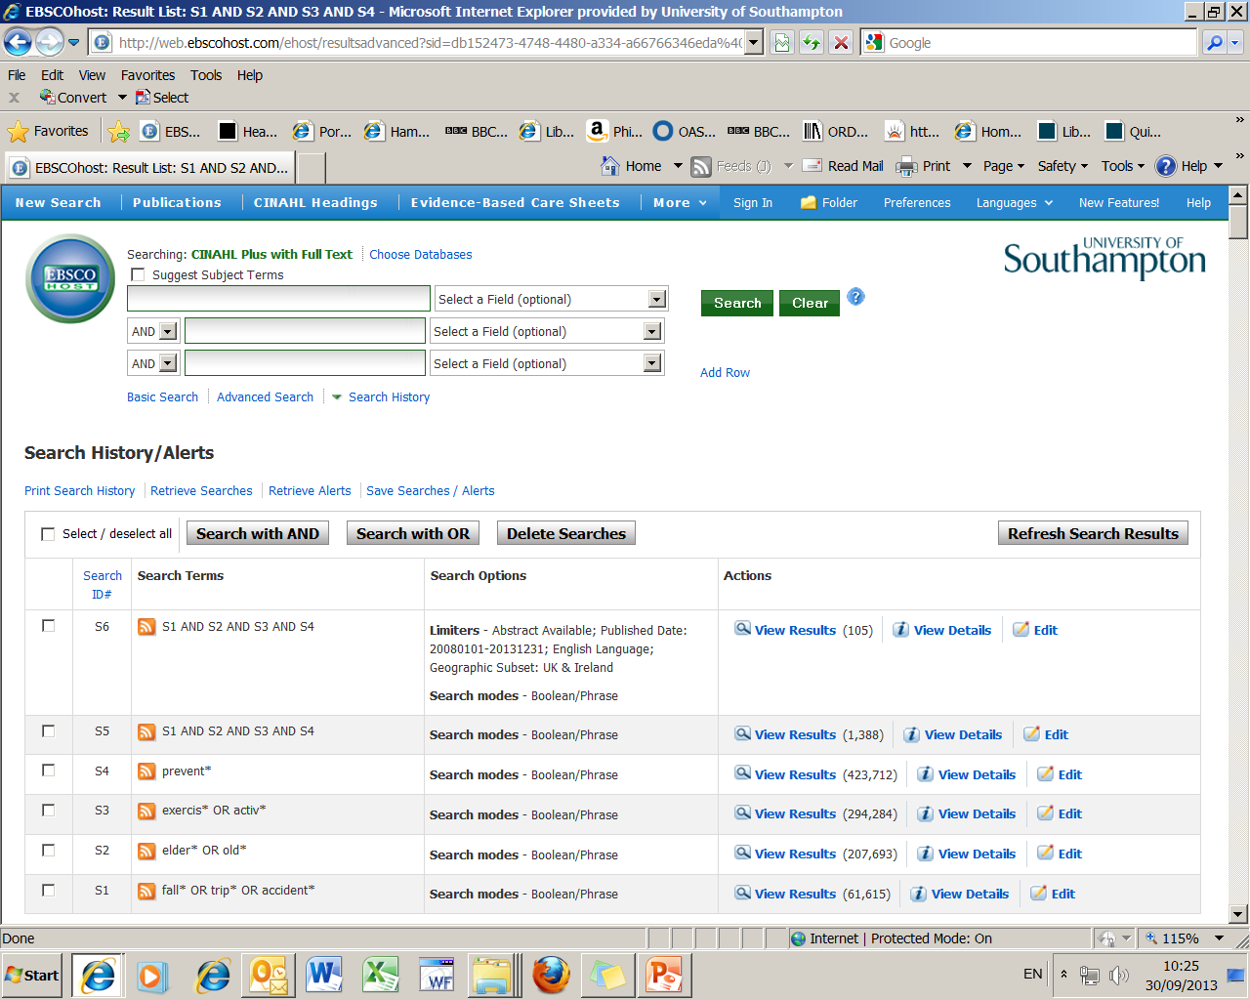
Final result
Notes:
We are now back at the Search History page and have narrowed down our results to 82 and hopefully as they are in date order we can find some relevant and timely articles to inform us about our original question.
“What research evidence is there to support the theory that exercise or exercise programmes help in the prevention of falls in the elderly?”
How do I look at these and what information do I need to keep?

Slide 29
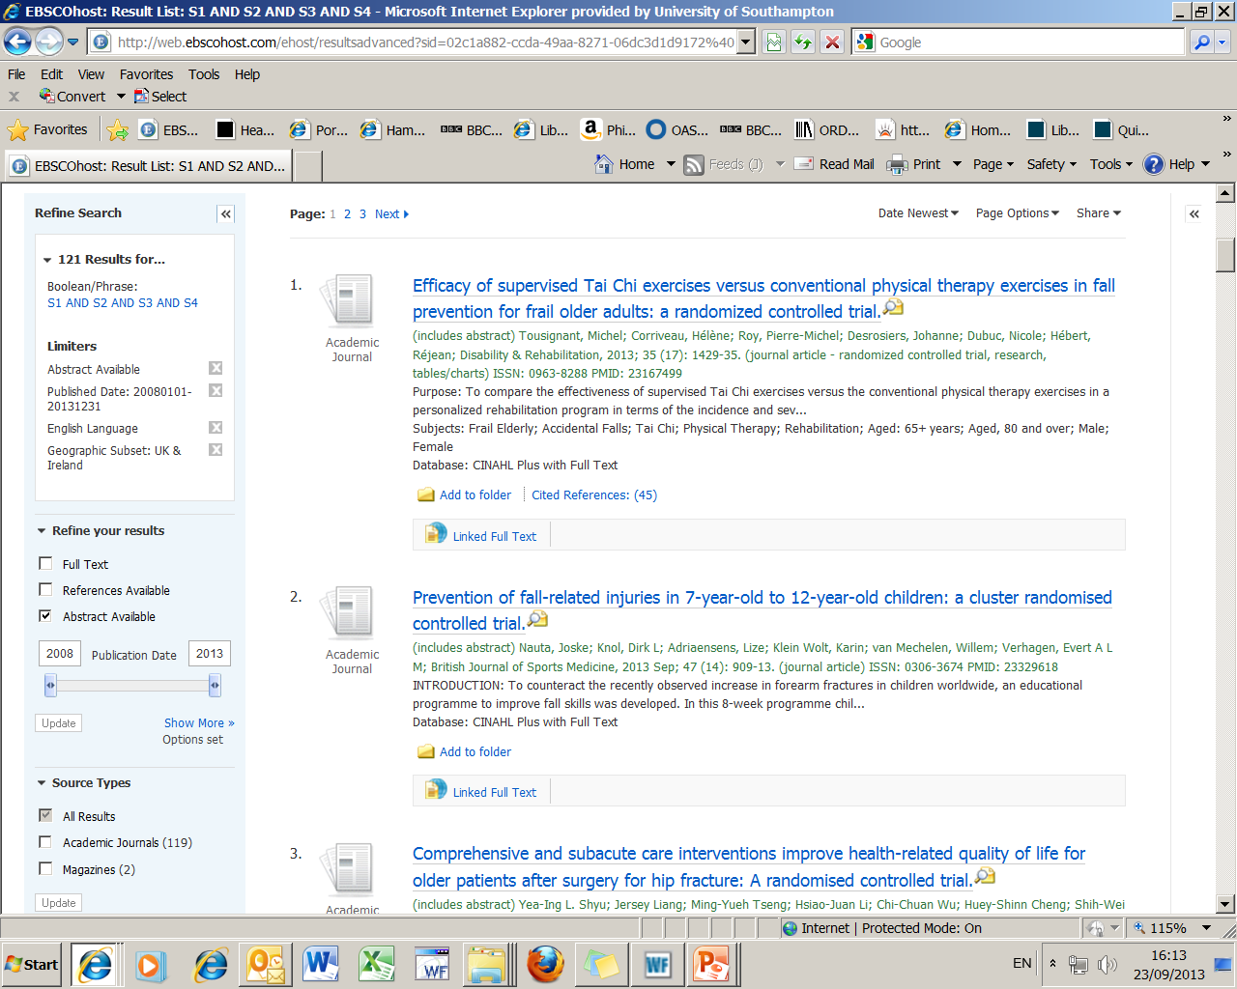
See full details of the reference by using this title link
If you just want to look at the abstract
hold mouse over magnifying glass
Notes:
If you scroll down the page, you will find the first set of results from the search.
The title of the article is in blue.
Next in green are the authors, the name of journal they published the article in, followed by the year, volume, issue no and pages. If you read any article and use it in your assignment, you must reference it and this is the information they will need.
In black is the beginning of the abstract which you can read in full by selecting the yellow magnifying glass icon after the title. This opens the abstract in a separate window so you can see what it is all about and judge whether it is appropriate for you.
If you decide that you would like to read the full article there are a number of options as this version of CINAHL does not automatically give you access to the whole of the article - we call this Full Text.

Slide 30
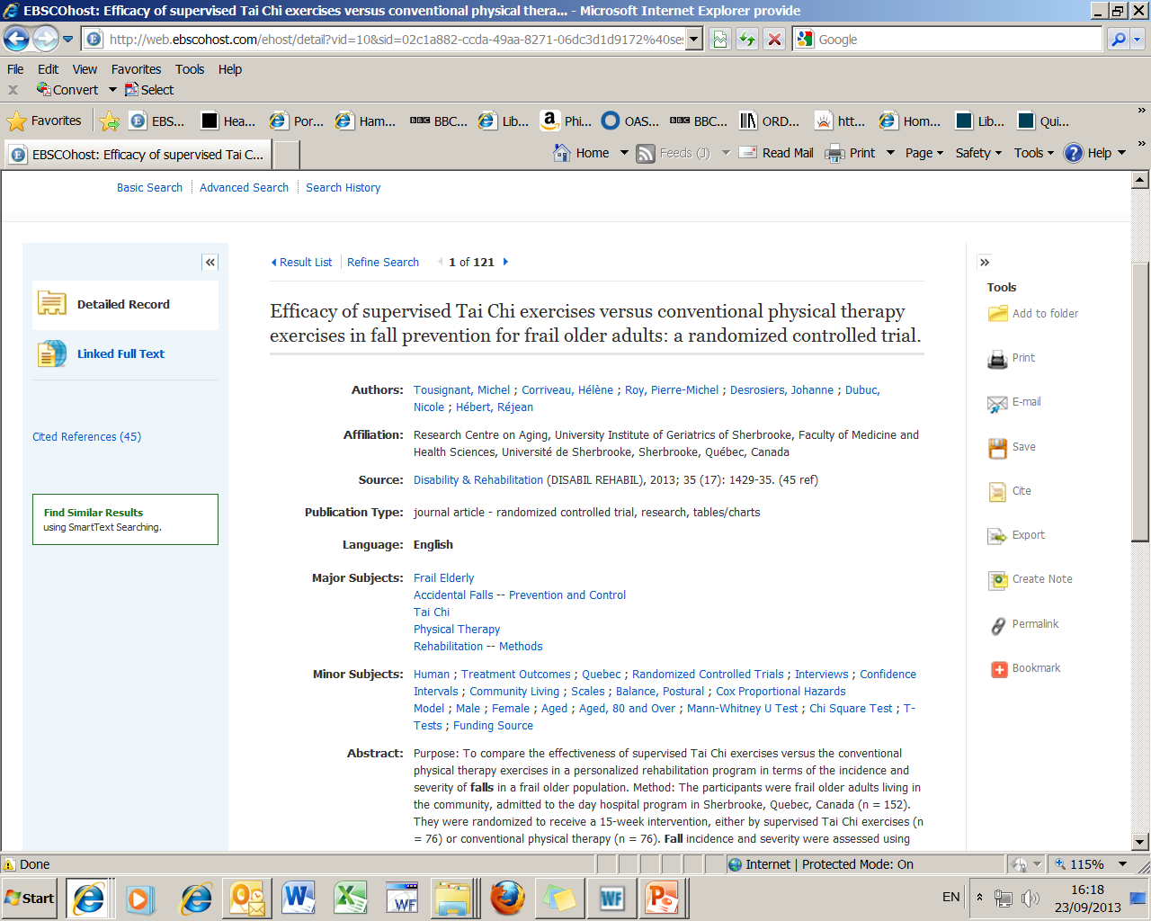
2. Return to results link at the top of the page
1. Full details of the reference

Slide 31
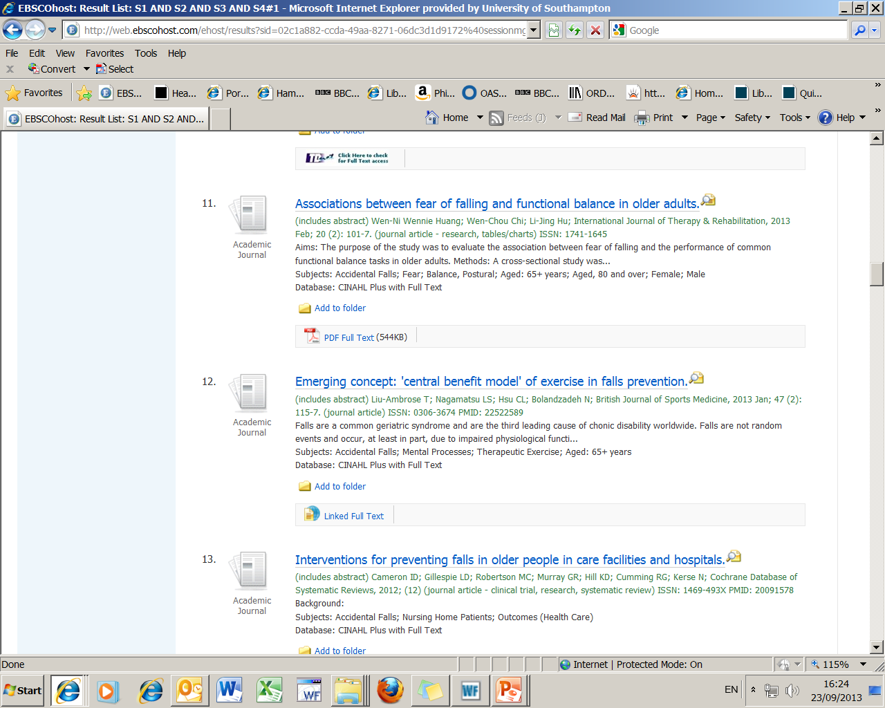
Both of these links
will take you straight
to the full text of the
article
Notes:
You might be lucky and have either of these full text link as show here, this will automatically open up the whole article for you to read.

Slide 32
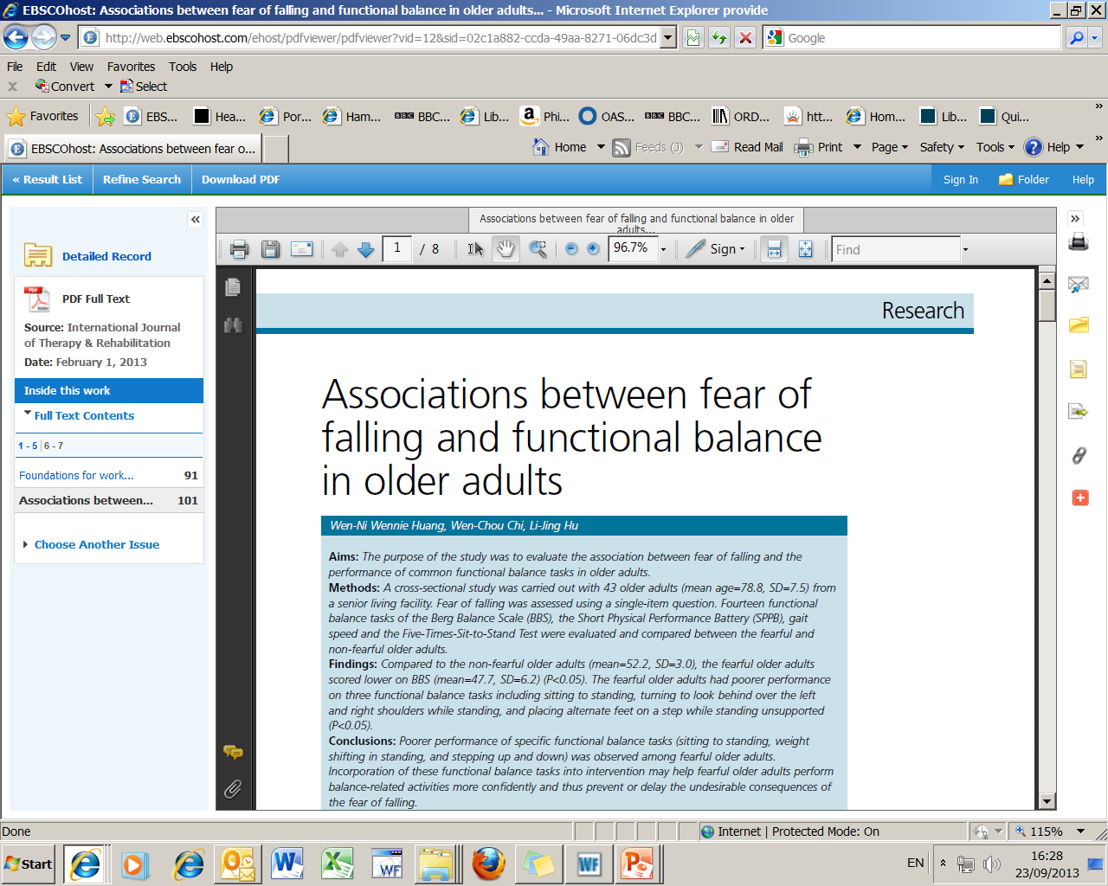
To save, print or email article use
one of these options
Notes:
This is the full text of the article ; to print, email as an attachment or save the article as pdf onto a datastick use the icons .

Slide 33
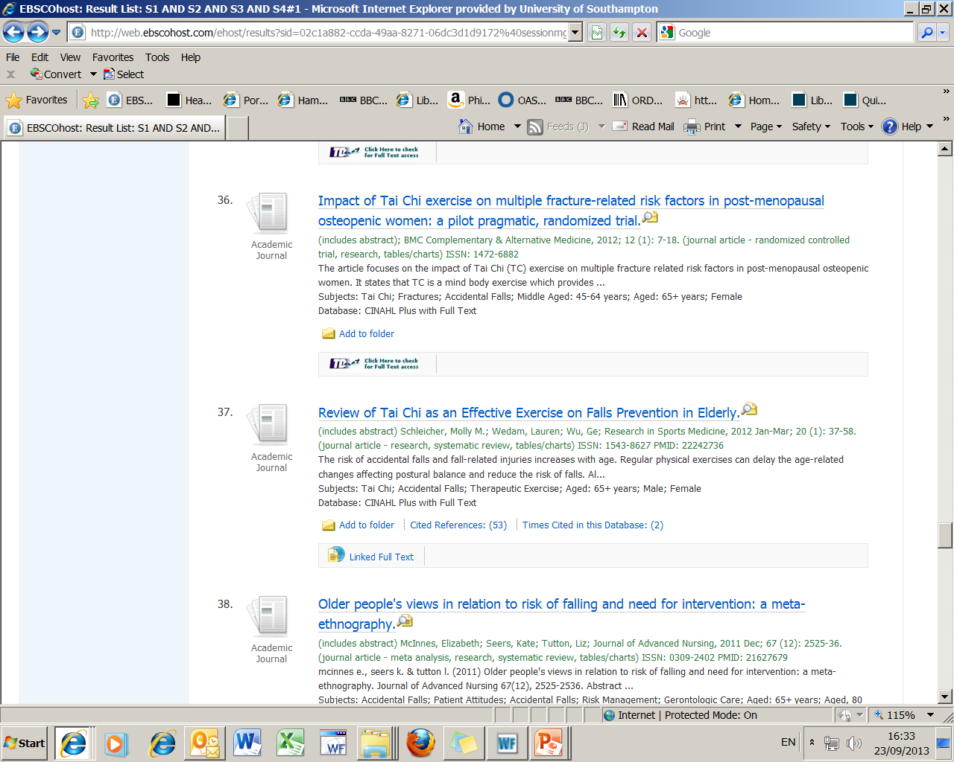
If there is no full-text link
then use this link to TDNet
Notes:
If there is no full text link you can select the TDNet icon at the bottom of each reference. TDNet is the University of Southampton Library Journal Catalogue and will show us if we buy this journal and if so how you can access it.

Slide 34
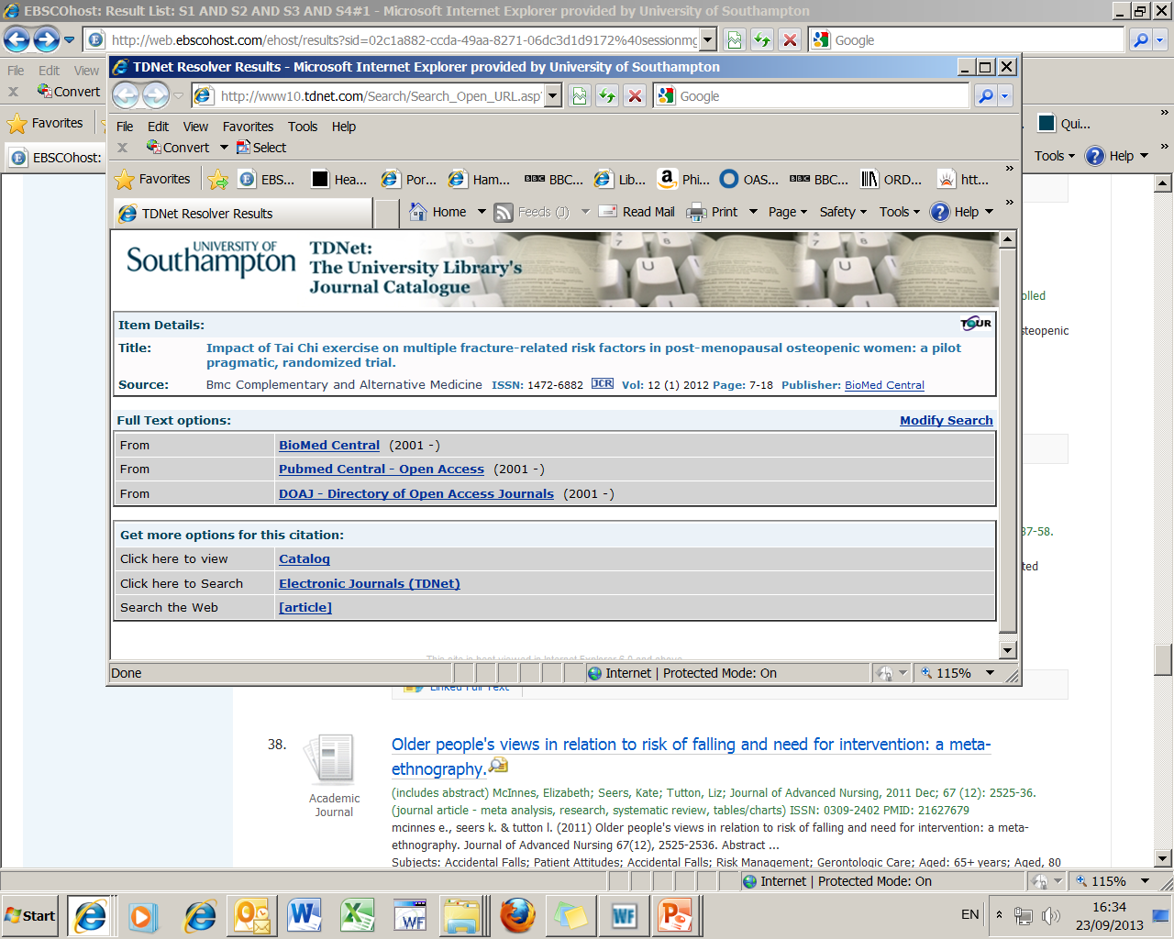
Use one of these links to open the full-text
Notes:
TD Net will open in a new window give you the information of the article you want.
Select this link and you will leave the University webpages and be taken to the journal article.

Slide 35
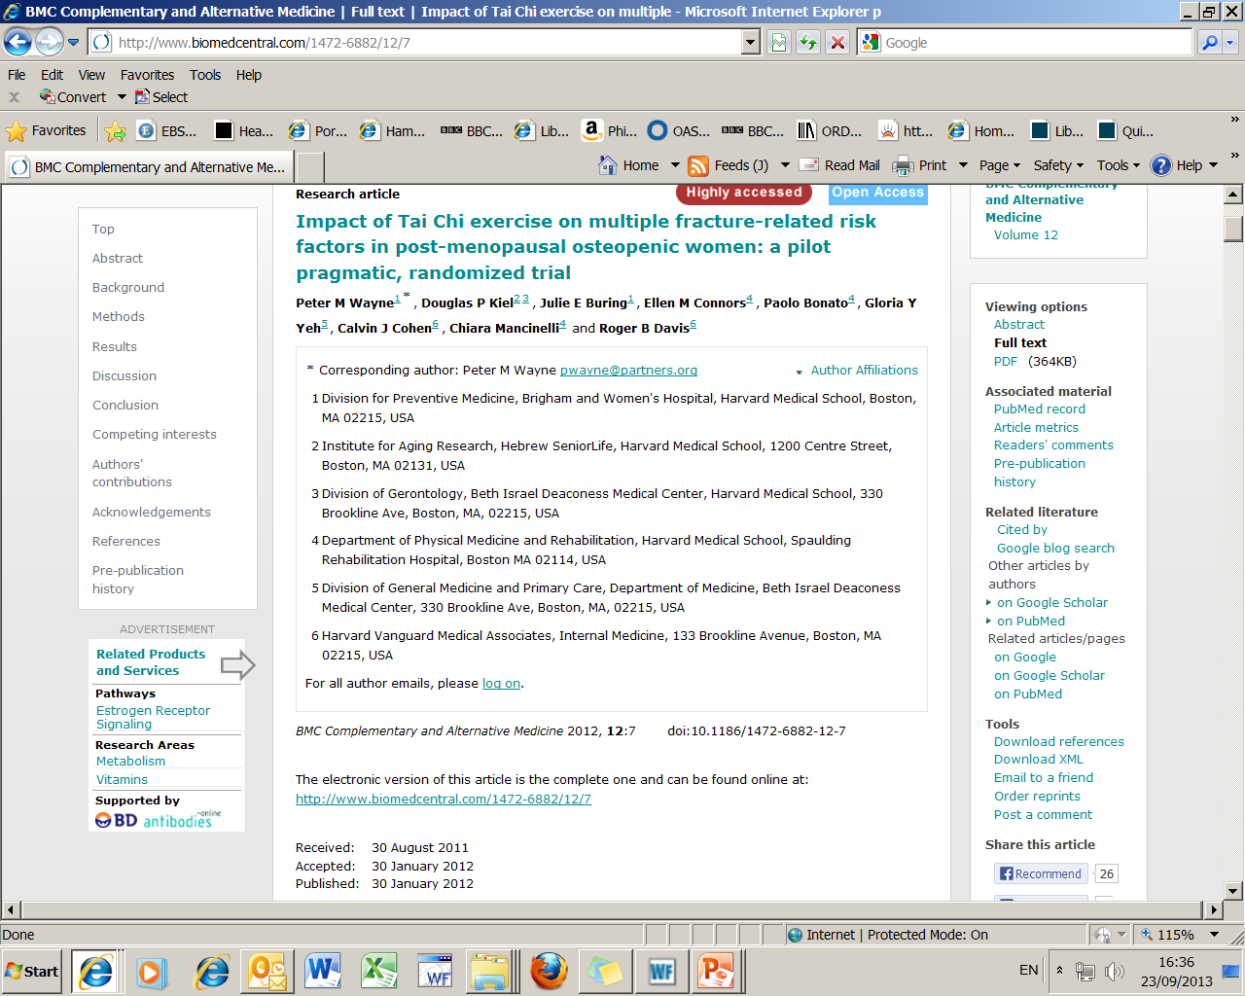
Scroll down to see the full text of the article
Notes:
At the top, you can see that the publisher recognises my computer as one belonging to the University of Southampton so you will have access to everything we have paid for.
When you are given the option of either the full text or PDF we always suggest using the PDF format as the page numbers and all tables and figures are displayed exactly as they are in the print copy.

Slide 36
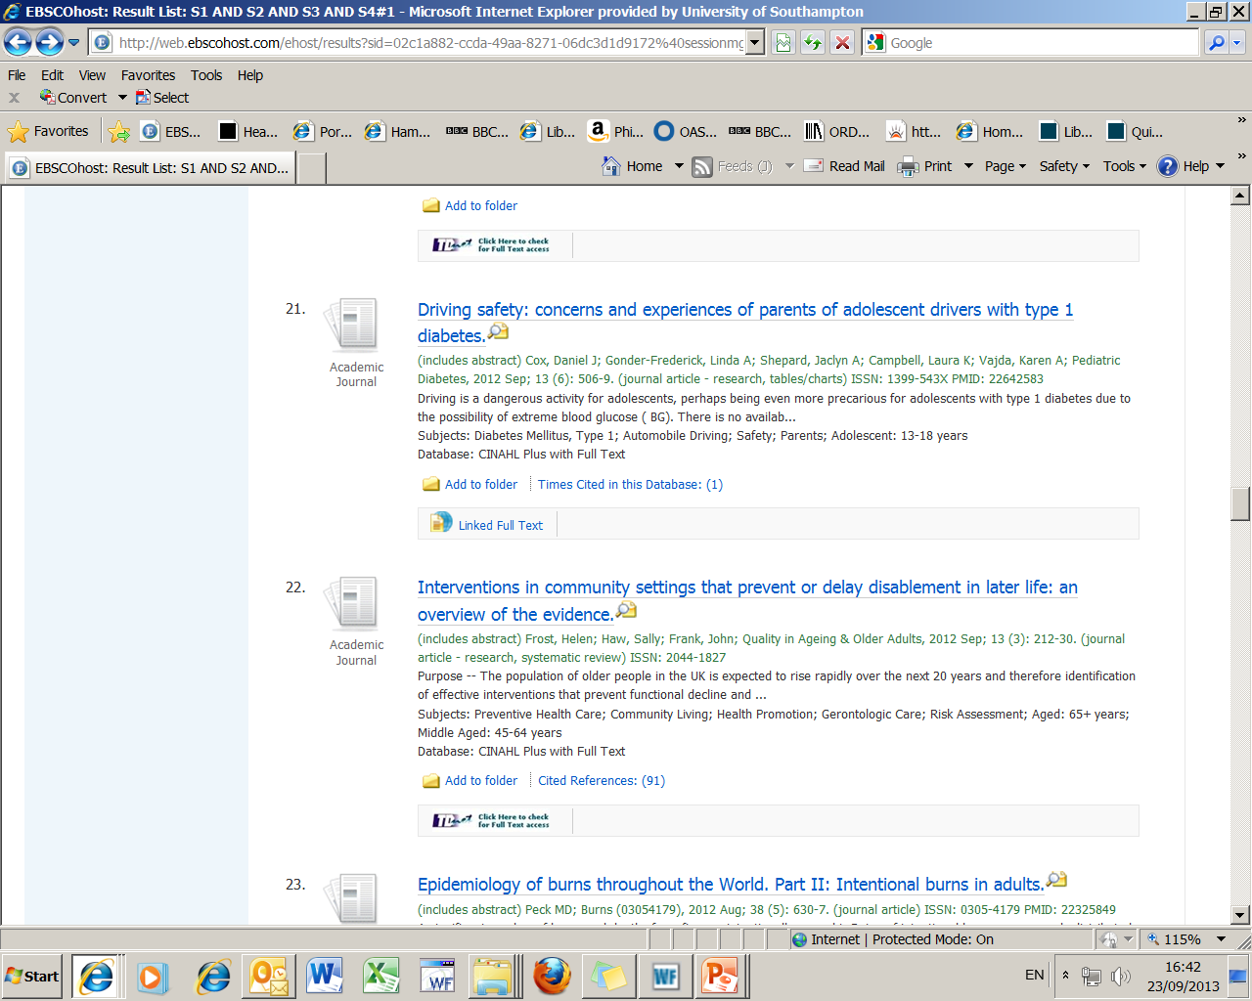
But sometimes when you
select the TDnet link at the
bottom of an article to read it
you may not be so lucky.
Notes:
But sometimes when you select the TDnet link at the bottom of an article to read it - you may not be so lucky.

Slide 37
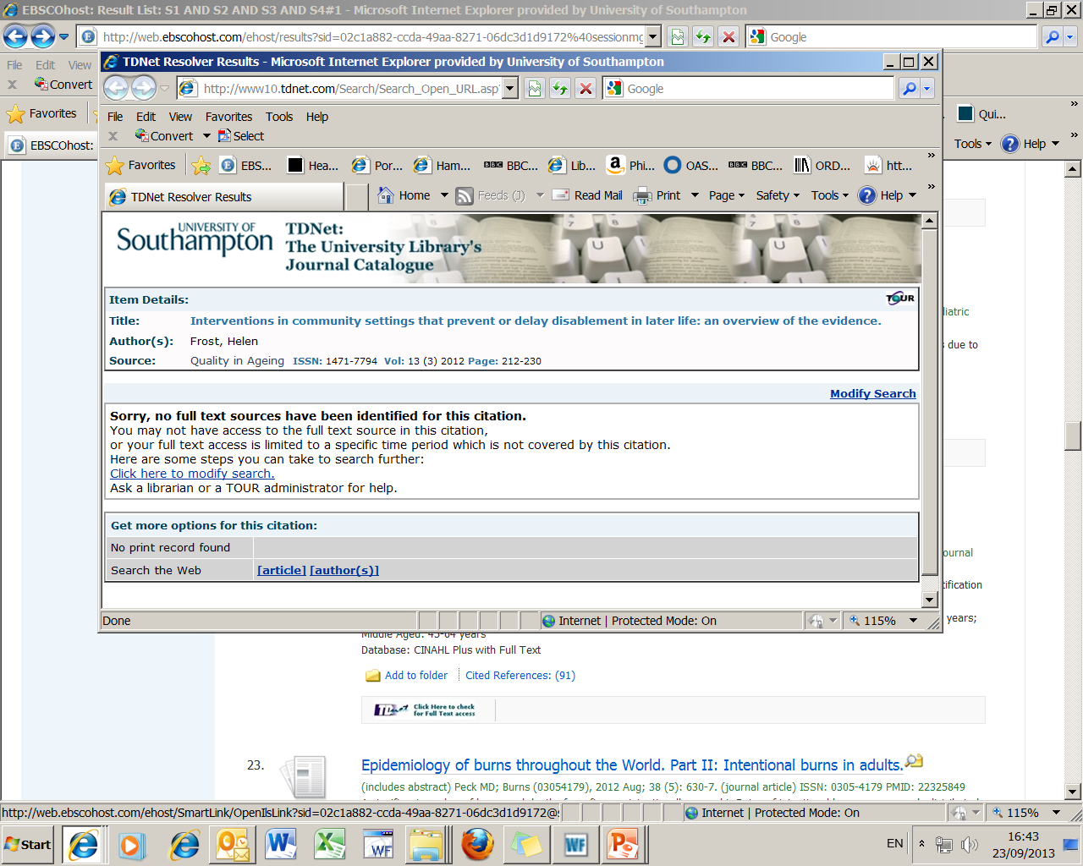
Notes:
TDNet tells us here there are no full text options to read this journal, this means the University of Southampton Library does not buy this journal and so you can’t read it.
This is one of the drawbacks of using a Worldwide Database, it can be frustrating to see what is written but then not be able to read it. One way of minimising this is to use the limit UK and Ireland journals within the options on the when you limit your search.

Slide 38
If we don’t have access to a reference which is really important then use our Inter-Library Loans service:
Login to WebCat
Go to:
Requests: inter-library loans and stack
Inter-library loan requests
Choose the relevant form for the item you are requesting, complete the form then submit
To check to see how many request you are entitled to go to: www.soton.ac.uk/library/services/ill.html

Slide 39
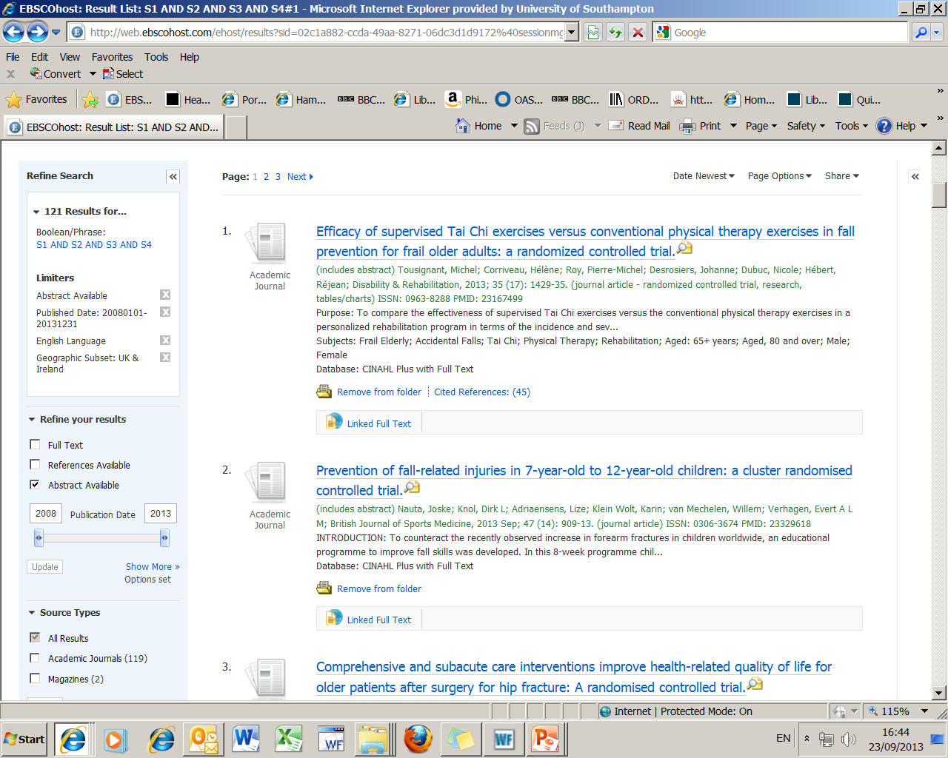
To save the references
(not the full text of the
article), use this Add to
folder link, once activated
the link changes to
Remove from folder
Notes:
If you want to save the references for another day or to keep them for referencing purposes you can select the ones you are interested in by selecting “Add to Folder”.

Slide 40
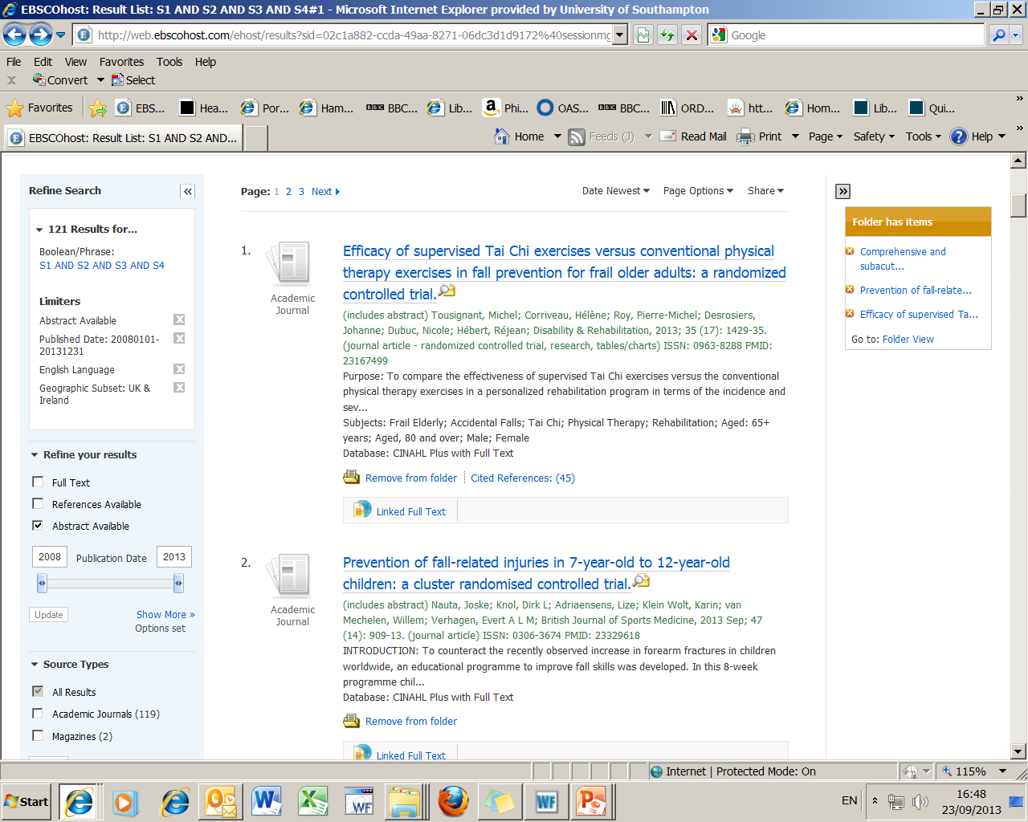
Then go to the folder view
at the top of the page, if the folder view is not showing use the << link to open it up
1. Add to folder those
references you want
to save, page by page…..
(it then changes to
‘remove from folder)
Notes:
A yellow box will appear on the right hand side with all the references that you have decided to keep, and the “Add to folder” will change to “Remove from folder”
When you have finished selecting the references you are interested in, select “Folder View” from the orange box.

Slide 41
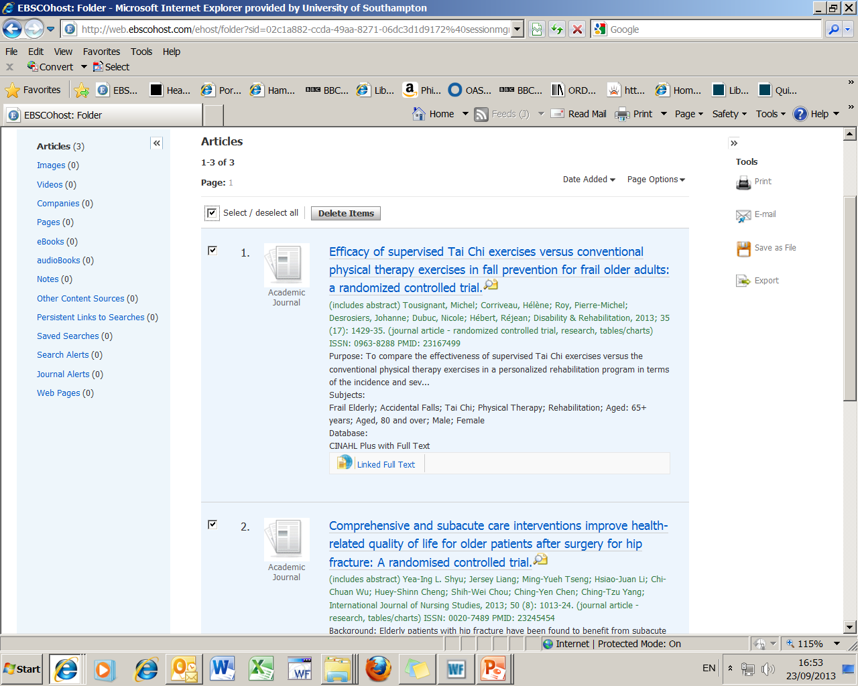
2. Choose your
method of output
1. Select your
references again
Notes:
You have the opportunity to edit your selection here or you can select them all. Make sure you do this this because if you don’t you won’t receive the details of the references!
You then have the option on the right hand side to Print, Email, Save them to a datastick or Export them to a software package.

Slide 42
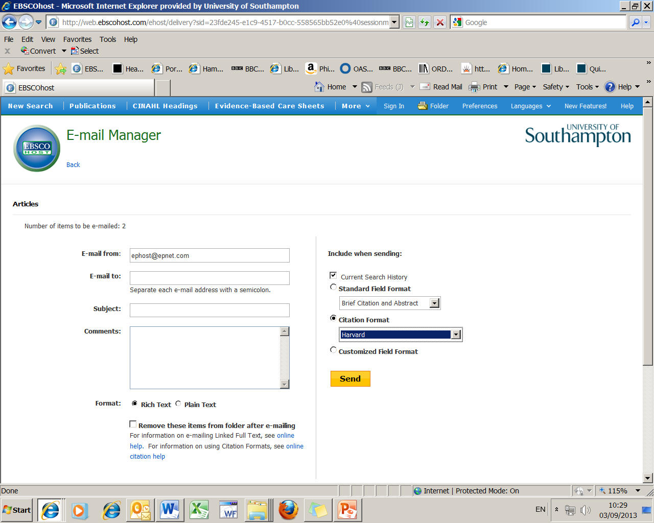
Change citation format
to Harvard as it is the
closest to the Health Sciences
Referencing guidelines
42

Slide 43
Summing up

Slide 44
When you have a piece of academic work to do:
First of all decide what information do you want, is it going to be in books, journal articles, a Department of Health publication or a practice guideline from your professional organisation?
Books – use WebCat/DelphiS
Journal articles – use CINAHL/DelphiS
DoH publications/professional guidelines – use their web sites

Slide 45
Updated 30.09.13 by smd

