Slide 1
Stream Reasoning with Linked Data
Open Data Open Day 2013
Sina Samangooei <ss@ecs>, Nick Gibbins <nmg@ecs>
26 June 2013

Slide 2
Overview
What is streaming data?
Data Stream Management Systems
Stream Reasoning
Example System (if we have time!)
Questions!

Slide 3
Streaming Data

Slide 4
Southampton Open Data Examples
Organisation
Academic Programmes
Events
iSolutions Workstations
Bus Information
static
volatile

Slide 5
Streaming data
Sensor networks
Smart energy
Traffic management
Environmental sensing
Social networking and microblogging
Twitter, Facebook
Telecommunication monitoring management
PRISM, TEMPORA
(not all currently open, but progress in this direction ☺ )

Slide 6
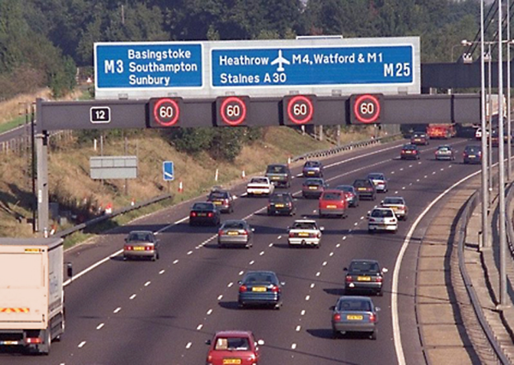
Example: MIDAS
Notes:
Motorway Incident Detection and Automatic Signalling
Used for active traffic management (variable speed limits)
M25, M42, Birmingham Box (M42, M5, M6) – high traffic
~1000km as of 2006
Estimate average of 10E5 observations per hour (probably peaking at over 10E7 observations per hour)

Slide 7
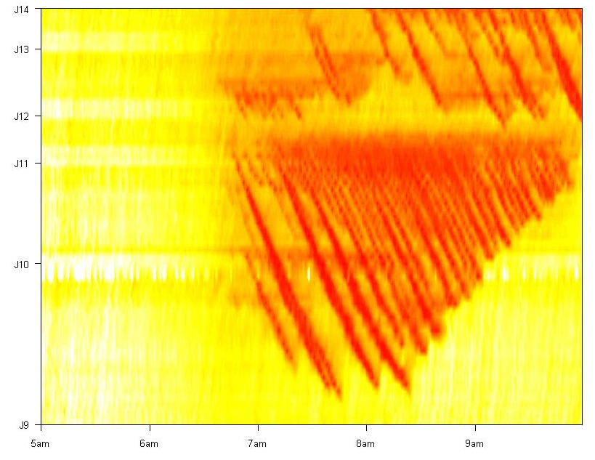
Example: MIDAS
Notes:
Figure shows M25 (M23 to M4 clockwise)

Slide 8
Example: Twitter
Twitter provides a streaming API
Connect to stream and be pushed new tweets as they arrive
Potential for real-time queries and analytics:
What are the hottest topics under discussion on Twitter?
Which topics have my close friends discussed in the last hour?
Who is discussing about Italian food in northern Italy right now?
Which movie is my friend likely to watch next?
Which Tuscany red wine should I recommend to one of my friends?

Slide 9
Data Stream Management Systems

Slide 10
From DBMS to DSMS
Traditional DBMS:
“store now, query later”
Large static mainly unchanging data
Queried multiple times depending on application
Traditional databases aren’t good for highly volatile data
Optimisation based on amortised effort (indexes to improve queries)

Slide 11
Database Management System (DBMS)
query
results
query processor
stored data
on disk

Slide 12
Data Stream Management Systems
Deal with data streams!
Formally!
“Data streams are unbounded sequences of time-varying data elements”
Less Formally!
An (almost) “continuous” flow of information
With more recent information being “more relevant” because it describes the current state of things

Slide 13
Data Stream Management Systems
In a DSMS
Knowledge is dynamic
There are real time (real fast?) constraints
Querying works on a push rather than pull mode
i.e. queries constructed and fed data
Other considerations
Parallelization/Distribution
Windowing
Static data

Slide 14
Data Stream Management System (DSMS)
continuous
query
stream of
results
data
streams
query processor
data
streams
Notes:
STORES NO DATA!

Slide 15
Stream Reasoning

Slide 16
Stream Reasoning
Linked Open Data builds on the Semantic Web
Ontologies, inference, etc
(even if most people ignore it ☺)
Stream Reasoning combines
stream processing
… and inference

Slide 17
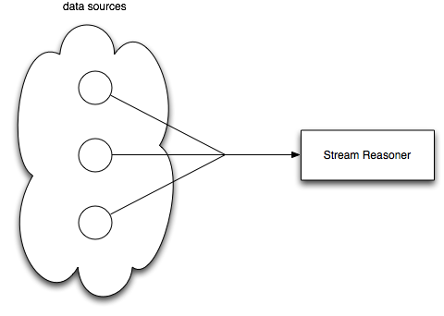
Stream Reasoning – Input
Raw data stream
Think:
traffic updates
weather reports
tweets
other reasoners
(could be triples)
Notes:
Stream reasoning as extension to DSMS – inferring new facts from what you already know

Slide 18
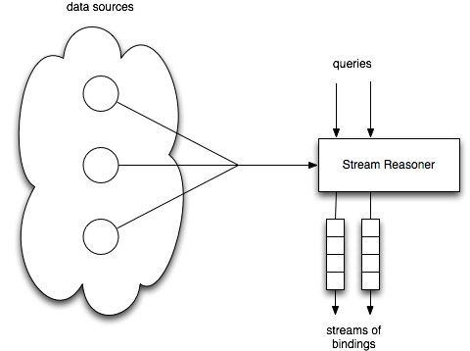
Stream Reasoning – Query
The query is registered
The stream flows through it

Slide 19
Stream Reasoning – Query Results
When the query is satisfied
another stream of bindings
is created

Slide 20
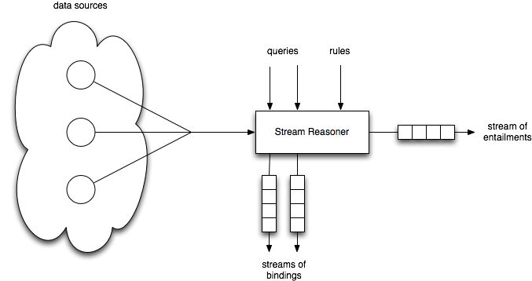
Stream Reasoning – Rules
Equivalent to a query, rules are registered
Notes:
rule: “IF this is true THEN this is also true”
entailment: the things that logically follow – the THEN part

Slide 21
Stream Reasoning – Entailments
Entailments produced

Slide 22
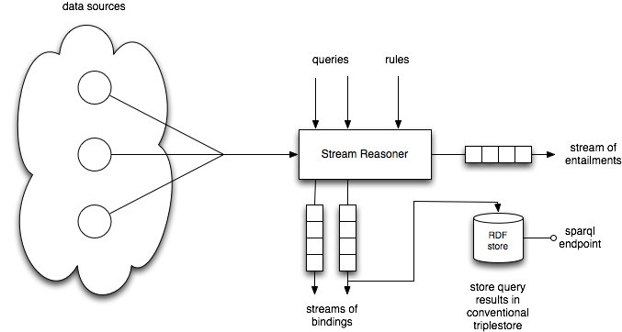
Stream Reasoning – Output 1
Query bindings might be stored in an external store and queried

Slide 23
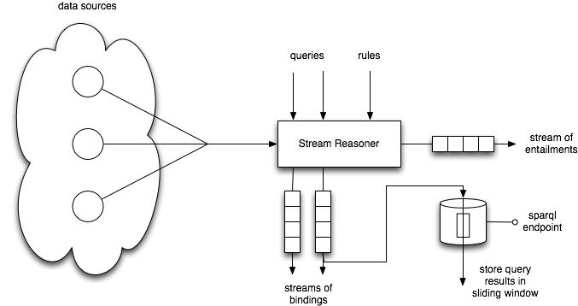
Stream Reasoning – Output 2
… or in a store which is itself windowed, showing a slice of query outputs

Slide 24
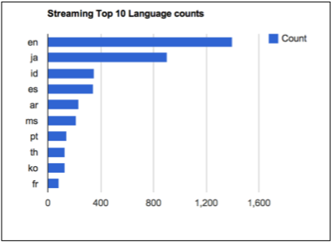
Example: Twitter Language Monitoring

Slide 25
Example: Live Twitter monitoring
Raw twitter API consumed

Slide 26
Example: Live Twitter monitoring
Raw tweets pre-processed and transformed to RDF

Slide 27
Example: Live Twitter monitoring
RDF stream passed through registered queries

Slide 28
Live Twitter Monitoring – Example Query
REGISTER QUERY Query1 AS
PREFIX foaf: …
select ?language (count(?post) as ?postCounts)
FROM STREAM <stream://twitter_posts_rdf>
[RANGE 1s STEP 100ms]
Where{
?post tma:langid ?langid .
?langid tma:langid_language ?language.
}
GROUP BY ?language

Slide 29
Example: Live Twitter monitoring
Graphs updated in real time

Slide 30
Conclusion
Current open data is largely dealt with statically (even when it’s volatile)
Traditional DBMS approach is problematic for highly volatile data
DSMSes bridge this gap by applying queries directly to streams
Stream reasoning combines linked data (and the Semantic Web) with DSMS

Slide 31
Example System

Slide 32
Example System: C-SPARQL
C-SPARQL is a extension to SPARQL which supports streams
Extensions supporting:
Query registration
Stream definition and windowing
Logical windows (time, window overlap etc.)
Physical windows (number of triples)
Custom aggregation primitives

Slide 33
An Simple Example of C-SPARQL Query
REGISTER QUERY WhatMyFriendsVisitedInTheLastHour AS
PREFIX sioc: <http://rdfs.org/sioc/ns#>
PREFIX foaf: <http://xmlns.com/foaf/0.1/>
PREFIX glue: <http://c-sparql.cefriel.it/sdow-demo/>
SELECT DISTINCT ?friend ?topic
FROM <http://c-sparql.cefriel.it/sdow-demo/glueusers.rdf>
FROM STREAM <http://c-sparql.cefriel.it/sdow-demo/interactions.trdf>
[ RANGE 60m STEP 5m ]
WHERE { glue:id1 foaf:knows ?friend .
?post sioc:has_creator ?friend .
?post rdf:type sioc:Post .
?post sioc:topic ?topic . }

Slide 34
An Simple Example of C-SPARQL Query
REGISTER QUERY WhatMyFriendsVisitedInTheLastHour AS
PREFIX sioc: <http://rdfs.org/sioc/ns#>
PREFIX foaf: <http://xmlns.com/foaf/0.1/>
PREFIX glue: <http://c-sparql.cefriel.it/sdow-demo/>
SELECT DISTINCT ?friend ?topic
FROM <http://c-sparql.cefriel.it/sdow-demo/glueusers.rdf>
FROM STREAM <http://c-sparql.cefriel.it/sdow-demo/interactions.trdf>
[ RANGE 60m STEP 5m ]
WHERE { glue:id1 foaf:knows ?friend .
?post sioc:has_creator ?friend .
?post rdf:type sioc:Post .
?post sioc:topic ?topic . }
Query registration
(for continuous execution)

Slide 35
An Simple Example of C-SPARQL Query
REGISTER QUERY WhatMyFriendsVisitedInTheLastHour AS
PREFIX sioc: <http://rdfs.org/sioc/ns#>
PREFIX foaf: <http://xmlns.com/foaf/0.1/>
PREFIX glue: <http://c-sparql.cefriel.it/sdow-demo/>
SELECT DISTINCT ?friend ?topic
FROM <http://c-sparql.cefriel.it/sdow-demo/glueusers.rdf>
FROM STREAM <http://c-sparql.cefriel.it/sdow-demo/interactions.trdf>
[ RANGE 60m STEP 5m ]
WHERE { glue:id1 foaf:knows ?friend .
?post sioc:has_creator ?friend .
?post rdf:type sioc:Post .
?post sioc:topic ?topic . }
FROM static data clause

Slide 36
An Simple Example of C-SPARQL Query
REGISTER QUERY WhatMyFriendsVisitedInTheLastHour AS
PREFIX sioc: <http://rdfs.org/sioc/ns#>
PREFIX foaf: <http://xmlns.com/foaf/0.1/>
PREFIX glue: <http://c-sparql.cefriel.it/sdow-demo/>
SELECT DISTINCT ?friend ?topic
FROM <http://c-sparql.cefriel.it/sdow-demo/glueusers.rdf>
FROM STREAM <http://c-sparql.cefriel.it/sdow-demo/interactions.trdf>
[ RANGE 60m STEP 5m ]
WHERE { glue:id1 foaf:knows ?friend .
?post sioc:has_creator ?friend .
?post rdf:type sioc:Post .
?post sioc:topic ?topic . }
FROM STREAM clause

Slide 37
An Simple Example of C-SPARQL Query
REGISTER QUERY WhatMyFriendsVisitedInTheLastHour AS
PREFIX sioc: <http://rdfs.org/sioc/ns#>
PREFIX foaf: <http://xmlns.com/foaf/0.1/>
PREFIX glue: <http://c-sparql.cefriel.it/sdow-demo/>
SELECT DISTINCT ?friend ?topic
FROM <http://c-sparql.cefriel.it/sdow-demo/glueusers.rdf>
FROM STREAM <http://c-sparql.cefriel.it/sdow-demo/interactions.trdf>
[ RANGE 60m STEP 5m ]
WHERE { glue:id1 foaf:knows ?friend .
?post sioc:has_creator ?friend .
?post rdf:type sioc:Post .
?post sioc:topic ?topic . }
WINDOW

Slide 38
An Simple Example of C-SPARQL Query
REGISTER QUERY WhatMyFriendsVisitedInTheLastHour AS
PREFIX sioc: <http://rdfs.org/sioc/ns#>
PREFIX foaf: <http://xmlns.com/foaf/0.1/>
PREFIX glue: <http://c-sparql.cefriel.it/sdow-demo/>
SELECT DISTINCT ?friend ?topic
FROM <http://c-sparql.cefriel.it/sdow-demo/glueusers.rdf>
FROM STREAM <http://c-sparql.cefriel.it/sdow-demo/interactions.trdf>
[ RANGE 60m STEP 5m ]
WHERE { glue:id1 foaf:knows ?friend .
?post sioc:has_creator ?friend .
?post rdf:type sioc:Post .
?post sioc:topic ?topic . }
Triples from a graph

Slide 39
An Simple Example of C-SPARQL Query
REGISTER QUERY WhatMyFriendsVisitedInTheLastHour AS
PREFIX sioc: <http://rdfs.org/sioc/ns#>
PREFIX foaf: <http://xmlns.com/foaf/0.1/>
PREFIX glue: <http://c-sparql.cefriel.it/sdow-demo/>
SELECT DISTINCT ?friend ?topic
FROM <http://c-sparql.cefriel.it/sdow-demo/glueusers.rdf>
FROM STREAM <http://c-sparql.cefriel.it/sdow-demo/interactions.trdf>
[ RANGE 60m STEP 5m ]
WHERE { glue:id1 foaf:knows ?friend .
?post sioc:has_creator ?friend .
?post rdf:type sioc:Post .
?post sioc:topic ?topic . }
Combined with triples from a stream

