Slide 1
COMP1205 – consolidating understanding
Or how the prospect of an exam can get you to focus…
http://www.edshare.soton.ac.uk/10994/
http://www.edshare.soton.ac.uk/11020/

Slide 2
What is COMP1205 Part II all about?

Slide 3
Topic Overview

Slide 4
Scenario
You are going to be asked a series of questions about various legal and ethical topics during a multiple choice exam
How can you best
collectively use online tools to
prepare a set of shared notes?

Slide 5
Discuss 1: target tools
What might you
Why would you use it?
List of target tools
Strengths of tool

Slide 6
How would you set about the task
Where would you find info?
How would you allocate tasks?

Slide 7
WikiSpaces?

Slide 8
GoogleDocs?

Slide 9
Facebook??

Slide 10
Wordpress?

Slide 11
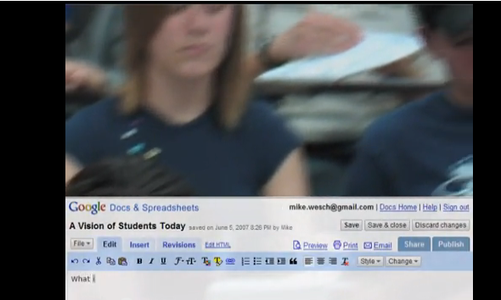
Example of Using GoogleDocs
Example is quite old, but the working practice is very clear….
A Vision of Students Today from 1 minute in…
http://www.youtube.com/watch?v=dGCJ46vyR9o

Slide 12
ECS Wiki?

Slide 13
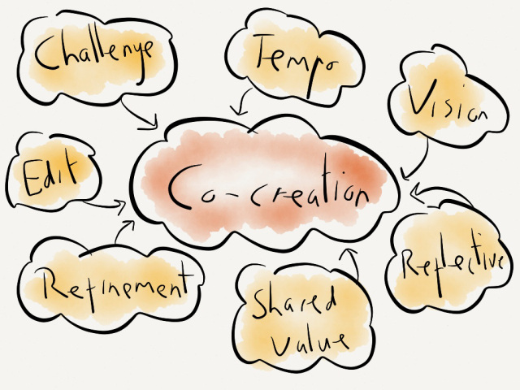
Shared spaces & co-creation
Delicious?
#hashtags
Storify?
Scoopit
Mendeley
Notes:
http://www.scoop.it/

Slide 14
Criteria??
Ease of use
Persistence
Push or pull
Aggregation
Trust
Closed or open
Roll back
Platform… Single/multiple platforms?
Think about technology affordances
Think about habits….

Slide 15
Proposition
Think about how many students there are…
~130
Think about how much expertise you have gained…
Individually..
Directed tasks
Closed
Open
Technical reports
Group Presentations

Slide 16
Via the presentations…
You provided references, your researched topics, relevant in different ways

Slide 17
Topic Areas (see how they relate)

Slide 18
Look at the presentations
Via the topic list
Read the scenarios
Use the references
Via the archived presentations
Look at the slide shows
Discuss the contents with the authors

Slide 19
If you created a presentation…
You have expertise
You can
use your expertise
Share your expertise
Collectively develop the COMP1205 course book

Slide 20
Essential Legislation Knowledge
DPA - http://www.edshare.soton.ac.uk/10483/
Copyright Design and Patents Act
Related slides – rights and ownership online http://www.edshare.soton.ac.uk/9939/
See the full list on the student wiki and the module notes page

Slide 21
The Data Protection Act
What do you know about

Slide 22
First calibrate you existing knowledge…
Use this as a model for the way you approach any of the legal topics

Slide 23
Who?
According to the Data Protection Act (1998) "a person who (either alone or jointly or in common with other persons) determines the purposes for which and the manner in which any personal data are, or are to be, processed" is the definition of:
A data subject
A data processor
A data controller
The Data Protection Commissioner
Notes:
According to the Data Protection Act (1998) "a person who (either alone or jointly or in common with other persons) determines the purposes for which and the manner in which any personal data are, or are to be, processed" is the definition of: A data subject A data processor A data controller The Data Protection Commissioner Which of the following rights does an individual NOT have under the Data Protection Act (1998)? The right to prevent data about the individual being used for direct marketing The right to have inaccurate data corrected or erased The right to prevent data about the individual being held The right to find out what data is being held about the individual

Slide 24
What?
In the Data Protection Act, processing is defined as ___________ information.
Obtaining
Recording
Holding
Carry out any operation on
all of the above
None of the above

Slide 25
Rights
Which of the following rights does an individual NOT have under the Data Protection Act (1998)?
The right to prevent data about the individual being used for direct marketing
The right to have inaccurate data corrected or erased
The right to prevent data about the individual being held
The right to find out what data is being held about the individual

Slide 26
Why questions?
To evaluate your knowledge and understanding
To remind you about the stage test
To focus you on the topic under discussion ☺
You might want to find out the answers to these questions

Slide 27
Data Protection Act (1998)
Where to find the answers…

Slide 28
Where? …basics
Text book
Bott Ch 14: Data Protection, Privacy and Freedom of Information
Government Legislation
Data Protection Act
Read and understand
Other Sources
Information Commissioners Office
.gov.uk

Slide 29
Data Protection Act 1998

Slide 30
ICO web site
http://www.ico.gov.uk/

Slide 31
Gov.uk

Slide 32
Think about a bigger picture…

Slide 33
Further sources?
Search youtube data protection act (sort of ironic?), copyright would be more so…
See also Holt and Newton (2004) for more background

Slide 34
YouTube –use your critical faculties
http://bit.ly/9DHj2c

Slide 35
BCS – book details + download

Slide 36
Google it!

Slide 37
DPA - extent
From Edwards and Rodrigues, The right to privacy and confidentiality for children: the law and current challenges (2008)

Slide 38
Checklist (from ICO)
Do I really need this information about an individual?
Do I know what I'm going to use it for?
Do the people whose information I hold know that I've got it, and are they likely to understand what it will be used for?
If I'm asked to pass on personal information, would the people about whom I hold information expect me to do this?
Am I satisfied the information is being held securely, whether it's on paper or on computer?
And what about my website? Is it secure?

Slide 39
Checklist continued
Is access to personal information limited to those with a strict need to know?
Am I sure the personal information is accurate and up to date?
Do I delete or destroy personal information as soon as I have no more need for it?
Have I trained my staff in their duties and responsibilities under the Data Protection Act, and are they putting them into practice?
Do I need to notify the Information Commissioner and if so is my notification up to date?

Slide 40
Data must be
* Fairly and lawfully processed
* Processed for limited purposes
* Adequate, relevant and not excessive
* Accurate and up to date
* Not kept for longer than is necessary
* Processed in line with your rights
* Secure
* Not transferred to other countries without adequate protection

Slide 41
Think about these pointers
Sources
Via a library search
Through selective searching (government and official sites)
Through popular sources/feeds
Use this approach
For private study
For group preparation
you are expected to demonstrate familiarity with sources of information in the exam

Slide 42
There are some related resources in EdShare
http://www.edshare.soton.ac.uk/9625

Slide 43
Related topics…
Privacy and Ownership
Privacy
DPA ✓
Surveillance
Freedom of Information
Human Rights Act
Pointers plus private study
You need to do this private study for the exam

Slide 44
Use the DPA example/model
This class has identified four topics which come within the frame of privacy
Use the range of sources shown for the DPA
identify information on each topic
Surveillance
Freedom of Information
Human Rights Act
Questions
Books
Guidance from official web sites – e.g. .gov.uk
The source legislation – http://legislation.gov.uk from the national archive
Business advice – business link – http://www.businesslink.gov.uk/
Public Services Portal – http://www.direct.gov.uk/
Library Searches http://www.soton.ac.uk/library/
YouTube searches http://www.youtube.com/
Professional bodies – e.g. British Computer Society http://www.bcs.org/

Slide 45
Conducting private study
Find Information
Google searches for orientation
Keywords
Keywords + ‘tutorial’
Keywords + ‘quiz’
Keywords + ‘ac.uk’ | ‘.edu’
Critical reading of responses
Targeted searches to gather information
Further work to organise information
Organise/review
You might want to work alone
You might like to work together
Study groups
Revision groups
Student wiki

Slide 46
Starting points

Slide 47
Starting points

Slide 48
Exam: Wednesday 29th May
Three weeks
Use co-creation and collaboration to prepare
Practice the skills we have purposefully introduced
Get to know your skills and abilities
Understand how you can work collaboratively with your peers
Practice WeThink, collective intelligence

Slide 49
A longer list…
Communications Act 2003 section 127 (Came into force 25th July 2003 replaced s43 Telecommunications Act 1984)
Computer Misuse Act 1990
Copyright design and patents 1988
Data Protection Act 1998
Defamation Act 1996
Disabilities Discrimination Act
Digital economy act 2010
Electronic Commerce (EC Directive) Regulations 2002
Electronic waste disposal
Equalities Act
Health and Safety
Harassment protection act 1997
Human rights act
Malicious Communications Act 1988 section 1
Postal Services Act 2000 section 85 (commenced 26th March 2001)
Regulation of Investigatory Powers Act 2000
Check the module web site, legal issues are put into two areas

Slide 50
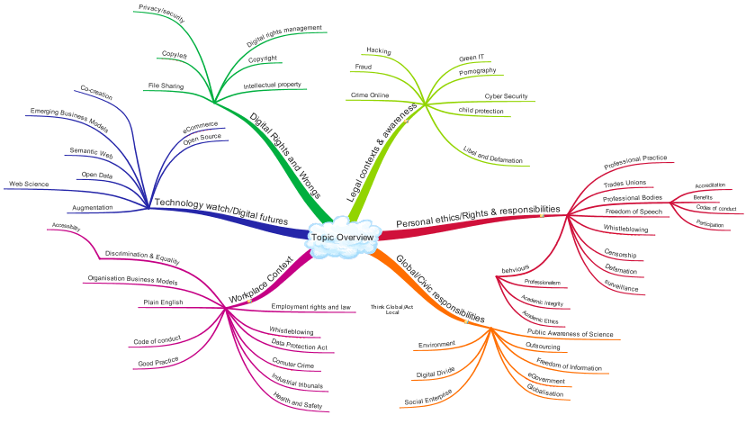
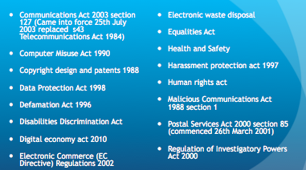
Legal areas
Information, Data and Living in a Connected World
Workplace perspectives: Rights and Responsibilities

Slide 51
Data and Information

Slide 52
Workplace Perspectives

Slide 53
Its not so complex…

Slide 54
Big Picture
Information, Data and Living in a Connected World
Workplace perspectives: Rights and Responsibilities

Slide 55
Overview
The following slides each indicate a broad area of legislation or workplace practice of which you should be aware
Each of the topic areas is likely to be featured among questions in the stage tests
Some of the topic areas are likely to be relevant to the open book examination
You are only expected to be familiar with the scope of the legislation
You are not expected to become legal experts

Slide 56
Further Resources and Independent study
You will find an overview document for this topic in Edshare
You are also advised to check the resources via Blackboard and via the Module Pages
I am assuming you will also work collaboratively to prepare ☺
Resources on the IT profession are also relevant to this topic area

Slide 57
Quick Think… How might it be relevant?
Shadowfax Scenario

Slide 58
Scenario – for reflection
Shadowfax is a chain of eight estate agents in Southampton affiliated to a national chain. You are the sole IT professional employed locally. You have administrative rights to all the computers systems, and are responsible for maintaining the security of the systems and supporting colleagues technical requirements.
By chance you discover that some staff are using the email system to send what you consider to be offensive images accompanying jokes of a sexual nature to other staff.
By looking at some of the admin logs you reach the conclusion that at least one member of staff, who appears to be the initial source of the emails, is also viewing what you consider to be pornography on various external websites via the office network. This activity is taking place out of office hours.

Slide 59
Make revision useful
Think about the scenario as we go through various aspects of law in the workplace
Keep this aspect of reflection when you continue with your revision
What other workplace scenarios might you imagine – draw on real life
yours and in the news
Friends and family
Get something out of your revision ☺

Slide 60
Workplace Rights and Responsibilities

Slide 61
Broad Scope
Employment Legislation
Getting a job
Keeping a job
Your rights whilst working
Equality in the workplace
Equality Act 2010
Sex Discrimination Act 1975
Equal Pay Act 1970
Agency Workers Regulations 2010
Trades Unions
ACAS, and Employment Disputes
Harassment and Bullying
Whistleblowing
Health and Safety at Work
Professional Bodies
Working Practice
Codes of conduct

Slide 62
Employment….
Employment terms and conditions incorporate
Pay
National Minimum Wage
Employment Contracts and Conditions
Time off and Holidays
Flexible Working
Working Hours
Sickness Absence
Business transfers and takeovers
Starting a new job

Slide 63
Sources of information…
https://www.gov.uk/

Slide 64
Can also include…
Working time regulations
Trades Unions and Collective Rights
Part time Work
Fixed Term Work
Employment Tribunals and Dispute Resolution
Work and Parents/Care duties
Maternity
Parental Leave
Time off for Dependents
Employment Act 2002
Equality Act 2010

Slide 65
Workplace rights defined include
Employment Laws and Practice
Equality Act 2010
Employment Rights Act 1996
Employment Act 2002
Trades Unions – the right to strike

Slide 66
Search for legislation
http://www.legislation.gov.uk

Slide 67
Workplace (Green Issues)

Slide 68
Rights and Employer Responsibilities

Slide 69
Discrimination Rights

Slide 70
Equality Act 2010

Slide 71
Harassment
unwanted conduct related to a relevant protected characteristic, which has the purpose or effect of violating an individual’s dignity or creating and intimidating, hostile, degrading, humiliating or offensive environment for that individual
The Equality Act 2010

Slide 72
Chartered Institute of Personnel and Development
http://www.cipd.co.uk
Notes:
Useful source of information

Slide 73
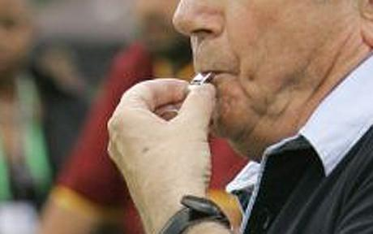
Whistleblowers…
an informant who exposes wrongdoing within an organization in the hope of stopping it; "the law gives little protection to … wordnetweb.princeton.edu/perl/webwn
A whistleblower is a person who alleges misconduct. More complex definitions may be used, but the issue is that the whistleblower usually faces reprisal. …en.wikipedia.org/wiki/Whistleblower
whistle-blower - One who reports a problem or violation to the authorities; especially, an employee or former employee who reports a violation by an employer en.wiktionary.org/wiki/whistle-blower
whistleblowing - the disclosure to the public or to authorities, usually by an employee, of wrongdoing in a company or government department en.wiktionary.org/wiki/whistleblowing
whistle blower - An employee who has inside knowledge of illegal activities occurring within his or her organization and reports these to the public. investor.lilly.com/glossary.cfm
Any person who makes a disclosure about improper conduct by public bodies and public officers under the Whistleblowers Protection Act 2001 www.ombudsman.vic.gov.au/www/default.asp

Slide 74
Whistleblowing rights
http://www.pcaw.org.uk

Slide 75
Public Interest Disclosure Act 1998
http://www.legislation.gov.uk/ukpga/1998/23/contents

Slide 76
Agencies and interest groups

Slide 77
Such as…
Government agencies
Charities and action groups
Professional bodies
Trades Unions
The next few slides give some examples, you need to familiarise yourself with these sources
Opportunities
Revision for the stage test
Preparation for the case study

Slide 78
Employment Tribunals
http://www.employmenttribunals.gov.uk/

Slide 79
Tribunals can consider….
CEC 1975 | Colleges of Education (Compensation) Regulations 1975
COMAH 1999 | Control of Major Accident Hazards Regulations 1999
DCOA 1994 | Deregulation and Contracting Out Act 1994
DDA 1995 | Disability Discrimination Act 1995
DRC 1999 | Disability Rights Commission Act 1999
EE(Age) Regs 2006 | Employment Equality (Age) Regulations 2006
EE (Religion or Belief) Regs 2003 | Employment Equality (Religion or Belief) Regulations 2003
EE (Sexual Orientation) Regs 2003 | Employment Equality (Sexual Orientation) Regulations 2003
EPA 1970 | Equal Pay Act 1970
ERA 1996 | Employment Rights Act 1996
ERelA1999 | Employment Relations Act 1999

Slide 80
Tribunals can consider….
ETA 1996 | Employment (Industrial) Tribunals Act 1996
FTE 2002 | Fixed Term Employees (Prevention of Less Favourable Treatment) Regulations 2002
FWR 2002 | Flexible Working (Procedural Requirements) Regulations 2002 and Flexible Working (Eligibility, Complaints and Remedy) Regulations 2002
HSCE 1996 | Health and Safety Consultation with Employee Regulations 1996
HSWA 1974 | Health and Safety at Work Act 1974
MPL 1999 | Maternity and Parental Leave Regulations 1999
MPL 2002 | Maternity and Parental Leave (Amendment) Regulations 2002
NESE 1994 | Notification of Existing Substances (Enforcement) Regulations 1994
NMWA 1998 | National Minimum Wage Act 1998
PAL 2002 | Paternity and Adoption Leave Regulations 2002
PIDA 1998 | Public Interest Disclosure Act 1998
PTW 2000 | Part Time Worker (Prevention of Less Favourable Treatment) Regulations 2000

Slide 81
Tribunals can consider….
RRA 1976 | Race Relations Act 1976
SDA 1975 | Sex Discrimination Act 1975
SRSC 1977 | Safety Representatives and Safety Committees Regulations 1977
SSPA 1975 | Social Security Pensions Act 1975
STA 1994 | Sunday Trading Act 1994
TCA 2002 | Tax Credits Act 2002
TULR(C) 1992 | Trade Union and Labour Relations (Consolidation) Act 1992
TUPE 1981 | Transfer of Undertakings (Protection of Employment) Regulations 1981
TURER 1993 | Trade Union Reform and Employment Rights Act 1993
WTR 1998 | Working Time Regulations 1998
RT (WT) R 2005 | Road Transport (Working Time) Regulations 2005

Slide 82
Health and Safety Executive
http://www.hse.gov.uk/
Notes:
Covers information on everything from workplace violence to electrical testing

Slide 83
Equality and Human Rights Commission
http://www.equalityhumanrights.com/

Slide 84
UK Human Right’s Blog
http://ukhumanrightsblog.com/

Slide 85
Public Concern at Work
http://www.pcaw.co.uk/

Slide 86
Trades Unions
May be active in your workplace
There may be some kind of local workers group
May not be usual in your workplace
Like professional bodies they require a subscription
They also are afforded some (limited) recognition in workplace law

Slide 87
TUC
http://bit.ly/tucrights

Slide 88
Worksmart (TUC)

Slide 89
Employment Issues
Notes:
Typical areas in which a union might provide support

Slide 90
Arbitration and Conciliation
http://www.acas.org.uk/

Slide 91
Professional Bodies
Professional Bodies
Require - codes of conduct
But they also usually offer the services of their legal departments
Sites can be informative
Special interest groups can provide networking, insights

Slide 92
Expectations

Slide 93
BCS Legal
http://www.bcs.org/category/9234

Slide 94
BCS - legal
“Enhanced Free Legal Helpline (Chartered, Professional and all Fellow grades), Free Online Legal service (not Affiliates) and Employment Disputes Service (Fellows only) The legal helpline… provides personal and business legal advice on subjects including Family, Employment, Consumer and Property Law.
Online Legal service, from Law Express, provides a virtual personal and business legal support system whenever you need it.
BCS Fellows involved in computing and related areas have an additional service - If you become involved in a dispute arising from your contract of employment (not contractors), DAS will find and pay for a lawyer to represent you at an Employment Tribunal or Civil Court.

Slide 95
Professional Indemnity Insurance
protects against financially crippling/reputation-damaging claims by dissatisfied clients.
Negligence: or breach of duty of care
Intellectual property: unintentionally infringing on others’ copyrights, trademarks, broadcasting rights, any act of passing off
Loss of documents/data: damaged, lost or stolen data and documents belonging to your clients
Dishonesty: liability arising from the theft of your clients’ money

Slide 96
CIPD – already shown
http://www.cipd.co.uk

Slide 97
Being a professional
Another (related) perspective

Slide 98
Expectations of a professional
BCS view - practices common to all disciplines
Maintain Your Technical Competence Adhere to Regulations Act Professionally as a Specialist Use Appropriate Methods and Tools Manage Your Workload Efficiently Participate Maturely Respect the Interests of your Customers Promote Good Practices within the Organisation Represent the Profession to the Public

Slide 99
Balance professionalism and legal rights and requirements
Can you think of other ways (in relation to the scenario perhaps) that the role of the professional is relevant?
An example of taking professional responsibility might be seen in relation to ensuring you have a suitable working environment.

Slide 100
Customising the workplace
Sadly I was unable to obtain any images of male computer workers!

Slide 101
Managing your environment

Slide 102
Advice.. And legislation
http://www.hse.gov.uk/msd/dse/

Slide 103
Other Areas

Slide 104
Other workplace related issues
Green ICT/Green IT
Security
Electronic Waste and Disposal
Computer Misuse Act 1990
Data Protection Act 1998
Digital Economy Bill
Freedom of Information Act 2000
Intellectual Property Rights
Patents, copyright, trademarks
Defamation Act 1996
Consumer Protection (Distance Selling) Regulations 2000

Slide 105
Meanwhile… Revisit Shadowfax
Shadowfax is a chain of eight estate agents in Southampton affiliated to a national chain. You are the sole IT professional employed locally. You have administrative rights to all the computers systems, and are responsible for maintaining the security of the systems and supporting colleagues technical requirements.
By chance you discover that some staff are using the email system to send what you consider to be offensive images accompanying jokes of a sexual nature to other staff.
By looking at some of the admin logs you reach the conclusion that at least one member of staff, who appears to be the initial source of the emails, is also viewing what you consider to be pornography on various external websites via the office network. This activity is taking place out of office hours.

Slide 106
Addenda
Example Bibliography
Geek Culture
Geek Culture: An Annotated Interdisciplinary Bibliography
http://reconstruction.eserver.org/011/GeekCulture.htm

Slide 107
http://www.edshare.soton.ac.uk/11020/

