Slide 1
COMP1205 – consolidating understanding
Or how the prospect of an exam can get you to focus…
http://www.edshare.soton.ac.uk/10994/

Slide 2
What is COMP1205 Part II all about?

Slide 3
Topic Overview

Slide 4
Scenario
You are going to be asked a series of questions about various legal and ethical topics during a multiple choice exam
How can you best
collectively use online tools to
prepare a set of shared notes?

Slide 5
Discuss 1: target tools
What might you
Why would you use it?
List of target tools
Strengths of tool

Slide 6
How would you set about the task
Where would you find info?
How would you allocate tasks?

Slide 7
WikiSpaces?

Slide 8
GoogleDocs?

Slide 9
Facebook??

Slide 10
Wordpress?

Slide 11
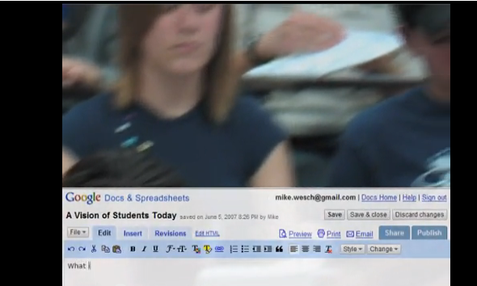
Example of Using GoogleDocs
Example is quite old, but the working practice is very clear….
A Vision of Students Today from 1 minute in…
http://www.youtube.com/watch?v=dGCJ46vyR9o

Slide 12
ECS Wiki?

Slide 13
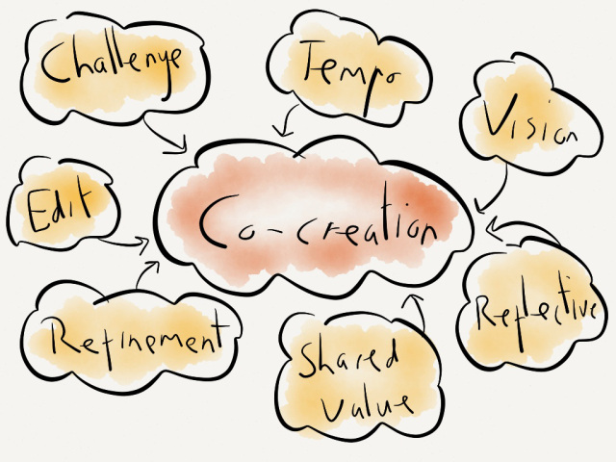
Shared spaces & co-creation
Delicious?
#hashtags
Storify?
Scoopit
Mendeley
Notes:
http://www.scoop.it/

Slide 14
Criteria??
Ease of use
Persistence
Push or pull
Aggregation
Trust
Closed or open
Roll back
Platform… Single/multiple platforms?
Think about technology affordances
Think about habits….

Slide 15
Proposition
Think about how many students there are…
~130
Think about how much expertise you have gained…
Individually..
Directed tasks
Closed
Open
Technical reports
Group Presentations

Slide 16
Via the presentations…
You provided references, your researched topics, relevant in different ways

Slide 17
Topic Areas (reminder)

Slide 18
Look at the presentations
Via the topic list
Read the scenarios
Use the references
Via the archived presentations
Look at the slide shows
Discuss the contents with the authors

Slide 19
If you created a presentation…
You have expertise
You can
use your expertise
Share your expertise
Collectively develop the COMP1205 course book

Slide 20
Essential Legislation Knowledge
DPA - http://www.edshare.soton.ac.uk/10483/
Copyright Design and Patents Act
Related slides – rights and ownership online http://www.edshare.soton.ac.uk/9939/
See the full list on the student wiki and the module notes page

Slide 21
The Data Protection Act
What do you know about

Slide 22
First calibrate you existing knowledge…
Use this as a model for the way you approach any of the legal topics

Slide 23
Who?
According to the Data Protection Act (1998) "a person who (either alone or jointly or in common with other persons) determines the purposes for which and the manner in which any personal data are, or are to be, processed" is the definition of:
A data subject
A data processor
A data controller
The Data Protection Commissioner
Notes:
According to the Data Protection Act (1998) "a person who (either alone or jointly or in common with other persons) determines the purposes for which and the manner in which any personal data are, or are to be, processed" is the definition of: A data subject A data processor A data controller The Data Protection Commissioner Which of the following rights does an individual NOT have under the Data Protection Act (1998)? The right to prevent data about the individual being used for direct marketing The right to have inaccurate data corrected or erased The right to prevent data about the individual being held The right to find out what data is being held about the individual

Slide 24
What?
In the Data Protection Act, processing is defined as ___________ information.
Obtaining
Recording
Holding
Carry out any operation on
all of the above
None of the above

Slide 25
Rights
Which of the following rights does an individual NOT have under the Data Protection Act (1998)?
The right to prevent data about the individual being used for direct marketing
The right to have inaccurate data corrected or erased
The right to prevent data about the individual being held
The right to find out what data is being held about the individual

Slide 26
Why questions?
To evaluate your knowledge and understanding
To remind you about the stage test
To focus you on the topic under discussion ☺
You might want to find out the answers to these questions

Slide 27
Data Protection Act (1998)
Where to find the answers…

Slide 28
Where? …basics
Text book
Bott Ch 14: Data Protection, Privacy and Freedom of Information
Government Legislation
Data Protection Act
Read and understand
Other Sources
Information Commissioners Office
.gov.uk

Slide 29
Data Protection Act 1998

Slide 30
ICO web site
http://www.ico.gov.uk/

Slide 31
DPA info on direct.gov
http://www.direct.gov.uk/en/Governmentcitizensandrights/Yourrightsandresponsibilities/DG_10031451

Slide 32
Further sources?
Search youtube data protection act (sort of ironic?), copyright would be more so…
See also Holt and Newton (2004) for more background

Slide 33
YouTube –use your critical faculties
http://bit.ly/9DHj2c

Slide 34
BCS – book details + download

Slide 35
Google it!

Slide 36
DPA - extent
From Edwards and Rodrigues, The right to privacy and confidentiality for children: the law and current challenges (2008)

Slide 37
Checklist (from ICO)
Do I really need this information about an individual?
Do I know what I'm going to use it for?
Do the people whose information I hold know that I've got it, and are they likely to understand what it will be used for?
If I'm asked to pass on personal information, would the people about whom I hold information expect me to do this?
Am I satisfied the information is being held securely, whether it's on paper or on computer?
And what about my website? Is it secure?

Slide 38
Checklist continued
Is access to personal information limited to those with a strict need to know?
Am I sure the personal information is accurate and up to date?
Do I delete or destroy personal information as soon as I have no more need for it?
Have I trained my staff in their duties and responsibilities under the Data Protection Act, and are they putting them into practice?
Do I need to notify the Information Commissioner and if so is my notification up to date?

Slide 39
Data must be
* Fairly and lawfully processed
* Processed for limited purposes
* Adequate, relevant and not excessive
* Accurate and up to date
* Not kept for longer than is necessary
* Processed in line with your rights
* Secure
* Not transferred to other countries without adequate protection

Slide 40
Think about these pointers
Sources
Via a library search
Through selective searching (government and official sites)
Through popular sources/feeds
Use this approach
For private study
For group preparation
you are expected to demonstrate familiarity with sources of information in the exam

Slide 41
There are some related resources in EdShare
http://www.edshare.soton.ac.uk/9625

Slide 42
Related topics…
Privacy and Ownership
Privacy
DPA ✓
Surveillance
Freedom of Information
Human Rights Act
Pointers plus private study
You need to do this private study for the exam

Slide 43
Use the DPA example/model
This class has identified four topics which come within the frame of privacy
Use the range of sources shown for the DPA
identify information on each topic
Surveillance
Freedom of Information
Human Rights Act
Questions
Books
Guidance from official web sites – e.g. .gov.uk
The source legislation – http://legislation.gov.uk from the national archive
Business advice – business link – http://www.businesslink.gov.uk/
Public Services Portal – http://www.direct.gov.uk/
Library Searches http://www.soton.ac.uk/library/
YouTube searches http://www.youtube.com/
Professional bodies – e.g. British Computer Society http://www.bcs.org/

Slide 44
Conducting private study
Find Information
Google searches for orientation
Keywords
Keywords + ‘tutorial’
Keywords + ‘quiz’
Keywords + ‘ac.uk’ | ‘.edu’
Critical reading of responses
Targeted searches to gather information
Further work to organise information
Organise/review
You might want to work alone
You might like to work together
Study groups
Revision groups
Student wiki

Slide 45
Starting points

Slide 46
Starting points

Slide 47
Exam: Wednesday 29th May
Three weeks
Use co-creation and collaboration to prepare
Practice the skills we have purposefully introduced
Get to know your skills and abilities
Understand how you can work collaboratively with your peers
Practice WeThink, collective intelligence

Slide 48
A longer list…
Communications Act 2003 section 127 (Came into force 25th July 2003 replaced s43 Telecommunications Act 1984)
Computer Misuse Act 1990
Copyright design and patents 1988
Data Protection Act 1998
Defamation Act 1996
Disabilities Discrimination Act
Digital economy act 2010
Electronic Commerce (EC Directive) Regulations 2002
Electronic waste disposal
Equalities Act
Health and Safety
Harassment protection act 1997
Human rights act
Malicious Communications Act 1988 section 1
Postal Services Act 2000 section 85 (commenced 26th March 2001)
Regulation of Investigatory Powers Act 2000
Check the module web site, legal issues are put into two areas
Information, Data and Living in a Connected World
Workplace perspectives: Rights and Responsibilities

Slide 49
addenda
Example Bibliography
Geek Culture
Geek Culture: An Annotated Interdisciplinary Bibliography
http://reconstruction.eserver.org/011/GeekCulture.htm

