Slide 1
NoSQL Databases
_{Beyond relational databases}
Modern (distributed) data storage and processing
Sina Samangooei
{ss@ecs, @sinjax, … }

Slide 2
Introduction
“…so, you have some data…”
RDBMS: power + problems
Some motivations for change…
NoSQL: a definition
NoSQL Databases
Key-Value; Column; Document; Graph etc.
More Generally
ACID, CAP, BASE, Eventual Consistency etc.

Slide 3
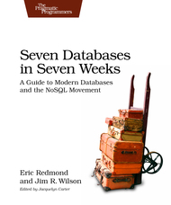
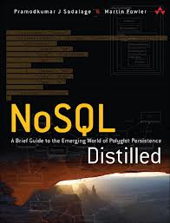
But first… some reading!
The structure/content of these slides are covered in greater depth in
“Seven Databases in Seven Weeks”
- Eric Redmond
“NoSQL Distilled”
- Martin Fowler

Slide 4
… and some watching!
I would absolutely recommend:
“Introduction to NoSQL” – Martin Fowler @ goto; 2012 http://www.youtube.com/watch?v=qI_g07C_Q5I
“The People vs. NoSQL Databases” – Panel Discussion @ goto; 2012 http://www.youtube.com/watch?v=191kCkNya5Q (NSWF language)
“MongoDB: It’s Not Just About Big Data” – Will Shulman http://www.youtube.com/watch?v=b1BZ9YFsd2o

Slide 5
So… you have some data
From RDBMS to NoSQL
Motivate and Define NoSQL

Slide 6
Relational Databases are awesome…
Relational Databases solve most data problems
Persistence
We can store data, and it will remain stored!
Integration
We can integrate lots of different apps through a central DB
SQL
Standard(ish), well understand, very expressive
Transactions
ACID transactions, strong consistency

Slide 7
Trends and Issues
A few key trends and issues…
…In use cases
…In technology
… have motivated change in data storage technologies
Key trends include:
Increasing volume of data and traffic
More complex data connectedness
Key Issues include:
The impedance mismatch problem

Slide 8
Issue – Impedance Mismatch 1
To store data persistently in modern programs:
…a single logical structure
…must be split up (The nice word is normalised)
Object Orientation
based on software engineering principals
Relational Paradigms
based on mathematics and set theory
Mapping from one world to the other has problems

Slide 9
Issue – Impedance Mismatch 2
Player Table
ID: 1001
USER: Steve
Player/Game
Games Played:
Date | Res | K | D | A
01/04/2009 | WIN | 20 | 2 | 10
01/05/2009 | LOOSE | 5 | 22 | 3
Games Table
Player/Team
Teams:
Team Table
Name: Killer Bee Keepers
Icon: http://imgur.com/a/...

Slide 10
Trend – Data Size
We (the world) are
… Creating, Storing, Processing…
… more data than ever before!
“From 2005 to 2020, the digital universe will grow by a factor of 300, from 130 exabytes to 40,000 exabytes, or 40 trillion gigabytes (more than 5,200 gigabytes for every man, woman, and child in 2020).
From now until 2020, the digital universe will about double every two years.”
- IDC – The Digital Universe in 2020
http://www.emc.com/leadership/digital-universe/index.htm

Slide 11
Trend – Increased Data Connectivity
The data we’re producing has fundamentally changed from
Isolated Text Documents (early 1990s)
… to html pages with links (early web)
… to blogs with ping back, RSS feeds(web 2.0)
… to social networks (… add links between people)
… to massive linked open data sets (web 3.0… one of them anyway)

Slide 12
Dealing with data size Trends
Two options when dealing with these trends:
Build Bigger Database machines
This can be expensive
Fundamental limits to machine size
Build Clusters of smaller machines
Lots of small machines (commodity machines)
Each machine is cheap, potentially unreliable
Needs a DBMS which understands clusters

Slide 13
Relational Databases suck…
RDBMS have fundamental issues
In dealing with (horizontal) scale
Designed to work on single, large machines
Difficult to distribute effectively
More subtle: An Impedance Mismatch
We create logical structures in memory
and then rip them apart to stick it in an RDBMS
The RDBMS data model often disjoint from its intended use
(Normalisation sucks sometimes)
Uncomfortable to program with (joins and ORM etc.)

Slide 14
NoSQL – A movement
NoSQL came to address
“web-scale problems”
… impedance mismatch on the way
Key attributes include:
Non-Relational (Though they can be, but aren’t good at it)
Schema Free (Except the implicit schema, application side)
Inherently Distributed (In different ways, Some more so than others)
Open Source (mostly… e.g. Oracle’s NoSQL)

Slide 15
Defining NoSQL
Quite hard to define a movement based around a negative
Is a CSV file NoSQL?
(How about a turnip?)
How about a non-relational database from the 80s/90s
(MUMPS, CLOB, XMLDB etc.)
NoSQL is not definable strictly
…but many folks have certainly tried!

Slide 16
Some NoSQL Definitions
“Next Generation Databases mostly addressing some of the points: being non-relational, distributed, open-source and horizontally scalable.”
- Stefan Edlich (nosql-database.org)

Slide 17
Some NoSQL Definitions
"NoSQL: a broad class of data management systems where the data is partitioned across a set of servers, where no server plays a privileged role."
- Emin Gün Sirer (hackingdistributed.com)

Slide 18
Some NoSQL Definitions
“[To organise a meetup in the late 2000s]… you need a twitter #hashtag…That’s all #nosql was ever meant to be, a twitter hashtag to organise a single meetup at one point in time”
- Martin Fowler (goto; 2012)

Slide 19
NoSQL Databases
The types. what they are for. how to use them.

Slide 20
NoSQL Varieties

Slide 21
NoSQL Varieties
Document Oriented (Lotus notes? Bit of a stretch! Still cool)
Key-Value stores (Amazon Dynamo)
Graph DBs (Triples! SPARQL! Ontologies! Woo!)
Column Oriented (Google’s BigTable)

Slide 22
Key-Value Stores - Basics
Take away message: A hashtable with persistence (sometimes, but an API at least!)
Use a key, ask a database for a value
The key is usually a string
The value can be anything (text, structure, an image etc.)
Database often unaware of value content
… sometimes it is!

Slide 23
Key-Value Stores - Examples
Riak
Buckets/Keys/Values/Links
Query with key, process with map-reduce
Secondary Indexes (metadata)
“Loves the Web” (but they all say this)
Redis
More understanding of value types (strings, integers, lists, hashes)
In memory (very fast)

Slide 24
Document Database - Basics
Database as storage of a mass of different documents
A document…
… is a complex data structure
… can contain completely different data from other documents
Document data stores understand their documents
Queries can run against values of document fields
Indexes can be constructed for document fields
Batch style (mapreduce etc.)often supported

Slide 25
Document Database - Basics
{
"_id": "1",
"name": "steve",
"games_owned": [
{"name":"Super Meat Boy"},
{"name":"FTL"},
],
}
{
"_id": "2",
"name": "darren",
"handle":"zerocool",
"games_owned": [
{"name":“FTL"},
{"name":“Assassin’s Creed 3“, “dev”: “ubisoft”},
],
}

Slide 26
Document Database - Examples
MongoDB
Master/Slave design
.find() queries like ORM
Geo-spatial indexing
CouchDB
Master/master
Only map reduce queries
Weird but pretty cool, see: http://sitr.us/2009/06/30/database-queries-the-couchdb-way.html
Favours availability to consistency (more on this in a bit)

Slide 27
Column DBs - Basics
Entries held in rows
Rows have unique keys
Tables define a set of “column families”
Rows contain 0 or more columns for each column family
No Schema
(Columns in a family change per row)
On Querying:
Key lookup is fast
Batch processing via mapreduce (OLAP lives here)

Slide 28
Column DBs - Basics
Player Details Column family
Name | “darren”
Team | “killer bee…"
… | …
SOME_KEY
game1 | <gamedata>
game2 | <gamedata>
… | …
game3 | <gamedata>
Games Column Family

Slide 29
Column DBs - Examples
Primarily for batch processing
Hbase
Uses HDFS for storage, Hadoop for processing
Built to treasure consistency over availability
Cassandra
Supports key ranges
Works over a variety of processing architectures
(Hadoop, Storm, etc.)

Slide 30
An Asside on Aggregates
These DBs represent a variety of “aggergate” databases
Columns, Key-Values, Documents
They store some form of self contained thing that is useful in isolation
A document in MongoDB
The column-families in Hbase
The values in Riak
Many leverage this for scale
It completely side steps the sharding issues in RDBMS

Slide 31
Graph DBs - basics
Focus on modelling the data’s structure
Graphs are composed of Vertices and Edges
Verticies are connected by edges
Edges have labels and direction
Both have properties
Queried with graph traversal api
Cypher, SPARQL
Can be much faster at querying graph like data structures
Like friends of friends or web links

Slide 32
Graph DBs - basics
The Matrix Revolution
Keanu Reeves
Acts In
Acts In
Acts In
Acts In
The Matrix Reloaded
Laurence Fishburne
Acts In
Acts In
Acts In
Acts In
Acts In
Carrie-Anne Moss
The Matrix

Slide 33
Graph DBs - examples
Neo4j
Not distributed
ACID transactions
Cypher for query:
4Store (5Store), other triple stores
RDF and Semantic Web technologies
5store supports 1000s of machines easily
SPARQL for query:
START m=node:node_auto_index(id="603") MATCH m<-[:ACTS_IN]-actor
RETURN actor;
SELECT ?a WHERE{
?a ACTS_IN ?m; ?m HAS_ID 603}

Slide 34
Polyglot Persistence
The real point here is no single DB will solve all problems
We’re entering an age of Polyglot Persistence
Lots of DB solutions
All good for different parts of the solution
Good interfaces to make them work with each other

Slide 35
On Consistency and Availability
ACID, BASE and CAP

Slide 36
ACID – A Recap
In an ideal world, database transactions should be:
Atomic
Entire transcation succeeds or the entire transactions rolls back
Consistent
A transaction must leave the database “valid” re: some defined rules
Isolated
Concurrent transactions behave as though they occurred serially
Durable
Once committed, transactions survive power loss, acts of god etc.

Slide 37
Dropping Relaxing ACID
ACID is a big deal in traditional RDBMS
Broken transactions in Banking is a big deal
Money leaving your account but not entering the seller’s account is a big deal
BUT In some situations the use case doesn’t need all or some of ACID
Seeing an old version of a facebook post
An amazon shopping cart forgetting your items
A tweet or two out of the 138 million per day being lost

Slide 38
CAP Theorem – What’s a CAP?
Brewer’s CAP theorem stands for:
Consistent: writes are atomic, all subsequent requests retrieve the new value
Available: The database will always return a value so long as the server is running
Partition Tolerant: The system will still function even if the cluster network is partitioned (i.e. the cluster looses contact with parts of itself)
The overly stated well cited issue is:
Of these 3, you can only ever build an algorithm which satisfies 2
Formal Proof by Gilbert and Lynch: http://portal.acm.org/citation.cfm?doid=564585.564601

Slide 39
CAP – Another Perspective
If you have a system that can get a network partition
(if your system is distributed this will definitely happen)
You must make a choice between:
Consistency (… and disallow writes during the partition)
Availability (… and have potential inconsistency)
Consistent
Partition
-OR-
Available

Slide 40
CAP – Another Perspective
If you have a system that can get a network partition
(if your system is distributed this will definitely happen)
You must make a choice between:
Consistency (… and disallow writes during the partition)
Availability (… and have potential inconsistency)
Consistent
Partition
Available

Slide 41
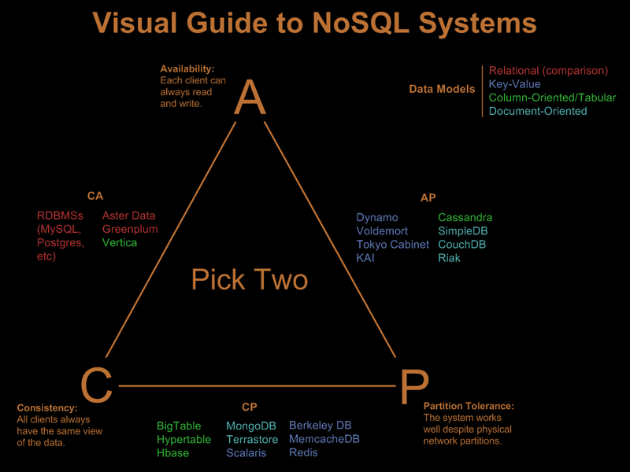
CAP Theorem – The DB perspective

Slide 42
BASE – An alternative to ACID
If we want CAP P, ACID can be restrictive, we can be BASE
BASE ostensibly means:
Basic Availability
The Application works basically all the time
Soft-state
Does not have to be consistent all the time
Eventual consistency
But will be in some known state eventually
But is more neumonic than precise
Get it? ACID… BASE… Chemicals…

Slide 43
Eventual Consistency
A work around of CAP.
From Amazon’s Dynamo paper:
“the storage system guarantees that if no new updates are made to the object, eventually all accesses will return the last updated value.”

Slide 44
Eventual Consistency - MVCC
Some Document DBs use Multi-Version Concurrency Control (MVCC)
Like a version control system
Writes without locks
Multiple versions of documents
Distributed Incremental Replication
Different versions on different machines
Collisions detected during replication
App developer can be informed/decide on collisions
Used by: CouchDB

Slide 45
Eventual Consistency – Vector Clocks
Vector Clocks are an extension of Lamport timestamps
They help understand the order of events in a distributed system
Vector clocks can be used to:
Identify the provenance of an item of data
Decide order in which data was changed
Help resolve conflicts
Flag inconsistencies for app specific decisions
Used by: Amazon’s Dynamo and Riak

Slide 46
Conclusion
RDBMS are still mostly what it’s about
90% of the world’s problems can be sorted out with a good join
For some companies, building large systems on a single RDBMS is no longer good enough
for some problems RDBMS aren’t a good fit
Increasingly, some problems are better solved by a set of non-RDBMS solutions
NoSQL means polyglot persistence and they will definitely form part of the future
They are worth having a look at

