Slide 1
The Open Educational Movement: MOOCs and OERs
Hugh Davis:
@HughDavis
April 2013

Slide 2
This Talk
What are OERs?
What are MOOCs?
Disruptive Technologies: Is there an avalanche coming?
Why Southampton are doing this
Futurelearn
Learning Resources in MOOCs

Slide 3



Open Educational Resources (OERs)
Freely Available
Usually Openly Licensed (e.g. CC/GNU)
Media for use in Education.
(preferably in some open format!)
Note: The “Open licenses” of CC are really “Some rights reserved”

Slide 4
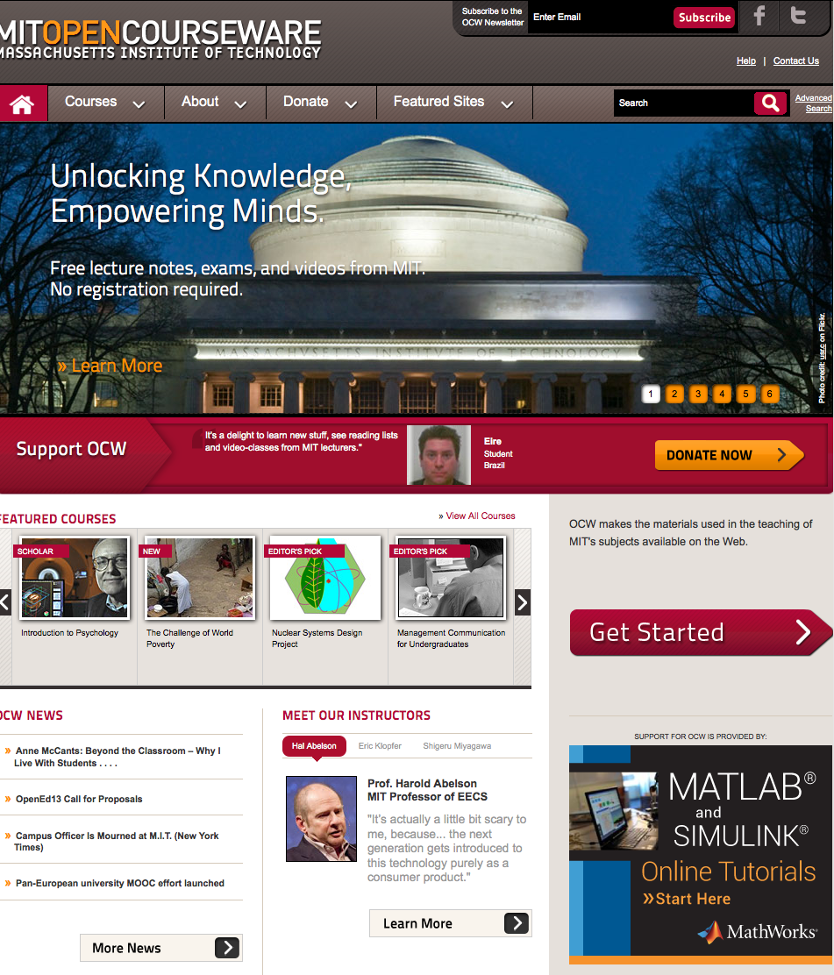
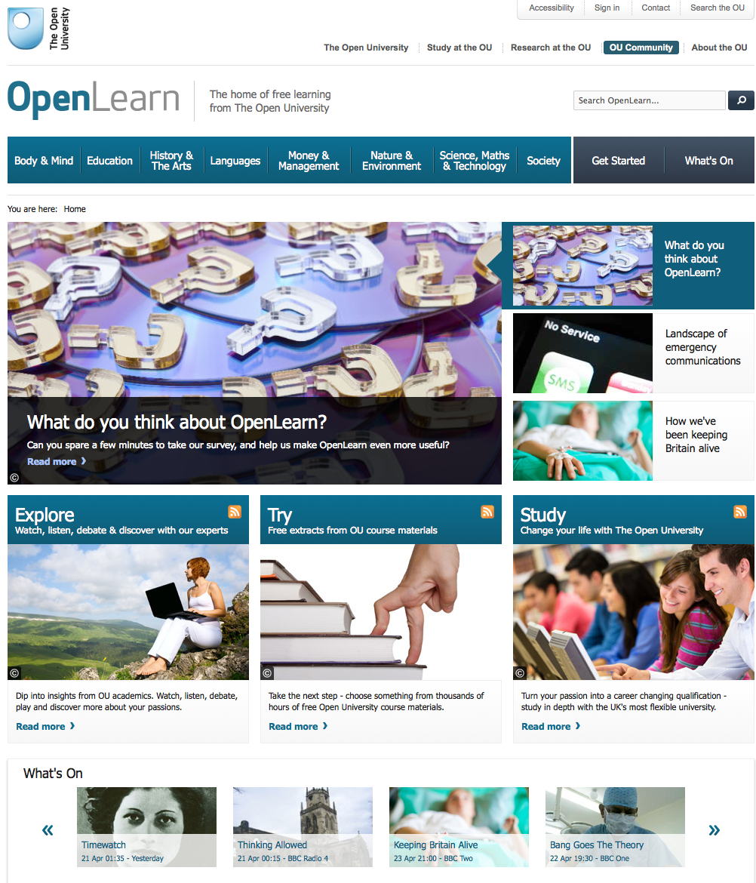
Example Projects
MIT OpenCourseware Openlearn (OU)

Slide 5
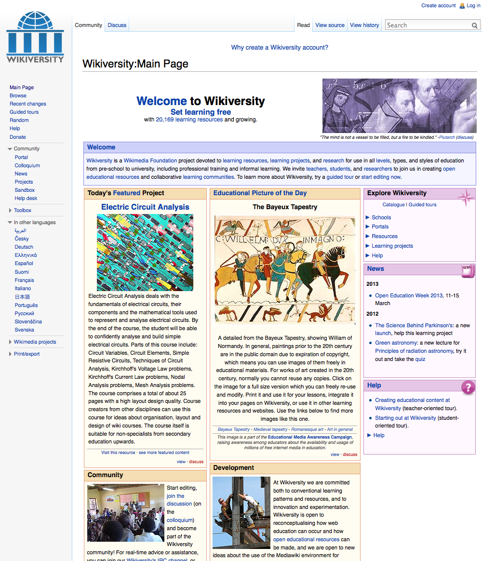
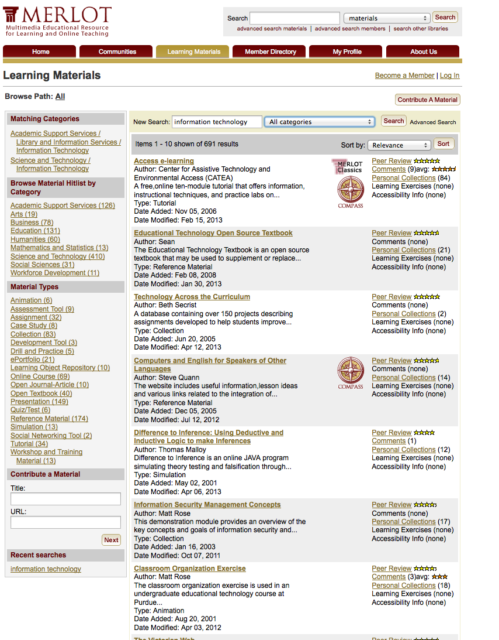
What to share? The course or the learning object?

Slide 6

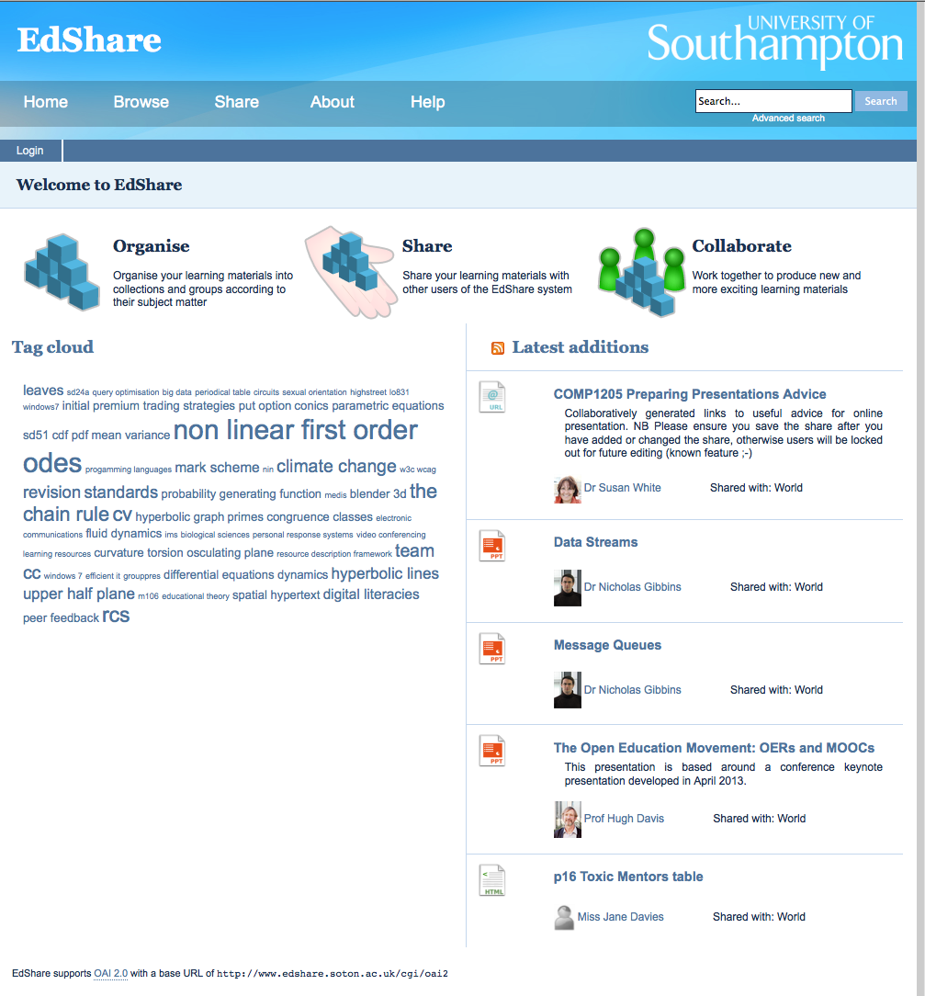
Resource Repositories/ Shares

Slide 7


Who’s Paying?
The Hewlett Foundation (OCW, = MIT, OU etc)
The Mellon Foundation, and loads more….
JISC/HEFCE (JORUM, EdShare)
UNESCO
Us? (Freely contributing, wiki xxx)

Slide 8
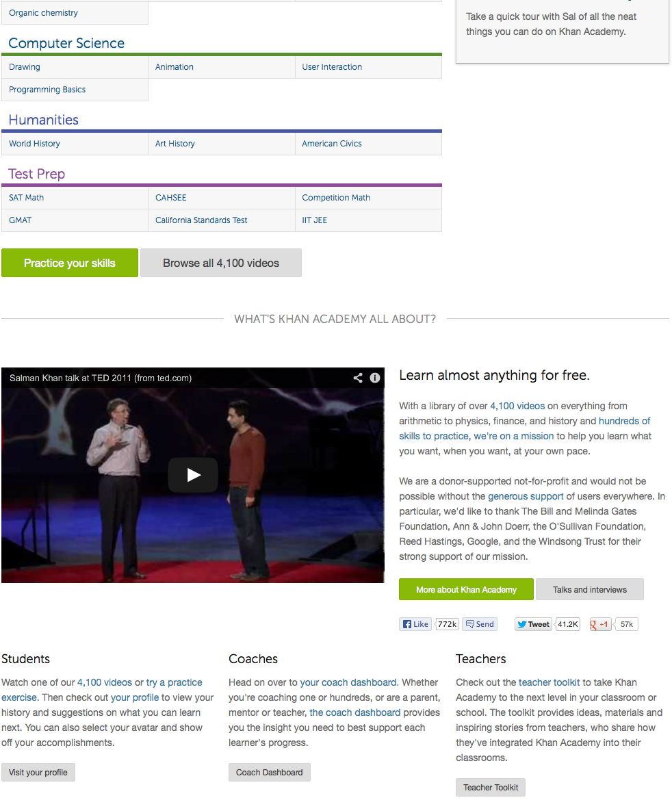
The Khan Academy
Thousands of Videos
http://www.youtube.com/watch?v=nTFEUsudhfss

Slide 9
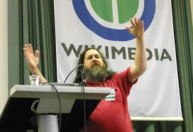


Politics of OER
There is a tension as to why people do OER
The belief that knowledge does not belong to anyone and education should be free
Cultural Imperialism – if the USA gives developing countries an US centric education, they will learn to love uncle Sam

Slide 10
What is a MOOC?
Massive - some have 10,000s registered.
Open = free, and anyone can register
Online although many have a parallel blended incarnation
Course (but not necessarily accredited for anything)

Slide 11
Most Courses consist of
Many short videos
  Some talking heads
  Some “worked examples”
  Some experiments etc.
On-line papers etc.
Discussion forums
On-line activities
Formative assessments
Assessment (and feedback) will need to be
Objective (multiple choice etc.)
Peer review
Self evaluation
Learning Design Workflow and Learning Analytics are central
The emphasis must be on the student as a self-motivated learner.

Slide 12

Why the Avalanche Alert?
Barber, M. Donnelly, K & Rizvi, S. (March 2013).
An Avalanche is Coming; Higher Education and the Revolution Ahead.
Institute for Public Policy Research.

Slide 13
The cost of a degree is rising in real terms while the value of a degree is falling
The classic university is educating for 20th century skills
Content is ubiquitous
(and free)
Employers attitudes to formal qualifications are changing in favour of demonstration of skills
Private providers can produce cheaper qualification routes
(or wish to be allowed to)
The three of four year degree course is no longer standard
The world distribution of wealth means that most potential students cannot afford higher education
Contract cheating makes current education meaningless
It would not be possible to build enough universities to educate the emerging Chinese market
Education is having its Napster moment

Slide 14

We need to maintain the Goldstandard
Students are looking for so much more out of an university than just formal learning
The best possible education is face to face with a true subject expert
STUDENTS
Contract Cheating shows that you need to examine face to face
We are signing our own death warrants
The hand-wringing citation of unemployment statistics and rising student fees comes not from the unemployed and poor, but from the new education industry that wants to find a way into the marketplace.
Have you looked at the drop-out rates?
We’re under fifteen feet of pure white snow

Slide 15
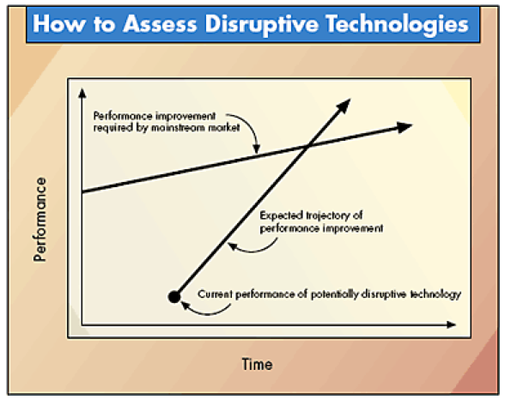
Assessing Disruptive Technologies
Joseph L. Bower and Clayton M. Christensen
Disruptive Technologies: Catching the Wave
Harvard Business Review 1995

Slide 16
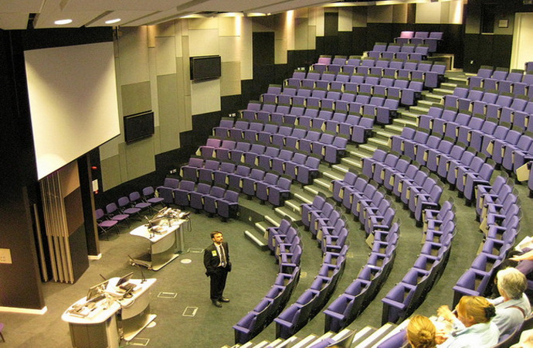

Motivations for making MOOCs
to enhance reputation
to boost recruitment
·to provide a public service
to create more flexible routes for entry
to explore new markets
to support our collaborative provision
to improve our on-line capability
to help us to become more agile and flexible

Slide 17
New Markets
Informal
Learning
YouTube,
iTunesU
Non Formal
Learning
MOOCs
OERs
Formal
Learning
Modules
And
Programmes
Pulling Students through from the Informal to the Formal (Martin Bean)
17

Slide 18
New Markets
Formal
Learning
Modules
Formal
Learning
Whole
Programmes
Informal
Learning
YouTube,
iTunesU
Non Formal
Learning
MOOCs
OERs
Pulling Students through from the Informal to the Formal

Slide 19

How do MOOCs make money?
Certifications
Authentic assessments
Human tutoring
Corporate learning
Sponsorship
Access to student records

Slide 20
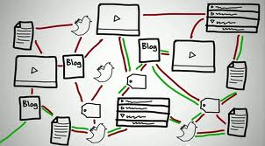
Types of MOOCs
xMOOCs –
Defined based on learning outcomes
Well defined journey through learning
Instructor led – “broadcast” mode
Learning can be assessed and certified
cMOOCs
Based on educational theories of connectivism – which hold that knowledge resides in the network and that learning is about making connections. See:- http://bit.ly/lyNmGX

Slide 21




MOOC Providers
Udacity, The first – “democratizing education” – but still for profit. Started at Stanford.
Coursera – for profit (but business model only just emerging). 2,000,000 people have taken a course, from the catalogue of around 200. Only 7-9% complete.
EdX. Not for Profit. MIT, Harvard, Berkeley
Futurelearn. - Based in UK at OU, and aspiring to include top 30-40 universities. For profit. Director is Simon Nelson – responsible previously for BBC digital strategy

Slide 22
Futurelearn Product Vision
Quality higher education, open to all, that combines learning through doing and social interactions with world-class storytelling from renowned institutions.
Futurelearn can be accessed any time and anywhere; it aggregates the best online learning materials; it uses the presence of a massive number of learners (and the data they produce) in innovative ways to improve learning; it challenges and rewards learners and celebrates small steps of progress and the big achievements.

Slide 23
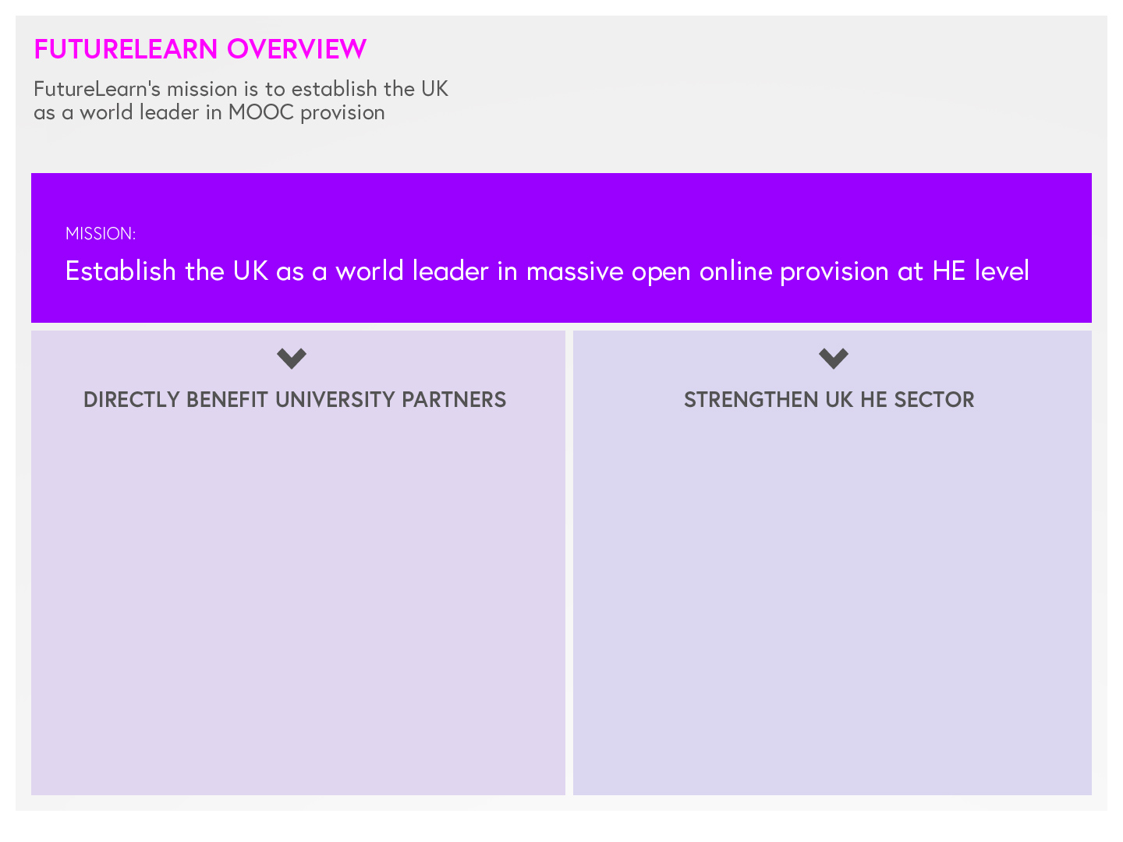

Generate revenue
to diversify income
Maintain world-leading brand
of UK HE, which currently has 18 of the top 100 universities
Attract additional students
particularly those outside the UK
Enable partners to fulfill their missions,
widening access to UK HE
Build international growth opportunity
HE exports in 2008/09 were £7.9bn²²
Build brand
through provision of innovative education
Build innovation
in UK HE
Stimulate innovation
among core campus based-delivery universities
Notes:
Key point is the Mission

Slide 24
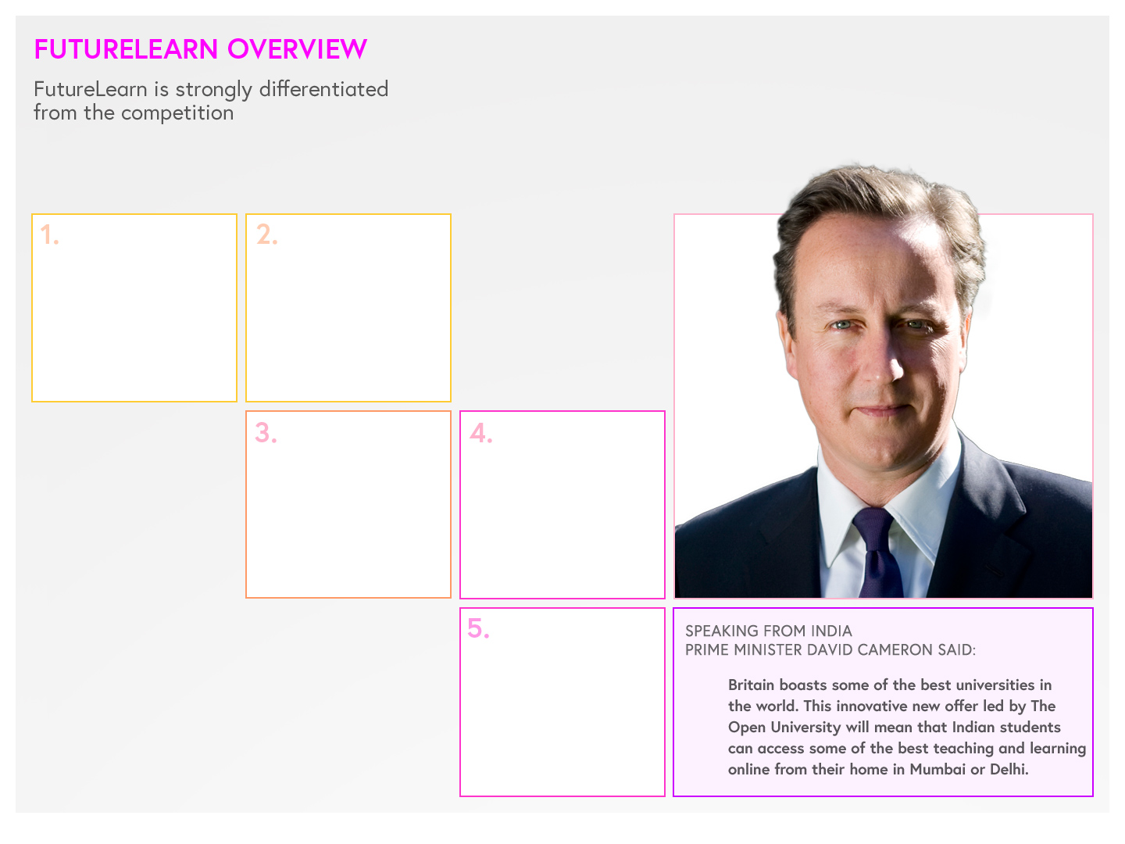



Representing UK higher education, the global number two HE brand, with 435K non-UK students at UK universities¹⁵ and an export value of £7.9bn¹⁶
Cross-party support in England, Wales, Scotland and Northern Ireland and from within the higher education sector
Participation of 17 elite UK universities, the British Library and British Council, with more partners in discussion
Hosted by The Open University, a global leader in online and distance education for 44 years, bringing a focus on student experience
Focus on employability, with clear pathways into accredited learning
Notes:
Key point = sub-heading
I think this also needs the key bullets at headline level, ie:
Representing the best of the UK
Hosted by the OU
Focused on employability
Cross-party support

Slide 25
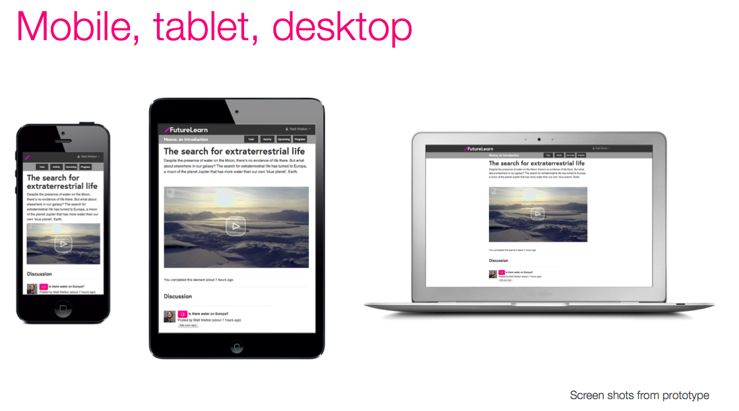
Built for Mobile Learning
HTML5 – and no Flash

Slide 26

learner presented with information
(eg multimedia educational content from a high-profile academic)
learner encouraged to reflect on activities
(eg note-taking, annotation)
learners together construct a shared understanding
(eg shared wiki, Google docs)
learners engage in discussion or argument
(eg discussion forum)
learners interact across time and space
(eg social-network tools such as Twitter, Facebook)
learner seeks and collates information
(eg search engines, web browsers)
learning through receiving formative feedback
(eg multiple-choice quizzes to self-assess performance; criterion based assessment, repeating an online assessment until reaching a desired level of performance)
Each style presents opportunities for learning apps

Slide 27
MOOC Structure
Learning Unit
1
Learning Unit
2
Learning Unit
3
Learning Unit
4
Learning Unit
5
Learning Unit
6
Up to 10
Learning Unit
1
Learning Unit
2
Up to 3
miniMOOCs have 2 or 3 Learning Units
Learning Unit
n
Weekly Learning Units: , 2- 6 hours study time
Meaningful title, clear learning goals, end-of-unit assessment
1
2
3
Each with 2 or 3 self-contained Learning Blocks
Learning Block
Learning Blocks
Sequence of elements
(This is just one example)
Video
Text
Discuss
Quiz

Slide 28
Proposed Platform Features
Course
List
Sign-in &
Registration
On-the-fly Cohorts
Social Learning Apps
Help Forum
Institution
Page
Learner Profile
Course Content
Text, images, gallery, slides, audio, video, embedded HTML5
My Notes
Q&A
Course
Page
Assessment
MCQ, Peer & Self
My Q&A
Related Material
Notifications
Educator
Profile
To-do list
My Notes
Certificates & Exams
Activity Feed
My Progress
Analytics Dashboard

Slide 29
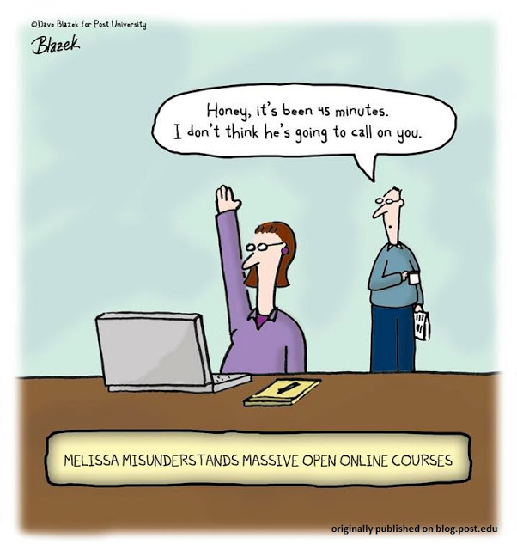
Patterns for Social Learning
Social Constructivist learning approach
Based on small on-the-fly groups
  Students remain in those groups for that activity
Carousel Learning
Lots of ideas for patterns of social learning
Post University cartoon/Dave Blazek, licensed under
a Creative Commons Attribution-NoDerivs 3.0

Slide 30
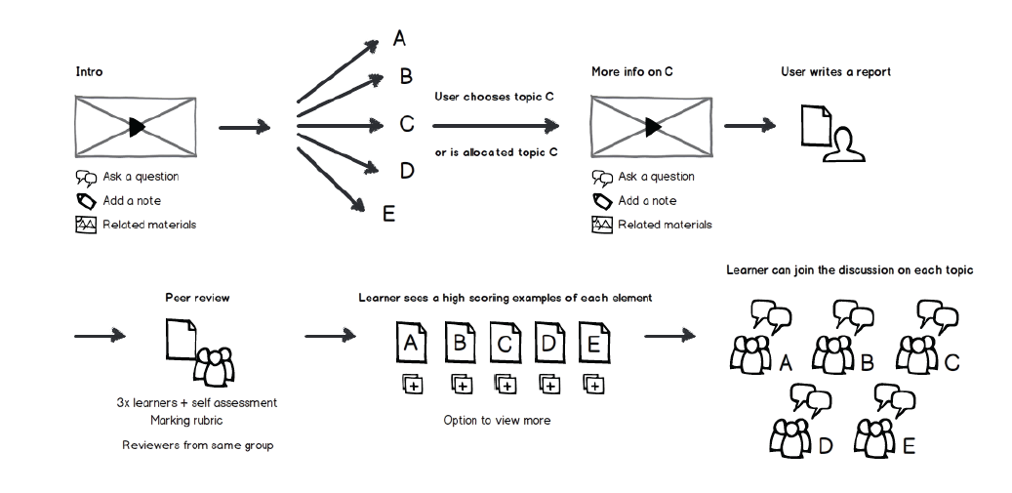
An example social learning pattern

Slide 31
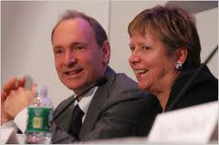


Collaboration within Futurelearn
There are some issues: who gets to do Business 101?
But the answer is in differentiation
Southampton intends to offer
Web Science and Oceanography
based MOOCs as its first offerings..

Slide 32
Managing Tensions
Concern for data ownership and institutional confidentiality
Potential for excellent analytics research
Vs
Keeping Institutional control
Ensuring Futurelearn Quality
Certification
Credit bearing
assessment

Slide 33


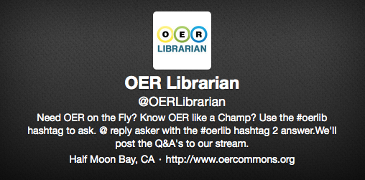
Learning Resources in MOOCs
OERs are allowed
But high quality is required
We need resources that can be accessed by
anyone – not just registered students…

Slide 34

Ownership of Materials developed
Who owns the work?
The text book?
What happens if the expert goes?
MOOCs will force us to sort out these issues if not already

Slide 35
Multiple opportunities for increasing collaboration in MOOCs
Groups internal to the University: CITE – academics – librarians
Academic disciplines within the University – Humanities and Maritime archaeology?
Groups across institutions – Oceanography at Southampton and OU
Librarians at OU, Southampton and elsewhere
Partners of FutureLearn – Universities within and beyond Russell Group
Universities and other organisations within FutureLearn – BL and British Council and Southampton

Slide 36
Thank you
Any Questions?
Hugh Davis: hcd@soton.ac.uk users.ecs.soton.ac.uk/hcd

