Slide 1
Gamification
Group N
Peter Fox, Tom Williams, Plamen Mangov, Matthew Hammick
Tutor: Gennaro Parlato
Topic 14:
Gaming as a driver for application online

Slide 2



Presenters
Peter Fox
Thomas Williams
Plamen Mangov

Slide 3
What is “Gamification”?
Gamification is the process of incorporating game design elements into non-game, regular applications and systems
The idea behind it is to make users engage more with the system or to make a mundane task more enjoyable.
It has uses across a wide range of environments, a few of which we will discuss.
Educational, motivational, social and business environments

Slide 4
Game design in Curricula
Core elements of game design apply very well to curriculum design
Well designed games teach you the core game mechanics
Make a more enjoyable and memorable course
Notes:
There are many core elements of game design that apply very well when designing a curriculum, when playing a well designed game, it will teach you the core game mechanics in order to complete sections of the game. Translating these teachings methods into a course can help make it more enjoyable and memorable.

Slide 5
Games as an educational tool
Video games have been prevalent for more than 30 years
Use in the classroom has been fairly limited until recently
Due to a lack of understanding in how to apply games to a learning environment
Video games have been used successfully as a learning tool
Notes:
Although video games have been prevalent for more than 30 years, their use in the classroom has been fairly limited until recently, this was mainly due to a lack of understanding in how to apply games in a learning environment. Much research has been done into the applications of games as learning aides.

Slide 6
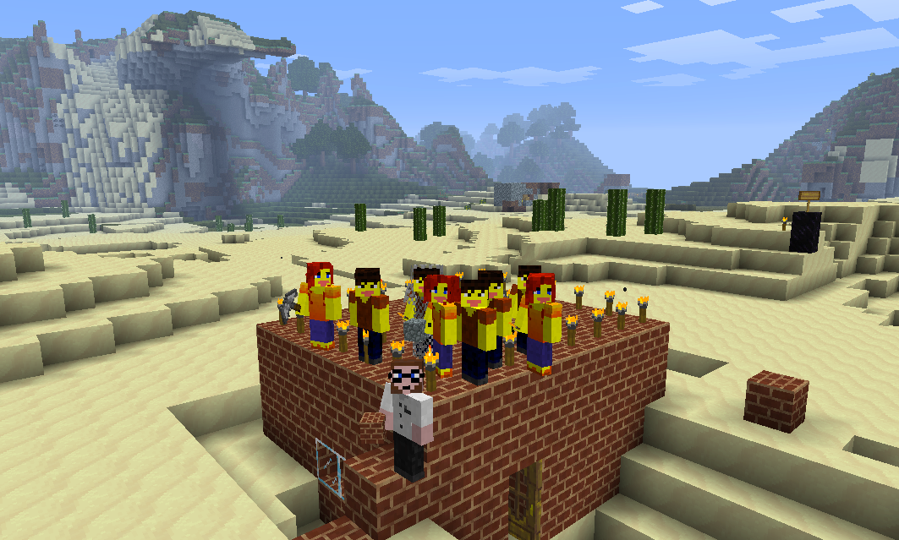
Games as an educational tool
There are now annual conferences on the topic
MinecraftEdu
  Minecraft, a lego like sandbox game
  1st and 2nd grade students taught mouse and keyboard skills
World of Classcraft
  Role playing, earn experience and levels for tasks completed
  Entire classroom turned
  into a game, not just select
  moments
  Concepts e.g. monsters are
  homework, boss battles are
  tests

Slide 7
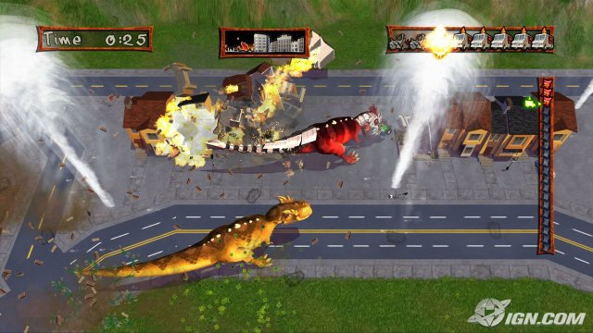
Business
A small game featuring/introducing a new product.
People play and gain some small in-game reward
Keep exposing themselves to the advertisement
Doritos Dash of Destruction
  Features a T-Rex trying to intercept delivery vans full of crisps.
Share with friends(the social
aspect, sharing inherent to
social networks)
  Creates more exposure.
  Creates self-sustained hype for the product.

Slide 8

Challenges
Rewards
Points

Slide 9
Social
Applications often used in businesses for internal motivation.
Employees take part in an activity to gain reward
Scoreboards (competition)
Material rewards (personal gain)
Keeps employees on task while improving motivation and skillset

Slide 10


Social
Social networks are a great way of supporting gamified apps
Users of the network share a lot of things with each other, especially something they find fun and enjoyable
This means users are likely to encourage friends to use the app and increasing its usage

Slide 11
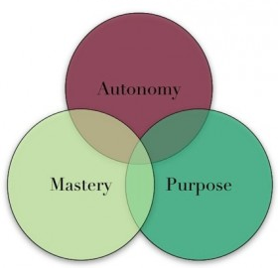
Motivation
Autonomy
Mastery
Purpose
These characteristics are inherently present in games

Slide 12
Summary
Gamification is used in many settings, a lot of time the users don't even realise it.
It's use is on the rise, expected by 2015, top 2000 public companies will use gamification

Slide 13
References
http://www.yukaichou.com/gamification-examples/top-10-gamification-examples-human-race/
http://blog.badgeville.com/2012/11/21/when-gamification-is-good-for-social-business/
http://www.informationweek.com/thebrainyard/news/social_networking_private_platforms/232901543
Vassileva, Julita. "Motivating participation in social computing applications: a user modeling perspective." User Modeling and User-Adapted Interaction 22.1-2 (2012): 177-201.
http://blog.oktopost.com/%E2%80%9Cgamify%E2%80%9D-your-social-media-marketing-campaigns/
Squire, Kurt D. "Video games in education." Int. J. Intell. Games & Simulation 2.1 (2003): 49-62.
Chandler, Curtis. "The Use of Game Dynamics to Enhance Curriculum and Instruction: What Teachers Can Learn from the Design of Video Games." Journal of Curriculum and Instruction 6.2 (2013): 60-75.
Mingfong Jan and Kurt Squire. 2010. Learning argumentation through a role-playing game-based curriculum. In Proceedings of the 9th International Conference of the Learning Sciences - Volume 2 (ICLS '10), Kimberly Gomez, Leilah Lyons, and Joshua Radinsky (Eds.), Vol. 2. International Society of the Learning Sciences 247-248.
Akilli, Göknur Kaplan. "Games and simulations: A new approach in education." Gaming and Simulations: Concepts, Methodologies, Tools and Applications (3 Volumes) 1 (2010): 150.
http://minecraftedu.com/
http://gamesineducation.org/
http://www.gamification.co/2013/03/08/gamifying-the-classroom-with-world-of-classcraft/

