Slide 1
Digital Divide
By Arthur Fabre , Izaan Siddiq , Shu Sam Chen , Ibrahim Dirar , Denys Demchenko , Tom Kemp , Lohith Bommireddipalli
COMP1205 – Group Presentations
Group S
Tutor : Robert Damper
Notes:
Hi
We are Group S; Our tutor is Bob Damper.
The topic of our presentation is the “The Digital Divide”.

Slide 2
Shu Sam Chen
Tom Kemp
Arthur Fabre
Denys Demchenko
Ibrahim Dirar
Izaan Siddiqi
Lohith Bommireddipalli
Notes:
Meet the team.
Unfortunately, Ibz is missing his mugshot because he was camping in the woods.

Slide 3
Outline
What is the “Digital Divide”?
Causes
Modern Britain
Less Economically Developed Countries
Tackling the issue
Implications
Conclusion
Notes:
First, we shall explore what the “Digital Divide is. How does it affect the general population (at a macroscopic level)? How does it affect you? Or those near you?
Once we explore what it is, we need to find out how, and more importantly, why this is happening.
We shall look a Modern Britain, an example of an MEDC (more-economically-developed-country) and how this differs to the same issues in a LEDC (less-economically-developed-country)
We shall also discuss the actions at present time to address the issue.
Finally, we explore the social and technical implication of the divide.

Slide 4
What is the “Digital Divide”?
Is defined as,¹
“an economic inequality between groups, broadly construed, in terms of access to, use of, or knowledge of information and communication technologies “
Notes:
Ways in which new technology is adopted and spreads in regions where the communications infrastructure is fragmented and the real cost of devices is relatively high, may be significantly different to patterns observed in more highly developed regions.
Even in highly developed regions there may be large variations in the reach and impact of technologies related to disposable incomes, spending priorities and levels of education.
These pheneomena are sometimes referred to as the ‘digital divide’.

Slide 5
Causes
Whilst the causes to the digital divide have been attributed to several specific socio-economic factors, broadly speaking, there are 3 main requirements, which the lack of, would create a divide.
Notes:
Causes
Discuss the SPECIFIC causes later; for now:
Broadly speaking there are 3 main features, which the lack of, would cause a digital divide -
ACCESS – this encompasses the infrastructure, connectivity and the availability of devices
KNOWLEDGE – if one doesn’t know HOW, he will not use a resource, nor will BE ABLE to use that resource
APPLICABILITY – this contributes to the “2nd level Digital Divide” between producers of internet content and its consumers.

Slide 6
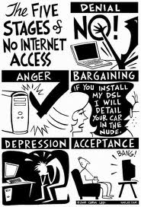
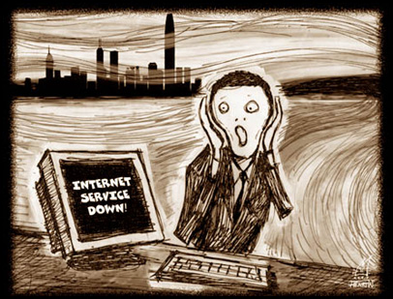
Access
Notes:
Access, or rather, the lack of access to the resources in the internet causes a divide between those with the access and those without.
Clearly, if anyone of us lost access to the internet for more than a period of 3 hours, we would undoubtly go into shock.
This has drastic implications which are discusses later

Slide 7
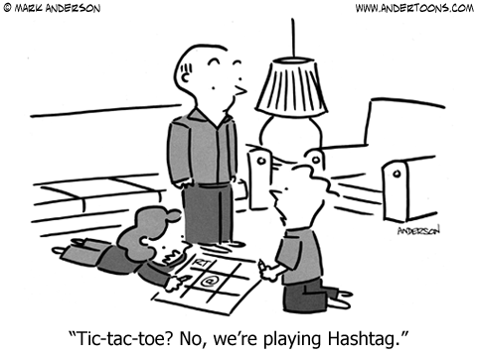
Knowledge
Notes:
The lack of information on how to access the resources that are available often creates a social divide. As illustrated, often is the case between different generations.
Source: http://www.andertoons.com/internet/cartoon/6507/tic-tac-toe-no-were-playing-hashtag/

Slide 8
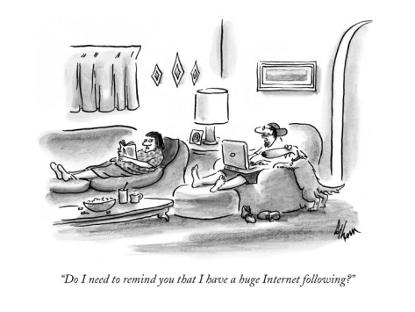
Applicability
Notes:
The 2nd level digital divide:
Web 2.0 technologies like Facebook, YouTube, Twitter, and Blogs enable users to participate online and create content without having to understand how the technology actually works, leading to an ever increasing digital divide between those who have the skills and understanding to interact more fully with the technology and those who are passive consumers of it.
A ready example is how amateur streamers have

Slide 9
Causes
Per-capita-income³
Telecommunication access
Education
Notes:
Studies show that there are direct correlations between PCI and the adoption of technology to facilitate internet access.
However, the pricing of telecommunications access does not show up as statistically or economically important in explaining the Internet gap.
This result should not be construed as implying that pricing policies are not important.
Rather, it suggests that such issues are swamped by economic, demographic and institutional factors in samples with widely varying Internet penetration rates.
And lastly education; studies conducted by the NTIA show that where the infrastructure exists, education becomes irrelavant as a couase as computer literacy is not taught in schools – rather it is gained by usage. However, in Africa, recent programmes (such as the one-laptop-per-child schemes have shown remarkable effect in IT literacy of the ENTIRE community.

Slide 10
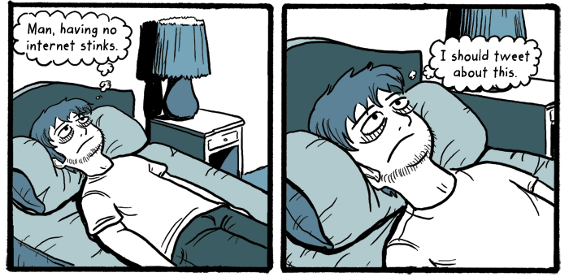
Digital Divide in Britain
Notes:
It would be easy to assume the digital divide in an economically developed country such as the United Kingdom would be less prevalent, but instead it is more. In fact, it is exacerbated - the prevalence of digital technologies and the Internet means that those who do not have access feel their absence even more keenly; as the Internet becomes increasingly entwined with everyday life the people who are cut off from it will see themselves denied the ability to undertake opportunities offered to their digitally-enabled fellows.
The digital divide also makes itself known in the speed of internet access - outlying communities are often stuck relying on 20th-century infrastructure while major cities are upgraded with the most modern fibre-optic connections. The difference in the quality and speed of the Internet connections provided by the two are stark and readily apparent, and since plans to roll out newer infrastructure to those outlying communities and less population-dense areas are in the distant future, another divide cracks open between the high-speed cities and the slower speeds of the countryside.

Slide 11
Digital Divide in Britain
Notes:
The digital divide also makes itself known in the speed of internet access - outlying communities are often stuck relying on 20th-century infrastructure while major cities are upgraded with the most modern fibre-optic connections. The difference in the quality and speed of the Internet connections provided by the two are stark and readily apparent, and since plans to roll out newer infrastructure to those outlying communities and less population-dense areas are in the distant future, another divide cracks open between the high-speed cities and the slower speeds of the countryside.

Slide 12
Digital Divide in LEDCs
Global Issue
Adverse socio-economic effect between LEDCs and MEDCs.
Not so pronounced among LEDCs themselves
Integration of technology into lifestyle
For example in 2011 54,1 % of Europeans had a mobile phone vs. 3.8 % of Africans.
Artificial Digital Divide
Internet Censorship causes the population to be unable to access resources causing social difference between the population and the rest of the world
Notes:
The Digital Divide Abroad (arthur)
1. Both a global and national issue
a. Mostly a global issue � the divide is not very pronounced within lesser developed countries themselves
b. Divide lies between wealthy and third world countries � is only increasing the gap
c. Has a number of consequences on education on social phenomena which we will discuss later on
d. Can be both created naturally or artificially
2. Naturally
a. Western countries typically have higher adoption rates when it comes to technology
i. Mobile phone and internet subscriptions
For example in 2011 54,1 % of Europeans had a mobile phone vs. 3.8 % of Africans
ii. Interestingly the divide in subscriptions per capita is closing in recent years, whereas the divide in kbps per capita is dramatically increasing � there is not only a divide in the amount of people using the internet but also a digital divide in the quality of services offered
3. Artificial digital divide
a. Usually created by internet censorship
b. Inhabitants become unable to access certain resources
i. Outcome is mostly the same as with a natural digital divide

Slide 13
A comparison of the problems
Britain (MEDC)
LEDCs
Motivated mainly by social considerations.
Ready assimilation of any new technology as it is relatively cheap.
Motivated by economic constraints.
Adoption of technology is limited by availability and education.

Slide 14
What steps are being taken to address the digital divide?
Modern Britain
Less developed regions
Notes:
Tom’s bit… all up to him

Slide 15
Modern Britain
5.2 million households don’t have internet access. The expressed reasons are:
Don't need Internet (not useful, not interesting, etc) | 54%
Lack of skills | 22%
Equipment costs too high | 15%
Other | 15%
Access costs too high (telephone, broadband subscription) | 14%
Have access to the Internet elsewhere | 8%
Privacy or security concerns | 4%
Physical or sensorial disability | 3%
Broadband Internet is not available in our area | ~
Source: Office for National Statistics 2012
Notes:
There are a number of different problems leading to a digital divide in the uk so there are therefore a number of different solutions
Data source: http://www.ons.gov.uk/ons/rel/rdit2/internet-access---households-and-individuals/2012/stb-internet-access--households-and-individuals--2012.html#tab-Reasons-for-no-household-Internet-access

Slide 16
Skills & Willingness
Digital Advisory Board
Digital Champion - Martha Lane Fox
Education
Race Online 2012
Go ON UK
Assisted Digital
UK Online Centres
‘Digital by default’ services
Notes:
http://digital.cabinetoffice.gov.uk/2011/07/28/an-introduction-to-assisted-digital/
http://www.bbc.co.uk/news/education-20899109
http://www.ukonlinecentres.com/
http://www.go-on.co.uk/
Image source: http://www.telegraph.co.uk/technology/internet/9226442/Martha-Lane-Fox-heads-new-board-to-push-digital-government.html

Slide 17
Equipment costs & infrastructure
Get online @ home
£99 for refurbished desktop PC (if eligible - £149 if not)
£169 for a laptop computer (if eligible - £199 if not)
Subsidised internet connection
Government investment in network infrastructure where private companies aren’t providing good enough services
£530 million put aside (left over from digital switch over) for developing broadband in rural areas
Target of everyone in UK having at least 2Mbps by 2015
Community projects: Broadband for the Rural North
Notes:
http://www.getonlineathome.org/
https://www.gov.uk/government/policies/transforming-uk-broadband
http://www.telegraph.co.uk/technology/broadband/9226314/The-villagers-digging-for-victory.html
http://www.bbc.co.uk/news/technology-21442348

Slide 18
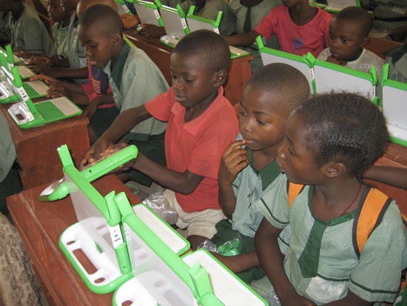
Less developed regions
One laptop per child
Notes:
Right source: http://www.theopen-road.com/october-round-up/one-laptop-per-child-ethiopia-1
Left Source: http://en.wikipedia.org/wiki/OLPC_XO-1

Slide 19
Implications
Nationally
Social networking
Assimilation
Global
Infrastructure
Education
Notes:
Nationally
Social networking is an essential tool in the current marketplace. Not being able to connect with people could be detrimental to any career. Not to mention that the primary method of communication.
OFCOM⁴, revealed that in 2012, 75% of the population of the UK have access to an internet and this figure is projected in increase with the advent of tablets
Assimilation of new technology is fast because as most of the product is developed within the EEA, the cost is affordable. Adoption of new technologies is also driven my consumerist culture fuelled by the capitalistic drive of the economy.
Global
The lack of proper infrastructure is the primary cause of the digital divide in LEDCs. This makes collaboration with domestic and foreign entities difficult and inhibits the development of a region.
Education has proven to be the most effective method of rectifying this problem. However, the dependency on technology may effectively cripple systems where they may develop a divide between those who had access to the technology in comparisons with those who didn't.
Global Implications of Digital Divide
Digital divide has a negative influence on:
cultural exchange
lack of technology in certain regions makes it harder to communicate with the population of those places
development of a culture
level of education
Free content exchange helps in reducing poverty and inequality. (Pekka Himanen) The population of countries with poor access to online resources is unable to escape poverty and inequality and this further broadens the gap between developed and third world countries.
Implications of Digital Divide
Nationally, digital divide affects individuals in a number of ways. They:
miss out on career opportunities
a lot of companies are now posting job vacancies on employment websites
are unable to connect with peers on social networking websites
The phenomena also has some technological implications. Countries with a noticeable divide are less likely to adopt new technologies because the population simply isn't too concerned or motivated. Developed countries keep improving while third world countries remain more or less the same in terms of technology.

Slide 20
Conclusion
Any questions?

Slide 21
References
[1] Digital Divide, Internet Encyclopaedia, Wikipedia.
Available from : http://en.wikipedia.org/wiki/Digital_divide [Accessed 20 April 2013]
[2] NORRIS, PIPPA, 2003, “Digital Divide: Civic engagement, information poverty, and the Internet worldwide”, 1-3
[3] Chinn, Menzie D. , Fairlie Robert W. (2004) The Determinants of the Global Digital Divide : A cross country analysis of computer and internet penetration. Center Discussion Paper. Yale University.
Available from : http://www.econ.yale.edu/growth_pdf/cdp881.pdf [Accessed on 20 Apr 2013]
[4] OFCOM (2012). Research report.
Availble from : http://stakeholders.ofcom.org.uk/binaries/research/consumer-experience/tce-12/1_intro_summary.pdf [Accessed 20 Apr 2013]
[5] KRAEMER, K. L. , 2011 , One Laptop Per Child (OLPC): A Novel Computerization Movement? , Proceedings of the 44th Hawaii International Conference on System Sciences, 11, 1530-1605
Notes:
A compilation of all the references.

Slide 22
Bibliography
Get online @ Home - http://www.getonlineathome.org/
Stimulating private sector investment to achieve a transformation in broadband in the UK by 2015 - https://www.gov.uk/government/policies/transforming-uk-broadband
The villagers digging for victory - http://www.telegraph.co.uk/technology/broadband/9226314/The-villagers-digging-for-victory.html
Fast fibre: A community shows the way - http://www.bbc.co.uk/news/technology-21442348
An introduction to Assisted Digital - http://digital.cabinetoffice.gov.uk/2011/07/28/an-introduction-to-assisted-digital/
A third of poorest pupils 'without internet at home' - http://www.bbc.co.uk/news/education-20899109
Notes:
Include any no referencable internet resources.

Slide 23
Bibliography
UK Online Centres - http://www.ukonlinecentres.com/
Go ON UK - http://www.go-on.co.uk/
Statistical bulletin: Internet Access - Households and Individuals, 2012 - http://www.ons.gov.uk/ons/rel/rdit2/internet-access---households-and-individuals/2012/stb-internet-access--households-and-individuals--2012.html
Laptop Per Child (OLPC): A Novel Computerization Movement? - http://ieeexplore.ieee.org/xpl/articleDetails.jsp?tp=&arnumber=5718728&contentType=Conference+Publications
Digital Divide in the UK? - http://www.21stcenturychallenges.org/challenges/digital-divide/
Notes:
Include any no referencable internet resources.

