Slide 1
Open Education OERs and MOOCs
Group 13
Tutor: Ed Zaluska
Izidor Flajsman, Abhishek Ghosh, Sam Lavers,
Dan Cousins, John McMahon
Notes:
Time: 0s

Slide 2
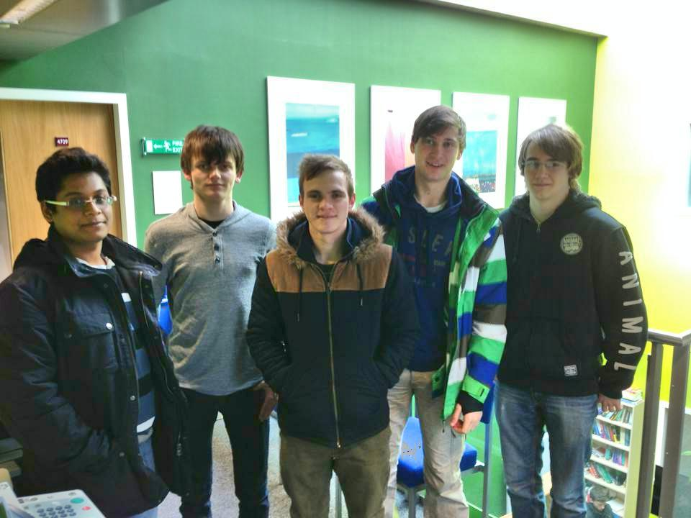
Abhishek Dan John Izi Sam

Slide 3

Introduction
Notes:
Time: 30s
1 introduction(IZI)
- What is open education? We think of two things
Open Educational Resources (OER) are freely accessible, usually openly licensed documents and media that are useful for teaching, learning, educational, assessment and research purposes. Although some people would consider the use of an open format to be an essential characteristic of OER this is not a universally acknowledged requirement.
eg.
A massive open online course (MOOC) is an online course aiming at large-scale interactive participation and open access via the web.
eg. code academy,
We will talk about why these two models are starting to revolutionise the way we learn? look at...
- at its cost licensing
- impact
- participation models
- and its future
is open education starting to represent a real competitor to traditional education?

Slide 4


Cost & Licensing
Notes:
Time: 1:20
2. cost + licensing(SABER lol no)
- Cost?
- it is cheaper thats why it is so popular
- start to present a real competion to Univerities...U only have to pay for some technologhy. we’ll speak more about it.
- you can advertise online, or sell data that users are generating
- licensing?
- Normally it should have an open liscencing that allows users to do whatever they want.
However
- Khans Academy, Udacity, Coursera are all protected uder the United Stated copy right laws. The websites allow only your own peosonal, non-commerical use of resources. So universities can not use it in ther classes.
- everyone can get a free eduction..lets look at what the impacts of that are

Slide 5

Impact of Open Education
Altogether there are over 3000 freely available university courses currently online. And more OER projects are emerging at universities in Australia, Brazil, Canada, Hungary, India, Iran, Ireland, the Netherlands, Portugal, Russia, South Africa, Spain, Thailand, the UK, the US, and Vietnam.
MIT OpenCourseWare, Connexions Project, China Open Resources for Education (CORE) consortium, ParisTech OCW project, Japan Opencourseware Consortium, MERLOT.......
Positive
Easily Accessible
Life-Long Learning Experience
Bringing Closer the Global Community
New Learning Experience
Negative
Employment Factors
Communication/Less Interaction
Courses Availability
Technological Infrastructure
Notes:
Time: 1:30
MIT is now reporting close to 16 million visits since October 2003; these visits are split about evenly between first-time and repeat visits.
Rice University's Connexions has more than one million people from 194 countries are tapping into the 3,755 modules and 197 courses developed by a worldwide community of authors in fields ranging from computer science to music and from mathematics to biodiversity.
From large institution-based or institution-supported initiatives to numerous small-scale activities, the number of OER related programmes and projects have been growing fast within the past few years. According to OECD(Organisation for Economic Co-operation and Development) (OECD, 2007), there are more than 3000 open access courses (open courseware) currently available from over 300 universities worldwide.

Slide 6
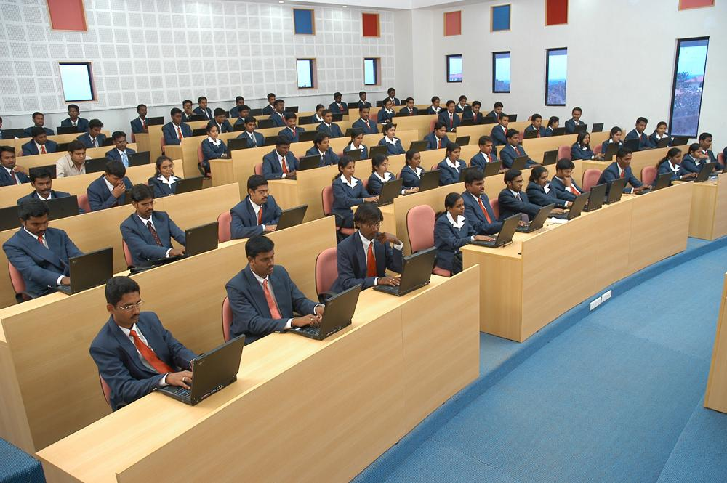
Participation Models
videos
Online lecture notes
Textbooks with open copyright licenses
Online quizzes and assessments
Games based learning
Interactive user forums
Notes:
Time: 1:30
Open textbooks can be distributed in printed, e-book or audio formats
The quizzes usually allow as many retries as the user needs
Games based learning encourages users to participate and makes it more interesting. Example - http://railsforzombies.org
http://ruby.about.com/od/rubyonrails/a/Rails-For-Zombies.htm
User forums help create a community of students and professors and allows for topical discussions

Slide 7

Technical & Social Implications
Game based lessons encourage social learning, encourages participation
Websites
Meetings & clubs (School, Hackerspace)
Learning on the move (Daily commute)
Videos (eg. YouTube)
Notes:
Time: 1:30
Games encourage participation from people maybe deterred by the daunting prospect of learning a language - rails for zombies provides an immersive experience
Websites accessible everywhere, can be quickly picked up at any time
Meetings / after school clubs (requires someone to already be familiar with the course material)
Lessons could easily be learnt on the daily commute to/from work
Videos provide passive learning, can watch during free moments such as mealtimes

Slide 8

Future & Conclusions
Selective Access Learning vs. OERs
  Assessment/Credibility
Sustainability
  Funding growing infrastructures
Challenges
  Ensuring quality of material
Development
  Inclusion and participation

Slide 9
References
Wiley, d. (2006). On the sustainability of open educational resource initiatives in Higher Education [online].OECD.
Atkins, D.E., Brown, J.S., & Hammond, A.L. (2007) A review of the open educational resources (OER) movement: Achievements, challenges, and new opportunities. Retrieved October, 18, 2009 from www.oerderves.org/.../a-review-of-the-open-educational-resources-oer-move ment_final.pdf
D’Antoni, S. (2008) Open educational resources: The way forward. Deliberations of an international community of interest. Retrieved October 10, 2009 from the UNESCO OER Wiki at http://oerwiki.iiep-unesco.org/index.php?title=OER:_the_Way_Forward
McCRACKEN, R: (2006). Cultural responses to open licences and the accessibility and usability of open educational resources. http://www.oecd.org/document/32/0,2340,en_2649_33723_36224352_1_1_1_1,00.html
Carson, S.: (2005) “2004 MIT OCW Program Evaluation Findings Report” from http://ocw.mit.edu/OcwWeb/Global/AboutOCW/evaluation.htm
McCracken, R: (2006) “Cultural responses to open licences and the accessibility and usability of open educational resources” from http://www.oecd.org/document/32/0,2340,en_2649_33723_36224352_1_1_1_1,00.html
Downes, S.: “Models for Sustainable Open Educational Resources”, National Research Council Canada (2006) from http://www.oecd.org/document/32/0,2340,en_2649_33723_36224352_1_1_1_1,00.html
Alec Couros, (2009) "Open, connected, social – implications for educational design", Campus-Wide Information Systems, Vol. 26 Iss: 3, pp.232 - 239

